Slide 1
Practical guide to Agent Memory, Context, and Memory Engineering
Memory Architecture for Autonomous Agents
Eli Schilling
Cloud Architect / Developer Advocate
Oracle North America

Slide 2
Agenda
1
2
3
4
5
6
Workshop Intro
Meet the Oracle Team
Why AI Agents Need Memory
Implementing Agent Memory
Context, Memory, and Harness Engineering
Code: Live Hands-on Session

Slide 3
AI Dev Hub Repo with Agent Memory Workshop
https://github.com/oracle-devrel/oracle-ai-developer-hub/tree/main/workshops/agent_memory_workshop

Slide 4
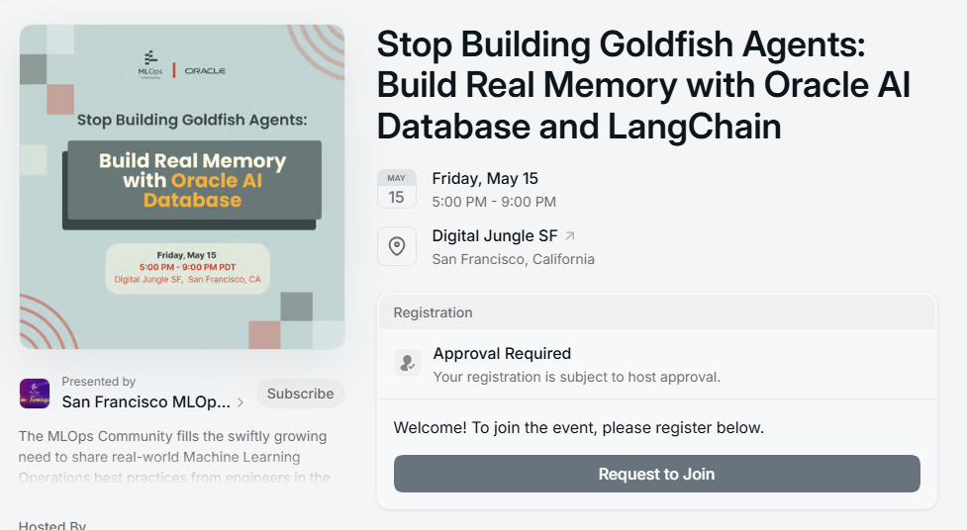
https://luma.com/p8d635rz
Sign up now for priority registration!
Notes:
Register now for priority access!

Slide 5

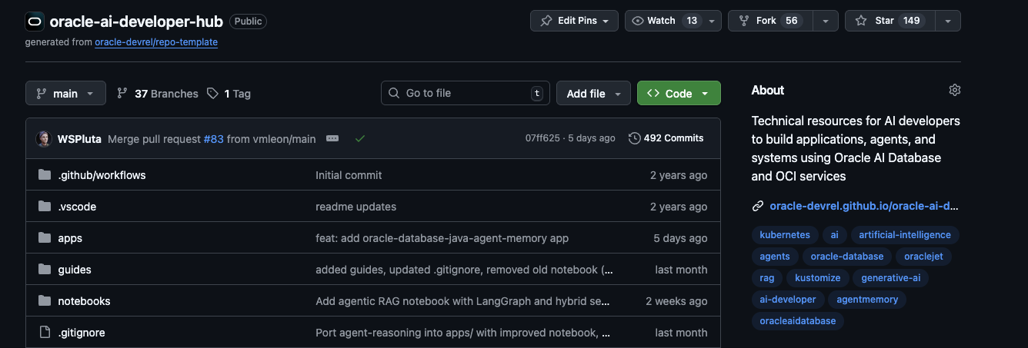


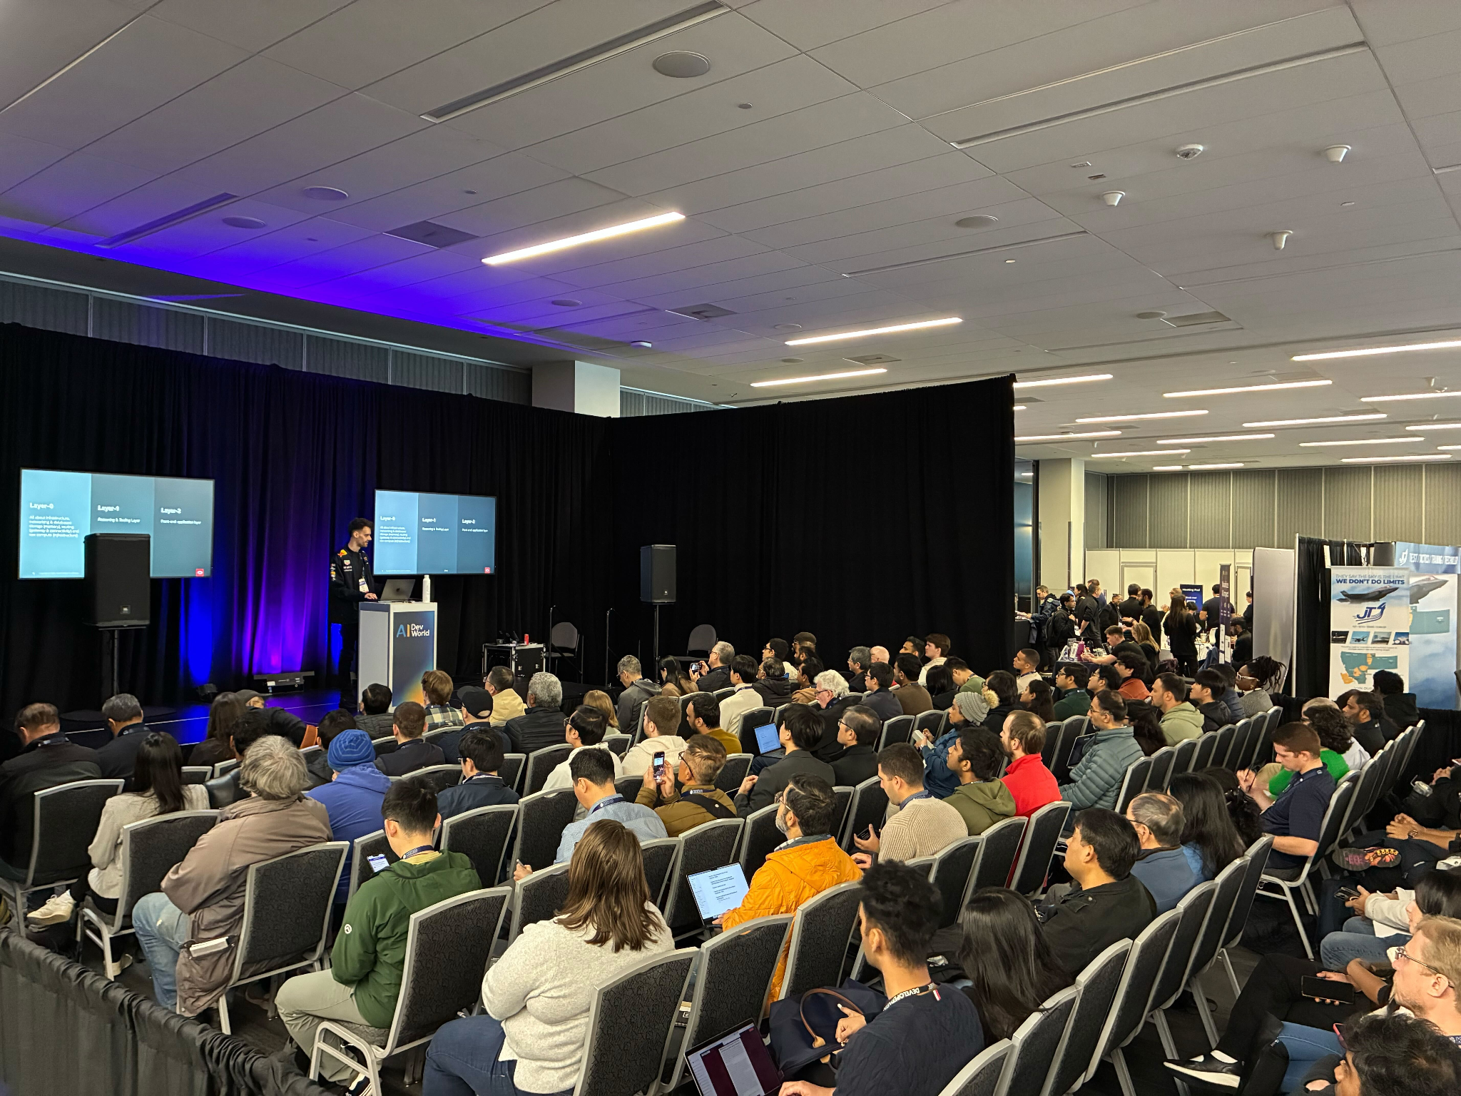
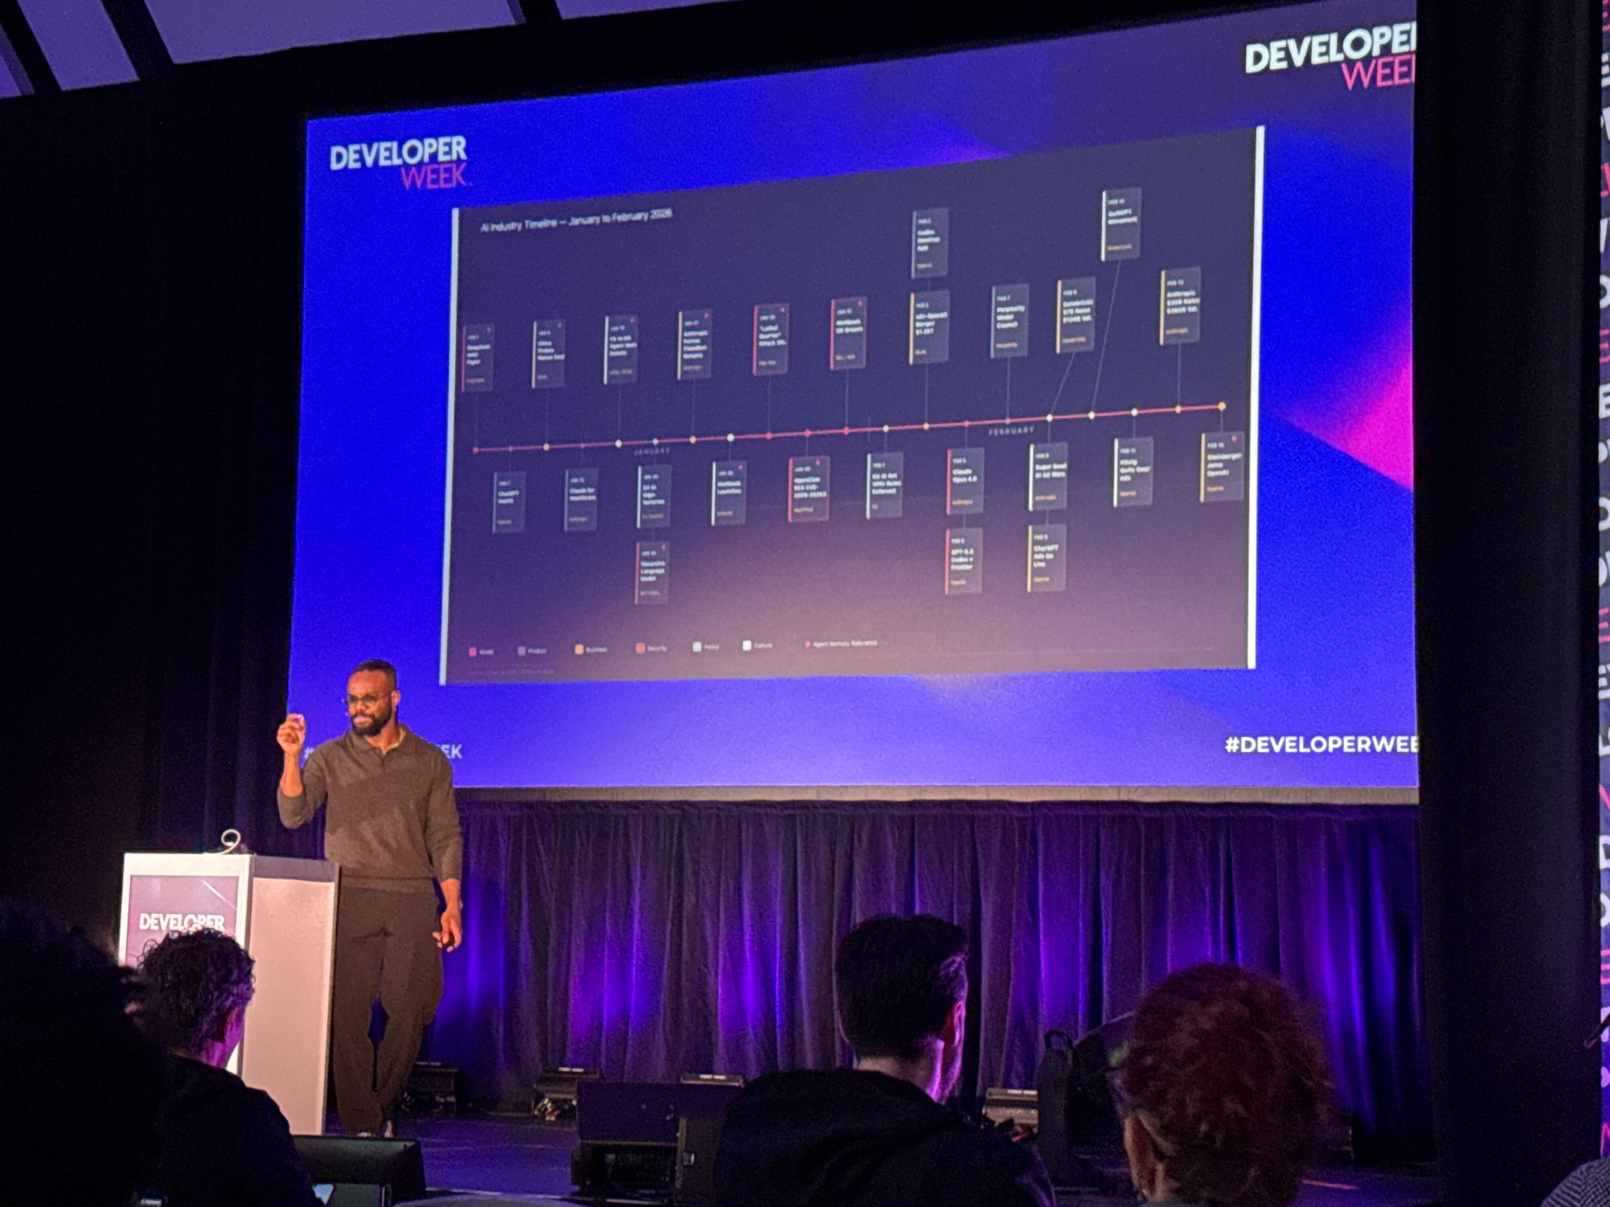

https://www.deeplearning.ai/short-courses/agent-memory-building-memory-aware-agents/

Slide 6









Meet the Oracle Crew
Girdhari Ghantiyala
Nacho Martinez
Sr. Director Software Development
Data Science Advocate
Federico Kamelhar
Kartik Talamadupula
Sr. Principal SA – Agentic AI
AI Architect
Richmond Alake
Director, AI Developer Experience
Arjun Upadhyay
Eli Schilling
Consulting Member of Technical Staff
Architect and Developer Evangelist
Tara Van Cleave
Niranjan Mohapatra
Developer Marketing, North America Lead
Consulting Member of Technical Staff

Slide 7
Why AI Agents Need Memory
The Case for Persistent State in Autonomous AI Systems

Slide 8
Quote of the day:
An AI Agent without memory is just autocomplete with ambition. Give your agents the memory they deserve so they can stop forgetting and start learning.

Slide 9
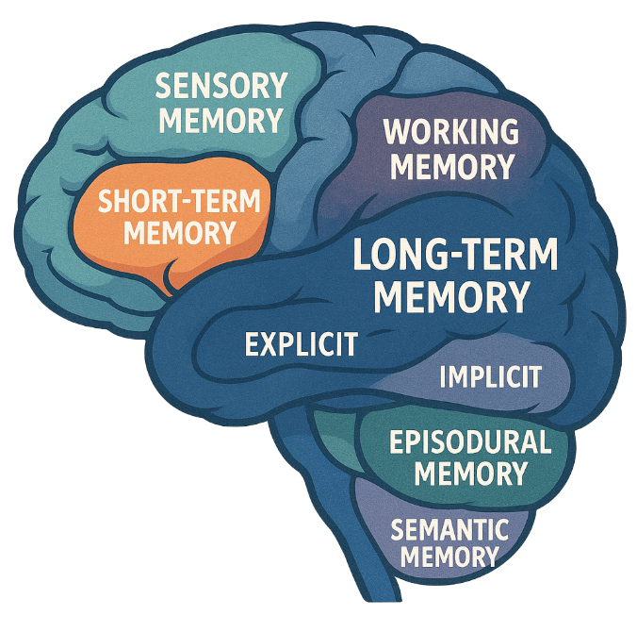
Why Agents Need Memory
The brief after image you see when you look away from a bright light
Remembering a phone number just long enough to dial it
Humans have a good ability to retain, recall and reuse information over short and long period of time.
Where you parked your car at the mall today
Remembering your wedding day
Riding a bike without thinking about balance
Your first day of school
Knowing that dogs are animals

Slide 10
Why Agents Need Memory
WITHOUT MEMORY
WITH MEMORY
Forgets every session
Persistent across sessions
×
Each conversation starts from a blank slate. The agent cannot recall what the user said yesterday, last week, or five minutes ago in a prior call.
✓
Conversation history, entity facts, and task state are stored in Oracle AI Database — retrievable days or weeks later, just in time.
Contradicts itself
Consistent decisions
×
Without stored decisions, the agent re-derives conclusions independently each turn — often reaching conflicting answers on the same question.
✓
Prior reasoning is stored as workflow memory. The agent references past decisions before acting, ensuring coherent, non-contradictory behaviour.
Repeats the same mistakes
Learns from experience
×
There is no mechanism to record that a tool failed, a plan was rejected, or a user corrected an error. The same failure recurs on the next turn.
✓
Errors, corrections, and user feedback are encoded into procedural memory. The agent improves its patterns over time across thousands of interactions.
Cannot execute long tasks
Executes long horizon tasks
×
Any task spanning multiple sessions — data migration, contract negotiation, code review — cannot proceed without persistent state from prior steps.
✓
Episodic memory preserves step-by-step task state. The agent can pause, resume, and continue multi-session workflows without losing context.

Slide 11
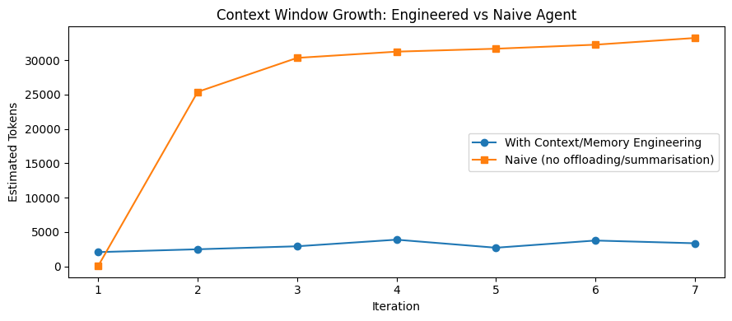

Slide 12
AI Application Evolution
Revisiting the progression that led to Modern AI Systems

Slide 13


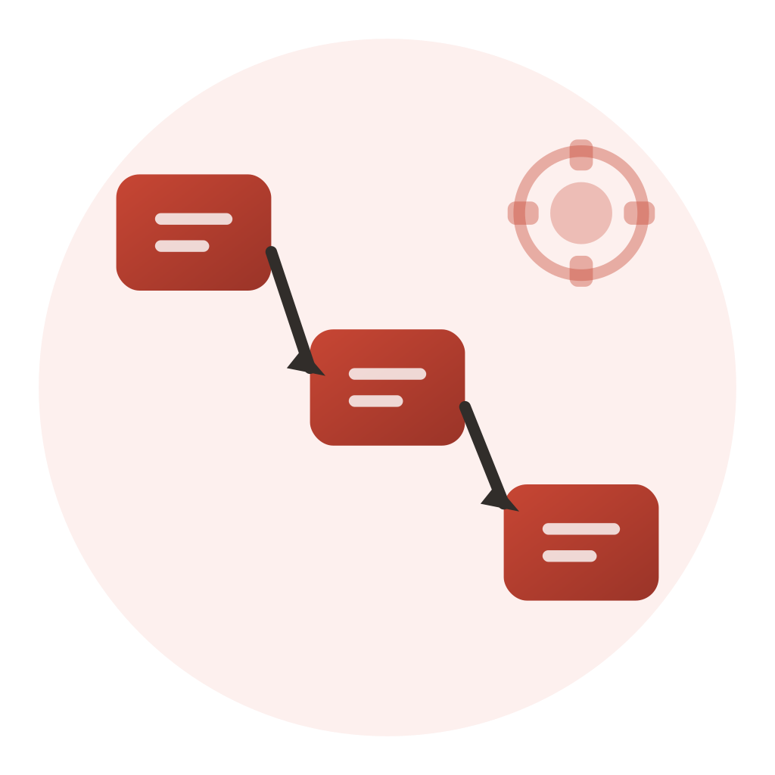

Form Factors and Maturity Levels of AI Application
LLM Chatbots
RAG Applications
LLM-Driven Workflows
Agentic AI
Single-turn or multi-turn conversational interfaces powered by large language models. Minimal context retention, best suited for Q&A, summarization, and general assistance
LLM responses grounded in your organization's data through retrieval-augmented generation. Connects models to internal knowledge bases for accurate, domain-specific answers.
Multi-step processes orchestrated by LLMs within human-defined logic. Automates structured tasks like document processing, approvals, and data transformation with predictable outputs.
Autonomous systems that plan, reason, use tools, and make decisions with minimal human intervention. Maintain persistent memory and adapt dynamically to accomplish complex goals
1
2
3
4

Slide 14
INFORMATION RETRIEVAL IN RAG
The mechanism that determines which knowledge reaches your LLM — and how accurately it does so.
DEFINITION
Information Retrieval (IR) in a RAG pipeline is the process of identifying and surfacing the most relevant stored knowledge — chunks, facts, or structured records — in response to a user query, so the LLM can generate accurate, grounded answers. The quality of retrieval determines the quality of generation: garbage in, garbage out.
Retrieval Strategies
Vector
Lexical
Graph
Relational
Spatial
Semantic similarity
via embeddings
Keyword / BM25
full-text matching
Relationship traversal
entity-linked data
Structured SQL
filters & joins
Geo-proximity &
location-aware queries
Production-grade RAG agents rarely use a single retrieval method.
Each data modality and query type is best served by a different retrieval strategy. The most resilient pipelines combine vector, lexical, and structured retrieval in a hybrid or agentic routing layer — matching the strategy to the nature of the question.
RETRIEVAL QUALITY DETERMINES GENERATION QUALITY
Exact match
High relevance
Good context
Marginal
Noise / hallucination risk
← Better retrieval
More retrieval noise →
Notes:
Some additional context that helps set the stage for today’s workshop:

Slide 15


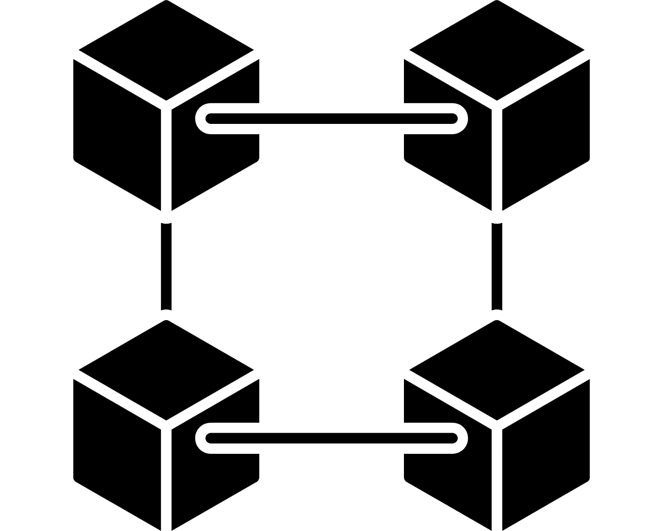
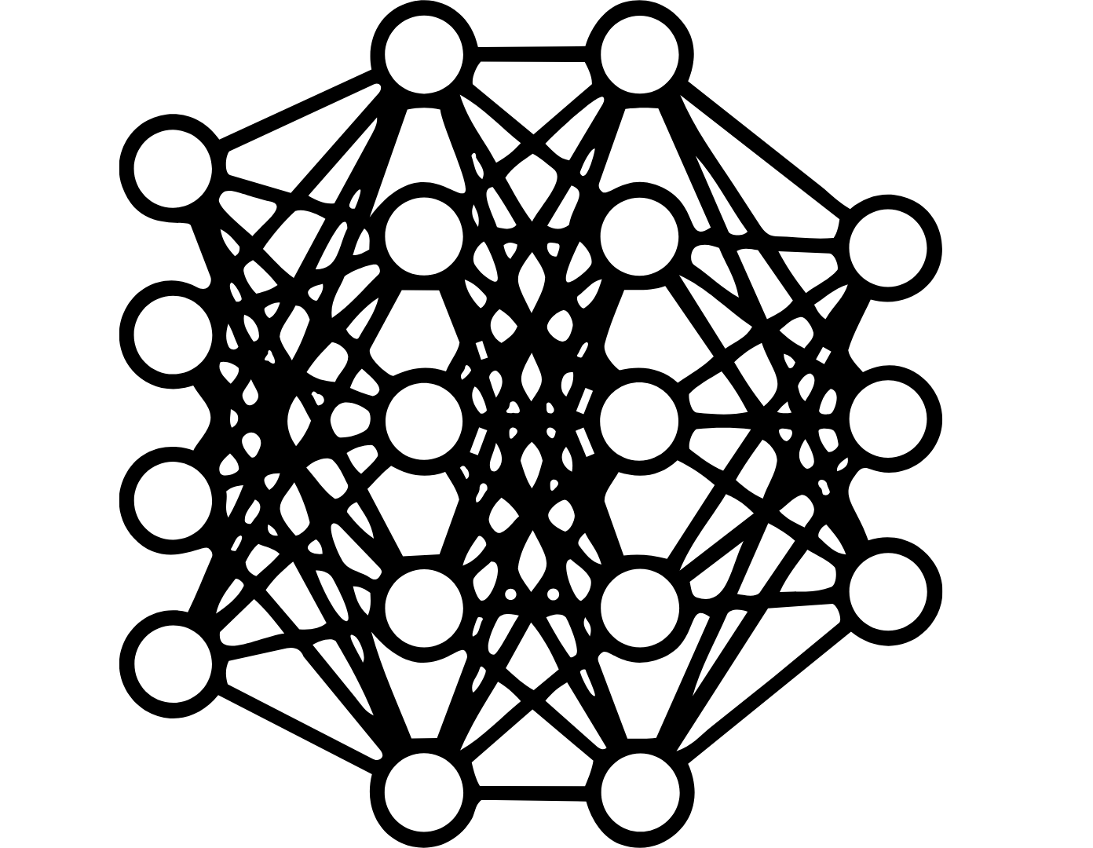
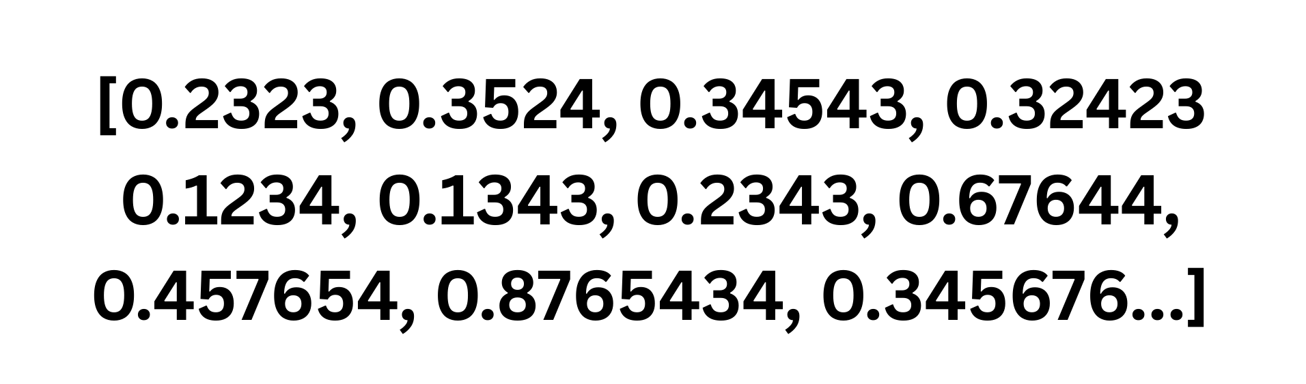
RAG Pipeline
"We find that retrieval-augmented generation significantly reduces hallucin…all Questions benchmark when using contriver-based retrieval."
Data Object
Relational
Data ingested into a Data Processing pipeline
Chunks passed into an embedding model.
Embedding Generation
{ "paper_id": "2312.10997", "title": "Benchmarking RAG for Factual Consistency", "authors": ["Chen, Wei", "Patel, Anika", "Yamamoto, Kenji"], "section": "Results", "page": 7, "chunk_index": 42}
Chunking
Data objects are broken into chunks
JSON
Data Deduplication
Data Sync Logic
Text Normalization
Data Ingestion
Data Sources
Entity extraction
Spatial
PII Redaction
Content Classification
Embedding Model
(:Paper {paper_id: "2312.10997", title: "Benchmarking RAG for Factual Consistency"})
-[:HAS_SECTION]→ (:Section {name: "Results"})
-[:CONTAINS_CHUNK]→ (:Chunk D_BY]→ (:Author {name: "Yamamoto, Kenji"})
Vector
Graph

Slide 16
RAG Pipeline
"We find that retrieval-augmented generation significantly reduces hallucin…all Questions benchmark when using contriver-based retrieval."
Data Object
Relational
Data ingested into a Data Processing pipeline
Chunks passed into an embedding model.
Embedding Generation
{ "paper_id": "2312.10997", "title": "Benchmarking RAG for Factual Consistency", "authors": ["Chen, Wei", "Patel, Anika", "Yamamoto, Kenji"], "section": "Results", "page": 7, "chunk_index": 42}
Chunking
Data objects are broken into chunks
Anti Pattern
JSON
Data Deduplication
Data Sync Logic
Text Normalization
Data Ingestion
Data Sources
Entity extraction
Spatial
PII Redaction
Content Classification
Embedding Model
(:Paper {paper_id: "2312.10997", title: "Benchmarking RAG for Factual Consistency"})
-[:HAS_SECTION]→ (:Section {name: "Results"})
-[:CONTAINS_CHUNK]→ (:Chunk D_BY]→ (:Author {name: "Yamamoto, Kenji"})
Vector
Graph

Slide 17
RAG Pipeline
"We find that retrieval-augmented generation significantly reduces hallucin…all Questions benchmark when using contriver-based retrieval."
Spatial
JSON
Data Object
Graph
Data ingested into a Data Processing pipeline
Chunks passed into an embedding model.
Embedding Generation
{ "paper_id": "2312.10997", "title": "Benchmarking RAG for Factual Consistency", "authors": ["Chen, Wei", "Patel, Anika", "Yamamoto, Kenji"], "section": "Results", "page": 7, "chunk_index": 42}
Operational
Chunking
Data objects are broken into chunks
Data Deduplication
Vector
Text Normalization
Data Ingestion
Data Sources
Entity extraction
PII Redaction
Content Classification
Embedding Model
(:Paper {paper_id: "2312.10997", title: "Benchmarking RAG for Factual Consistency"})
-[:HAS_SECTION]→ (:Section {name: "Results"})
-[:CONTAINS_CHUNK]→ (:Chunk D_BY]→ (:Author {name: "Yamamoto, Kenji"})
Oracle AI Database
The Converged Database
A converged database is a single database engine that natively supports multiple data models and workload types: relational, vector, graph, spatial, JSON, and key-value — without requiring separate systems for each.
Notes:
A converged database is a single database engine that natively supports multiple data models and workload types — relational, vector, graph, spatial, JSON, and key-value — without requiring separate systems for each. Rather than forcing architects to stitch together a vector store for semantic search, a graph database for entity traversal, and a relational system for transactional records, a converged database handles all of these within one engine, one query interface, and one operational stack. The practical consequence for AI agent pipelines is significant: a single SQL statement can join across structured customer records, semantically retrieved policy documents, and graph-traversed relationship paths simultaneously, with full ACID guarantees spanning every data type. This eliminates the data synchronisation tax — the per-inference latency, consistency risk, and engineering overhead incurred when an agent must coordinate reads and writes across multiple disconnected stores. Oracle Database 23ai is the canonical example, providing vector search, native graph traversal, spatial indexing, JSON storage, and relational querying within a single converged engine purpose-built for the demands of production AI workloads.

Slide 18
WHAT IS AN AI AGENT?
A goal-directed computational entity — not a chatbot, not a workflow — that perceives, reasons, acts, and remembers.
DEFINITION
An AI agent is a computational entity endowed with cognitive capabilities that enable it to reason about information and inputs from its environment, accept inputs from multiple sources, take actions by accessing system resources and external tools, and maintain persistent augmented memory via an external store — all in autonomous pursuit of a defined goal with minimal human intervention at each step.
PERCEIVE
REASON & PLAN
ACT
REMEMBER
Environmental Awareness
Cognitive Processing
Tool & System Access
Augmented Memory
Accepts structured and unstructured inputs — text, API responses, tool outputs, database reads — and builds a contextual model of the current situation.
Uses an LLM as its reasoning core to interpret goals, decompose complex tasks into sub-steps, evaluate trade-offs, and select the best course of action.
Executes decisions by calling APIs, querying databases, running code, invoking sub-agents, or writing to systems of record. Action distinguishes an agent from a model.
Maintains short-term working memory (context window) and long-term persistent memory via an external vector store — enabling continuity, personalisation, and learning across sessions.
Inputs from environment
LLM as reasoning engine
Tools, APIs, system resources
External memory store

Slide 19
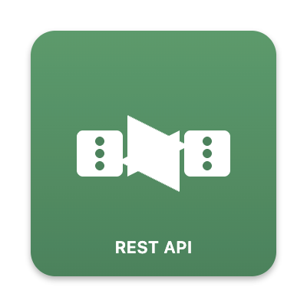







AI AGENTS — AUTONOMOUS SYSTEMS
Beyond predefined steps: agents plan, reason, use tools, and adapt dynamically to accomplish complex goals with minimal human intervention.
REASON
Dynamic Planning & Reasoning
1
Given a goal, the agent autonomously determines the sequence of steps required — generating its execution plan at runtime, not at design time. It reasons through ambiguity, evaluates options, and re-plans in real time as new information arrives.
vs Workflow: execution path is fixed and predefined by the engineer
ACT
Dynamic Tool Use
Memory
2
Agents dynamically select and invoke external tools — APIs, databases, code interpreters, web search, sub-agents — based on what the current task requires. Tool selection is decided by the LLM at runtime, not wired at design time.
vs Workflow: tools are called only at fixed, pre-wired nodes
Action
Reasoning
MEMORY
Persistent Memory Across Sessions
AI Agent
3
Agents maintain state across sessions via external memory stores, recalling prior context, user preferences, and episodic history. This enables personalisation, continuous improvement, and long-horizon task execution.
Perception
vs Workflow: stateless between runs unless memory is manually passed
ADAPT
Adaptive Goal Pursuit
4
Agents observe the outcome of each action, evaluate progress against the goal, and revise their approach. They recover from errors, reroute around failures, and handle novel situations that no engineer anticipated.
vs Workflow: outcomes are constrained to predefined terminal states

Slide 20
Classification of Agent Memory
Agent memory is organised into three tiers: storage duration, cognitive function, and concrete implementation.
LLM Context
Window
Short Term
Memory (STM)
Working
Memory
Session
Memory
Semantic
Cache
Workflow
Toolbox
Procedural
Tool Logs
Agent Memory
Long Term
Memory (LTM)
Episodic
Conversations
Semantic
Summaries
Knowledge
Base
Coordination
Entity
Memory
Shared
Memory
Persona
Memory

Slide 21
How do you give Agents Memory
The Implementation Path From Context Window to Persistent Memory Store

Slide 22
Agent Memory — System Components
DEFINITION
Agent Memory is the exocortex that augments an LLM; capturing, encoding, storing, linking, and retrieving information beyond the model's parametric and context limits. It provides the persistence and structure required for long-horizon reasoning, adaptation and reliable behaviour.

Slide 23
Agent Memory — System Components
The engineering stack that enables AI agents to encode, store, retrieve and inject information beyond the context window.
DEFINITION
Agent Memory is the exocortex that augments an LLM — capturing, encoding, storing, linking, and retrieving information beyond the model's parametric and context limits. It provides the persistence and structure required for long-horizon reasoning and reliable behaviour. It is not a single component but a system of collaborating parts.
THE SYSTEM COMPONENTS
1
Embedding Model
2
Oracle AI Database
3
Reranking Model
4
Memory Manager
5
LLM
Converts raw text — conversations, documents, tool outputs — into dense vector representations that capture semantic meaning.
A converged database engine that stores vector, relational, document, and graph data in a single system — the Memory Core.
A scoring model that takes an initial set of retrieved candidates and reorders them by relevance to the query — improving retrieval precision before context is assembled.
The software abstraction that unifies read and write operations across all memory types behind a consistent API.
The reasoning engine that consumes the assembled context window and generates outputs — which in turn become new memory inputs.
▶
▶
▶
▶
ROLE
ROLE
ROLE
ROLE
ROLE
Encoding layer. Every piece of information must be embedded before it can be stored in vector-enabled memory.
Storage layer. Holds all memory types: SQL tables for conversational history, vector-enabled tables for semantic search.
Retrieval refinement.
Reranks candidate memories retrieved, ensuring the most contextually relevant results are injected into the context window
Orchestration layer. Decides what to write, when to retrieve, how to format memory for injection into the context window.
Consumer and producer. Reads injected memory at inference time; its outputs are stored back into memory after each turn.

Slide 24
Agent Memory Types — Definitions & Use Cases
Each memory type serves a distinct cognitive function and is optimised for a specific retrieval pattern.
Memory Type
Definition
When to Use
Storage
Retrieval
LLM Context Window
The active, in-context information currently being reasoned over. Ephemeral by nature — exists only during a single inference call.
Always active. Populated from all other memory types via injection.
In-memory (runtime)
Direct — no retrieval needed
Session Memory
Short-lived conversational state for the current session. Stores recent turns before consolidation or offloading.
Multi-turn conversations within a single session. Cleared or summarised at session end.
SQL table
Exact lookup by thread_id
Workflow
Learned action patterns, tool call sequences, and multi-step execution plans extracted from past agent runs.
Retrieving prior steps for similar tasks. Prevents re-planning from scratch for known task types.
Vector-enabled SQL table
Semantic similarity search
Toolbox
Dynamic registry of available tool definitions, their schemas, and descriptions.
Before each LLM call. Only semantically relevant tools are retrieved — scales to 100+ tools without context bloat.
Vector-enabled SQL table
Semantic similarity search
Conversations
Full conversation history stored durably across sessions — the agent's autobiographical record.
Resuming prior sessions. Referencing what was said, decided, or agreed in past interactions.
SQL table
Exact lookup by thread_id
Summaries
Compressed representations of long conversations or task histories — condensed without losing key decisions.
Context window is filling. Long-running tasks where full history is too large to inject.
Vector-enabled SQL table
Semantic search + JIT expansion
Knowledge Base
General-purpose semantic memory. Stores facts, documents, search results, and domain knowledge.
Answering factual queries. Injecting domain context. RAG-style retrieval at inference time.
Vector-enabled SQL table
Semantic similarity search
Entity Memory
Structured records of people, systems, organisations, and concepts mentioned in context.
Personalisation. Referencing known entities. Avoiding re-extraction of facts already encountered.
Vector-enabled SQL table
Semantic + attribute filter
Persona Memory
Persistent user preferences, communication styles, goals, and profile data.
Personalising agent behaviour. Remembering user tone, format preferences, and stated goals.
SQL/JSON table
Exact lookup by user_id
Shared Memory
Cross-agent memory shared among multiple agents in a multi-agent system — enabling coordination.
Multi-agent workflows. Shared task state, delegated work results, and inter-agent communication.
SQL/vector-enabled table
Semantic + key lookup
ORACLE

Slide 25
Agent Memory – Three Key Elements
Three engineering disciplines that work together to encode, manage and surface memory across the agent lifecycle.
1
Context Engineering
2
Memory Engineering
3
Harness Engineering
What the agent perceives
What the agent retains
How memory is orchestrated
Shapes the information available to the agent at inference time. Decides what goes into the context window, which memories, documents, tool outputs, and history are selected, compressed, and assembled before the LLM processes them.
Governs how information is encoded, structured, stored, retrieved, and forgotten across time. Spans all memory types — episodic, semantic, procedural, and working — and defines the full five-stage memory lifecycle from ingestion to forgetting.
Designs the agent loop structure that determines when memory read and write operations are triggered — programmatically by the system or dynamically by the agent itself. Defines the memory-first harness that wraps every agent action.
CONTRIBUTION
CONTRIBUTION
CONTRIBUTION
Controls the quality and relevance of what enters the context window. Without it, agents receive noisy, unfiltered input that degrades reasoning and wastes token budget.
Provides the durable, retrievable knowledge layer that persists beyond the context window; turning a stateless model into a system that learns and recalls across sessions.
Ensures memory operations happen at the right points in the agent loop, so the agent acts on what it knows, records what it learns, and never loses continuity between turns.

Slide 26
Key Elements
Context, Memory, and Harness Engineering

Slide 27

RETREIEVAL ENGINE
vector_search(query, k=10)
→ rerank → top 3 Semantic similatiry saerch
Hybrid Search
TECHNIQUES
KNOWLEDGE BASE
Context Engineering
The practice of selecting, structuring, and prioritizing tokens within a finite context window, optimizing the signal-to-noise ratio of inputs to reliably produce desired model behavior.
Context Retrieval
Documents | PDFs
Context Reduction
Internal Docs | Wiki
Context Offloading
Vector Embeddings
LLM Context Window
[Augmented Prompt] + [retrieved documents] + [user query]
Sandbox
External Source
Developer Instructions
Skills.MD / Agents.MD
Tool Schemas
Conversation History
USER INPUT
QUERY
OUTPUT
GROUNDED RESPONSE
Copyright © 2026, Oracle and/or its affiliates

Slide 28
TECHNIQUES
USER INPUT
QUERY
Context Retrieval
Summarisations
Context Reduction
Knowledge Base
Context Offloading
Entity Memory
Memory Engineering
The engineering discipline focused on designing, building, and maintaining memory systems for AI agents. It encompasses the storage, retrieval, classification, and lifecycle management of agent memory.
LARGE LANGUAGE MODEL
Context Window
Persona Memory
Sandbox
system: "You are an helpful assistant..."
Memory Manager
Summary Memory
Conversations
Workflow Memory
Toolbox
Knowledge Base
Workflow
Entity Memory
Session Memory
OUTPUT
GROUNDED RESPONSE
Copyright © 2026, Oracle and/or its affiliates

Slide 29
Agent Loop
A cyclical, iterative execution pattern inside a single agent run/turn where an agent repeatedly: assembles context (instructions, conversation state, retrieved memory, tool outputs, relevant data), invokes an LLM to reason/decide, and then acts (responds, calls tools, writes memory/state, or updates the plan), until a stop condition is met, e.g., a final answer is produced, a goal is completed, an error/timeout occurs, or the agent explicitly decides to exit.
Agent Loop
1. Assemble Context
(instructions, state, memory, tool outputs, data)
2. Invoke LLM
(Reason/Decide)
(Cyclical / Iterative)
3. Act
(Respond, call tools, ask user for input)
Copyright © 2026, Oracle and/or its affiliates

Slide 30
Outer Harness
Agent Harness and MemOps
The infrastructure and scaffolding surrounding an LLM-enabled agent designed to ensure reliable, desirable outcomes. Components include memory operations, control systems, environment information, coding principles, and task-specific tooling. Memory operations are particularly critical, enabling agents to adapt reliably and extend their capabilities over time.
Agent Loop
1. Assemble Context
(instructions, state, memory, tool outputs, data)
2. Invoke LLM
(Reason/Decide)
(Cyclical / Iterative)
3. Observe / Act
(Respond, call tools, ask user for input)
Inner Harness
START CONDITION
User Provides an input
STOP CONDITION
Final answer, goal completed, error or timeout, asking user for input
Copyright © 2026, Oracle and/or its affiliates

Slide 31
SKILLS.MD
Outer Harness
AGENTS.MD
Agent Loop
Summarisations
1. Assemble Context
(instructions, state, memory, tool outputs, data)
Knowledge Base
2. Invoke LLM
(Reason/Decide)
Entity Memory
Persona Memory
(Cyclical / Iterative)
Sandbox Environment
Memory Manager
3. Observe / Act
(Respond, call tools, ask user for input)
Memory Extractaction
Extract memory units from agent’s response
Conversations
Context Engineering
Context Retrieval
Context Offloading
Toolbox
Workflow
Inner Harness
Session Memory
START CONDITION
User Provides an input
STOP CONDITION
Final answer, goal completed, error or timeout, asking user for input
Copyright © 2026, Oracle and/or its affiliates
Notes:
Continuity: Context -> Memory -> Agent Harness

Slide 32
Agent Memory Workshop GitHub Repo
https://github.com/oracle-devrel/oracle-ai-developer-hub/tree/main/workshops/agent_memory_workshop

Slide 33

Come see us at Booth #401

Slide 34
Thanks for being here!

