Slide 1
ORACLE
AI Developer Experience
How Oracle Database meets the demand of the AI Agent Era.

Slide 2
NO COMPROMISE ·
ORACLE AI DATABASE
Don't compromise in the age of AI. CHOOSE BOTH

Slide 3
NO COMPROMISE ·
ORACLE AI DATABASE
Don't compromise in the age of AI. CHOOSE BOTH
AGENT MEMORY
Filesystem
+
Database
DATA MODELLING
JSON
+
Relational
VELOCITY
Fast innovation
+
Enterprise security
RETRIEVAL
Vector
+
Lexical
DEPLOYMENT
Cloud
+
On-prem

Slide 4
AGENDA
WHAT WE'LL COVER
AGENDA
What we'll talk through.
01
The four shapes
05
What is an agent
FORM FACTOR · EVOLUTION
MODEL + HARNESS = AGENT
02
Where the field heads
06
Inside the harness
AUTOMATION + AUTONOMY · CONVERGE
FOURTEEN SURFACES
03
Four ways to build
07
One substrate
NO CODE → CUSTOM CODE
HARNESS LIVES IN THE DATABASE
04
Four front doors
08
Many shapes
BUILD MODES → ORACLE PRODUCTS
ONE ENGINE · MANY OUTPUTS

Slide 5
OVERVIEW 01 OF 03
FORM FACTOR · EVOLUTION
WHERE THE FIELD IS TODAY
Four shapes AI applications take.
LLM Chatbot
RAG Applications
AI Application
LLM-Driven Workflow (Automation)
AI Agents (Autonomy)

Slide 6
OVERVIEW 02 OF 03
FORM FACTOR · CONVERGENCE
WHERE THE FIELD IS HEADING
Automation and autonomy converge.
Chatbots flatten. RAG flattens. Autonomy generates the automation.
LLM Chatbot
WHERE WE'RE HEADING
RAG Applications
Autonomous systems that build automated workflows.
AI Application
Automation
Autonomy

Slide 7
OVERVIEW 03 OF 03
BUILD MODES · THE SPECTRUM
HOW AI APPLICATIONS GET BUILT
Four modes on a spectrum.
From no-code to custom code, the same database can serve all four.
No Code
Low Code
AI Application
PRO CODE
Framework
Custom Code

Slide 8
PORTFOLIO MAPPING
BUILD MODES · ORACLE PRODUCTS
MEETING THE DEVELOPER WHERE THEY ARE
Same database. Four front doors.
No Code
Private Agent Factory
Low Code
AI Application
Select AI · APEX AI Assistant
PRO CODE
Framework
langchain · llamaindex · OAMP · Haystack
Custom Code
SDKs · MCP Server · REST APIs

Slide 9
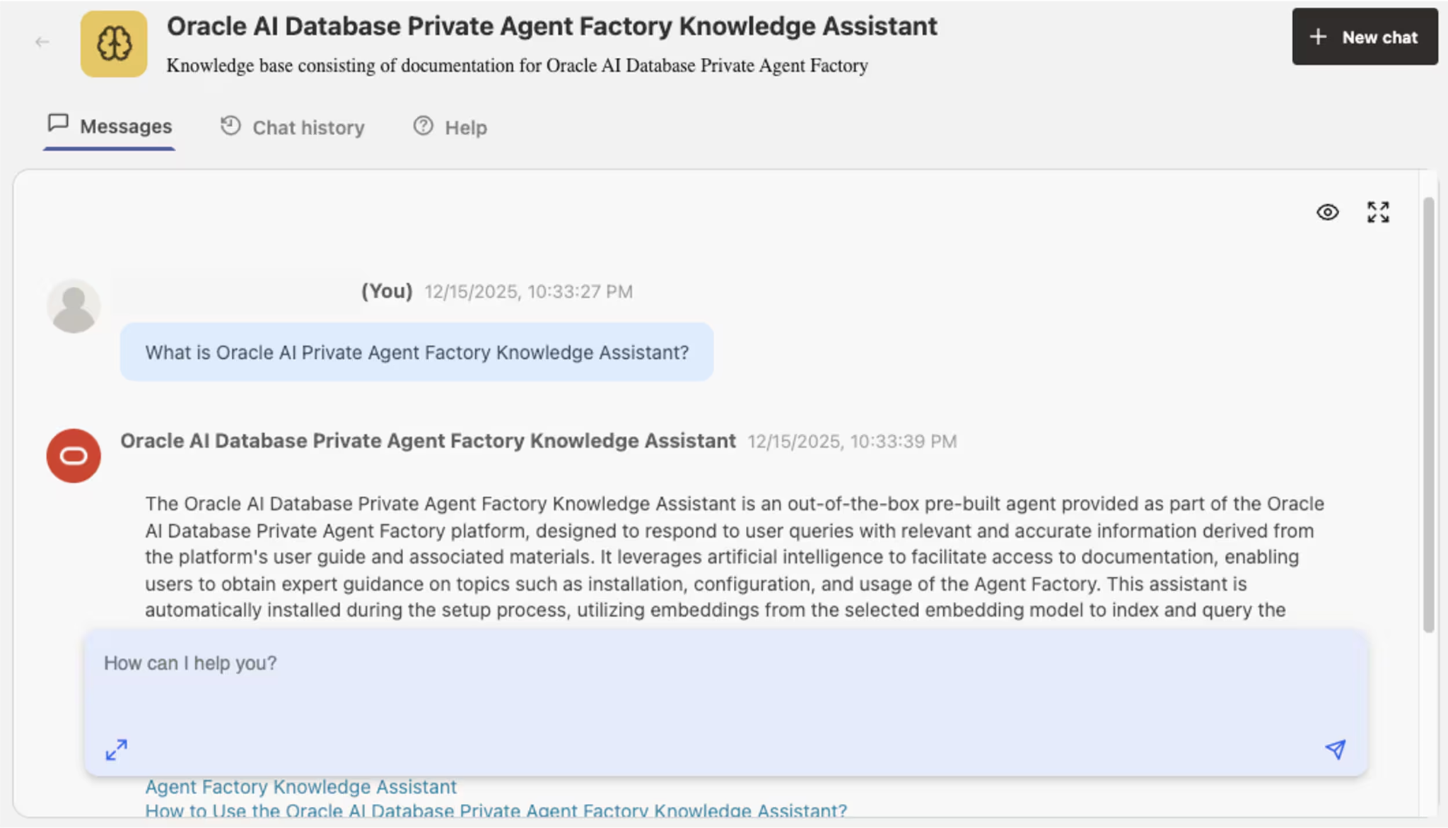
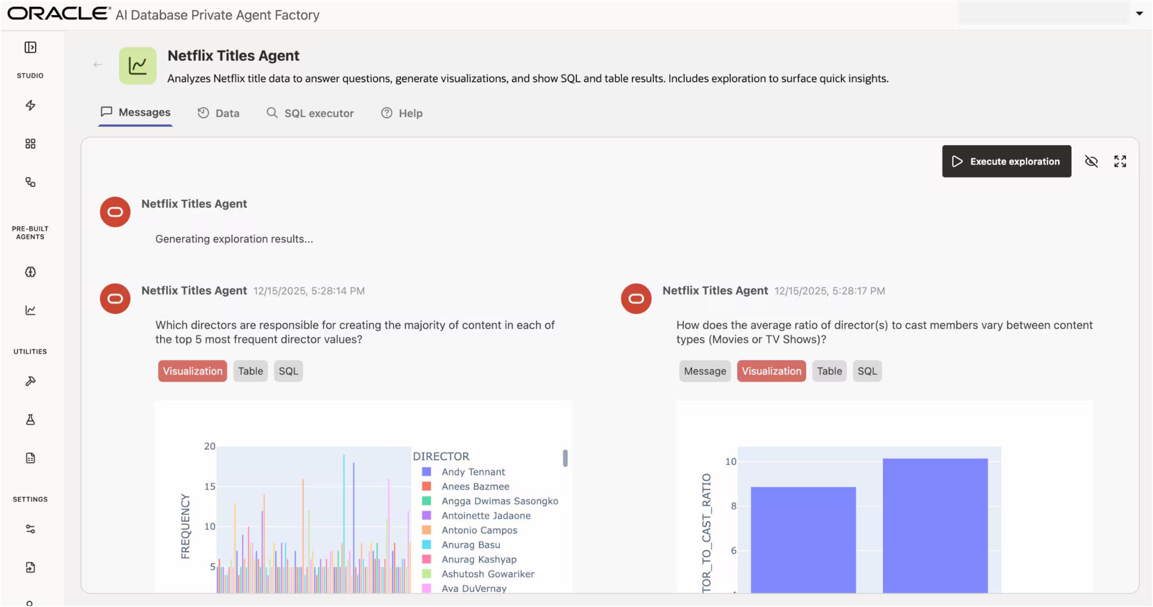
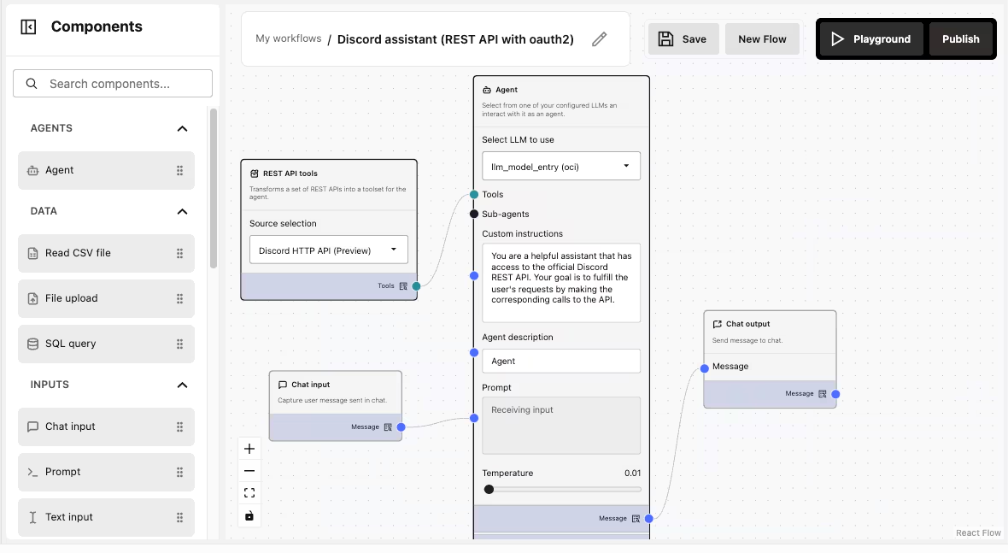
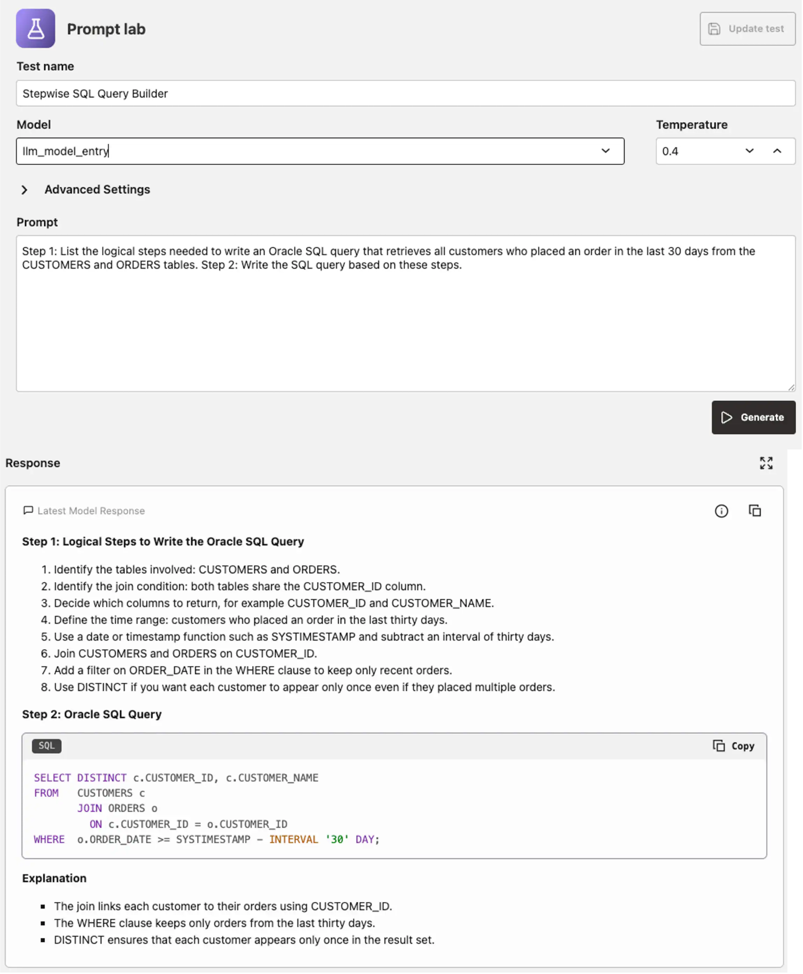
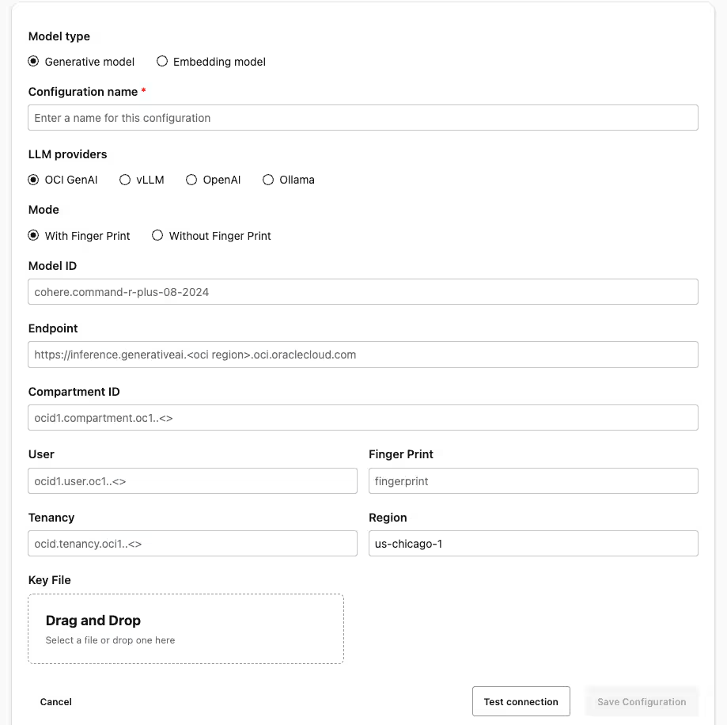
PORTFOLIO MAPPING | PRIVATE AGENT FACTORY
BUILD MODES · ORACLE PRODUCTS

Slide 10
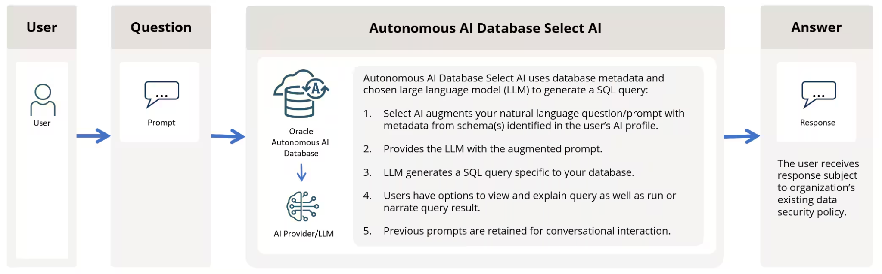
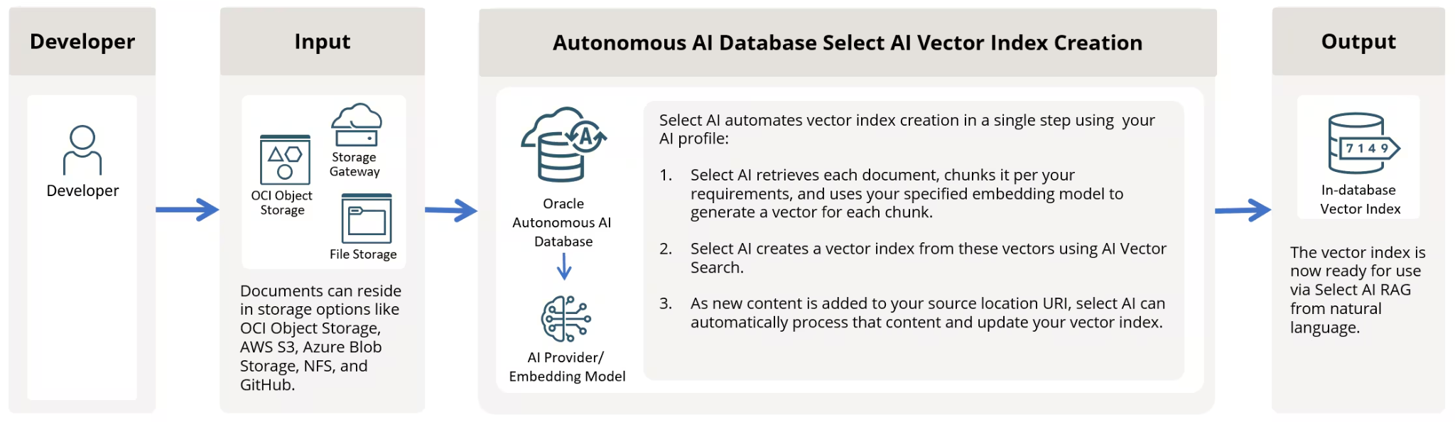
PORTFOLIO MAPPING | SELECT AI
BUILD MODES · ORACLE PRODUCTS

Slide 11
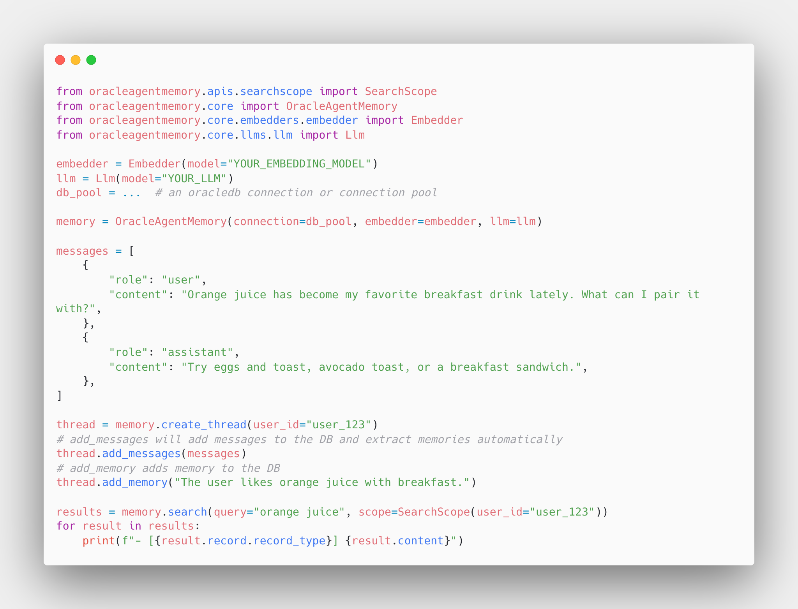
PORTFOLIO MAPPING | AI AGENT MEMORY
BUILD MODES · ORACLE PRODUCTS

Slide 12
WORKING DEFINITION 01 OF 02
WHAT IS AN AGENT
WHAT THE AGENT DOES
Four primitives. One agent.
Agent

Slide 13
WORKING DEFINITION 01 OF 02
WHAT IS AN AGENT
WHAT THE AGENT DOES
Four primitives. One agent.
Perception
Memory
Agent
Action
Reasoning

Slide 14
WORKING DEFINITION 01 OF 02
WHAT IS AN AGENT
WHAT THE AGENT DOES
Four primitives. One agent.
Agent
=
Model
+
Harness

Slide 15
WORKING DEFINITION 02 OF 02
THE REFRAMING
THE REFRAMING
An agent is a model plus a harness.
PROMPTS
LLM PROVIDER
EMBED MODEL
RERANK MODEL
Agent
=
Model
+
Harness
MEMORY
RETRIEVAL
TOOL REGISTRY
SANDBOX
SECURITY
MEMORY MANAGER
MEMORY ENG.
CONTEXT ENG.
AGENT LOOP
OBSERVABILITY

Slide 16
REFERENCE 02 OF 04
HARNESS · INTO THE DATABASE
WHERE THE HARNESS LIVES
Harness surfaces. One Component.
Every component of the harness ends up reading from, writing to, or governed by one place.
HARNESS
PROMPTS
LLM PROVIDER
EMBED MODEL
RERANK MODEL
MEMORY (DB + FS)
RETRIEVAL
TOOL REGISTRY
SANDBOX
SECURITY
MEMORY MANAGER
MEMORY ENG.
CONTEXT ENG.
ORACLE AI DATABASE
AGENT LOOP
OBSERVABILITY

Slide 17
REFERENCE 02 OF 04
HARNESS · INTO THE DATABASE
WHERE THE HARNESS LIVES
One engine. Many shapes.
AI Database (JSON)
JSON · OLTP
HARNESS
Globally Distributed
PROMPTS
LLM PROVIDER
RAFT · RESIDENCY
EMBED MODEL
RERANK MODEL
AI Vector Database
MEMORY (DB + FS)
RETRIEVAL
VECTORS · RAG
TOOL REGISTRY
SANDBOX
AI Lakehouse
SECURITY
MEMORY MANAGER
APACHE ICEBERG
Exadata for AI
MEMORY ENG.
CONTEXT ENG.
ORACLE AI DATABASE
VECTOR OFFLOAD
AGENT LOOP
OBSERVABILITY
API for MongoDB
MONGO COMPATIBLE
True Cache
MID-TIER CACHE

Slide 18
Oracle AI Database Unified Memory Core for AI Agents

Slide 19
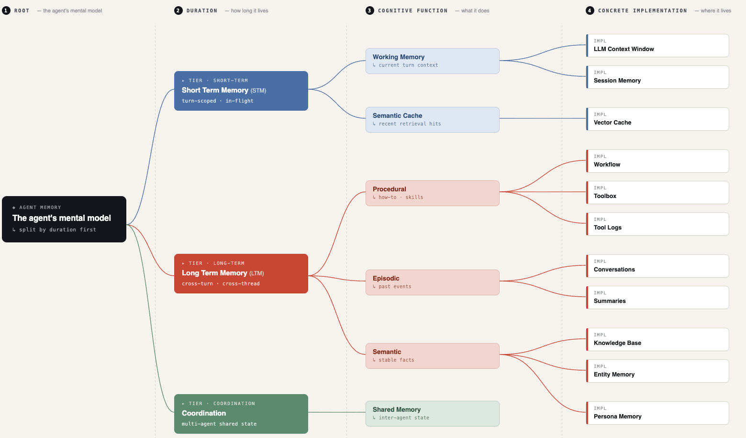
HARNESS | AGENT MEMORY
HARNESS · INTO THE DATABASE
Unified Memory Core for AI Agents

Slide 20
HARNESS DEEP DIVE 01 OF 02
MEMORY · THE SUBSTRATE
MEMORY SUBSTRATE
Filesystem flexibility. Database durability.
TODAY'S CHOICE
ORACLE'S ANSWER
FILESYSTEM ONLY
DATABASE ONLY
DATABASE FILE SYSTEM
Blobs, files, scratchpads.
Structured rows, queries.
DBFS
+ POSIX semantics
+ ACID guarantees
+ Append-friendly
+ Indexes, queries
A filesystem that IS the database.
+ Cheap to scale
+ Governance baked in
POSIX-mounted, FUSE on Linux
− No ACID
− Rigid for blobs/files
Backed by SecureFiles LOBs
− No queries, no indexes
− Schema upfront
ACID + RLS + audit, transparent
One backup. One restore.

Slide 21
HARNESS DEEP DIVE 02 OF 02
MEMORY MANAGER · THE DISCIPLINE
MEMORY MANAGER
Agent Memory is a discipline.
Schemas, indexes, lifecycle, retrieval, governance. The harness has to manage all of it.
MEMORY ENGINEERING · 5 SURFACES
SCHEMAS
INDEXES
LIFECYCLE
RETRIEVAL
GOVERNANCE
Memory types
Make it findable
Write, evict, refresh
Read in context
Scope by identity
episodic · semantic · procedural · working
vector · lexical · graph · hybrid
expiry · summarisation · compaction
top-k · fusion · rerank
user · agent · thread · RLS
ORACLE'S ANSWER · OAMP
01
02
03
Oracle AI Agent
memory
thread
scratchpad
Memory Package
facts, corrections, events
scoped conversations
ephemeral working state
pip install oracleagentmemory

Slide 22
Agent Harness Use Case Focus
Migration Agent
Enterprise Data Agent

Slide 23
Oracle AI Database Don’t Compromise In The Age AI

Slide 24
NO COMPROMISE ·
ORACLE AI DATABASE
Don't compromise in the age of AI.

Slide 25
NO COMPROMISE ·
ORACLE AI DATABASE
Don't compromise in the age of AI.
CHOOSE BOTH

Slide 26
NO COMPROMISE ·
ORACLE AI DATABASE
Don't compromise in the age of AI. CHOOSE BOTH
AGENT MEMORY
Filesystem
+
Database
DATA MODELLING
JSON
+
Relational
VELOCITY
Fast innovation
+
Enterprise security
RETRIEVAL
Vector
+
Lexical
DEPLOYMENT
Cloud
+
On-prem

