Slide 1
ORACLE
AI Developer Experience
Oracle AI Database and Agent Memory

Slide 2
AGENDA
WHAT WE'LL COVER
AGENDA
What we'll talk through.
01
The four shapes
05
What is an agent
FORM FACTOR · EVOLUTION
MODEL + HARNESS = AGENT
02
Where the field heads
06
Inside the harness
AUTOMATION + AUTONOMY · CONVERGE
FOURTEEN SURFACES
03
Four ways to build
07
One substrate
NO CODE → CUSTOM CODE
HARNESS LIVES IN THE DATABASE
04
Four front doors
08
Many shapes
BUILD MODES → ORACLE PRODUCTS
ONE ENGINE · MANY OUTPUTS

Slide 3



Instructors
Anant Srivastava
Nacho Martinez
Casius Lee
Principal Technologist
Data Science Advocate
AI Developer Advocate

Slide 4
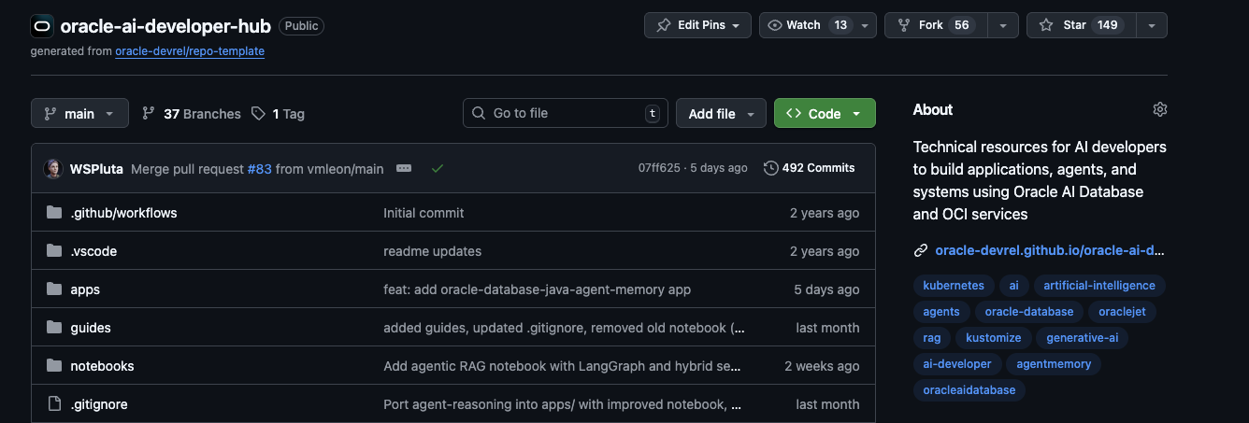
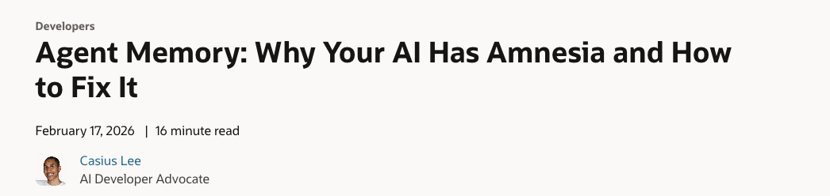
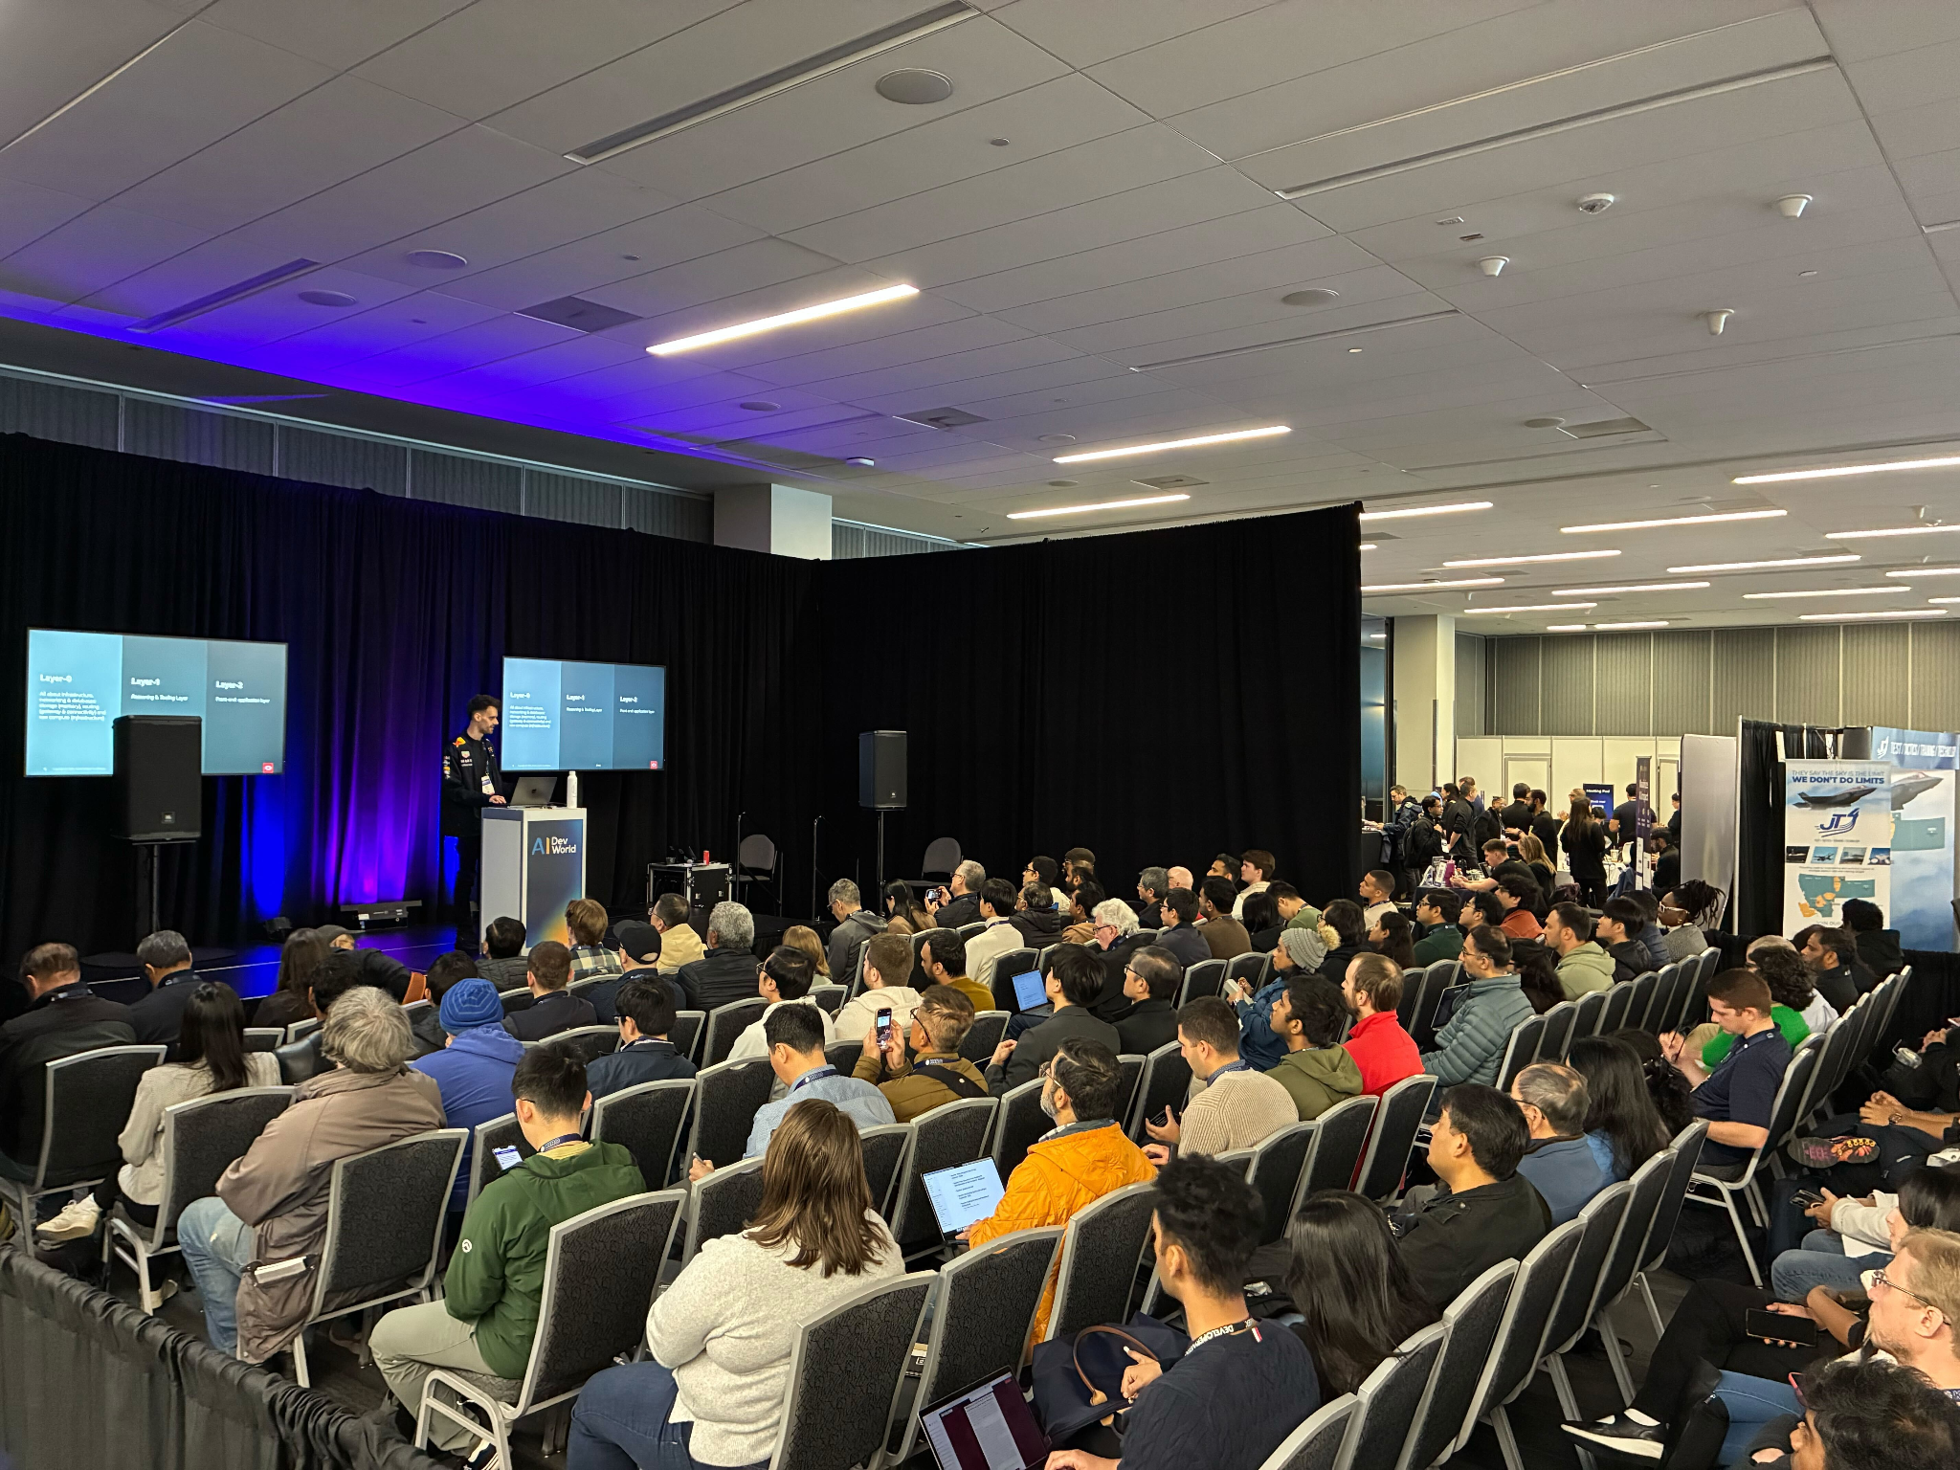
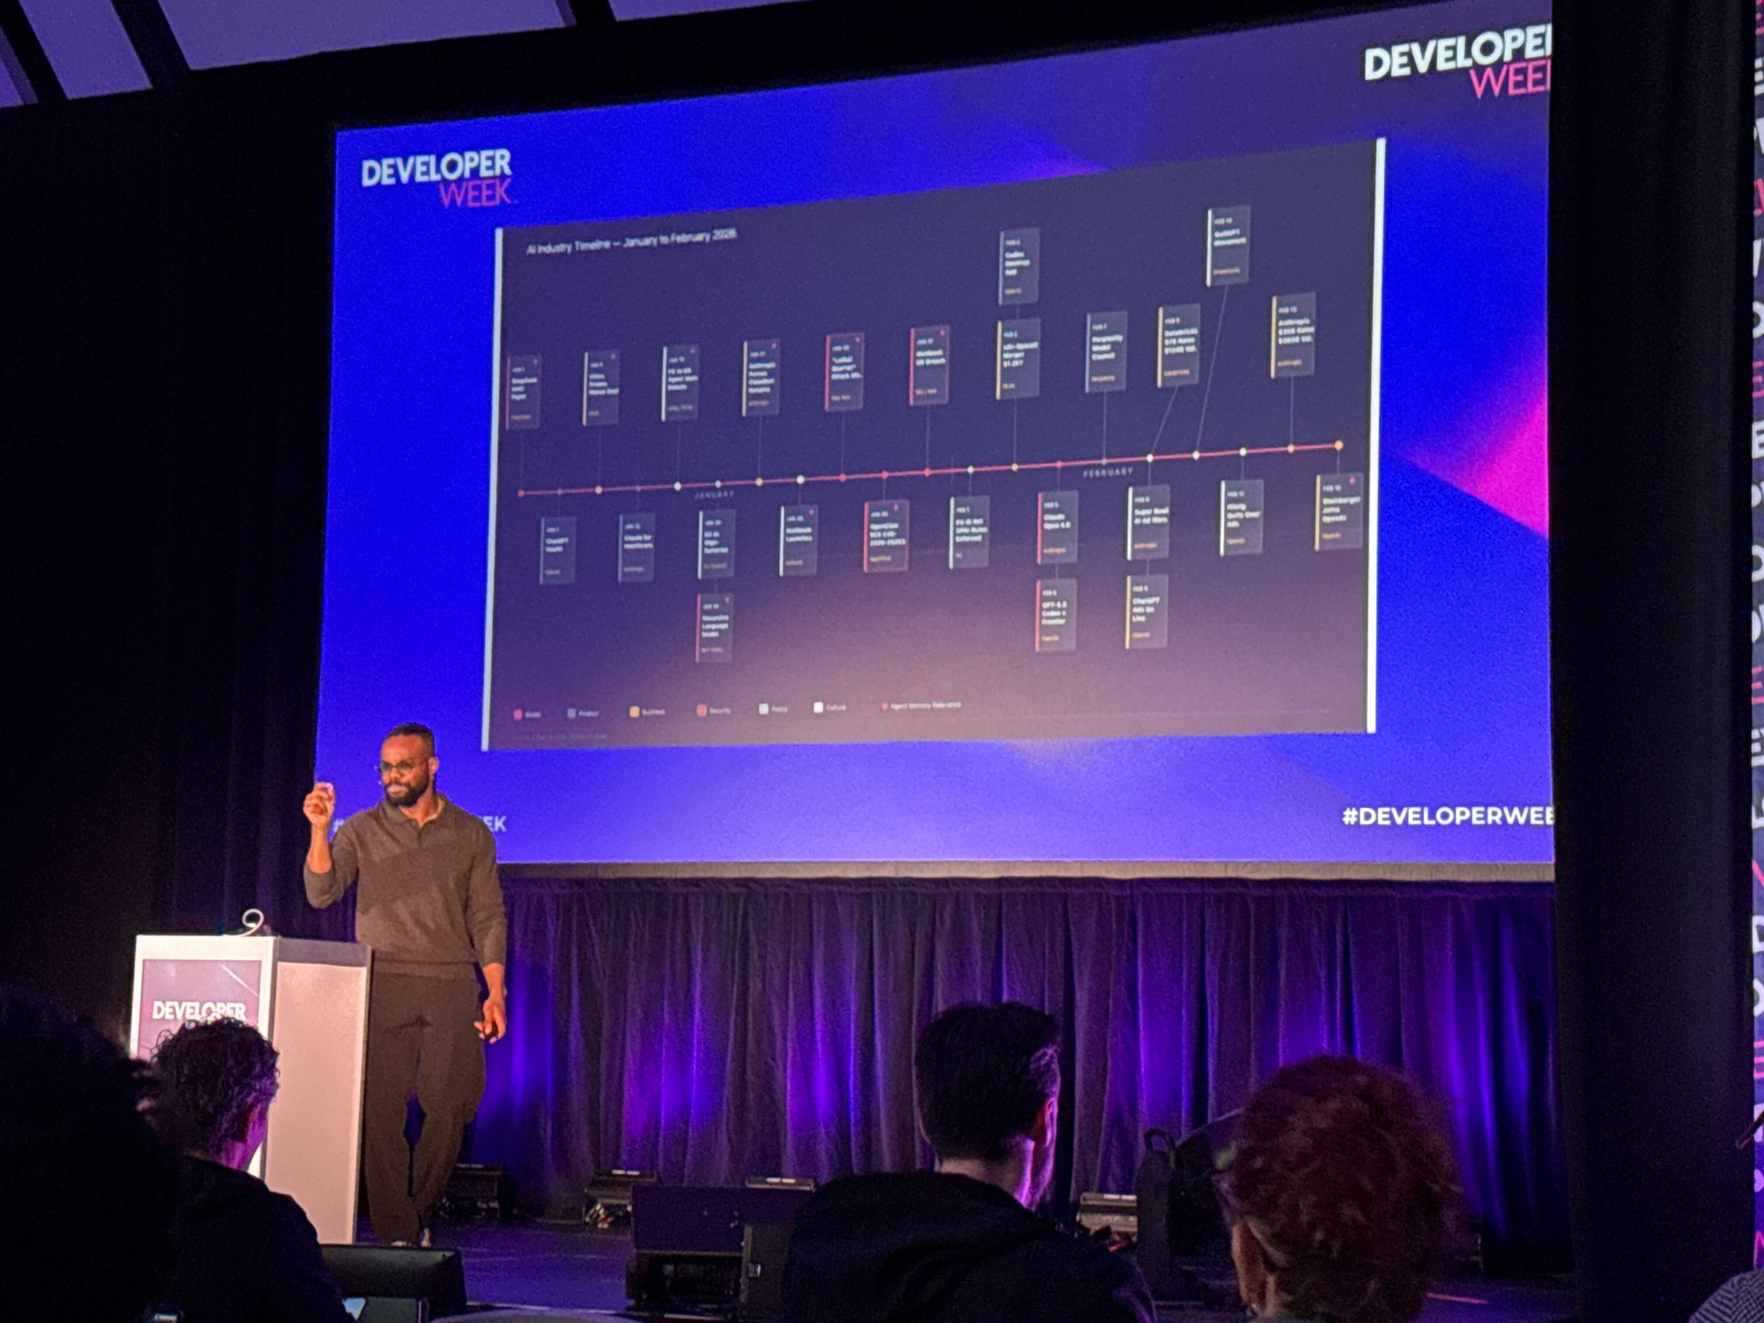
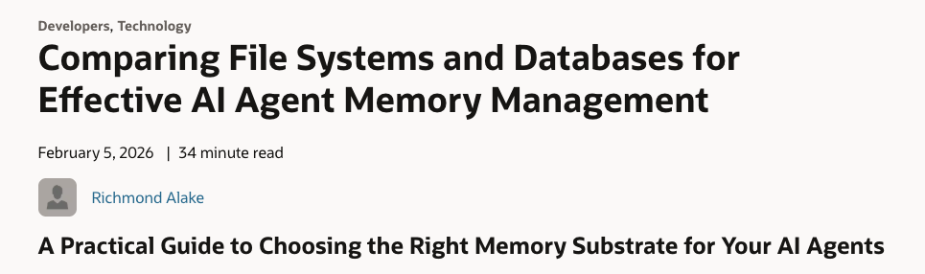

Slide 5

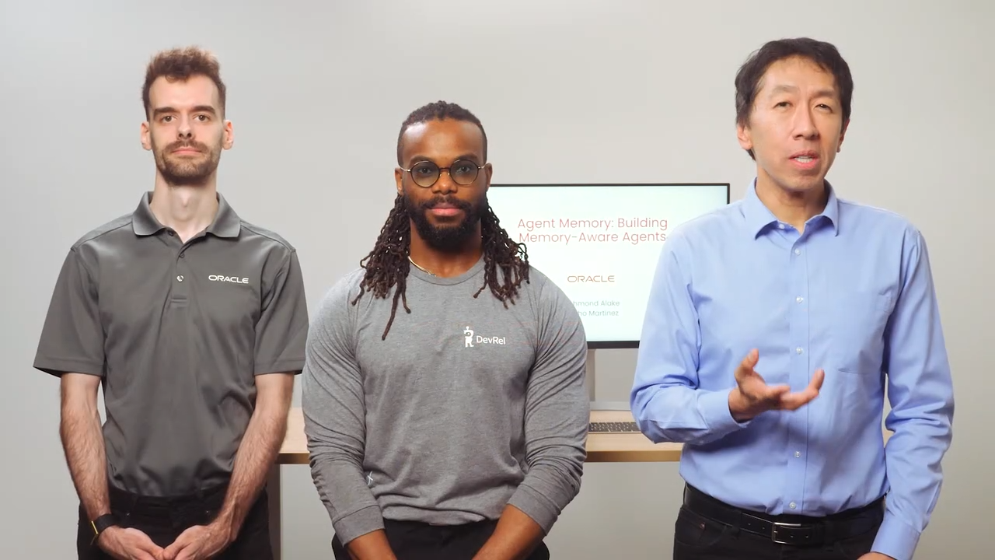

Slide 6
OVERVIEW 01 OF 03
FORM FACTOR · EVOLUTION
WHERE THE FIELD IS TODAY
Four shapes AI applications take.
LLM Chatbot
RAG Applications
AI Application
LLM-Driven Workflow (Automation)
AI Agents (Autonomy)

Slide 7
OVERVIEW 02 OF 03
FORM FACTOR · CONVERGENCE
WHERE THE FIELD IS HEADING
Automation and autonomy converge.
Chatbots flatten. RAG flattens. Autonomy generates the automation.
LLM Chatbot
WHERE WE'RE HEADING
RAG Applications
Autonomous systems that build automated workflows.
AI Application
Automation
Autonomy

Slide 8


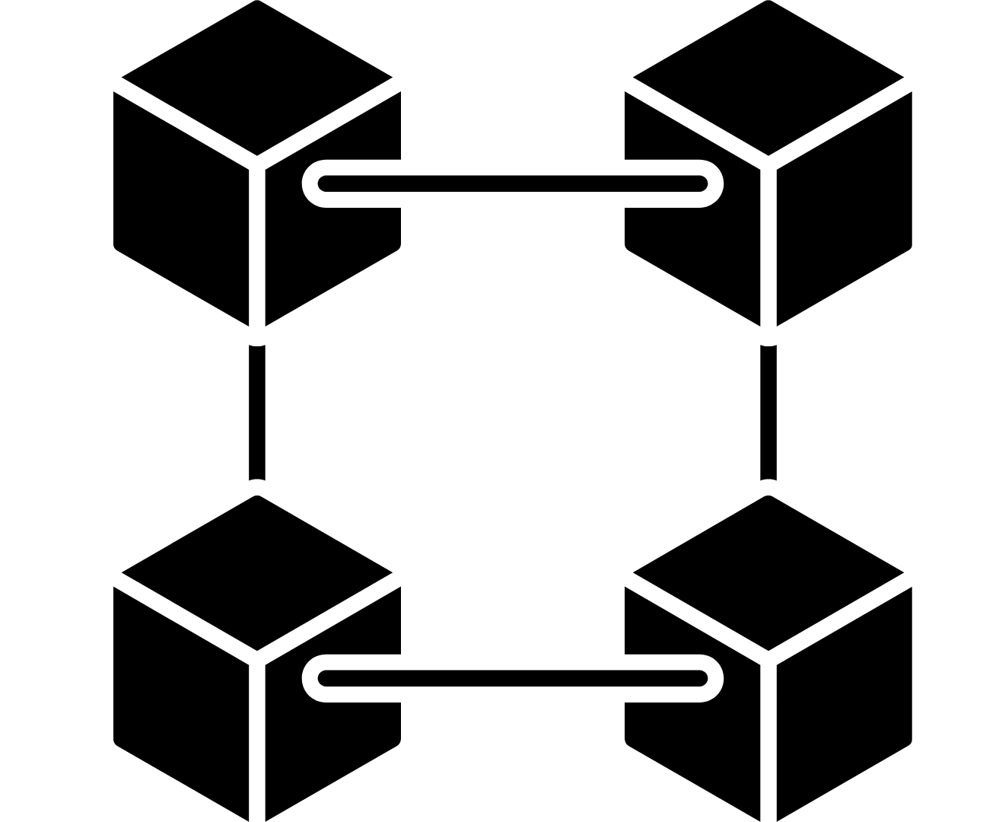
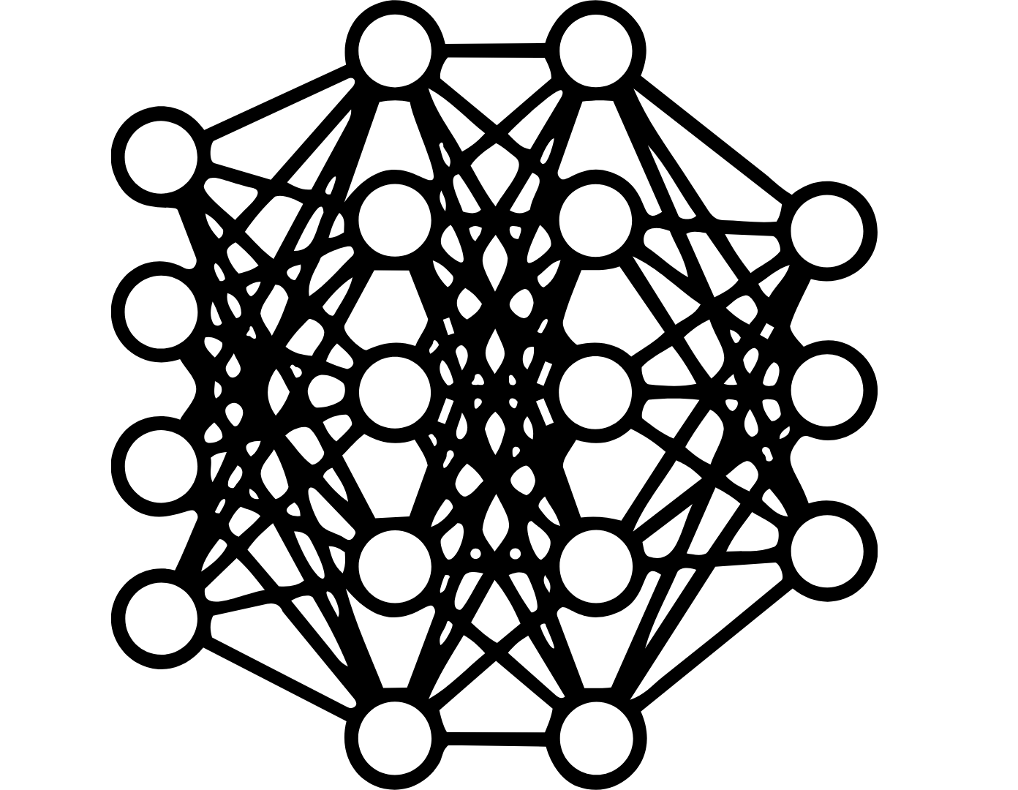
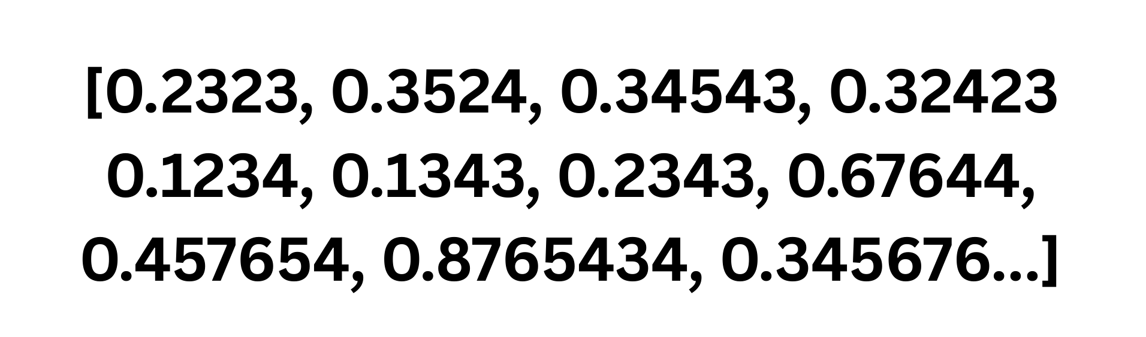
RAG Pipeline
"We find that retrieval-augmented generation significantly reduces hallucin…all Questions benchmark when using contriver-based retrieval."
Data Object
Data ingested into a Data Processing pipeline
Chunks passed into an embedding model.
Embedding Generation
{ "paper_id": "2312.10997", "title": "Benchmarking RAG for Factual Consistency", "authors": ["Chen, Wei", "Patel, Anika", "Yamamoto, Kenji"], "section": "Results", "page": 7, "chunk_index": 42}
Chunking
Data objects are broken into chunks
Data Deduplication
Text Normalization
Data Sources
Entity extraction
PII Redaction
Content Classification
Embedding Model
(:Paper {paper_id: "2312.10997", title: "Benchmarking RAG for Factual Consistency"})
-[:HAS_SECTION]→ (:Section {name: "Results"})
-[:CONTAINS_CHUNK]→ (:Chunk D_BY]→ (:Author {name: "Yamamoto, Kenji"})

Slide 9
RAG Pipeline
"We find that retrieval-augmented generation significantly reduces hallucin…all Questions benchmark when using contriver-based retrieval."
Data Object
Relational
Data ingested into a Data Processing pipeline
Chunks passed into an embedding model.
Embedding Generation
{ "paper_id": "2312.10997", "title": "Benchmarking RAG for Factual Consistency", "authors": ["Chen, Wei", "Patel, Anika", "Yamamoto, Kenji"], "section": "Results", "page": 7, "chunk_index": 42}
Chunking
Data objects are broken into chunks
JSON
Data Deduplication
Text Normalization
Data Ingestion
Data Sources
Entity extraction
Spatial
PII Redaction
Content Classification
Embedding Model
(:Paper {paper_id: "2312.10997", title: "Benchmarking RAG for Factual Consistency"})
-[:HAS_SECTION]→ (:Section {name: "Results"})
-[:CONTAINS_CHUNK]→ (:Chunk D_BY]→ (:Author {name: "Yamamoto, Kenji"})
Vector
Graph

Slide 10
RAG Pipeline
"We find that retrieval-augmented generation significantly reduces hallucin…all Questions benchmark when using contriver-based retrieval."
Data Object
Relational
Data ingested into a Data Processing pipeline
Chunks passed into an embedding model.
Embedding Generation
{ "paper_id": "2312.10997", "title": "Benchmarking RAG for Factual Consistency", "authors": ["Chen, Wei", "Patel, Anika", "Yamamoto, Kenji"], "section": "Results", "page": 7, "chunk_index": 42}
Chunking
Data objects are broken into chunks
JSON
Data Deduplication
Data Sync Logic
Text Normalization
Data Ingestion
Data Sources
Entity extraction
Spatial
PII Redaction
Content Classification
Embedding Model
(:Paper {paper_id: "2312.10997", title: "Benchmarking RAG for Factual Consistency"})
-[:HAS_SECTION]→ (:Section {name: "Results"})
-[:CONTAINS_CHUNK]→ (:Chunk D_BY]→ (:Author {name: "Yamamoto, Kenji"})
Vector
Graph

Slide 11
RAG Pipeline
"We find that retrieval-augmented generation significantly reduces hallucin…all Questions benchmark when using contriver-based retrieval."
Data Object
Relational
Data ingested into a Data Processing pipeline
Chunks passed into an embedding model.
Embedding Generation
{ "paper_id": "2312.10997", "title": "Benchmarking RAG for Factual Consistency", "authors": ["Chen, Wei", "Patel, Anika", "Yamamoto, Kenji"], "section": "Results", "page": 7, "chunk_index": 42}
Chunking
Data objects are broken into chunks
Anti Pattern
JSON
Data Deduplication
Data Sync Logic
Text Normalization
Data Ingestion
Data Sources
Entity extraction
Spatial
PII Redaction
Content Classification
Embedding Model
(:Paper {paper_id: "2312.10997", title: "Benchmarking RAG for Factual Consistency"})
-[:HAS_SECTION]→ (:Section {name: "Results"})
-[:CONTAINS_CHUNK]→ (:Chunk D_BY]→ (:Author {name: "Yamamoto, Kenji"})
Vector
Graph

Slide 12
RAG Pipeline
"We find that retrieval-augmented generation significantly reduces hallucin…all Questions benchmark when using contriver-based retrieval."
Spatial
JSON
Data Object
Graph
Data ingested into a Data Processing pipeline
Chunks passed into an embedding model.
Embedding Generation
{ "paper_id": "2312.10997", "title": "Benchmarking RAG for Factual Consistency", "authors": ["Chen, Wei", "Patel, Anika", "Yamamoto, Kenji"], "section": "Results", "page": 7, "chunk_index": 42}
Operational
Chunking
Data objects are broken into chunks
Data Deduplication
Vector
Text Normalization
Data Ingestion
Data Sources
Entity extraction
PII Redaction
Content Classification
Embedding Model
(:Paper {paper_id: "2312.10997", title: "Benchmarking RAG for Factual Consistency"})
-[:HAS_SECTION]→ (:Section {name: "Results"})
-[:CONTAINS_CHUNK]→ (:Chunk D_BY]→ (:Author {name: "Yamamoto, Kenji"})
Oracle AI Database
Notes:
A converged database is a single database engine that natively supports multiple data models and workload types — relational, vector, graph, spatial, JSON, and key-value — without requiring separate systems for each. Rather than forcing architects to stitch together a vector store for semantic search, a graph database for entity traversal, and a relational system for transactional records, a converged database handles all of these within one engine, one query interface, and one operational stack. The practical consequence for AI agent pipelines is significant: a single SQL statement can join across structured customer records, semantically retrieved policy documents, and graph-traversed relationship paths simultaneously, with full ACID guarantees spanning every data type. This eliminates the data synchronisation tax — the per-inference latency, consistency risk, and engineering overhead incurred when an agent must coordinate reads and writes across multiple disconnected stores. Oracle Database 23ai is the canonical example, providing vector search, native graph traversal, spatial indexing, JSON storage, and relational querying within a single converged engine purpose-built for the demands of production AI workloads.

Slide 13

"We find that retrieval-augmented generation significantly reduces hallucin…all Questions benchmark when using contriver-based retrieval."
Spatial
JSON
Data Object
Graph
Data ingested into a Data Processing pipeline
Chunks passed into an embedding model.
Embedding Generation
{ "paper_id": "2312.10997", "title": "Benchmarking RAG for Factual Consistency", "authors": ["Chen, Wei", "Patel, Anika", "Yamamoto, Kenji"], "section": "Results", "page": 7, "chunk_index": 42}
Operational
Chunking
Data objects are broken into chunks
Data Deduplication
Vector
Text Normalization
Data Ingestion
Data Sources
Entity extraction
PII Redaction
Content Classification
Embedding Model
(:Paper {paper_id: "2312.10997", title: "Benchmarking RAG for Factual Consistency"})
-[:HAS_SECTION]→ (:Section {name: "Results"})
-[:CONTAINS_CHUNK]→ (:Chunk D_BY]→ (:Author {name: "Yamamoto, Kenji"})
Oracle AI Database
User Query
Embedding passed as query vector for semantic retrieval
Natural language response grounded in domain specific data
Embedding
Reranked Documents + User Query
Top k documents matched against query vector via Vector Search (or Hybrid)
Large Language Model
Reranking Model

Slide 14
WORKING DEFINITION 01 OF 02
WHAT IS AN AGENT
WHAT THE AGENT DOES
Four primitives. One agent.
Agent

Slide 15
WORKING DEFINITION 01 OF 02
WHAT IS AN AGENT
WHAT THE AGENT DOES
Four primitives. One agent.
Perception
Memory
Agent
Action
Reasoning

Slide 16
WORKING DEFINITION 01 OF 02
WHAT IS AN AGENT
WHAT THE AGENT DOES
Four primitives. One agent.
Agent
=
Model
+
Harness

Slide 17
CODE
https://github.com/speechlyze/supplychain_demand_agent_workshop

Slide 18
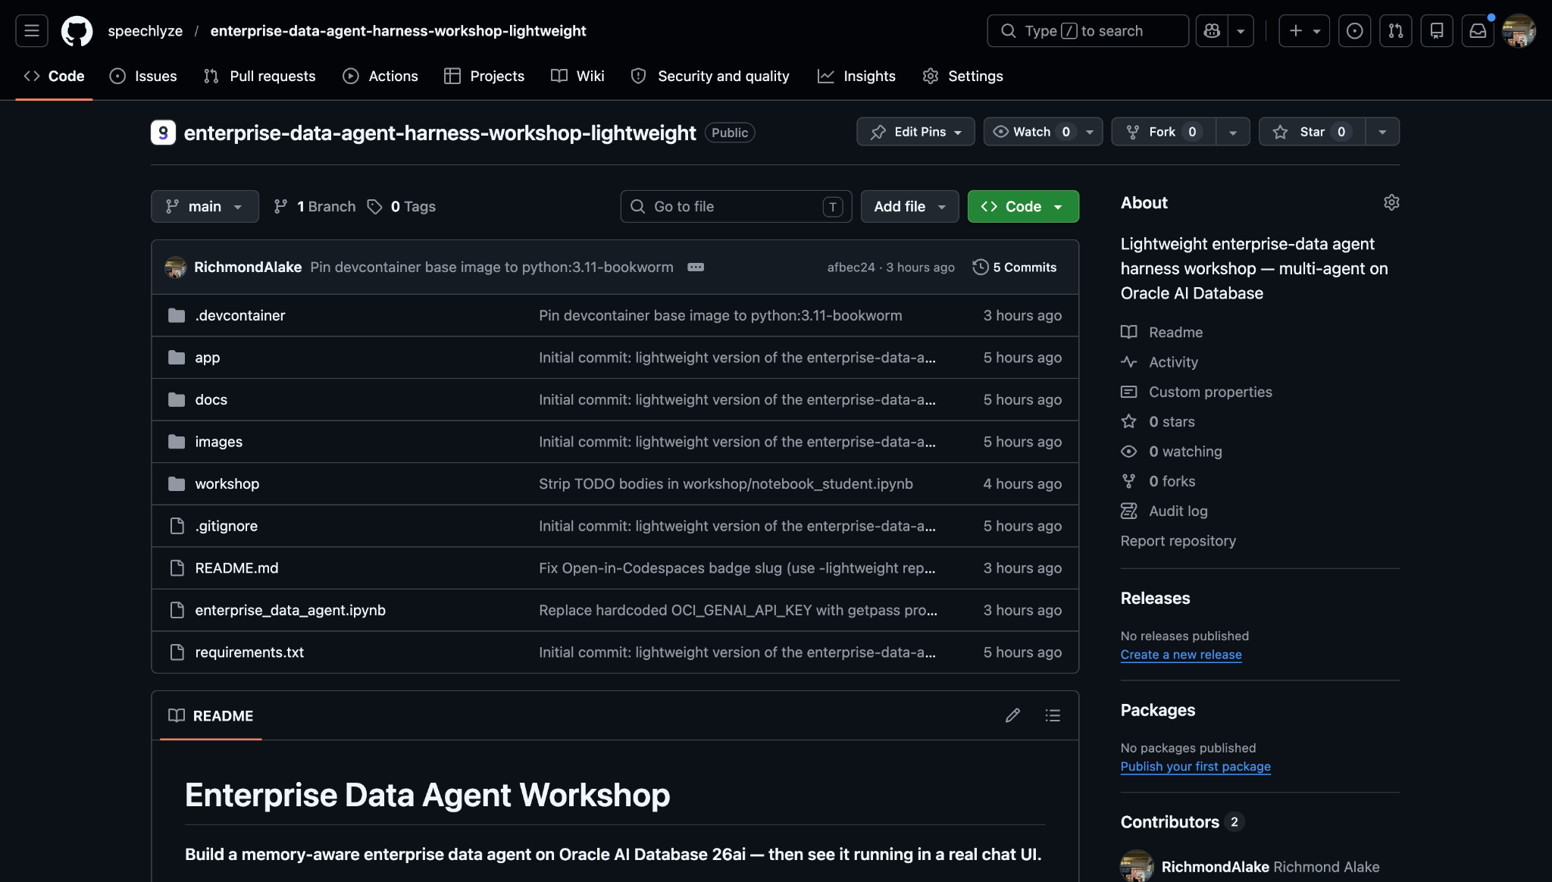

Slide 19
WORKING DEFINITION 02 OF 02
THE REFRAMING
THE REFRAMING
An agent is a model plus a harness.
PROMPTS
LLM PROVIDER
EMBED MODEL
RERANK MODEL
Agent
=
Model
+
Harness
MEMORY
RETRIEVAL
TOOL REGISTRY
SANDBOX
SECURITY
MEMORY MANAGER
MEMORY ENG.
CONTEXT ENG.
AGENT LOOP
OBSERVABILITY

Slide 20
REFERENCE 02 OF 04
HARNESS · INTO THE DATABASE
WHERE THE HARNESS LIVES
Harness surfaces. One Component.
Most component of the harness ends up reading from, writing to, or governed by one place.
EMBED MODEL
LLM PROVIDER
RERANK MODEL
AGENT LOOP
MEMORY (DB + FS)
TOOL REGISTRY
RETRIEVAL
CONTEXT ENG.
SECURITY
SANDBOX
PROMPTS
MEMORY ENG.
MEMORY MANAGER
OBSERVABILITY
ORACLE AI DATABASE

Slide 21
Oracle AI Database Unified Memory Core for AI Agents

Slide 22
HARNESS | AGENT MEMORY
Unified Memory Core for AI Agents
1
ROOT — the agent's mental model
DURATION — how long it lives
FUNCTION — what it does
IMPLEMENTATION — where it lives
2
3
4
Working Memory
IMPL
LLM Context Window
● TIER · SHORT-TERM
↳ current turn context
IMPL
Short Term Memory (STM)
Session Memory
turn-scoped · in-flight
Semantic Cache
↳ recent retrieval hits
IMPL
Workflow
Procedural
IMPL
↳ how-to · skills
Toolbox
IMPL
● AGENT MEMORY
Tool Logs
The agent's mental model
● TIER · LONG-TERM
IMPL
Long Term Memory (LTM)
Episodic
Conversations
↳ split by duration first
↳ past events
cross-turn · cross-thread
IMPL
Summaries
Semantic
IMPL
Knowledge Base
↳ stable facts
IMPL
● TIER · COORDINATION
Entity Memory
Coordination
Shared Memory
IMPL
Persona Memory
multi-agent shared state
↳ inter-agent state

Slide 23
HARNESS DEEP DIVE 01 OF 02
MEMORY · THE SUBSTRATE
MEMORY SUBSTRATE
Filesystem flexibility. Database durability.
TODAY'S CHOICE
ORACLE'S ANSWER
FILESYSTEM ONLY
DATABASE ONLY
DATABASE FILE SYSTEM
Blobs, files, scratchpads.
Structured rows, queries.
DBFS
+ POSIX semantics
+ ACID guarantees
+ Append-friendly
+ Indexes, queries
A filesystem that IS the database.
+ Cheap to scale
+ Governance baked in
POSIX-mounted, FUSE on Linux
− No ACID
− Rigid for blobs/files
Backed by SecureFiles LOBs
− No queries, no indexes
− Schema upfront
ACID + RLS + audit, transparent
One backup. One restore.

Slide 24
HARNESS DEEP DIVE 02 OF 02
MEMORY MANAGER · THE DISCIPLINE
MEMORY MANAGER
Agent Memory is a discipline.
Schemas, indexes, lifecycle, retrieval, governance. The harness has to manage all of it.
MEMORY ENGINEERING · 5 SURFACES
SCHEMAS
INDEXES
LIFECYCLE
RETRIEVAL
GOVERNANCE
Memory types
Make it findable
Write, evict, refresh
Read in context
Scope by identity
episodic · semantic · procedural · working
vector · lexical · graph · hybrid
expiry · summarisation · compaction
top-k · fusion · rerank
user · agent · thread · RLS
ORACLE'S ANSWER · OAMP
01
02
03
Oracle AI Agent
memory
thread
scratchpad
Memory Package
facts, corrections, events
scoped conversations
ephemeral working state
pip install oracleagentmemory

Slide 25
Oracle AI Agent Memory — Threads, Memories, Facts
ORACLE
Agent / Application
OracleAgentMemory
all three scoped by (user_id, agent_id, thread_id) — same SDK, different lifetime
THREADS short-term
MEMORIES long-term · semantic
FACTS long-term · structured
one live conversation
messages · rolling summary · context card
prose-shaped observations
“Priya prefers conservative buy volumes.”
atomic durable truths
“Priya works in EU region, timezone CET.”
retrieved by recency + ranking
retrieved by semantic search
retrieved by exact match or search
Memory Extractor LLM-driven bridge: thread messages → typed records
Three building blocks behind one SDK. Threads hold the live conversation; Memories and Facts persist what's worth keeping; all three live on Oracle.

Slide 26
Threads, double-clicked: write turns → read context
ORACLE
WRITE SIDE
READ SIDE
agent appends turns
agent loads context before each LLM call
add_messages()
OracleThread
get_messages(limit=N)
append user / assistant / tool turns
raw recent turns (transcripts)
one conversation handle
scoped by (thread_id, user_id, agent_id)
state held in Oracle:
· messages (vector + relational)
· rolling summary
· derived context-card rankings
delete_message(id)
get_summary(except_last=1)
redaction / corrections
compact narrative of earlier turns
get_context_card()
relevance-ranked records for the current turn
ANSWER LATER TURNS CHEAPLY
Before each model call, the agent loads get_summary(except_last=1) + get_context_card() instead of resending the full transcript. LangGraph state carries only the latest user message; Oracle holds everything else.
scope: one session · ends when thread is closed
shortcuts thread.add_memory(...) · thread.search(...)
Three reads instead of one transcript. get_summary + get_context_card give the model what came before; the framework only sends the latest message.

Slide 27
Long-term, double-clicked: typed records → scoped search
ORACLE
PRODUCERS
TYPED STORE
CONSUMER
who writes records
what's written
how it's retrieved
AUTOMATIC
Memory Extractor
reads thread messages → emits typed records via its own LLM
MemoryRecord general observations
SEARCH
OracleAgentMemory
.search(
query=...,
scope=SearchScope(
user_id=...,
agent_id=...,
record_types=...
)
)
→ ranked OracleSearchResult[]
PreferenceRecord user-stated preferences
GuidelineRecord learned rules
FactRecord durable structured truths
MANUAL
Application
add_memory()
add_user()
add_agent()
use when do_not_extract_memories=True
UserProfileRecord who the user is
AgentProfileRecord who the agent is
ThreadRecord per-thread metadata
thread_id is optional. Leave it out and search spans every conversation this user has had with the agent.
families:
Memories
Facts
Threads
Seven typed record kinds, three families. SearchScope narrows by who and by what kind — same row shape in Oracle, different semantic intent.

Slide 28
CODE
https://github.com/speechlyze/supplychain_demand_agent_workshop

Slide 29
ORACLE
AI Developer Experience
Part 2: Oracle AI Database and Langchain for AI Agents

Slide 30
CODE
https://github.com/speechlyze/supplychain_demand_agent_workshop

Slide 31
Reference architecture by provider layer
ORACLE
LangChain
APPLICATION
EXTERNAL
Model providers
ChatOpenAI · OpenAIEmbeddings model clients — OpenAI wire protocol
OpenAI default
@tool · create_agent ReAct agents + tools API
gpt-5.5
text-embedding-3-small
OracleVS · OracleSemanticCache · OracleChatMessageHistory Oracle-backed retrieval / cache / history · langchain-oracledb
agents + tools registered into the graph
LangGraph
ORCHESTRATION
OCI Generative AI alt
create_supervisor multi-agent topology — supervisor + handoff tools
xai.grok-4-1-fast-
reasoning
AsyncOracleSaver · AsyncOracleStore short + long-term memory · langgraph-oracledb
compile(checkpointer=, store=) attach both memory horizons to the runtime
checkpoints, memory, vectors, cache, chat history
Oracle AI Database
SUBSTRATE
AI Vector Search HNSW · COSINE · 1536-d
single tenant · single auth · single workload
Relational + JSON storage for the rows that aren't vectors
Tables created automatically by the layers above:
Switched via LLM_PROVIDER
env var. Same wire protocol — swap base_url, not code.
supplychain_demand created by OracleVS
langchain_demand_cache created by OracleSemanticCache
langchain_planner_chat created by OracleChatMessageHistory
agent_memory_* created by AsyncOracleStore
checkpoint_* created by AsyncOracleSaver

Slide 32
Demand planning today: every step is hers
ORACLE
1
Priya asks
2
Hunts for data
3
Emails the experts
4
Combines manually
5
Answers (eventually)
ERP
last year's sales
⌛
Planner · Priya
BI dashboard
current inventory
Planner · Priya
⏱ 3–5 days later
“How aggressively should we stock soccer merchandise this season?”
spreadsheet
policy.pdf
“Buy moderately aggressive on cleats. Conservative elsewhere.”
›
CRM
promo plans
›
waits 1–3 days
›
›
+ gut feel
SharePoint
regional notes
Same question — but no system to ask. The work is hers.
Logs into separate systems, exports CSVs, copies numbers into a working file.
Pings sales lead, marketing, regional managers. Half reply same day, half take days.
Combines numbers in Excel, hunts through a 40-page policy PDF, applies her own judgment.
Another planner would have answered differently. None of the reasoning is captured for next time.
⚠ Multiply this across 50+ planners, every quarter. No shared memory of past decisions.
Today's flow: a planner alone with a question, four systems, and several days. No shared substrate, no carried context, no memory of past quarters.

Slide 33
Demand planning with a human in the loop
ORACLE
1
Priya asks
2
System splits work
3
Both query Oracle
4
Supervisor combines
5
Priya gets the answer
LangGraph
supervisor
Oracle
return
supervisor
AI Database
Planner · Priya
Demand history
Planner · Priya
“How aggressively should we stock soccer merchandise this season?”
delegate
“Buy moderately aggressive, concentrated in cleats — clears the 500-visitor threshold, matches your conservative bias.”
›
demand
_analyst
policy
_agent
›
Policy + prefs
›
›
Response cache
policy · prefs · demand
Her request carries her user_id so the system can look up her saved preferences.
A supervisor delegates to two specialists — one for evidence, one for policy + preferences.
Everything the agents need — vector knowledge, memory, cache — lives on Oracle.
Policy says stay conservative, Priya's bias is cautious, demand says cleats lead — all three weighed.
One answer, three inputs honoured.
↻ follow-ups continue on the same thread_id
A planner asks in plain language. A multi-agent system — backed entirely by Oracle AI Database — returns a buy recommendation that respects policy, preferences, and demand.

Slide 34
Multi-agent demand planning on Oracle AI Database
ORACLE
Multi-agent system
Oracle AI Database
LangGraph
supervisor
plans + synthesises
Vector knowledge
demand reports + policy
Planner
user
ask
delegate / return
retrieve
Agent memory
+ persist
short + long term
answer
demand_analyst
history
policy_agent
policy + prefs
LLM cache
semantic
completions
LLM
OpenAI · OCI GenAI
A LangGraph supervisor and two specialist agents — all of their knowledge, memory, and LLM cache live on Oracle AI Database.

Slide 35
Multi-agent topology: supervisor, specialists, and Oracle
ORACLE
Planner request
carries user_id + thread_id
⤷ user_id unlocks her saved preferences — even on a brand-new thread
request
1
4
answer
Supervisor
plans · delegates · synthesises
orchestrator LLM · LangGraph
delegate ⇄ summary
2
3
delegate ⇄ summary
policy_agent
demand_analyst
↻ ReAct loop
↻ ReAct loop
tools
tools
• get_planner_policy()
• get_user_memory(user_id)
• search_demand_reports(query) vector similarity, k=5
A
B
Oracle AI Database
all state lives here
Knowledge demand reports + policy memo
Memory user prefs + thread checkpoints
One orchestrator, two specialists, one database. The supervisor plans and synthesises; each specialist runs its own ReAct loop against a focused tool surface; everything they retrieve and remember lives on Oracle.

Slide 36
Supervisor memory: short-term + long-term, both on Oracle
ORACLE
⏱ this conversation's timeline
∞ facts that survive every conversation
framework-managed · every step
explicit · tool-called by policy_agent
Supervisor
AsyncOracleSaver
checkpointer
short-term · per-thread
scope: thread_id
“demand-plan-soccer-2026Q3”
multi-agent graph · LangGraph
AsyncOracleStore
store
long-term · cross-thread
scope: namespace tuple
(“users”, user_id, “memories”)
supervisor = supervisor_graph.compile(
checkpointer=saver,
store=agent_store,
)
Scenario
AsyncOracleSaver short-term
AsyncOracleStore long-term
Same thread_id, follow-up turn
Priya continues her session
Restores prior messages
→ conversation resumes
Returns same user prefs
→ policy_agent reads it
New thread_id, same user_id
Priya opens a fresh chat
Nothing to restore
→ starts blank
Returns same user prefs
→ preferences carry over
New thread_id, new user_id
Michael takes over
Nothing to restore
→ starts blank
Returns Michael's prefs
→ different user, scoped
⤷ user_id in the planner's request is the only signal that lets the middle row work — fresh thread, recalled preferences.
Short-term per-thread checkpoints let a conversation resume. Long-term cross-thread memory lets the same planner be recognised on a brand-new thread.

Slide 37
Semantic cache: every prompt looked up in Oracle before the LLM
ORACLE
Agent / User issues prompt
Latency
why bother with the cache
ChatOpenAI client
cache=semantic_cache
MISS
LangChain
≈ full LLM round-trip
embed(prompt)
HIT
OpenAI Embeddings
text-embedding-3-small · 1536-d
≈ 1× embed + 1× vector search
speedup grows as the cache fills
1536-d vector
Why “semantic”?
OracleSemanticCache
paraphrases hit too, not just exact strings
vector search · distance_strategy=COSINE
any near match where score < 0.05 ?
1st call — MISS
“What is supply-chain demand planning?”
HIT
MISS
both embed within 0.05 cosine distance →
HIT
Return stored response
1× embed + 1× search
2nd call — HIT
“Can you explain supply chain demand planning in one sentence?”
MISS
Forward to LLM provider
1× full LLM call + write back
a literal-match cache would have missed
Response back to agent / user

Slide 38
One substrate vs many: the multi-agent stack on a single database
ORACLE
The typical multi-agent stack
Oracle AI Database
four stores, four SDKs, four ops surfaces
one connection, one transaction boundary, one ops surface
Multi-agent system
Multi-agent system
Oracle AI Database
→
• Vector knowledge AI Vector Search
• Agent memory short + long term
Vector DB
knowledge
KV / cache
checkpoints
Memory store
long-term
Tables
app data
• LLM cache semantic
• Tables SQL · ACID
ACID across vector + memory + cache + tables
×
4 connection strings
✓
1 connection string
×
4 SDKs · 4 query languages
✓
1 SDK · just SQL + vectors
×
4 ops dashboards
✓
1 ops dashboard
×
App-level consistency across stores
✓
ACID across all of them

Slide 39
NO COMPROMISE ·
ORACLE AI DATABASE
Don't compromise in the age of AI. CHOOSE BOTH

Slide 40
NO COMPROMISE ·
ORACLE AI DATABASE
Don't compromise in the age of AI. CHOOSE BOTH
AGENT MEMORY
Filesystem
+
Database
DATA MODELLING
JSON
+
Relational
VELOCITY
Fast innovation
+
Enterprise security
RETRIEVAL
Vector
+
Lexical
DEPLOYMENT
Cloud
+
On-prem

Slide 41
CODE
https://github.com/speechlyze/supplychain_demand_agent_workshop

