Slide 1
Oracle Cloud Infrastructure (OCI) Network Firewall
Sachin Sharma
Senior Domain Specialist

Slide 2




OCI Network Firewall features
✕
✓
✕
Stateful Rules
Stateful filtering Allow or Deny rules based on 5-tuple information for both IPv4 and IPv6 traffic.
✓
IDS and IPS
Industry-leading signature-based threat detection and prevention (IDS/IPS) engine to automatically stop known malware, spyware, C2 and vulnerability exploits.
URL & FQDN filtering
Control inbound and outbound HTTP/S traffic to a specified list of FQDN including wild cards and custom URLs.
Flexible Policy Enforcement
Secure inbound, outboud and lateral network/application traffic.
Can be enforced on OCI gateways as well as intra-vcn subnet traffic.
Customer applications
Oracle Cloud Infrastructure
Notes:
We support 3 major feature categories. The first one is Stateful Firewalling – which allows you to enforce allow or deny stateful filtering rules for both IPv4 and IPv6 traffic based on 5-tuple information. We take into account the direction and context of the flow when enforcing rules. We also support IDS, IPS and URL filtering features. These rules are part of our flexible firewall policy, which can be easily enforced using our VCN route rules and applied to your inbound, outbound as well as lateral traffic.

Slide 3
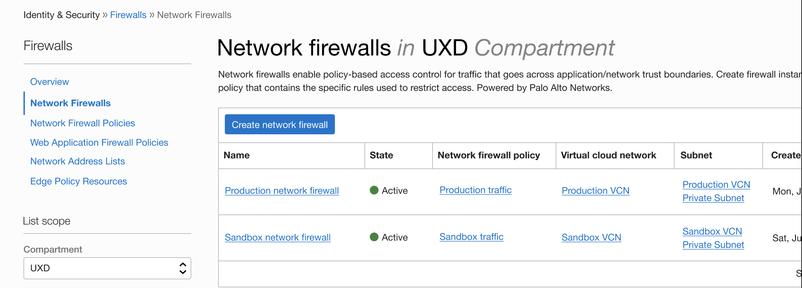
OCI Network Firewall
Customer benefits
Cloud-Native Firewall - Scalable native service that eliminates the need to manage additional third-party security infrastructure.
Deep Integration with OCI - Natively integrated with OCI platform including logging and metrics services.
Layered Defense - Easily apply deeper security controls and segmentation for encrypted and non-encrypted traffic to customer workloads on OCI.
Advanced Threat Protection – Industry leading threat protection to help monitor and block malware, spyware and vulnerability exploits.
Meet Compliance Goals – Helps meet compliance requirements and stringent security needs of regulated environments.
OCI Network Firewall is a cloud-native managed firewall service that is built using industry leading Palo Alto Networks next-generation firewall technology. It provides advanced threat protection capabilities including custom URL filtering, intrusion prevention and detection (IDS/IPS), and TLS inspection to help prevent malicious traffic and malware propagation.
Notes:
OCI Network Firewall is as a turn-key service that enables customers to immediately take advantage of the firewall without the need to configure and manage additional security infrastructure.
It is offered as an OCI native service offering that is elastically scalable with in built-in high availability and resiliency. And provides best-in-class ML-Powered capabilities to protect your workloads on OCI.
With the firewall service, you can monitor and apply granular security controls on your VCN, centrally manage network firewall security policies and easily enforce them across their VCNs. Virtual Cloud Networks (VCNs).
It is tightly integrated with OCI platform including services such as logging and metrics. The firewall is capable of inspecting both encrypted as well as non-encrypted traffic in both the inbound and outbound directions. Finally, it also helps meet your compliance goals and requirements.

Slide 4
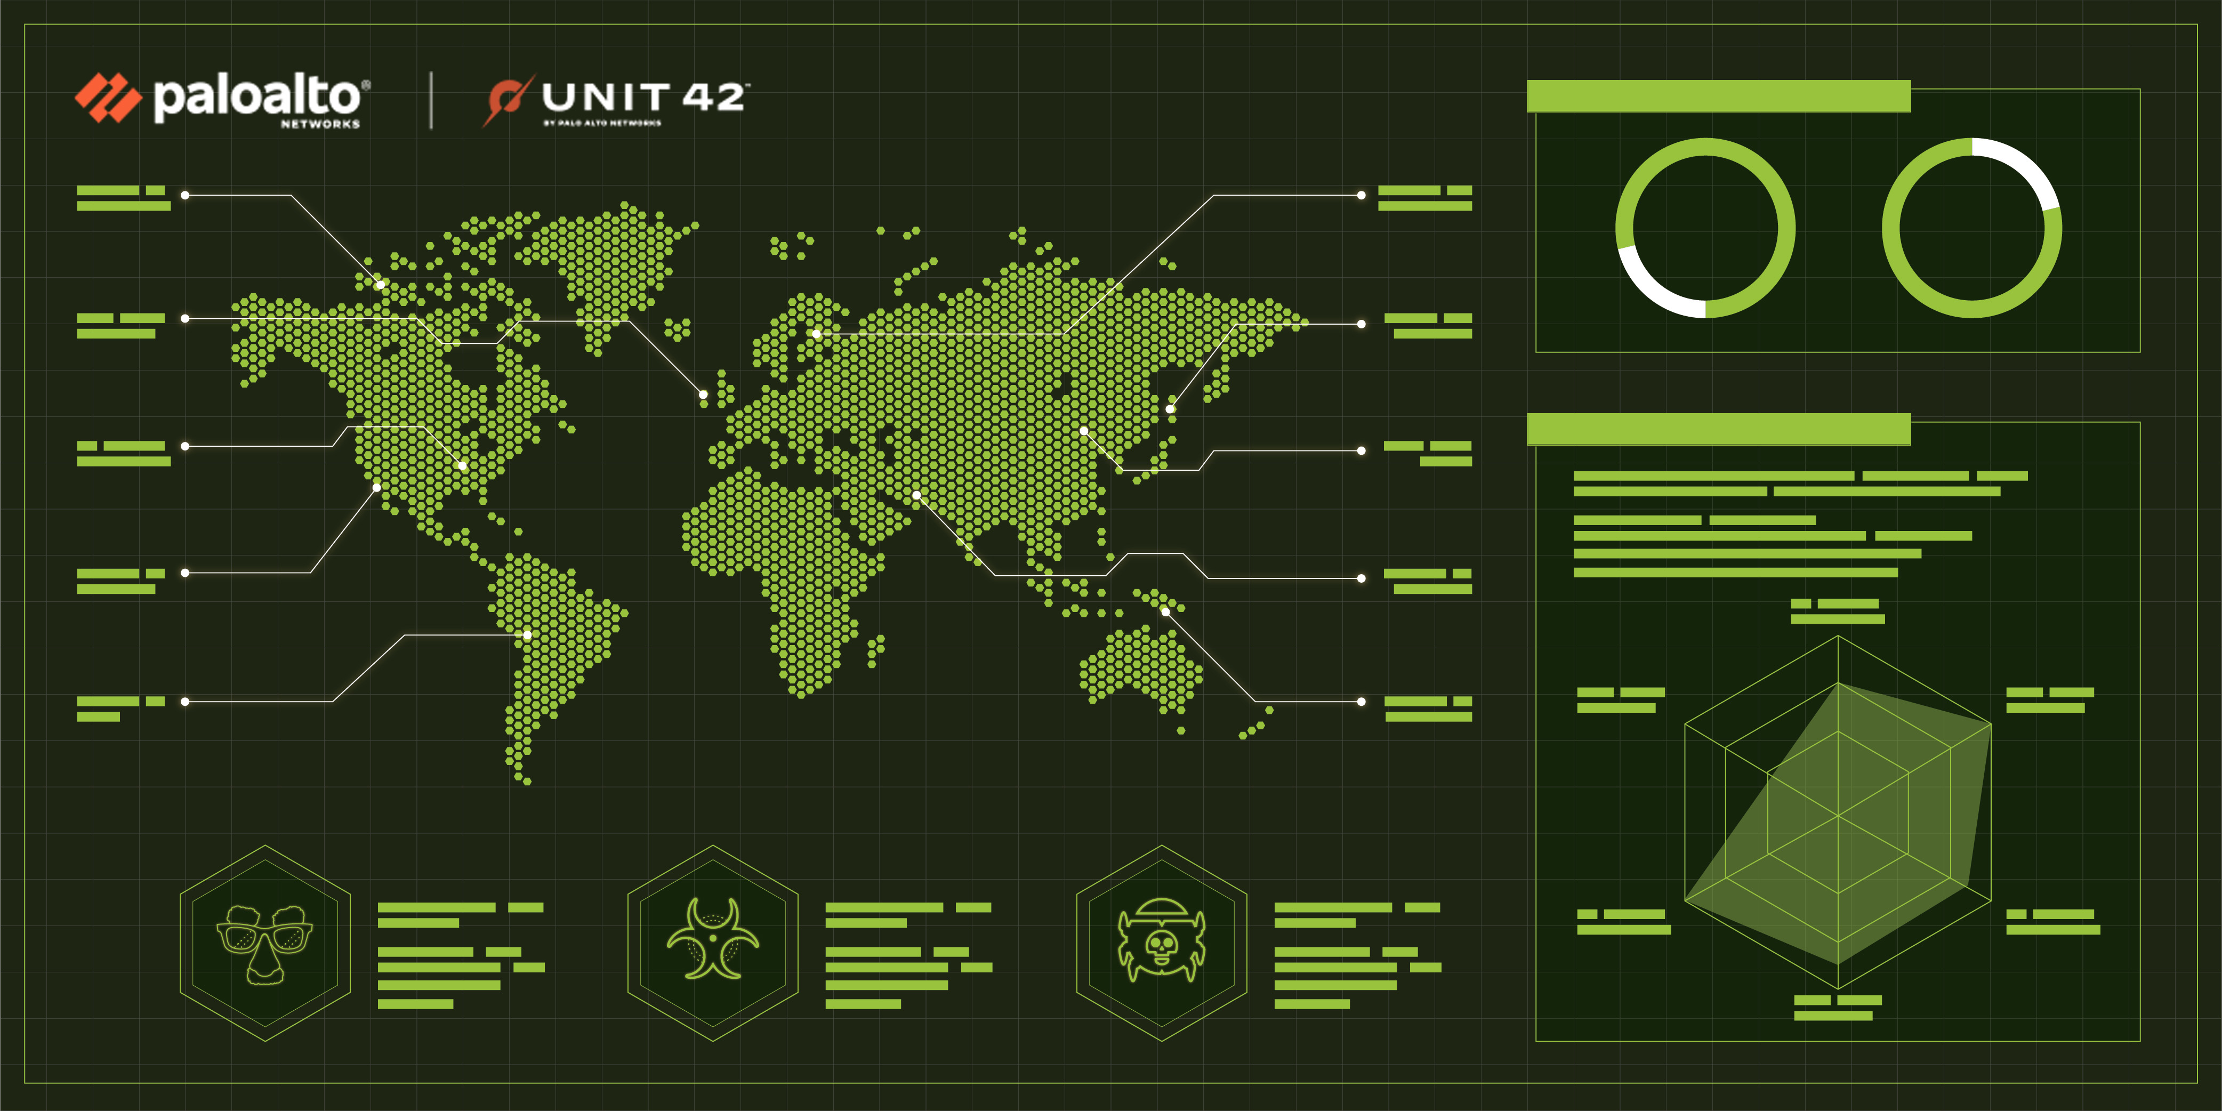
Intrusion Detection and Prevention and TLS/SSL encrypted traffic inspection
Integrated IDS and IPS solution built with Palo Alto Networks’ threat analysis engine and Unit 42 - security research teams that identify new threat signatures and detection mechanisms.
Helps detect (IDS) and block (IPS) known exploits, malware, malicious URLs, spyware, command and control (C2) attacks.
Use case: OCI Network firewall is to be able to apply Intrusion Detection and Prevention (IDS/IPS) controls to the traffic, including encrypted traffic over SSL/TLS secure channels and to do this, the NGFW must decrypt the SSL/TLS encrypted traffic.

Slide 5
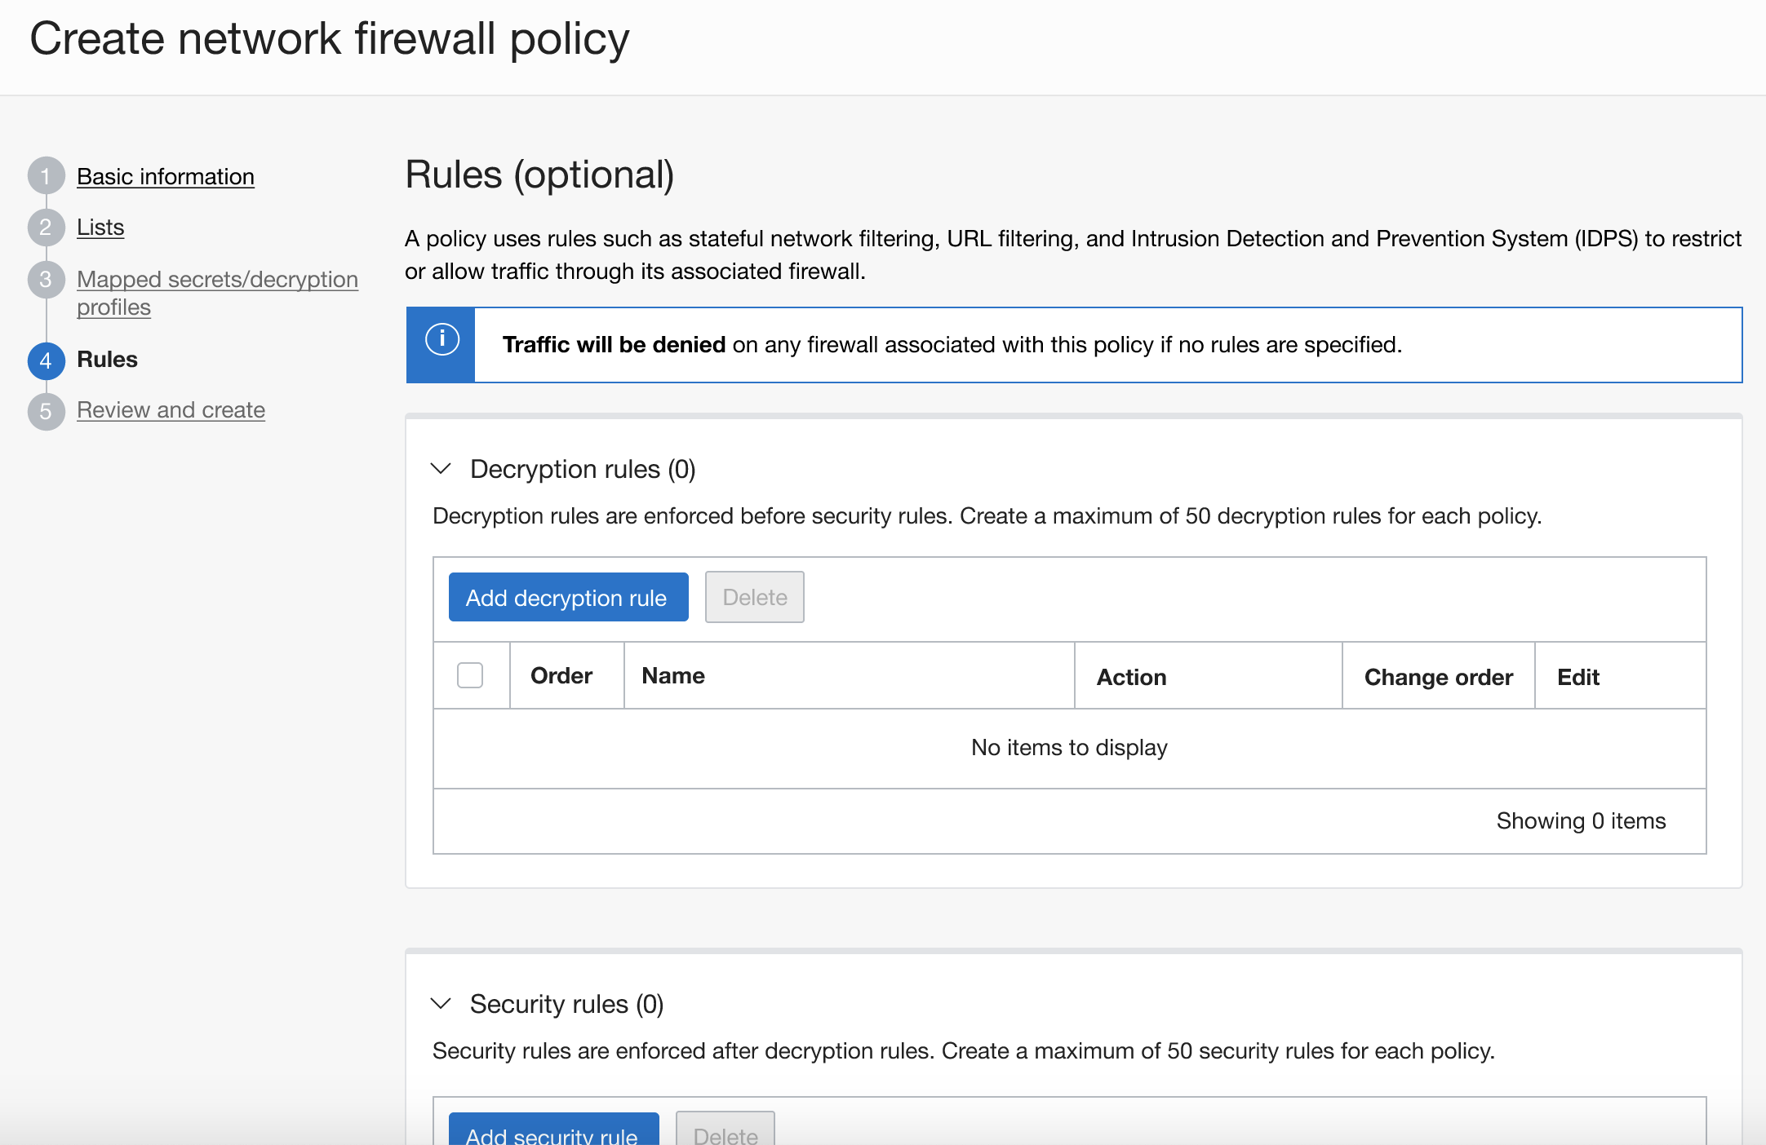
Stateful Firewall Rules
Enforce allow or deny stateful filtering rules based on 5-tuple information (source and destination IP address (both IPv4 and IPv6), port, and protocol.
Rules can be enforced in a customer defined priority order across multiple virtual networks.
The stateful firewall takes into account the context of traffic flows for more granular policy enforcement.

Slide 6
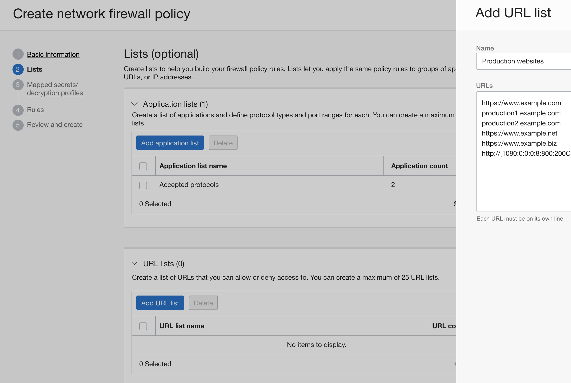
URL and FQDN Filtering
Use these rules to restrict traffic to a user specified list of fully qualified domain names (FQDN) including wild cards and custom URLs.
Flexible enforcement for both inbound and outbound traffic
SSL Inspection - allows inspection of HTTPS (TLS 1.2 and 1.3) encrypted traffic. Natively integrated with highly secure OCI Vault.

Slide 7
Difference between Network Security List/groups and OCI Network Firewall features
Network Security lists and groups
Stateful Rules and Stateless Rules for both IPv4 and IPv6 traffic.
CIDR Range or Service (Source IP and Destination IP)
Protocol
Source port
Destination port
>> Access control list on Subnet and NIC level.
>>By default every traffic is denied. Rules need to be created to allow the traffic.
Deny rules can not be created.
OCI Network Firewall
Stateful filtering Allow or Deny rules based on 5-tuple information for both IPv4 and IPv6 traffic.
Signature-based threat detection and prevention (IDS/IPS) engine.
Control inbound and outbound HTTP/S traffic to a specified list of FQDN including wild cards and custom URLs.
Decryption profiles for inbound and outbound HTTPS inspection.
Policies manage traffic for intra VCN and Inter VCN centrally.
Notes:
We support 3 major feature categories. The first one is Stateful Firewalling – which allows you to enforce allow or deny stateful filtering rules for both IPv4 and IPv6 traffic based on 5-tuple information. We take into account the direction and context of the flow when enforcing rules. We also support IDS, IPS and URL filtering features. These rules are part of our flexible firewall policy, which can be easily enforced using our VCN route rules and applied to your inbound, outbound as well as lateral traffic.

Slide 8
OCI Network Firewall and WAF – Better Together
OCI Network Firewall helps secure network and application workloads. It enables policy based visibility and control over applications, users and content including access control, SSL decryption, threat prevention, URL filtering and IDS/IPS capabilities.
OCI WAF is primarily focused on the security of web applications and operates at the layer 7 (HTTP/S). It helps stop layer 7 attacks whether it’s an attempt to exploit vulnerable code-level vulnerabilities such as SQL injection and other OWASP Top 10 vulnerabilities, or a layer 7 DDoS attack.
Layered Defense - In most cases it’s important to employ both technologies given the various potential points for intrusion across both networks and web applications.
For e.g., in 3-tier architecture web-tier can be protected using WAF. But, web tier to app tier and app tier to database tier communications are protected using Network Firewall.
Notes:
Though, both NGFWs and WAFs are considered firewalls and network functions, they interact with traffic at different points. Given the various potential points for intrusion across both a network and a web app, in most cases it’s important to employ both technologies.
The OCI WAF act as a reverse proxy that will inspect all traffic flows or requests prior to these arriving at the origin Web application. It will also inspect any request going from the Web application server to the end user. This is very powerful and will allow you to control data leakage from your applications servers as well as protecting your servers from outside threats.

Slide 9
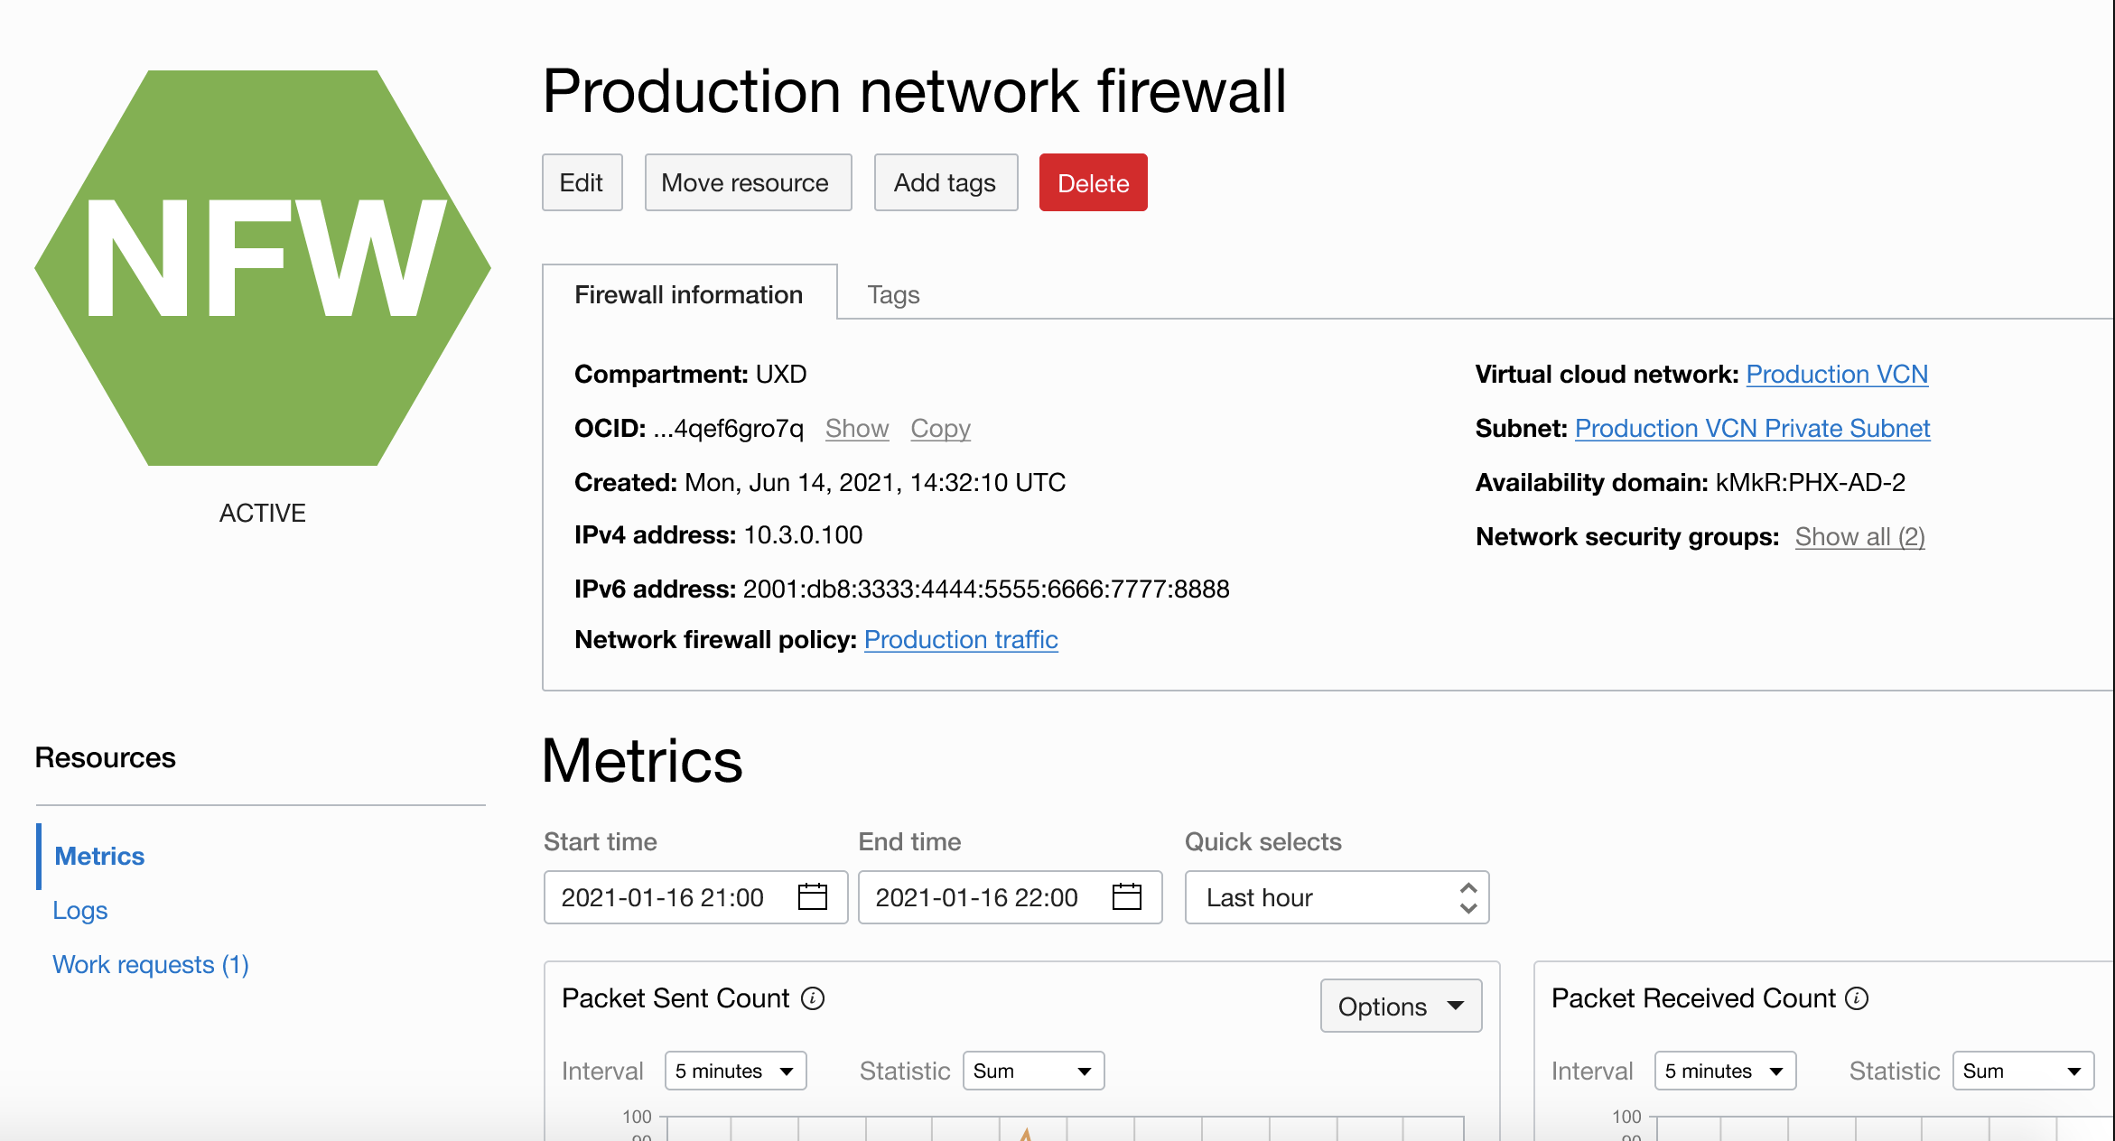
Logging, Monitoring and Analytics
Network Firewall metrics help monitor the health, capacity, and performance of firewall policies and resources.
Alarms and Notifications can be configured to notify you when metrics meet alarm-specified triggers.
Network Firewall logs (integrated with OCI logging) enable you to understand what rules and the countermeasures triggered by requests.
Logging Analytics provides the analytics, making it simpler to explore the data, analyze patterns and out-liners, provide machine learning in the form of clustering and linking, create dashboards, provide topology drill-downs and much more.

Slide 10
OCI Network Firewall – Key Use Cases
Internet facing applications: Perimeter security
Protect against known vulnerabilities, until you have time to patch/update
For example: CVE-2017-5638 for Apache Struts
Outbound: Protect against exfiltration
Allow Ubuntu servers to only do apt-get to *.canonical.com for updates
Allow only connections to payment gateway to *.amex.com
East-West between VCNs or subnets: App Segmentation & Zero Trust
Block all threats from moving laterally between different trust domains
Allow only approved DB admins to only run SQL transactions against MySQL
Notes:
The firewall service allows you to monitor and apply granular security controls to enable use cases such as: perimeter security to protect against threats from the internet until you have time to patch/update. Protect against data exfiltration by restricting outbound data to only trusted networks or applications. For example, only allowing traffic to trusted servers for image updates.

Slide 11





OCI Network Firewall Is...
Best-in-class
Powered by Industry Leading Palo Alto Networks technology, best-in-class network security for all your apps
Cloud-Native
Deep integration with OCI platform and features, cloud-native form factor & deployment models
Automated
Easy integration into DevOps processes for automated deployment and scaling
Easy to Manage
Centralized management and Flexible Policy Enforcement
Copyright © 2022, Oracle and/or its affiliates.

Slide 12
Thank you

