Slide 1
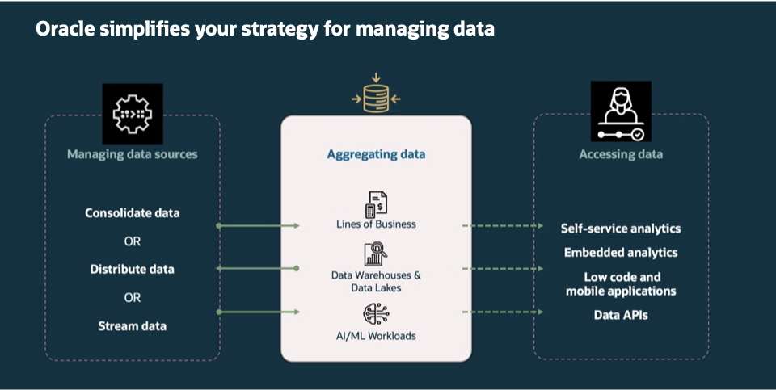
Oracle Simplifies Your Strategy For Managing Data

