Slide 1
External ECC Load Balancer
ECC Node (1)
ECC Node (2)
ECC Node (3)
Internal ZK Load Balancer
ZK Node (1)
ZK Node (2)
ZK Node (3)
Internal Solr Load Balancer
Solr Node (1)
Solr Node (2)
Solr Node (3)

Slide 2



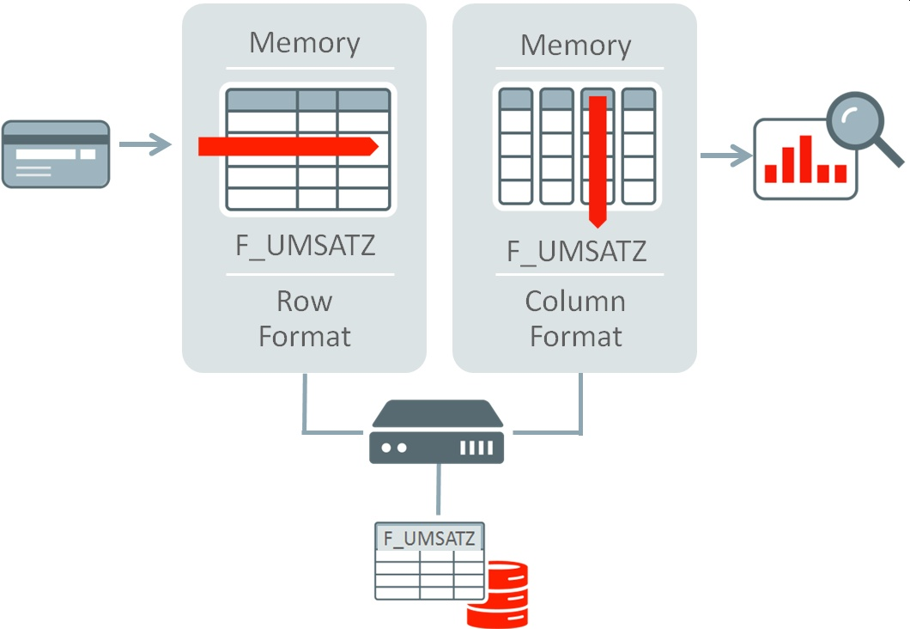

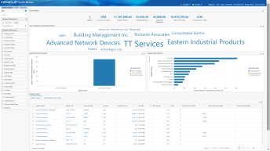
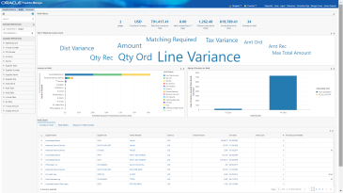
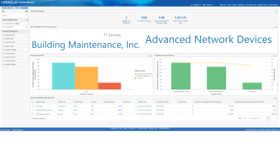
Data Load Technical Overview
Execution Flow
EBS
ECC
ECC Datasets
Command Center Data Load CP
(Full/Incremental)
Initiate data load in ECC
EBS Views
ECC Data Load Concurrent Program
Data pulled from EBS Ingested into ECC
Admin User
Read data
Command Center
Pages
Page requested
Page returned
Business User
2
Copyright © 2020, Oracle and/or its affiliates | Confidential: Internal/Restricted/Highly Restricted

Slide 3






Download log: log file details are based on the log level selected while submitting the job
Resubmit: user can resubmit finished jobs
Download SQL Plan Statistics: This is displayed if SQL Plan Statistics flag is enabled and for Full / Incremental / Query Loads only
Pending: The job didn’t start yet
Running: The job is running
Success: The job finished successfully
Partial Success: The job finished successfully, but there are some records failed to be ingested.
Failure: The job failed.
Cancelled: The job cancelled
Show details of the job

