Slide 1
Oracle JSON Database & Autonomous Database What’s new in 21c
Jan 2021

Slide 3


Oracle Converged Database - Enables Simplicity and Data Synergy
Oracle Converged Database Supports all Workloads, Data Types
OLTP
Analytics
Microservices, IoT, Key-Value
ML, AI, R, Big Data
Relational
Documents
Graph, Spatial
Micro-Service IoT, Key-Value
TEXT
Traditional
Next Generation
Structured and Unstructured

Slide 4
Summary
Oracle Database 21c JSON (NEW Jan 2021)
SQL/JSON
New JSON Type enables strong typing, improved performance, and is fully integrated into the Converged Database
New JSON Update syntax for piecewise updates
New Multivalued Index for fast array searches
New SQL/JSON syntax for common usecases
SODA
Collections based on JSON Type
New developer APIs
Autonomous JSON Database (NEW Aug 2020)
New Low-cost cloud service optimized for JSON-centric Apps
Native JSON storage and JSON APIs
More JSON features than MongoDB for a lower price
2x faster than MongoDB and AWS DocumentDB (blog)
All the benefits of Autonomous Database
Availability, security, transparent scale-out without losing ACID transactions
Use SQL for cross-collection queries, reporting, and analysis

Slide 5
New JSON Features in Oracle Database 21c
1
JSON Type
2
JSON Update
3
Multivalued Index
4
SQL/JSON Enhancements
5
SODA Enhancements
6
Performance Improvements
7
Autonomous JSON Database

Slide 6
1. JSON Type
New datatype for optimized storage of JSON
JSON Binary Type
New datatype in SQL, PLSQL
Natively supported in OCI, JDBC
Based on OSON - Optimized Binary representation
Self-contained format
Fast field lookups
Piecewise Updatable
Scans up to 10x faster than text
Updates up to 10x faster than text
Integrated with the Oracle Database platform
Parallel Query
RAC
Golden Gate
…
Leverage Advanced Security features
VPD, Encryption, ..
Manage JSON together with other data
Operational simplicity from converged database
CREATE TABLE J_PURCHASEORDER (
id INTEGER PRIMARY KEY,
po_document JSON
);

Slide 7
JSON Type
JDBC extended with native support for JSON
New JSON facilities in JDBC (package oracle.sql.json)
Read, create, and modify JSON type values
Client-side OSON encoding
Object and stream APIs supporting SQL primitives (TIMESTAMP, DATE, RAW, etc.)
Implements JSR-374 (javax.json) directly over OSON.
Integrates with JSR-367 (javax.json.bind) for automatic domain objects mappings to and from OSON
ResultSet rs = stmt.executeQuery( "SELECT po_document FROM j_purchaseorder" );
rs.next();
JsonObject po =
rs.getObject(1, JsonObject.class);
int poNumber = po.getInt("PONumber");
String user = po.getString("User");

Slide 8
2. JSON update
New JSON_TRANSFORM operator
JSON_Transform
new SQL/JSON operator following existing SQL/JSON syntax and semantics, e.g predicates
Allows multiple operations in one execution (e.g. SET, APPEND, REMOVE)
Supports piece-wise updates
JSON_Transform over JSON type is optimized to reduce log sizes (partial updates on disk)
JSON_Transform in SELECT to modify data before shipping to client (e.g. remove private data)

Slide 9
JSON Update
JSON_TRANSFORM Example
UPDATE employees e SET e.jcol = JSON_TRANSFORM (e.jcol, SET '$.job' = 'Surfing Instructor', SET '$.salary' = (e.jcol.salary / 3), REMOVE '$.phones[*]?(@.type == "work")',
APPEND '$.children' = 'Fiona’)
WHERE e.jcol.id = 123;
{ "id” : 123, ”name” : "John Smith", "age” : 25, "job” : "Programmer", "salary” : 60000, "phones” :
[ {"type” : "mobile", "number” : "555-123-4567"}, {"type” : "work", "number” : "555-999-1111"} ], "children” :["Sydney","Sierra"] }
{ "id” :123, "name" : "John Smith", "age " : 25, "job " : "Surfing Instructor", "salary” : 20000, "phones” :
[ {"type” : "mobile", "number” : "555-123-4567"} ],
"children” : ["Sydney","Sierra","Fiona"]
}

Slide 10
3. Multivalued Index (MVI)
Speed up queries over JSON array elements
Functional Index on JSON Array Data
Use to index array items that are scalars
Maintained as a B-Tree
Index values are extracted from array list with duplicates removed
Supported on JSON type column only
Queries over array items use index
Significantly speeds up queries over array items
Queries may refer to the array items using simplified syntax or the JSON operators such as JSON_EXISTS
MVI Creation Syntax
New MULTIVALUE keyword
Simple dot notation
t.jcol.a.b.c
Specify the scalar type of MVI using typeitem() trailing function
string(), number(), stringOnly(), numberOnly() etc
typeitem() trailing function with ‘Only’ converts only JSON values that are of the given type (e.g., number) to the related SQL data type
typeitem() trailing functions without “only” allows conversion, when possible, of any JSON value to the given SQL data type
Notes:
For multivalue index, we only index items in an array that are scalars. If an item in an array is a JSON object or array, then MVI doesn't apply to that particular item. Specifically, the path expression (in simplified dot notation) in the multi-value index definition specifies the selected values and their type using the trailing typeitem trailing function. Any selected value that is not scalar or that cannot be converted with the typeitem trailing function gets ignored.
For example, in each of the following insertion case, MVI has only two index entries created, one for 1 and the other one for 2.
create table t (col json);
create multivalue index mvi on t t (t.col.a.number());
Case 1) insert into t values ('{a:[1,2,"d"]}');
Case 2) insert into t values ('{a:[1,2,["d"]]}');
Case 3) insert into t values ('{a:[1,2,{}]}');
Case 4): insert into t values ('{a:[1,2,[3, 4]]}');

Slide 11
MultiValued Index
Example
CREATE TABLE jsontab (a NUMBER, doc JSON);
INSERT INTO jsontab VALUES (1,
'{"credit_score": [710, 720, 710, 730]}’);
INSERT INTO jsontab VALUES (2,
'{"credit_score": [750, 730, 750, 750]}’);
CREATE MULTIVALUE INDEX jsontab_idx
ON jsontab t
(t.doc.credit_score.number());
SELECT COUNT(*)
FROM jsontab t
WHERE JSON_EXISTS(t.doc,
'$.credit_score?(@ == 750)’);
COUNT(*)
----------
1
Benefits
Less space consumption than a materialized view
Improved DML performance
On-par query performance with current existence join plan with parent collection table

Slide 12
4. SQL/JSON Enhancements
JSON-like Construction Syntax in SQL
Simplified syntax for Generation
Create JSON type values in SQL using syntax that resembles the JSON text.
SELECT JSON {
'empno' : empno,
'name' : ename,
'salary' : sal,
'department' : (
SELECT JSON { 'name' : dname, 'loc' : loc }
FROM dept d
WHERE d.deptno = e.deptno
)
}
FROM emp e
WHERE e.empno = 7839;
{
"empno" : 7839, "name" : "KING", "salary" : 5000, "department" : { "name" : "ACCOUNTING", "loc" : "NEW YORK" } }

Slide 13
SQL/JSON Enhancements
New JSON Functions
INSERT INTO players VALUES( JSON('{"name" : "Beda",
"scores" : [12, 10, 8] }')
JSON()
Parse JSON text to JSON type
JSON_TRANSFORM()
Update JSON
JSON_EQUAL()
Compare two JSON type values for equality
sum(), avg(), count(), etc
New JSON path step functions
UPDATE players t SET t.col=
JSON_TRANSFORM(t.col,
APPEND ‘$.scores’ = 11)
SELECT * FROM players WHERE JSON_EQUAL(col, :1)
SELECT t.col.scores[*].sum()
FROM players t;

Slide 14
5. SODA Enhancements
JSON Type based collections with better functionality and performance
JSON type backed Collections
New SQL type designed for compressed storage, fast lookups and partial updates
SODA drivers default to JSON type starting 21c
Supported only if compatibility set to 20.0 or higher
Flashback Support*
Retrieve documents as it existed at an earlier time
SCN and timestamp-based flashbacks supported
Online redefinition
PL/SQL interfaces for redefining a BLOB collection to JSON collection
Collections can be altered without significantly affecting its availability
Reads and writes during much of redefinition process possible
Cursor = coll.find()
.asOfTimestamp(‘2021-01-19T21:54:54.789743Z’)
.getCursor();

Slide 15
SODA Enhancements
JSON Type based collections with better functionality and performance
Dynamic Dataguide*
Dynamically generate Dataguide for a collection using functional evaluation
Also gathers statistics on collections
No need to create JSON search index
Lock operator*
Exclusive document-level locks support for Transaction semantics on collections
Lock released after commit/rollback
Hints*
Specify hints to execute SODA operations
Can be used to tune SODA queries
All SQL hints supported
* Java, PLSQL, OCI drivers (node.js, python coming soon)
dg = coll.find()
.filter(‘{"salary" : {"$exists" : true}}’)
.getDataGuide();
doc = coll.find()
.key(‘key-1’)
.lock().getOne();
cursor = coll.find()
.hint(‘MONITOR’)
.filter(‘{"address.zip" : 94088 }’)
.getCursor();

Slide 16
6. Performance Improvements
Significant improvement in performance across the board
Faster Table Scans
Binary JSON enables faster scans
Exadata smart scans upto 8KB for JSON Type
IMC with JSON up to 14x faster
New Index structures created transparently

Slide 17
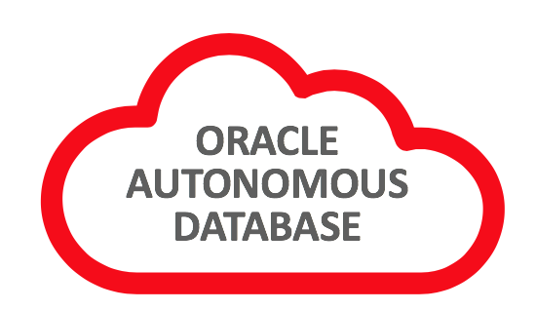

7. Autonomous JSON Database
Use SQL and SODA together in one place in Oracle Autonomous Database
Always-Free Autonomous Transaction Processing allows you to trial full JSON capabilities at no cost.
Autonomous JSON Database provides unlimited JSON/SODA collections at a lower pricepoint than full ADB.
Featuring
One-touch database creation
SODA and SQL APIs with no configuration
Binary JSON storage for SODA collections
JSON-aware Apex applications for no-code / low-code development
Sign up now for free at http://cloud.oracle.com

Slide 20
Deep Dive Slides (remove before sharing externally)

Slide 21
1. JSON Type

Slide 22
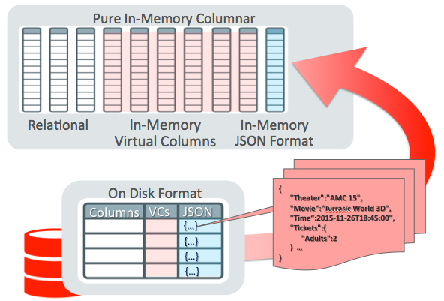


Native JSON – Advanced Optimizations
Parallel Query
Materialized View
ExaData (DB Machine)
Storage Cell Node Smart Scan
JSON Path Evaluation in Storage Node
In Memory Columnar Store
SIMD Scan for JSON_VALUE()
Path/Value InMemory Index
for JSON_EXISTS() &
JSON_TEXTCONTAINS() Predicates

Slide 23
OSON – Oracle’s optimized Binary JSON
SELF-CONTAINED
Field encoding dictionary is stored inside each OSON document
No central schema management and evolution Issues
Fully transportable, distributable, platform Independent without any conversion
FAST FIELD LOOK UP with a field jump table for rapid SQL/JSON path navigation
Tree based encoding gives constant-time access to field values given field name
Leaf Scalar datatypes (numbers, dates etc) uses the same format as relational scalar
Avoid data format conversions and enables fast memcomp based range comparisons
PARTIAL UPDATABLE
InPlace Update if length fits, otherwise append bytes in the end with forward address
Avoid Whole Document Replacement as much as possible

Slide 24
OSON - Logical-Segment Architecture
1: po 2:id
3: podate 4:items
….
Field-Id-Name Dictionary Segment
Ref Field ID
offset
1:2014-09-08
Phone
100
Ipad
….
Leaf-Value-Segment
Tree Navigation Segment with Field Jump Table

Slide 25
OSON – upto 2.7x more compact than BSON

Slide 26
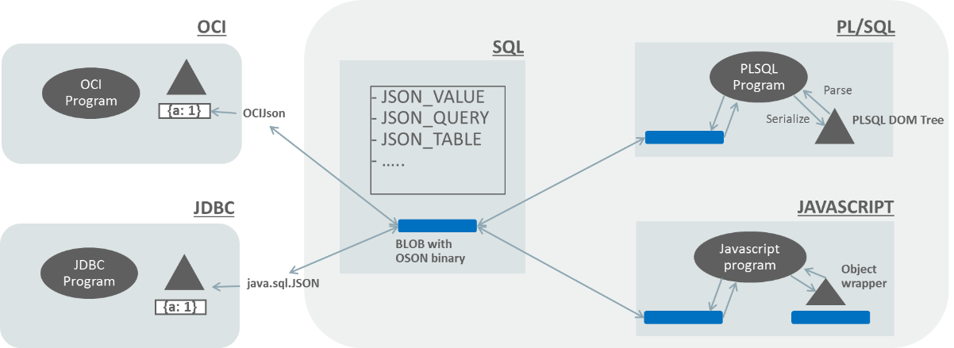
OSON – End to end support without conversions

Slide 27
2. JSON Update

Slide 28
Query Plan Using MVI
----------------------------------------------------
| Id | Operation | Name |
-----------------------------------------------------------
| 0 | SELECT STATEMENT | |
| 1 | TABLE ACCESS BY INDEX ROWID BATCHED| JSONTAB |
| 2 | HASH UNIQUE | |
|* 3 | INDEX RANGE SCAN (MULTI VALUE) | JSONTAB_IDX |
-----------------------------------------------------------
Predicate Information (identified by operation id):
---------------------------------------------------
3 - access(JSON_QUERY("DOC" /*+ LOB_BY_VALUE */ FORMAT OSON ,
'$.credit_score.number()' RETURNING NUMBER ASIS WITHOUT ARRAY WRAPPER
ERROR ON ERROR NULL ON EMPTY NULL ON MISMATCH MULTIVALUE)=750)

Slide 29
3. Indexing JSON Array Data
Approach before 21c
Materialized view + B-tree index
Space consumption
Maintenance overhead
Need of its rowid index to join the parent collection table
Benefits of MVI
Less space consumption
Improved DML performance
On-par query performance with current existence join plan with parent collection table

Slide 30
Example - Multivalued Index Creation
create table jsontab (a number, doc json);
insert into jsontab values (1, '{"credit_score": [710, 720, 710, 730]}’);
insert into jsontab values (2, '{"credit_score": [750, 730, 750, 750]}’);
SQL> create multivalue index jsontab_idx on jsontab t (t.doc.credit_score.number()') );
Index created.
SQL> select num_rows, blevel, leaf_blocks, distinct_keys from
user_indexes where index_name = 'JSONTAB_IDX’;
NUM_ROWS BLEVEL LEAF_BLOCKS DISTINCT_KEYS
---------- ---------- ----------- -------------
5 0 1 4

Slide 31
Example - Multivalued Index Content
row#0[8019] flag: -------, lock: 0, len=13 col 0; len 3; (3): c2 08 0b <-- 710 col 1; len 6; (6): 00 41 85 b3 00 00 <-- rowid of the 1st row row#1[8006] flag: -------, lock: 0, len=13 col 0; len 3; (3): c2 08 15 <-- 720 col 1; len 6; (6): 00 41 85 b3 00 00 <-- rowid of the 1st row row#2[7993] flag: -------, lock: 0, len=13 col 0; len 3; (3): c2 08 1f <-- 730 col 1; len 6; (6): 00 41 85 b3 00 00 <-- rowid of the 1st row row#3[7980] flag: -------, lock: 0, len=13 col 0; len 3; (3): c2 08 1f <-- 730 col 1; len 6; (6): 00 41 85 b3 00 01 <-- rowid of the 2nd row row#4[7967] flag: -------, lock: 0, len=13 col 0; len 3; (3): c2 08 33 <-- 750 col 1; len 6; (6): 00 41 85 b3 00 01 <-- rowid of the 2nd row

Slide 32
Answer JSON_EXISTS Query Using MVI
SQL> create multivalue index jsontab_idx on jsontab t (t.doc.credit_score.number());
Index created.
SQL> select count(*) from jsontab where JSON_EXISTS(doc,
'$.credit_score?(@ == 750)');
COUNT(*)
----------
1

Slide 33
Query Plan Using MVI
----------------------------------------------------
| Id | Operation | Name |
-----------------------------------------------------------
| 0 | SELECT STATEMENT | |
| 1 | TABLE ACCESS BY INDEX ROWID BATCHED| JSONTAB |
| 2 | HASH UNIQUE | |
|* 3 | INDEX RANGE SCAN (MULTI VALUE) | JSONTAB_IDX |
-----------------------------------------------------------
Predicate Information (identified by operation id):
---------------------------------------------------
3 - access(JSON_QUERY("DOC" /*+ LOB_BY_VALUE */ FORMAT OSON ,
'$.credit_score.number()' RETURNING NUMBER ASIS WITHOUT ARRAY WRAPPER
ERROR ON ERROR NULL ON EMPTY NULL ON MISMATCH MULTIVALUE)=750)

Slide 34
3. Multivalued Index

Slide 35
4. SQL/JSON Enhancements

Slide 36
5. SODA Enhancements

Slide 37
6. Performance Improvements

