Slide 1
Six Journeys for Success in Oracle Cloud
XXXX
Solution Engineer, Oracle

Slide 2
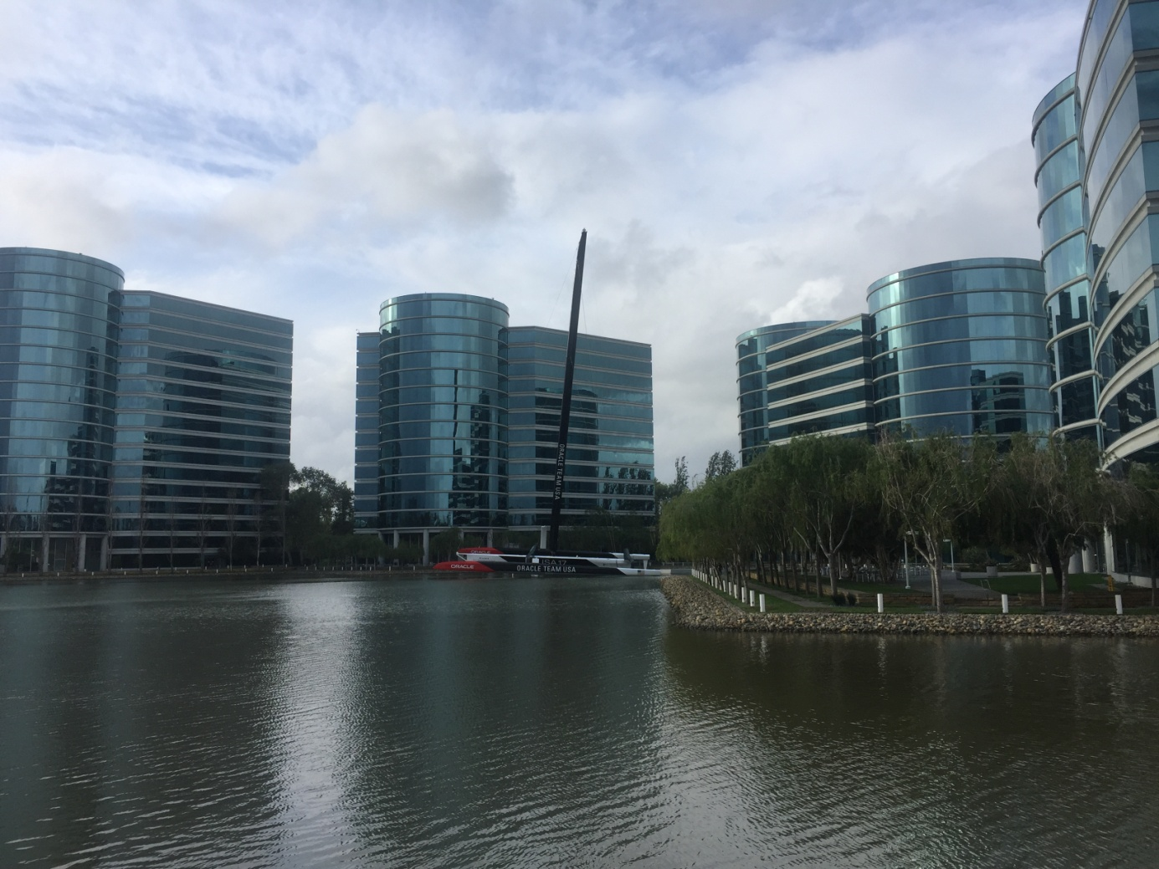
Oracle at-a-Glance
~$40B in revenue
#2 Largest software company in the world
Fastest Growing public cloud company at scale
#1 in WW SaaS enterprise applications for 1,000+ employee companies
Over $5B in R&D annually; 17,000+ patents
40,000 developers
420,000+ customers in 145 countries
140,000+ employees
25,000+ partners globally
Notes:
Oracle today is a 40-billion-dollar revenue company. We're the second largest software company in the world, and we invest over five billion dollars annually in R&D. Oracle's strategy is to enable your organization's journey to the Cloud. To date, Oracle's helped over 25,000 customers transition to the Cloud. In doing so, we've had great financial success. So far in Fiscal 2017, our revenues for SaaS and PaaS have grown at more than 80 percent annually, making us the fastest-growing Cloud at scale in the industry.

Slide 3


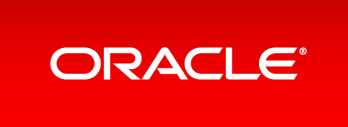
The Most Complete Cloud
DaaS
SaaS
PaaS
CLOUD
IaaS
Copyright © 2017 Oracle and/or its affiliates. All rights reserved. |
Notes:
Customers like our Cloud because it's the most complete offering in the industry,

Slide 4
The Most Complete Cloud
The Most Complete Cloud
Data-as-a-Service
Data Cloud provides data from a wide variety of Oracle and third-party sources that customers can leverage for deeper insights into their clients to enable modern marketing campaigns.
DaaS
DaaS
SaaS
SaaS
PaaS
PaaS
CLOUD
CLOUD
IaaS
IaaS
Copyright © 2017 Oracle and/or its affiliates. All rights reserved. |
Notes:
Starting with our Data as a Service layer. Data Cloud provides data from a wide variety of Oracle and third-party sources that customers can leverage for deeper insights into their clients to enable modern marketing campaigns.

Slide 5
The Most Complete Cloud
Software-as-a-Service
Oracle offers the most integrated, complete cloud suite of SaaS applications enabling customers to modernize their business using the latest technologies such as Artificial Intelligence and Machine Learning.
DaaS
DaaS
SaaS
SaaS
PaaS
PaaS
CLOUD
IaaS
IaaS
Copyright © 2017 Oracle and/or its affiliates. All rights reserved. |
Notes:
Our Software as a Service layer: Oracle offers the most integrated, complete Cloud suite of SaaS applications, enabling customers to modernize their business using the latest technologies such as artificial intelligence and machine learning.

Slide 6
The Most Complete Cloud
Platform-as-a-Service
Oracle offers the broadest range of PaaS services in the industry that enables developers, IT professionals and business leaders to develop, extend and secure applications that leverage advanced analytics.
DaaS
DaaS
SaaS
SaaS
PaaS
PaaS
CLOUD
IaaS
IaaS
Copyright © 2017 Oracle and/or its affiliates. All rights reserved. |
Notes:
Our Platform as a Service layer: Oracle offers the broadest range of PaaS services in the industry that enables developers, IT professionals, and business leaders to develop, extend, and secure applications that leverage advanced analytics.

Slide 7
The Most Complete Cloud
Infrastructure-as-a-Service
Oracle offers the highest performance, lowest cost IaaS in the industry, enabling customers to run their application workloads in the Oracle Cloud.
DaaS
DaaS
SaaS
SaaS
PaaS
PaaS
CLOUD
IaaS
IaaS
Copyright © 2017 Oracle and/or its affiliates. All rights reserved. |
Notes:
Our Infrastructure as a Service layer: Oracle offers the highest performance, lowest cost IaaS in the industry, enabling customers to run their application workloads in the Oracle Cloud.

Slide 8






Oracle Develops Offerings for Three Deployment Models
On-Premises
Cloud at
Customer
Public Cloud
For All Your Workloads
Copyright © 2017 Oracle and/or its affiliates. All rights reserved. |
Notes:
Oracle develops offerings for three distinct deployment models: Traditional On-Premise, Cloud at Customer, and Public Cloud.

Slide 9



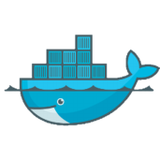
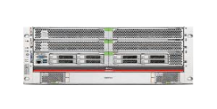
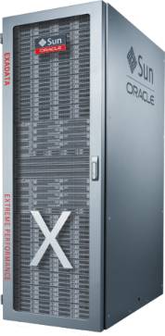


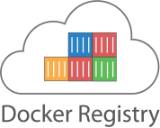


IaaS Compute Portfolio
Move
Workloads
3
Bare Metal
Elastic Compute
Container Service
Ravello
Dedicated Compute
Engineered Systems
Hypervisor
Hardware—Physical Servers & Storage
Core Data Center & Access Network
Data Center Regions & Availability Domains
Notes:
Oracle offers a whole host of IaaS-based computing portfolio, everything from bare metal compute, to elastic compute, to a container services to help you manage your data, to ability to help migrate your data through products like Rovelo. We also offer customers who want their own dedicated environment, Dedicated Compute. And we offer the highest performance systems in the world with Oracle Engineered Systems.

Slide 10
Questions?

