Slide 1

INVARIANT MANIFOLDS for reaction kinetics
Andrei Zinovyev
Institut des Hautes Études Scientifiques

Slide 2
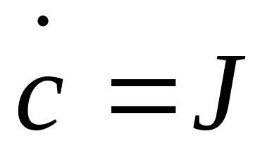
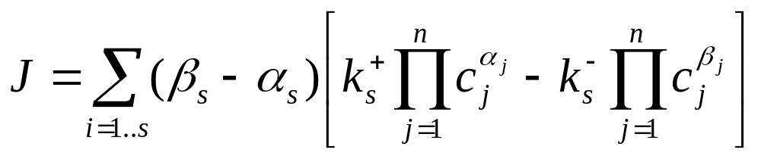
Stoichiometric equations
α_{s1}A₁ + … + α_{sn}A_{n} ⇔ β_{s1}A₁ + … + β_{sn}A_{n}
n – number of species, s – number of reactions
c1
cn
c2

Slide 3
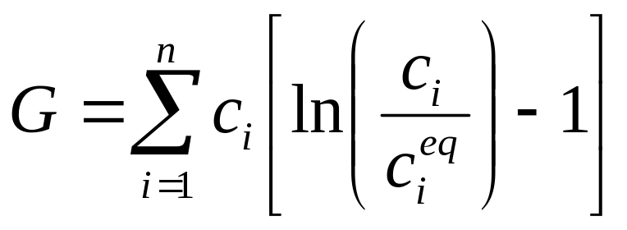
Pure dissipative systems
G
c
c_{eq}

Slide 4

What is Description Reduction?
1 Shorten list of species
  eliminate some
  create “integrated” components
2 Shorten list of reactions
  eliminate some
  “freeze” fast reactions
3 Decompose motion into fast and slow

Slide 5
Positively Invariant Manifold
fast motion
slow
motion
EQUILIBRIUM
Ω
Why Invariant?
once the point on the manifold,
the trajectory will stay on it until the equilibrium

Slide 6
Projector P_{c} on (some) manifold induces new (reduced) dynamics
Δ
induced dynamics
tangent space
J
P_{c} J
Ω
ΤxΩ
Δ = (1-P_{c})J - invariance defect

Slide 7
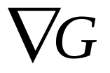
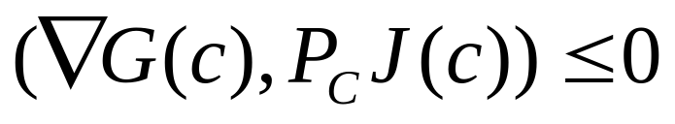
Thermodynamic projector
J
P_{c} J
The induced dynamics is dissipative only if

Slide 8
Quasi-equilibrium manifold usually is not invariant
entropy
S→max
macroscopic (reduced) variables

Slide 9
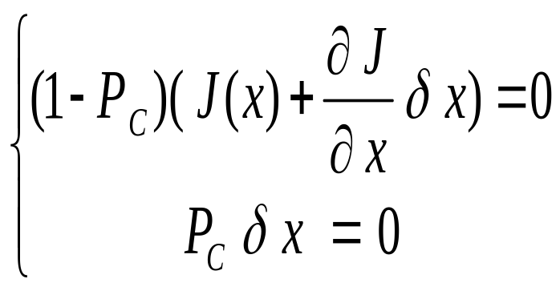
Correction of invariance defect
C₁
corrections
invariant manifold
invariance equation
1.0
(1-P_{c})J = 0
0.8
0.6
Newton iterations
equilibrium
0.4
0.2
0.05
0.10
0.15
0.20
C₃
quasi-equilibrium manifold

Slide 10
Invariant grid
tangent space
J
EQUILIBRIUM
tangent space
invariance defect is corrected
for every node independently

Slide 11
Growing Invariant Flag

Slide 12
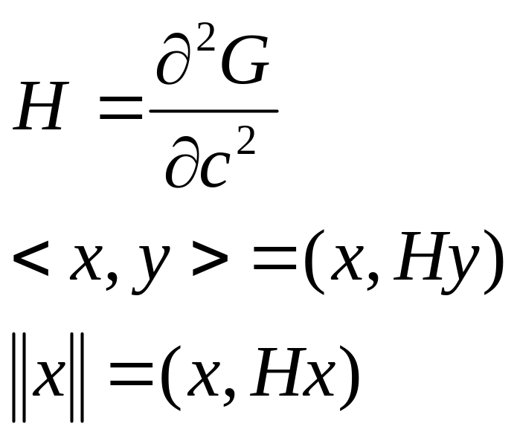
Entropic scalar product
2
1
0
equilibrium
-1
natural parameter
entropy
-2

Slide 13
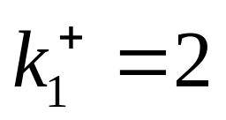
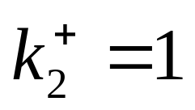
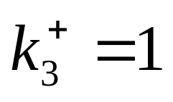
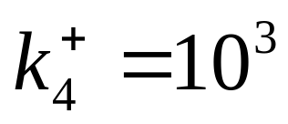
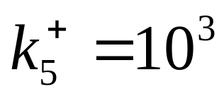
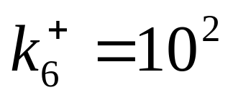
Hydrogen burning model reaction
1: H₂ ⇔ 2H
2: O₂ ⇔ 2O
3: H₂O ⇔ H + OH
4: H₂ + O ⇔ H + OH
5: O₂ + H ⇔ O + OH
6: H₂ + O ⇔ H₂O
Conservation laws:
2c_{H2} +2c_{H2O}+c_{H}+c_{OH =} b_{H}
2c_{O2}+c_{H2O}+c_{O}+c_{OH} = b_{O}

Slide 14
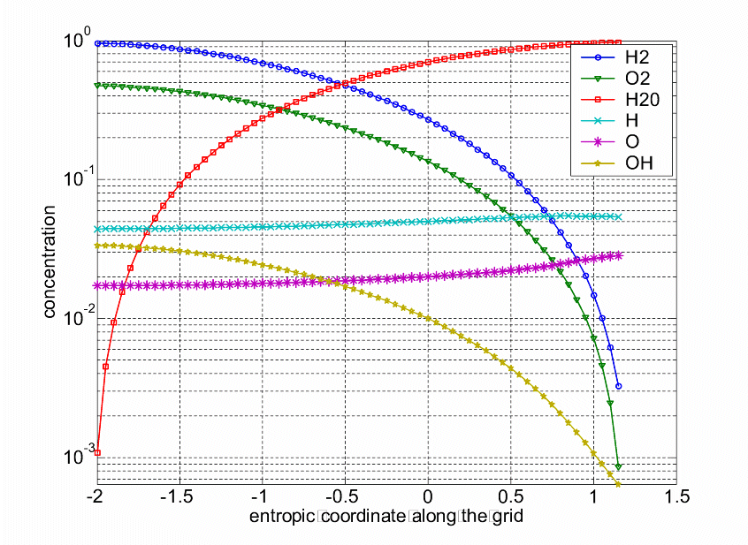
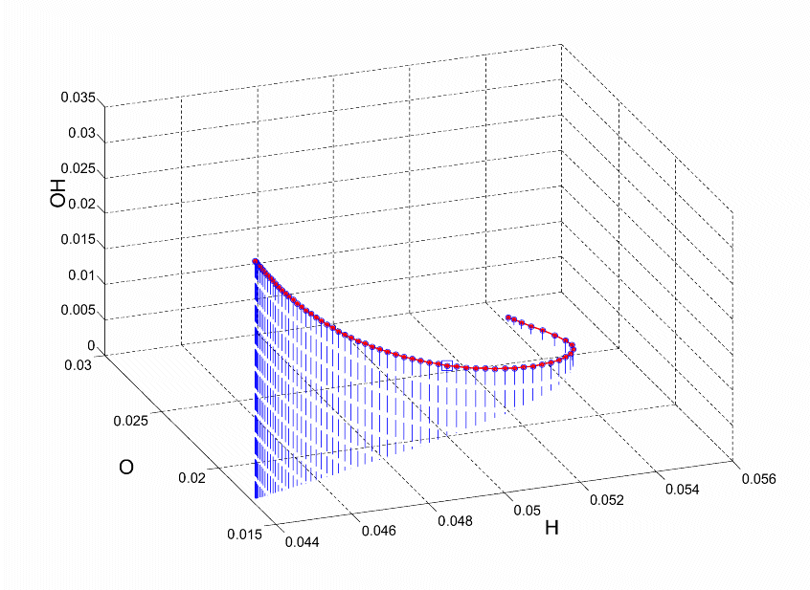
One-dimensional dynamics

Slide 15
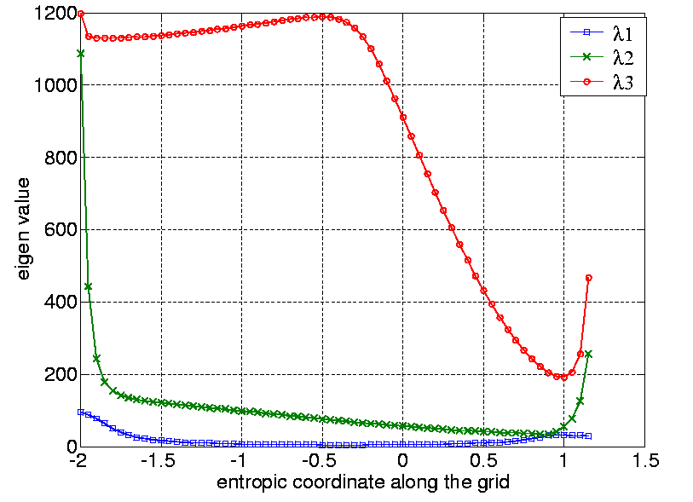
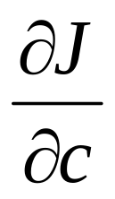
Separation of times
λ is the
eigen value
of symmetrised
matrix

Slide 16
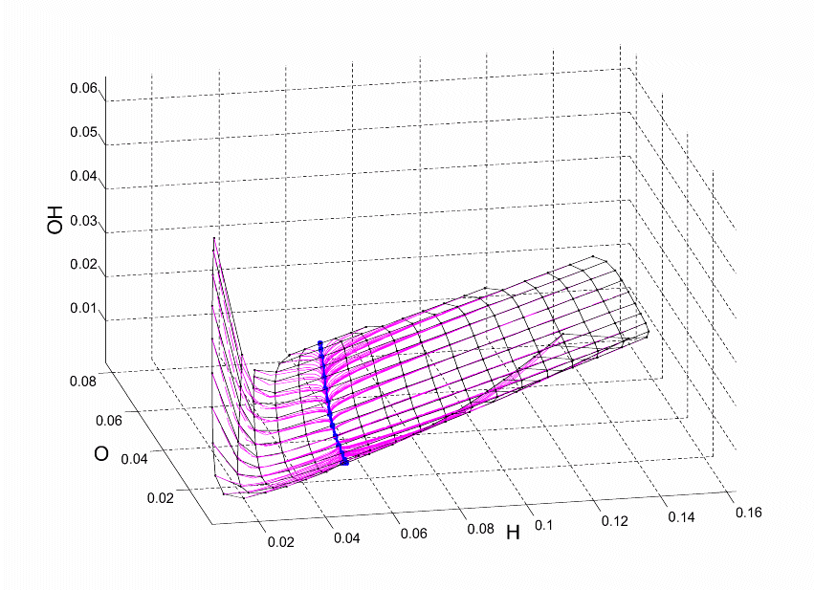
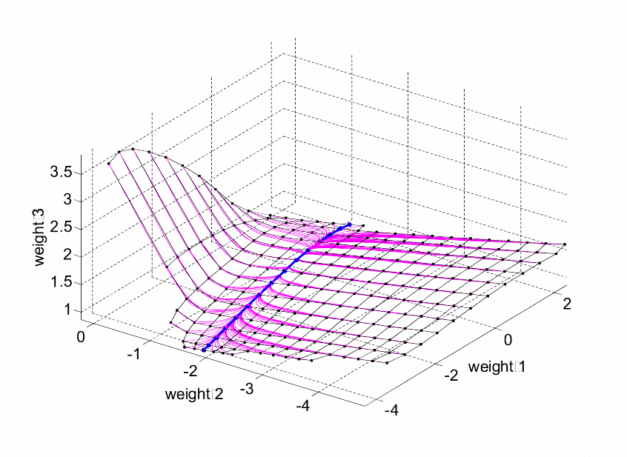
Two-dimensional dynamics

Slide 17
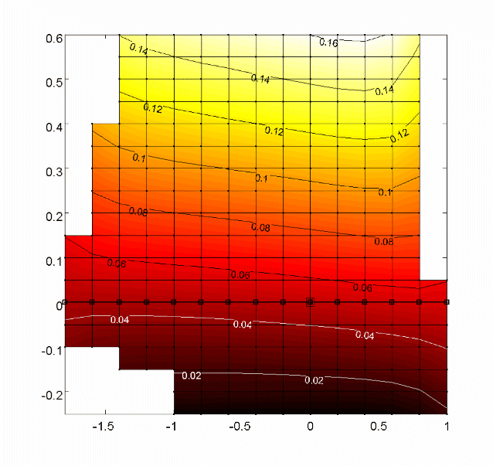
Visualizing functions: concentration of H
“Fast”
coordinate

Slide 18
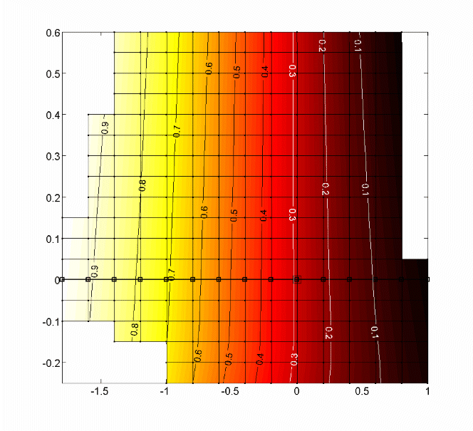
Visualizing functions: concentration of H₂
“Slow”
coordinate

Slide 19
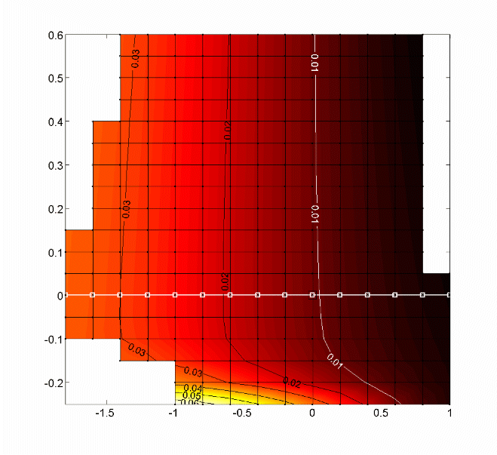
Visualizing functions: concentration of OH

Slide 20
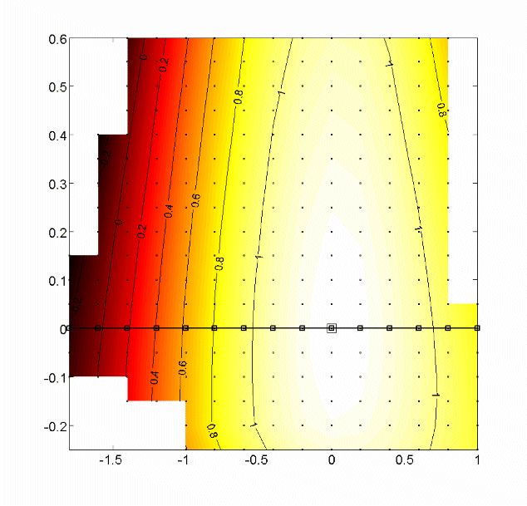
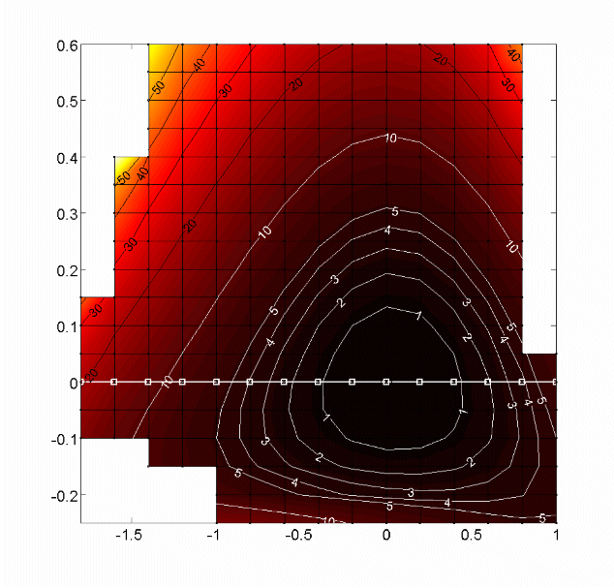
Visualizing functions:
Entropy and entropy production
Entropy
Entropy production

Slide 21
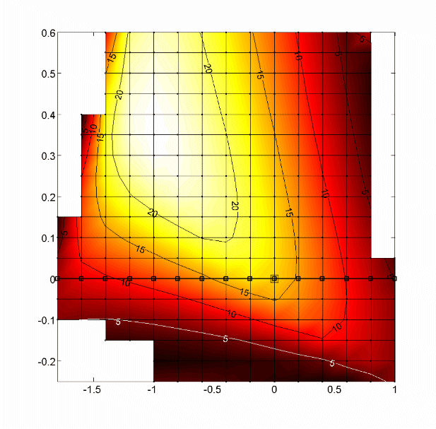
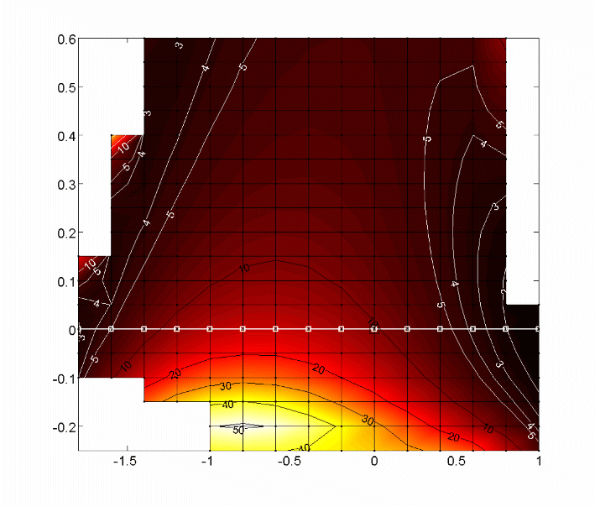
Visualizing functions:
Separation of relaxation times
λ₂/λ₁
λ₃/λ₂

Slide 22
Papers
Gorban A, Karlin I, Zinovyev A.
Constructive Methods of Invariant Manifolds
for Kinetic Problems
2004. Physics Reports 396, pp.197-403.
Gorban A, Karlin I, Zinovyev A.
Invariant Grids for Reaction Kinetics
2004. Physica A, V.333, pp.106-154

Slide 23
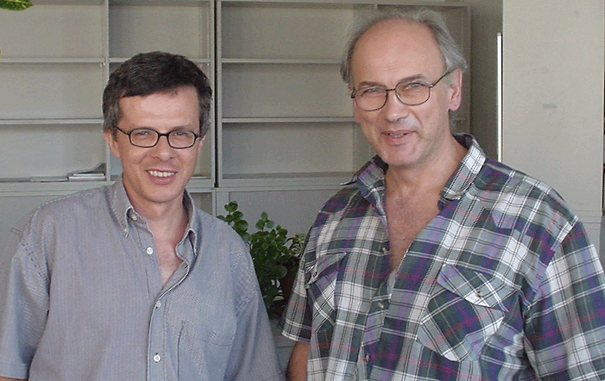
People
Doctor Iliya Karlin
ETH, Zurich
Professor Alexander Gorban
University of Leicester, UK

