Slide 1
Mathematical model of
NF-κB regulatory module
Tomasz Lipniacki and Pawel Paszek
with
Allan Brasier, Bruce Luxon and Marek Kimmel

Slide 2
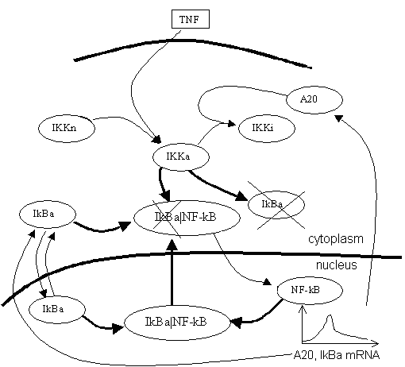
Two feedback model of NF-κB dynamics
Key players:
  NF-κB (transcription factor)
  IκBα (inhibits NF-κB)
  IKK (destroys IκBα )
  TNF (activates IKK)
  A20 (inactivates IKK)
Feedbacks
  NF-κB promotes
  transcription of IκBα
  NF-κB promotes
  transcription of A20

Slide 3
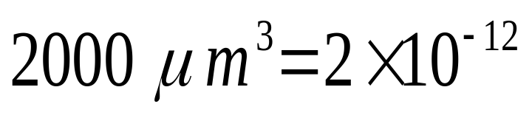
The cell: mammalian fibroblast
Average volume W=V+U=
l
Ratio of cytoplasmic and nuclear volumes K_{V}=V/U=5
Cytoplasmic concentration of 1μM corresponds to 10⁶ molecules, the same nuclear concentration to 2×10⁵molecules
IκBα or A20 during TNF stimulation:
1 active gene
100 - 300 mRNAs
50,000 - 300,000 proteins

Slide 4
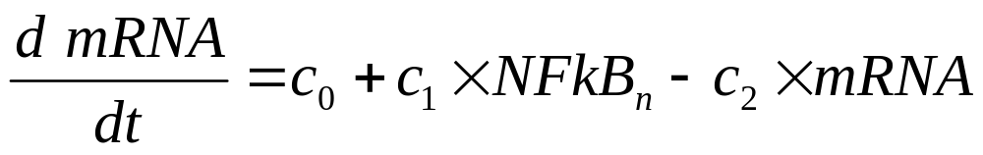
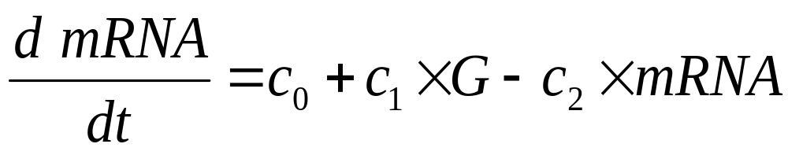
mRNA transcription
Continuous description
Discrete description
G=1 when NF-κB occupies regulatory site
G=0 when the regulatory site is empty
Transcription velocity 40bp/s
Spacing between subsequent mRNA polymerases 250bp
c₁= 40/250 = 0.16 [mRNA/s]

Slide 5
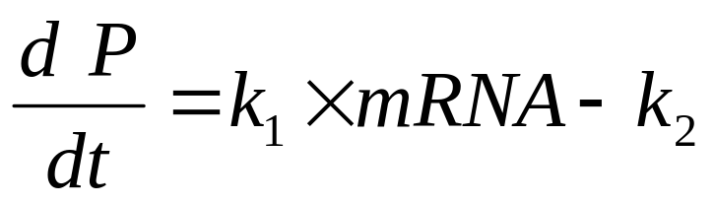
Translation
Translation speed = 15a.a./s
10 ribosomes processing simultaneously 300a.a. long protein, i.e. one ribosome every 30 a.a. of synthesized protein, this gives
translation rate k₁= 0.5/s,
The number protein molecules produced in time t=1/2h is of order
t × c₁ × t × k₁/2 =121,500
in fact less because of the mRNA degradation.

Slide 6
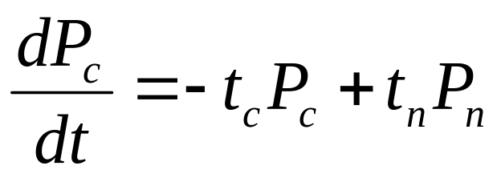
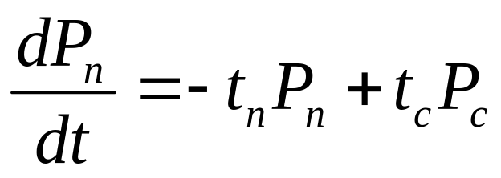
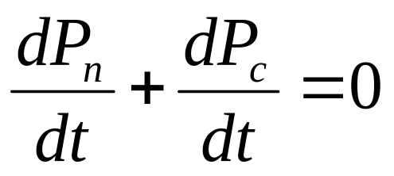
Transport
Amount of protein in the cytoplasm
Amount of protein in the nucleus
The last NOT true for concentrations.

Slide 7
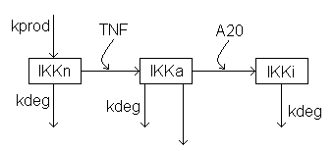
Activation and inactivation of IKK
TNF phosphorylates IKK at specific sites, activating it.
A20 triggers IKK inactivation.
Non-active IKK (IKKn) is produced at constant rate
All forms degrade at the same rate.

Slide 8
The model: processes considered
IKK activation, IKKn->IKKa
IKK inactivation, IKKa->IKKi
Synthesis of protein
complexes
Catalytic degradation
of IκBα
mRNA transcription
mRNA translation
Transport between compartments
14 ODEs

Slide 9
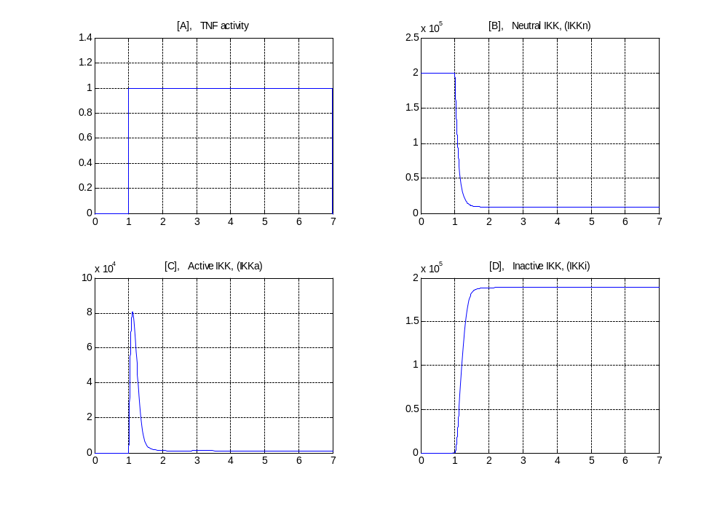
TNF signal and IKK activity

Slide 10
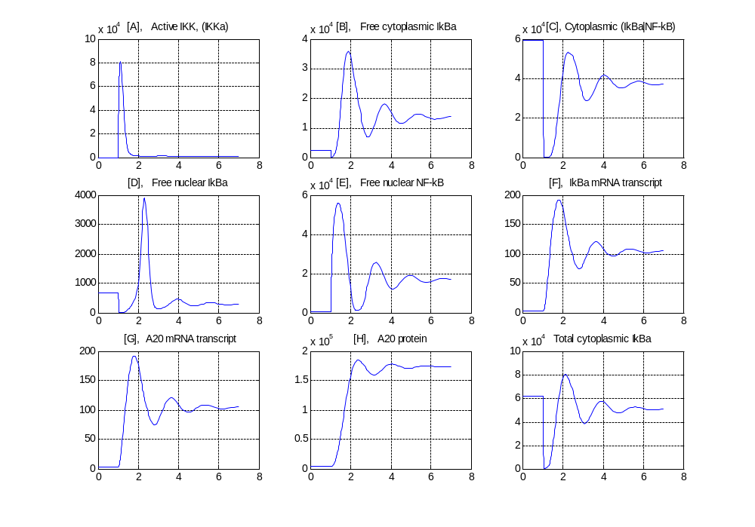
Time evolution of the main variables

Slide 11
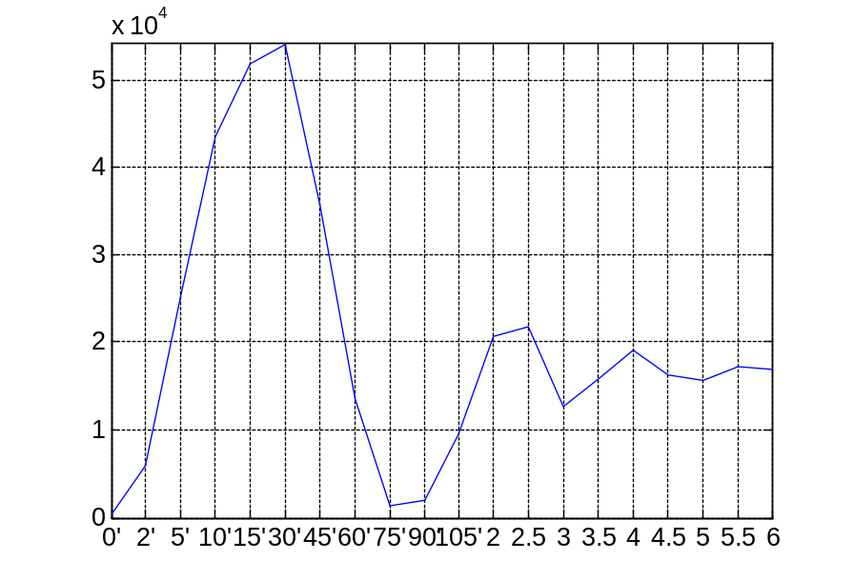
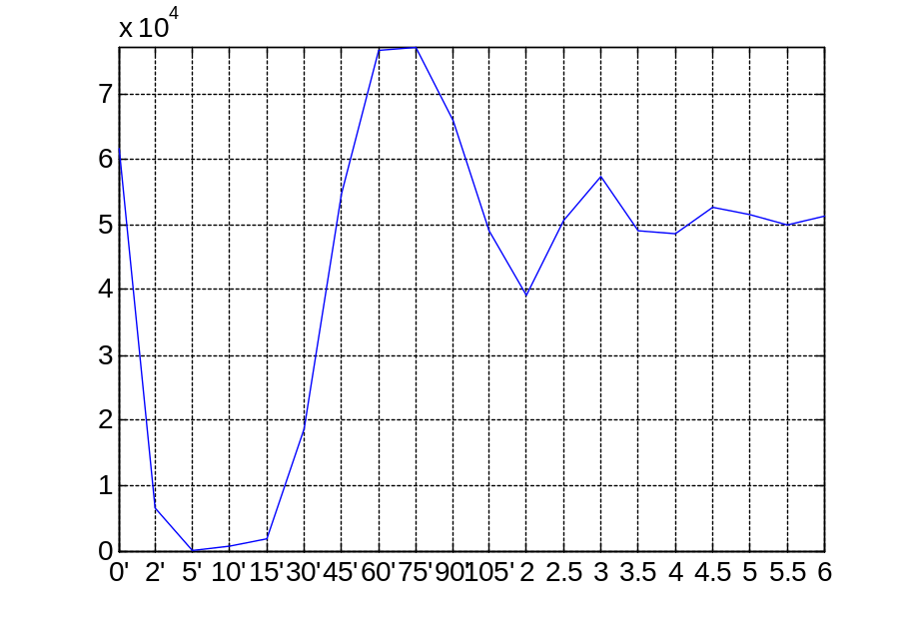
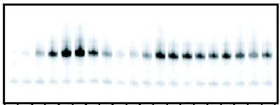

Hoffmann, Levchenko, Scott, Baltimore, 2002, Science, 298, p.1241
Constant TNF (mouse fibroblasts)
  Nuclear NF-κB Cytoplasmic IκBα

Slide 12
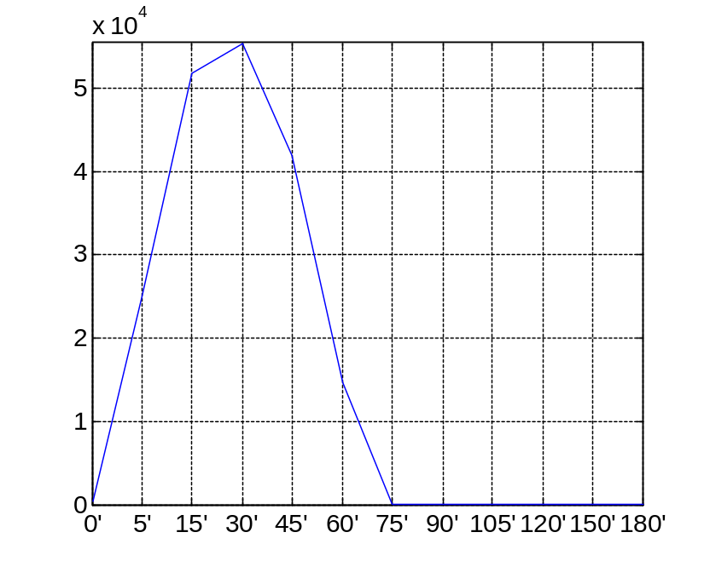
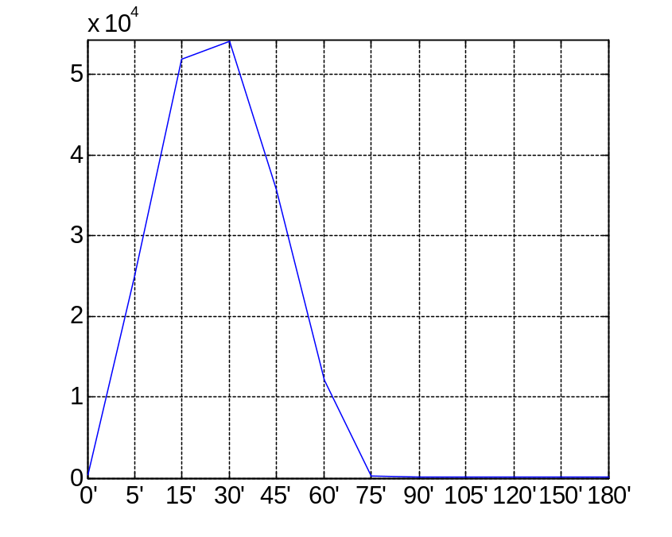


Hoffmann et al., 2002, Science, 298, p.1241
TNF pulse (mouse fibroblasts)
  Nuclear NF-κB (15 min. pulse) Nuclear NF-κB (1 hr. pulse)

Slide 13
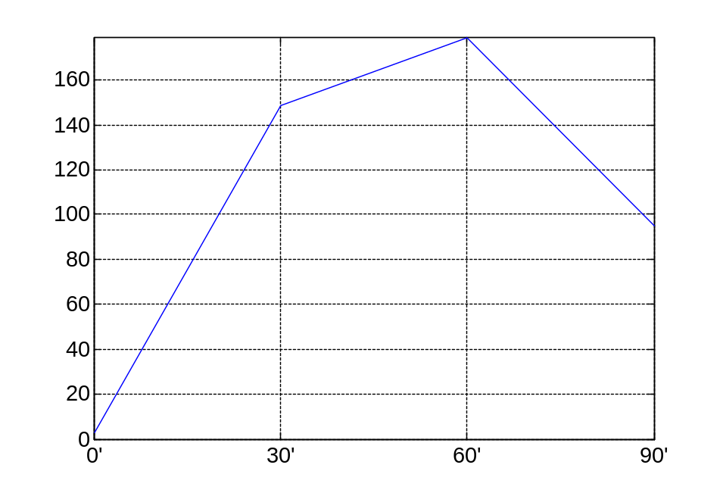
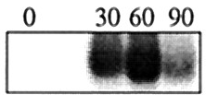
Lee, Boone, Chai, Libby, Chien, Lodolce, Ma, 2000, Science, 289, p. 2350
Constant TNF (mouse fibroblasts)
A20 message level

Slide 14
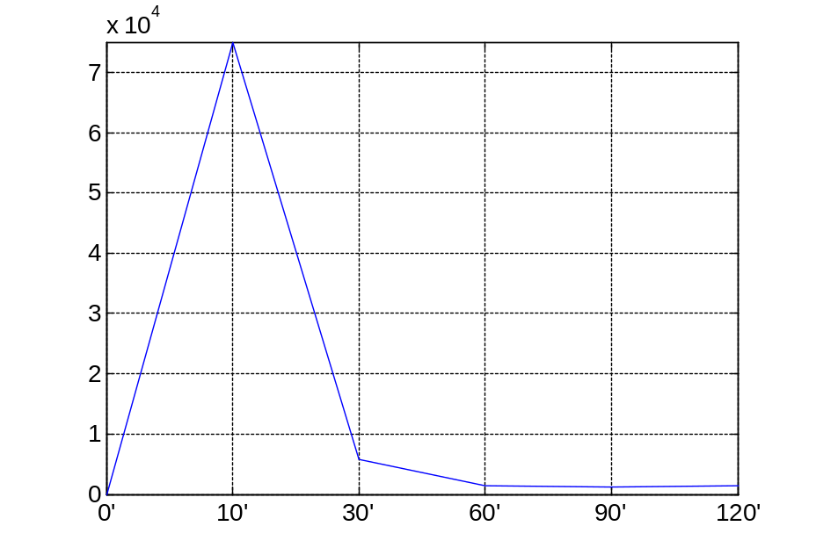
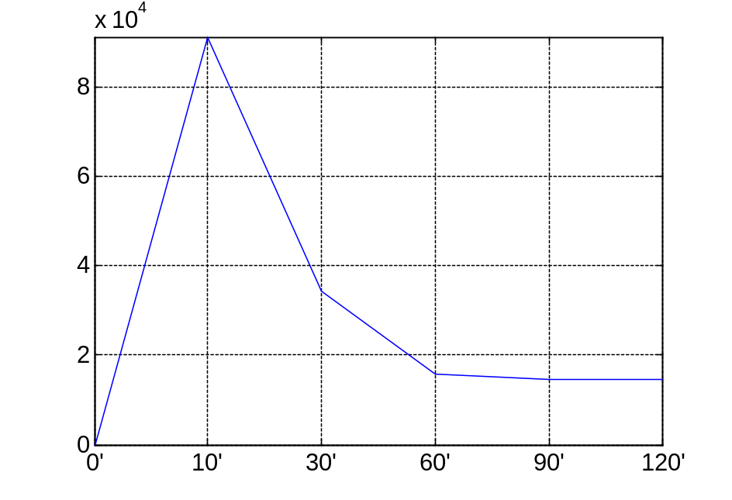
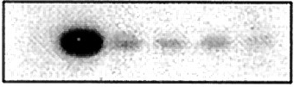
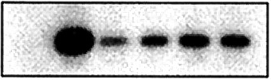
IKK kinase activity, Lee et al., 2000
Wild Type cells
A20-/- cells

Slide 15
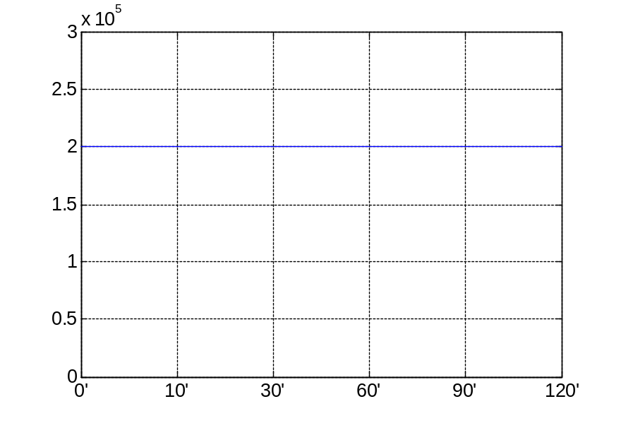
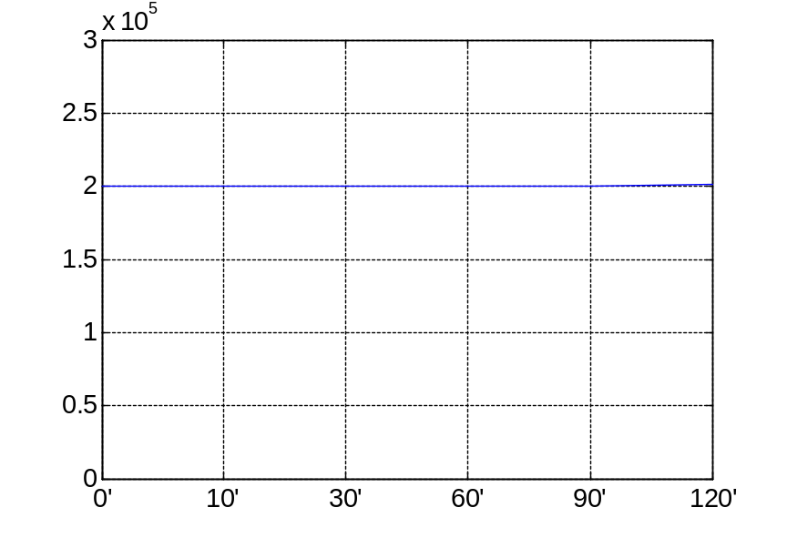


IKK protein, Lee et al., 2000
Wild type cells
A20 -/- cells

Slide 16
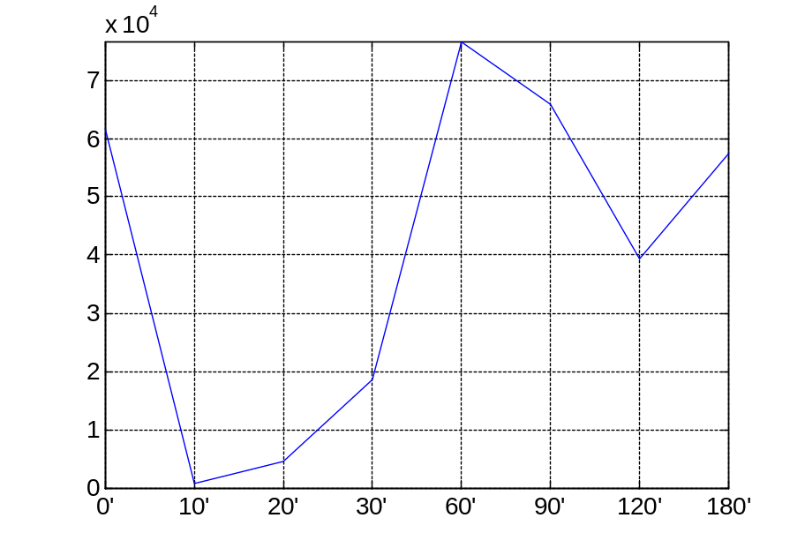
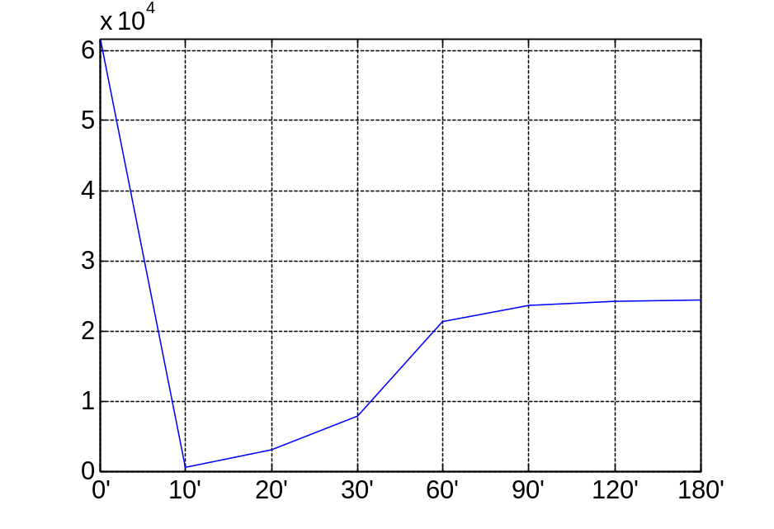


Cytoplasmic IκBα, Lee et al., 2000
Wild type cells
A20 -/- cells

Slide 17
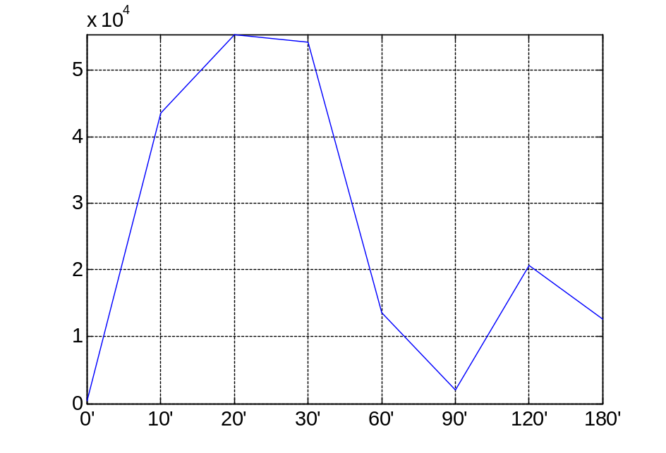
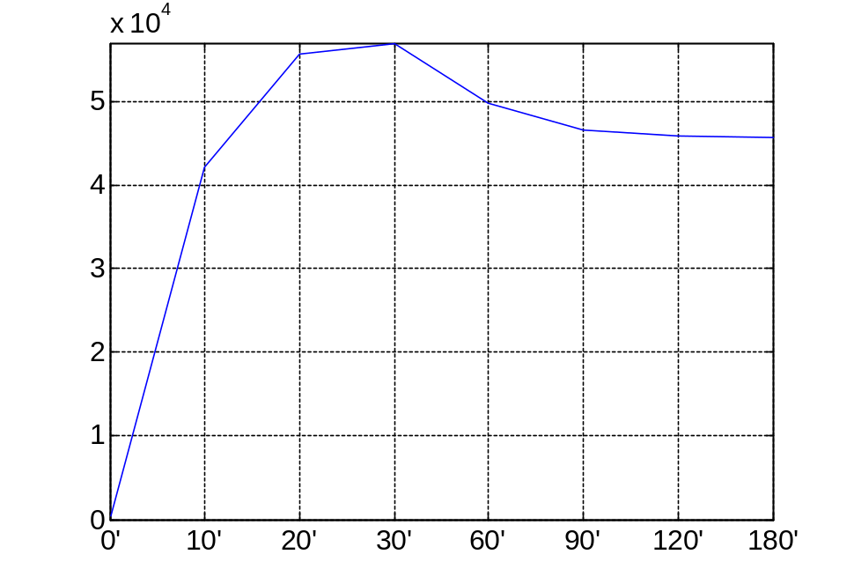
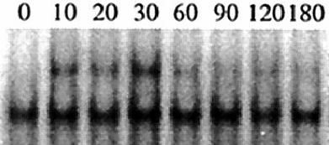
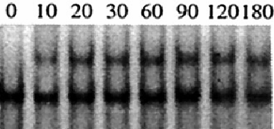
Nuclear NF-κB, Lee et al., 2000
Wild type cells
A20 -/- cells

Slide 18
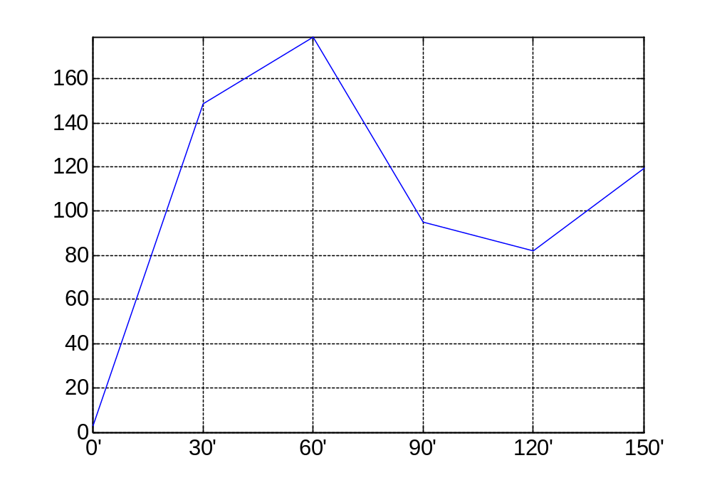
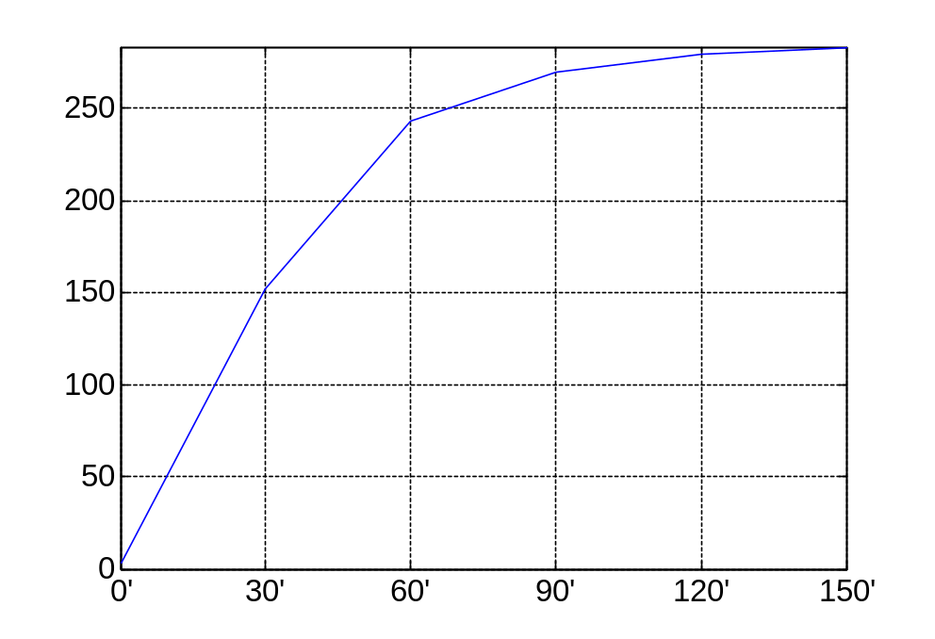
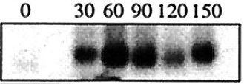
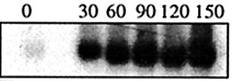
mRNA IκBα, Lee et al., 2000,
Wild type cells
A20 -/- cells
  Note: Low level of cytoplasmic IκBα, high mRNA level

Slide 19
Results
Inclusion of A20 revealed the second feedback loop in NF- κB regulation.
The model predicts observed transient IKK activity.
Using in part Hoffmann et al. 2002 model we amend it in three main points: intercompartment transport, transcription speed and amount of IκBα.
k_{v} – (cytoplasmic/nuclear volume) - new parameter appeared
Comment:
After parameter fitting, the model traces satisfactorily experimental data but there is still large freedom in parameter fitting.

Slide 20
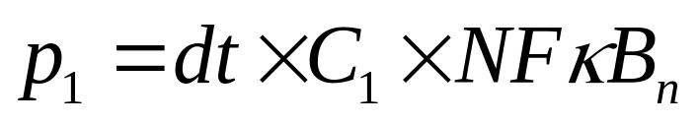
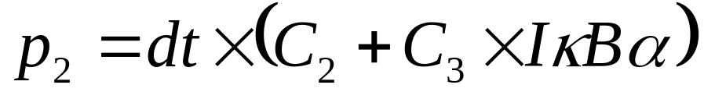
Single cell kinetics
ODEs for processes involving many molecules.
Stochastic switch for mRNA transcription:
The NF-κB binding probability, G: 0 → 1
The NF-κB detachment probability, G: 1 → 0
Discreet transcription regulation:

Slide 21
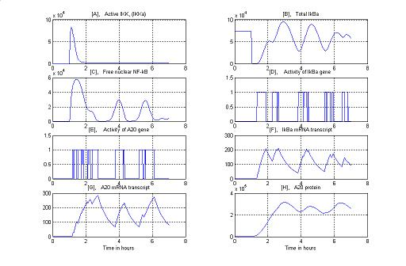
Simulation of single wild type cell

Slide 22
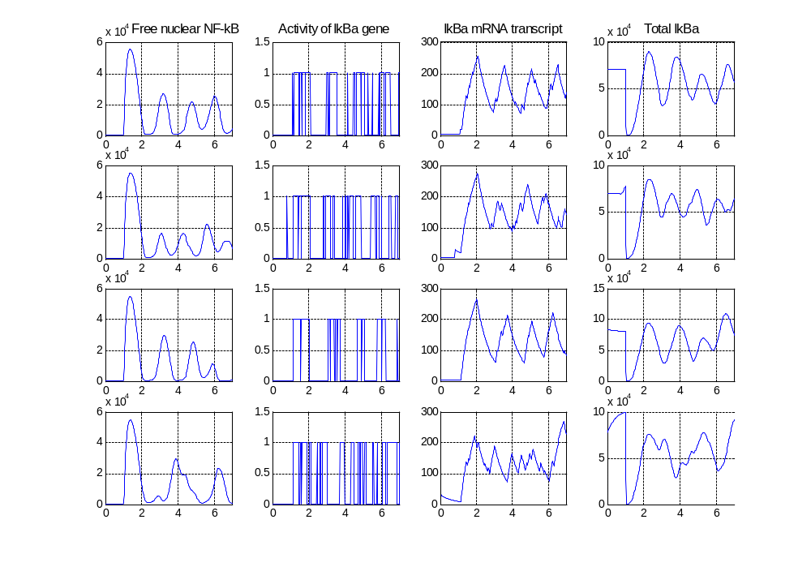
Four single cell simulations

Slide 23
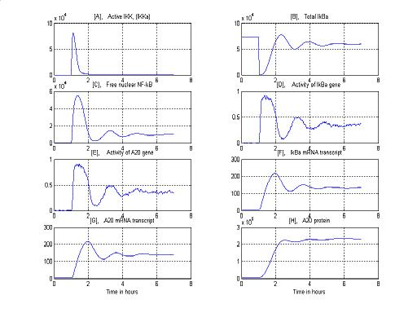
Outcome averaged over 500 runs
The “averaged” trajectory converges to steady state, while single cell
trajectories do not.

Slide 24
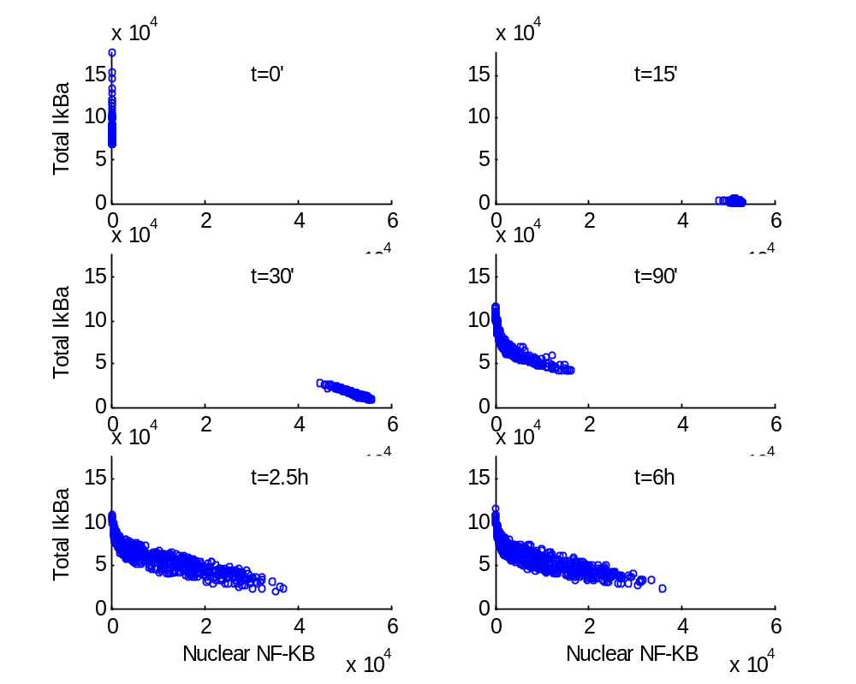
Scatter plots of total IκBα vs. NF-κB_{n}

Slide 25
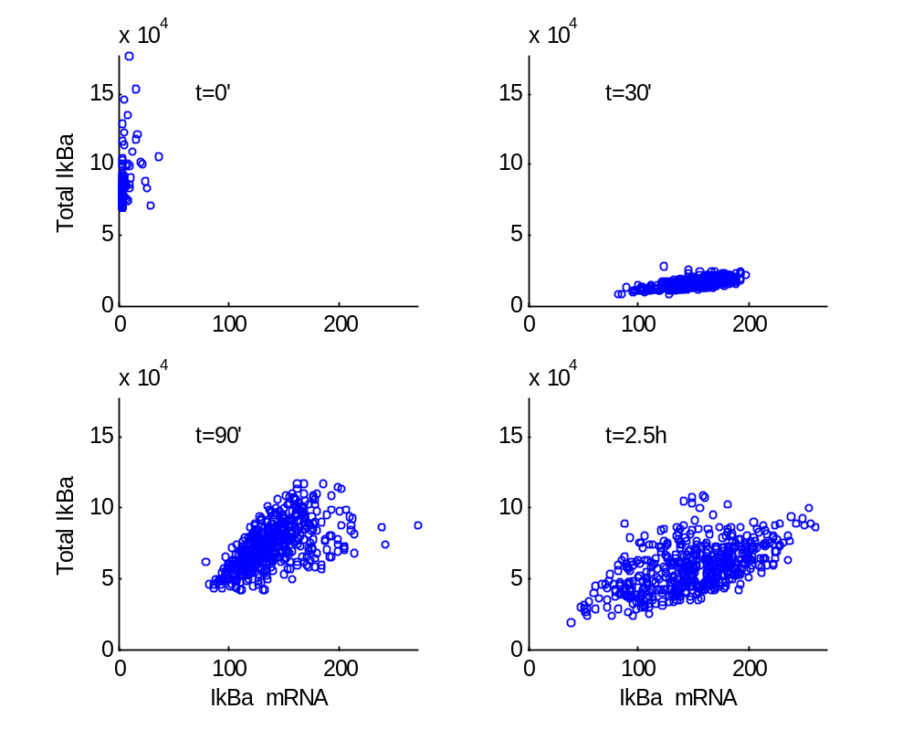
Scatter plots of total IκBα vs. IκBα mRNA

Slide 26
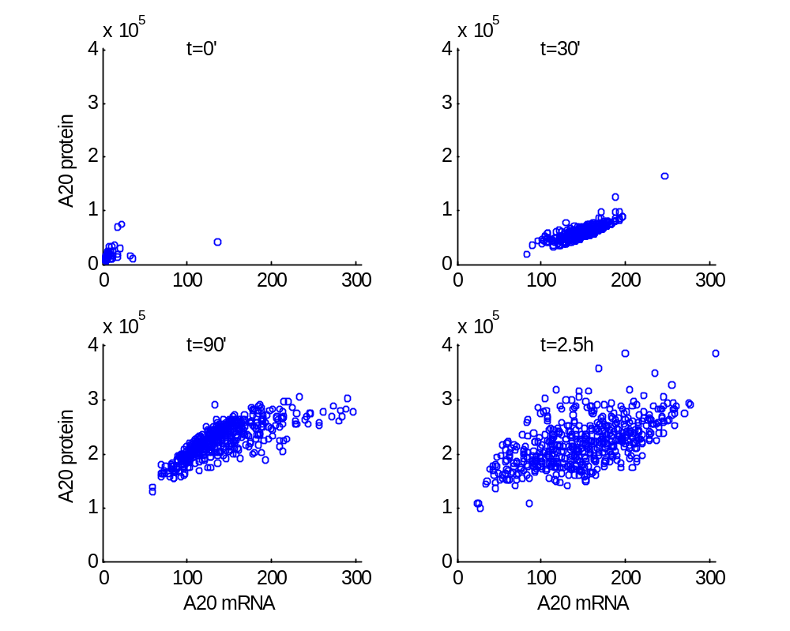
Scatter plots of A20 vs. A20 mRNA

Slide 27
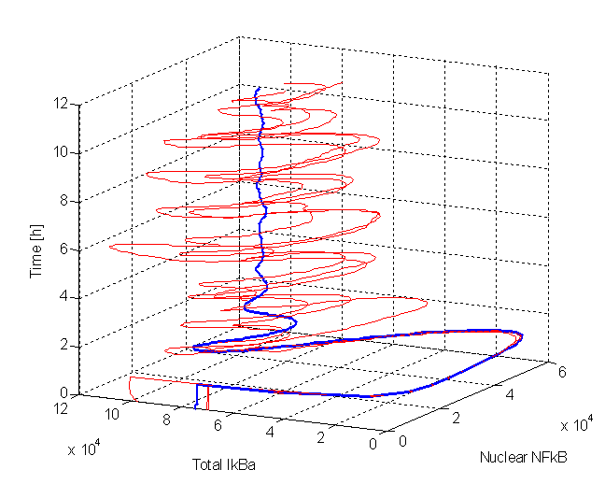
Trajectories projected on (IκBα,NF-κB_{n,},time) hiperplane, red: 3 single cells, blue: cell population
Any single cell trajectory differs from the “averaged” trajectory

Slide 28
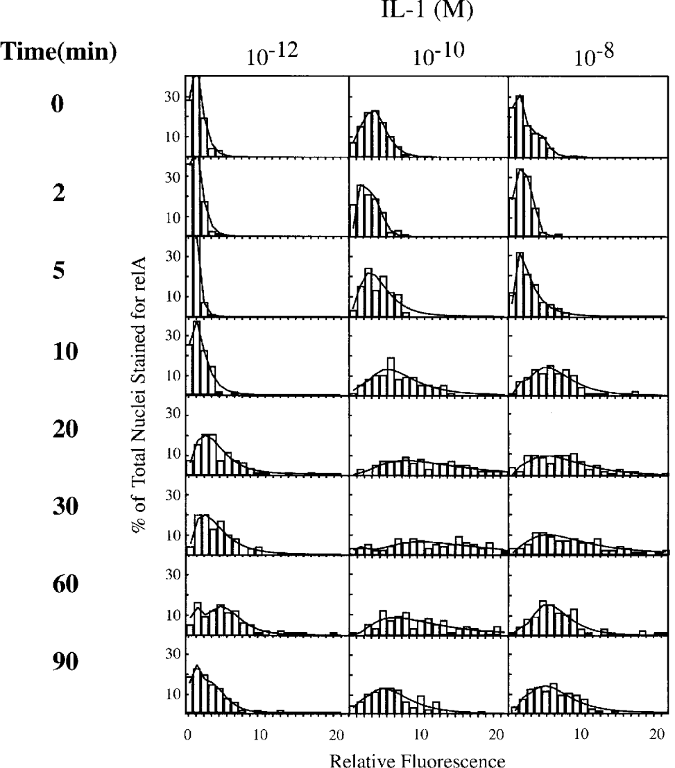
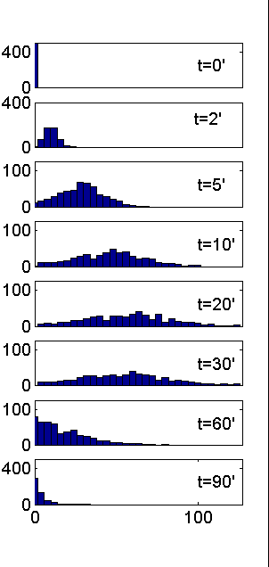
Scholey, et al. Biochem. J. (2003) 369, p. 331
Time dependent histograms of relA levels in nuclei of human fibroblasts following treatment with IL-1β compared with our simulation of 500 cells, now, with varied level of NF- κB: mean = 60,000, SD = 30,000

Slide 29
Conclusions
The constructed two-feedback-model traces satisfactorily data
resulted from wild type and A20-deficient cells.
- mRNAs of A20 and IκBα
- NF-κB nuclear binding (pulse like and persistent stimulation)
- IκBα cytoplasmic protein
-IKK and IKK kinase activity
The analysis of the kinetics at the single cell level reveals that
kinetics of any single cell is considerably different to the kinetics
averaged over the entire cell population.
This work was supported by NHLBI contract N01-HV-28184,
Proteomic technologies in airway inflammation (A. Kurosky, P.I.)

