Slide 1

Mathematical Models in Infectious Diseases Epidemiology and Semi-Algebraic Methods
Institut de Recherche Mathématique de Rennes
Université de Rennes
9 avril 2008
Séminaire interdisciplinaire sur les applications
de méthodes mathématiques à la biologie
Thierry Van Effelterre
Mathematical Modeller
Bio WW Epidemiology
GlaxoSmithKline Biologicals, Rixensart

Slide 2
The roadmap
Why do we need mathematical models in infectious diseases epidemiology?
Impact of vaccination: direct and indirect effects
Potential for spread and disease elimination
A model for Hepatitis A
Mathematical models in infectious diseases epidemiology and semi-algebraic methods

Slide 3
The roadmap
Why do we need mathematical models in infectious diseases epidemiology?
Impact of vaccination: direct and indirect effects
Potential for spread and disease elimination
A model for Hepatitis A
Mathematical models in infectious diseases epidemiology and semi-algebraic methods

Slide 4
Why do we need mathematical models in infectious diseases epidemiology?
A population-based model integrates knowledge and data about an infectious disease
  natural history of the disease,
  transmission of the pathogen between individuals,
  epidemiology, …
  in order to
  better understand the disease and its population-level dynamics
  evaluate the population-level impact of interventions: vaccination, antibiotic or antiviral treatment, quarantine, bednet (ex: malaria), mask (ex: SARS, influenza), …

Slide 5
Why do we need mathematical models in infectious diseases epidemiology?
We will describe “mechanistic” models, i.e. models that try to capture the underlying mechanisms (natural history, transmission, … )
in order to better understand/predict the evolution of the disease in the population.
These models are dynamic → they can account for both direct and indirect “herd protection” effects induced by vaccination.

Slide 6
“ Modeling can help to ...
Modify vaccination programs if needs change
Explore protecting target sub-populations by vaccinating others
Design optimal vaccination programs for new vaccines
Respond to, if not anticipate changes in epidemiology that may accompany vaccination
Ensure that goals are appropriate, or assist in revising them
Design composite strategies, … ”
Walter Orenstein, former Director of the National Immunization Program in the Center for Diseases Control (CDC)

Slide 7
The roadmap
Why do we need mathematical models in infectious diseases epidemiology?
Impact of vaccination: direct and indirect effects
Potential for spread and disease elimination
A model for Hepatitis A
Mathematical models in infectious diseases epidemiology and semi-algebraic methods

Slide 8
Direct and Indirect Effects of vaccination
Vaccination induces both direct and indirect
“herd protection” effects:
Direct effects: vaccinated individuals are no more (or much less) susceptible to be infected/have the disease.
Indirect effects (“herd protection”): when a fraction of the population is vaccinated, there are less infectious people in the population, hence both vaccinated AND non-vaccinated have a lower risk to be infected (lower force of infection).

Slide 9
Impact of vaccination
Example 1:
Infections for which the immunity acquired by natural infection can be assumed to be life-long:
hepatitis A, varicella, mumps, rubella, …
4 infectivity stages: Susceptible (S), Latent (L), Infectious (I) and Recovered-Immune (R)
Births
Indirect effect
Infected
Recovery
Infectious
S
L
I
R
Direct effect
Deaths
vaccinated

Slide 10
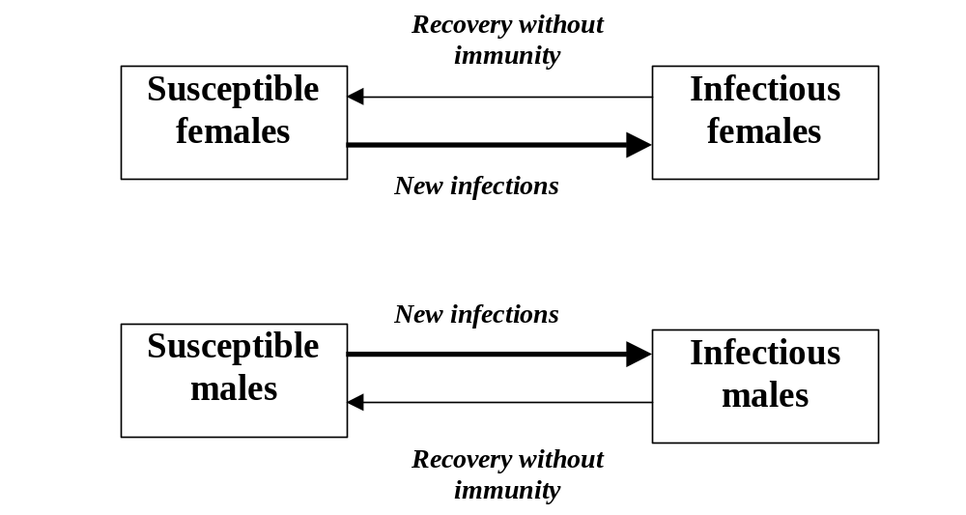
Impact of vaccination
Example 2:
Sexually Transmitted Infections without immunity after recovery.
Example: gonorrhea
effect
effect
effect
effect

Slide 11
The force of infection
The force of infection λ is the probability for a susceptible host to acquire the infection.
In a simple model with homogeneous “mixing”, it has 3 “factors”: λ = m x (I / N) x t
  m : “mixing” rate
  I / N : proportion of contacts with infectious hosts
  t : probability of transmission of the infection once a contact is made between an infectious host and a susceptible host → Incidence of new infections = λ x S (“catalytic model”)

Slide 12
Kind of outcomes from models
Prediction of future incidence/prevalence under different vaccination strategies/”scenarios”:
  age at vaccination,
  population
  vaccine characteristics
  …
Estimate of the minimal vaccination coverage / vaccine efficacy needed to eliminate disease in a population
…

Slide 13
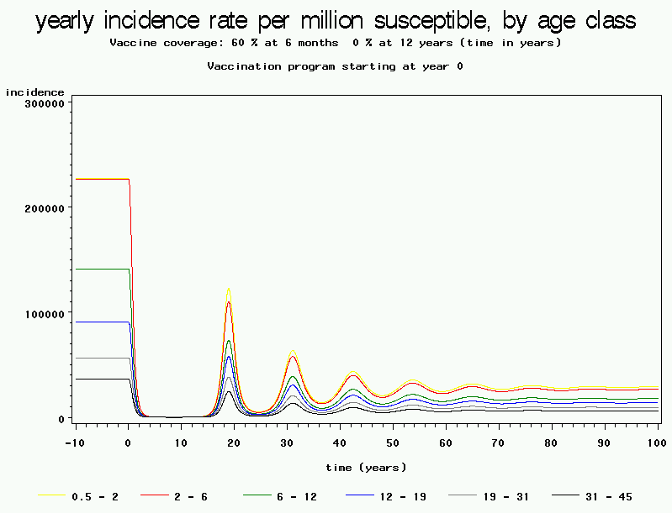
60% immunization
Varicella (Belgium)
Impact of different vaccination coverage/vaccine efficacy
Yearly incidence rate / million susceptibles
Vaccination as young as possible
“Epidemiological Modelling of
Varicella Spreading in Belgium”
Van Effelterre, 2003
Age classes: 0.5 - 1, 2 - 5, 6 - 11, 12 - 18, 19 - 30, 31 - 45
(years)

Slide 14
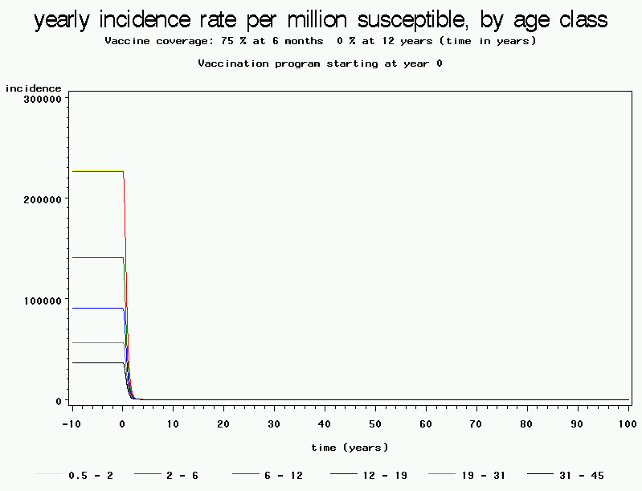
Varicella (Belgium)
Impact of different vaccination coverage/vaccine efficacy
Yearly incidence rate / million susceptibles
Vaccination as young as possible
75% immunization
“Epidemiological Modelling of
Varicella Spreading in Belgium”
Van Effelterre, 2003
Age classes: 0.5 - 1, 2 - 5, 6 - 11, 12 - 18, 19 - 30, 31 - 45
(years)

Slide 15
Varicella (Belgium):
Anticipate changes in epidemiology after vaccine introduction
Yearly incidence rate / million susceptibles
Vaccination as young as possible
60% immunization
“Epidemiological Modelling of
Varicella Spreading in Belgium”
Van Effelterre, 2003
18 yrs

Slide 16
The roadmap
Why do we need mathematical models in infectious diseases epidemiology?
Impact of vaccination: direct and indirect effects
Potential for spread and disease elimination
A model for Hepatitis A
Mathematical models in infectious diseases epidemiology and semi-algebraic methods

Slide 17
Potential for spread of an infection
The basic reproduction number R₀ (“R nought”) =
key quantity in infectious disease epidemiology: R₀ = average number of new infectious cases generated by one primary case during its entire period of infectiousness in a totally susceptible population.
R₀ < 1 → No invasion of the infection within the population; only small epidemics.
R₀ > 1 → Endemic infection; the bigger the value of R₀ the bigger the potential for spread of the infection within the population.
R₀ is a threshold value at which there is a « bifurcation » with exchange of stability between the « infection-free » state
and the « endemic » state.

Slide 18
Illustration with the simple « S-I-R » model
Dynamical system:
d/dt(S) = µ * N – β * S * I – µ * S
d/dt(I) = β * S* I – γ*I – µ * I
d/dt(R) = γ * I – µ * R
Where
µ = birth rate = death rate
β = transmission coefficient
γ = recovery rate
N = population size
2-dimensional dynamical system
(R is redundant since S + I + R = N = constant)
S
I
R

Slide 19
Illustration with the simple « S-I-R » model
Equilibria of the dynamical system:
d/dt(S) = d/dt(I) = d/dt(R) = 0
→ 2 equilibria:
(S = N, I = 0, R = 0): « infection-free state »
(S = S_{e}, I = I_{e}, R= R_{e}): « endemic state »
Evaluating the sign of the real part of
the Jacobian’s eigenvalues
R₀ = ( β * N ) / γ < 1 → (N,0,0) is stable
R₀ = ( β * N ) / γ > 1 → (S_{e}, I_{e}, R_{e}) is stable
There is a minimal (threshold) population for an infection to be endemic in the population:
N > γ / β

Slide 20
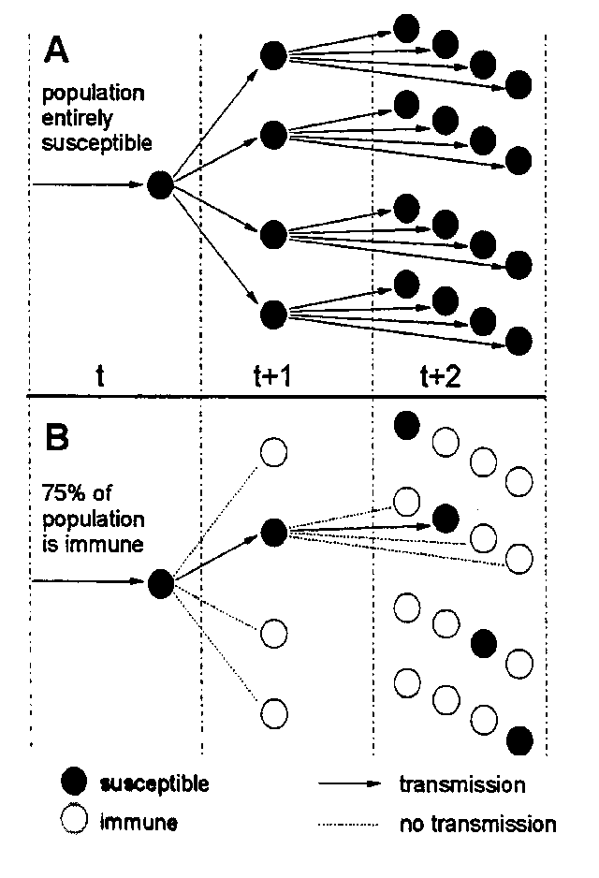
Evaluation of the potential for spread of an infection
R₀ = 4
with whole population susceptible
R₀ = 4
with 75% population immune
(25% susceptible)

Slide 21
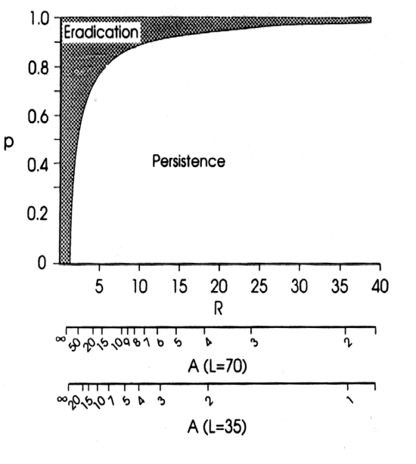
Evaluation of the potential for spread of an infection
Vaccination reduces the proportion of susceptibles in the population.
The minimal immunization coverage needed to eliminate an infection in the population, p_{c}, is related to R₀ by the relation p_{c} = 1 – ( 1 / R₀ )

Slide 22
Evaluation of the potential for spread of an infection
  Infection p_{c}
  Measles 90% - 95% Pertussis 90% - 95% H. parvovirus 90% - 95% Chicken pox 85% - 90% Mumps 85% - 90% Rubella 82% - 87% Poliomyelitis 82% - 87% Diphtheria 82% - 87% Scarlet fever 82% - 87% Smallpox 70% - 80%
“Infectious Diseases in Humans”
Anderson, May

Slide 23
Evolutionary aspects in epidemiology
Those models can also be used to better understand other aspects related to the “ecology” of interactions between humans, pathogens and the environment:
Examples:
  potential replacement of strains of a pathogen by others under various selective pressures.
  impact of antibiotic use and of vaccines upon the evolution of the resistance to antibiotics at the population level
  the impact of different strategies of antibiotic use (cycling, sub-populations, combination therapies, ...) upon the evolution of the resistance of pathogens to those antibiotics
  …

Slide 24
The roadmap
Why do we need mathematical models in infectious diseases epidemiology?
Impact of vaccination: direct and indirect effects
Potential for spread and disease elimination
A model for Hepatitis A
Mathematical models in infectious diseases epidemiology and semi-algebraic methods

Slide 25
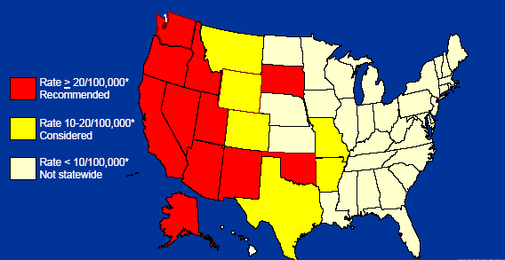
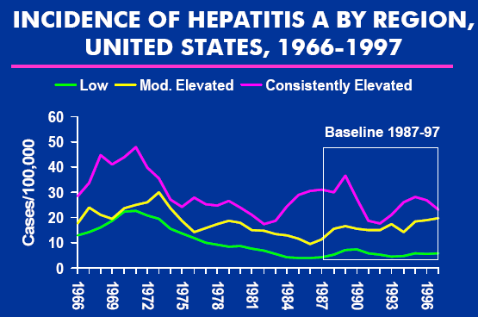
Modelling Hepatitis A in the United States
The Context
Yearly Incidence rate / 100,000:
≥ 20
10 – 20
< 10

Slide 26
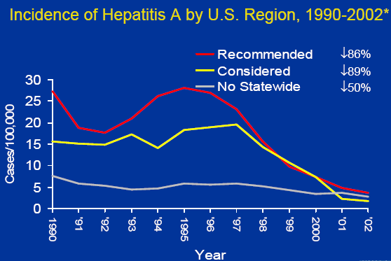
Modelling Hepatitis A in the United States
Yearly incidence rate per 100,000
for Hepatitis A, by “1999 ACIP Region”, 1990 - 2002

Slide 27
Objectives of the Model
Evaluate
  the impact of different vaccination strategies on the future evolution of Hepatitis A in the U.S. population, in terms of incidence of infectives, proportion of susceptibles, …
  the potential of spread of Hepatitis A in the U.S. with an estimate of R₀ , and the minimal immunization coverage needed for elimination

Slide 28
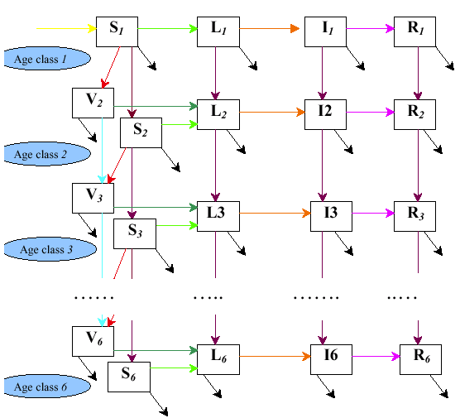
Flows:
Births:
F.O.I.:
Infectious:
Recovery:
Ageing:
Vaccination
Deaths
Health states:
S: Susceptible L: Latent I: Infected
R: Recovered-Immune V: Vaccinated
“A Mathematical Model of Hepatitis A
Transmission in the United States Indicates Value of
Universal Childhood Immunization”
Van Effelterre & Al
Clinical Infectious Diseases, 2006

Slide 29
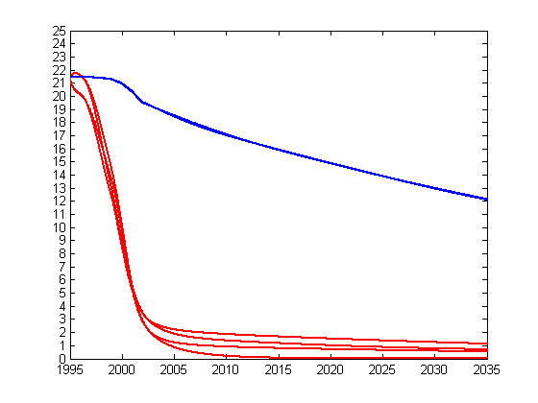
Herd Protection Effects
Projection in the 17 Vaccinated States
Predicted Incidence rate per 100,000
Period 1995 - 2035
Not accounting for
herd protection
(static model)
Accounting for
herd protection
(dynamic model)
Van Effelterre & al,
Clinical Infectious Diseases, 2006:43

Slide 30
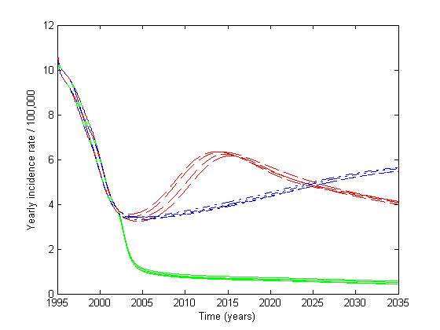
Incidence rate for the whole U.S.
with Different Immunization Strategies
Nationwide
at 12 years of age
Regional
(ACIP 1999)
at 2 years of age
Nationwide
at 1 year of age
Van Effelterre & Al,
Clinical Infectious Diseases, 2006:43

Slide 31
The roadmap
Why do we need mathematical models in infectious diseases epidemiology?
Impact of vaccination: direct and indirect effects
Potential for spread and disease elimination
A model for Hepatitis A
Mathematical models in infectious diseases epidemiology and semi-algebraic methods

Slide 32
Mathematical models in infectious diseases epidemiology and semi-algebraic methods
All mathematical expressions in the dynamical systems are polynomial and state variables are constrained to be ≥ 0 characterized by Semi-algebraic Sets.
Semi-algebraic methods give more insight to understand the models and their outcomes.
Efficient semi-algebraic methods useful to
  Characterize thresholds (ex: R₀)
  Compute exact number of steady states.
  Assess stability of specific steady states.
  Determine bifurcation sets where there is a qualitative change in population dynamics
  (ex: Hopf bifurcations)
  …

Slide 33
Mathematical models in infectious diseases epidemiology and semi-algebraic methods
Realistic models usually have a great number of states (might be up to several hundreds), to account for
  Different states in natural history of the diseases
  Risk factors (age, …)
However, simplified models can help to get a better insight about key aspects like
  Thresholds (R₀)
  Stability of specific endemic states
  …

Slide 34
Mathematical models in infectious diseases epidemiology and semi-algebraic methods
Example:
A simple model for a bacterial disease with
  2 types of circulating strains:
    susceptible to antibiotics
    resistant to antibiotics
  Assume that individuals under antibiotic treatment can be colonized by the resistant strain,
  but not by the susceptible strain
  Resistant strain is less transmissible than susceptible strain (“fitness cost paid” for resistance)
  Question: evaluate the minimal population-level usage of antibiotics under which the resistant strain cannot be endemic in the population

Slide 35
Model states
The model has 6 different states:
Currently not under Antibiotic (AB) treatment effect
  Non-carrier
  Carrier of susceptible strain
  Carrier of resistant strain
  Carrier of susceptible and resistant strain
Currently under Antibiotic treatment effect
  Non-carrier
  Carrier of resistant strain

Slide 36
MODEL
STATES
Carrier
of susceptible
strain
Carrier
of susceptible
and resistant strain
Non-Carrier
Carrier
of resistant
strain
Non-Carrier
+ AB treatment
Carrier
of resistant
Strain
+ AB treatment

Slide 37
Model flows
Individuals can be
colonized by susceptible strain
colonized by resistant strain
co-colonized
clear the strain, or one of the 2 strains if co-colonized
start an antibiotic treatment
end up period of antibiotic effect

Slide 38
Be colonized
by susceptible strain
Carrier
of susceptible
strain
Carrier
of susceptible
and resistant strain
Non-Carrier
Carrier
of resistant
strain
Non-Carrier
+ AB treatment
Carrier
of resistant
Strain
+ AB treatment

Slide 39
Be colonized
by resistant strain
Carrier
of susceptible
strain
Carrier
of susceptible
and resistant strain
Non-Carrier
Carrier
of resistant
strain
Non-Carrier
+ AB treatment
Carrier
of resistant
Strain
+ AB treatment

Slide 40
Be co-colonized
Carrier
of susceptible
strain
Carrier
of susceptible
and resistant strain
Non-Carrier
Carrier
of resistant
strain
Non-Carrier
+ AB treatment
Carrier
of resistant
Strain
+ AB treatment

Slide 41
Be co-colonized
Carrier
of susceptible
strain
Carrier
of susceptible
and resistant strain
Non-Carrier
Carrier
of resistant
strain
Non-Carrier
+ AB treatment
Carrier
of resistant
Strain
+ AB treatment

Slide 42
Clear the susceptible
strain
Carrier
of susceptible
strain
Non-Carrier
Carrier
of susceptible
and resistant strain
Carrier
of resistant
strain
Non-Carrier
+ AB treatment
Carrier
of resistant
Strain
+ AB treatment

Slide 43
Clear the resistant
strain
Carrier
of susceptible
strain
Carrier
of susceptible
and resistant strain
Non-Carrier
Carrier
of resistant
strain
Non-Carrier
+ AB treatment
Carrier
of resistant
Strain
+ AB treatment

Slide 44
Clear the resistant
strain
Carrier
of susceptible
strain
Carrier
of susceptible
and resistant strain
Non-Carrier
Carrier
of resistant
strain
Non-Carrier
+ AB treatment
Carrier
of resistant
Strain
+ AB treatment

Slide 45
Clear the susceptible
strain
Carrier
of susceptible
strain
Carrier
of susceptible
and resistant strain
Non-Carrier
Carrier
of resistant
strain
Non-Carrier
+ AB treatment
Carrier
of resistant
Strain
+ AB treatment

Slide 46
Start Antibiotic
treatment
Carrier
of susceptible
strain
Carrier
of susceptible
and resistant strain
Non-Carrier
Carrier
of resistant
strain
Non-Carrier
+ AB treatment
Carrier
of resistant
Strain
+ AB treatment

Slide 47
Be colonized
by resistant strain
Carrier
of susceptible
strain
Carrier
of susceptible
and resistant strain
Non-Carrier
Carrier
of resistant
strain
Non-Carrier
+ AB treatment
Carrier
of resistant
Strain
+ AB treatment

Slide 48
Clear the resistant
strain
Carrier
of susceptible
strain
Carrier
of susceptible
and resistant strain
Non-Carrier
Carrier
of resistant
strain
Non-Carrier
+ AB treatment
Carrier
of resistant
Strain
+ AB treatment

Slide 49
Start Antibiotic
treatment
Carrier
of susceptible
strain
Carrier
of susceptible
and resistant strain
Non-Carrier
Carrier
of resistant
strain
Non-Carrier
+ AB treatment
Carrier
of resistant
Strain
+ AB treatment

Slide 50
Start Antibiotic
treatment
Carrier
of susceptible
strain
Carrier
of susceptible
and resistant strain
Non-Carrier
Carrier
of resistant
strain
Non-Carrier
+ AB treatment
Carrier
of resistant
Strain
+ AB treatment

Slide 51
Start Antibiotic
treatment
Carrier
of susceptible
strain
Carrier
of susceptible
and resistant strain
Non-Carrier
Carrier
of resistant
strain
Non-Carrier
+ AB treatment
Carrier
of resistant
Strain
+ AB treatment

Slide 52
End period of antibiotic
effect
Carrier
of susceptible
strain
Carrier
of susceptible
and resistant strain
Non-Carrier
Carrier
of resistant
strain
Non-Carrier
+ AB treatment
Carrier
of resistant
Strain
+ AB treatment

Slide 53
End period of antibiotic
effect
Carrier
of susceptible
strain
Carrier
of susceptible
and resistant strain
Non-Carrier
Carrier
of resistant
strain
Non-Carrier
+ AB treatment
Carrier
of resistant
Strain
+ AB treatment

Slide 54
ALL FLOWS
Carrier
of susceptible
Strain (S)
Carrier
of susceptible
and resistant strain
(B)
Non-Carrier
(N)
Carrier
of resistant
Strain (X)
Non-Carrier
+ AB treatment
(A)
Carrier
of resistant
Strain
+ AB treatment (Y)

Slide 55
Dynamical system
The dynamical system is characterized by a system of
5 ordinary differential equations:
d/dt(N) = μ – α*N – β1*(S+B)*N – β2*(X+Y+B)*N + γ*S + γ*X + δ*A – μ*N
d/dt(S) = β1*(S+B)*N – σ*β2*(X+Y+B)*S – γ*S + γ*B – α*S - μ *S
d/d(A) = α*N - δ*A - β2*(X+Y+B)*A + γ*Y + α*S – μ*A
d/dt(X) = β2*(X+Y+B)*N – γ*X – α*X + δ*Y – σ* β1*(B+S)*X + γ*B – μ*X
d/dt(Y) = β2*(X+Y+B)*A – γ*Y + α*X - δ*Y + α*B – μ*Y
B is redundant since
N + S+ A + X + Y + B = 1
(the state variables are percentages of the total population)

Slide 56
Model parameters
α: rate at which antibiotic treatment starts
δ: rate at which antibiotic treatment ends
β1: transmission rate for susceptible strain
β2: transmission rate for the resistant strain
γ: clearance rate (end of colonization)
μ : birth rate (= death rate)
σ : reduction in risk of co-colonization if already colonized compared to colonization if non-carrier

Slide 57
Equilibria
The equilibria of the dynamical system are characterized by
a polynomial system: ODE system with right-hand-sides = 0
Examples:
Carriage-free Equilibrium
N = (δ + μ)/ (δ + α + μ)
S = 0
A = α/( δ + α + μ)
X = 0
Y = 0
Equilibrium with carriage of susceptible strain only
N = 1/R₀
S = ((δ+ μ)/(δ + α + μ)) – (1/R₀),
A = α/( δ + α + μ)
X = 0
Y=0

Slide 58
Stabilility of Equilibria
Characterization of the stability of an equilibrium:
all eigenvalues of the Jacobian of the system of ordinary differential equations, evaluated at the equilibrium, must have a negative real part.
The set of model parameters for which an equilibrium is stable (or unstable) is a semi-algebraic set.

Slide 59
Minimal Antibiotic usage for which the resistant strain is endemic
Characterize the condition on the model parameters,
in particular the frequency and duration of AB treatment,
for which
  equilibrium with susceptible and resistant strains both endemic
  equilibrium with only the susceptible strain endemic
  exchange stability.
  Even for such simple models: this translates into sign conditions
  on polynomials that might be quite complex!
  Need efficient semi-algebraic methods in order to simplify those sign conditions.
  The goal: simplify the sign conditions as much as possible.
  Gain insight/quantify the impact of model parameters onto the persistence/non persistence of the resistant strain
  within the population.

Slide 60
Conclusions
Mathematical models are very important in infectious diseases epidemiology. They can help to
  Better understand the natural history of the disease and its population-level dynamics
  Evaluate impact of interventions, like vaccination, …
Although realistic model might be quite complex,
simplified models can help to get a better insight into population-level dynamics and impact of interventions.
Semi-algebraic methods can be very useful for those models:
  Characterize algebraically thresholds (like R₀) , stability of specific endemic states, …
  as a function of the model parameters
  Count exact number of endemic states
  Characterize “bifurcations” in population-level dynamics
  …

Slide 61
To Learn More about
Modeling of Infectious Diseases …
  Anderson R.M., May R. M.:
  “Infectious disease in humans, dynamics and control”, Oxford University Press, 1991.
  Hethcote H.W.: “The mathematics of Infectious diseases”
  SIAM, 2000
  Available on-line: http://www.math.rutgers.edu/~leenheer/hethcote.pdf
  Anderson R.M., Nokes D.J.: “Mathematical models of transmission and control” Oxford textbook on public health, Vol.2, Chap. 14, Oxford Medical Publications, 1991
  Bailey N.T.: “The biomathematics of malaria”,
  Charles Griffin and Co., 1982

Slide 62
To Learn More about
Modeling of Infectious Diseases …
    Becker N.J.: “Analysis of infectious disease data”, Chapman and Hall, 1989
    Daley D.J., Gany J.: “Epidemic modelling. An introduction”, Cambridge Univ. Press, 1999
    Diekmann O., Heesterbeek J.A.P.: “Mathematical epidemiology of infectious diseases”, Wiley, 2000
    Mollison D. Editor: “Epidemic models. Their structure and relation to data”, Cambridge Univ. Press, 1995
    Wai-yuan T.: “Stochastic modeling of AIDS epidemiology and HIV epidemics”, World Scientific, 2000

Slide 63
Merci de votre attention.
Vos questions sont bienvenues!

