Slide 1
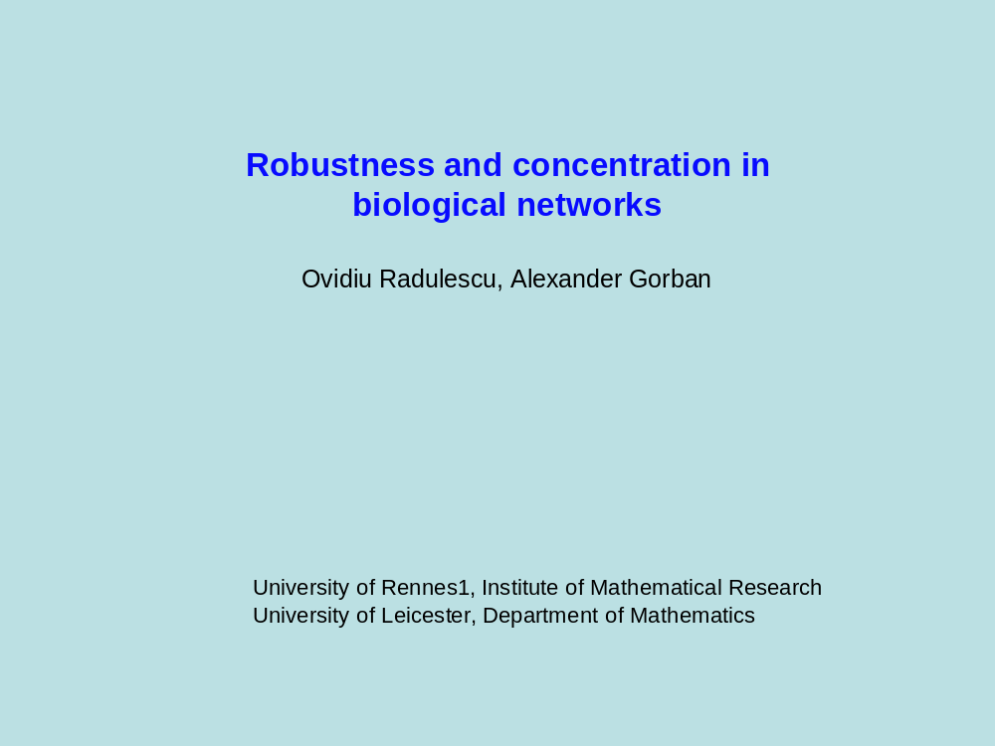

Slide 2

Anatole France: ‘’La rôtisserie de la Reine Pédauque’’

Slide 3
Robustness
Robustness = reduced variability, structural stability, small
Sensitivity with respect to changes of parameters
Robustness with respect to variations of the constants
Dynamical system dX/dt = F(X,C).
Trajectory X=Ψ(t,C,X0)
There are properties of the trajectory that are robust
with respect variations of the constants C.
Let P = φ (C1,C2,…,Cn) be such a property.

Slide 4
Two types of robustness
Robustness with respect to distributed attacks:
random, independent changes of Ci produce small changes of P:
Var(P) << Var(Ci)
Robustness with respect to concentrated (terrorist) attacks:
varying a small number of constants Ci while keeping all the
Other constant does not produce a significative change of P
I= {1,2,…,n}, for all I0 ⊂ I , # I0 << n,
Var[ φ (C1,C2,…,Cn) | I \ I0 ] << Var(Ci)

Slide 5
Some properties of biological networks are robust
von Dassow 2000: "segment polarity network is robust"
u(x,t) pattern can be seen as a vector X in an infinite dimensional space
dX/dt = F(X,C)
X(0) = X0

Slide 6
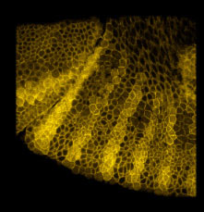
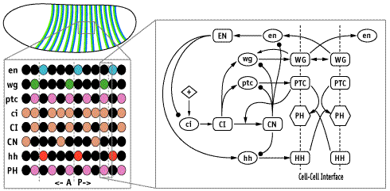

Slide 7
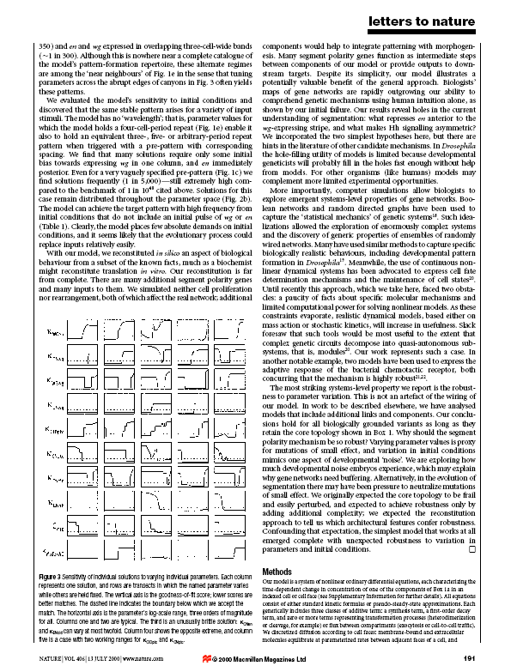

Slide 8
Comment
What you saw is robustness with respect to concentrated attacks (change
of one parameter only, while the others are kept fixed)
the robust property P is the goodness of fit score between unperturbed and
perturbed patterns (L2 distance).

Slide 9
Robustness and concentration effects
Consider Ci i.i.d. random variables
Which generic properties are robust properties?
The law of large numbers tells us that the mean is robust
Var [ ∑Ci / n] = Var[Ci] / n → 0

Slide 10
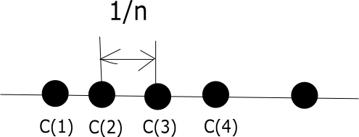
Order statistics
C1,C2, … , Cn are i.i.d. random variables
Order the variables
C(1) < C(2) < … < C(n)
Var[C(i)] ~ 1/n² if i < i0 or i > n-i0
Var[C(i)] ~ 1/n if i ~ n
for instance for i = [n/2] we have the median property M ~ 1/n
By ordering we loose randomness

Slide 11
Geometrical theory of concentration
(after Misha Gromov: Metric Structures for Riemannian and
Non-Riemannian Spaces)
Concentration effects: an unknown object is observed via functions
defined on it. We speak of concentration when the object thus
observed appears much smaller than it is in reality.
Concentration generalizes law of large number asking only the fact
that one atom contributes little to the observed function.

Slide 12
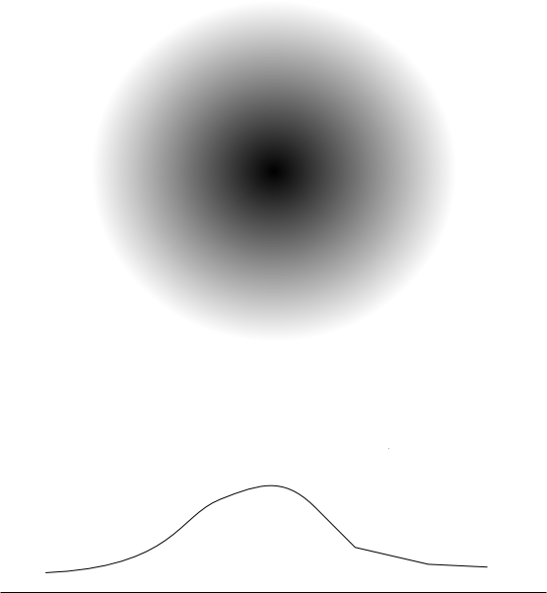
Concentration of a uniformly filled sphere

Slide 13
Paul Lévy:
any 1-lipschitzian function f (|f(x)-f(y)|< |x-y|)
defined on Sn is concentrated in a region of size 1/√n
near its average.
2) Cube concentration
projection of the hypercube [0,1]^{n} uniformly filled on its
diagonal (of length √n)
(x1,x2,…,xn) → x1+x2+… + xn
is concentrated near the center (1/2,…,1/2) in a
region of size √n : law of large numbers
3) Simplex concentrations
0 < x1 < x2 < …< xn < 1
ξ_{i} = x _{i+1} – x _{i} are in a simplex ∑ ξ_{i} = 1
The concentration property or order statistics can be seen
as the effect of concentration in a simplex: the mass of a
simplex concentrates near its center (1/n,1/n,…,1/n)

Slide 14
Linear chemical kinetics
Linear chemical mechanisms: all the reactions have the following
form:
Ai → Aj
order kinetic constants in decreasing order:
k1 < k2 < … < kq
Kinetic equation dC/dt=KC, C is the concentration vector.
Trajectory C(t) = exp(Kt) C0

Slide 15
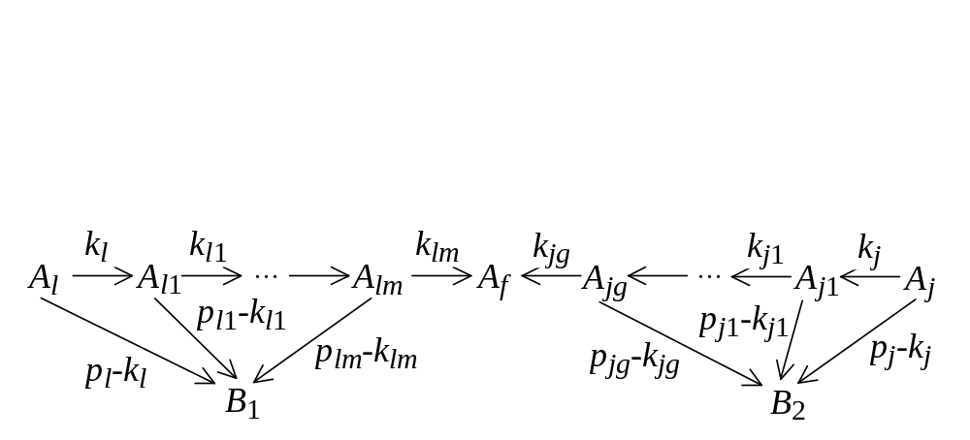
Linear chemical kinetics
Definition: A linear network is weakly ergodic, if for any initial state
C0, exp(Kt) C0 tends to limit states in a one-dimensional subspace.
Property:
A linear network is weakly ergodic, if for each two vertices
Ai, Aj (i ≠ j) we can find such a vertex Ak such that oriented paths
exist from Ai to Ak and from Aj to Ak. One of these paths can be
degenerated: it might be i=k or j=k.

Slide 16
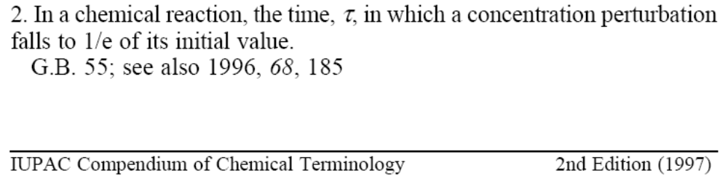
RELAXATION TIME

Slide 17
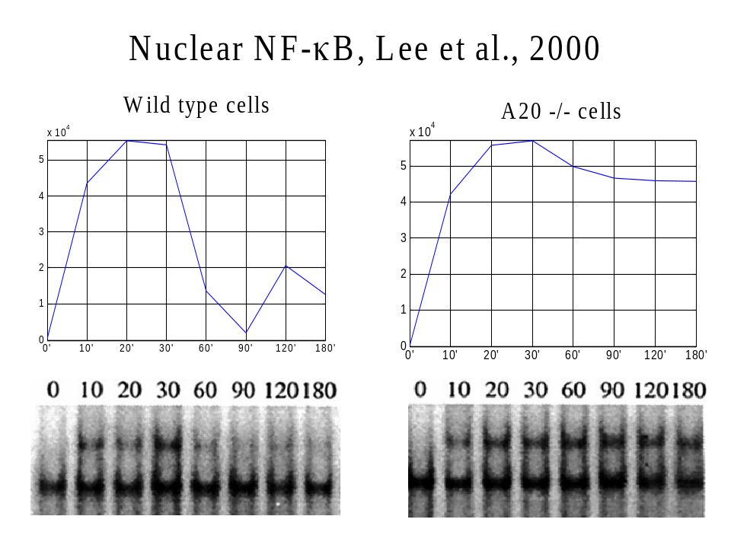

Slide 18
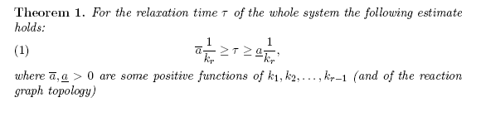
Ergodicity boundary and relaxation time
Ergodicity boundary
The reaction constant kr is the ergodicity boundary if the reaction graph for reactions with constants k₁=0,k₂=0, … , k _{r-1}=0 (and the rest unchanged) is ergodic, but for reactions with constants
k1,k2, …,kr (and the rest unchanged) it is not.

Slide 19
Sketch of the proof
conservation law = conserved linear combination of the concentrations
bC(t) = b1 C1(t) + b2 C2(t) + … + bn Cn(t)
d(bC)/dt = b K C = 0, bK=0 (zero eigenvector of K)

Slide 20
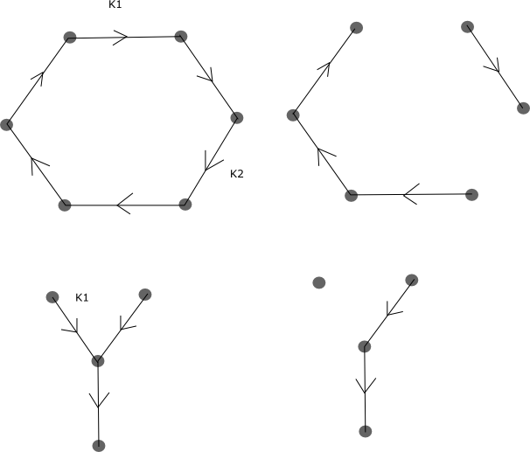
non-overlapping sinks ↔conservation laws ↔ zero eigenvectors of K
a sink is a subgraph with no outgoing connections.

Slide 21
When slow connections are discarded one by one, at a certain moment
two non-overlapping sinks will appear for the first time, K will
have degenerated zero eigenvalue. Degeneracy is lifted going one
step back.
Analytic perturbation theory for K= K> + kr Q

Slide 22
Take home message
The well known concept of stationary reaction rates limitation
by ``narrow places" or ``limiting steps" should be complemented by
the ergodicity boundary limitation of relaxation time.
It should be stressed that the relaxation process is limited not by
the classical limiting steps (narrow places), but by absolutely
different reactions.
For the cycle, the second slowest reaction controls
relaxation.

Slide 23
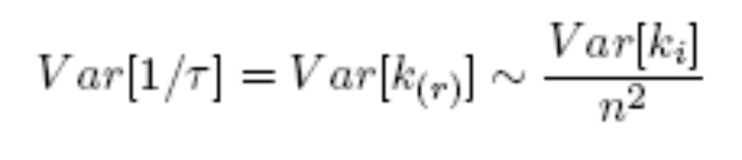
Consequence 1
Robustness with respect to distributed attack.
Suppose are i.i.d.
Order them
Order statistics (simplex) concentration effect:

Slide 24
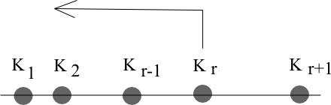
Consequence 2
Robustness with respect to concentrated attack (r-fold redundancy)
Suppose that every node of the network is on a cycle.
Then the ergodicity boundary is r >= 2.
Suppose one can only decrease constants.
Decreasing ki, i < r has no effect
Decreasing kr increases relaxation time up to 1/kr-1 then no effect.
Decreasing ki, i > r no effect unless kr-1 < ki < kr
Relxation time stays always between 1/kr and 1/kr-1
The only way to increase relaxation time indefinitely is to coordinately decrease of all slowest r constants.
If r=1, there is no limit to increasing relaxation time, by decreasing constant k1.

Slide 25
GENE NETWORK
NF-κB factor
Receptors
Gene A
Gene B
Gene C

Slide 26
GENE NETWORK
NF-κB factor
SIGNALS
Receptors
Signaling
pathways
Gène A
Gène B
Gène C

Slide 27
GENE NETWORK
NF-κB factor
SIGNALS
Receptors
Signaling
pathways
Gène A
Gène B
Gène C

Slide 28
GENE NETWORK
NF-κB factor
Receptors
Gène A
Gène B
Gène C

Slide 29
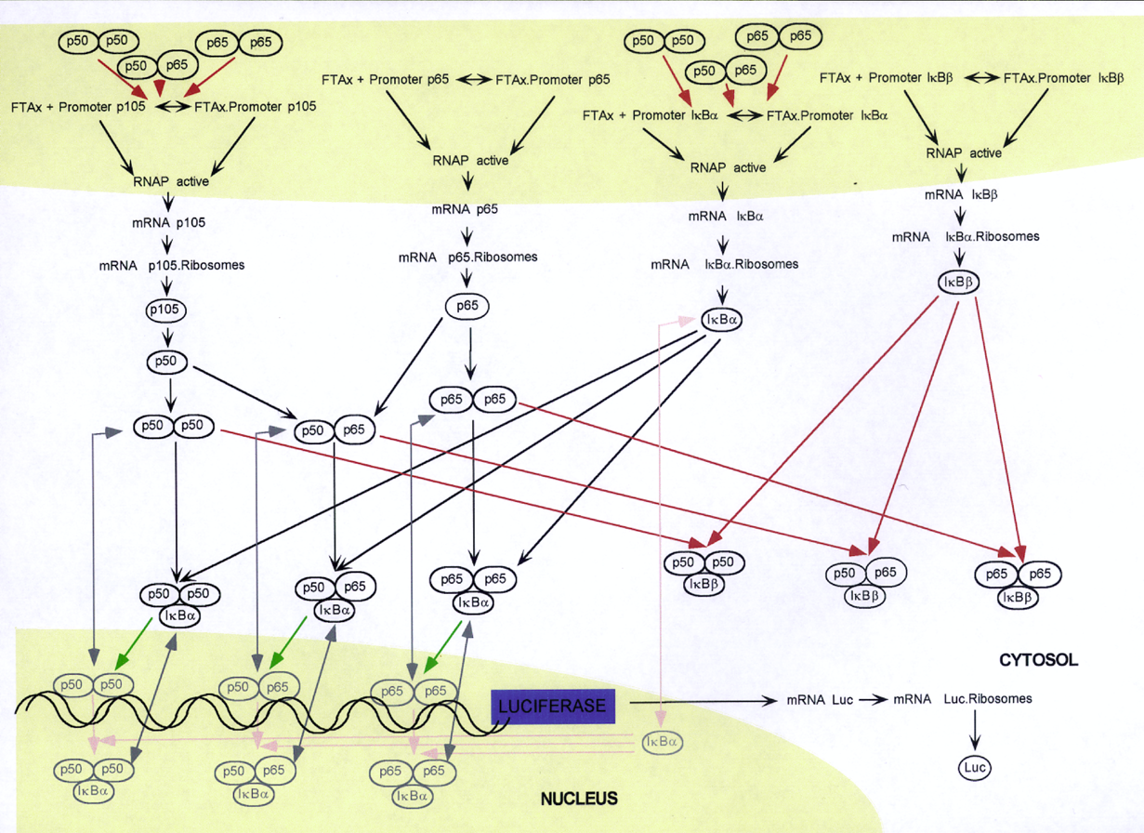

Slide 31
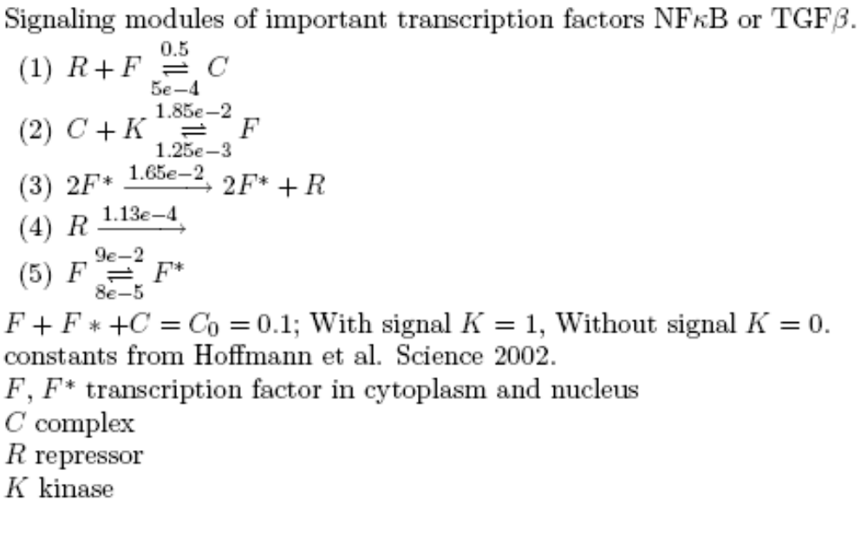

Slide 32
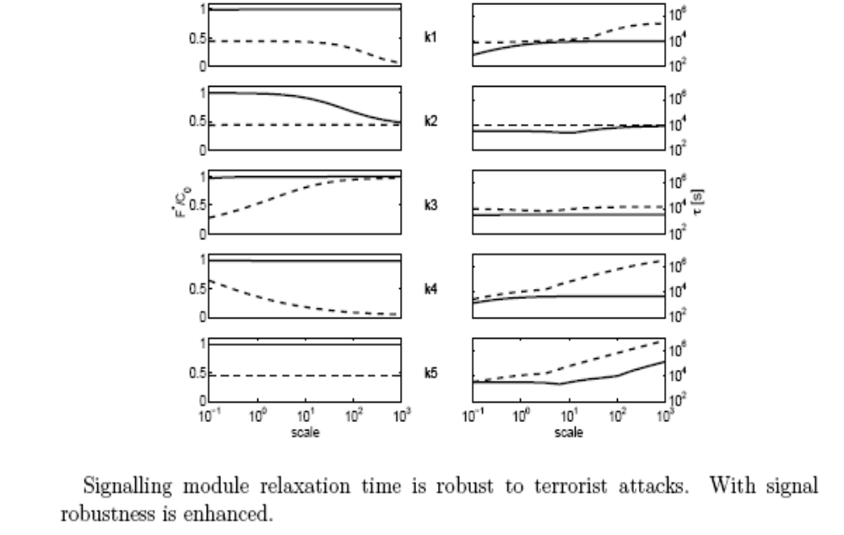

Slide 33
CONCLUSIONS
the relaxation time of linear networks of chemical reactions is robust,
both with respect to distributed and concentrated attacks.
this is concentration phenomenon
similar phenomenon is valid for nonlinear networks,
mathematical justification still needed
Lévy/Milman/Gromov/Talagrand concentration as a unifying principle

