Slide 1
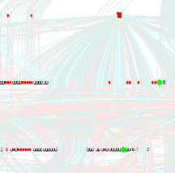

New qualitative approaches in molecular biology
  Ovidiu Radulescu
  IRMAR (UMR 6625), IRISA
  University of Rennes 1

Slide 2
Objectives and methodology
Integrate heterogeneous data collected in high-throughput experiments
Use qualitative analysis as unifying modeling framework
Algorithms for creating and for correcting detailed models
Use modeling to propose new experiments

Slide 3
Summary
Static response of networks
Qualitative analysis
Qualitative equations and Galois field coding
Comparison model/data
Example 1: lactose operon
Experiment design
Example 2: E.coli transcriptional network

Slide 4
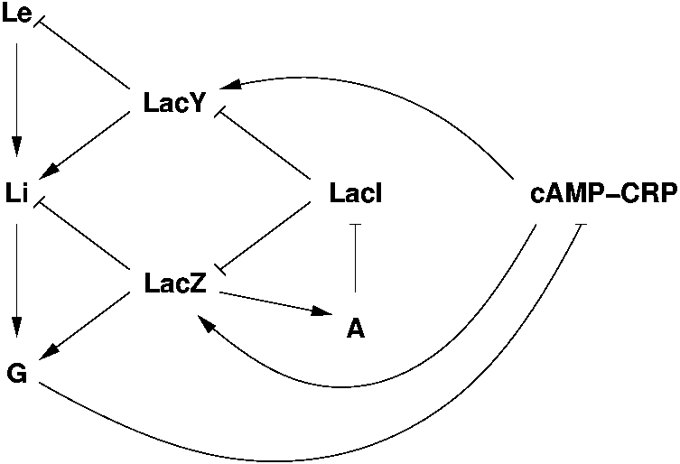
Static response
Lactose operon

Slide 5
Static response
+

Slide 6
Static response
+
?
?
?
?
?
?
?

Slide 7
Topology and response
Differential dynamics dX/dt= F(X,P)
Interaction graph (G,A,s) defined by the Jacobian
A ⊂ G×G, (i,j) ∈A iff ∂ F _{j} / ∂ x_{i} ≠0
s:A→{-1,1}, s(i,j)=sign( ∂ F _{j} / ∂ x_{i} )
Steady state F(X,P)=0
Steady state shift
δ X = - (∂ F/∂ X) ⁻¹ (∂ F/∂ P) δ P

Slide 8
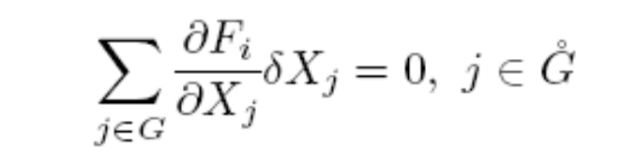
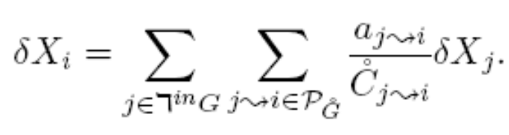

Propagation of interaction, graph boundary

Slide 9
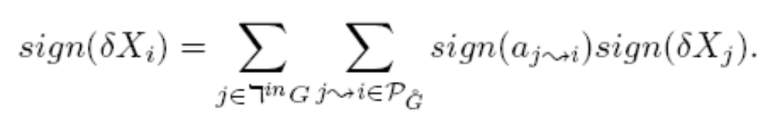
Qualitative equations, sign algebra

Slide 10
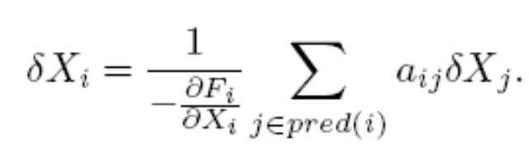

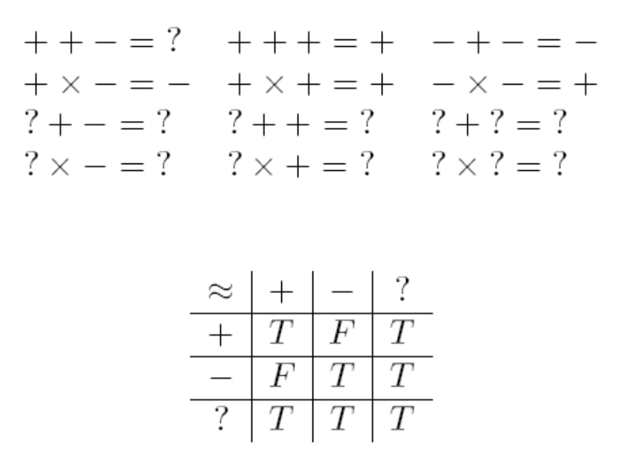
Qualitative equations, sign algebra
Li=Le+LacY-LacZ

Slide 11
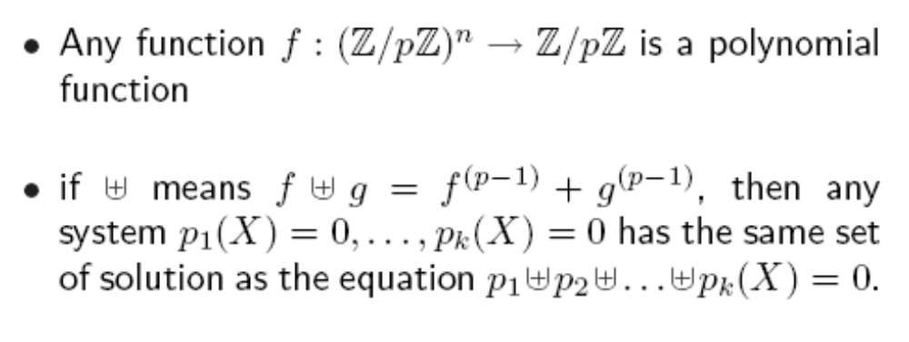
Polynomial coding of systems of qualitative equations

Slide 12



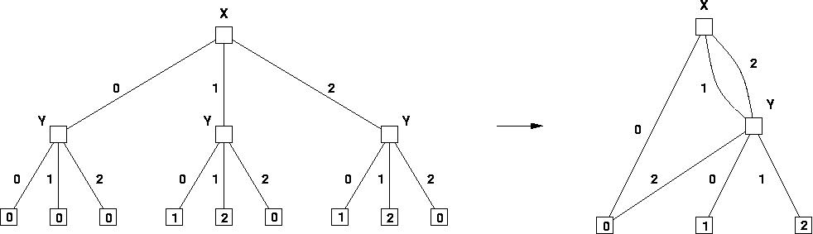

Polynomial coding of systems of qualitative equations

Slide 13
Implementation
Software: Gardon, GARMeN, Sigali
Coherence between model and data
  from interaction graph write qualitative equations
  Galois field coding
  substitute experimental values
  existence of at least one solution coherence
Corection
  most parcimonious
  use Hamming distance
  can be applied to arcs (model) or nodes (data)

Slide 14
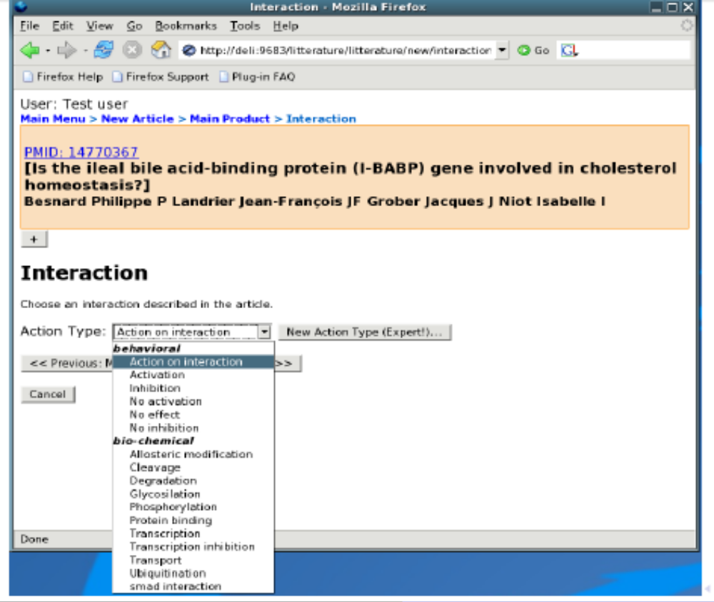
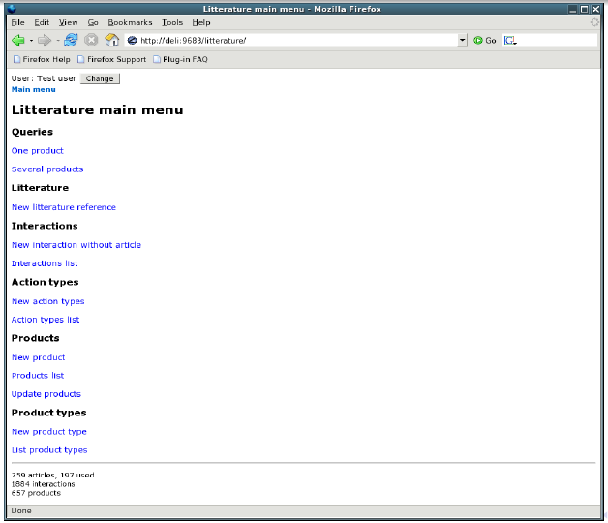
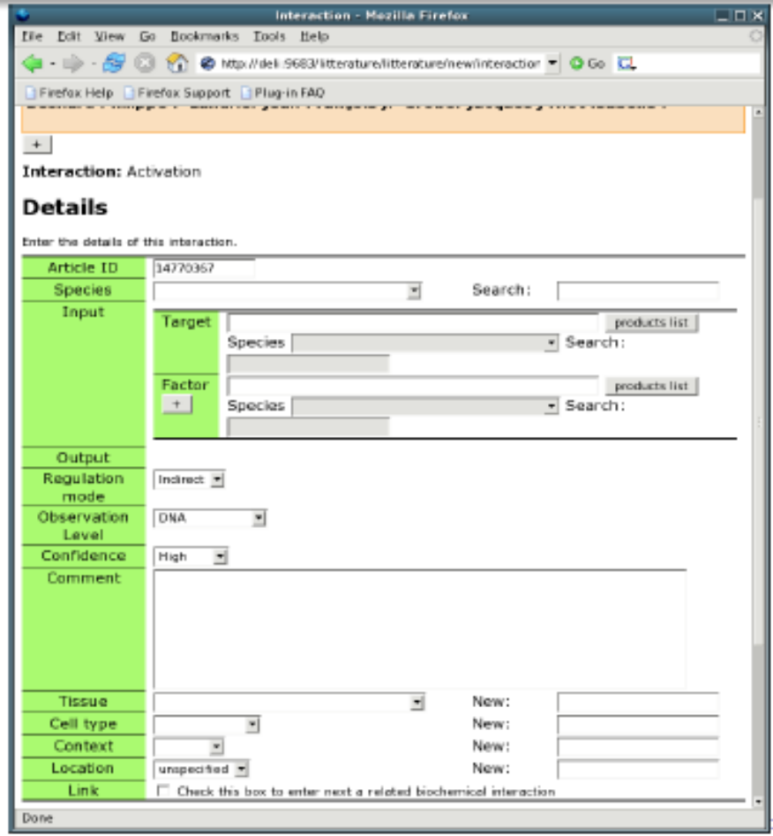
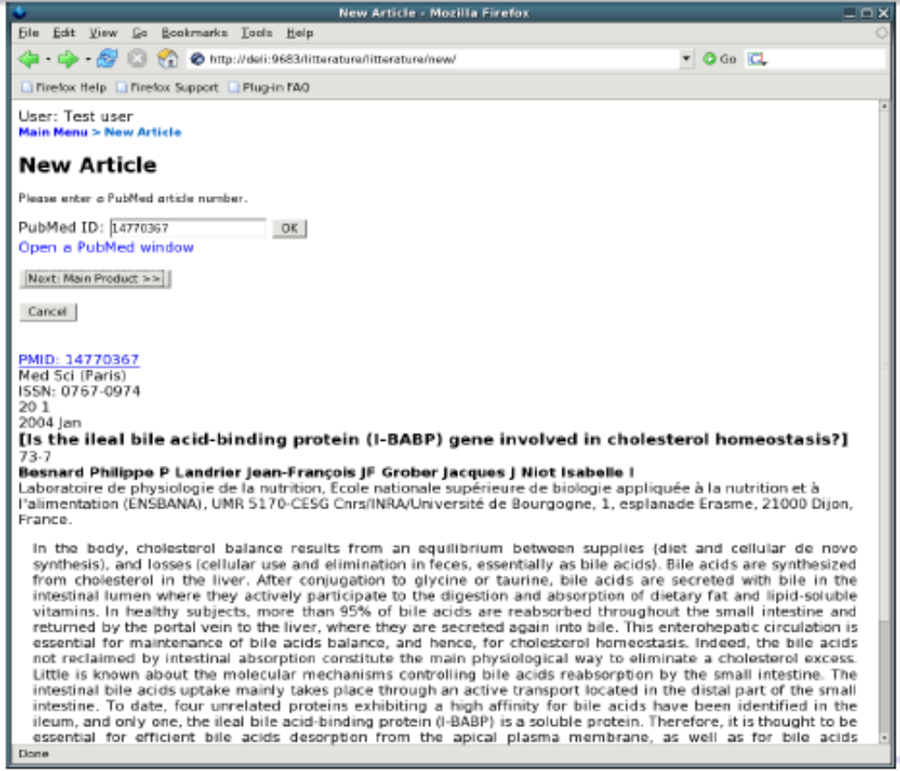
Gardon: knowledge data base

Slide 15

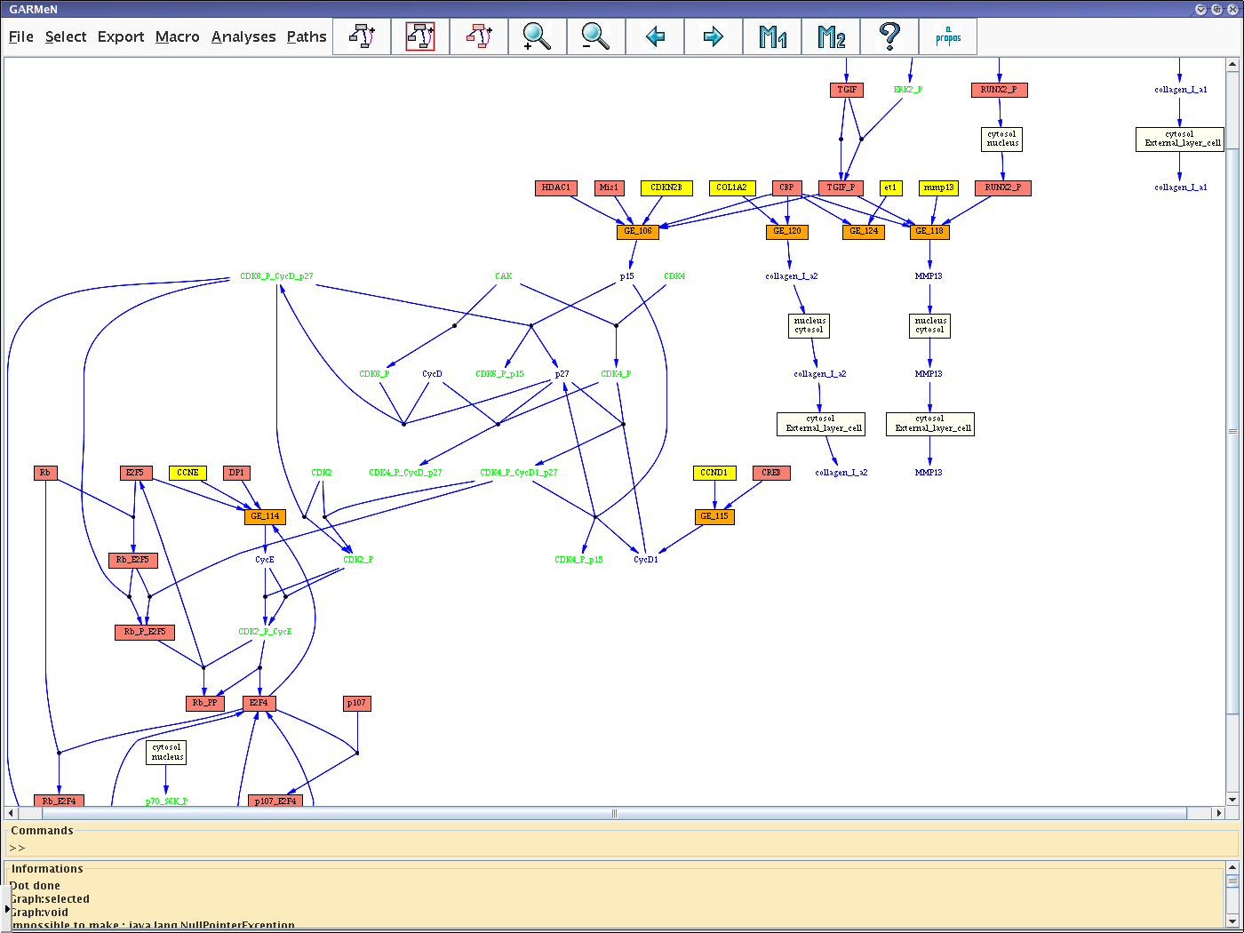
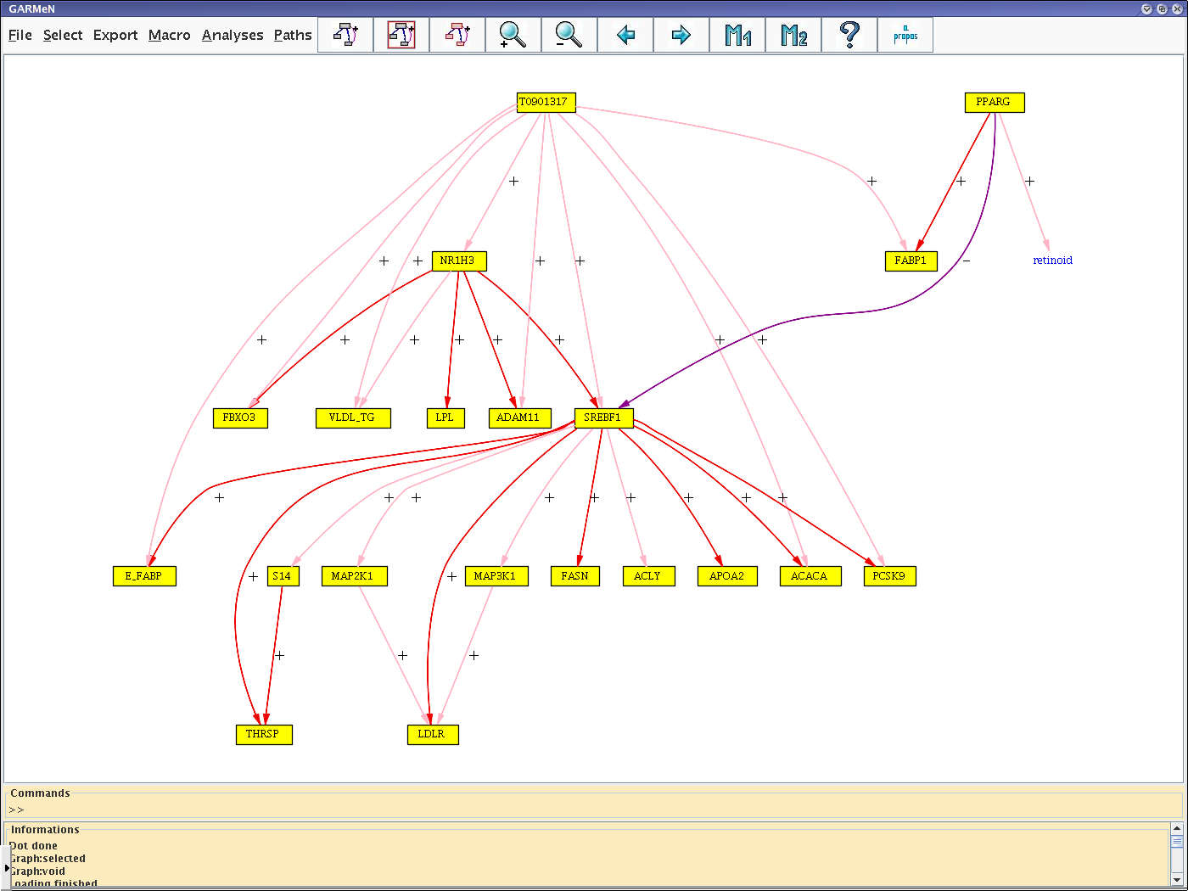
GARMeN: modeling support

Slide 16
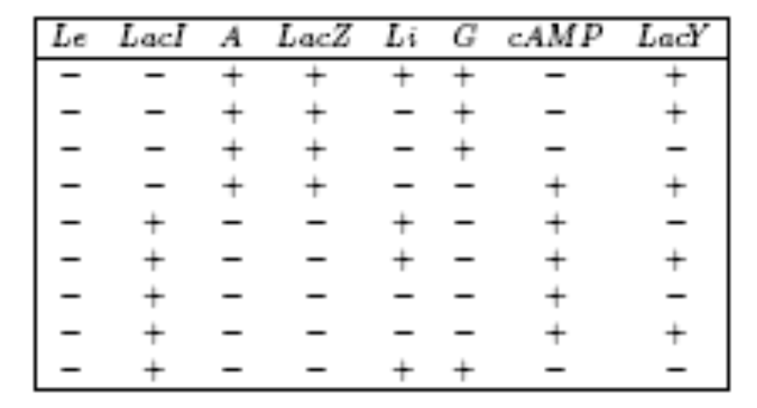
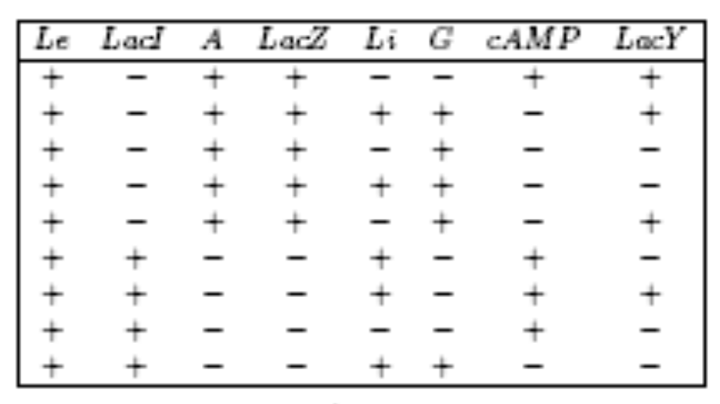
Experiment design
256 valuations, only 18 solutions of qualitative equations
many valuations are inconsistent with the model
use data to invalidate or validate model

Slide 17
Invalidate
+
+

Slide 18
Invalidate
+
-
+

Slide 19
Validation power
Any value of the triplet
(Le,G,A) can be extended
to a solution
These variables have no
validation power

Slide 20
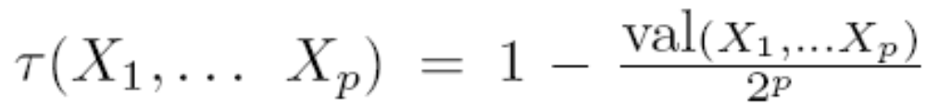
Validation power
Only 2 values (out of 8) of
(LacI,A,LacZ), namely
(+,−, −) (−, +,+) can be extended
to a solution

Slide 21
Predictive power
Given (X1,X2,…,Xr,P) a number H(X1,X2,…,Xr,P) of variables (hard components) can be predicted.
PP(1,2,…,r)= max H(X1,X2,…,Xr,P) / N
size of the sphere of influence
+
+
+

Slide 22
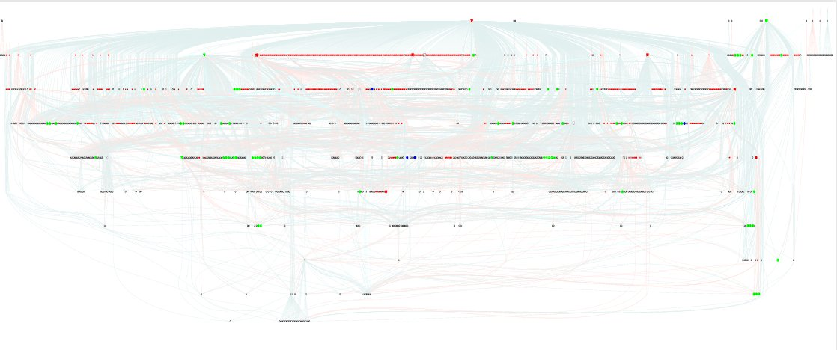
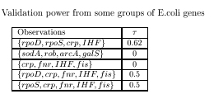
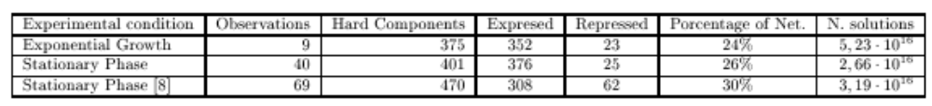
Transcriptional network of E.Coli
1258 nodes 2526 interactions
Without sigma-factors the network is incompatible
microarray data (Guttierez-Rios et al 2006) not compatible with model,
it becomes compatible after 6 corrections {xthA,cfa,gor,cpxR,crp,glpR}

Slide 23
Conclusions
Tools for qualitative modeling of data
Model validation, model correction, experiment design
sequential reverse engineering Comparison1> Correction1>Comparison2 …
Include heterogeneous data
CGH arrays,
clinical samples
Transcriptome data
Time series, clinical samples
MicroRNA expression
ChIP-CHIP data
EWS/FLI1

Slide 24
Acknowledgements
Anne Siegel, Michel Le Borgne, Philippe Veber, projet Symbiose, IRISA Rennes
E.Coli example Carito Vargas

