Slide 1
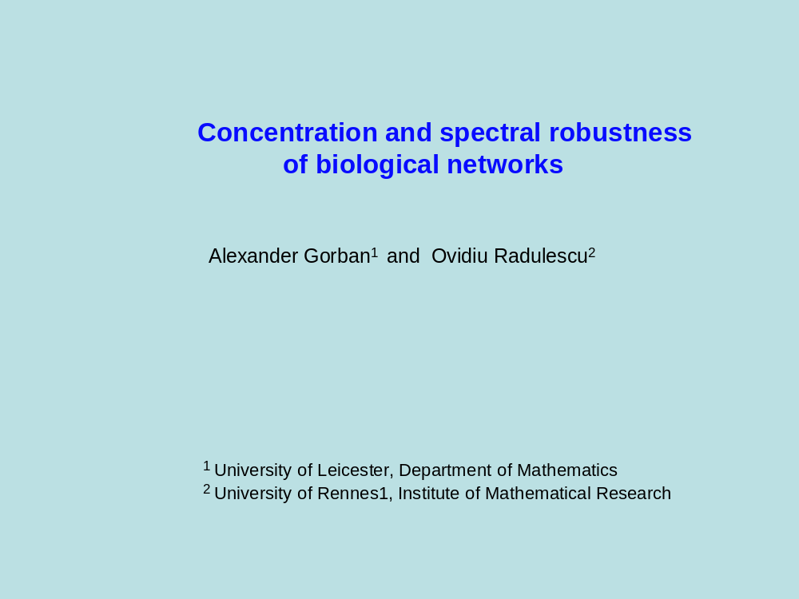

Slide 2
Robustness
Robustness = reduced variability, structural stability, small
sensitivity with respect to changes of parameters
Robustness with respect to variations of the constants
Dynamical system dX/dt = F(X,C).
Trajectory X=Ψ(t,C,X0)
There are properties of the trajectory that are robust
with respect variations of the constants C.
Let P = φ (C1,C2,…,Cn) be such a property.

Slide 3
Two types of robustness
Robustness with respect to distributed attacks:
random, independent changes of C_{i} produce small changes of P:
Var(P) << Var(C_{i})
Robustness with respect to concentrated (terrorist) attacks:
varying a small number of constants Ci while keeping all the
other constant does not produce a significative change of P
I= {1,2,…,n}, for all I0 ⊂ I , # I0 << n,
Var[ φ (C1,C2,…,Cn) | I \ I0 ] << Var(Ci)

Slide 4
Some properties of biological networks are robust
von Dassow 2000: "segment polarity network is robust"
u(x,t) pattern can be seen as a vector X in an infinite dimensional space
dX/dt = F(X,C)
X(0) = X0

Slide 5
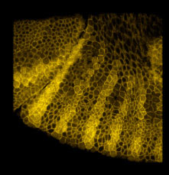
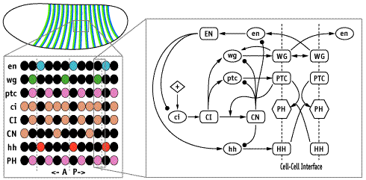

Slide 6
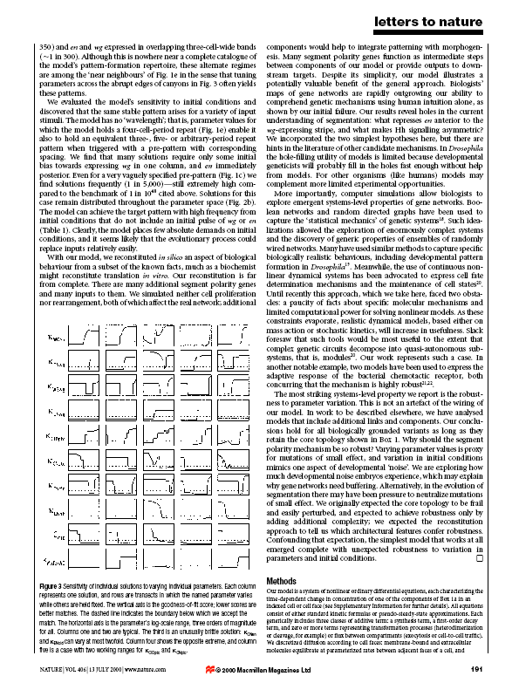

Slide 7
Comment
What you saw is robustness with respect to concentrated attacks (change
of one parameter only, while the others are kept fixed).
the robust property P is the goodness of fit score between unperturbed and
perturbed patterns.
Von Dassow also illustrated the robustness with respect
to distributed attacks

Slide 8
Robustness and concentration effects
Consider Ci i.i.d. random variables
Which generic properties are robust properties?
The law of large numbers tells us that the mean is robust
Var [ ∑Ci / n] = Var[Ci] / n → 0

Slide 9
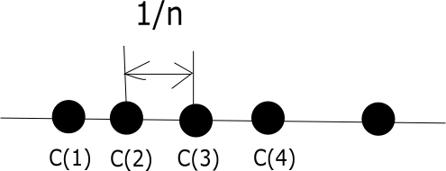
Order statistics
C1,C2, … , Cn are i.i.d. random variables
Order the variables
C(1) < C(2) < … < C(n)
Var[C(i)] ~ 1/n² if i < i0 or i > n-i0
Var[C(i)] ~ 1/n if i ~ n
for instance for i = [n/2] we have the median property Var[M] ~ 1/n
By ordering we loose randomness

Slide 10
Geometrical theory of concentration
(after Misha Gromov: Metric Structures for Riemannian and
Non-Riemannian Spaces)
Concentration effects: an unknown object is observed via functions
defined on it. We speak of concentration when the object thus
observed appears much smaller than it is in reality.
Concentration generalizes the law of large number asking only the fact
that one atom contributes little to the observed function.

Slide 11
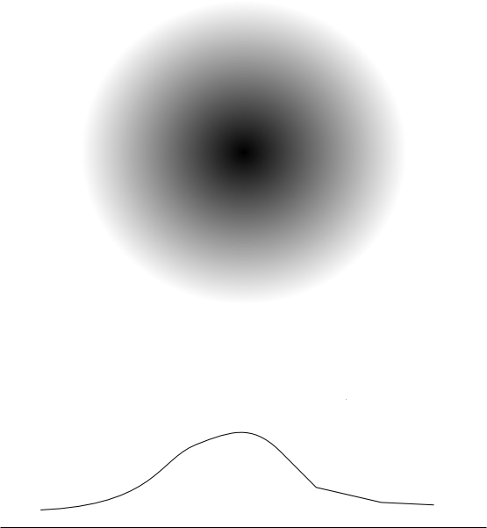
Concentration of a uniformly filled sphere

Slide 12
Paul Lévy:
any 1-lipschitzian function f (|f(x)-f(y)|< |x-y|)
defined on Sn is concentrated in a region of size 1/√n
near its average.
2) Cube concentration
projection of the hypercube [0,1]^{n} uniformly filled on its
diagonal (of length √n)
(x1,x2,…,xn) → x1+x2+… + xn
is concentrated near the center (1/2,…,1/2) in a
region of size √n : law of large numbers
3) Simplex concentrations
0 < x1 < x2 < …< xn < 1
ξ_{i} = x _{i+1} – x _{i} are in a simplex ∑ ξ_{i} = 1
The concentration property or order statistics can be seen
as the effect of concentration in a simplex: the mass of a
simplex concentrates near its center (1/n,1/n,…,1/n)

Slide 13
Linear chemical kinetics
Linear chemical mechanisms: all the reactions have the following
form:
Ai → Aj
order kinetic constants in decreasing order:
k1 < k2 < … < kq
Kinetic equation dC/dt=KC, C is the concentration vector.
Trajectory C(t) = exp(Kt) C0

Slide 14
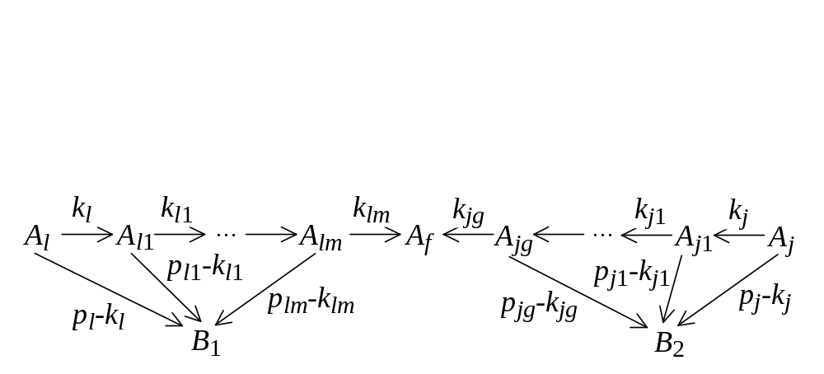
Linear chemical kinetics
Definition: A linear network is weakly ergodic, if for any initial state
C0, exp(Kt) C0 tends to limit states in a one-dimensional subspace.
Property:
A linear network is weakly ergodic, iff for each two vertices
Ai, Aj (i ≠ j) we can find such a vertex Ak such that oriented paths
exist from Ai to Ak and from Aj to Ak. One of these paths can be
degenerated: it might be i=k or j=k.

Slide 15
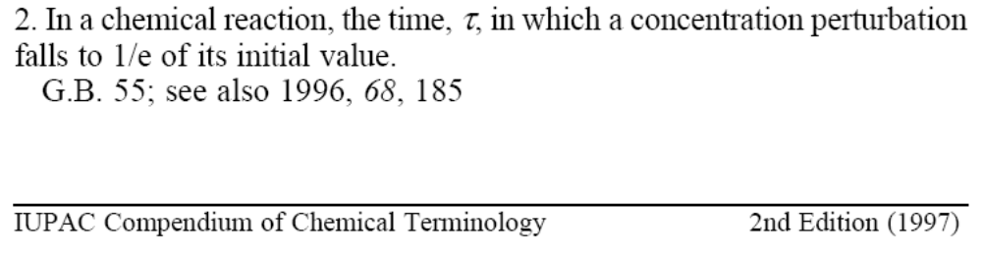
RELAXATION TIME

Slide 16
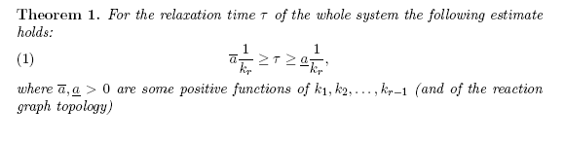
Ergodicity boundary and relaxation time for networks with
well separated timescales
Well separated time scales : k1 << k2 << … <<kn
Let us eliminate reactions one by one, begining with the slowest.
The ergodicity boundary kr is the constant of the first reaction whose elimination breaks down the ergodicity.

Slide 17
K2
>
K1
<
K3
A
B
C
D
Limiting step rule for chains: the slowest reaction
controls the relaxation time

Slide 18
K1<K2<K3<K4<K5
K3
B
C
K2
K1
A
D
K4
K5
E
Cycle rule: the second slowest reaction
controls the relaxation time

Slide 19
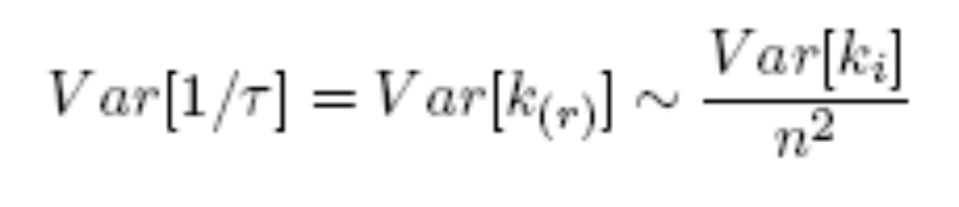
Consequence 1
Robustness with respect to distributed attacks.
Suppose are i.i.d.
Order them
Order statistics (simplex) concentration effect:

Slide 20
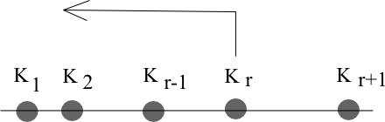
Consequence 2
Robustness with respect to concentrated attacks (r-fold redundancy)
Decrease constants.
Decreasing ki, i < r has no effect
Decreasing kr increases relaxation time up to 1/kr-1 then no effect.
Decreasing ki, i > r no effect unless kr-1 < ki < kr
The only way to increase relaxation time indefinitely is to coordinately decrease of all slowest r constants.

Slide 21
GENE NETWORK
NF-κB factor
Receptors
Gene A
Gene B
Gene C

Slide 22
GENE NETWORK
NF-κB factor
SIGNALS
Receptors
Signaling
pathways
Gène A
Gène B
Gène C

Slide 23
GENE NETWORK
NF-κB factor
SIGNALS
Receptors
Signaling
pathways
Gène A
Gène B
Gène C

Slide 24
GENE NETWORK
NF-κB factor
Receptors
Gène A
Gène B
Gène C

Slide 25
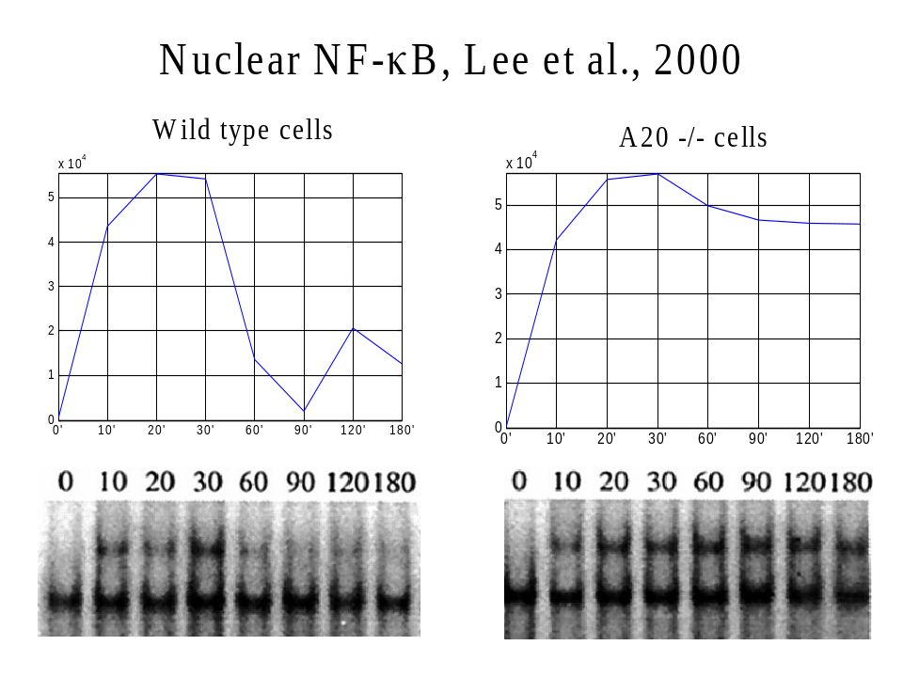

Slide 26
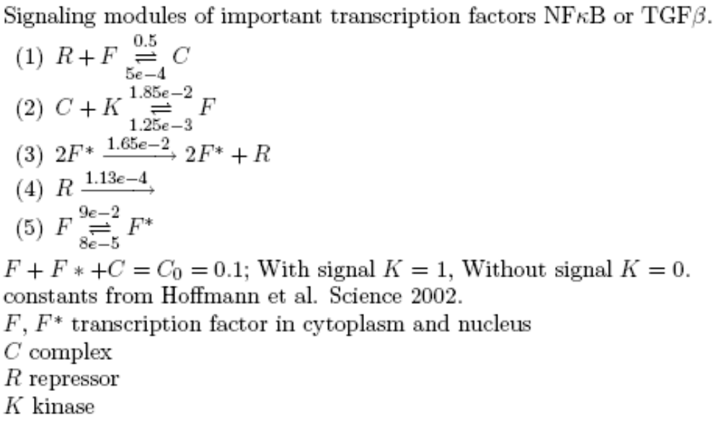

Slide 27
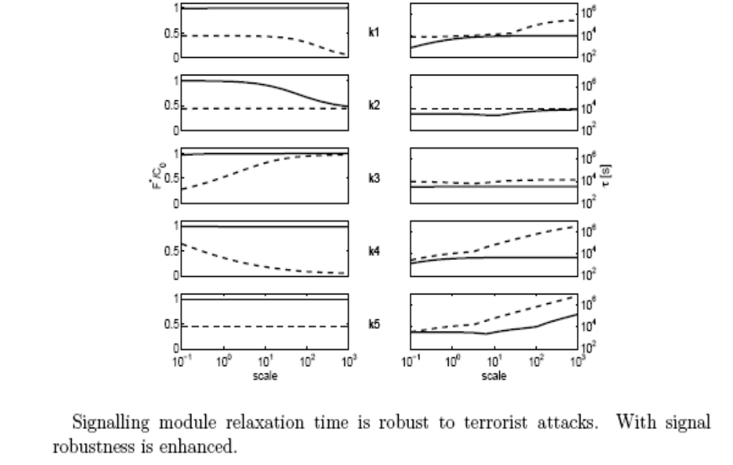

Slide 28
CONCLUSIONS
the relaxation time of linear networks of chemical reactions is robust,
both with respect to distributed and concentrated attacks.
this is concentration phenomenon
similar phenomena are valid for nonlinear networks,
mathematical justification still needed
proof for pattern formation in Drosophila, in progress
Lévy/Milman/Gromov/Talagrand concentration as a unifying principle:
Number matters!

