Slide 1
Interfaces and shear banding
Ovidiu Radulescu
Institute of Mathematical Research of Rennes, FRANCE
Notes:
Questions de jacques:
hierarchies
Difficultés de la biologie systemique
Commenter sur correction de modele et predictions

Slide 2
Summary
PAST RESULTS (98-02)
shear banding of thinning wormlike micelles
some rigorous results on interfaces
importance of diffusion
timescales
experiment
FUTURE?

Slide 3
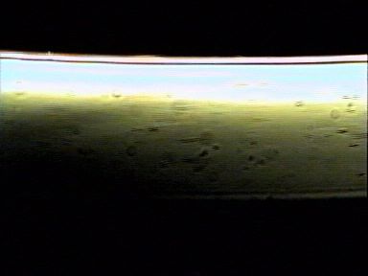
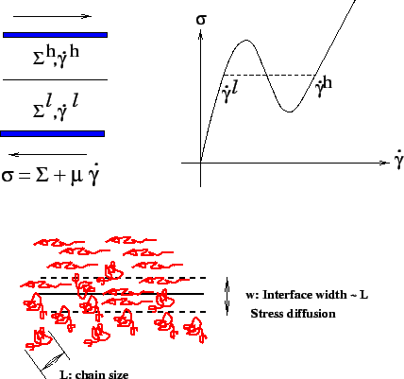
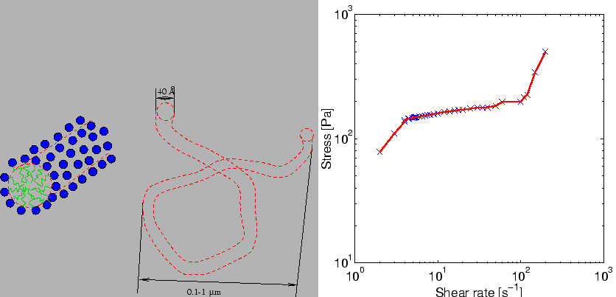
SHEAR BANDING OF THINNING WORMLIKE MICELLES
Hadamard Instability

Slide 4
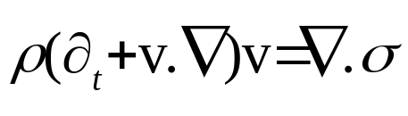
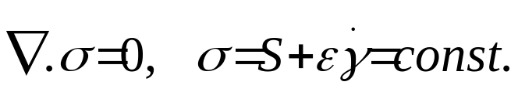
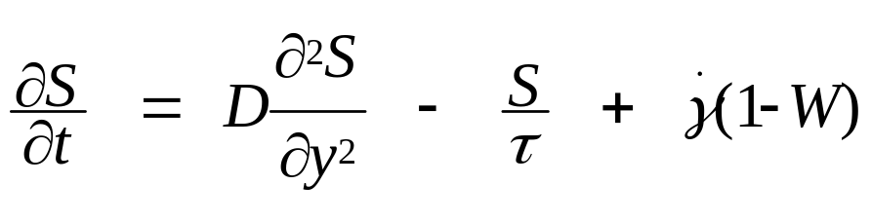
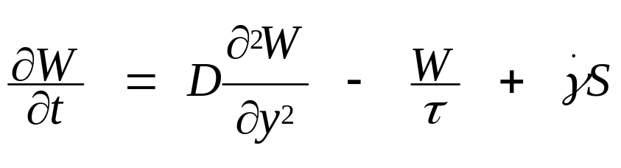
Model: Fluid-structure coupling
Navier-Stokes
Johnson-Segalman constitutive model + stress diffusion
Re=0 approximation
principal flow equations
Stress dynamics is described by a reaction-diffusion system
reaction term is bistable

Slide 5
Is D important?

Slide 6
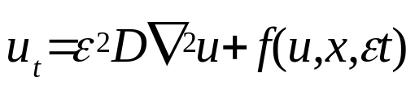
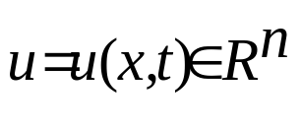
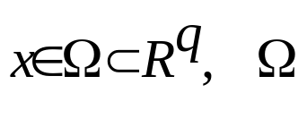

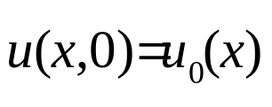

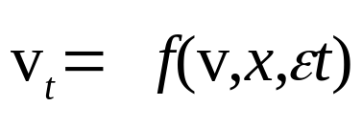
Some asymptotic results for R-D PDE
Cauchy problem for the PDE system
is compact with smooth frontier
initial data
no flux boundary conditions
idea : consider the following shorted equation

Slide 7
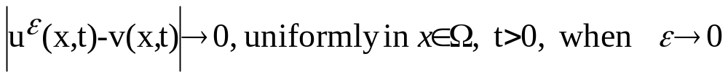
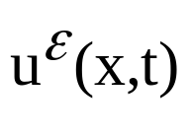
Classification of patterning mechanisms
Patterning is diffusion neutral if for vanishing diffusion, the solution of the full system converges uniformly to the solution of the shorted equation
solution of the full system
v(x,t) solution of the shorted equation
If not, patterning is diffusion dependent

Slide 8
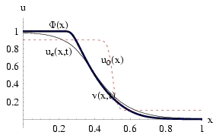

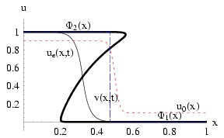
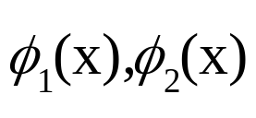
Classification of interfaces
Type 1 interface
For a given x, the shorted equation has only one attractor
Patterning with type 1 interfaces is diffusion neutral
Type 2 interface
For a given x, the shorted equation has several attractors, here 2:
Patterning with type 2 interfaces is diffusion dependent
The width of type 2 interfaces can be arbitrarily small

Slide 9

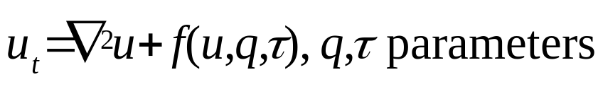
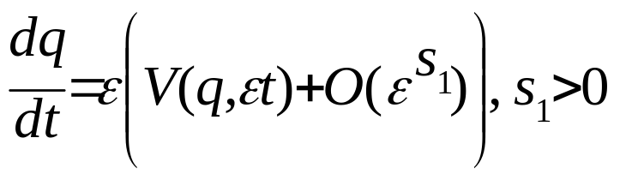

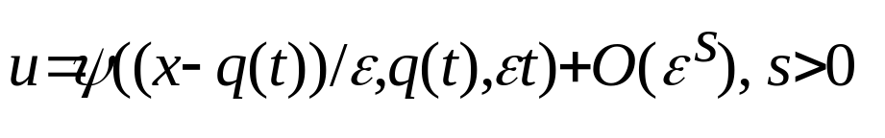
Theorem on type II interfaces in the bistable case
Invariant manifold decomposition for
Travelling wave solution
for the space homogeneous eq.
Equation for the position q(t)
of the interface
The solution of space inhomogeneous equation is of the moving interface type
Equilibrium is for discrete, eventually unique positions : pattern selection
The velocity of a type II interface is proportional to the square root of the
diffusion coefficient: evolution towards equilibrium is slow

Slide 10


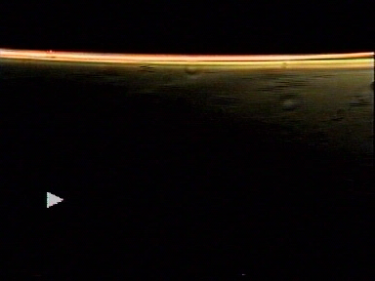
Stress diffusion and step-shear rate transients
10s⁻¹
30s⁻¹
summer 98 , Montpellier, 02 Le Mans

Slide 11
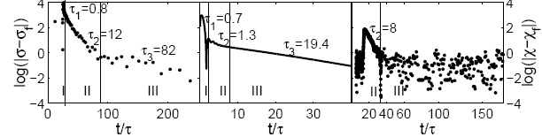
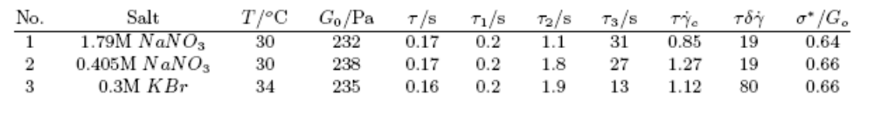
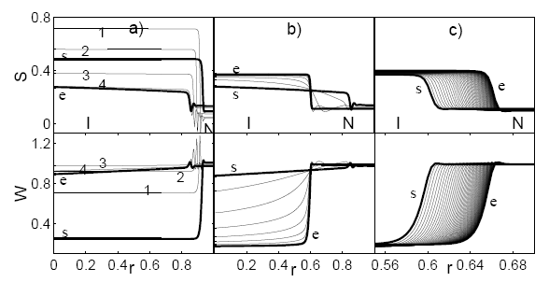
Three time scales

Slide 12
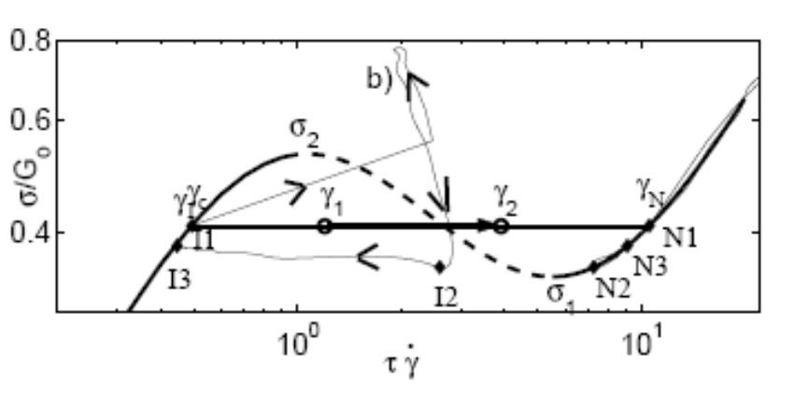
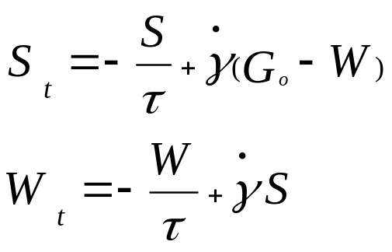
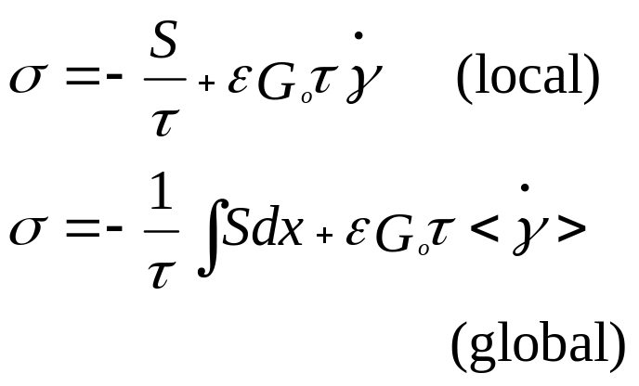
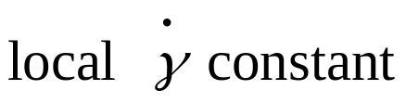
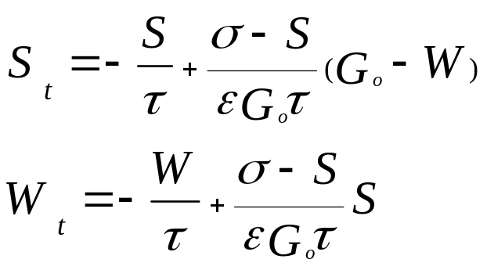

Shorted dynamics at imposed shear: multiple choices
Shorted equation
Constraints at imposed shear

Slide 13
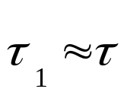
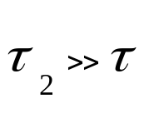
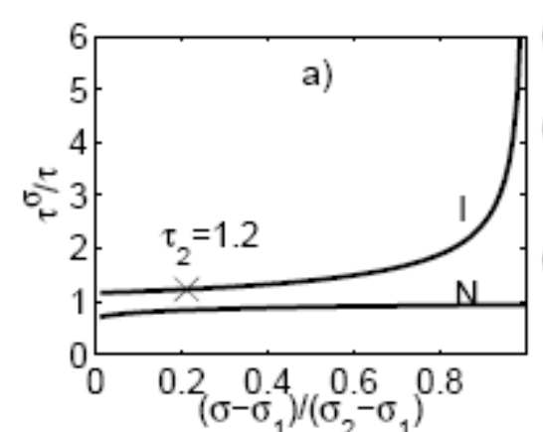
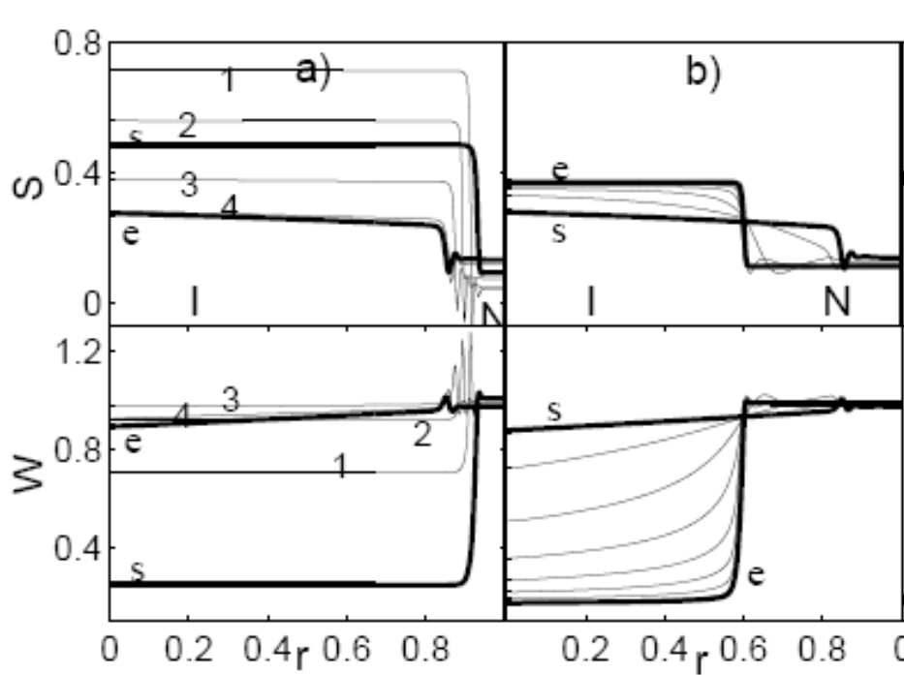
First and second time scale
The second time scale is
critical retardation
Isotropic band dynamics
is limiting

Slide 14
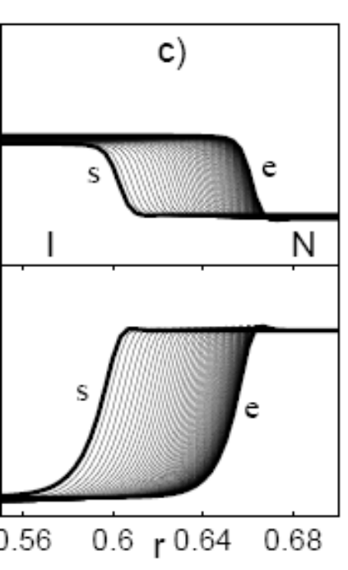
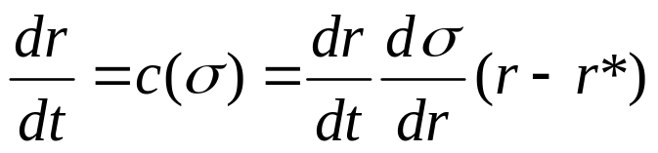
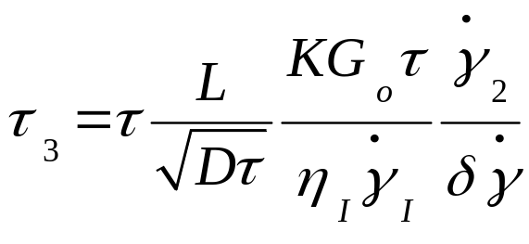
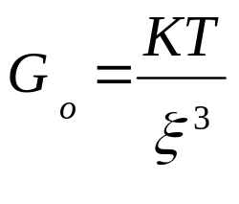
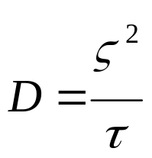
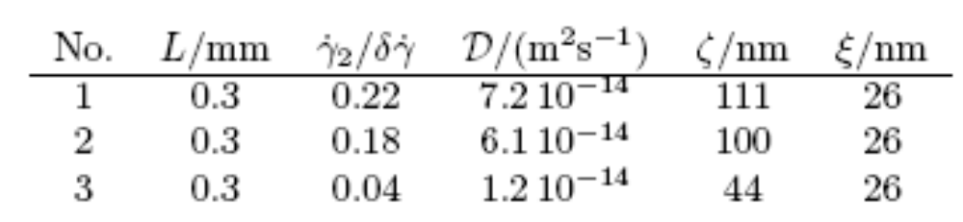
Third time scale
Stress correlation length ζ
Mesh size ξ

Slide 15
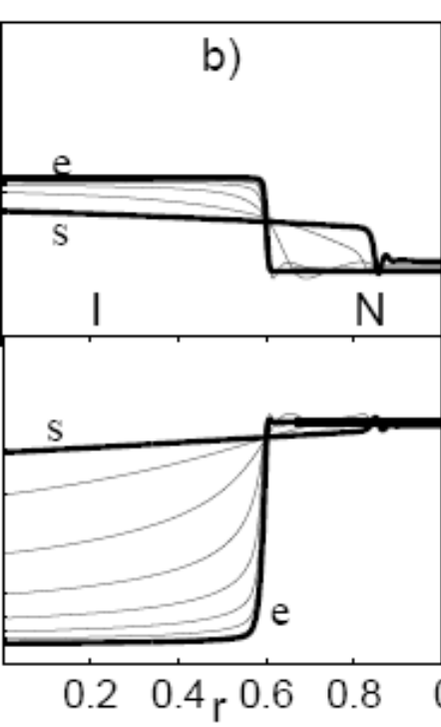
Is D important?
D is small but at long times ensures pattern selection
Dynamical selection is not excluded

Slide 16
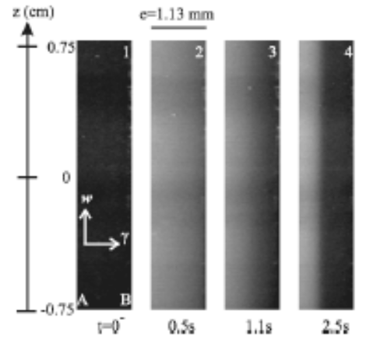
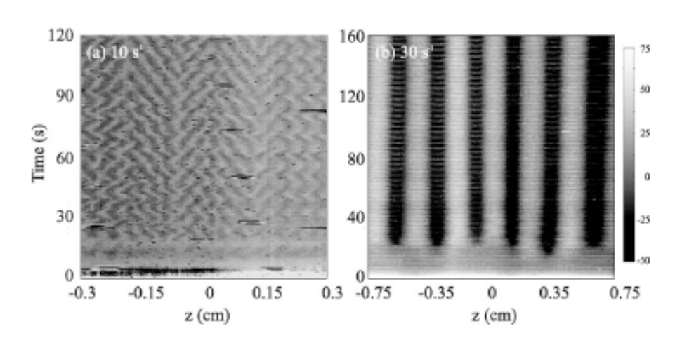
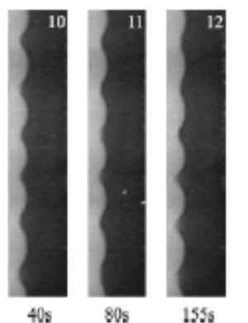
Is there a future for interfaces?
2D and 3D instabilities : one route to chaos
amplitude equations for the interface deformation Kuramoto-Sivanshinsky (Lerouge, Argentina, Decruppe 06)
primary instability: lamelar phase (periodic ondulation)
lamellar to chaotic transition
secondary instability: breathing modes ?
first order type, coexistence? (Chaté, Manneville 88)
what about the role of diffusion in this case? Coarse graining?

Slide 17
Is there a future for interfaces?
Kink-kink interactions: second route to chaos?
collisions, radiation effects, destroy kinks
although weak interaction lead to ODEs that may sustain chaos, analytical proofs are difficult
strong interaction, even more difficult; negative feed-back + delay = sustained oscillations, pass from interacting kinks to coupled oscillators
possible route to chaos?
chaos in RD equations
scalar : no chaos
vectorial : GL compo + diffusive compo
(Cates 03, Fielding 03)

Slide 18
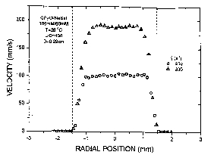
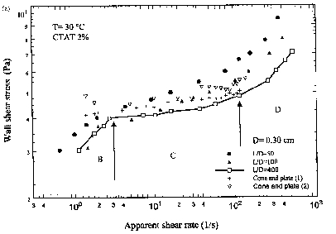
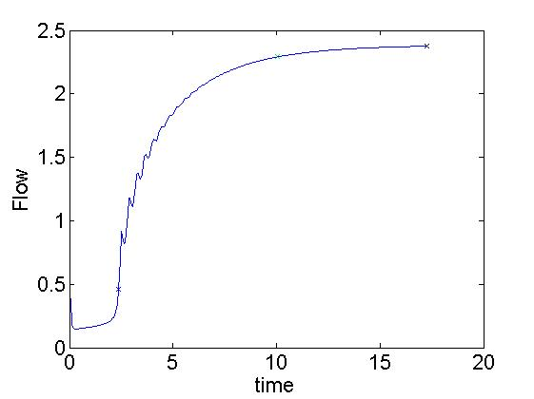
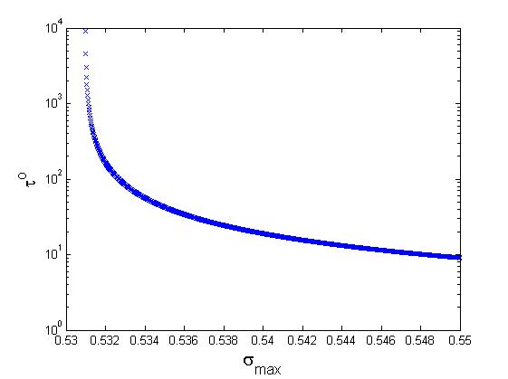
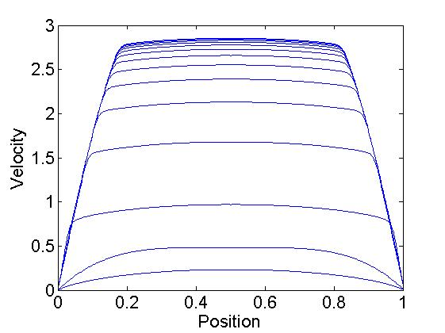
CRITICAL RETARDATION IN POISEUILLE FLOW
EXPERIMENTS
Velocity profile by PIV (Mendez-Sanchez 03)
Flow curves depend on residence time
THEORY
Velocity profile
Critical retardation
Spurt

Slide 19
Conclusion
Generic aspects of shear banding could be explained by interface models
Diffuse interfaces ensure pattern selection, but dynamical selection should not be excluded
Possible routes to chaos via interfaces: front instability, kink interactions
Critical retardation is a generic property of bistable systems which deserves more study

Slide 20
Aknowledgements
P.D. Olmsted (U. Leeds)
S.Lerouge (U. Paris 7), J-P. Decruppe (U. Metz)
J-F. Berret (CNRS), G. Porte (U. Montpellier 2)
S.Vakulenko (Institute of Print, St. Petersburg)

