Slide 1

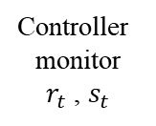
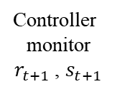




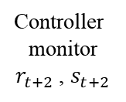


Controller
monitor
$r_{t}$ , $s_{t}$
Controller
monitor
$r_{t+1}$ , $s_{t+1}$
Controller
monitor
$r_{t+2}$ , $s_{t+2}$
monitoring period
Control delay
Controller
deploy $a_{t−1}$
Controller
deploy $a_{t}$
Controller
deploy $a_{t+1}$
STRIDE output
$$a_{t}$$
STRIDE output
$$a_{t+1}$$
STRIDE output
$$a_{t+2}$$
Delay-corrected tuple： $$(s_{t}, a_{t−1}, r_{t+1}, s_{t+1})$$

