Slide 1
Automated Music Genre Classification Using Spotify Audio Features
An Interpretable Statistical Analysis

Slide 2
Introduction
Music streaming platforms rely on genre labels
Genre labels support recommendations and discovery
Manual labeling is inconsistent and difficult to scale
Many genres overlap in sound characteristics

Slide 3
Research Question & Hypothesis
Can audio features be used to classify music genres?
Focus on 20 widely recognized genres
Hypothesis:
Spotify audio features significantly influence genre classification

Slide 4
Data Overview
Spotify audio features dataset
~114,000 tracks across 114 genres
Balanced subset:
  20 genres
  20,000 tracks total

Slide 5
Audio Features Used
Tempo and loudness
Energy and danceability
Valence (emotional tone)
Acousticness and instrumentalness
Speechiness and liveness

Slide 6
Analysis Approach
Data preparation and standardization
Multinomial logistic regression
Interpretable statistical classification model

Slide 7
Model Evaluation
Likelihood ratio testing
McFadden’s pseudo-R²
Classification accuracy

Slide 8
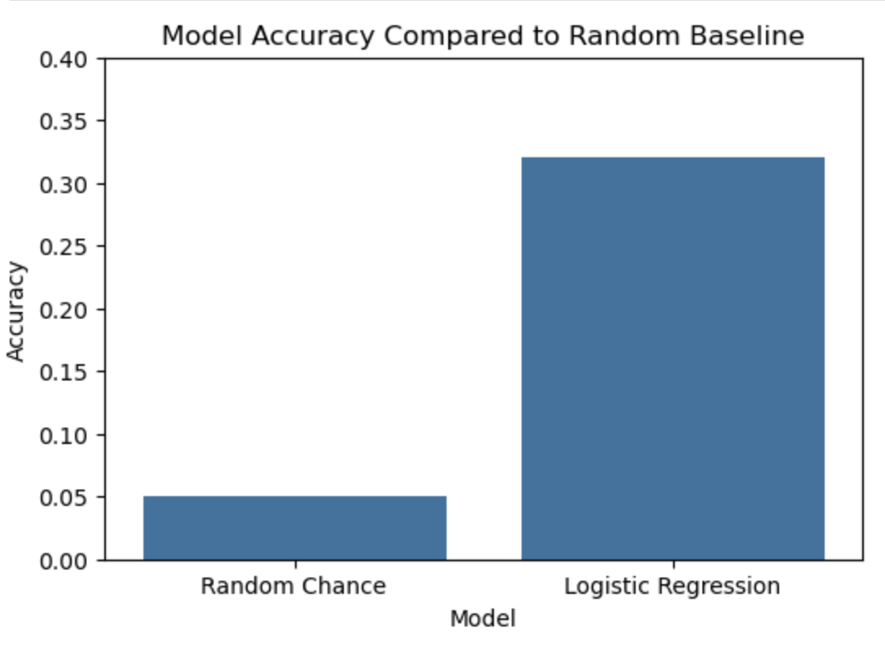
Model Performance (Optional Visual Slide)
Model Accuracy Comparison
Logistic regression accuracy ≈ 32%
Random guessing ≈ 5%
More than 6× better than chance

Slide 9
Genre-Level Results
Higher performance:
  Classical
  Opera
  Death metal
Lower performance:
  Pop
  Rock
  Alternative
  Soul

Slide 10
Key Feature Insights
Most influential features:
  Acousticness
  Valence
  Danceability
  Loudness
Tempo and liveness less consistent

Slide 11
Limitations
Overlap between music genres
Subjective genre labeling
Linear assumptions of logistic regression

Slide 12
Proposed Actions
Use logistic regression as a baseline model
Integrate into broader modeling pipelines
Inform development of advanced ML models

Slide 13
Expected Benefits
Meaningful improvement over random guessing
Better recommendations and content discovery
Explainable insights for business stakeholders

Slide 14
Conclusion
Audio features provide useful genre signal
Interpretable models add analytical value
Clear path for future improvement

Slide 15
Thank You
Thank you
Questions?

