Slide 1
רעיון עקרוני
The HR management software provides a centralized platform that enables easy and efficient access to employee data, allowing HR professionals to manage employee records, job descriptions, salaries, benefits, and other HR-related information. This software helps to reduce manual paperwork, minimize errors, and enhance the overall efficiency of HR processes.

Slide 2
Entities
Employee – name, ID, job title, team(fk), skills(fk), certifications,day start,day end,rank(fk), salary(fk).
Job – job id ,job title, job description, required skills(fk), qualifications, and experience.
Skills- skill_id , skill_name.
Personality-id, personality_id, personality_name.
team – team id, team name , departmentID(fk).
Department – departmentID, department_name.
pay check - pay checkID, month,pay_rank,salary,start_day,employeeID(fk)
Candidates: id ,name ,interview id(fk),skill(fk),job(id)
Interview- id, employee name(fk),candidate(fk),description.
Status-id,answer

Slide 3
ERD

Slide 4
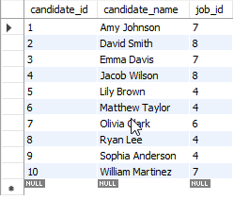
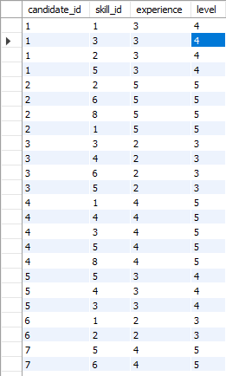
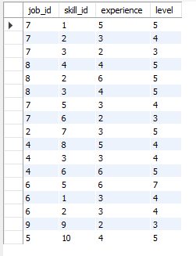
Flow of query num?

Slide 5
Flow of trigger num?

Slide 6
Flow of function num?

Slide 7
Flow of function num?

Slide 8
Flow of function num?

