Slide 1
some tips for CNN constructing
super orange
2020/10/4

Slide 2
algorithm
size of output(convolution/pooling)

Slide 3

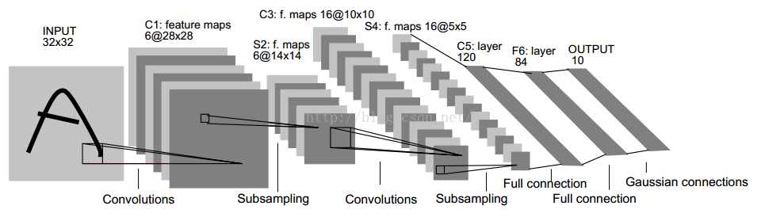
模型参数的计算（LeNet为例）
卷积核是有厚度的
C1层是一个卷积层，由6个特征图Feature Map构成。特征图中每个神经元与输入为5*5的邻域相连。特征图的大小为28*28，这样能防止输入的连接掉到边界之外（32-5+1=28）。C1有156个可训练参数（每个滤波器5*5=25个unit参数和一个bias参数，一共6个滤波器，共(5*5+1)*6=156个参数），共156*(28*28)=122,304个连接。
C3层也是一个卷积层，它同样通过5x5的卷积核去卷积层S2，然后得到的特征map就只有10x10个神经元，但是它有16种不同的卷积核，所以就存在16个特征map了。 C3中每个特征图由S2中所有6个或者几个特征map组合而成。为什么不把S2中的每个特征图连接到每个C3的特征图呢？原因有2点。第一，不完全的连接机制将连接的数量保持在合理的范围内。第二，也是最重要的，其破坏了网络的对称性。由于不同的特征图有不同的输入，所以迫使他们抽取不同的特征（希望是互补的）。
C5层是一个卷积层，有120个特征图。每个单元与S4层的全部16个单元的5*5邻域相连。由于S4层特征图的大小也为5*5（同滤波器一样），故C5特征图的大小为1*1（5-5+1=1）：这构成了S4和C5之间的全连接。之所以仍将C5标示为卷积层而非全相联层，是因为如果LeNet-5的输入变大，而其他的保持不变，那么此时特征图的维数就会比1*1大。C5层有48120（120*（16*5*5+1）=48120由于与全部16个单元相连，故只加一个偏置）个可训练连接。

Slide 4
construction of your CNN
layer_name | kernel_size | kernel_num | padding | strike | activation | output

Slide 5
important functions（tensorflow.keras）
from keras import layers,models,Model,Sequential
输入图片
input_image=layers.Input(shape=(input_height,input_width,3),dtype='float32')
设置padding
x=layers.ZeroPadding2D(((1,2),(1,2)))(input_image)
卷积层
x=layers.Conv2D(filters=48,kernel_size=11,strikes=4,activation="relu")(x)
池化层
x=layers.MaxPool2D(pool_size=3,strikes=2)(x)

Slide 6
important functions（tensorflow.keras）
拉成一维向量
x=layers.Flatten()(x)
随机失活神经元
x=layers.Dropout(0.2)(x)
全连接层
x=layers.Dense(2048,activation="relu")(x)
输出预测结果
predict=layers.Softmax()(x)
建立模型
model=models.Model(inputs=input_image,outputs=predict)

Slide 8
important functions(torch.nn)
import torch.nn as nn
import torch
卷积层
nn.Conv2d(3, 48, kernel_size=11, stride=4, padding=2)
ReLU函数
nn.ReLU(inplace=True)
最大池化
nn.MaxPool2d(kernel_size=3, stride=2)

Slide 9
important functions(torch.nn)
dropout随机失活神经元
nn.Dropout(p=0.5)
全连接层
nn.Linear(128 * 6 * 6, 2048)
拉成一维向量
x=torch.flatten(x,start_dim=1)

Slide 10
Alex-net
input | layer_name | kernel_size | kernel_num | padding | strike | activation | output
(224,224,3) | Conv_1 | 11 | 48*2 | [1,2] | 4 | relu | (55,55,48)
(55,55,48) | Max_pool | 3 | None | 0 | 2 | None | (27,27,48)
(27,27,48) | Conv_2 | 5 | 128*2 | [2,2] | 1 | relu | (27,27,128)
(27,27,128) | Max_pool | 3 | None | 0 | 2 | None | (13,13,128)
(13,13,128) | Conv_3 | 3 | 192*2 | [1,1] | 1 | relu | (13,13,192)
(13,13,192) | Conv_4 | 3 | 192*2 | [1,1] | 1 | relu | (13,13,192)
(13,13,192) | Conv_5 | 3 | 128*2 | [1,1] | 1 | relu | (13,13,128)
(13,13,128) | Max_pool | 3 | None | 0 | 2 | None | (6,6,128)
拉成一维向量
(6*6*128) | FC1 | 2048 | None | None | None | None | (None,2048)
(None,2048) | FC2 | 2048 | None | None | None | None | (None,2048)
(None,2048) | FC3 | 1000 | None | None | None | None | (None,1000)

Slide 11
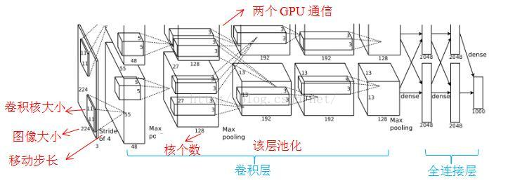
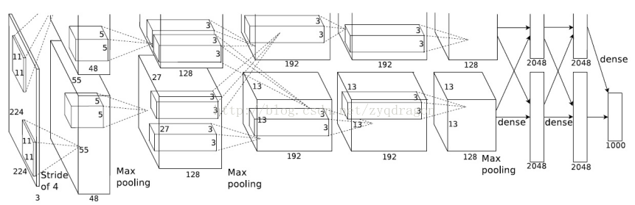

Slide 12
Alex-net-tensorflow
from keras import layers,models,Model,Sequential
#Sequential: following a particular order
#-----------------------------------------------Alex-net
def AlexNet(input_height=224,input_width=224,class_num=1000):
input_image=layers.Input(shape=(input_height,input_width,3),dtype='float32') #output(None,224,224,3)
x=layers.ZeroPadding2D(((1,2),(1,2)))(input_image) #output(None,227,227,3)
x=layers.Conv2D(filters=48,kernel_size=11,strikes=4,activation="relu")(x) #output(None,55,55,48)
x=layers.MaxPool2D(pool_size=3,strikes=2)(x) #output(None,27,27,48)
#padding设置为SAME，则说明输入图片大小和输出图片大小是一致的
x=layers.Conv2D(filters=128,kernel_size=5,strikes=1,activation="relu")(x) #output(None,27,27,128)
x=layers.MaxPool2D(pool_size=3,strikes=2)(x) #output(None,13,13,128)
x=layers.Conv2D(filters=192,kernel_size=3,strikes=1,activation="relu")(x) #output(None,13,13,192)
x=layers.Conv2D(filters=192,kernel_size=3,strikes=1,activation="relu")(x) #output(None,13,13,192)
x=layers.Conv2D(filters=128,kernel_size=3,strikes=1,activation="relu")(x) #output(None,13,13,128)
x=layers.MaxPool2D(pool_size=3,strikes=2)(x) #output(None,6,6,128)
x=layers.Flatten()(x) #拉成一维向量6*6*128
x=layers.Dropout(0.2)(x) #随机失活函数，比例0.2
x=layers.Dense(2048,activation="relu")(x) #output 1*2048
x=layers.Dropout(0.2)(x)
x=layers.Dense(2048,activation="relu")(x) #output 1*2048
x=layers.Dense(class_num)(x) #output 1*class_num
predict=layers.Softmax()(x)
model=models.Model(inputs=input_image,outputs=predict)
return model

Slide 13
Alex-net-pytorch
class AlexNet(nn.Module):
def __init__(self, num_classes=1000, init_weights=False):
super(AlexNet,self).__init__()
self.features=nn.Sequential(
nn.Conv2d(3, 48, kernel_size=11, stride=4, padding=2), # input[3, 224, 224] output[48, 55, 55]
nn.ReLU(inplace=True),
nn.MaxPool2d(kernel_size=3, stride=2), # output[48, 27, 27]
nn.Conv2d(48, 128, kernel_size=5, padding=2), # output[128, 27, 27]
nn.ReLU(inplace=True),
nn.MaxPool2d(kernel_size=3, stride=2), # output[128, 13, 13]
nn.Conv2d(128, 192, kernel_size=3, padding=1), # output[192, 13, 13]
nn.ReLU(inplace=True),
nn.Conv2d(192, 192, kernel_size=3, padding=1), # output[192, 13, 13]
nn.ReLU(inplace=True),
nn.Conv2d(192, 128, kernel_size=3, padding=1), # output[128, 13, 13]
nn.ReLU(inplace=True),
nn.MaxPool2d(kernel_size=3, stride=2),
)
self.classifier=nn.Sequential(
nn.Dropout(p=0.5),
nn.Linear(128 * 6 * 6, 2048),
nn.ReLU(inplace=True),
nn.Dropout(p=0.5),
nn.Linear(2048, 2048),
nn.ReLU(inplace=True),
nn.Linear(2048, num_classes),
)
def forward(self,x):
x=self.features(x)
x=torch.flatten(x,start_dim=1)
x=self.classifier(x)
return x

Slide 14
LeNet-net
input | layer_name | kernel_size | kernel_num | padding | strike | activation | output
(32,32,1) | Conv_1 | 5*5 | 6 | [2,2] | 1 | relu | (28,28,6)
(28,28,6) | Max_pool | 2 | None | 0 | 2 | None | (14,14,6)
(14,14,6) | Conv_2 | 5 | 16 | [2,2] | 1 | relu | (10,10,16)
(10,10,16) | Max_pool | 2 | None | 0 | 2 | None | (5,5,16)
拉成一维向量
(5，5，16) | FC1 | 120 | None | None | None | None | (None,120)
(None,120) | FC2 | 84 | None | None | None | None | (None,84)
(None,84) | FC3 | 1000 | None | None | None | None | (None,10)

Slide 15
Le-net-pytorch
class LeNet(nn.Module):
def __init__(self):
super(LeNet, self).__init__()
self.conv1 = nn.Conv2d(3, 16, 5)
self.pool1 = nn.MaxPool2d(2, 2)
self.conv2 = nn.Conv2d(16, 32, 5)
self.pool2 = nn.MaxPool2d(2, 2)
self.fc1 = nn.Linear(32*5*5, 120)
self.fc2 = nn.Linear(120, 84)
self.fc3 = nn.Linear(84, 10)
def forward(self, x):
x = F.relu(self.conv1(x)) # input(3, 32, 32) output(16, 28, 28)
x = self.pool1(x) # output(16, 14, 14)
x = F.relu(self.conv2(x)) # output(32, 10, 10)
x = self.pool2(x) # output(32, 5, 5)
x = x.view(-1, 32*5*5) # output(32*5*5)
x = F.relu(self.fc1(x)) # output(120)
x = F.relu(self.fc2(x)) # output(84)
x = self.fc3(x) # output(10)
return x

Slide 16
VGG16Net
input | layer_name | kernel_size | kernel_num | padding | strike | activation | output
(224,224,3) | Conv_1*2 | 3*3 | 64 | [1,1] | 1 | relu | (224,224,64)
(224,224,64) | Max_pool | 2*2 | None | 0 | 2 | None | (122,112,64)
(122,112,64) | Conv_2*2 | 3*3 | 128 | [1,1] | 1 | relu | (122,112,128)
(122,112,64) | Max_pool | 2*2 | None | 0 | 2 | None | (56,56,128)
(56,56,128) | Conv_3*3 | 3*3 | 256 | [1,1] | 1 | relu | (56,56,256)
(56,56,128) | Max_pool | 2*2 | None | 0 | 2 | None | (28,28,256)
(28,28,256) | Conv_4*3 | 3*3 | 512 | [1,1] | 1 | relu | (28,28,512)
(28,28,512) | Max_pool | 2*2 | None | 0 | 2 | None | (14,14,512)
(14,14,512) | Conv_4*3 | 3*3 | 512 | [1,1] | 1 | relu | (14,14,512)
(14,14,512) | Max_pool | 2*2 | None | 0 | 2 | None | (14,14,512)
(14，14，512) | FC1 | 120 | None | None | None | None | (None,4096)
(None,4096) | FC2 | 84 | None | None | None | None | (None,4096)
(None,4096) | FC3 | 1000 | None | None | None | None | (None,1000)

Slide 17
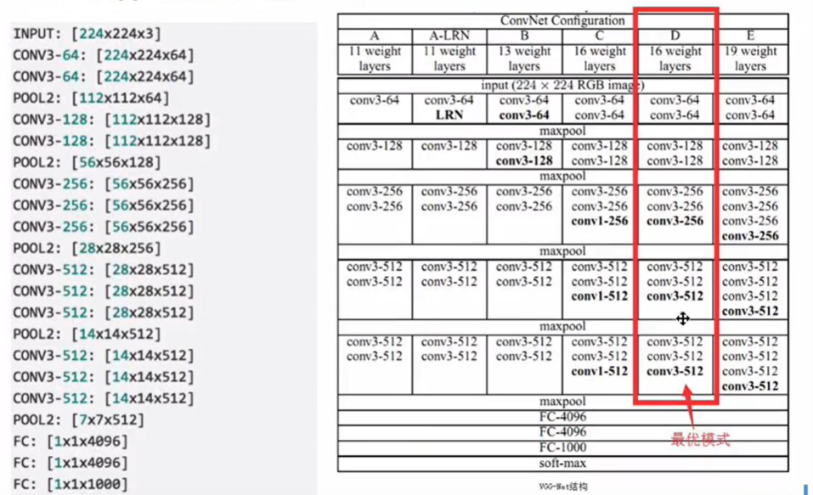
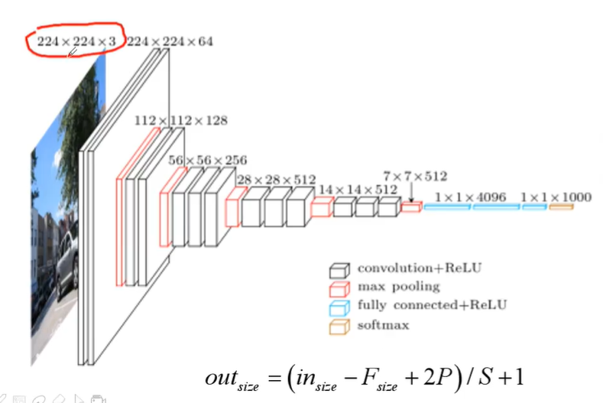
提取特征的部分正是这些卷积和池化。
迁移学习，只需要修正分类器即可
迁移学习训练是比较块的

Slide 19
MobileNet
input | layer_name | kernel_size | kernel_num | padding | strike | activation | output
(224,224,3) | Conv_1*2 | 3*3 | 64 | [1,1] | 1 | relu | (224,224,64)
(224,224,64) | Max_pool | 2*2 | None | 0 | 2 | None | (122,112,64)
(122,112,64) | Conv_2*2 | 3*3 | 128 | [1,1] | 1 | relu | (122,112,128)
(122,112,64) | Max_pool | 2*2 | None | 0 | 2 | None | (56,56,128)
(56,56,128) | Conv_3*3 | 3*3 | 256 | [1,1] | 1 | relu | (56,56,256)
(56,56,128) | Max_pool | 2*2 | None | 0 | 2 | None | (28,28,256)
(28,28,256) | Conv_4*3 | 3*3 | 512 | [1,1] | 1 | relu | (28,28,512)
(28,28,512) | Max_pool | 2*2 | None | 0 | 2 | None | (14,14,512)
(14,14,512) | Conv_4*3 | 3*3 | 512 | [1,1] | 1 | relu | (14,14,512)
(14,14,512) | Max_pool | 2*2 | None | 0 | 2 | None | (14,14,512)
(14，14，512) | FC1 | 120 | None | None | None | None | (None,4096)
(None,4096) | FC2 | 84 | None | None | None | None | (None,4096)
(None,4096) | FC3 | 1000 | None | None | None | None | (None,1000)

