Slide 1
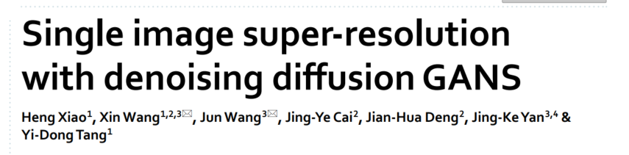
Guilin University
https://www.nature.com/articles/s41598-024-52370-3

Slide 2
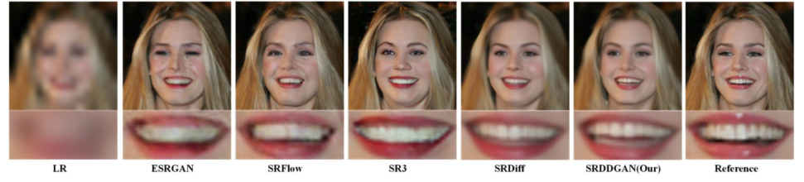
What is SR
Super Resolution（SR）
Input(LR)
Output(HR)
Super‑resolution (SR) refers to the reconstruction from the corresponding low‑ resolution (LR) image input to a high‑resolution (HR) image.
It has a wide range of real-world applications, including remote sensing imaging, video surveillance ,object detection, and medical imaging.

Slide 3
Background
What is the problem?
How to handle?
traditional
SR
CNN
Harder to solve
but easier to use
SISR
SRDDGAN
GAN
Machine learning
RSISR
Diffusion

Slide 4
Diffusion SR
advantages
limits
Use diffusion in SR
More detail
More creative
Complex input
Very slow
Limit input size

Slide 5
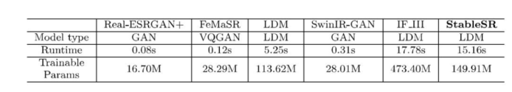
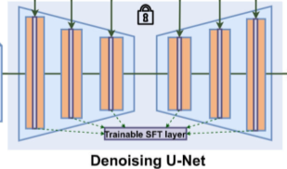
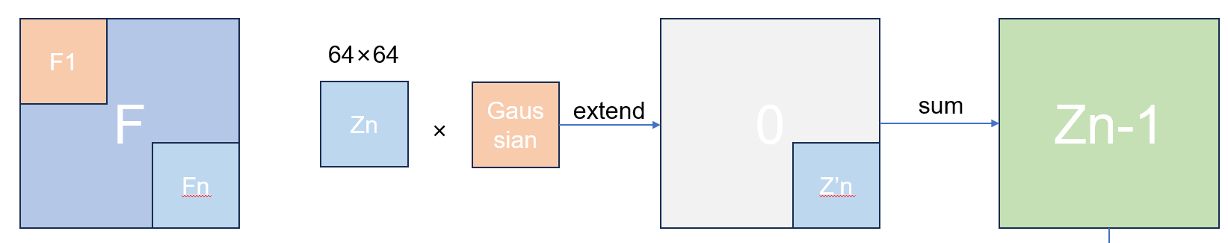
Limit
100 times Runtime comparing to GAN
The construction of Unet is fixed, so the input is fixed too.
We can partition the picture and denoise each block, but it is even slower

Slide 6
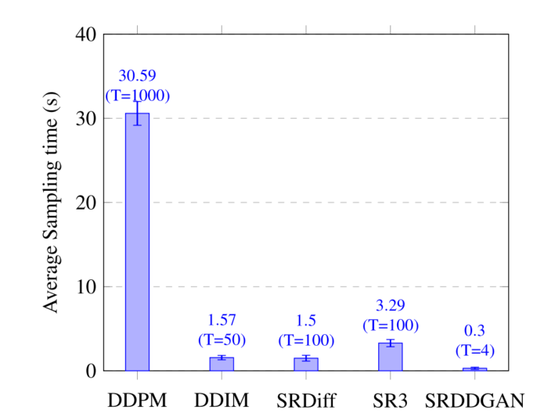
Contribution
Less timestep.
Much faster compared to other diffusion SR models
How do this paper do this?

Slide 7

Diffusion
image
βt
Forward process
Noise N(0,1)
Reverse process

Slide 8
Big step
image
Noise N(0,1)
Need large β

Slide 9
Why need small step
10%
75%
image
15%

Slide 10
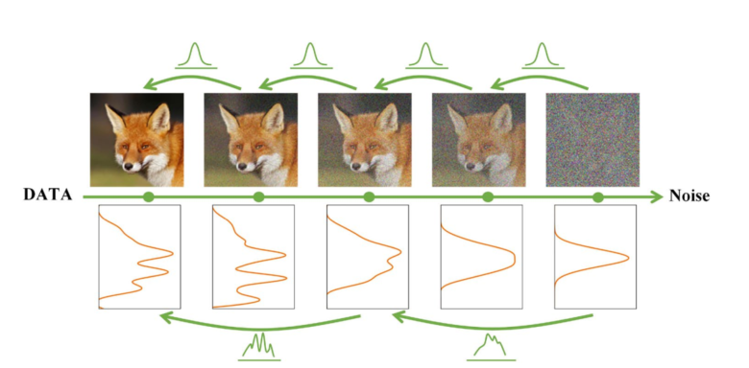
Main idea
Small step
Big step

Slide 11
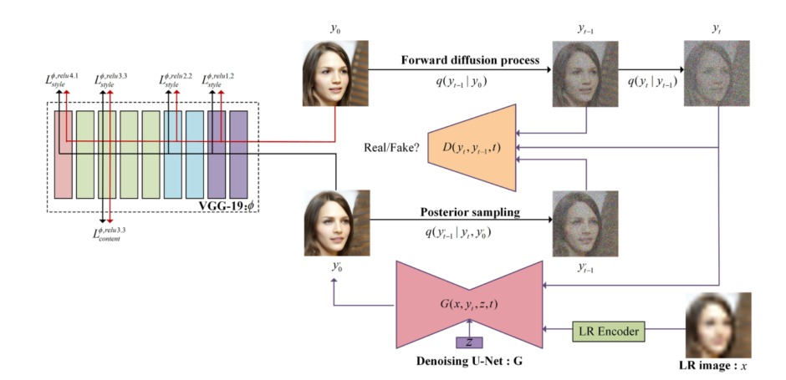
Structure
N(0,1)
SRDDGAN

Slide 12
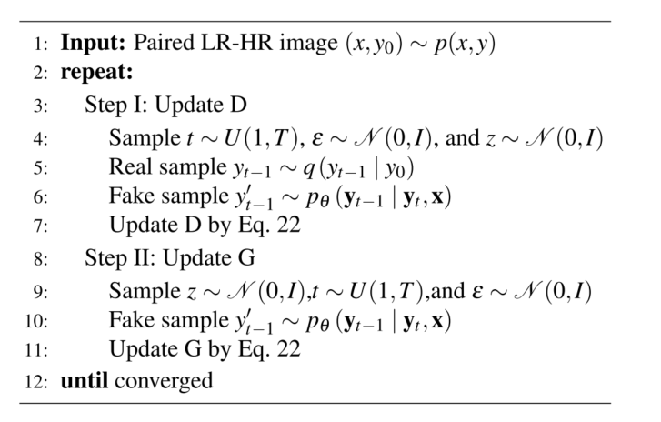
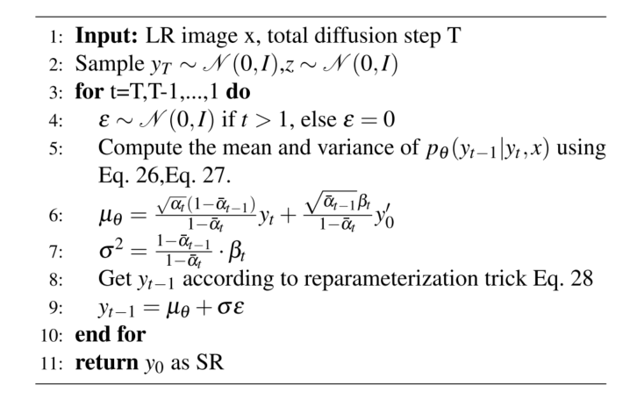
Algorithm
Train
Run

Slide 13
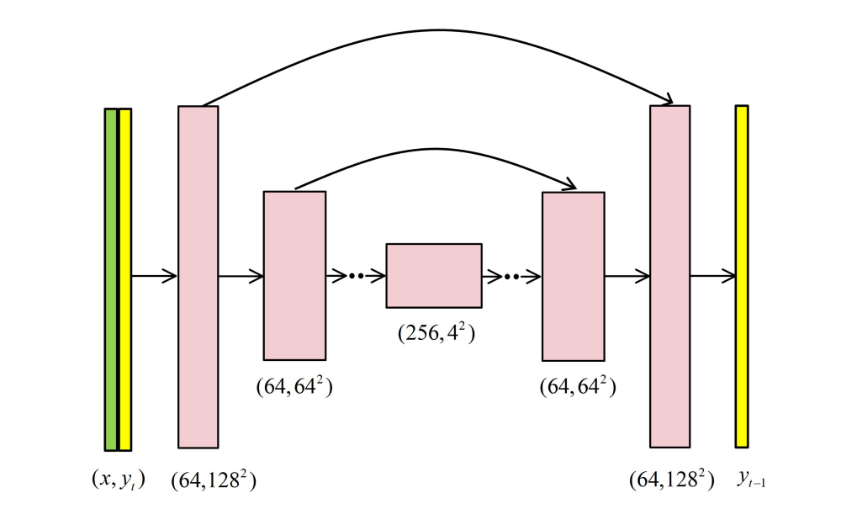
Generator
NCSN++
Yt
Input LR
Z
NCSN++ is from: 2011.13456.pdf (arxiv.org)
https://github.com/yang-song/score_sde

Slide 14
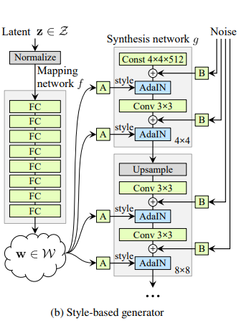
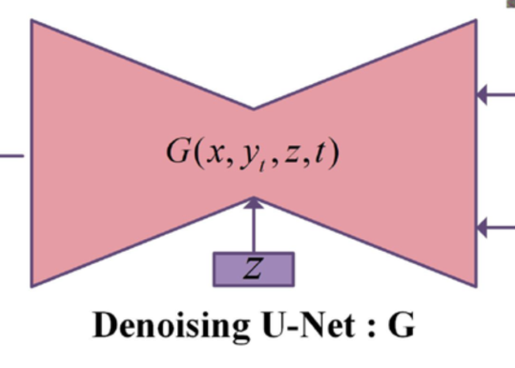
Noise Z
Injecting instance noise into the generator has been identified as an integral approach to enhancing the stability of GAN training and reducing overfitting induced by the discriminator focusing on pure data.
A Style-Based Generator Architecture for Generative Adversarial Netowrks

Slide 15
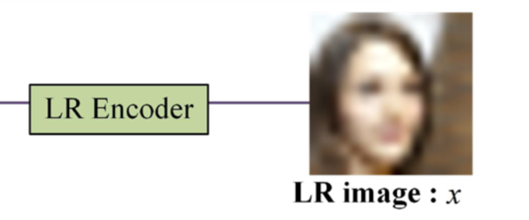
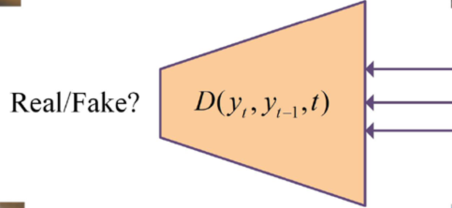
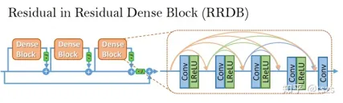
Encoder and D
Our discriminator is created with a convolutional neural network using ResNet blocks, which are designed similarly to generators.
SRFlow

Slide 16

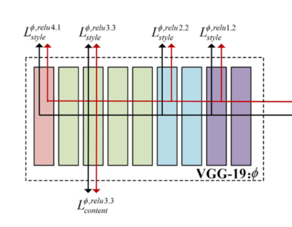
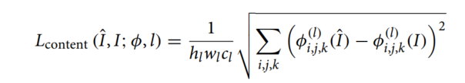
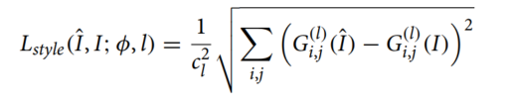
Loss function
1603.08155.pdf (arxiv.org)

Slide 17
theory
Z

Slide 18

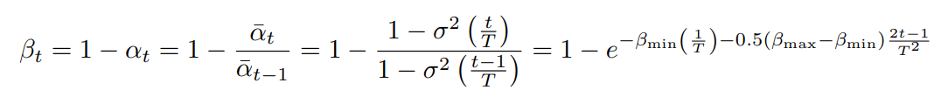
β
Use Variance Preserving Stochastic Differential Equation (VPSDE ) to determine the magnitude of βt for each step.
https://arxiv.org/abs/2011.13456

Slide 19
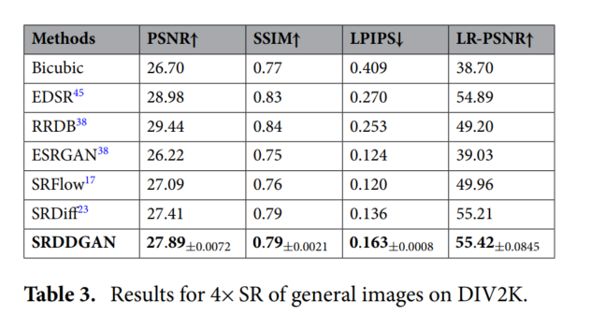
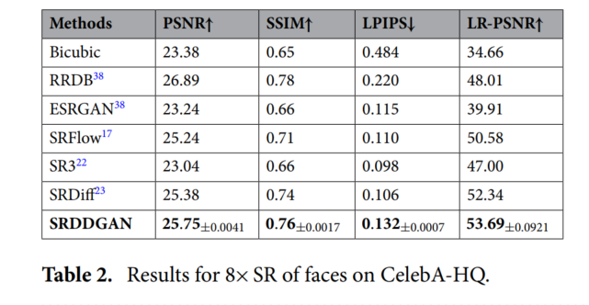
experiment
PSNR，SSIM is almost same
LPIPS is worse，means the output is different from the HR in human perception
LR-PSNR is better，means the consistency between the output and HR is high

Slide 20
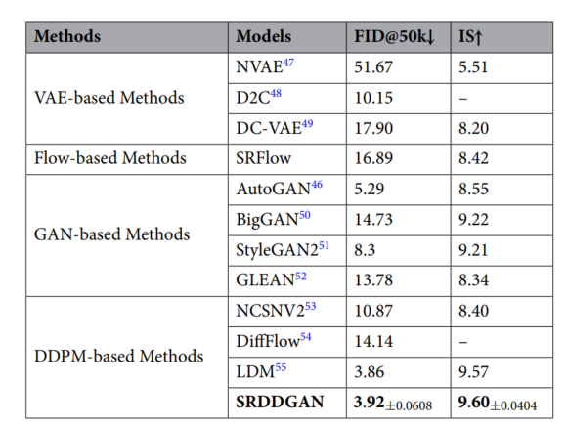
experiment
IS,FID is better
They are used to assess the quality and diversity of the generated images.

Slide 21
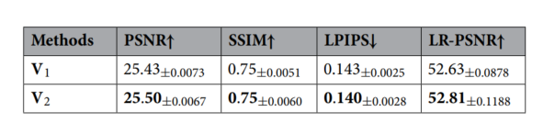
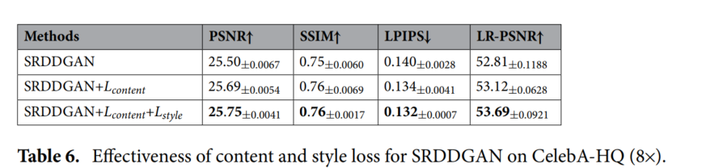
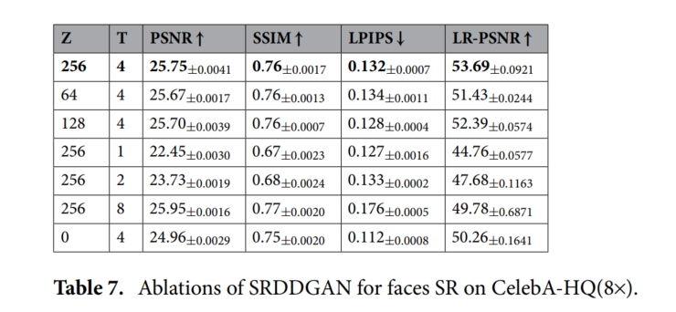
Ablation Study
The effectiveness of LR Encoder(V2 is with Encoder)
Effectiveness of content and style loss
Effectiveness of Z and T

Slide 22
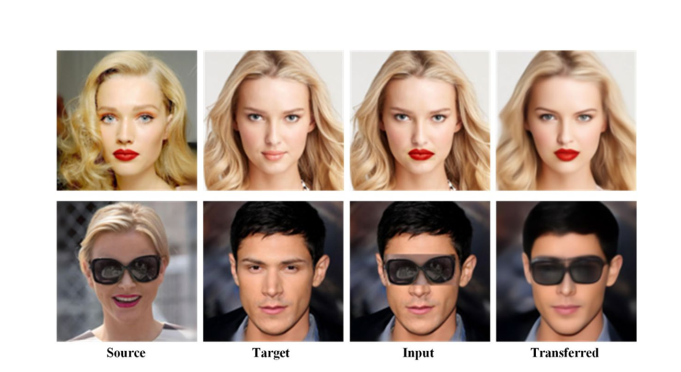
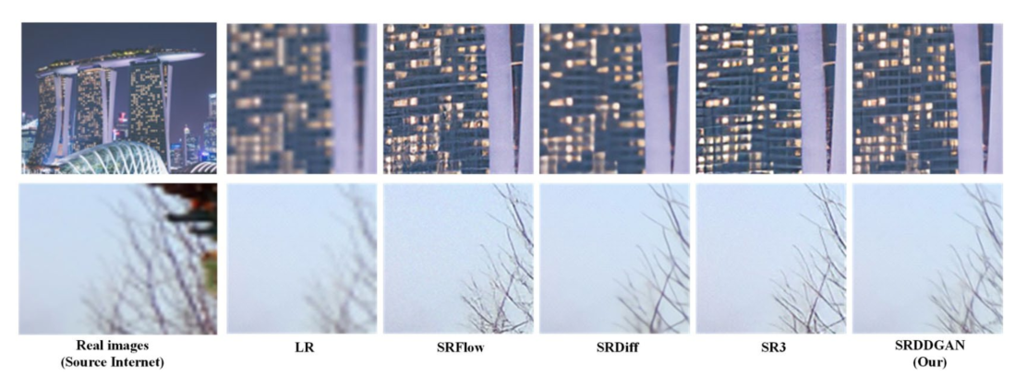
extension
It can be used in content fusion
And it can work in real-world datasets

Slide 23
Thanks

