Slide 1
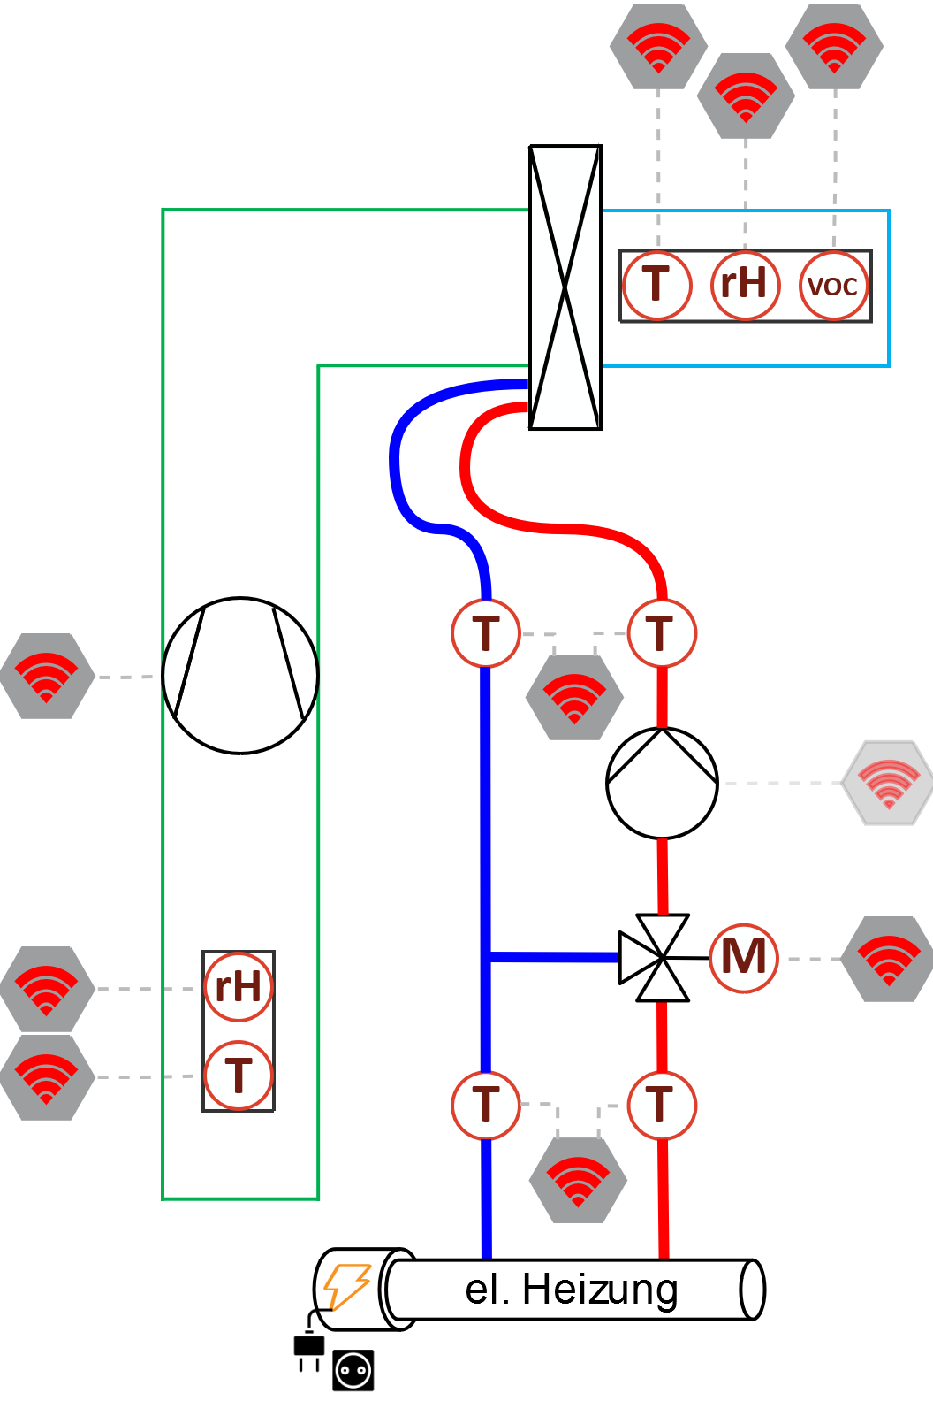
ED & PLC
Multisensor:Air_Outlet
actuator:Fan
Water_Supply
Water_Return
actuator:Three_Way_Valve
Multisensor:Air_Inlet
Water_Supply_Primary
Water_Return_Primary

Slide 2
LCGW
Multisensor:Temperature:Air_Outlet_LCGW
Multisensor:Humidity:Air_Outlet_LCGW
Multisensor:VOC:Air_Outlet_LCGW
Water_Supply_And_Return_LCGW:
measured_Supply_Temperature
actuator:Fan
Water_Supply_And_Return_LCGW:
measured_Return_Temperature
actuator:Three_Way_Valve
Multisensor:Temperature:Air_Inlet_LCGW
Multisensor:Humidity:Air_Inlet_LCGW
Water_Supply_And_Return_Primary_LCGW:
measured_Supply_Temperature_Primary
Water_Supply_And_Return_Primary_LCGW:
measured_Return_Temperature_Primary

Slide 3
Variable names
Air_Outlet_Temperature
Air_Outlet_Humidity
Air_Outlet_VOC
Return_Temperature
Supply_Temperature
Fan
Air_Inlet_Temperature
Three_Way_Valve
Air_Inlet_Humidity
Supply_Temperature_Primary
Return_Temperature_Primary

