Slide 1
Collect and pre-process data
Choose algorithm
Split dataset into training and testing
Train models with training dataset
Evaluate models with testing dataset

Slide 2
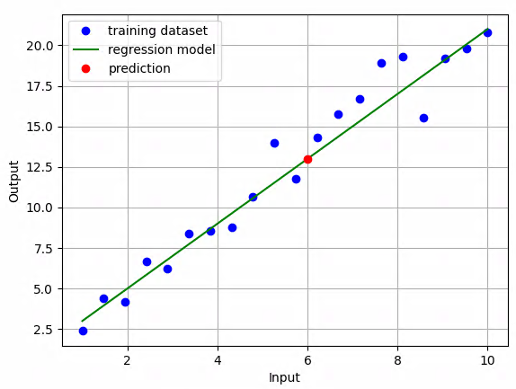
import matplotlib.pyplot as plt
import numpy as np
x = np.linspace(1, 10, 20)
y = 2 * x + 1
n = np.random.normal(0, 1, 20)
plt.plot(x, y + n, 'bo', label='training dataset')
plt.plot(x, y, 'g', label='regression model')
plt.plot([6], [13], 'ro', label='prediction')
plt.ylabel('Output')
plt.xlabel('Input')
plt.legend()
plt.grid()
plt.savefig("High_resoltion.png",dpi=500)
plt.show()

Slide 3
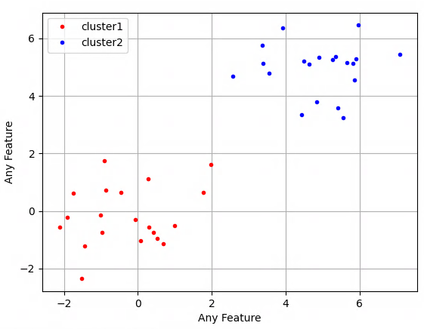
import matplotlib.pyplot as plt
import numpy as np
x1 = np.random.normal(0, 1, 20)
y1 = np.random.normal(0, 1, 20)
plt.plot(x1, y1, 'r.', label='cluster1')
x2 = np.random.normal(5, 1, 20)
y2 = np.random.normal(5, 1, 20)
plt.plot(x2, y2, 'b.', label='cluster2')
plt.ylabel('Any Feature')
plt.xlabel('Any Feature')
plt.legend()
plt.grid()
plt.savefig("High_resoltion.png",dpi=500)
plt.show()

Slide 4
Input Data
Encoder
Latent Space
Decoder
Reconstructed Data

Slide 5
Input Data
Encoder
Latent Space
Decoder
Reconstructed Data

Slide 6
Current State
Take an Action
Reward Function
State Transition Function
Resulting Rewards
Resulting State

Slide 7
 | A | B | C
1
2
3
Trap
Target
Trap
Robot

Slide 8
Latent Space
Generator

Slide 9
Setting parameters of the function “slice_seq_to_windows” in the file app/helper_func/utils.py
Beginning of the sequence
End of the sequence
One Data Sequence
n_features
seq_len
Window
Window
window_overlap_length
Window
Window
When irregular_window_at_end = True, the overlap length between the last two windows is different from the number set by window_overlap_length.
When irregular_window_at_end = False, this happens to the first two windows.
window_length

Slide 10
Latent
Mean
Data Sampled by Latent Mean and Variance
Latent
Variance
Encoder
Latent Space
Decoder

Slide 11
Latent
Mean (m)
f(m, v, s)
Latent
Variance (v)
Sampled Value (s)
Encoder
Latent Space
Decoder

Slide 12
Inputs
Weights
Output
X₁
W₁
X₂
W₂
Y
W_{N}
X_{N}
Bias

Slide 13
Beginning of the sequence
End of the sequence
One Data Sequence
Window
Window
window_overlap_length
Window
Window
window_length

Slide 14
Input Window
Encoder
First Layer
Second Layer
Third Layer
Latent Values
Decoder
First Layer
Second Layer
Third Layer
Reconstructed Window

Slide 15
Encoder
Decoder
Input
Window
Reconstructed
Window
Latent
Values
First
Layer
Second
Layer
Third
Layer
First
Layer
Second
Layer
Third
Layer

Slide 16
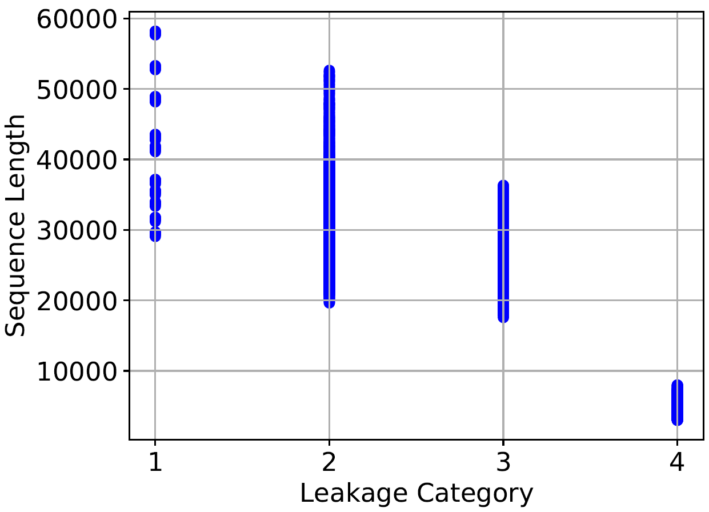
import pandas as pd
import matplotlib.pyplot as plt
ax = plt.subplot()
for i in range(3395, 6915):
print(i)
d = pd.read_csv('dataset_%s.csv' % i)
ax.scatter([d.leakage[0]], [len(d.leakage)], color='blue')
ax.set_xticks([0, 1/3, 2/3, 1])
ax.set_xticklabels(['1', '2', '3', '4'])
ax.set_xlabel('Leakage Category', fontsize=16)
ax.set_ylabel('Sequence Length', fontsize=16)
ax.xaxis.set_tick_params(labelsize=16)
ax.yaxis.set_tick_params(labelsize=16)
plt.grid()
plt.savefig('seq_len_leakage.pdf', bbox_inches='tight')
plt.close()

Slide 17
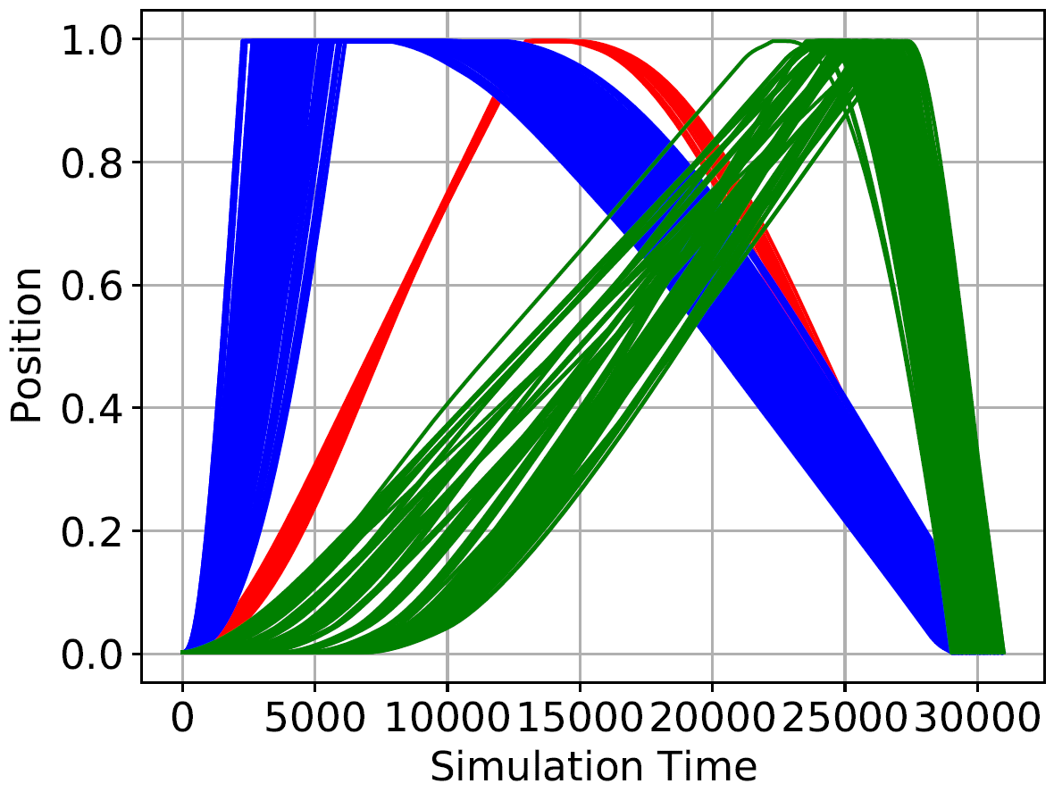
import pandas as pd
import matplotlib.pyplot as plt
ax = plt.subplot()
for i in range(3395, 6915):
print(i)
d = pd.read_csv('dataset_%s.csv' % i)
leakage, length = d.leakage[0], len(d.leakage)
plotted = []
# print('length', length)
if (29000 < length < 31000):
# print('leakage', leakage)
if leakage < 0.1:
if 'red' in plotted:
plt.plot(d.x, color='red')
else:
plt.plot(d.x, color='red', label='leakage 1')
plotted.append('red')
# print('level 1')
elif leakage < 0.5:
if 'blue' in plotted:
plt.plot(d.x, color='blue')
else:
plt.plot(d.x, color='blue', label='leakage 2')
plotted.append('blue')
# print('level 2')
elif leakage < 0.7:
if 'green' in plotted:
plt.plot(d.x, color='green')
else:
plt.plot(d.x, color='green', label='leakage 3')
plotted.append('green')
# print('level 3')
ax.set_xlabel('Simulation Time', fontsize=16)
ax.set_ylabel('Position', fontsize=16)
ax.xaxis.set_tick_params(labelsize=16)
ax.yaxis.set_tick_params(labelsize=16)
plt.grid()
plt.savefig('position_leakage.pdf', bbox_inches='tight')
plt.close()
plt.show()

Slide 18
Classification
Model
4 Leakage
Category
Input Data
Encoder
Latent Space
Decoder
Reconstructed Data

Slide 19
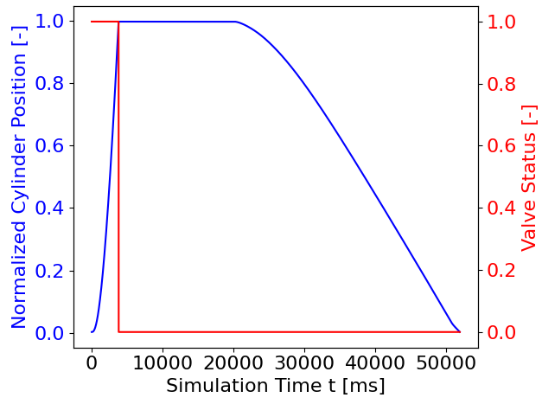
import pandas as pd
fn = '/home/tzuchen/Master_Thesis/Data/dataset_sequences/dataset_5000.csv'
import matplotlib.pyplot as plt
d = pd.read_csv(fn)
fig, ax1 = plt.subplots()
colos_ax_displacement = 'blue'
color_line_displacement = 'blue'
color_ax_valve = 'magenta'
color_line_valve = 'magenta'
fontsize = 16
plt.grid()
ax1.plot(d.x, color=color_line_displacement, linewidth=3)
ax1.set_xlabel('Simulation Time t [ms]', fontsize=fontsize)
ax1.set_ylabel('Normalized Cylinder Displacement [-]', color= colos_ax_displacement, fontsize=fontsize)
ax1.tick_params(axis='y', labelcolor= colos_ax_displacement)
ax1.xaxis.set_tick_params(labelsize=fontsize)
ax1.yaxis.set_tick_params(labelsize=fontsize)
ax2 = ax1.twinx()
ax2.set_ylabel('Valve Status [-]', color= color_ax_valve, fontsize=fontsize)
ax2.plot(d.valve_status, color= color_line_valve, linewidth=3)
ax2.tick_params(axis='y', labelcolor= color_ax_valve )
ax2.xaxis.set_tick_params(labelsize=fontsize)
ax2.yaxis.set_tick_params(labelsize=fontsize)
fig.tight_layout()
plt.savefig('position_valve.pdf', bbox_inches='tight')

Slide 20
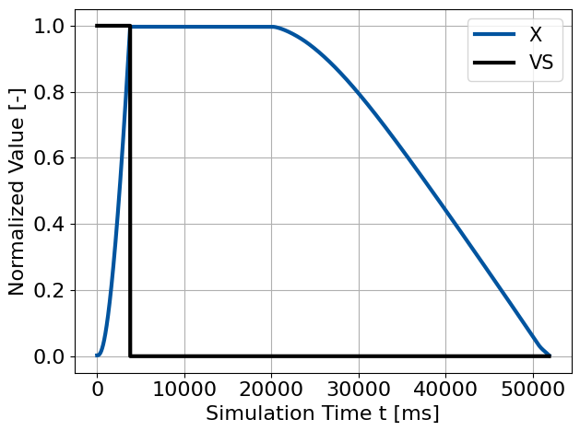
import pandas as pd
fn = '/home/tzuchen/Master_Thesis/Data/dataset_sequences/dataset_5000.csv'
import matplotlib.pyplot as plt
d = pd.read_csv(fn)
fig, ax1 = plt.subplots()
colos_ax_displacement = 'k'
color_line_displacement = '#00549f'
color_ax_valve = 'k'
color_line_valve = 'k'
fontsize = 16
plt.grid()
ax1.plot(d.x, color=color_line_displacement, linewidth=3, label="X")
ax1.set_xlabel('Simulation Time t [ms]', fontsize=fontsize)
ax1.set_ylabel('Normalized Value [-]', color= colos_ax_displacement, fontsize=fontsize)
ax1.tick_params(axis='y', labelcolor= colos_ax_displacement)
ax1.xaxis.set_tick_params(labelsize=fontsize)
ax1.yaxis.set_tick_params(labelsize=fontsize)
ax1.plot(d.valve_status, color= color_line_valve, linewidth=3, label="VS")
ax1.legend(prop={'size': 15})
fig.tight_layout()
plt.savefig('position_valve.pdf', bbox_inches='tight')

Slide 21
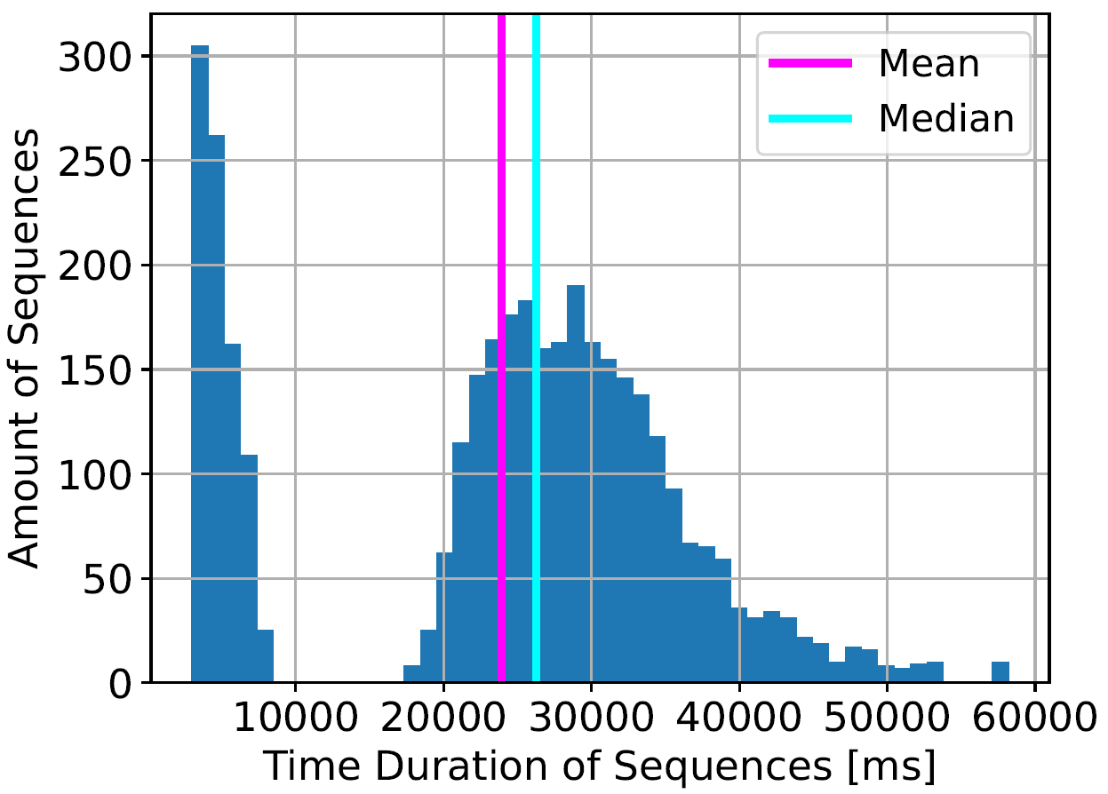
import pandas as pd
import matplotlib.pyplot as plt
import numpy as np
d = pd.read_csv('/home/tzuchen/Master_Thesis/Data/all_seq_length.csv')
color_hist = 'b'
color_mean = 'magenta'
color_median = 'cyan'
length = sorted(d.length[3395:])
ax = plt.subplot()
plt.grid()
(n, bins, _) = ax.hist(length, bins=50)
#ax.vlines(x=np.mean(length), ymin=0, ymax=max(n), label='Mean', color='red')
#ax.vlines(x=np.median(length), ymin=0, ymax=max(n), label='Median', color='green')
plt.axvline(x=np.mean(length), label='Mean', color=color_mean, linewidth=3)
plt.axvline(x=np.median(length), label='Median', color=color_median, linewidth=3)
ax.set_xlabel('Time Duration of Sequences [ms]', fontsize=16)
ax.set_ylabel('Amount of Sequences', fontsize=16)
ax.xaxis.set_tick_params(labelsize=16)
ax.yaxis.set_tick_params(labelsize=16)
plt.legend(prop={'size': 15})
plt.savefig('seq_len_count.pdf', bbox_inches='tight')

Slide 22
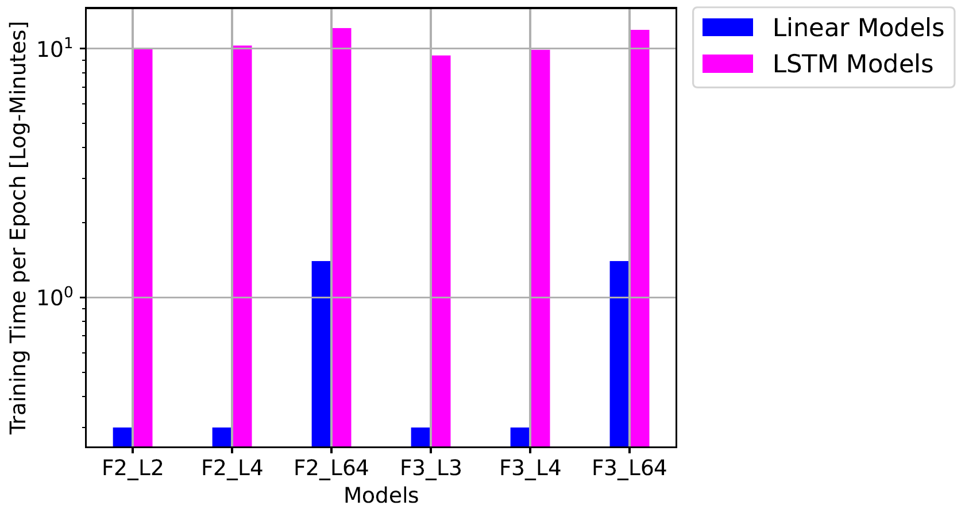
import matplotlib.pyplot as plt
fontsize = 13
x_labels = ['F2_L2', 'F2_L4', 'F2_L64', 'F3_L3', 'F3_L4', 'F3_L64']
x = np.arange(len(x_labels)) # the label locations
width = 0.2 # the width of the bars
linear_time = [0.3, 0.3, 1.4, 0.3, 0.3, 1.4]
lstm_time = [10.0, 10.3, 12.1, 9.4, 9.9, 11.9]
fig, ax = plt.subplots()
linear_plot = ax.bar(x - width * 0.5, linear_time, width,
label='Linear Models', color='blue')
lstm_plot = ax.bar(x + width * 0.5, lstm_time, width, label='LSTM Models',
color='magenta')
ax.set_ylabel('Training Time per Epoch [Log-Minutes]', fontsize=fontsize)
ax.set_xlabel('Models', fontsize=fontsize)
ax.set_xticks(x)
ax.set_xticklabels(x_labels, fontsize=fontsize)
ax.yaxis.set_tick_params(labelsize=fontsize)
ax.set_yscale('log')
ax.legend(loc='upper center', prop={'size': 15},
bbox_to_anchor=(1.25, 1.03), ncol=1, fancybox=True)
plt.grid()
plt.show()
# plt.savefig(output_dir + 'training_time.pdf', bbox_inches='tight')
# plt.close()

Slide 23
x
Load Mass
Cylinder
L_{intern}
L_{ext_rod}
L_{ext_piston}
Valve

Slide 24
Linear
Layer
Last Window
Weights
Output
Latent
Mean
3rd Window
Weights
Output
2nd Window
Weights
Output
Linear
Layer
Update
Linear
Layer
Latent
Variance
1st Window
Weights
Output
Linear
Layer
Windows of a
data sequence
LSTM Layer

Slide 25
Linear
Layer
Last Window
Weights
Output
Latent
Mean
3rd Window
Weights
2nd Window
Weights
Linear
Layer
Update
Linear
Layer
Latent
Variance
1st Window
Weights
Linear
Layer
Windows of a
data sequence
LSTM Layer

Slide 26
Decoded Latent
LSTM
Layer
Latent
Mean
LSTM
Layer
Linear
Layer
Last Window
(Reconstructed)
Linear
Layer
Random
Sampling
Latent
Sample
3rd Window
(Reconstructed)
Latent
Variance
1st Window
(Original)
2nd Window
(Reconstructed)

Slide 27
Linear
Layer
Latent
Mean
Linear
Layer
Linear
Layer
Linear
Layer
Input Data
LSTM
Layer
Latent
Variance

Slide 28
Latent
Mean
Random
Sampling
Latent
Sample
Linear
Layer
Linear
Layer
LSTM
Layer
Latent
Variance
LSTM
Layer
Reconstructed
Data

Slide 29
Input Sequences

Slide 30
Model
Training Data
Train Model with Mini-Batches
Evaluate Model with Testing Data
Data Sequences
Testing Data
Notes:
Common pipeline of training machine learning models

Slide 31
Model
Training Data
Train Model with Mini-Batches
Evaluate Trained Model with Testing Data
Data Sequences
Testing Data
Notes:
Common pipeline of training machine learning models

Slide 32
Input Windows
Encoder
Latent Space
Decoder
Reconstructed Windows

