Slide 1
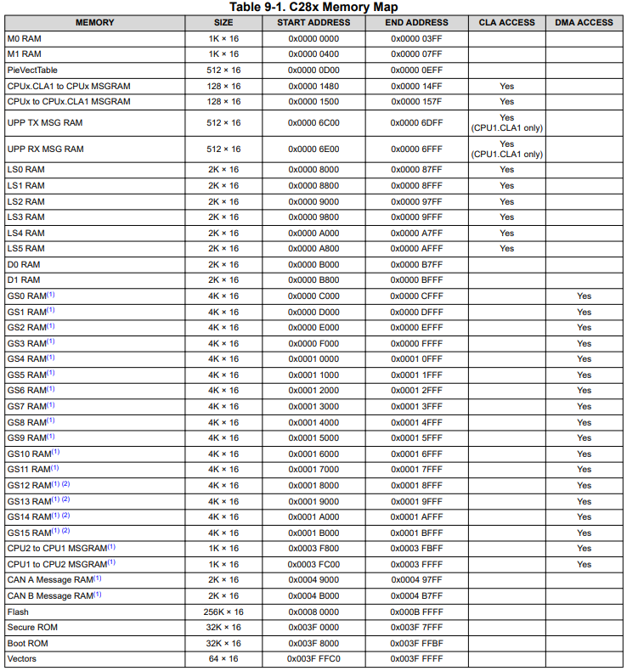
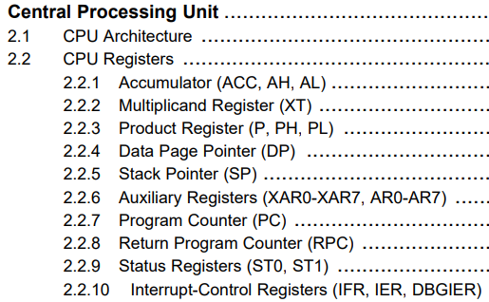
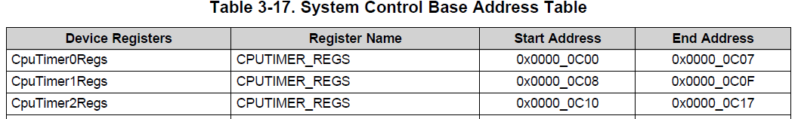
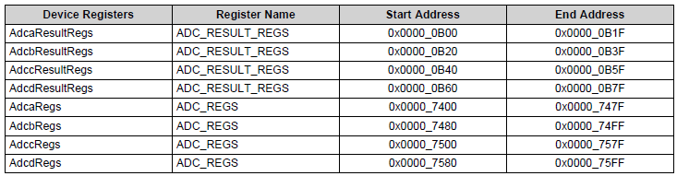
Memory Address
Programming model
General purpose register (GPR) 當CPU程序運作中， 實際參與計算、輔助運行時的內部暫存器。
Segment register 系統設定暫存器或使用者自定義暫存器。
Status and instruction register CPU指令設定及儲存之系統暫存器。
Segment register 3.)
GPR 1.)
Status and instruction register 2.)
※Reference: 1. “TMS320C28x CPU and Instruction Set”; 2.“TMS320F2837xD Delfino Microcontrollers”; 3. “TMS320F2837xD Dual-Core Microcontrollers datasheet (Rev. O)”.

Slide 2
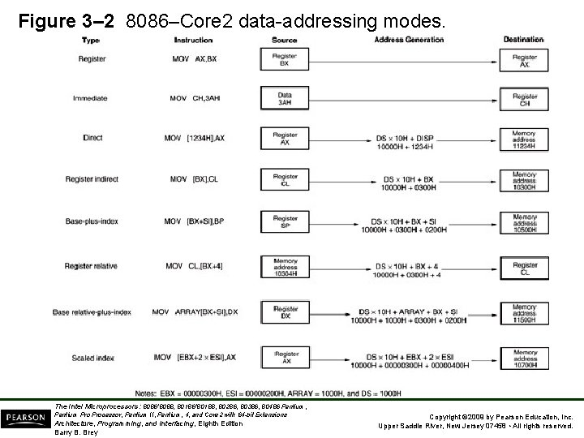
Data-addressing Modes
Register
Immediate
Direct
Register indirect
Base-plus-index
Register relative
Base relative-plus-index
Scaled index

Slide 3
Data-addressing Modes
Mode | Instruction | Code
Register | MOV AX,BX | MOV AH,AL
Immediate | MOV CH,3AH | MOV AH,#100
 |  | MOV AR0,#0000000001100100b
 |  | MOV T,#0x0064
Direct | MOV [1234H],AX | MOVW DP,#Timerpage MOV @TIMER0PRD,AH
 |  | MOV *(0x0C02),AH
Register indirect | MOV [BX],CL | MOV AR0,#TIMER0PRD MOV *AR0,AH
Register relative | MOV CL,[BX+4] | MOVW DP,#Timerpage MOV @TIMER0PRD+1,AH
※ Reference : “TMS320F2837xD Delfino Microcontrollers”, Chapter 6.7.2, Table 6-7

Slide 4
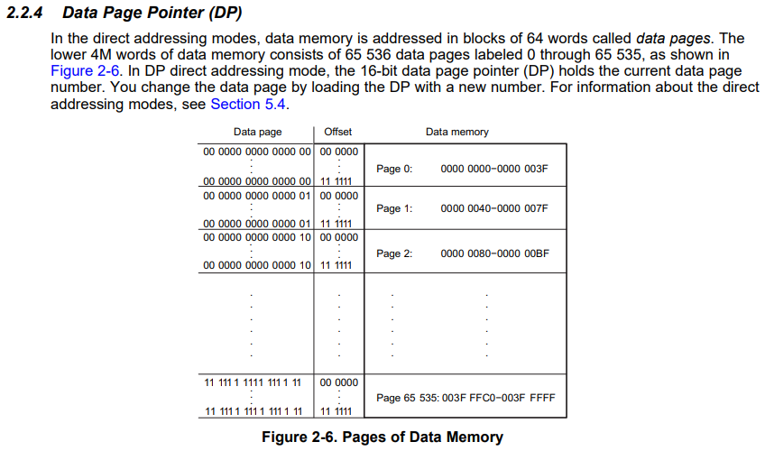
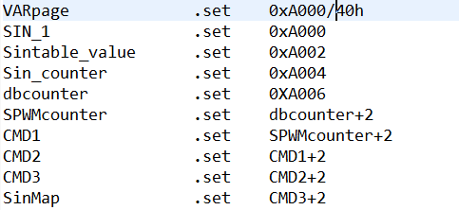
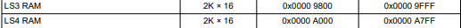
Assembly Language Instructions
Common Code instructions： Operator(ADD, SUB, ABS…), MOV, Branch ※TMS320C28x CPU and Instruction Set, Chapter 6, C28x Assembly Language Instructions .
Data segment setting：
Built up memory page.
Set self-definition register, name & memory address.
※ Reference : “TMS320C28x CPU and Instruction Set”.

Slide 5
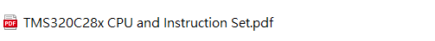
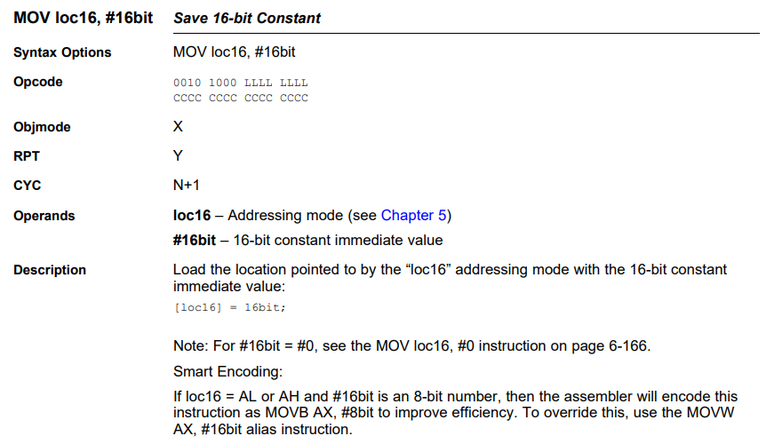
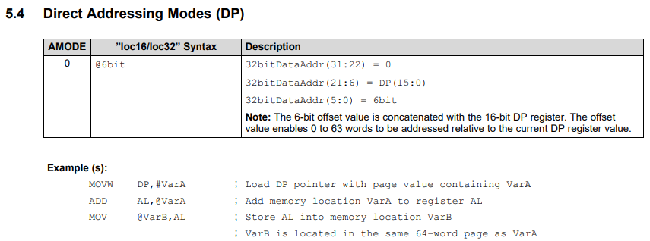
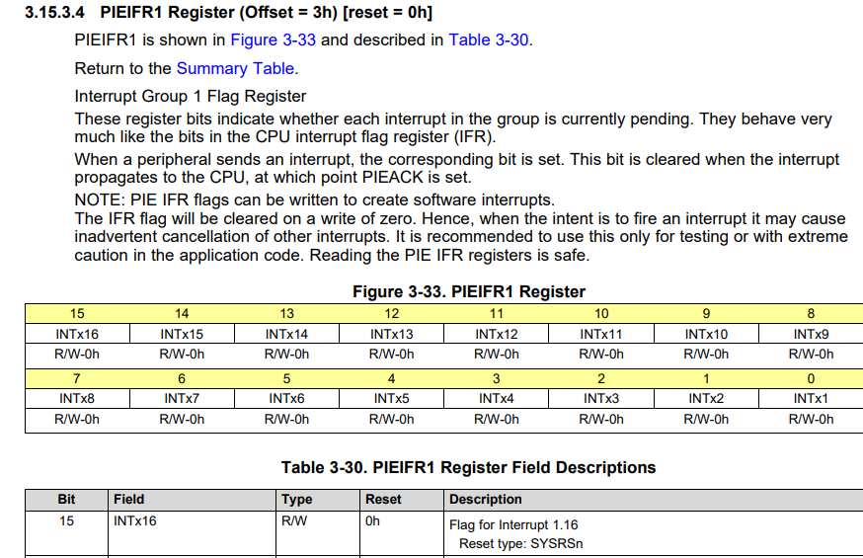
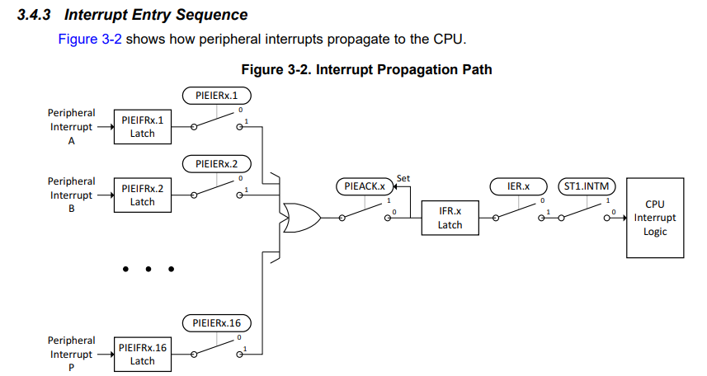
Datasheet introduce
組合語言語法與定址模式說明
所有功能說明與暫存器使用說明

Slide 6

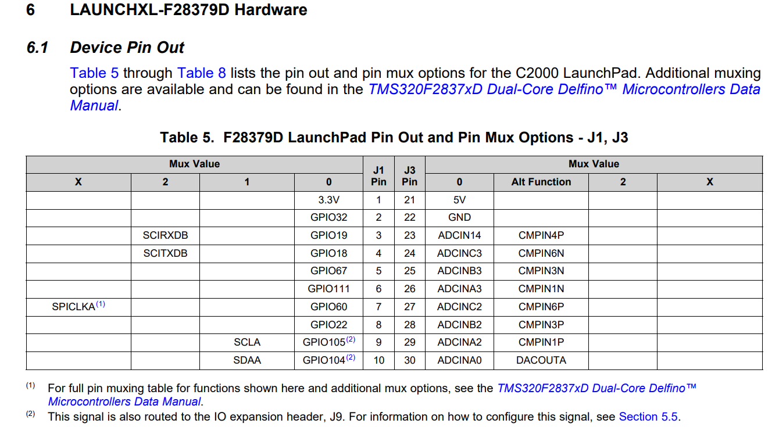
Datasheet introduce
通用輸入輸出腳位說明

Slide 7
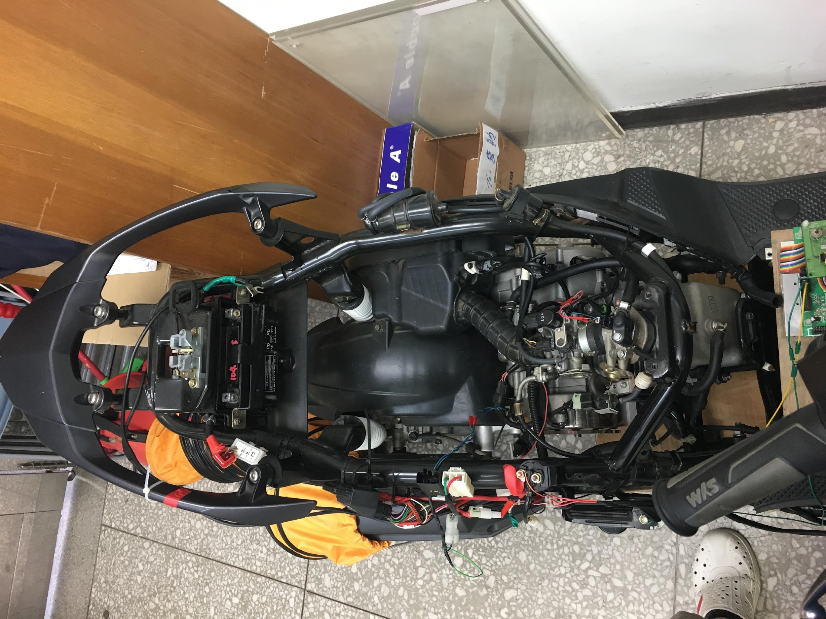
實習一
整體晶片運作必先設定時脈 => Clocking__3.7章節
CPU Timer 模組功能設置__3.8章節
中斷功能設置__3.4章節
通用輸入輸出腳位, F28379D Overview pdf
實驗說明：
範例題：使用Timer1計時器，產生週期為10u sec之中斷，並以GPIO2
在每次進入中斷時將GPIO 2 拉高電位；在每次離開中斷時將
GPIO 2 拉低電位。
實驗題：利用Timer1計時器，產生週期為100u sec之中斷，以每4次Timer1
中斷進入1次Timer2中斷，並以GPIO 2及GPIO 3 I/O腳分別觀察
Timer1與Timer2之中斷時間，及觀察兩個Timer中斷之優先權 。

Slide 8
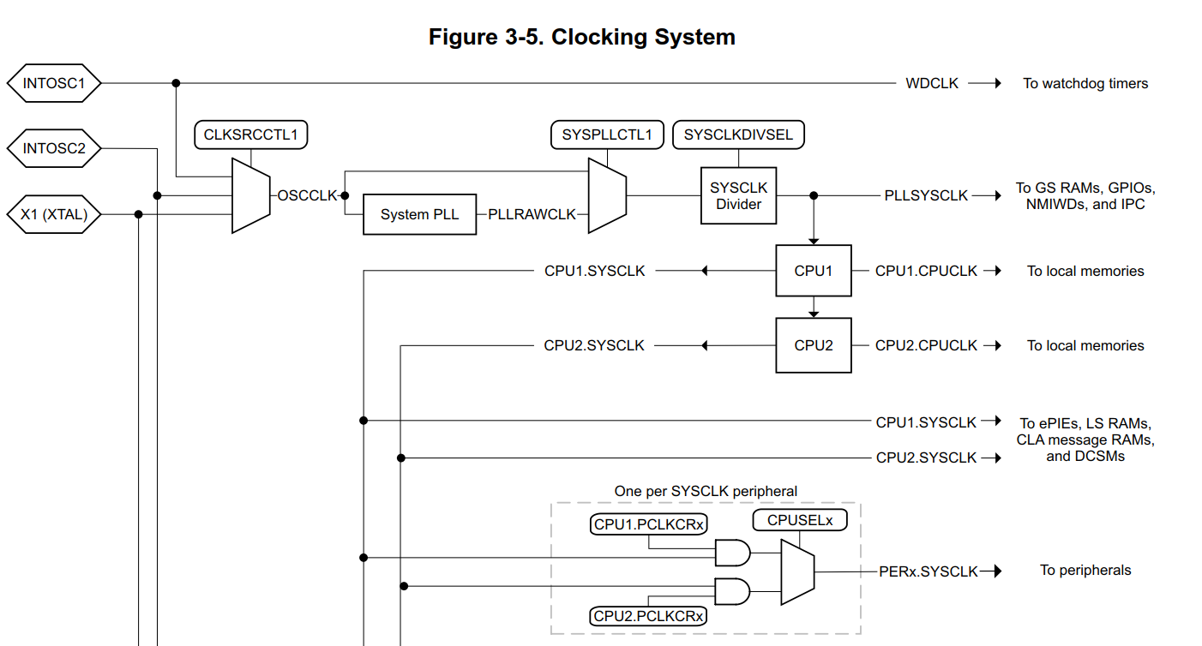
3.7 Clocking

Slide 9
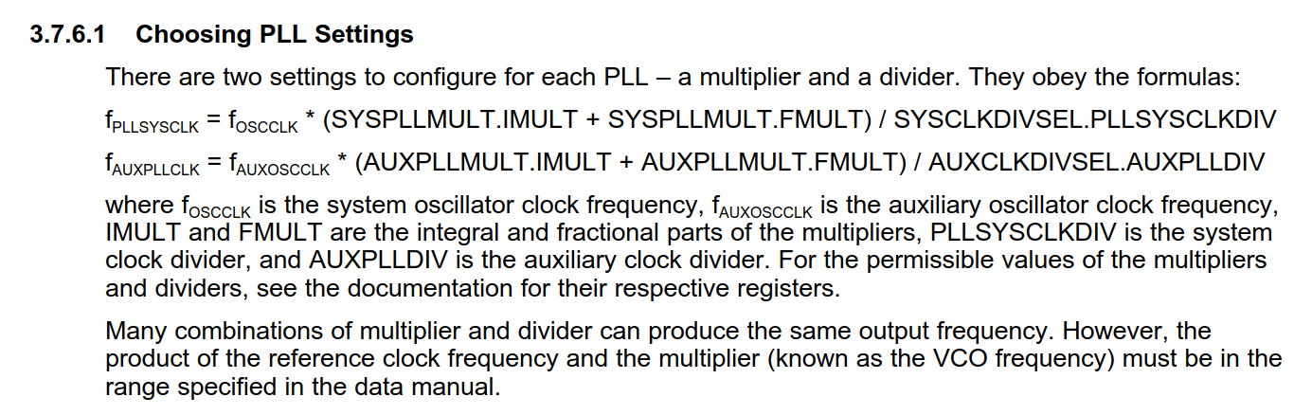
3.7 Clocking

Slide 10
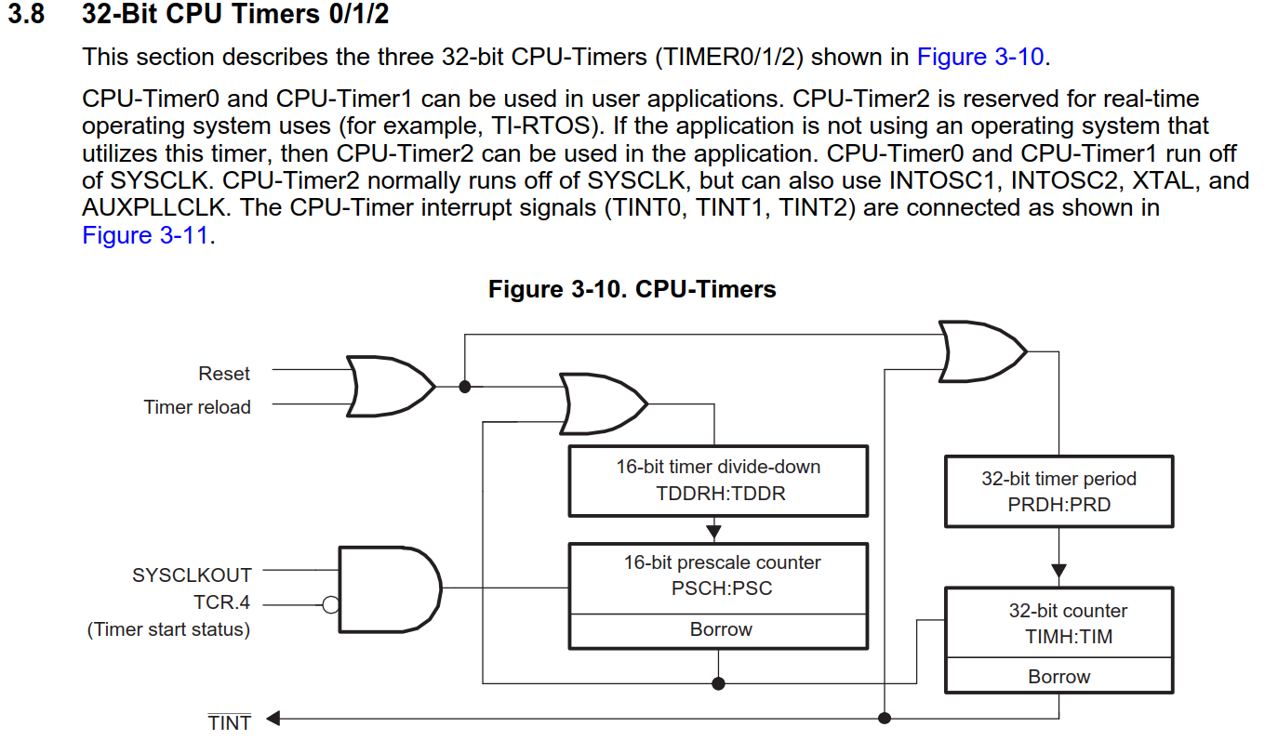
3.8 CPU Timer

Slide 11
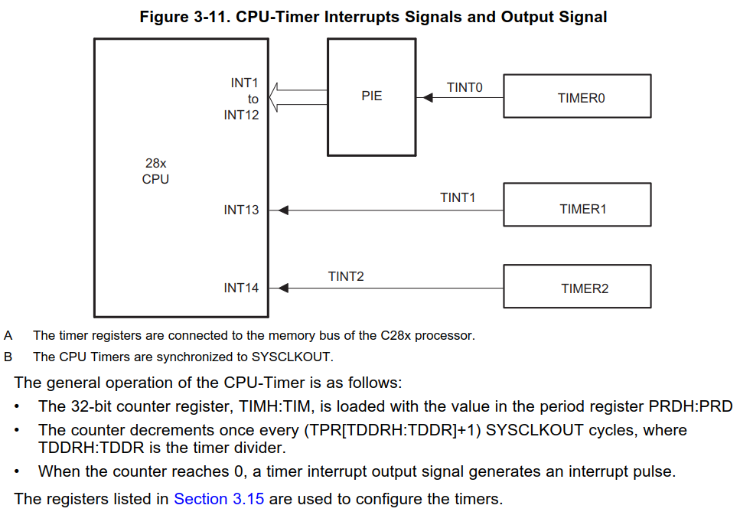
3.8 CPU Timer

Slide 12
What is Interrupt
Software execution flow
Initial setup
Setup system clock, setup module, setup peripheral…
Reset register, I/O state…
Main loop
Do nothing, waiting for interrupt
When an interrupt occurred
Interrupt
Interrupt code execution
Return to main loop

Slide 13
What is Interrupt
Software execution flow
Initial setup
Setup system clock, setup module, setup peripheral…
Reset register, I/O state…
Main loop
Do nothing, waiting for interrupt
When multiple interrupt occurred
Interrupt 1
Interrupt with highest priority executes first
Interrupts switch timing depends on EINT setting
Interrupt 2
Interrupt with lower priority executes
Return to main loop

Slide 14
EINT setting
Interrupts timing with / without EINT
Scenario 1:
Description | Execution timing
Interrupt 1: with “EINT”
Interrupt 2:
Interrupt2 “interrupts” interrupt1
Interrupt2 has finished
return to interrupt1
Scenario 2:
Description | Execution timing
Interrupt 1: No “EINT”
Interrupt 2:
Interrupt2 is waiting for interrupt1 to finish

Slide 15
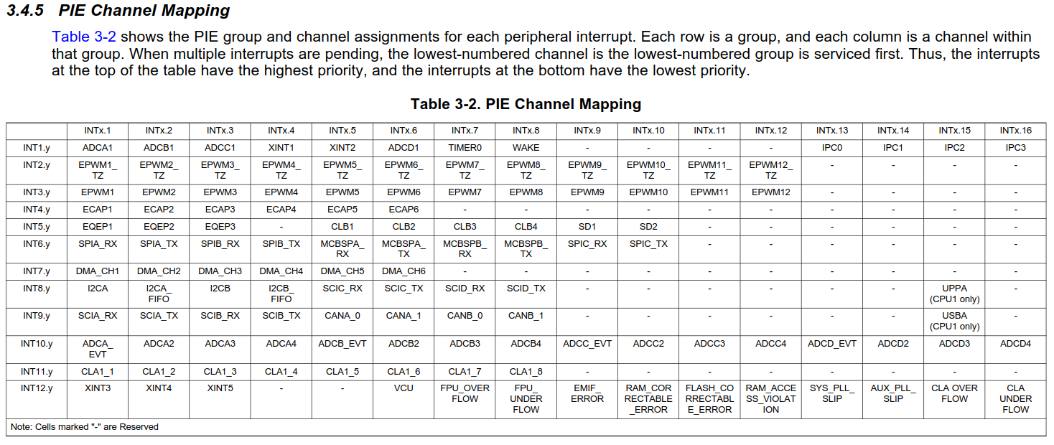
3.4 Peripheral Interrupt
Interrupt “Member”
Interrupt “Group”

Slide 16
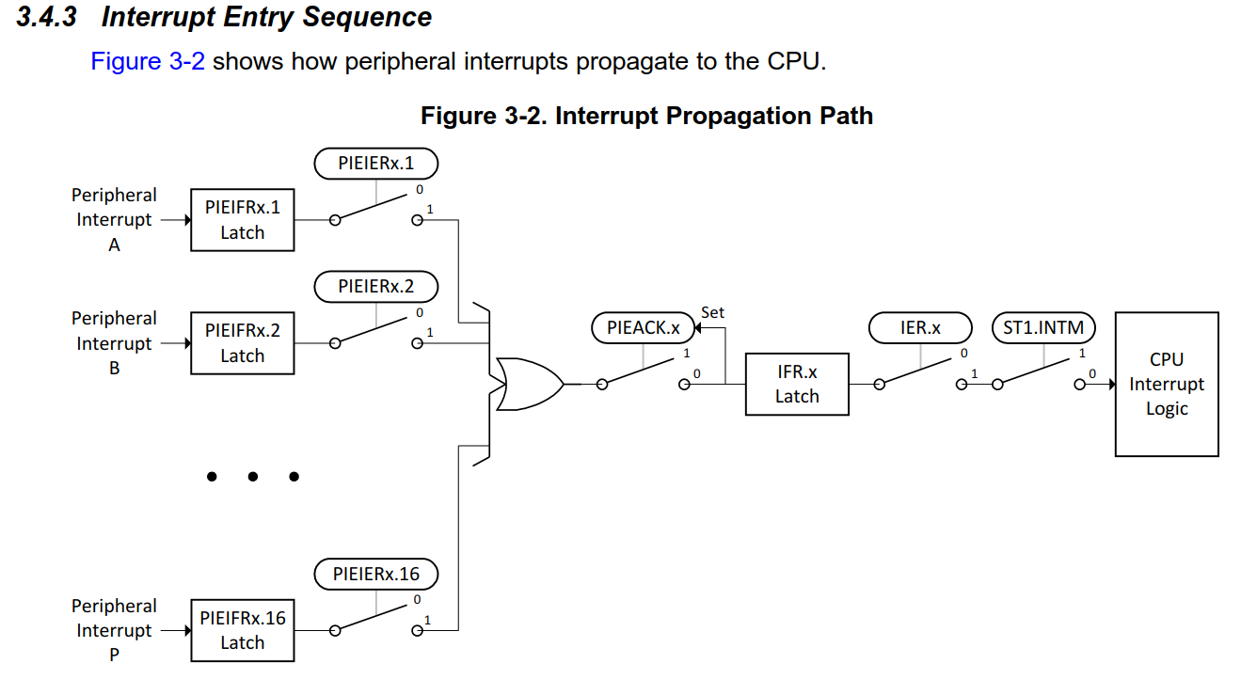
3.4 Peripheral Interrupt
Interrupt Group
IER: Enable
IFR: Flag
INTM: Master
PIEACK: Acknowledge
Interrupt Member

Slide 17
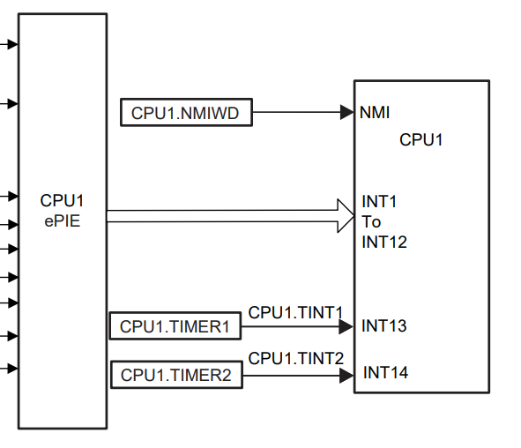
3.4 Peripheral Interrupt
“MUXed” see last page
Direct link to CPU

Slide 18
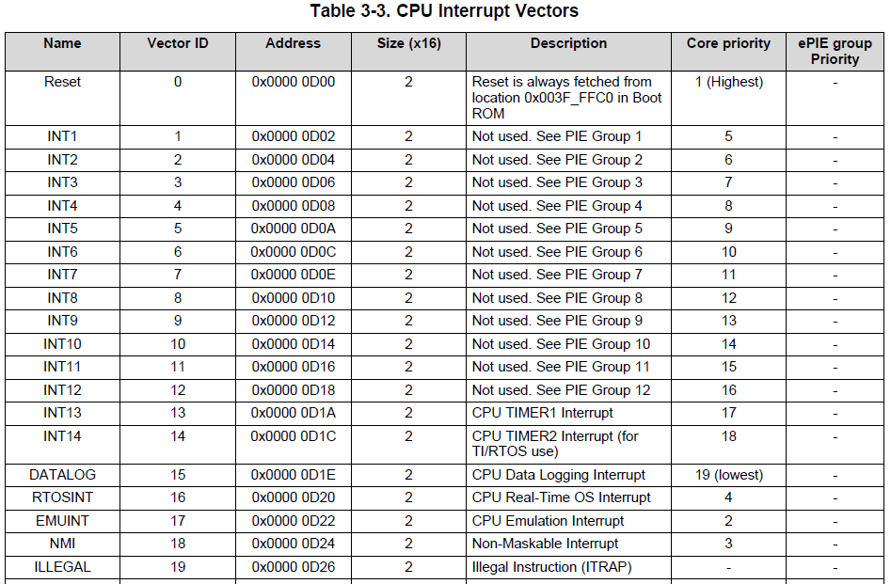
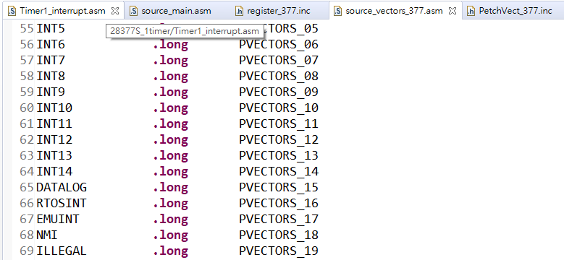
3.4 Peripheral Interrupt

Slide 19
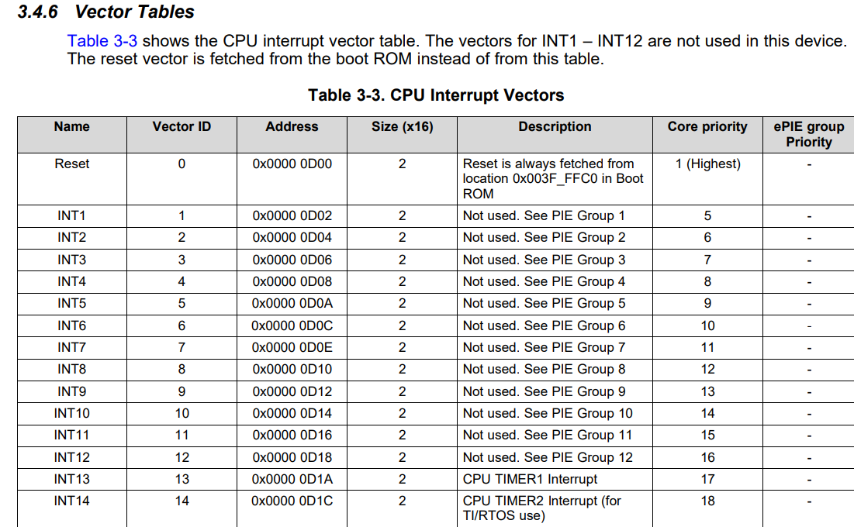
Interrupt Priority

Slide 20
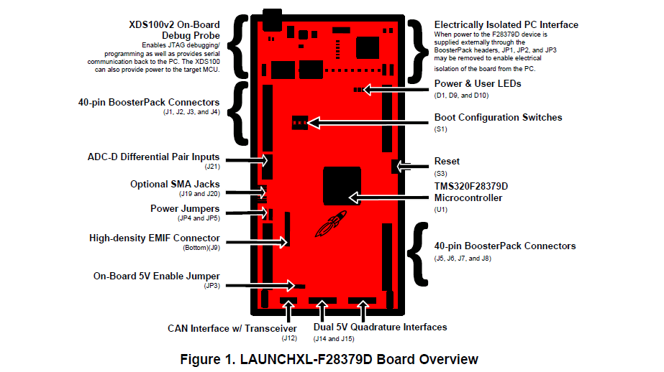
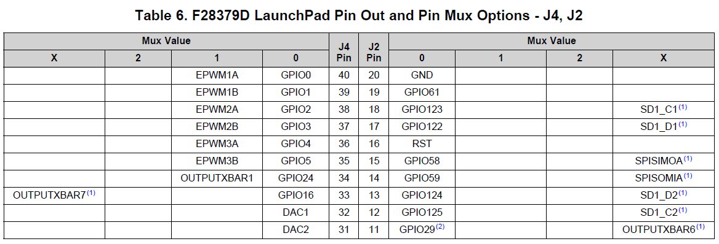
GPIO

Slide 21
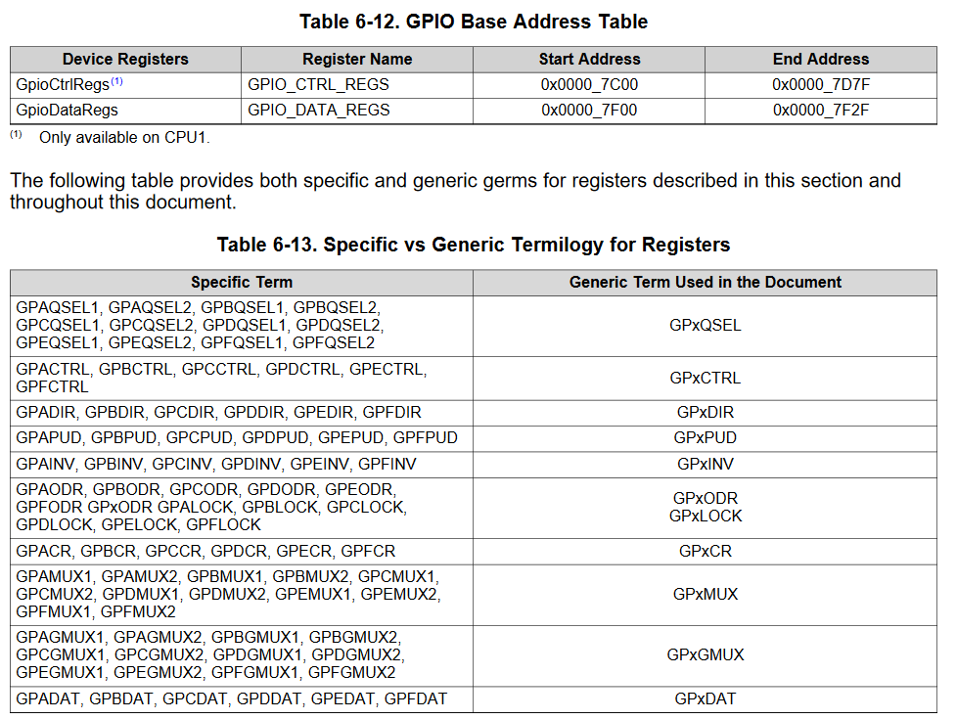
6 GPIO

Slide 22
實習一
實驗說明
範例題：使用Timer1計時器，產生週期為10u sec之中斷，並在每次進入中斷時將GPIO 3 拉高電位；在每次離開中斷時將GPIO 3 拉低電位。
(系統頻率為200MHz)
實驗題：利用Timer1計時器，產生週期為100u sec之中斷，並在每次進入中斷
將GPIO 3 拉高電位；在每次離開中斷時將GPIO 3 拉低電位。
利用Timer2計時器，產生週期為400u sec之中斷，並在每次進入中斷
將GPIO 4 拉高電位；在每次離開中斷時將GPIO 4 拉低電位。
以示波器查看GPIO 3及GPIO 4 波形並觀察Timer1和Timer2之中斷時間，以及觀察兩個Timer中斷之優先權 。
(系統頻率為100MHz)
繳交期限:2024/10/7
作業繳交: google classroom
課程代碼: gs4fyai
問題請洽:
助教信箱:t113318009@ntut.org.tw

Slide 23
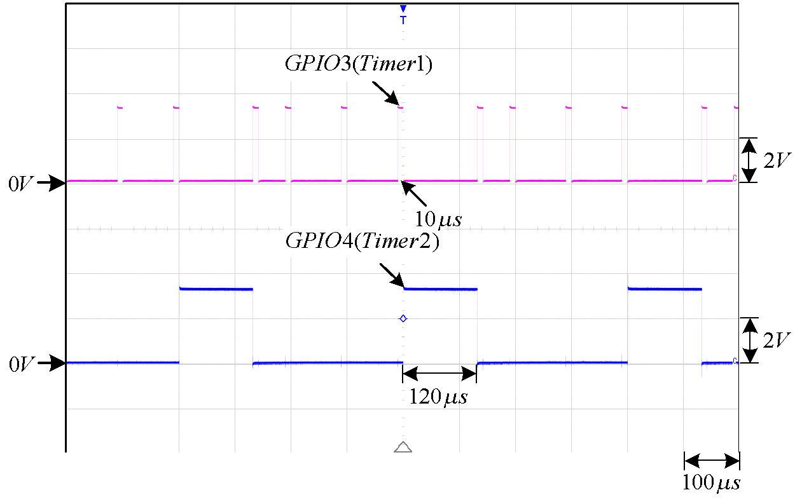
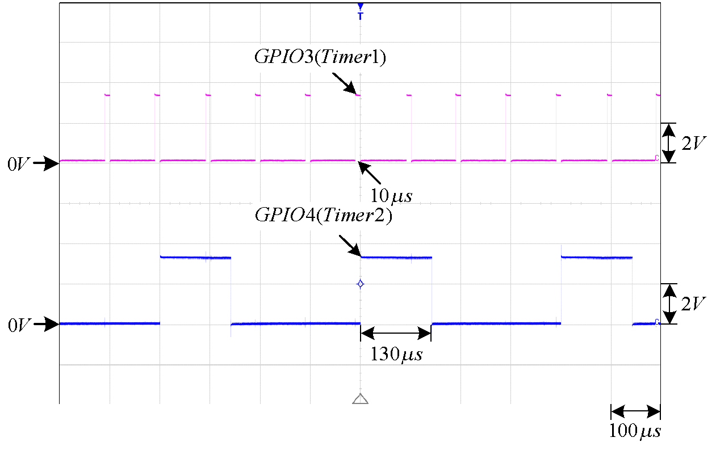
實驗波形
本次作業請做出允許中斷插入(右邊波形)
不允許中斷插入
允許Timer1中斷插入Timer2中斷

