Slide 1

Development of new water spray strategies for improving the energy performance of indirect evaporative cooling systems
新型喷淋策略开发及其对间接蒸发冷却系统能效的提升
Presenter: MA Xiaochen
22 July 2024

Slide 2
Outline 汇报提纲
Research background and literature review
研究背景与文献综述
Research gaps and objectives
研究不足与目标
Development of FDM model for spray distribution optimization of IEC
喷淋分布的 FDM 建模与优化
Development of CFD model for IEC considering water film formation with spray parameter analysis
考虑水膜形成的 CFD 分析
Performance assessment and optimization of water spray strategy for IEC based on ANN modeling and GA
基于 ANN–GA 的喷淋策略优化
Performance analysis and nozzle setting optimization of IEC for energy recovery in data centers
数据中心 IEC 性能与喷嘴优化
Conclusions and recommendations for future work
结论与未来研究方向

Slide 3
Outline 汇报提纲
Research background and literature review
研究背景与文献综述
Research gaps and objectives
研究不足与目标
Development of FDM model for spray distribution optimization of IEC
喷淋分布的 FDM 建模与优化
Development of CFD model for IEC considering water film formation with spray parameter analysis
考虑水膜形成的 CFD 分析
Performance assessment and optimization of water spray strategy for IEC based on ANN modeling and GA
基于 ANN–GA 的喷淋策略优化
Performance analysis and nozzle setting optimization of IEC for energy recovery in data centers
数据中心 IEC 性能与喷嘴优化
Conclusions and recommendations for future work
结论与未来研究方向

Slide 4
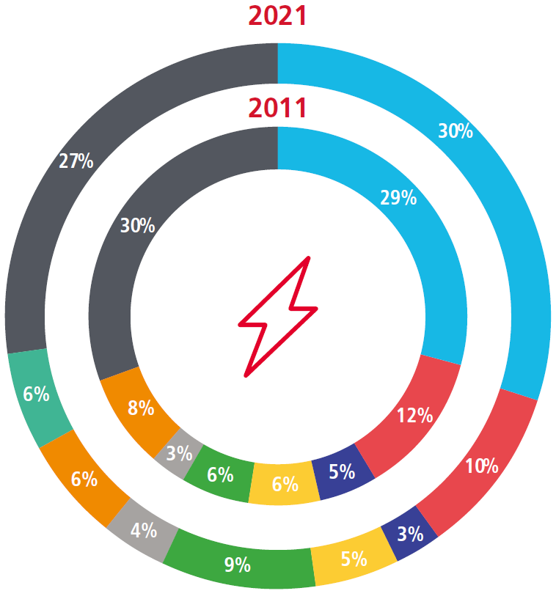
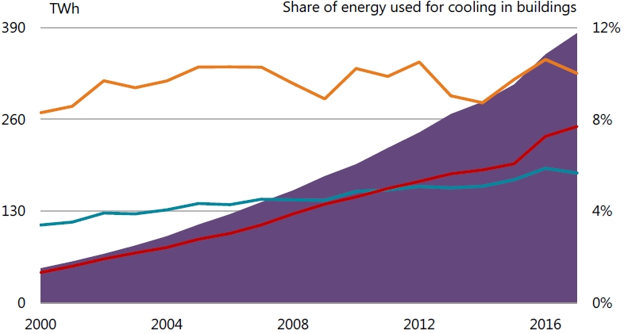
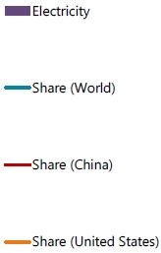
1. Research background and literature review
研究背景与文献综述
1.1 Cooling energy use in buildings 建筑制冷能耗
China: cooling energy use has been growing fast in past 10 years, accounting for 1/5 of global cooling energy use.
中国：过去十年，制冷能耗快速增长，约占全球制冷能耗的五分之一。
Hong Kong: the electricity end use for A/C increased by 29% in past 10 years and is about 30% of the total electricity use in building sector.
香港：过去十年，空调用电量增长了 29%，约占建筑部门总用电量的 30%。
1.46GWh
US
World
1.30GWh
China
Electricity use for space cooling, 2000-2017
Electricity Consumption by End-use in HK, 2011-2021
Source: International Energy Agency (IEA). The Future of Cooling in China. 2019
Source: EMSD. Hong Kong Energy End-use Data. 2023
Seek for environmental friendly technology for cooling 发展环境友好型制冷技术，降低建筑制冷能耗

Slide 5
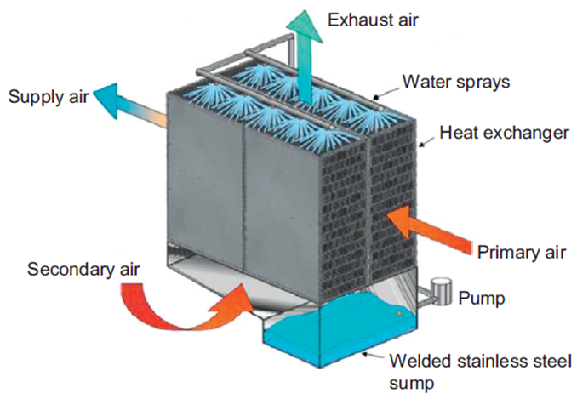
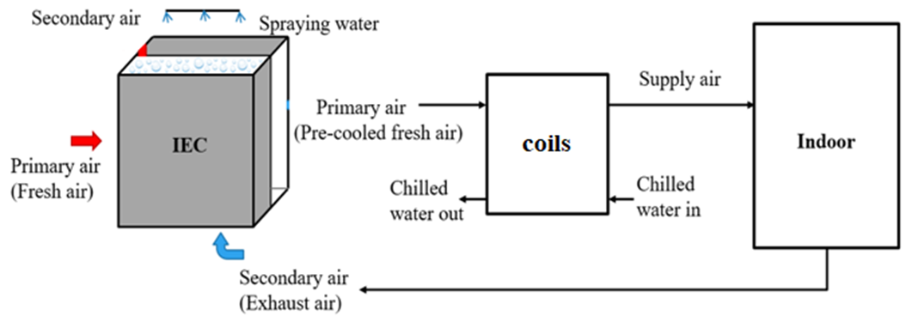
1. Research background and literature review
研究背景与文献综述
1.2 Development of indirect evaporative cooling (IEC) 间接蒸发冷却（IEC）技术的发展
The IEC technology is a green and energy-saving technology that uses water to evaporate and absorb heat for cooling.
间接蒸发冷却（IEC）利用水蒸发吸热实现降温，是一种绿色节能技术。
Conventional IEC: for sensible cooling-dominant buildings under dry climates. 传统 IEC：适用于干燥气候下以显热负荷为主的建筑。
Updated IEC: for energy recovery in hot and humid regions. 拓展应用：用于湿热地区的能量回收。
Fig.1.2.1 Schematic diagram of a traditional IEC
Key point: the process of evaporation of water into air. 核心过程：水向空气中蒸发，并进行传热传质。
Enhanced! 强化换热！
Fig.1.2.2 System diagram of an IEC for energy recovery
Source: A statistical modeling approach on the performance prediction of indirect evaporative cooling energy recovery systems. 2019

Slide 6
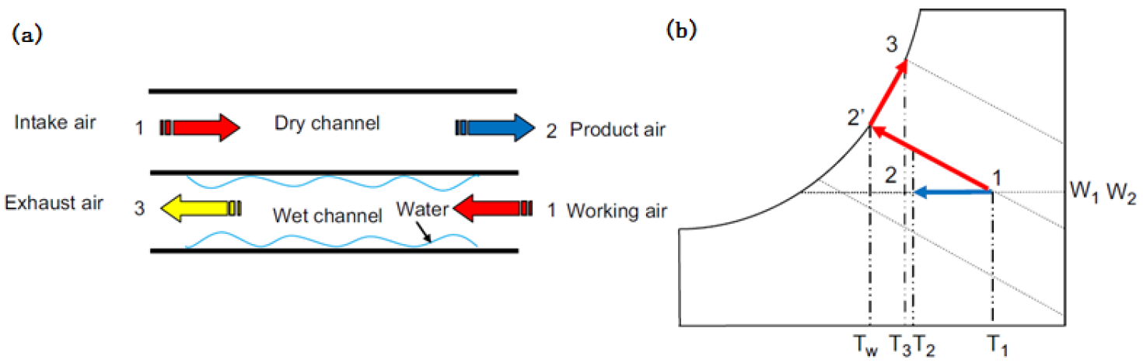
  Appendix 附录
  Working principle 工作原理
Fig. 8.1 (a) schematics and (b) psychrometric process of traditional IEC
When IEC is applied in hot and humid areas, the primary air humidity is high and the wet-bulb temperature of the secondary air (exhaust air) in the air-conditioned space is low, resulting in condensation where the temperature of the plate surface is lower than the dew-point temperature of the primary air.
在湿热地区，一次空气湿度较高，而空调空间排风作为二次空气时，其湿球温度较低。当换热板表面温度低于一次空气露点温度时，一次空气侧会发生冷凝。
(c) Upper side configuration (d) Lower side configuration

Slide 7
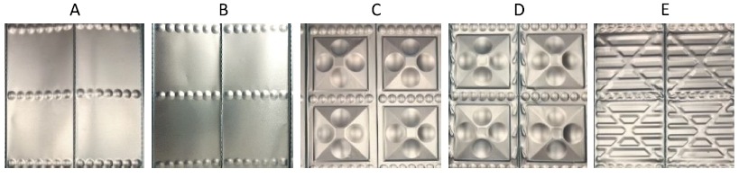
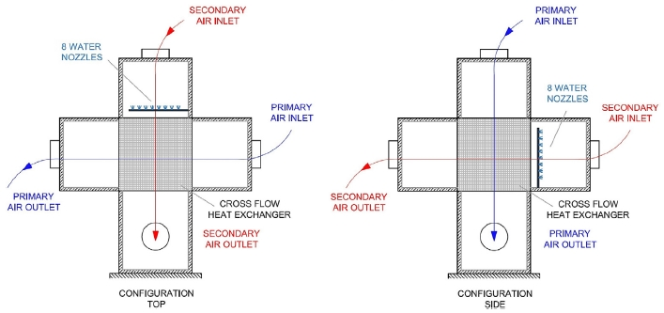
1. Research background and literature review
研究背景与文献综述
1.3 Research on wettability of secondary air channel 二次空气通道的润湿性研究
Water supply 供水方式
Low water supply Low wettability and heat & mass transfer
供水量过低 → 润湿不足，传热传质性能下降
High water supply Higher film thickness and thermal resistance
供水量过高 → 水膜增厚，传热热阻增大
Plate structure 换热板结构
Air flow direction 气流方向
Fig.1.3.1 Plate with different pitch or protrusion geometry
Fig.1.3.2 Scheme of Top and Side configuration
Source: Effect of plates coating on performance of an indirect evaporative cooling system. 2019;
Effect of heat exchanger plates geometry on performance of an indirect evaporative cooling system, 2020

Slide 8
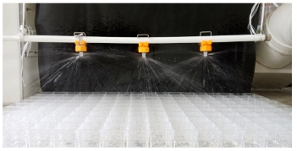
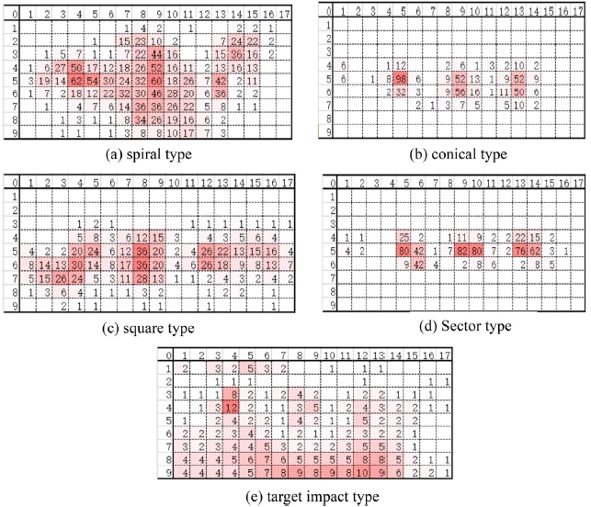
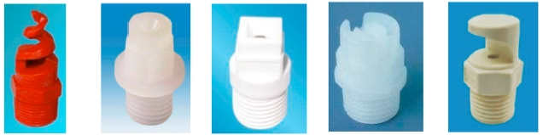
1. Research background and literature review
研究背景与文献综述
Water spray nozzle 喷淋喷嘴
Arrangement 布置方式
Distributions 喷淋分布
Fig.1.3.3 The photos of water distribution effect^{[1]}
Types 喷嘴类型
Fig.1.3.5 Water distribution volume of spraying nozzles(220 L/h) ^{[1]}
Fig.1.3.4 Five types of commonly used spray nozzle^{[1]}
[1] Sun T, Huang X, Chen Y, Zhang H. Experimental investigation of water spraying in an indirect evaporative cooler from nozzle type and spray strategy perspectives.

Slide 9
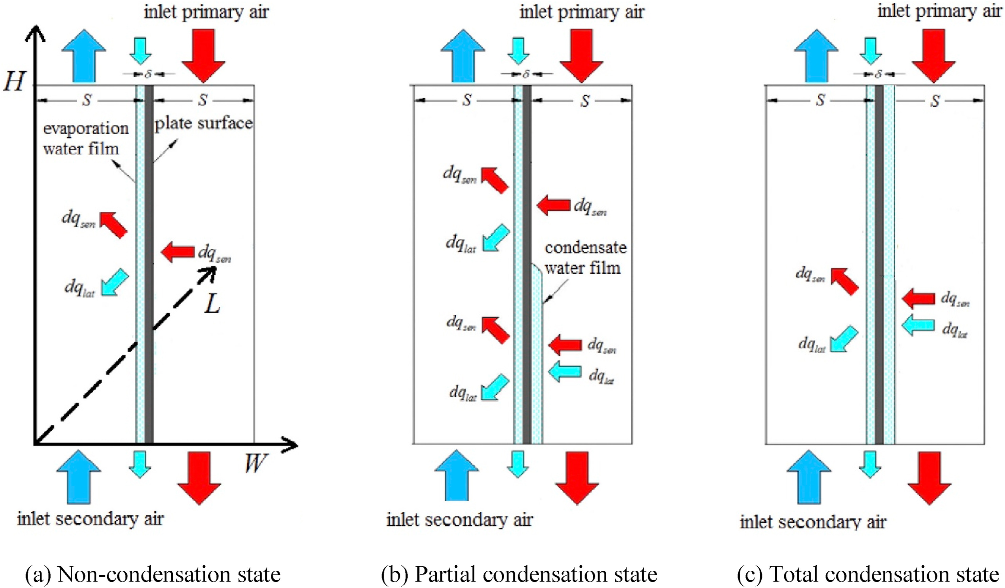
1. Research background and literature review
研究背景与文献综述
1.4 Research on previous model 现有 IEC 模型研究
Fig.1.3.5 Previous model of the IEC
Assumption: the thin water film entirely and evenly covered the surface of the wet channel. 假设：水膜完整、均匀覆盖湿通道。
Ideal! 理想！

Slide 10
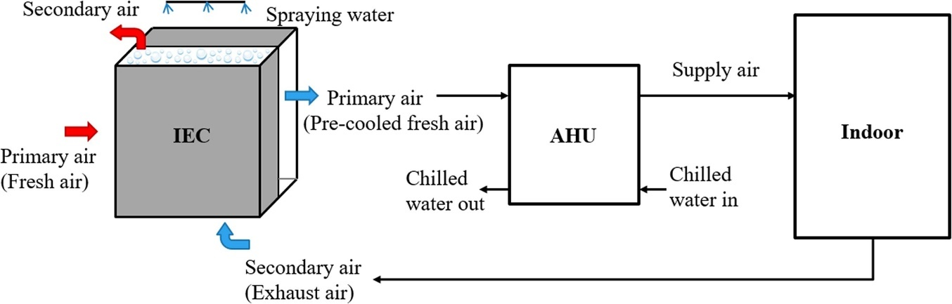
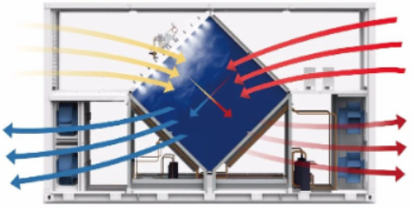
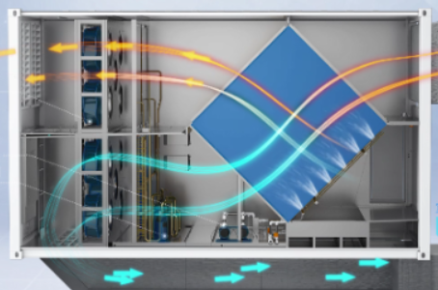
1. Research background and literature review
研究背景与文献综述
1.5 IEC as the recovery unit IEC 作为能量回收单元
Fig.1.5.1 Schematics diagram of IEC followed by AHU
Various nozzle settings for diamond-shaped IEC 菱形 IEC 的不同喷嘴布置方式
A more standardized nozzle arrangement guideline has not yet emerged. 尚缺乏标准化的喷嘴布置指导方法。

Slide 11
Outline 汇报提纲
Research background and literature review
研究背景与文献综述
Research gaps and objectives
研究不足与目标
Development of FDM model for spray distribution optimization of IEC
喷淋分布的 FDM 建模与优化
Development of CFD model for IEC considering water film formation with spray parameter analysis
考虑水膜形成的 CFD 分析
Performance assessment and optimization of water spray strategy for IEC based on ANN modeling and GA
基于 ANN–GA 的喷淋策略优化
Performance analysis and nozzle setting optimization of IEC for energy recovery in data centers
数据中心 IEC 性能与喷嘴优化
Conclusions and recommendations for future work
结论与未来研究方向

Slide 12
2. Research gaps and objectives
研究不足与目标
  2.1 Research gaps 研究不足
Most of the existing analysis about water spray of IEC are based on experimental data, and few mathematical models can quantitatively simulate the various parameters.
现有 IEC 喷淋分析多依赖实验数据，能够定量模拟各项参数的数学模型较少。
The existing heat and mass transfer model of IEC has not fully discussed on the wetting ratio, and the ideal assumption needs to be corrected.
现有传热传质模型对润湿率的讨论不足，需修正完全润湿的理想假设。
The current 2D model is not enough to accurately simulate the state of the water film distribution, and to deal with more complex hydraulic and thermal properties.
二维模型难以准确描述水膜分布，也难以处理复杂的水力与热力特性。
The optimal nozzle arrangement and parameter setting to maintain the best wetted situation of the IEC wet channel have not been identified.
湿通道达到最佳润湿状态所需的喷嘴布置与参数尚不明确。
There is a need for straightforward method to predict the IEC performance for use in reality and optimize spray design parameters in large scale projects.
大型工程需要简便、高效的 IEC 性能预测与喷淋参数优化方法。
The diamond-shaped IEC used as heat recovery units combined with AHU in DCs require targeted water spray system settings.
数据中心采用的菱形 IEC 与空气处理机组（AHU）耦合时，需要有针对性的喷淋设计。

Slide 13
2. Research gaps and objectives
研究不足与目标
  2.2 Research objectives 研究目标
To propose a FDM model for predicting the water spray distribution of the nozzles in IEC.
建立有限差分（FDM）模型，预测 IEC 喷嘴的喷淋分布。
To establish a 3D CFD model to identify the formation and flow state of the water membrane covering the plate surface.
建立三维 CFD 模型，研究换热板表面水膜的形成与流动状态。
To set up the test bench with the complete IEC system that can investigate the practical wetted sections in single channel pair for model verification.
搭建完整 IEC 实验台，测量单对通道的实际润湿区域并验证模型。
To conduct the parametric analysis and determine the optimal water spraying strategies for IEC system.
开展参数分析，确定 IEC 系统的最优喷淋策略。
To develop high-efficiency prediction model based on ML to accurately predict the performance of IEC system combined with genetic algorithm for multi-objective optimization.
建立高效的机器学习预测模型，结合遗传算法开展多目标优化。
To establish and verified a CFD model based on the diamond-shaped IEC to explore the optimal nozzle configurations and performances, as well as the enhancement strategies for IEC in DCs
建立并验证菱形 IEC 的 CFD 模型，优化喷嘴布置并研究数据中心应用中的性能强化策略。
Notes:
PIEC model to do the parameter analysis as and determine the inter…
Compare

Slide 14
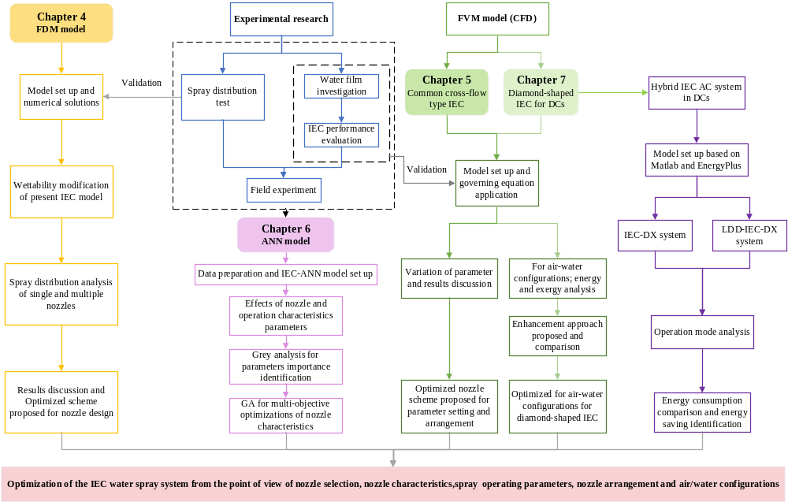
Section 3
第3部分
FDM model
FDM 模型
Section 4
第4部分
Common cross-flow type IEC
常规叉流式 IEC
Section 6
第6部分
Diamond-shaped IEC
菱形 IEC
Section 5
第5部分
ANN model
ANN 模型
Notes:
PIEC model to do the parameter analysis as and determine the inter…
Compare

Slide 15
Outline 汇报提纲
Research background and literature review
研究背景与文献综述
Research gaps and objectives
研究不足与目标
Development of FDM model for spray distribution optimization of IEC
喷淋分布的 FDM 建模与优化
Development of CFD model for IEC considering water film formation with spray parameter analysis
考虑水膜形成的 CFD 分析
Performance assessment and optimization of water spray strategy for IEC based on ANN modeling and GA
基于 ANN–GA 的喷淋策略优化
Performance analysis and nozzle setting optimization of IEC for energy recovery in data centers
数据中心 IEC 性能与喷嘴优化
Conclusions and recommendations for future work
结论与未来研究方向

Slide 16
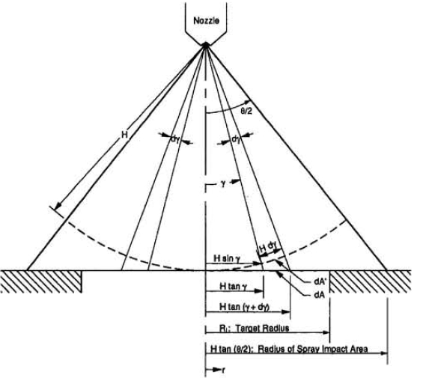
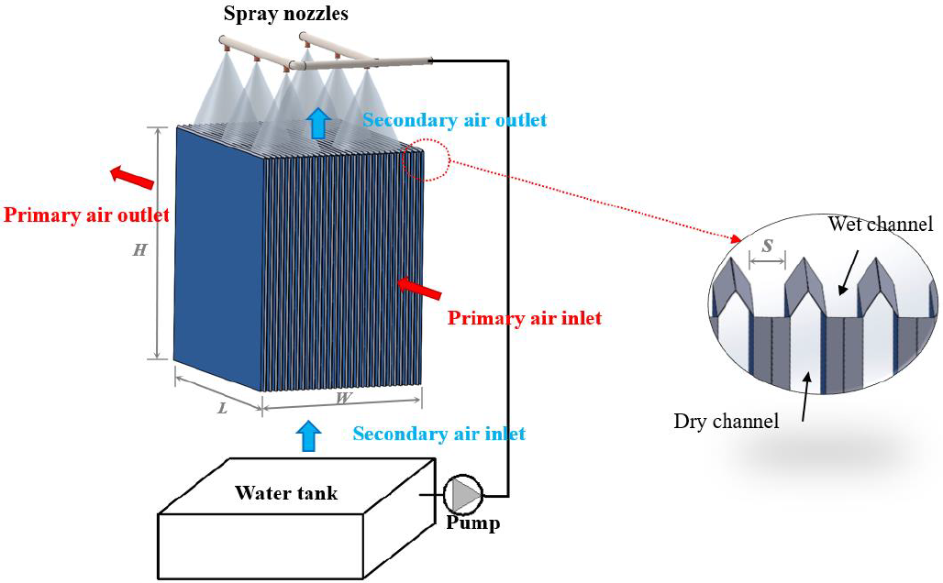
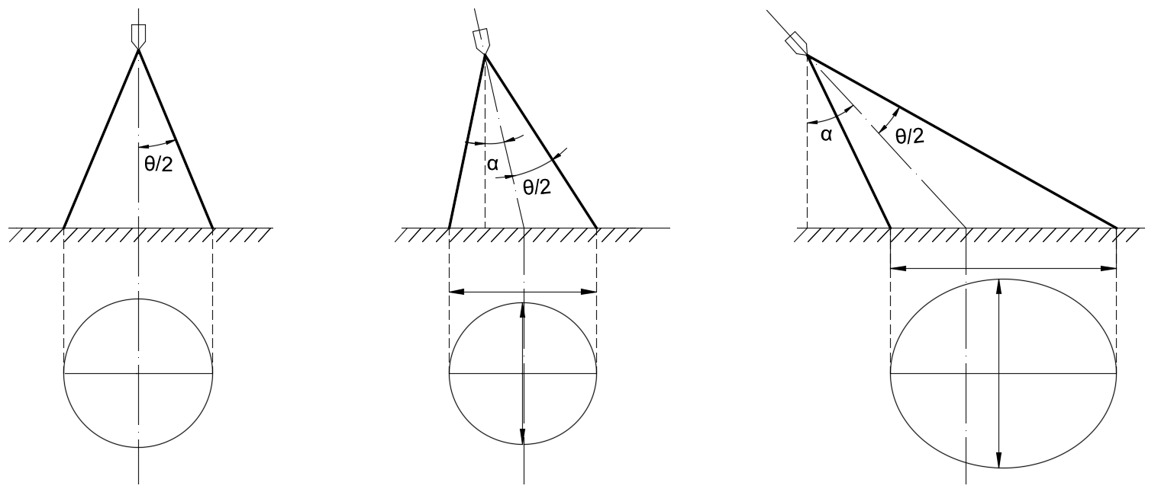
3. Development of FDM model for nozzle optimization of IEC
喷淋分布的 FDM 建模与优化
  3.1 Mathematical model 数学模型
Fig. 3.1.2 Geometry used in volumetric flux distribution model ^{[1]}
Fig. 3.1.1 Configuration of an IEC system
Assumption：
模型假设：
The total spray flow rate, Q, is uniformly distributed over any spherical surface centered at the spray orifice.
总喷淋流量 Q 在以喷口为球心的任一球面上均匀分布。
Fig. 3.1.3 Three scenarios of spray impact area
[1] Mudawar I, Estes KA. Optimizing and predicting CHF in spray cooling of a square surface. J Heat Transfer 1996;118:672–9. https://doi.org/10.1115/1.2822685.

Slide 17
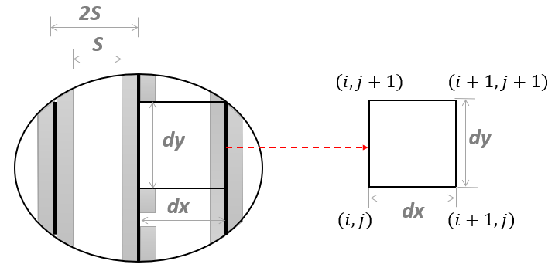
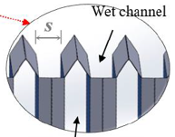
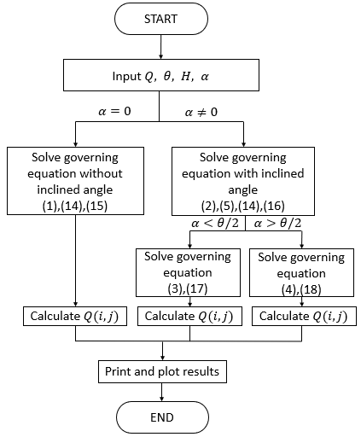
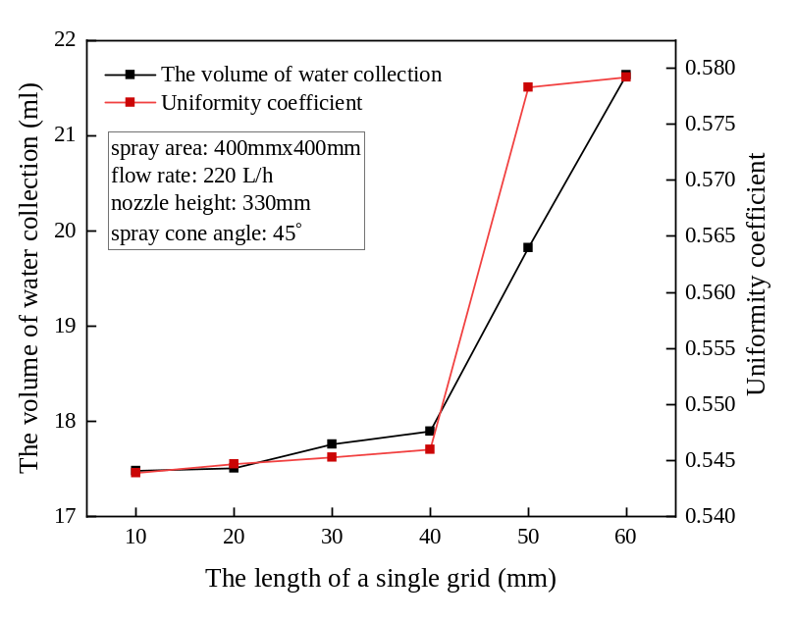
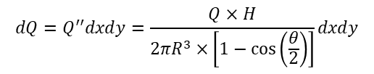

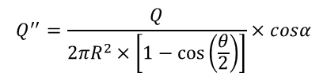
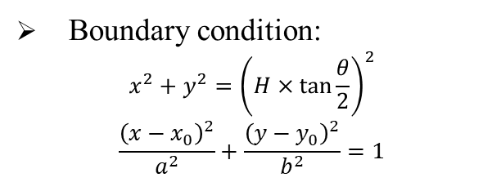


3. Development of numerical model for nozzle optimization of IEC
喷淋分布的 FDM 建模与优化
3.2 Model equations 模型方程
Differential element division: 微元划分：
Simulation process (MATLAB) 模拟流程（MATLAB）
Boundary condition:
$$\begin{aligned}x^{2}+y^{2}={\left(H×\tan{\frac{θ}{2}}\right)}^{2}\end{aligned}$$
$$\begin{aligned}\frac{{\left(x−x_{0}\right)}^{2}}{a^{2}}+\frac{{\left(y−y_{0}\right)}^{2}}{b^{2}}=1\end{aligned}$$
Imaginary spherical surface: 假想球面：
$$\begin{aligned}Q_{(i,j)}=\int_{x_{i}}^{x_{i+1}}{\int_{y_{i}}^{y_{i+1}}{\frac{Q×H}{{2π\left(\sqrt{x^{2}+y^{2}+H^{2}}\right)}^{3}×\left[1−\cos\left(\frac{θ}{2}\right)\right]}dxdy}}\#\end{aligned}$$
$$R=\sqrt{x^{2}+y^{2}+H^{2}}$$
$$cosα=\frac{H}{R}$$
$$\begin{aligned}dA={2πR}^{2}×\frac{sinα}{cosα}dα\#\end{aligned}$$
$$\begin{aligned}A={2πR}^{2}×\frac{\left[1−\cos\left(\frac{θ}{2}\right)\right]}{cosα}\#\end{aligned}$$
Grid independence: 网格无关性：
Volume flux of spray surface area: 喷淋表面的体积通量：
$$\begin{aligned}&Q^{′′}=\frac{Q}{{2πR}^{2}×\left[1−\cos\left(\frac{θ}{2}\right)\right]}×cosα\#\end{aligned}$$
Fig. 3.2.2 Flow chart of simulation procedure
$$dQ=Q^{′′}dxdy=\frac{Q×H}{{2πR}^{3}×\left[1−\cos\left(\frac{θ}{2}\right)\right]}dxdy$$
Fig.3.2.1 Proof of grid independence

Slide 18
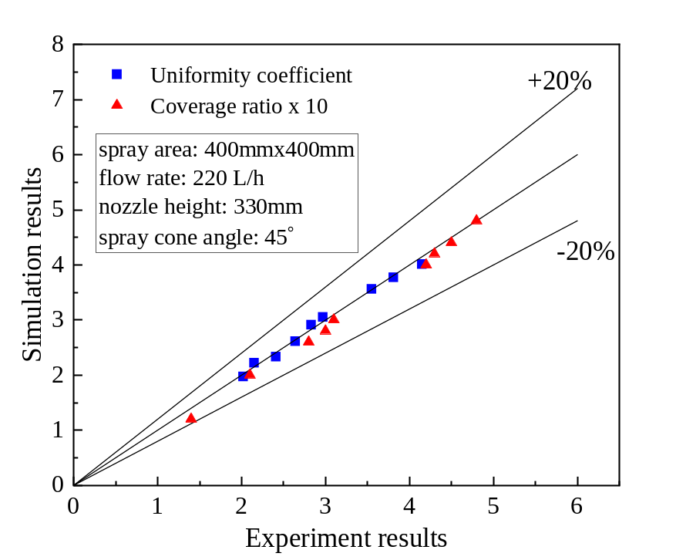
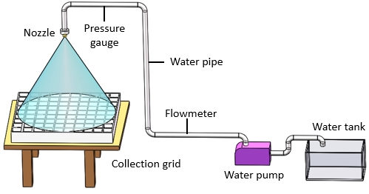
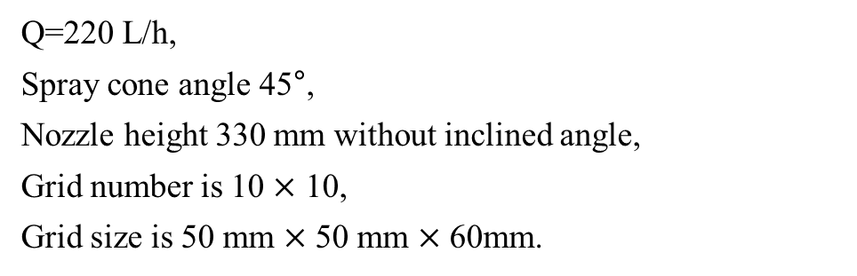
3. Development of numerical model for nozzle optimization of IEC with experimental validation
喷淋分布的 FDM 建模与优化
3.3 Experiment validation 实验验证
Validation result: 验证结果：
Condition: 实验条件：
Q=220 L/h,
Spray cone angle 45°,
Nozzle height 330 mm without inclined angle,
Grid number is 10 $×$ 10,
Grid size is 50 mm $×$ 50 mm $×$ 60mm.
Fig. 3.3.2 Validation results
The maximum discrepancy is acceptable. 最大偏差在可接受范围内。
Fig. 3.3.1 Experiment bench

Slide 19
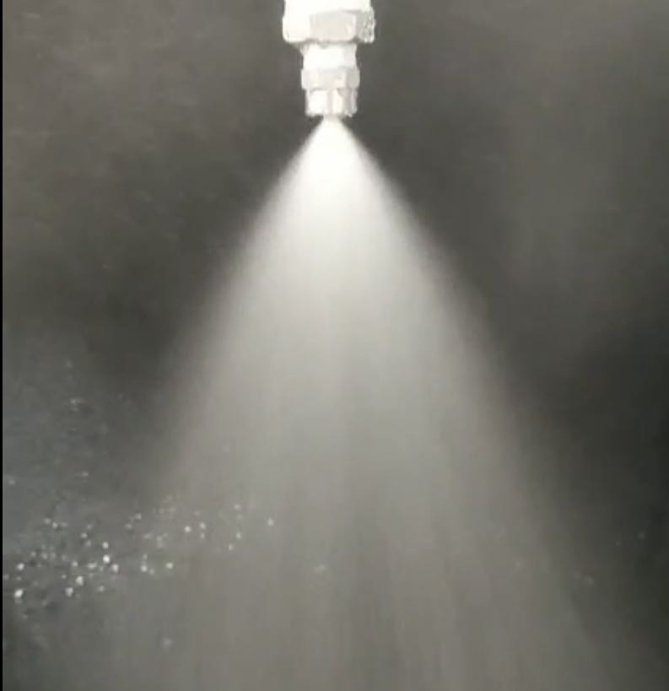
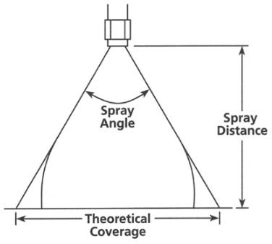
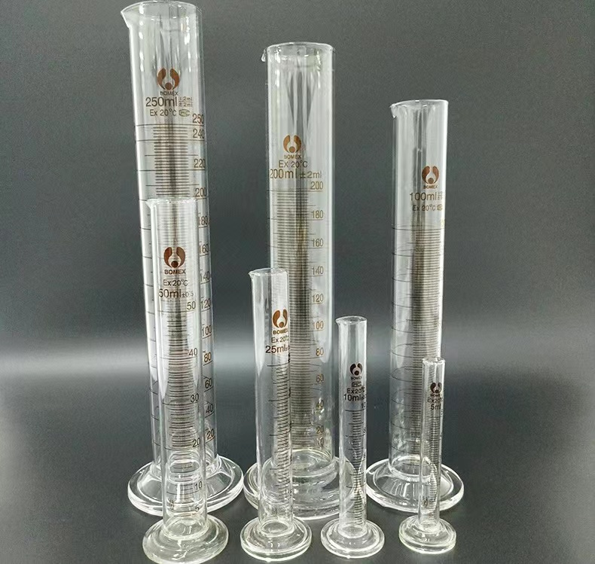
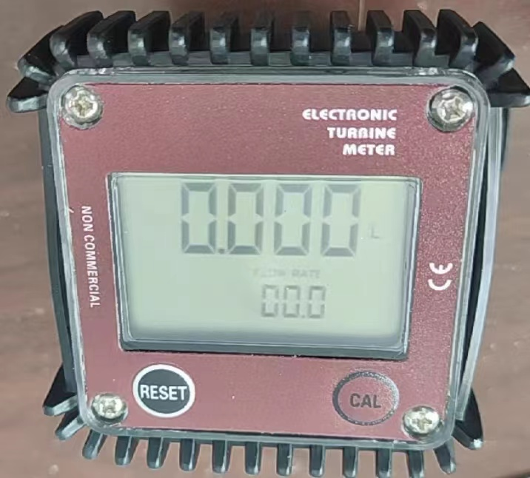
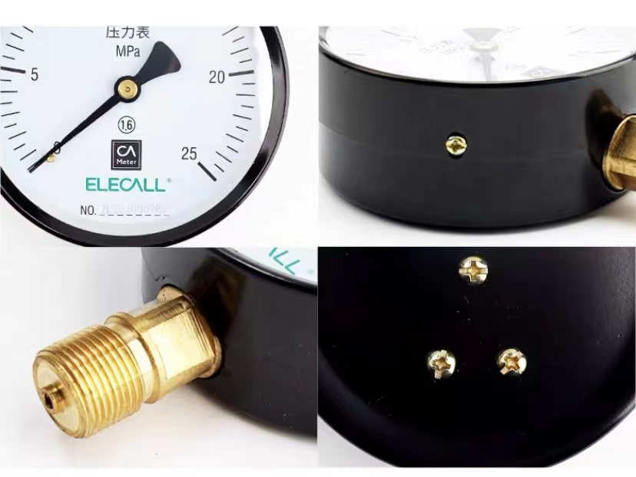
  Appendix 附录
Instrument selection 实验仪器选型
Table 8.1 Solid nozzle selection
Nozzle | Orifice diameter (mm) | Volumetric flow rate | Pressure | Spray angle
1 | 2.4 | 1.9-8.4 | 0.4-10 | 45-50
2 | 3.0 | 2.9-13 | 0.4-10 | 60-70
3 | 3.2 | 6.7-16.2 | 0.4-10 | 70-75
Fig. 3.3.1 Photos of the nozzles
Table 8.2 Instrument parameters list
Instrument | Parameter | Range | Accuracy
Flowmeter | Water flow rate | 1.9-8.4 | 0.4-10
Pressure gage | Water pressure | 2.9-13 | 0.4-10
Measuring cylinder | Water volume | 6.7-16.2 | 0.4-10
Fig. 8.3 Photos of test instrument

Slide 20

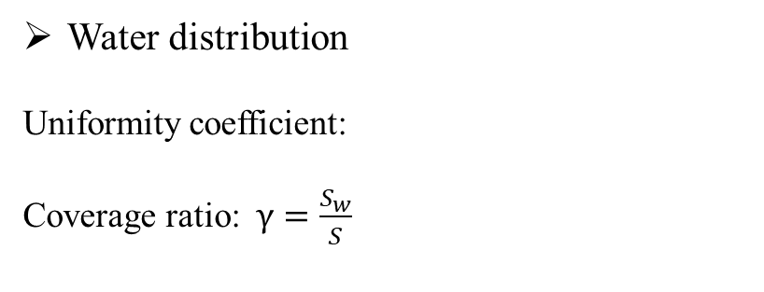
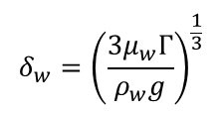

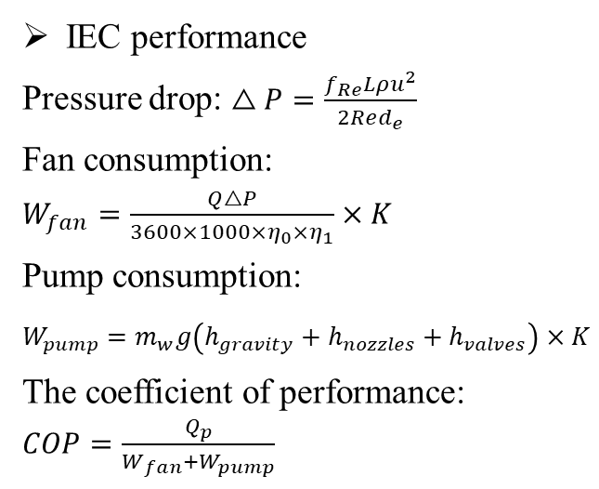
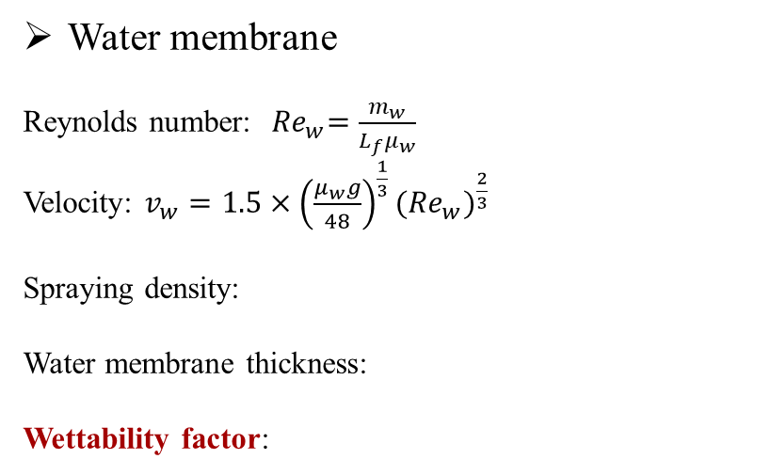

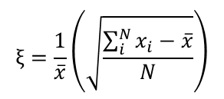

3. Development of numerical model for nozzle optimization of IEC with experimental validation
喷淋分布的 FDM 建模与优化
3.4 Performance indexes 性能评价指标
Water distribution
Uniformity coefficient:
Coverage ratio: $γ=\frac{S_{w}}{S}$
IEC performance
Pressure drop: $\begin{aligned}△P=\frac{f_{Re}Lρu^{2}}{2Red_{e}}\end{aligned}$
Fan consumption: $\begin{aligned}W_{fan}=\frac{Q△P}{3600×1000×η_{0}{×η}_{1}}×K\end{aligned}$
Pump consumption: $\begin{aligned}W_{pump}=m_{w}g\left(h_{gravity}+h_{nozzles}+h_{valves}\right)×K\end{aligned}$
The coefficient of performance: $COP=\frac{Q_{p}}{W_{fan}+W_{pump}}$
$$ξ=\frac{1}{\overline{x}}\left(\sqrt{\frac{\sum_{i}^{N}{x_{i}−\overline{x}}}{N}}\right)$$
Water membrane
Reynolds number:${ Re}_{w}=\frac{m_{w}}{L_{f}μ_{w}}$
Velocity: $v_{w}=1.5×{\left(\frac{μ_{w}g}{48}\right)}^{\frac{1}{3}}{({Re}_{w})}^{\frac{2}{3}}$
Spraying density:
Water membrane thickness:
Wettability factor:
Wet-bulb efficiency:
湿球效率：
Cooling capacity:
制冷量：
$$Γ=\frac{{\dot{m}}_{w}}{\left(n+1\right)L_{f}}$$
$$η_{wb}=\frac{t_{p,in}−t_{p,out}}{t_{p,in}−t_{wb,s,in}}$$
$$δ_{w}={\left(\frac{{3μ}_{w}Γ}{ρ_{w}g}\right)}^{\frac{1}{3}}$$
$$Q_{c}=m_{p}c_{pa}\left(t_{p,in}−t_{p,out}\right)$$
$$σ={\dot{m}}_{w}\frac{h}{2δ_{w}v_{w}ρ_{w}}$$

Slide 21
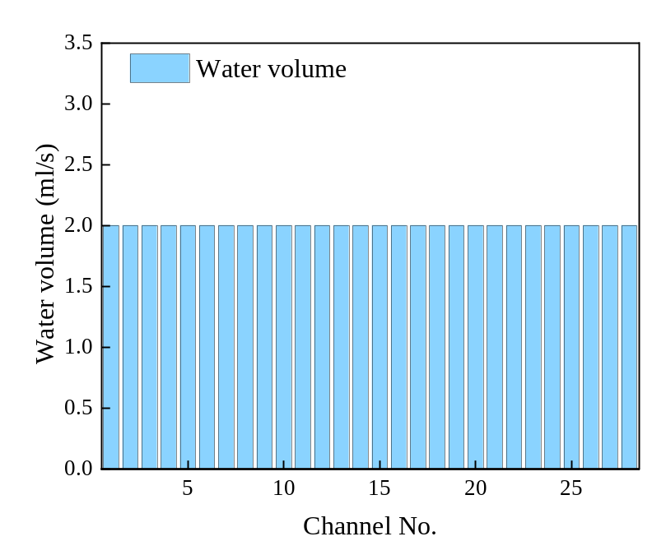
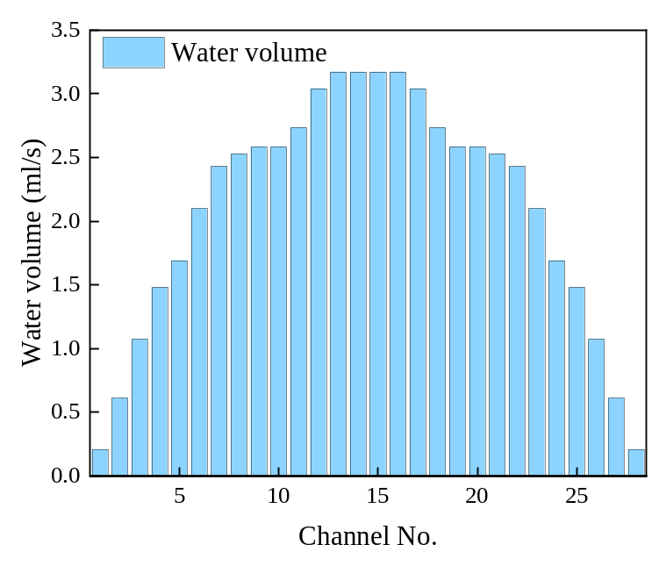
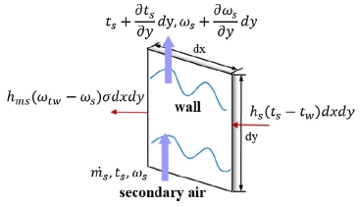

3. Development of numerical model for nozzle optimization of IEC with experimental validation
喷淋分布的 FDM 建模与优化
3.5 Results and discussions 结果与讨论
3.5.1 The water density and wettability in channels 通道内的喷淋密度与润湿性
Water density modification 喷淋密度修正
Original spraying density: 原始喷淋密度：
$$Γ=\frac{{\dot{m}}_{w}}{\left(n+1\right)L_{f}}$$
Fig. 3.5.1 Heat and mass transfer of the
secondary air flow channel
Ideal scenario 理想工况
Reality scenario 实际工况

Slide 22
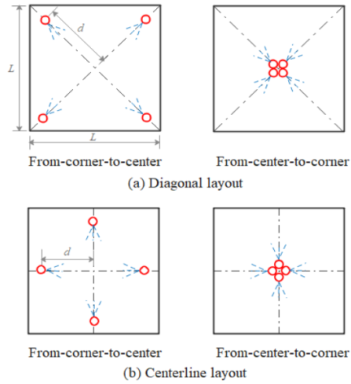
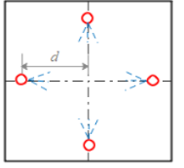
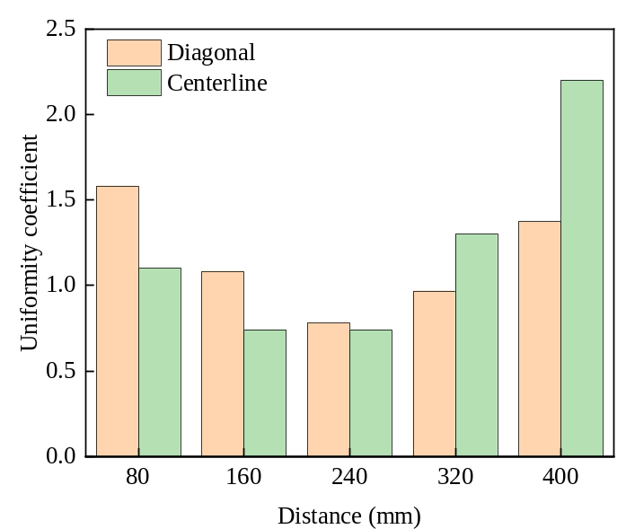
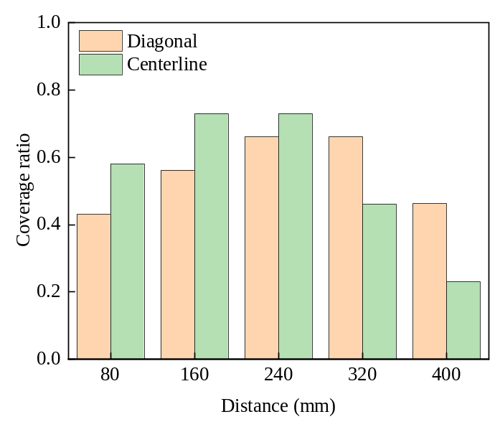
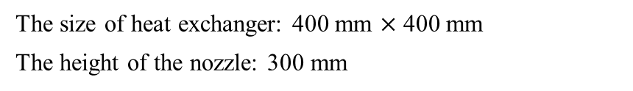
3. Development of numerical model for nozzle optimization of IEC with experimental validation
喷淋分布的 FDM 建模与优化
3.5 Results and discussions 结果与讨论
3.5.2 Results of multiple nozzles 多喷嘴喷淋结果
Arrangement schemes 喷嘴布置方案
The size of heat exchanger: 400 mm $×$ 400 mm
The height of the nozzle: 300 mm
(a) Diagonal (b) Centerline （a）对角线布置 （b）中心线布置
Fig. 3.5.2 Nozzle arrangement schemes
The effect of the nozzle distance on the spray distribution 喷嘴间距对喷淋分布的影响
Uniformity coefficient 均匀性系数
Coverage ratio 覆盖率
Spray optimal arrangement: Centerline with 160 mm distance. 最优布置：沿中心线布置，喷嘴间距为 160 mm。
Uniformity coefficient is 0.74 and coverage ratio is 0.72. 均匀性系数为 0.74，覆盖率为 0.72。

Slide 23
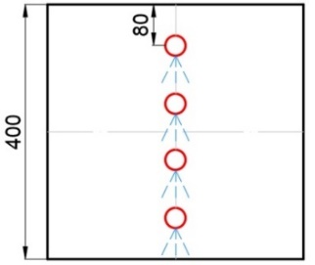
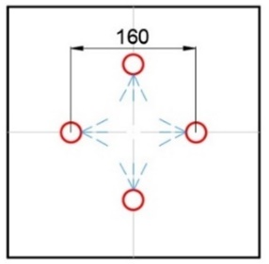
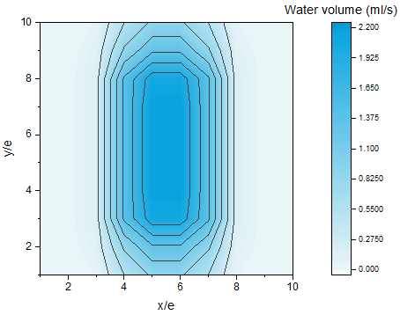

3. Development of numerical model for nozzle optimization of IEC with experimental validation
喷淋分布的 FDM 建模与优化
3.5 Results and discussions 结果与讨论
3.5.3 Comparison between original and optimized schemes 原始与优化布置方案对比
Original arrangement scheme 原始布置方案
Optimized arrangement scheme 优化布置方案
Fig. 3.5.3 Original arrangement scheme
Fig. 3.5.4 Optimized arrangement scheme
Wettability value: 0.48 润湿系数：0.48
Wettability value: 0.89 润湿系数：0.89
46%

Slide 24



3. Development of numerical model for nozzle optimization of IEC with experimental validation
喷淋分布的 FDM 建模与优化
3.5 Results and discussions 结果与讨论
3.5.4 Performance improvement with optimized nozzle arrangement 优化喷嘴布置带来的性能提升
For dehumidification 除湿性能
For COP value 性能系数（COP）
Fig. 15 Average value of COP
Fig. 3.5.5 Average value of the dehumidification rate
Fig. 3.5.6 Average value of the COP
The improvement of dehumidification rate is 5.85% .
除湿率提高 5.85%。
The improvement of COP value is 16% .
性能系数（COP）提高 16%。

Slide 25
Outline 汇报提纲
Research background and literature review
研究背景与文献综述
Research gaps and objectives
研究不足与目标
Development of FDM model for spray distribution optimization of IEC
喷淋分布的 FDM 建模与优化
Development of CFD model for IEC considering water film formation with spray parameter analysis
考虑水膜形成的 CFD 分析
Performance assessment and optimization of water spray strategy for IEC based on ANN modeling and GA
基于 ANN–GA 的喷淋策略优化
Performance analysis and nozzle setting optimization of IEC for energy recovery in data centers
数据中心 IEC 性能与喷嘴优化
Conclusions and recommendations for future work
结论与未来研究方向

Slide 26




4. Development of CFD model for IEC considering water film formation with spray parameter analysis
考虑水膜形成的 CFD 分析
4.1 Model description (ANSYS) 模型描述（ANSYS）
Flowchart 建模流程
Model of single wet channel 单个湿通道模型
Different heat transfer for different coverage area 不同润湿区域的传热过程
Fig.4.1.3 Geometry used in volumetric flux distribution model
Fig.4.1.2 Configuration of an IEC system
$$φ=\frac{A_{w}}{A_{pl}}$$
Coverage factor: 覆盖系数：

Slide 27














4. Development of CFD model for IEC considering water film formation with spray parameter analysis
考虑水膜形成的 CFD 分析
4.2 Model equations 模型方程
(1) Conservation of mass （1）质量守恒
(5) Discrete phase model (DPM) （5）离散相模型（DPM）
$$\frac{∂}{∂t}\left(ρ\right)+∇∙\left(ρu\right)=0$$
$$\frac{d\left(\vec{X_{g}}\right)}{dt}=\vec{V_{g}}$$
(2) Conservation of momentum （2）动量守恒
$$\frac{d\left(m_{d}\vec{F_{d}}\right)}{dt}=\vec{F_{D}}+\vec{F_{g}}$$
$$\frac{∂}{∂t}\left(ρE\right)+∇∙\left(ρu^{2}\right)=−∇P+∇∙\left(μ\left(∇u+∇u^{T}\right)\right)+ρg+F$$
$${\vec{F}}_{d}=−\frac{π}{8}C_{D}ρ_{a}D_{d}^{2}{\vec{V}}_{r}\left|{\vec{V}}_{r}\right|$$
(3) Mass transfer （3）传质
(6) Turbulence model （6）湍流模型
$$h_{ms}\left(ω_{t_{w}}−ω_{s}\right)σ∙dxdy={\dot{m}}_{s}\frac{∂ω_{s}}{∂y}∙dy$$
$${Re}_{s}=4\overline{ω}δ/v$$
Applied $k−ε$ turbulence model
$$\frac{∂ω_{e}}{∂y}={\dot{m}}_{s}\frac{∂ω_{s}}{∂y}$$
(7) Calculation method （7）求解方法
(4) VOF multi-phase model （4）流体体积（VOF）多相流模型
EWF coupled DPM model 欧拉壁膜（EWF）与 DPM 耦合模型
$$ρ=α_{1}ρ_{1}+α_{g}+ρ_{g}$$
The SIMPLE and PRESTO! pressure 采用 SIMPLE 算法与 PRESTO! 压力插值格式
$$μ=α_{1}μ_{1}+α_{g}+μ_{g}$$
Fig.4.2.1 Sketch of meshing in the model
$$\frac{∂α_{1/g}}{∂t}+\vec{u}∙∇α_{1/g}=0$$

Slide 28




4. Development of CFD model for IEC considering water film formation with spray parameter analysis
考虑水膜形成的 CFD 分析
4.3 Model validation 模型验证
Illustration of the experimental and numerical results 实验与数值模拟结果对比
Grid independence 网格无关性
(a) Experimental plate （a）实验板面
(b) Numerical result （b）数值模拟结果
Fig.4.3.1 Coverage ratio at different numbers of grid
The grid number of 113200 could be decided as the simulation number for further research. 后续模拟采用 113,200 个网格。
(c) Experimental result in ImageJ （c）ImageJ 处理后的实验结果
The ICEM software in ANSYS was applied to the mesh computational model. 采用 ANSYS ICEM 对计算模型进行网格划分。

Slide 29


4. Development of CFD model for IEC considering water film formation with spray parameter analysis
考虑水膜形成的 CFD 分析
4.4 Environment validation 实验验证
Conditions: 实验条件：
Validation result: 验证结果：
Q=0.01 kg/s;
流量 Q = 0.01 kg/s
Spray cone angle = 45°;
喷雾锥角 = 45°
Nozzle height =150 mm
喷嘴高度 = 150 mm
Requirements: 实验要求：
Outermost transparent casing;
外壳采用透明材料；
Sliding nozzles mounted on top
顶部安装可滑动喷嘴。
Fig.4.4.2 Validation results
The maximum discrepancy is 7.1%, which was acceptable for the further analysis. 最大偏差为 7.1%，满足后续分析要求。
Fig.4.4.1 Experiment bench

Slide 30


4. Development of CFD model for IEC considering water film formation with spray parameter analysis
考虑水膜形成的 CFD 分析
4.4 Environment validation 实验验证
Experiment bench 实验台
Validation result: 验证结果：
Fig.4.4.4 Validation results
Fig.4.4.3 Validation results
The maximum discrepancy is 8.2%, which was acceptable for the further analysis. 最大偏差为 8.2%，满足后续分析要求。

Slide 31





  Appendix 附录
Spray characteristics 喷雾特性
Theoretical mass flow rate is given by Lefebvre and McDonell 理论质量流量采用 Lefebvre 与 McDonell 的关联式计算。
$${\dot{m}}_{th}=ρA_{O}{(\frac{2∆P}{ρ})}^{0.5}$$
The average droplet diameter is obtained from the following equation: 平均液滴直径由下式计算：
$$d=9.5d_{j}/(∆P_{1}sin(α/2))$$
The correlation for spray cone angle based on inviscid theory (Abramovich, 1944) overpredicts the spray cone angle by 25%.
基于无黏理论的喷雾锥角关联式（Abramovich，1944）会将喷雾锥角高估约 25%。
$$2α=334.32K^{−0.165}{(\frac{D_{S}}{D_{O}})}^{−0.484}W_{e}^{0.043}{Re}_{p}^{−0.065}$$
Fig. 8.4 Nozzle spray characteristics
Ideal object: nozzle with a orifice diameter of 3.0 mm
Operating condition: at a pressure of 1.5 bar, the spray flow rate is 5.4 L/min, the spray cone angle is 68$°$.
The parameters are interrelated and cannot be adjusted individually.
各喷淋参数相互关联，不能独立调节。
Maximise the film coverage and to balance the effects of each factor.
需平衡各因素影响，以最大化水膜覆盖率。

Slide 32






4. Development of CFD model for IEC considering water film formation with spray parameter analysis
考虑水膜形成的 CFD 分析
4.5 Results and discussions 结果与讨论
4.5.1 Influence for single nozzle 单喷嘴参数的影响
Spray droplet diameter 喷雾液滴直径
0.05 mm
0.15 mm
0.25 mm
Fig. 4.5.2 Coverage ratio with different diameter
Droplet flow is counter-current to the airflow.
液滴与气流呈逆流运动。
Too small, be blown away before contact with the plate surface.
液滴过小：接触板面前易被气流吹离。
Two large, slide out of the wet channel before making contact with the plate surface.
液滴过大：接触板面前可能滑出湿通道。
0.35 mm
0.45 mm
Fig. 4.5.1 Coverage area with different diameter

Slide 33




4. Development of CFD model for IEC considering water film formation with spray parameter analysis
考虑水膜形成的 CFD 分析
4.5.2 Influence for multiple nozzles 多喷嘴参数的影响
Spray distance 喷嘴间距
0 mm
20 mm
Fig. 4.5.4 Impact of nozzle gap on coverage factor
The best wetting situation of the plate surface occurs at a nozzle of 40 mm (1) and the gap was 80 mm (2).
在图示布置下，喷嘴位置参数为 40 mm（1）、间距为 80 mm（2）时，板面润湿效果最佳。
The spray of nozzles are too far apart causing some droplets to escape from the boundary.
喷嘴间距过大，部分液滴会逸出边界。
While being too close caused a large number of spray droplets to collide and splash against each other.
喷嘴间距过小，大量液滴相互碰撞并飞溅。
40 mm
60 mm
Fig. 4.5.3 Variation of the nozzle distance

Slide 34







4. Development of CFD model for IEC considering water film formation with spray parameter analysis
考虑水膜形成的 CFD 分析
4.5.3 Influence on IEC performance 对 IEC 性能的影响
Conventional scheme 常规方案
Optimized scheme 优化方案
Linear distribution 线性布置
Triangular distribution 三角形布置
Fig. 4.5.5 Comparison between conventional and optimized schemes
The water film coverage ratio of conventional and optimized schemes are 0.72 and 0.91.
常规方案与优化方案的水膜覆盖率分别为 0.72 和 0.91。
Most rapid temperature drop at the top of the heat exchanger plate, due to the widest area covered by the water film and the longest contact between airflow and water flow.
换热板顶部降温最快，因为该区域水膜覆盖最广，气流与水流接触时间最长。

Slide 35




4. Development of CFD model for IEC considering water film formation with spray parameter analysis
考虑水膜形成的 CFD 分析
4.5.4 The effect of inlet parameter of primary air and secondary air 一次、二次空气入口参数的影响
Inlet temperature of primary air 一次空气入口温度
An inlet air temperature of 32°C, with increases of 15.1% and 17.6% for 𝜀𝑤 and COP. 入口温度为 32 ℃ 时，湿球效率与 COP 分别提高 15.1% 和 17.6%。
Inlet velocity of secondary air 二次空气入口速度
An inlet air velocity of 2 m/s, with increases of 10.4% and 14.9% for 𝜀_{𝑤} and COP. 入口速度为 2 m/s 时，湿球效率与 COP 分别提高 10.4% 和 14.9%。

Slide 36
Outline 汇报提纲
Research background and literature review
研究背景与文献综述
Research gaps and objectives
研究不足与目标
Development of FDM model for spray distribution optimization of IEC
喷淋分布的 FDM 建模与优化
Development of CFD model for IEC considering water film formation with spray parameter analysis
考虑水膜形成的 CFD 分析
Performance assessment and optimization of water spray strategy for IEC based on ANN modeling and GA
基于 ANN–GA 的喷淋策略优化
Performance analysis and nozzle setting optimization of IEC for energy recovery in data centers
数据中心 IEC 性能与喷嘴优化
Conclusions and recommendations for future work
结论与未来研究方向

Slide 37


5. Performance assessment and optimization of water spray strategy for IEC based on ANN modeling and GA
基于 ANN–GA 的喷淋策略优化
  5.1 Concept and model set up 研究思路与模型建立
Data preparation 数据准备
Table 5.1.1 Solid nozzle selection
The six parameters of the spray system that affect the performance of IEC can be identified in the table.
表中列出了影响 IEC 性能的六项喷淋参数。
Evaluation indexes: wet-bulb efficiency and pressure drop.
评价指标：湿球效率与压降。
Collection of experimental data 实验数据采集
(weight ratio) （权重比）
Conducted on a laboratory-scale prototype of the IEC system
采用实验室尺度的 IEC 原型开展研究。
Components: cross-flow heat exchanger, nozzles and water pump.
主要部件：叉流换热器、喷嘴和水泵。
Keep the other basic parameters of the IEC constant, change the six main parameters, and record the effects.
保持其他基础参数不变，改变六项主要参数并记录性能变化。
Fig.5.1.1 Schematic diagram of the IEC system

Slide 38


5. Performance assessment and optimization of water spray strategy for IEC based on ANN modeling and GA
基于 ANN–GA 的喷淋策略优化
  5.2 Design of model setting 神经网络模型设计
A 3-layer network with a hidden layer comprising 14 neurons, can effectively capture the relationship between the input and output variables.
采用三层神经网络，隐含层包含 14 个神经元，用于建立输入与输出变量之间的映射关系。
The dataset could be divided into three sections: the training dataset, validation dataset, and testing dataset, with portions of 70%, 15%, and 15%, correspondingly
数据集按 70%、15%、15% 划分为训练集、验证集和测试集。
Equations describe the model 模型描述方程
Input layer
$$X={\left(x_{1},x_{2},…,x_{i},x_{n}\right)}^{T}$$
Hidden layer
$$net_{j}=w_{1j}⋅x_{1}+…+w_{nj}⋅x_{n}$$
$$h_{j}=f\left(net_{j}−a_{j}\right)$$
$$H={\left(h_{1},h_{2},…,h_{j},…,h_{i}\right)}^{T}$$
Hidden layer
$$net_{k}=w_{1k}⋅h_{1}+…+w_{lk}⋅h_{l}$$
$$o_{k}=g\left(net_{k}−b_{k}\right)$$
$$O={\left(o_{1},o_{2},…o_{k},…o_{m}\right)}^{T}$$
$$Y={\left(y_{1},y_{2},…,y_{k},…,y_{m}\right)}^{T}$$
Fig.5.2.1 Structure of the IEC-ANN model

Slide 39





5. Performance assessment and optimization of water spray strategy for IEC based on ANN modeling and GA
基于 ANN–GA 的喷淋策略优化
  5.3 Model validations 模型验证
Evaluation metrics of neural network 神经网络评价指标
Coefficient of determination (r²)
$$r^{2}=\frac{{\left[n\sum_{k=1}^{n}{Y_{P}\left(k\right)}Y_{T}\left(k\right)−\sum_{k=1}^{n}{Y_{P}\left(k\right)}\sum_{k=1}^{n}{Y_{T}\left(k\right)}\right]}^{2}}{[n{\sum_{k=1}^{n}{Y_{P}{\left(k\right)}^{2}\left[\sum_{k=1}^{n}{Y_{P}\left(k\right)}\right]}}^{2}]{\left[n\sum_{k=1}^{n}{Y_{P}{\left(k\right)}^{2}[}\sum_{k=1}^{n}{Y_{T}\left(k\right)}\right]}^{2}]}$$
Root mean square error (RMSE)
$$RMSE=\sqrt{\frac{\frac{n}{i=k}{\left(Y_{P}\left(k\right)−Y_{T}\left(k\right)\right)}^{2}}{n}}$$
Validation results 验证结果
Validation results for $ε_{wb}$
Validation results for $∆P$
Fig.5.3.1 Validation results of the proposed IEC-ANN model

Slide 40





5. Performance assessment and optimization of water spray strategy for IEC based on ANN modeling and GA
基于 ANN–GA 的喷淋策略优化
  5.4 Results and discussions 结果与讨论
5.4.1 Effect of variations in a single factor 单因素变化的影响
Effect of pressure on droplet diameter and coverage ratio 压力对液滴直径和覆盖率的影响
Nozzle characteristics parameters 喷嘴特性参数
(a) Effect of pressure on cone angle （a）压力对喷雾锥角的影响
(b) Effect of pressure on flow rate （b）压力对流量的影响
(a) The peak value of 67° is achieved at a pressure of 0.15 MPa.
(b) The increasing trend of spray flow rate with the rise in pressure.
(c) The trend of $ε_{wb}$ with pressure is consistent with spray angle.
(d) The maximum coverage ratio is achieved at a pressure of 0.15 MPa.
(c) Effect of pressure on $ε_{wb}$
Fig.5.4.1 The effect of nozzle pressure variations

Slide 41


5. Performance assessment and optimization of water spray strategy for IEC based on ANN modeling and GA
基于 ANN–GA 的喷淋策略优化
  5.4 Results and discussions 结果与讨论
5.4.1 Effect of variations in a single factor 单因素变化的影响
Nozzle spacing 喷嘴间距
Nozzle aperture 喷嘴孔径
Nozzle count 喷嘴数量
Fig.5.4.2 The effect of three other nozzle parameters variations
The peak value of wet-bulb efficiency is achieved at a spacing of 80 mm.
The $ε_{wb}$ initially increases with increasing nozzle aperture size and decreases with apertures larger than 6 mm.
The $ε_{wb}$demonstrates an initial increase as the number of nozzles increases, but it starts to decline when n≥10.

Slide 42





5. Performance assessment and optimization of water spray strategy for IEC based on ANN modeling and GA
基于 ANN–GA 的喷淋策略优化
  5.4 Results and discussions 结果与讨论
5.4.1 Effect of variations in a single factor 单因素变化的影响
Operation characteristics parameters 运行特性参数
Ratio of air to water
Initial stage: improves the convective heat and mass transfer coefficient, thus optimising the $ε_{wb}$.
Later stage: disrupts the formation of a water film, increasing the pressure drop
Fig.5.4.3 The effect of operation parameters on $ε_{wb}$
Spray density
喷淋密度的影响
Lower stage: Uneven water film distribution, presence of dry areas
喷淋密度较低：水膜分布不均，存在干区。
Higher stage: thicker water film lead to clogging of secondary air channel, increasing air resistance.
喷淋密度较高：水膜增厚，可能堵塞二次空气通道并增大空气阻力。
Fig.5.4.4 The effect of operation parameters on pressure drop

Slide 43





5. Performance assessment and optimization of water spray strategy for IEC based on ANN modeling and GA
基于 ANN–GA 的喷淋策略优化
  5.4 Results and discussions 结果与讨论
5.4.2 Combined effect of variations in two factors 双因素变化的耦合影响
The importance of different design parameters 不同设计参数的重要性
Spacing and pressure 间距与压力
Aperture and pressure 孔径与压力
Small spacing: increasing the pressure rapidly brings the IEC performance to its peak and then decreases.
Low pressure: aperture ${ ε}_{wb}$
High pressure: aperture ${ ε}_{wb}$
Ratio $<$Count $<$ Density $<$ Pressure $<$ Spacing $<$ Aperture
The smallest impact factor with a correlation coefficient of 0.5228, remains important.

Slide 44


5. Performance assessment and optimization of water spray strategy for IEC based on ANN modeling and GA
基于 ANN–GA 的喷淋策略优化
  5.4 Results and discussions 结果与讨论
5.4.3 Optimization of IEC-ANN model based on Genetic algorithm 基于遗传算法的 IEC–ANN 模型优化
Genetic algorithm 遗传算法
Four key aspects: determining the basic operating parameters, chromosome encoding and decoding, evaluating individual fitness, and implementing the three genetic operators.
四个关键环节：确定基本运行参数、染色体编码与解码、个体适应度评价，以及执行三种遗传操作。
Multi-objectives optimization 多目标优化
Optimization targets: wet-bulb efficiency and pressure drop Minimizing power consumption & Maximizing cooling performance.
优化指标：湿球效率与压降。
The optimization function comprises of both a fitness as well as a constraint function.
目标：降低能耗，同时提升制冷性能。 优化函数由适应度函数与约束函数组成。
$$J(P,s,d,n,Γ,v)=W_{1}\frac{ε_{wb}}{Rε_{wb}}+W_{2}\frac{ΔP}{RΔP}$$
Fig.5.4.3 The flow of GA-ANN optimization

Slide 45

5. Performance assessment and optimization of water spray strategy for IEC based on ANN modeling and GA
基于 ANN–GA 的喷淋策略优化
  5.4 Results and discussions 结果与讨论
5.4.3 Optimization of IEC-ANN model based on Genetic algorithm 基于遗传算法的 IEC–ANN 模型优化
Results derived from GA 遗传算法优化结果
An equal-weight distribution yields the best conditions for optimization of IEC performance.
采用等权重分配时，IEC 获得最佳综合优化效果。
Under this condition, the optimal operating parameters are fixed, which is an increase of 23.2% in comparison with the base system.
据此确定最优运行参数，相比基准系统，性能提升 23.2%。

Slide 46
Outline 汇报提纲
Research background and literature review
研究背景与文献综述
Research gaps and objectives
研究不足与目标
Development of FDM model for spray distribution optimization of IEC
喷淋分布的 FDM 建模与优化
Development of CFD model for IEC considering water film formation with spray parameter analysis
考虑水膜形成的 CFD 分析
Performance assessment and optimization of water spray strategy for IEC based on ANN modeling and GA
基于 ANN–GA 的喷淋策略优化
Performance analysis and nozzle setting optimization of IEC for energy recovery in data centers
数据中心 IEC 性能与喷嘴优化
Conclusions and recommendations for future work
结论与未来研究方向

Slide 47


6. Performance analysis and nozzle setting optimization of IEC for energy recovery in data centers
数据中心 IEC 性能与喷嘴优化
  6.1 Model description 模型描述
Internal circulation
内循环模式
Fresh air as the working air
新风作为工作空气，室内回风作为送风。
Indoor return air as supply air
独立通道可避免气流交叉污染。
Separated channels avoid the cross-contamination.
Fig.6.1.1 A typical IEC air-conditioning system of DC
Diamond shaped IEC: compactness and flexible arrangement
菱形 IEC：结构紧凑，布置灵活。
Space claim in ANSYS work bench
在 ANSYS Workbench 中建立几何模型。
Fig. 6.1.2 Two types of IEC models set up in work bench

Slide 48




6. Performance analysis and nozzle setting optimization of IEC for energy recovery in data centers
数据中心 IEC 性能与喷嘴优化
  6.2 Model details 模型细节
Boundary conditions 边界条件
Grid independence 网格无关性
Model validation 模型验证
450,000
$$≤$$
10%

Slide 49



6. Performance analysis and nozzle setting optimization of IEC for energy recovery in data centers
数据中心 IEC 性能与喷嘴优化
  6.3 Four schemes of nozzle configurations 四种喷嘴布置方案
Determination of the test water flow rate 实验供水流量的确定
The wet-bulb efficiency grows with the increase of water supply flow rate.
湿球效率随供水流量增加而提高。
and stabilizes at a maximum value when the flow rate arrives 65 L/s.
当流量达到 65 L/s 时，湿球效率趋于最大值并保持稳定。
(a) Top configuration (b) Bottom configuration （a）顶部布置 （b）底部布置
(c) Upper side configuration (d) Lower side configuration （c）上侧布置 （d）下侧布置
Fig. 6.3.1 The determination of test spray flow rate

Slide 50








6. Performance analysis and nozzle setting optimization of IEC for energy recovery in data centers
数据中心 IEC 性能与喷嘴优化
  6.3 Four schemes of nozzle configurations (aluminium) 四种喷嘴布置方案（铝板）
Water film distribution 水膜分布
Temperature distribution 温度分布
  TOP 顶部
  BOTTOM 底部
  Upper side 上侧
  Lower side 下侧
(c) Upper side configuration (d) Lower side configuration

Slide 51






  Appendix 附录
  Comparison of configurations of axial characteristics 不同布置的轴向特性对比
Film formation 水膜形成
water vapor content distribution 水蒸气浓度分布
Temperature distribution 温度分布
(a) Upper side c (b) Lower side
(a) Upper side c (b) Lower side
(a) Upper side c (b) Lower side
More smooth and diffuse continuous water film.
水膜更加平滑、连续，扩散更充分。
Incomplete water film coverage due to aggregation from uneven gravity distribution.
重力分布不均导致液体聚集，水膜覆盖不完整。
The water vapor concentration significantly higher.
水蒸气浓度明显更高。
The water membrane transfers more mass to the airflow.
水膜向气流传递的水分更多。
More temperature drop.
降温幅度更大。
The temperature drop follows the same trend as the increase in water vapour concentration.
温降与水蒸气浓度增加呈相同变化趋势。
(c) Upper side configuration (d) Lower side configuration

Slide 52

  Appendix 附录
  Specific gaps in the four configurations 四种布置方案的性能差异
Fig. 8.5 The coverage ratio and outlet temperature of four configurations
The temperature drop follows the same trend as the water film coverage coefficient.
温降与水膜覆盖系数呈相同变化趋势。
The best results are achieved in the upper side configuration, with a 59.2% and 27.4% improvement compared to the worst one.
上侧布置的效果最佳；与最差方案相比，两项性能指标分别提升 59.2% 和 27.4%。
(c) Upper side configuration (d) Lower side configuration

Slide 53







6. Performance analysis and nozzle setting optimization of IEC for energy recovery in data centers
数据中心 IEC 性能与喷嘴优化
  6.4 Approaches for cooling performance enhancement 制冷性能强化措施
Hydrophilic coating (Epoxy coating-Hydrophilic lacquer) 亲水涂层
Fiber coating (70% rayon + 30% polyester textile) 纤维涂层
Contact angle 接触角
Contact angle 接触角
$$≈$$
0°
77.8°
diffusion 扩散
57.8°
(a) Water film distribution (b) Temperature distribution
(a) Water film distribution (b) Temperature distribution
(c) Upper side configuration (d) Lower side configuration

Slide 54


6. Performance analysis and nozzle setting optimization of IEC for energy recovery in data centers
数据中心 IEC 性能与喷嘴优化
  6.5 Assessment of the degree of enhancement 性能强化效果评价
Effect on coverage ratio and contact angle 对覆盖率与接触角的影响
Comparison of the three performance indexes 三项性能指标对比
Both the hydrophilic and fiber coating increase the wetting ratio by decreasing the contact angle
亲水涂层与纤维涂层均可通过减小接触角提高润湿率。
Besides, the fiber coating also increases the diffusion rate of the water film compared to the hydrophilic one, thus achieving a wetting ratio close to 1, which is regarded as complete wetting.
纤维涂层还能提高水膜扩散速率，使润湿率接近 1，达到近乎完全润湿。
The wet-bulb efficiency of the IEC was optimized for both the increased hydrophilic and fiber coating on the plate surface, by 5.7% and 14.5% respectively.
亲水涂层与纤维涂层分别使湿球效率提高 5.7% 和 14.5%。
The energy saving by pump resulting in a further increase for fiber coating in the COP value of 16.1%.
纤维涂层还可降低水泵能耗，使 COP 提高 16.1%。
(c) Upper side configuration (d) Lower side configuration
Fig. 11. The water film distribution of the four nozzle configurations
(a) Top configuration (b) Bottom configuration
(c) Upper side configuration (d) Lower side configuration

Slide 55
Outline 汇报提纲
Research background and literature review
研究背景与文献综述
Research gaps and objectives
研究不足与目标
Development of FDM model for spray distribution optimization of IEC
喷淋分布的 FDM 建模与优化
Development of CFD model for IEC considering water film formation with spray parameter analysis
考虑水膜形成的 CFD 分析
Performance assessment and optimization of water spray strategy for IEC based on ANN modeling and GA
基于 ANN–GA 的喷淋策略优化
Performance analysis and nozzle setting optimization of IEC for energy recovery in data centers
数据中心 IEC 性能与喷嘴优化
Conclusions and recommendations for future work
结论与未来研究方向

Slide 56
  7. Conclusions and recommendations for future work
结论与未来研究方向
7.1 Conclusions 研究结论
1. We developed a FDM model to simulate the spray distribution above heat exchanger.
1. 建立了预测换热器上方喷淋分布的 FDM 模型。
For the IEC with 400 mm length and width, the optimal nozzle arrangement scheme is the scheme with four nozzles separated by 160 mm along the centerline.
对于长、宽均为 400 mm 的 IEC，最优方案为四个喷嘴沿中心线布置，间距为 160 mm。
With the same water flow rate supplied (220 L/h), the optimized centerline scheme could increase the wettability factor of the IEC plate surface from 0.48 to 0.89, and the COP is increased up to 16%.
在相同供水量（220 L/h）下，优化方案使板面润湿系数由 0.48 提高至 0.89，COP 提高达 16%。
2. We proposed a novel 3D CFD model to investigate the water film inside wet channels, and the cooling performance of the whole IEC system.
2. 建立了研究湿通道水膜及 IEC 整体制冷性能的三维 CFD 模型。
Optimal nozzle parameters for maximum coverage were determined to be a droplet diameter of 0.25 mm, a pressure of 1.5 bar, a flow rate of 5.4 L/min, and a spray cone angle of 68°.
最大覆盖率对应的最优参数为：液滴直径 0.25 mm、压力 1.5 bar、流量 5.4 L/min、喷雾锥角 68°。
The refined IEC water distribution system employs a triangular nozzle arrangement based on distance analysis. This optimized configuration enhances water film coverage by 20.9% and significantly improves wet-bulb efficiency and COP by 15.1% and 17.6%, respectively.
基于间距分析采用三角形喷嘴布置后，水膜覆盖率提高 20.9%，湿球效率与 COP 分别提高 15.1% 和 17.6%。

Slide 57

  7. Conclusions and recommendations for future work
结论与未来研究方向
7.1 Conclusions
3. We trained a ML-based prediction model to estimate the performance of the IEC system, and GA was applied to optimize the IEC-ANN model.
The optimal parameters were found to be: nozzle pressure of 0.15 MPa, spacing of 85 mm, aperture of 6 mm, count of 11, spray density of 0.85 kg/(s$∙$m2), and air velocity of 2 m/s.
The wet-bulb efficiency is 0.85, the pressure drop is 210 Pa, and the COP is 12.4, which represents a 23.2% improvement over the baseline system.
4. We developed a CFD model based on the diamond-shaped IEC to explore the air-water flow, heat transfer, and mass transfer capabilities of the IEC as a heat recovery unit in data centers.
The nozzles are installed as upper side configuration when the water film distribution area in the wet channel is the largest and the temperature drop is the best, with 59.2% and 27.4% improvement over the worst case.
Benefit from the addition of hydrophilic coatings and fibre coatings, the water film coverage and COP are increased by 7.4% and 16.1%, respectively.

Slide 58
  7. Conclusions and recommendations for future work
结论与未来研究方向
7.2 Future work 未来研究方向
The primary focus of this study is on the common cross-flow plate-type IEC, which may not be applicable to other specialized types, such as tubular IEC. Therefore, it is necessary to conduct extensive simulations and experimental research on various types of IEC in the future to generalize the findings.
本研究主要针对常规叉流板式 IEC，结论未必适用于管式等其他结构。未来需对不同类型 IEC 开展更多模拟与实验，以拓展结论的适用范围。
For the three operating modes of the IEC system in data centers, it is crucial to regulate the start and stop cycles of the water spray system to meet indoor requirements while minimizing the energy consumption. Therefore, it is necessary to further control the activation states of the three modes based on climatic conditions.
针对数据中心 IEC 的三种运行模式，应根据气候条件优化模式切换及喷淋启停，在满足室内需求的同时降低能耗。
Future work will involve the development of ANN models for different spray parameters under various climatic conditions to achieve a more comprehensive analysis and optimization of the IEC system.
未来可建立覆盖不同气候条件与喷淋参数的 ANN 模型，实现更全面的 IEC 性能分析与优化。

Slide 59
  Academic contributions 学术成果
Published papers:
[1] X. Ma, W. Shi, and H. Yang, “Study on water spraying distribution to improve the energy recovery performance of indirect evaporative coolers with nozzle arrangement optimization,” Applied Energy, vol. 318, 2022.
[2] X. Ma, W. Shi, and H. Yang, “Improving the performance of indirect evaporative cooler for energy recovery from the perspective of nozzle configuration: A CFD model analysis,” Journal of Building Engineering, vol. 76, p. 107195, 2023/10/01/ 2023.
[3] X. Ma, W. Shi, and H. Yang, “Spray parameter analysis and performance optimization of indirect evaporative cooler considering surface wettability,” Journal of Building Engineering, vol. 82, p. 108175, 2024/04/01/ 2024.
[4] X. Ma, W. Shi, Lin Lu and H. Yang, “Performance assessment and optimization of water spray strategy for indirect evaporative cooler based on artificial neural network modeling and genetic algorithm,” Applied Energy, vol. 318, 2024.
Conference papers:
[1] X. MA, W. Shi, and H. Yang. Study on water spraying distribution for improvement of indirect evaporative coolers with nozzle arrangement optimization. The 13th International Conference on Applied Energy (ICAE2021), virtual, 29 Nov - 2 Dec, 2021.
[2] X. MA, W. Shi, and H. Yang. Effect of spray nozzle parameters on surface wettability and performance improvement of indirect evaporative cooler. The 2022 MIT "A+B" Applied Energy Symposium (MITAB 2022), virtual, 5-8 July, 2022.
[3] X. MA, W. Shi, and H. Yang. Development of a wettability combined CFD model of indirect evaporative cooler with spray and water film optimization. The 14th International Conference on Applied Energy (ICAE2022), Bochum, Germany, 8-11 Aug, 2022.

Slide 60
Thank you! 谢谢！ 敬请批评指正
60

Slide 61
  Appendix 附录
  Working principle 模型假设与适用性
Assumption：
模型假设：
The total spray flow rate, Q, is uniformly distributed over any spherical surface centered at the spray orifice.
总喷淋流量 Q 在以喷口为球心的任一球面上均匀分布。
Non-Uniform Edges: In reality, the edges of the spray area might not be perfectly straight or uniformly distributed.
边界不均匀：实际喷淋区域的边缘未必平直，分布也未必均匀。
Complex Geometries: The actual spray might have a more complex geometry, such as an elliptical or fan-shaped distribution, which is oversimplified by a cone.
复杂几何形态：实际喷雾可能呈椭圆形或扇形，圆锥模型对其进行了简化。
Fig. 8.2 Geometry used in volumetric flux distribution model ^{[1]}
However, the results we obtain do not necessitate fine-grained precision at every line and point, but rather within individual small grids. The foundational model has already been validated, and the model we are using has also been successfully verified. To achieve more accurate analysis, we have employed the Discrete Phase Model (DPM) in subsequent models to simulate the dispersion of spray droplets.
本研究关注各微小网格内的平均结果，而非每条线、每个点的精细分布。基础模型与本研究模型均已通过验证。为提高分析精度，后续模型采用离散相模型（DPM）模拟喷雾液滴的弥散过程。
(c) Upper side configuration (d) Lower side configuration

Slide 62
  Appendix 附录
  Specific gaps in the four configurations 四种布置方案的性能差异
Fig. 8.5 The coverage ratio and outlet temperature of four configurations
The temperature drop follows the same trend as the water film coverage coefficient.
温降与水膜覆盖系数呈相同变化趋势。
The best results are achieved in the upper side configuration, with a 59.2% and 27.4% improvement compared to the worst one.
上侧布置的效果最佳；与最差方案相比，两项性能指标分别提升 59.2% 和 27.4%。
(c) Upper side configuration (d) Lower side configuration

Slide 63
  Appendix 附录
  IEC-ANN model IEC–ANN 模型
Accurate measurements: Use precise instruments to collect data. Regularly maintain equipment to ensure consistent accuracy.
精确测量：采用高精度仪器采集数据，并定期维护设备。
Replication and Validation: Conduct multiple trials and replicate experiments to validate results.
重复与验证：开展多次重复实验，验证结果的可靠性。
Normalization and standardization: Normalize data to ensure that different features contribute equally to the model training process.
归一化与标准化：统一特征尺度，避免不同量纲影响模型训练。
Cross-Validation: Use cross-validation techniques to assess the performance of the machine learning model. This helps in ensuring that the model generalizes well to unseen data.
交叉验证：评估模型对未见数据的泛化能力。
Evaluation metrics: The reliability of the model was verified with the evaluation parameters
评价指标：采用模型评价参数验证预测可靠性。
Fig.8.6 Structure of the IEC-ANN model
(c) Upper side configuration (d) Lower side configuration

Slide 64




  Appendix 附录
  Validation of the film thickness 水膜厚度验证
Fig. 8.7 Valdation of film thickness between simulation results and Nusselt empirical formula
Uncertainty analysis: 不确定性分析：
Less than $±$2.5%
(c) Upper side configuration (d) Lower side configuration

