Slide 1

Development of new water spray strategies for improving the energy performance of indirect evaporative cooling systems
新型喷淋策略开发及其对间接蒸发冷却系统能效的提升
Presenter: MA Xiaochen
22 July 2024

Slide 2
汇报提纲
Outline
1
Research background and literature review
研究背景与文献综述
2
Research gaps and objectives
研究不足与研究目标
3
Development of FDM model for spray distribution optimization of IEC
喷淋分布的 FDM 建模与优化
4
Development of CFD model for IEC considering water film formation with spray parameter analysis
考虑水膜形成的 CFD 模型与喷淋参数分析
5
Performance assessment and optimization of water spray strategy for IEC based on ANN modeling and GA
基于 ANN–GA 的喷淋策略评价与优化
6
Performance analysis and nozzle setting optimization of IEC for energy recovery in data centers
数据中心 IEC 性能分析与喷嘴优化
7
Conclusions and recommendations for future work
研究结论与未来展望

Slide 3
汇报提纲
Outline
1
Research background and literature review
研究背景与文献综述
2
Research gaps and objectives
研究不足与研究目标
3
Development of FDM model for spray distribution optimization of IEC
喷淋分布的 FDM 建模与优化
4
Development of CFD model for IEC considering water film formation with spray parameter analysis
考虑水膜形成的 CFD 模型与喷淋参数分析
5
Performance assessment and optimization of water spray strategy for IEC based on ANN modeling and GA
基于 ANN–GA 的喷淋策略评价与优化
6
Performance analysis and nozzle setting optimization of IEC for energy recovery in data centers
数据中心 IEC 性能分析与喷嘴优化
7
Conclusions and recommendations for future work
研究结论与未来展望

Slide 4
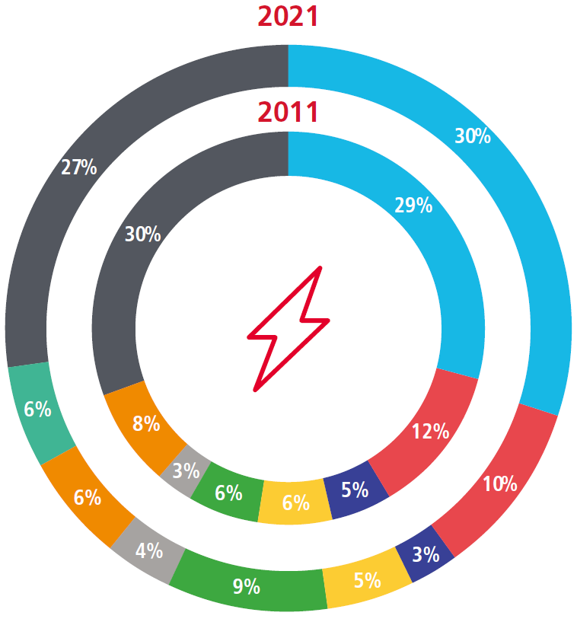
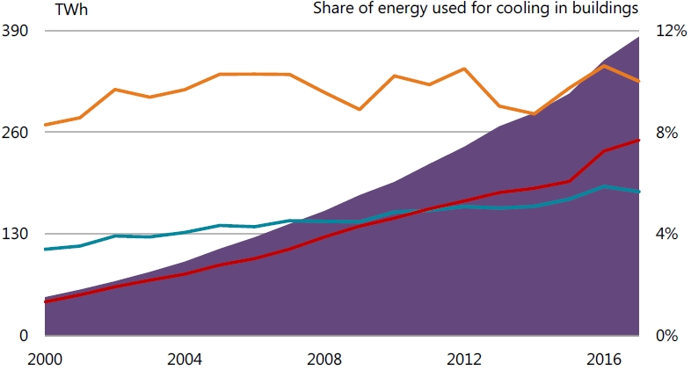
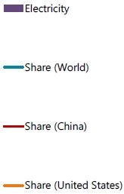
建筑制冷能耗
1. Research background and literature review
1.1 Cooling energy use in buildings
China: cooling energy use has been growing fast in past 10 years, accounting for 1/5 of global cooling energy use.
中国：过去十年，制冷能耗快速增长，约占全球制冷能耗的五分之一。
Hong Kong: the electricity end use for A/C increased by 29% in past 10 years and is about 30% of the total electricity use in building sector.
香港：过去十年，空调用电量增长了 29%，约占建筑部门总用电量的 30%。
1.46GWh
US
World
1.30GWh
China
Electricity use for space cooling, 2000-2017
Electricity Consumption by End-use in HK, 2011-2021
Source: International Energy Agency (IEA). The Future of Cooling in China. 2019
Source: EMSD. Hong Kong Energy End-use Data. 2023
Seek for environmental friendly technology for cooling

Slide 5
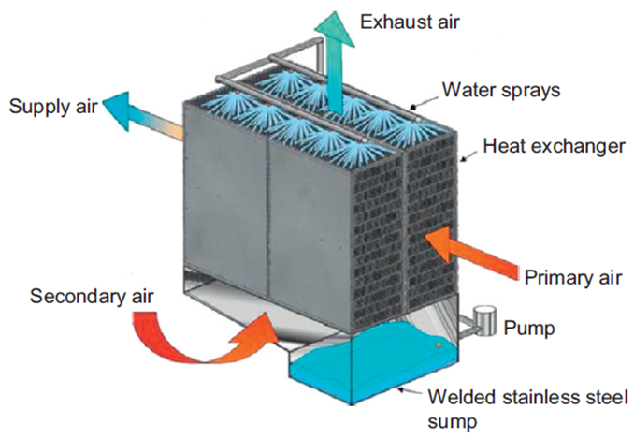
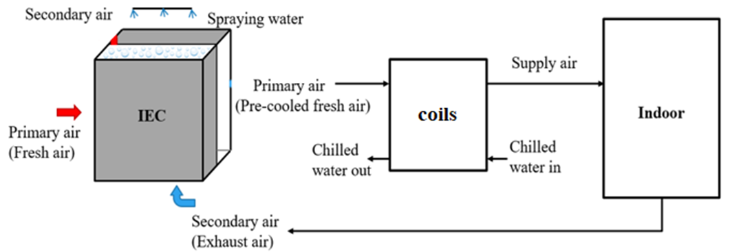
间接蒸发冷却（IEC）技术的发展
1. Research background and literature review
1.2 Development of indirect evaporative cooling (IEC)
The IEC technology is a green and energy-saving technology that uses water to evaporate and absorb heat for cooling.
间接蒸发冷却（IEC）利用水蒸发吸热实现降温，是一种绿色节能技术。
Conventional IEC: for sensible cooling-dominant buildings under dry climates.
Updated IEC: for energy recovery in hot and humid regions.
Fig.1.2.1 Schematic diagram of a traditional IEC
Key point: the process of evaporation of water into air.
Enhanced!
Fig.1.2.2 System diagram of an IEC for energy recovery
Source: A statistical modeling approach on the performance prediction of indirect evaporative cooling energy recovery systems. 2019

Slide 6
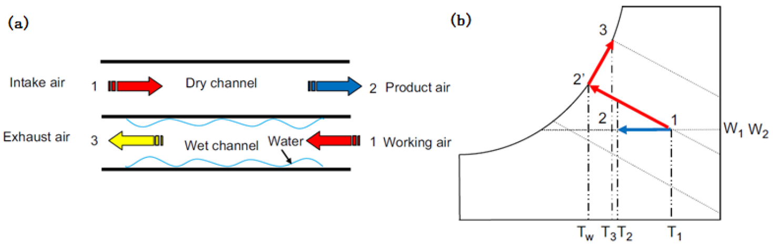
工作原理
Appendix
Working principle
Fig. 8.1 (a) schematics and (b) psychrometric process of traditional IEC
When IEC is applied in hot and humid areas, the primary air humidity is high and the wet-bulb temperature of the secondary air (exhaust air) in the air-conditioned space is low, resulting in condensation where the temperature of the plate surface is lower than the dew-point temperature of the primary air.
在湿热地区，一次空气湿度较高，而空调空间排风作为二次空气时，其湿球温度较低。当换热板表面温度低于一次空气露点温度时，一次空气侧会发生冷凝。
(c) Upper side configuration (d) Lower side configuration

Slide 7
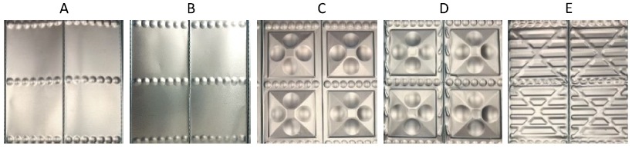
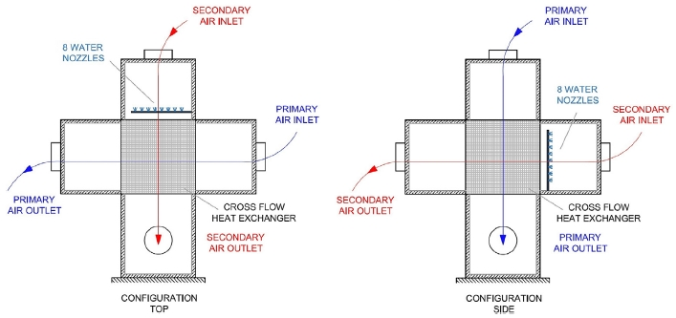
二次空气通道的润湿性研究
1. Research background and literature review
1.3 Research on wettability of secondary air channel
Water supply
Low water supply Low wettability and heat & mass transfer
供水量过低 → 润湿不足，传热传质性能下降
High water supply Higher film thickness and thermal resistance
供水量过高 → 水膜增厚，传热热阻增大
Plate structure
Air flow direction
Fig.1.3.1 Plate with different pitch or protrusion geometry
Fig.1.3.2 Scheme of Top and Side configuration
Source: Effect of plates coating on performance of an indirect evaporative cooling system. 2019;
Effect of heat exchanger plates geometry on performance of an indirect evaporative cooling system, 2020

Slide 8
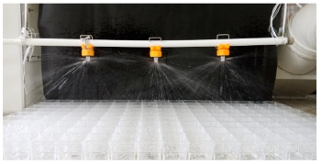
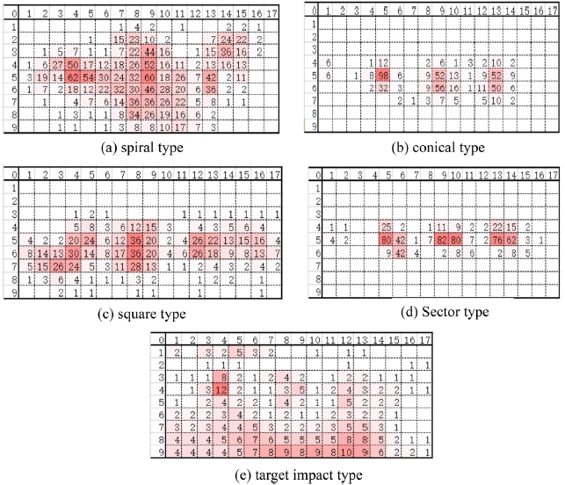
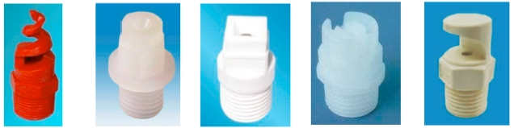
喷淋喷嘴
1. Research background and literature review
Water spray nozzle
Arrangement
Distributions
Fig.1.3.3 The photos of water distribution effect^{[1]}
Types
Fig.1.3.5 Water distribution volume of spraying nozzles(220 L/h) ^{[1]}
Fig.1.3.4 Five types of commonly used spray nozzle^{[1]}
[1] Sun T, Huang X, Chen Y, Zhang H. Experimental investigation of water spraying in an indirect evaporative cooler from nozzle type and spray strategy perspectives.

Slide 9
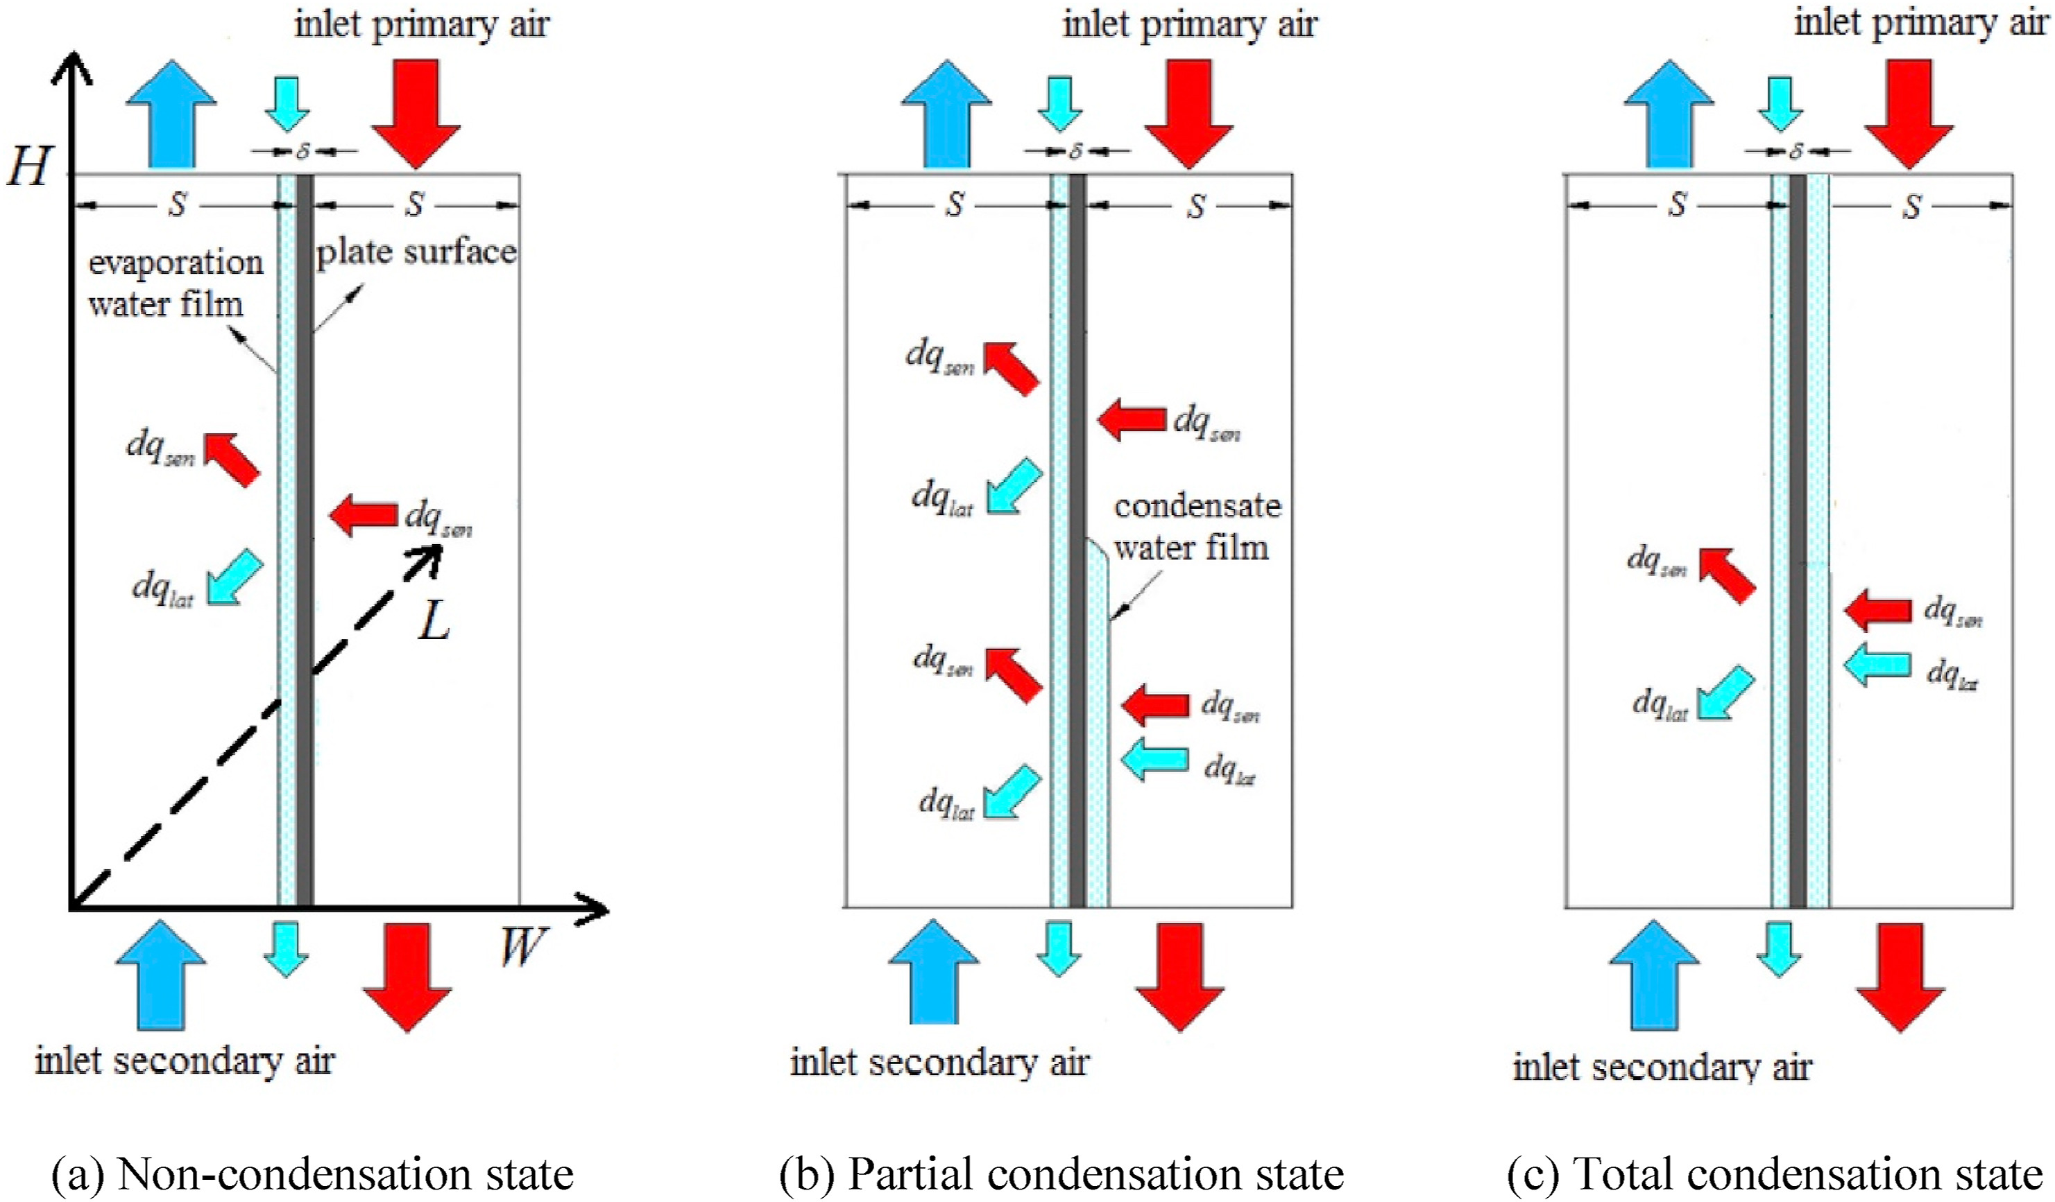
现有 IEC 模型研究
1. Research background and literature review
1.4 Research on previous model
Fig.1.3.5 Previous model of the IEC
Assumption: the thin water film entirely and evenly covered the surface of the wet channel.
Ideal!

Slide 10
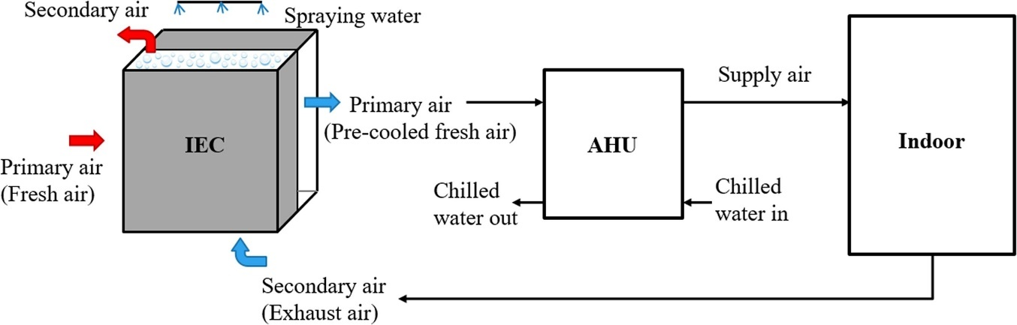
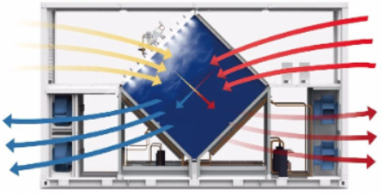
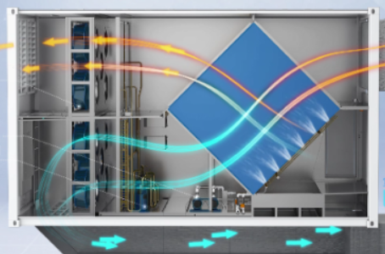
IEC 作为能量回收单元
1. Research background and literature review
1.5 IEC as the recovery unit
Fig.1.5.1 Schematics diagram of IEC followed by AHU
Various nozzle settings for diamond-shaped IEC
A more standardized nozzle arrangement guideline has not yet emerged.

Slide 11
汇报提纲
Outline
1
Research background and literature review
研究背景与文献综述
2
Research gaps and objectives
研究不足与研究目标
3
Development of FDM model for spray distribution optimization of IEC
喷淋分布的 FDM 建模与优化
4
Development of CFD model for IEC considering water film formation with spray parameter analysis
考虑水膜形成的 CFD 模型与喷淋参数分析
5
Performance assessment and optimization of water spray strategy for IEC based on ANN modeling and GA
基于 ANN–GA 的喷淋策略评价与优化
6
Performance analysis and nozzle setting optimization of IEC for energy recovery in data centers
数据中心 IEC 性能分析与喷嘴优化
7
Conclusions and recommendations for future work
研究结论与未来展望

Slide 12
研究不足
2. Research gaps and objectives
2.1 Research gaps
1
Most of the existing analysis about water spray of IEC are based on experimental data, and few mathematical models can quantitatively simulate the various parameters.
现有 IEC 喷淋分析多依赖实验数据，能够定量模拟各项参数的数学模型较少。
2
The existing heat and mass transfer model of IEC has not fully discussed on the wetting ratio, and the ideal assumption needs to be corrected.
现有传热传质模型对润湿率的讨论不足，需修正完全润湿的理想假设。
3
The current 2D model is not enough to accurately simulate the state of the water film distribution, and to deal with more complex hydraulic and thermal properties.
二维模型难以准确描述水膜分布，也难以处理复杂的水力与热力特性。
4
The optimal nozzle arrangement and parameter setting to maintain the best wetted situation of the IEC wet channel have not been identified.
湿通道达到最佳润湿状态所需的喷嘴布置与参数尚不明确。
5
There is a need for straightforward method to predict the IEC performance for use in reality and optimize spray design parameters in large scale projects.
大型工程需要简便、高效的 IEC 性能预测与喷淋参数优化方法。
6
The diamond-shaped IEC used as heat recovery units combined with AHU in DCs require targeted water spray system settings.
数据中心采用的菱形 IEC 与空气处理机组（AHU）耦合时，需要有针对性的喷淋设计。

Slide 13
研究目标
2. Research gaps and objectives
2.2 Research objectives
1
To propose a FDM model for predicting the water spray distribution of the nozzles in IEC.
建立有限差分（FDM）模型，预测 IEC 喷嘴的喷淋分布。
2
To establish a 3D CFD model to identify the formation and flow state of the water membrane covering the plate surface.
建立三维 CFD 模型，研究换热板表面水膜的形成与流动状态。
3
To set up the test bench with the complete IEC system that can investigate the practical wetted sections in single channel pair for model verification.
搭建完整 IEC 实验台，测量单对通道的实际润湿区域并验证模型。
4
To conduct the parametric analysis and determine the optimal water spraying strategies for IEC system.
开展参数分析，确定 IEC 系统的最优喷淋策略。
5
To develop high-efficiency prediction model based on ML to accurately predict the performance of IEC system combined with genetic algorithm for multi-objective optimization.
建立高效的机器学习预测模型，结合遗传算法开展多目标优化。
6
To establish and verified a CFD model based on the diamond-shaped IEC to explore the optimal nozzle configurations and performances, as well as the enhancement strategies for IEC in DCs
建立并验证菱形 IEC 的 CFD 模型，优化喷嘴布置并研究数据中心应用中的性能强化策略。
Notes:
PIEC model to do the parameter analysis as and determine the inter…
Compare

Slide 14
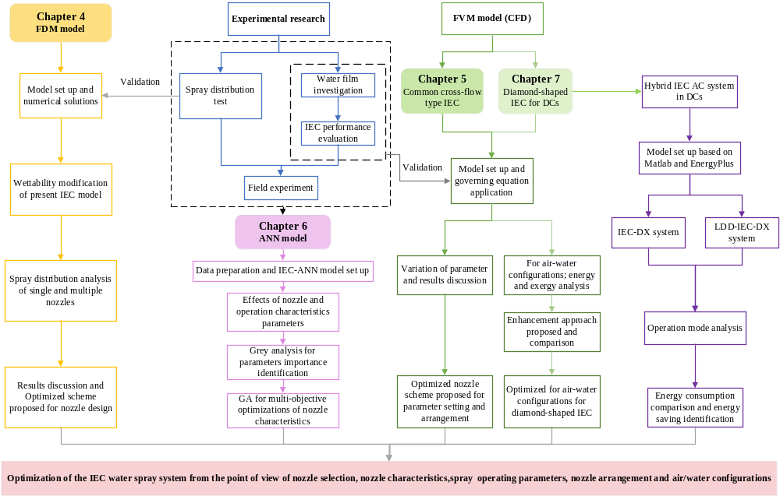
Section 3
FDM model
Section 4
Common cross-flow type IEC
Section 6
Diamond-shaped IEC
Section 5
ANN model
Notes:
PIEC model to do the parameter analysis as and determine the inter…
Compare

Slide 15
汇报提纲
Outline
1
Research background and literature review
研究背景与文献综述
2
Research gaps and objectives
研究不足与研究目标
3
Development of FDM model for spray distribution optimization of IEC
喷淋分布的 FDM 建模与优化
4
Development of CFD model for IEC considering water film formation with spray parameter analysis
考虑水膜形成的 CFD 模型与喷淋参数分析
5
Performance assessment and optimization of water spray strategy for IEC based on ANN modeling and GA
基于 ANN–GA 的喷淋策略评价与优化
6
Performance analysis and nozzle setting optimization of IEC for energy recovery in data centers
数据中心 IEC 性能分析与喷嘴优化
7
Conclusions and recommendations for future work
研究结论与未来展望

Slide 16
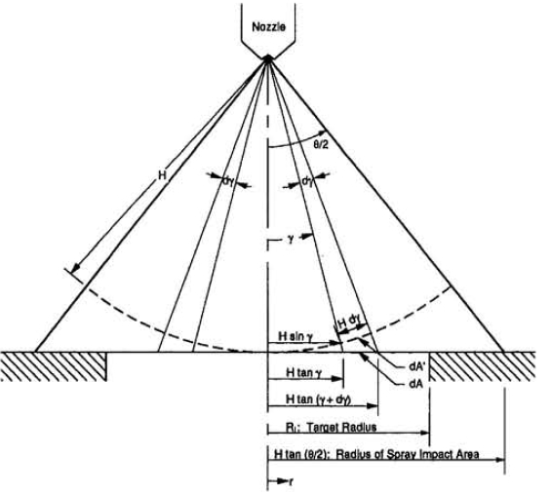
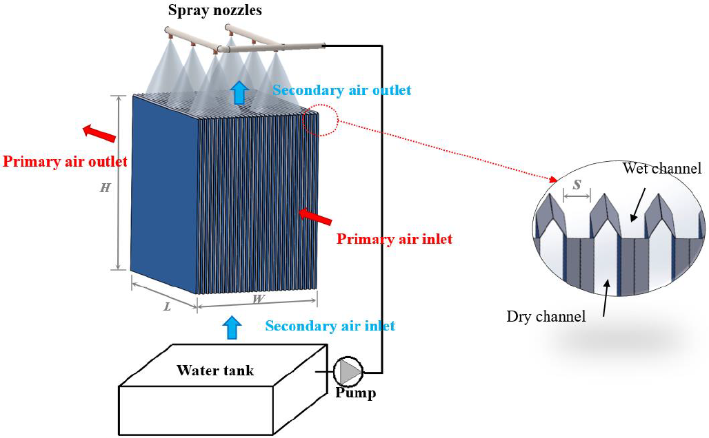
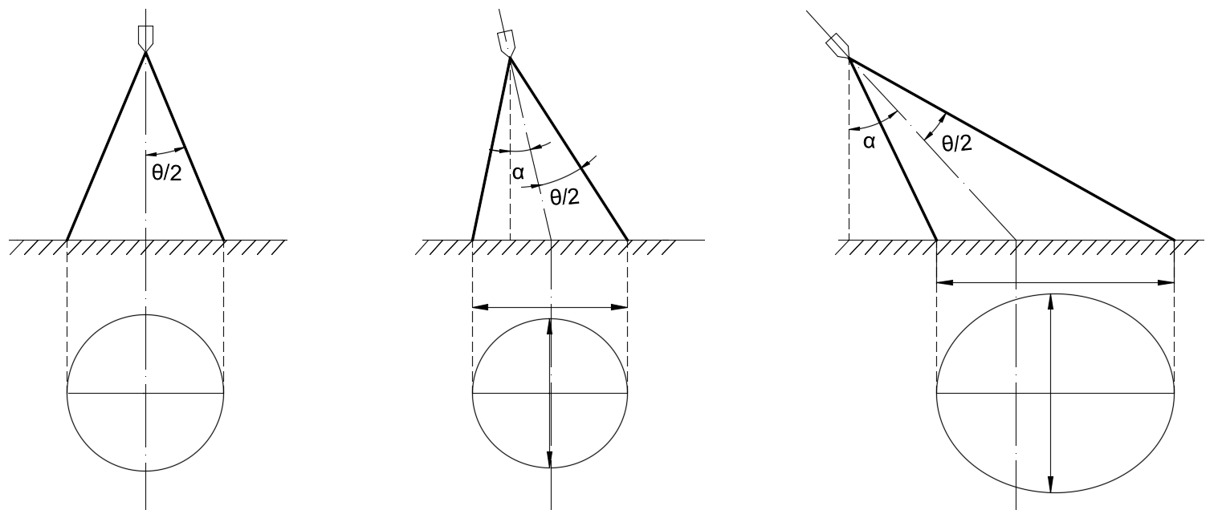
数学模型
3. Development of FDM model for nozzle optimization of IEC
3.1 Mathematical model
Fig. 3.1.2 Geometry used in volumetric flux distribution model ^{[1]}
Fig. 3.1.1 Configuration of an IEC system
Assumption：
模型假设：
The total spray flow rate, Q, is uniformly distributed over any spherical surface centered at the spray orifice.
总喷淋流量 Q 在以喷口为球心的任一球面上均匀分布。
Fig. 3.1.3 Three scenarios of spray impact area
[1] Mudawar I, Estes KA. Optimizing and predicting CHF in spray cooling of a square surface. J Heat Transfer 1996;118:672–9. https://doi.org/10.1115/1.2822685.

Slide 17
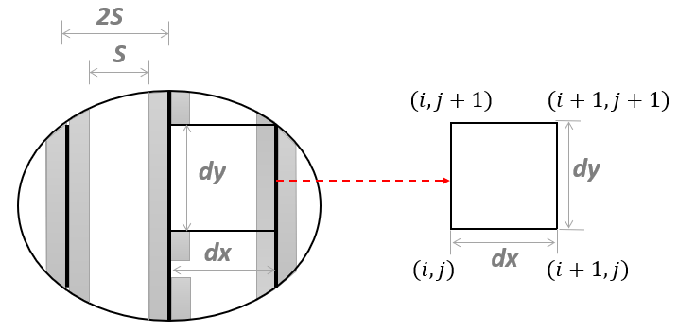
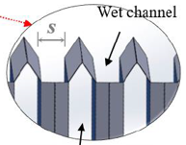
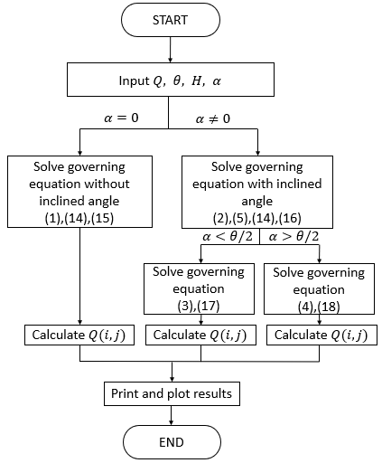
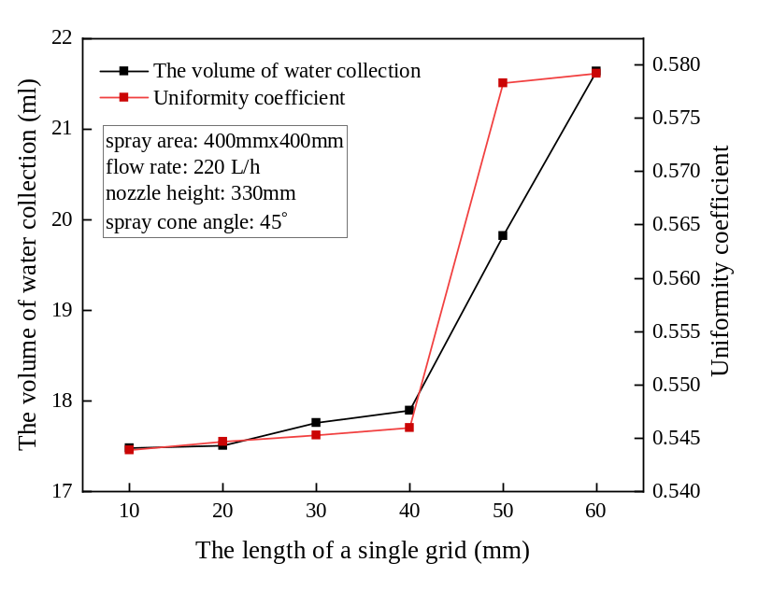
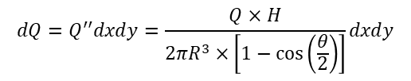

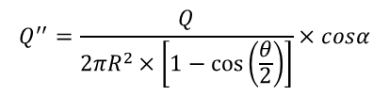
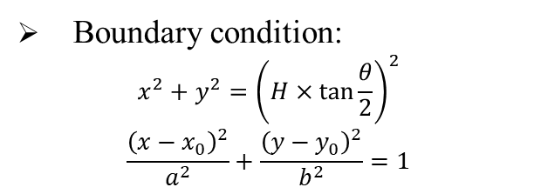


模型方程
3. Development of numerical model for nozzle optimization of IEC
3.2 Model equations
Differential element division:
Simulation process (MATLAB)
Boundary condition:
$$\begin{aligned}x^{2}+y^{2}={\left(H×\tan{\frac{θ}{2}}\right)}^{2}\end{aligned}$$
$$\begin{aligned}\frac{{\left(x−x_{0}\right)}^{2}}{a^{2}}+\frac{{\left(y−y_{0}\right)}^{2}}{b^{2}}=1\end{aligned}$$
Imaginary spherical surface:
$$\begin{aligned}Q_{(i,j)}=\int_{x_{i}}^{x_{i+1}}{\int_{y_{i}}^{y_{i+1}}{\frac{Q×H}{{2π\left(\sqrt{x^{2}+y^{2}+H^{2}}\right)}^{3}×\left[1−\cos\left(\frac{θ}{2}\right)\right]}dxdy}}\#\end{aligned}$$
$$R=\sqrt{x^{2}+y^{2}+H^{2}}$$
$$cosα=\frac{H}{R}$$
$$\begin{aligned}dA={2πR}^{2}×\frac{sinα}{cosα}dα\#\end{aligned}$$
$$\begin{aligned}A={2πR}^{2}×\frac{\left[1−\cos\left(\frac{θ}{2}\right)\right]}{cosα}\#\end{aligned}$$
Grid independence:
Volume flux of spray surface area:
$$\begin{aligned}&Q^{′′}=\frac{Q}{{2πR}^{2}×\left[1−\cos\left(\frac{θ}{2}\right)\right]}×cosα\#\end{aligned}$$
Fig. 3.2.2 Flow chart of simulation procedure
$$dQ=Q^{′′}dxdy=\frac{Q×H}{{2πR}^{3}×\left[1−\cos\left(\frac{θ}{2}\right)\right]}dxdy$$
Fig.3.2.1 Proof of grid independence

Slide 18
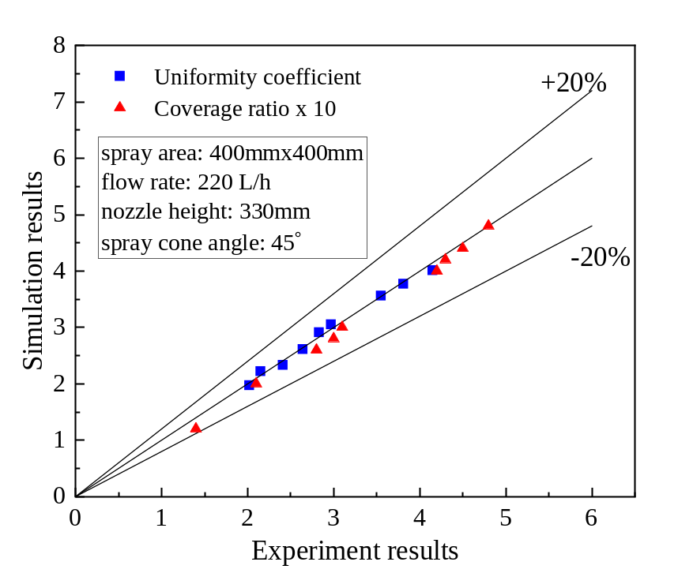
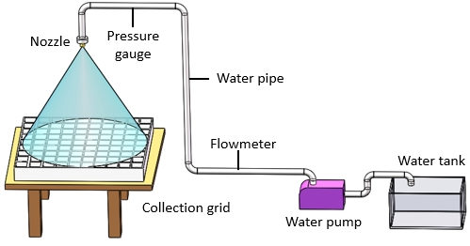
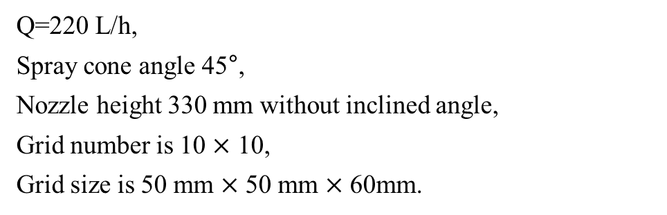
实验验证
3. Development of numerical model for nozzle optimization of IEC with experimental validation
3.3 Experiment validation
Validation result:
Condition:
Q=220 L/h,
Spray cone angle 45°,
Nozzle height 330 mm without inclined angle,
Grid number is 10 $×$ 10,
Grid size is 50 mm $×$ 50 mm $×$ 60mm.
Fig. 3.3.2 Validation results
The maximum discrepancy is acceptable.
Fig. 3.3.1 Experiment bench

Slide 19
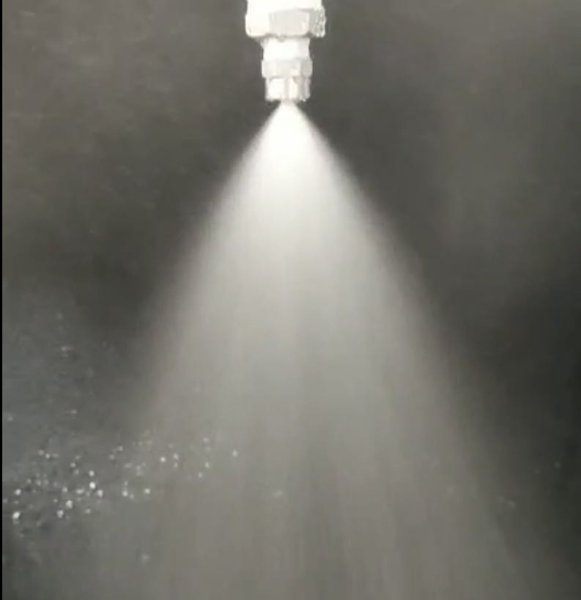
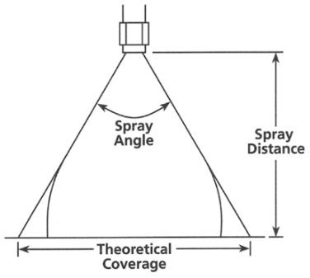
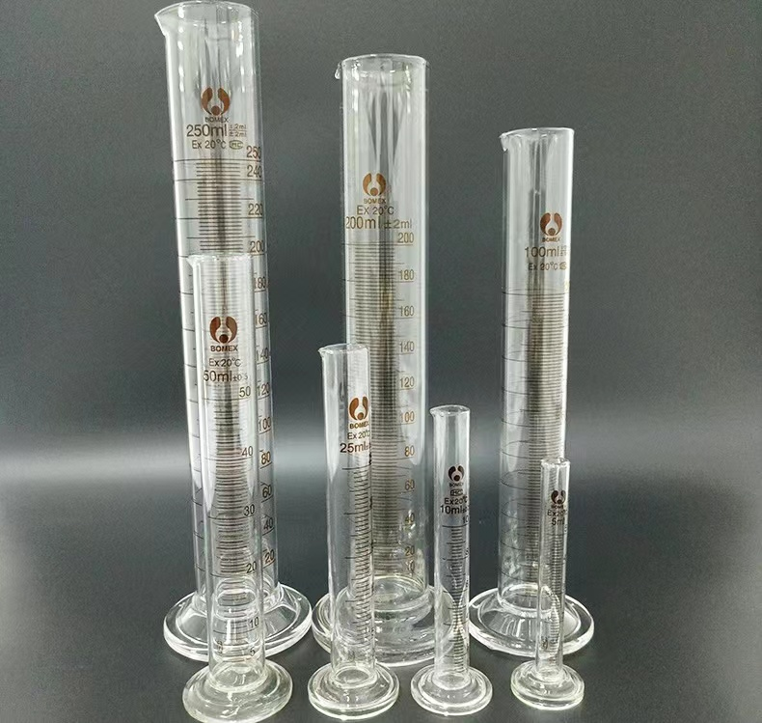
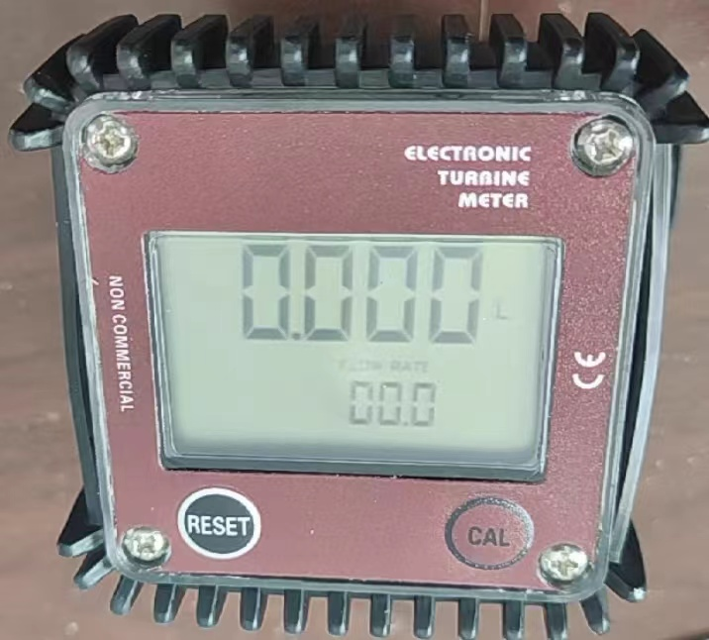
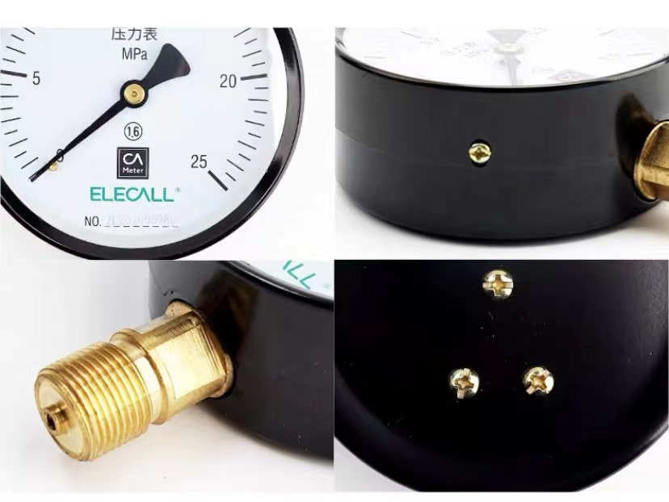
实验仪器选型
Appendix
Instrument selection
Table 8.1 Solid nozzle selection
Nozzle | Orifice diameter (mm) | Volumetric flow rate | Pressure | Spray angle
1 | 2.4 | 1.9-8.4 | 0.4-10 | 45-50
2 | 3.0 | 2.9-13 | 0.4-10 | 60-70
3 | 3.2 | 6.7-16.2 | 0.4-10 | 70-75
Fig. 3.3.1 Photos of the nozzles
Table 8.2 Instrument parameters list
Instrument | Parameter | Range | Accuracy
Flowmeter | Water flow rate | 1.9-8.4 | 0.4-10
Pressure gage | Water pressure | 2.9-13 | 0.4-10
Measuring cylinder | Water volume | 6.7-16.2 | 0.4-10
Fig. 8.3 Photos of test instrument

Slide 20

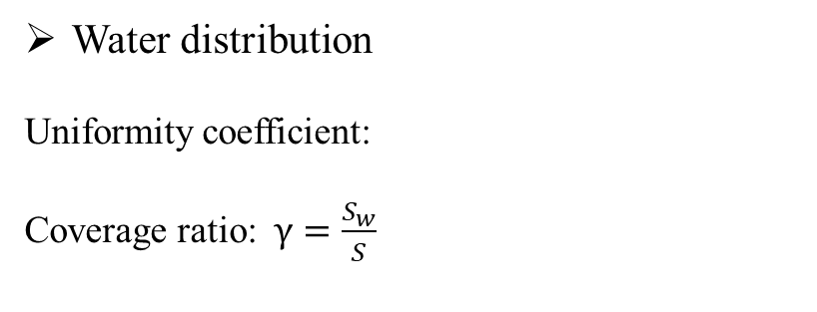
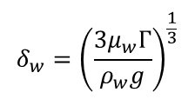

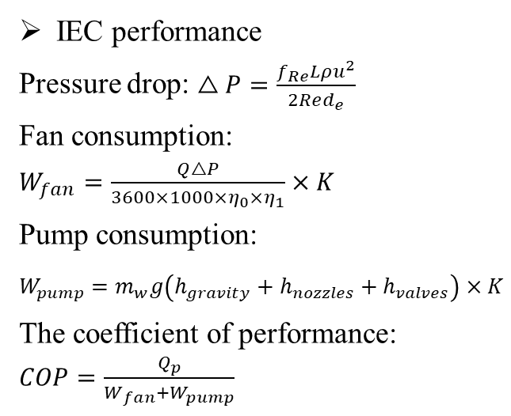
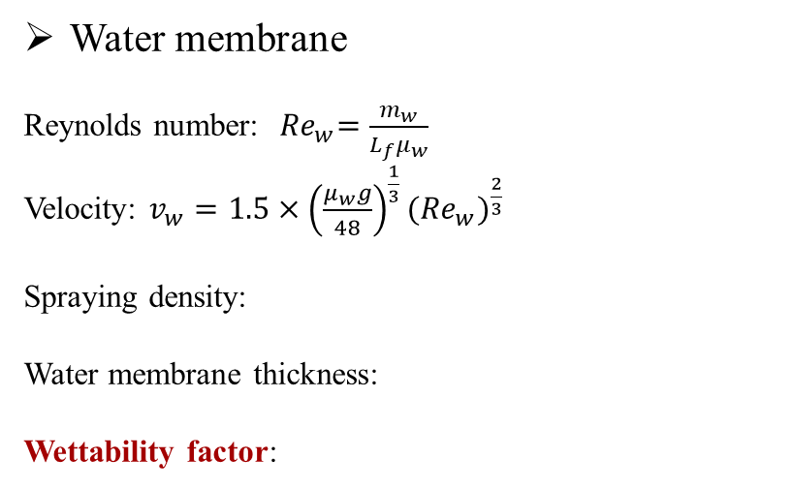

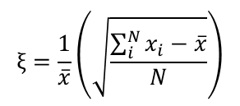

性能评价指标
3. Development of numerical model for nozzle optimization of IEC with experimental validation
3.4 Performance indexes
Water distribution
Uniformity coefficient:
Coverage ratio: $γ=\frac{S_{w}}{S}$
IEC performance
Pressure drop: $\begin{aligned}△P=\frac{f_{Re}Lρu^{2}}{2Red_{e}}\end{aligned}$
Fan consumption: $\begin{aligned}W_{fan}=\frac{Q△P}{3600×1000×η_{0}{×η}_{1}}×K\end{aligned}$
Pump consumption: $\begin{aligned}W_{pump}=m_{w}g\left(h_{gravity}+h_{nozzles}+h_{valves}\right)×K\end{aligned}$
The coefficient of performance: $COP=\frac{Q_{p}}{W_{fan}+W_{pump}}$
$$ξ=\frac{1}{\overline{x}}\left(\sqrt{\frac{\sum_{i}^{N}{x_{i}−\overline{x}}}{N}}\right)$$
Water membrane
Reynolds number:${ Re}_{w}=\frac{m_{w}}{L_{f}μ_{w}}$
Velocity: $v_{w}=1.5×{\left(\frac{μ_{w}g}{48}\right)}^{\frac{1}{3}}{({Re}_{w})}^{\frac{2}{3}}$
Spraying density:
Water membrane thickness:
Wettability factor:
Wet-bulb efficiency:
Cooling capacity:
$$Γ=\frac{{\dot{m}}_{w}}{\left(n+1\right)L_{f}}$$
$$η_{wb}=\frac{t_{p,in}−t_{p,out}}{t_{p,in}−t_{wb,s,in}}$$
$$δ_{w}={\left(\frac{{3μ}_{w}Γ}{ρ_{w}g}\right)}^{\frac{1}{3}}$$
$$Q_{c}=m_{p}c_{pa}\left(t_{p,in}−t_{p,out}\right)$$
$$σ={\dot{m}}_{w}\frac{h}{2δ_{w}v_{w}ρ_{w}}$$

Slide 21
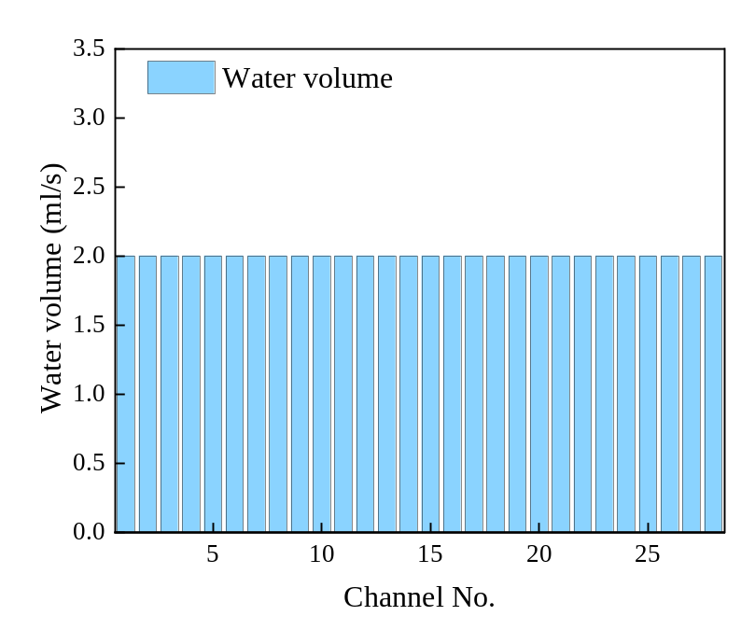
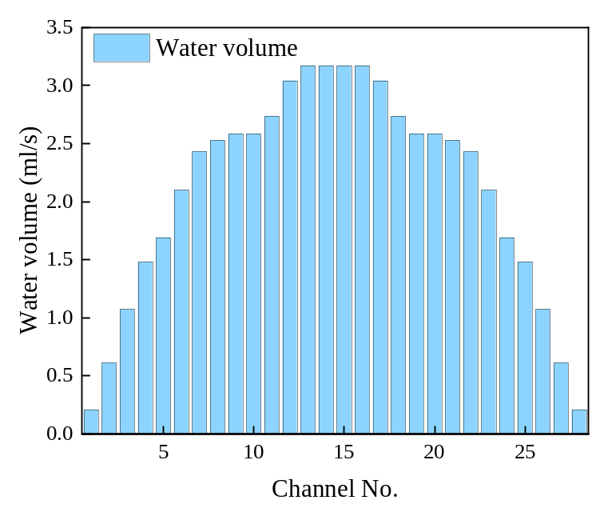
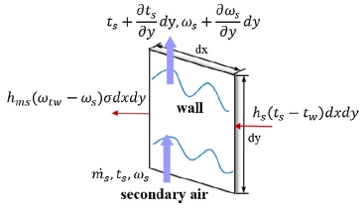

通道内的喷淋密度与润湿性
3. Development of numerical model for nozzle optimization of IEC with experimental validation
3.5.1 The water density and wettability in channels
Water density modification
Original spraying density:
$$Γ=\frac{{\dot{m}}_{w}}{\left(n+1\right)L_{f}}$$
Fig. 3.5.1 Heat and mass transfer of the
secondary air flow channel
Ideal scenario
Reality scenario

Slide 22
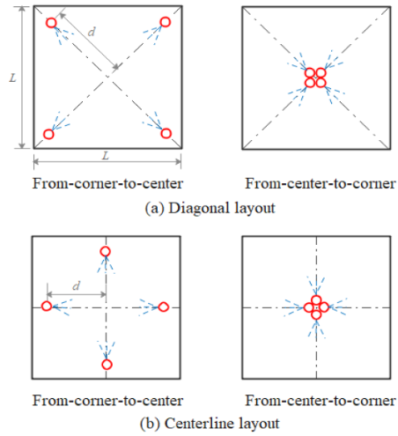
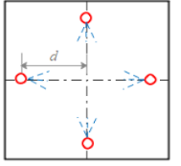
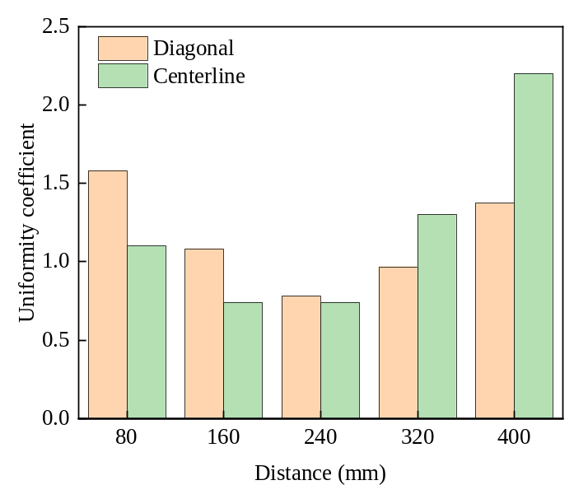
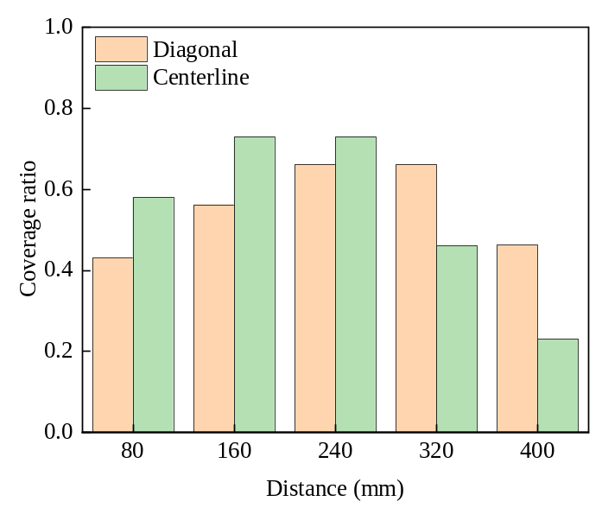
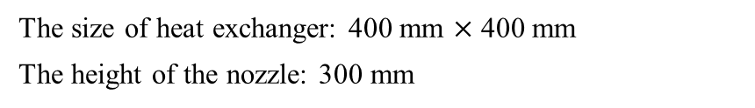
多喷嘴喷淋结果
3. Development of numerical model for nozzle optimization of IEC with experimental validation
3.5.2 Results of multiple nozzles
Arrangement schemes
The size of heat exchanger: 400 mm $×$ 400 mm
The height of the nozzle: 300 mm
(a) Diagonal (b) Centerline
Fig. 3.5.2 Nozzle arrangement schemes
The effect of the nozzle distance on the spray distribution
Uniformity coefficient
Coverage ratio
Spray optimal arrangement: Centerline with 160 mm distance.
Uniformity coefficient is 0.74 and coverage ratio is 0.72.

Slide 23
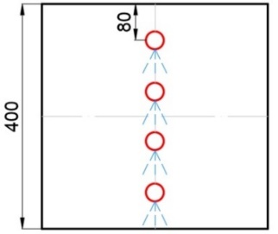
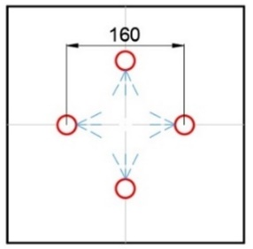
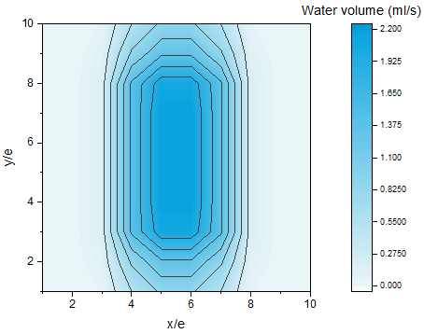

原始与优化布置方案对比
3. Development of numerical model for nozzle optimization of IEC with experimental validation
3.5.3 Comparison between original and optimized schemes
Original arrangement scheme
Optimized arrangement scheme
Fig. 3.5.3 Original arrangement scheme
Fig. 3.5.4 Optimized arrangement scheme
Wettability value: 0.48
Wettability value: 0.89
46%

Slide 24



优化喷嘴布置带来的性能提升
3. Development of numerical model for nozzle optimization of IEC with experimental validation
3.5.4 Performance improvement with optimized nozzle arrangement
For dehumidification
For COP value
Fig. 15 Average value of COP
Fig. 3.5.5 Average value of the dehumidification rate
Fig. 3.5.6 Average value of the COP
The improvement of dehumidification rate is 5.85% .
除湿率提高 5.85%。
The improvement of COP value is 16% .
性能系数（COP）提高 16%。

Slide 25
汇报提纲
Outline
1
Research background and literature review
研究背景与文献综述
2
Research gaps and objectives
研究不足与研究目标
3
Development of FDM model for spray distribution optimization of IEC
喷淋分布的 FDM 建模与优化
4
Development of CFD model for IEC considering water film formation with spray parameter analysis
考虑水膜形成的 CFD 模型与喷淋参数分析
5
Performance assessment and optimization of water spray strategy for IEC based on ANN modeling and GA
基于 ANN–GA 的喷淋策略评价与优化
6
Performance analysis and nozzle setting optimization of IEC for energy recovery in data centers
数据中心 IEC 性能分析与喷嘴优化
7
Conclusions and recommendations for future work
研究结论与未来展望

Slide 26




模型描述（ANSYS）
4. Development of CFD model for IEC considering water film formation with spray parameter analysis
4.1 Model description (ANSYS)
Flowchart
Model of single wet channel
Different heat transfer for different coverage area
Fig.4.1.3 Geometry used in volumetric flux distribution model
Fig.4.1.2 Configuration of an IEC system
$$φ=\frac{A_{w}}{A_{pl}}$$
Coverage factor:

Slide 27














模型方程
4. Development of CFD model for IEC considering water film formation with spray parameter analysis
4.2 Model equations
(1) Conservation of mass
(5) Discrete phase model (DPM)
$$\frac{∂}{∂t}\left(ρ\right)+∇∙\left(ρu\right)=0$$
$$\frac{d\left(\vec{X_{g}}\right)}{dt}=\vec{V_{g}}$$
(2) Conservation of momentum
$$\frac{d\left(m_{d}\vec{F_{d}}\right)}{dt}=\vec{F_{D}}+\vec{F_{g}}$$
$$\frac{∂}{∂t}\left(ρE\right)+∇∙\left(ρu^{2}\right)=−∇P+∇∙\left(μ\left(∇u+∇u^{T}\right)\right)+ρg+F$$
$${\vec{F}}_{d}=−\frac{π}{8}C_{D}ρ_{a}D_{d}^{2}{\vec{V}}_{r}\left|{\vec{V}}_{r}\right|$$
(3) Mass transfer
(6) Turbulence model
$$h_{ms}\left(ω_{t_{w}}−ω_{s}\right)σ∙dxdy={\dot{m}}_{s}\frac{∂ω_{s}}{∂y}∙dy$$
$${Re}_{s}=4\overline{ω}δ/v$$
Applied $k−ε$ turbulence model
$$\frac{∂ω_{e}}{∂y}={\dot{m}}_{s}\frac{∂ω_{s}}{∂y}$$
(7) Calculation method
(4) VOF multi-phase model
EWF coupled DPM model
$$ρ=α_{1}ρ_{1}+α_{g}+ρ_{g}$$
The SIMPLE and PRESTO! pressure
$$μ=α_{1}μ_{1}+α_{g}+μ_{g}$$
Fig.4.2.1 Sketch of meshing in the model
$$\frac{∂α_{1/g}}{∂t}+\vec{u}∙∇α_{1/g}=0$$

Slide 28




模型验证
4. Development of CFD model for IEC considering water film formation with spray parameter analysis
4.3 Model validation
Illustration of the experimental and numerical results
Grid independence
(a) Experimental plate
(b) Numerical result
Fig.4.3.1 Coverage ratio at different numbers of grid
The grid number of 113200 could be decided as the simulation number for further research.
(c) Experimental result in ImageJ
The ICEM software in ANSYS was applied to the mesh computational model.
后续模拟采用 113,200 个网格。

Slide 29


实验验证
4. Development of CFD model for IEC considering water film formation with spray parameter analysis
4.4 Environment validation
Conditions:
Validation result:
Q=0.01 kg/s;
流量 Q = 0.01 kg/s
Spray cone angle = 45°;
喷雾锥角 = 45°
Nozzle height =150 mm
喷嘴高度 = 150 mm
Requirements:
Outermost transparent casing;
Sliding nozzles mounted on top
Fig.4.4.2 Validation results
The maximum discrepancy is 7.1%, which was acceptable for the further analysis.
Fig.4.4.1 Experiment bench
最大偏差为 7.1%，满足后续分析要求。

Slide 30


实验验证
4. Development of CFD model for IEC considering water film formation with spray parameter analysis
4.4 Environment validation
Experiment bench
Validation result:
Fig.4.4.4 Validation results
Fig.4.4.3 Validation results
The maximum discrepancy is 8.2%, which was acceptable for the further analysis.
最大偏差为 8.2%，满足后续分析要求。

Slide 31





喷雾特性
Appendix
Spray characteristics
Theoretical mass flow rate is given by Lefebvre and McDonell
$${\dot{m}}_{th}=ρA_{O}{(\frac{2∆P}{ρ})}^{0.5}$$
The average droplet diameter is obtained from the following equation:
$$d=9.5d_{j}/(∆P_{1}sin(α/2))$$
The correlation for spray cone angle based on inviscid theory (Abramovich, 1944) overpredicts the spray cone angle by 25%.
$$2α=334.32K^{−0.165}{(\frac{D_{S}}{D_{O}})}^{−0.484}W_{e}^{0.043}{Re}_{p}^{−0.065}$$
Fig. 8.4 Nozzle spray characteristics
The parameters are interrelated and cannot be adjusted individually.
Ideal object: nozzle with a orifice diameter of 3.0 mm
Operating condition: at a pressure of 1.5 bar, the spray flow rate is 5.4 L/min, the spray cone angle is 68$°$.
喷淋参数相互耦合，需综合优化水膜覆盖率。
Maximise the film coverage and to balance the effects of each factor.

Slide 32






单喷嘴参数的影响
4. Development of CFD model for IEC considering water film formation with spray parameter analysis
4.5.1 Influence for single nozzle
Spray droplet diameter
0.05 mm
0.15 mm
0.25 mm
Fig. 4.5.2 Coverage ratio with different diameter
Droplet flow is counter-current to the airflow.
液滴过小易被气流吹离；过大则可能在接触板面前滑出湿通道。
Too small, be blown away before contact with the plate surface.
0.35 mm
0.45 mm
Fig. 4.5.1 Coverage area with different diameter
Two large, slide out of the wet channel before making contact with the plate surface.

Slide 33




多喷嘴参数的影响
4. Development of CFD model for IEC considering water film formation with spray parameter analysis
4.5.2 Influence for multiple nozzles
Spray distance
0 mm
20 mm
Fig. 4.5.4 Impact of nozzle gap on coverage factor
The best wetting situation of the plate surface occurs at a nozzle of 40 mm (1) and the gap was 80 mm (2).
图示 40 mm、80 mm 参数下润湿效果最佳。
The spray of nozzles are too far apart causing some droplets to escape from the boundary.
40 mm
60 mm
喷嘴间距过大易使液滴逸出边界。
Fig. 4.5.3 Variation of the nozzle distance
While being too close caused a large number of spray droplets to collide and splash against each other.
间距过小则会加剧液滴碰撞与飞溅。

Slide 34







对 IEC 性能的影响
4. Development of CFD model for IEC considering water film formation with spray parameter analysis
4.5.3 Influence on IEC performance
Conventional scheme
Optimized scheme
Linear distribution
Triangular distribution
Fig. 4.5.5 Comparison between conventional and optimized schemes
The water film coverage ratio of conventional and optimized schemes are 0.72 and 0.91.
水膜覆盖率由 0.72 提高至 0.91。
Most rapid temperature drop at the top of the heat exchanger plate, due to the widest area covered by the water film and the longest contact between airflow and water flow.
板面顶部润湿充分、气水接触时间长，因此降温最快。

Slide 35




一次、二次空气入口参数的影响
4. Development of CFD model for IEC considering water film formation with spray parameter analysis
4.5.4 The effect of inlet parameter of primary air and secondary air
Inlet temperature of primary air
An inlet air temperature of 32°C, with increases of 15.1% and 17.6% for 𝜀𝑤 and COP.
入口温度为 32 ℃ 时，湿球效率与 COP 分别提高 15.1% 和 17.6%。
Inlet velocity of secondary air
An inlet air velocity of 2 m/s, with increases of 10.4% and 14.9% for 𝜀_{𝑤} and COP.
入口速度为 2 m/s 时，湿球效率与 COP 分别提高 10.4% 和 14.9%。

Slide 36
汇报提纲
Outline
1
Research background and literature review
研究背景与文献综述
2
Research gaps and objectives
研究不足与研究目标
3
Development of FDM model for spray distribution optimization of IEC
喷淋分布的 FDM 建模与优化
4
Development of CFD model for IEC considering water film formation with spray parameter analysis
考虑水膜形成的 CFD 模型与喷淋参数分析
5
Performance assessment and optimization of water spray strategy for IEC based on ANN modeling and GA
基于 ANN–GA 的喷淋策略评价与优化
6
Performance analysis and nozzle setting optimization of IEC for energy recovery in data centers
数据中心 IEC 性能分析与喷嘴优化
7
Conclusions and recommendations for future work
研究结论与未来展望

Slide 37


研究思路与模型建立
5. Performance assessment and optimization of water spray strategy for IEC based on ANN modeling and GA
5.1 Concept and model set up
Data preparation
Table 5.1.1 Solid nozzle selection
The six parameters of the spray system that affect the performance of IEC can be identified in the table.
表中列出了影响 IEC 性能的六项喷淋参数。
Evaluation indexes: wet-bulb efficiency and pressure drop.
评价指标：湿球效率与压降。
Collection of experimental data
(weight ratio)
Conducted on a laboratory-scale prototype of the IEC system
采用实验室尺度的 IEC 原型开展研究。
Components: cross-flow heat exchanger, nozzles and water pump.
主要部件：叉流换热器、喷嘴和水泵。
Keep the other basic parameters of the IEC constant, change the six main parameters, and record the effects.
保持其他基础参数不变，改变六项主要参数并记录性能变化。
Fig.5.1.1 Schematic diagram of the IEC system

Slide 38


神经网络模型设计
5. Performance assessment and optimization of water spray strategy for IEC based on ANN modeling and GA
5.2 Design of model setting
A 3-layer network with a hidden layer comprising 14 neurons, can effectively capture the relationship between the input and output variables.
采用三层神经网络，隐含层包含 14 个神经元，用于建立输入与输出变量之间的映射关系。
The dataset could be divided into three sections: the training dataset, validation dataset, and testing dataset, with portions of 70%, 15%, and 15%, correspondingly
数据集按 70%、15%、15% 划分为训练集、验证集和测试集。
Equations describe the model
Input layer
$$X={\left(x_{1},x_{2},…,x_{i},x_{n}\right)}^{T}$$
Hidden layer
$$net_{j}=w_{1j}⋅x_{1}+…+w_{nj}⋅x_{n}$$
$$h_{j}=f\left(net_{j}−a_{j}\right)$$
$$H={\left(h_{1},h_{2},…,h_{j},…,h_{i}\right)}^{T}$$
Hidden layer
$$net_{k}=w_{1k}⋅h_{1}+…+w_{lk}⋅h_{l}$$
$$o_{k}=g\left(net_{k}−b_{k}\right)$$
$$O={\left(o_{1},o_{2},…o_{k},…o_{m}\right)}^{T}$$
$$Y={\left(y_{1},y_{2},…,y_{k},…,y_{m}\right)}^{T}$$
Fig.5.2.1 Structure of the IEC-ANN model

Slide 39





模型验证
5. Performance assessment and optimization of water spray strategy for IEC based on ANN modeling and GA
5.3 Model validations
Evaluation metrics of neural network
Coefficient of determination (r²)
$$r^{2}=\frac{{\left[n\sum_{k=1}^{n}{Y_{P}\left(k\right)}Y_{T}\left(k\right)−\sum_{k=1}^{n}{Y_{P}\left(k\right)}\sum_{k=1}^{n}{Y_{T}\left(k\right)}\right]}^{2}}{[n{\sum_{k=1}^{n}{Y_{P}{\left(k\right)}^{2}\left[\sum_{k=1}^{n}{Y_{P}\left(k\right)}\right]}}^{2}]{\left[n\sum_{k=1}^{n}{Y_{P}{\left(k\right)}^{2}[}\sum_{k=1}^{n}{Y_{T}\left(k\right)}\right]}^{2}]}$$
Root mean square error (RMSE)
$$RMSE=\sqrt{\frac{\frac{n}{i=k}{\left(Y_{P}\left(k\right)−Y_{T}\left(k\right)\right)}^{2}}{n}}$$
Validation results
Validation results for $ε_{wb}$
Validation results for $∆P$
Fig.5.3.1 Validation results of the proposed IEC-ANN model

Slide 40





单因素变化的影响
5. Performance assessment and optimization of water spray strategy for IEC based on ANN modeling and GA
5.4.1 Effect of variations in a single factor
Effect of pressure on droplet diameter and coverage ratio
Nozzle characteristics parameters
(a) Effect of pressure on cone angle
(b) Effect of pressure on flow rate
(a) The peak value of 67° is achieved at a pressure of 0.15 MPa.
(b) The increasing trend of spray flow rate with the rise in pressure.
(c) The trend of $ε_{wb}$ with pressure is consistent with spray angle.
(d) The maximum coverage ratio is achieved at a pressure of 0.15 MPa.
(c) Effect of pressure on $ε_{wb}$
Fig.5.4.1 The effect of nozzle pressure variations

Slide 41


单因素变化的影响
5. Performance assessment and optimization of water spray strategy for IEC based on ANN modeling and GA
5.4.1 Effect of variations in a single factor
Nozzle spacing
Nozzle aperture
Nozzle count
Fig.5.4.2 The effect of three other nozzle parameters variations
The peak value of wet-bulb efficiency is achieved at a spacing of 80 mm.
The $ε_{wb}$ initially increases with increasing nozzle aperture size and decreases with apertures larger than 6 mm.
The $ε_{wb}$demonstrates an initial increase as the number of nozzles increases, but it starts to decline when n≥10.

Slide 42





单因素变化的影响
5. Performance assessment and optimization of water spray strategy for IEC based on ANN modeling and GA
5.4.1 Effect of variations in a single factor
Operation characteristics parameters
Ratio of air to water
Initial stage: improves the convective heat and mass transfer coefficient, thus optimising the $ε_{wb}$.
Later stage: disrupts the formation of a water film, increasing the pressure drop
Fig.5.4.3 The effect of operation parameters on $ε_{wb}$
Spray density
喷淋密度的影响
Lower stage: Uneven water film distribution, presence of dry areas
喷淋密度较低：水膜分布不均，存在干区。
Higher stage: thicker water film lead to clogging of secondary air channel, increasing air resistance.
喷淋密度较高：水膜增厚，可能堵塞二次空气通道并增大空气阻力。
Fig.5.4.4 The effect of operation parameters on pressure drop

Slide 43





双因素变化的耦合影响
5. Performance assessment and optimization of water spray strategy for IEC based on ANN modeling and GA
5.4.2 Combined effect of variations in two factors
The importance of different design parameters
Spacing and pressure
Aperture and pressure
Small spacing: increasing the pressure rapidly brings the IEC performance to its peak and then decreases.
Low pressure: aperture ${ ε}_{wb}$
High pressure: aperture ${ ε}_{wb}$
Ratio $<$Count $<$ Density $<$ Pressure $<$ Spacing $<$ Aperture
The smallest impact factor with a correlation coefficient of 0.5228, remains important.

Slide 44


基于遗传算法的 IEC–ANN 模型优化
5. Performance assessment and optimization of water spray strategy for IEC based on ANN modeling and GA
5.4.3 Optimization of IEC-ANN model based on Genetic algorithm
Genetic algorithm
Four key aspects: determining the basic operating parameters, chromosome encoding and decoding, evaluating individual fitness, and implementing the three genetic operators.
四个关键环节：确定基本运行参数、染色体编码与解码、个体适应度评价，以及执行三种遗传操作。
Multi-objectives optimization
Optimization targets: wet-bulb efficiency and pressure drop Minimizing power consumption & Maximizing cooling performance.
优化指标：湿球效率与压降。
The optimization function comprises of both a fitness as well as a constraint function.
目标：降低能耗，同时提升制冷性能。 优化函数由适应度函数与约束函数组成。
$$J(P,s,d,n,Γ,v)=W_{1}\frac{ε_{wb}}{Rε_{wb}}+W_{2}\frac{ΔP}{RΔP}$$
Fig.5.4.3 The flow of GA-ANN optimization

Slide 45

基于遗传算法的 IEC–ANN 模型优化
5. Performance assessment and optimization of water spray strategy for IEC based on ANN modeling and GA
5.4.3 Optimization of IEC-ANN model based on Genetic algorithm
Results derived from GA
An equal-weight distribution yields the best conditions for optimization of IEC performance.
采用等权重分配时，IEC 获得最佳综合优化效果。
Under this condition, the optimal operating parameters are fixed, which is an increase of 23.2% in comparison with the base system.
据此确定最优运行参数，相比基准系统，性能提升 23.2%。

Slide 46
汇报提纲
Outline
1
Research background and literature review
研究背景与文献综述
2
Research gaps and objectives
研究不足与研究目标
3
Development of FDM model for spray distribution optimization of IEC
喷淋分布的 FDM 建模与优化
4
Development of CFD model for IEC considering water film formation with spray parameter analysis
考虑水膜形成的 CFD 模型与喷淋参数分析
5
Performance assessment and optimization of water spray strategy for IEC based on ANN modeling and GA
基于 ANN–GA 的喷淋策略评价与优化
6
Performance analysis and nozzle setting optimization of IEC for energy recovery in data centers
数据中心 IEC 性能分析与喷嘴优化
7
Conclusions and recommendations for future work
研究结论与未来展望

Slide 47


模型描述
6. Performance analysis and nozzle setting optimization of IEC for energy recovery in data centers
6.1 Model description
Internal circulation
内循环模式
Fresh air as the working air
新风作为工作空气，室内回风作为送风。
Indoor return air as supply air
独立通道可避免气流交叉污染。
Separated channels avoid the cross-contamination.
Fig.6.1.1 A typical IEC air-conditioning system of DC
Diamond shaped IEC: compactness and flexible arrangement
Space claim in ANSYS work bench
Fig. 6.1.2 Two types of IEC models set up in work bench

Slide 48




模型细节
6. Performance analysis and nozzle setting optimization of IEC for energy recovery in data centers
6.2 Model details
Boundary conditions
Grid independence
Model validation
450,000
$$≤$$
10%

Slide 49



四种喷嘴布置方案
6. Performance analysis and nozzle setting optimization of IEC for energy recovery in data centers
6.3 Four schemes of nozzle configurations
Determination of the test water flow rate
The wet-bulb efficiency grows with the increase of water supply flow rate.
湿球效率随供水流量增加而提高。
and stabilizes at a maximum value when the flow rate arrives 65 L/s.
当流量达到 65 L/s 时，湿球效率趋于最大值并保持稳定。
(a) Top configuration (b) Bottom configuration
(c) Upper side configuration (d) Lower side configuration
Fig. 6.3.1 The determination of test spray flow rate

Slide 50








四种喷嘴布置方案（铝板）
6. Performance analysis and nozzle setting optimization of IEC for energy recovery in data centers
6.3 Four schemes of nozzle configurations (aluminium)
Water film distribution
Temperature distribution
  TOP
  BOTTOM
  Upper side
  Lower side
(c) Upper side configuration (d) Lower side configuration

Slide 51






不同布置的轴向特性对比
Appendix
Comparison of configurations of axial characteristics
Film formation
water vapor content distribution
Temperature distribution
(a) Upper side c (b) Lower side
(a) Upper side c (b) Lower side
(a) Upper side c (b) Lower side
More smooth and diffuse continuous water film.
The water vapor concentration significantly higher.
More temperature drop.
水膜连续均匀，可增强传热传质。
降温幅度更大。
Incomplete water film coverage due to aggregation from uneven gravity distribution.
水蒸气浓度更高，水膜向气流传递的水分更多。
The temperature drop follows the same trend as the increase in water vapour concentration.
重力分布不均易使液体聚集，造成覆盖不足。
The water membrane transfers more mass to the airflow.
温降与水蒸气浓度增加呈相同变化趋势。
(c) Upper side configuration (d) Lower side configuration

Slide 52

四种布置方案的性能差异
Appendix
Specific gaps in the four configurations
Fig. 8.5 The coverage ratio and outlet temperature of four configurations
The temperature drop follows the same trend as the water film coverage coefficient.
温降与水膜覆盖系数呈相同变化趋势。
The best results are achieved in the upper side configuration, with a 59.2% and 27.4% improvement compared to the worst one.
上侧布置的效果最佳；与最差方案相比，两项性能指标分别提升 59.2% 和 27.4%。
(c) Upper side configuration (d) Lower side configuration

Slide 53







制冷性能强化措施
6. Performance analysis and nozzle setting optimization of IEC for energy recovery in data centers
6.4 Approaches for cooling performance enhancement
Hydrophilic coating (Epoxy coating-Hydrophilic lacquer)
Fiber coating (70% rayon + 30% polyester textile)
Contact angle
Contact angle
$$≈$$
0°
77.8°
diffusion
57.8°
(a) Water film distribution (b) Temperature distribution
(a) Water film distribution (b) Temperature distribution
(c) Upper side configuration (d) Lower side configuration

Slide 54


性能强化效果评价
6. Performance analysis and nozzle setting optimization of IEC for energy recovery in data centers
6.5 Assessment of the degree of enhancement
Effect on coverage ratio and contact angle
Comparison of the three performance indexes
Both the hydrophilic and fiber coating increase the wetting ratio by decreasing the contact angle
亲水涂层与纤维涂层均可通过减小接触角提高润湿率。
Besides, the fiber coating also increases the diffusion rate of the water film compared to the hydrophilic one, thus achieving a wetting ratio close to 1, which is regarded as complete wetting.
纤维涂层还能提高水膜扩散速率，使润湿率接近 1，达到近乎完全润湿。
The wet-bulb efficiency of the IEC was optimized for both the increased hydrophilic and fiber coating on the plate surface, by 5.7% and 14.5% respectively.
亲水涂层与纤维涂层分别使湿球效率提高 5.7% 和 14.5%。
The energy saving by pump resulting in a further increase for fiber coating in the COP value of 16.1%.
纤维涂层还可降低水泵能耗，使 COP 提高 16.1%。
(c) Upper side configuration (d) Lower side configuration
Fig. 11. The water film distribution of the four nozzle configurations
(a) Top configuration (b) Bottom configuration
(c) Upper side configuration (d) Lower side configuration

Slide 55
汇报提纲
Outline
1
Research background and literature review
研究背景与文献综述
2
Research gaps and objectives
研究不足与研究目标
3
Development of FDM model for spray distribution optimization of IEC
喷淋分布的 FDM 建模与优化
4
Development of CFD model for IEC considering water film formation with spray parameter analysis
考虑水膜形成的 CFD 模型与喷淋参数分析
5
Performance assessment and optimization of water spray strategy for IEC based on ANN modeling and GA
基于 ANN–GA 的喷淋策略评价与优化
6
Performance analysis and nozzle setting optimization of IEC for energy recovery in data centers
数据中心 IEC 性能分析与喷嘴优化
7
Conclusions and recommendations for future work
研究结论与未来展望

Slide 56
研究结论
7. Conclusions and recommendations for future work
7.1 Conclusions
1. We developed a FDM model to simulate the spray distribution above heat exchanger.
1. 建立了预测换热器上方喷淋分布的 FDM 模型。
For the IEC with 400 mm length and width, the optimal nozzle arrangement scheme is the scheme with four nozzles separated by 160 mm along the centerline.
对于长、宽均为 400 mm 的 IEC，最优方案为四个喷嘴沿中心线布置，间距为 160 mm。
With the same water flow rate supplied (220 L/h), the optimized centerline scheme could increase the wettability factor of the IEC plate surface from 0.48 to 0.89, and the COP is increased up to 16%.
在相同供水量（220 L/h）下，优化方案使板面润湿系数由 0.48 提高至 0.89，COP 提高达 16%。
2. We proposed a novel 3D CFD model to investigate the water film inside wet channels, and the cooling performance of the whole IEC system.
2. 建立了研究湿通道水膜及 IEC 整体制冷性能的三维 CFD 模型。
Optimal nozzle parameters for maximum coverage were determined to be a droplet diameter of 0.25 mm, a pressure of 1.5 bar, a flow rate of 5.4 L/min, and a spray cone angle of 68°.
最大覆盖率对应的最优参数为：液滴直径 0.25 mm、压力 1.5 bar、流量 5.4 L/min、喷雾锥角 68°。
The refined IEC water distribution system employs a triangular nozzle arrangement based on distance analysis. This optimized configuration enhances water film coverage by 20.9% and significantly improves wet-bulb efficiency and COP by 15.1% and 17.6%, respectively.
基于间距分析采用三角形喷嘴布置后，水膜覆盖率提高 20.9%，湿球效率与 COP 分别提高 15.1% 和 17.6%。

Slide 57

研究结论
7. Conclusions and recommendations for future work
7.1 Conclusions
3. We trained a ML-based prediction model to estimate the performance of the IEC system, and GA was applied to optimize the IEC-ANN model.
3. 建立机器学习预测模型，并采用 GA 优化 IEC–ANN 模型。
The optimal parameters were found to be: nozzle pressure of 0.15 MPa, spacing of 85 mm, aperture of 6 mm, count of 11, spray density of 0.85 kg/(s$∙$m2), and air velocity of 2 m/s.
最优参数：喷嘴压力 0.15 MPa、间距 85 mm、孔径 6 mm、数量 11、喷淋密度 0.85 kg/(s·m²)、风速 2 m/s。
The wet-bulb efficiency is 0.85, the pressure drop is 210 Pa, and the COP is 12.4, which represents a 23.2% improvement over the baseline system.
湿球效率为 0.85，压降为 210 Pa，COP 为 12.4，较基准系统提高 23.2%。
4. We developed a CFD model based on the diamond-shaped IEC to explore the air-water flow, heat transfer, and mass transfer capabilities of the IEC as a heat recovery unit in data centers.
4. 建立菱形 IEC 的 CFD 模型，研究其在数据中心能量回收中的气水流动与传热传质性能。
The nozzles are installed as upper side configuration when the water film distribution area in the wet channel is the largest and the temperature drop is the best, with 59.2% and 27.4% improvement over the worst case.
上侧喷嘴布置效果最佳，水膜分布面积与温降较最差方案分别改善 59.2% 和 27.4%。
Benefit from the addition of hydrophilic coatings and fibre coatings, the water film coverage and COP are increased by 7.4% and 16.1%, respectively.
采用亲水和纤维涂层后，水膜覆盖率与 COP 分别提高 7.4% 和 16.1%。

Slide 58
未来研究方向
7. Conclusions and recommendations for future work
7.2 Future work
1
The primary focus of this study is on the common cross-flow plate-type IEC, which may not be applicable to other specialized types, such as tubular IEC. Therefore, it is necessary to conduct extensive simulations and experimental research on various types of IEC in the future to generalize the findings.
本研究主要针对常规叉流板式 IEC，结论未必适用于管式等其他结构。未来需对不同类型 IEC 开展更多模拟与实验，以拓展结论的适用范围。
2
For the three operating modes of the IEC system in data centers, it is crucial to regulate the start and stop cycles of the water spray system to meet indoor requirements while minimizing the energy consumption. Therefore, it is necessary to further control the activation states of the three modes based on climatic conditions.
针对数据中心 IEC 的三种运行模式，应根据气候条件优化模式切换及喷淋启停，在满足室内需求的同时降低能耗。
3
Future work will involve the development of ANN models for different spray parameters under various climatic conditions to achieve a more comprehensive analysis and optimization of the IEC system.
未来可建立覆盖不同气候条件与喷淋参数的 ANN 模型，实现更全面的 IEC 性能分析与优化。

Slide 59
学术成果
Academic contributions
Published papers:
[1] X. Ma, W. Shi, and H. Yang, “Study on water spraying distribution to improve the energy recovery performance of indirect evaporative coolers with nozzle arrangement optimization,” Applied Energy, vol. 318, 2022.
[2] X. Ma, W. Shi, and H. Yang, “Improving the performance of indirect evaporative cooler for energy recovery from the perspective of nozzle configuration: A CFD model analysis,” Journal of Building Engineering, vol. 76, p. 107195, 2023/10/01/ 2023.
[3] X. Ma, W. Shi, and H. Yang, “Spray parameter analysis and performance optimization of indirect evaporative cooler considering surface wettability,” Journal of Building Engineering, vol. 82, p. 108175, 2024/04/01/ 2024.
[4] X. Ma, W. Shi, Lin Lu and H. Yang, “Performance assessment and optimization of water spray strategy for indirect evaporative cooler based on artificial neural network modeling and genetic algorithm,” Applied Energy, vol. 318, 2024.
Conference papers:
[1] X. MA, W. Shi, and H. Yang. Study on water spraying distribution for improvement of indirect evaporative coolers with nozzle arrangement optimization. The 13th International Conference on Applied Energy (ICAE2021), virtual, 29 Nov - 2 Dec, 2021.
[2] X. MA, W. Shi, and H. Yang. Effect of spray nozzle parameters on surface wettability and performance improvement of indirect evaporative cooler. The 2022 MIT "A+B" Applied Energy Symposium (MITAB 2022), virtual, 5-8 July, 2022.
[3] X. MA, W. Shi, and H. Yang. Development of a wettability combined CFD model of indirect evaporative cooler with spray and water film optimization. The 14th International Conference on Applied Energy (ICAE2022), Bochum, Germany, 8-11 Aug, 2022.

Slide 60
Thank you!
谢谢，敬请指正
60

Slide 61
模型假设与适用性
Appendix
Working principle
Assumption：
模型假设：
The total spray flow rate, Q, is uniformly distributed over any spherical surface centered at the spray orifice.
总喷淋流量 Q 在以喷口为球心的任一球面上均匀分布。
Non-Uniform Edges: In reality, the edges of the spray area might not be perfectly straight or uniformly distributed.
边界不均匀：实际喷淋区域的边缘未必平直，分布也未必均匀。
Complex Geometries: The actual spray might have a more complex geometry, such as an elliptical or fan-shaped distribution, which is oversimplified by a cone.
复杂几何形态：实际喷雾可能呈椭圆形或扇形，圆锥模型对其进行了简化。
Fig. 8.2 Geometry used in volumetric flux distribution model ^{[1]}
However, the results we obtain do not necessitate fine-grained precision at every line and point, but rather within individual small grids. The foundational model has already been validated, and the model we are using has also been successfully verified. To achieve more accurate analysis, we have employed the Discrete Phase Model (DPM) in subsequent models to simulate the dispersion of spray droplets.
本研究关注各微小网格内的平均结果，而非每条线、每个点的精细分布。基础模型与本研究模型均已通过验证。为提高分析精度，后续模型采用离散相模型（DPM）模拟喷雾液滴的弥散过程。
(c) Upper side configuration (d) Lower side configuration

Slide 62
四种布置方案的性能差异
Appendix
Specific gaps in the four configurations
Fig. 8.5 The coverage ratio and outlet temperature of four configurations
The temperature drop follows the same trend as the water film coverage coefficient.
温降与水膜覆盖系数呈相同变化趋势。
The best results are achieved in the upper side configuration, with a 59.2% and 27.4% improvement compared to the worst one.
上侧布置的效果最佳；与最差方案相比，两项性能指标分别提升 59.2% 和 27.4%。
(c) Upper side configuration (d) Lower side configuration

Slide 63
IEC–ANN 模型
Appendix
IEC-ANN model
Accurate measurements: Use precise instruments to collect data. Regularly maintain equipment to ensure consistent accuracy.
精确测量：采用高精度仪器采集数据，并定期维护设备。
Replication and Validation: Conduct multiple trials and replicate experiments to validate results.
重复与验证：开展多次重复实验，验证结果的可靠性。
Normalization and standardization: Normalize data to ensure that different features contribute equally to the model training process.
归一化与标准化：统一特征尺度，避免不同量纲影响模型训练。
Cross-Validation: Use cross-validation techniques to assess the performance of the machine learning model. This helps in ensuring that the model generalizes well to unseen data.
交叉验证：评估模型对未见数据的泛化能力。
Evaluation metrics: The reliability of the model was verified with the evaluation parameters
Fig.8.6 Structure of the IEC-ANN model
评价指标：采用模型评价参数验证预测可靠性。
(c) Upper side configuration (d) Lower side configuration

Slide 64




水膜厚度验证
Appendix
Validation of the film thickness
Fig. 8.7 Valdation of film thickness between simulation results and Nusselt empirical formula
Uncertainty analysis:
Less than $±$2.5%
(c) Upper side configuration (d) Lower side configuration

