Slide 1

Development of new water spray strategies for improving the energy performance of indirect evaporative cooling systems
Presenter: MA Xiaochen
22 July 2024
中文要点｜报告主题
新型喷淋策略开发及其对间接蒸发冷却系统能效的提升

Slide 2
Outline
Research background and literature review
Research gaps and objectives
Development of FDM model for spray distribution optimization of IEC
Development of CFD model for IEC considering water film formation with spray parameter analysis
Performance assessment and optimization of water spray strategy for IEC based on ANN modeling and GA
Performance analysis and nozzle setting optimization of IEC for energy recovery in data centers
Conclusions and recommendations for future work
中文要点｜汇报提纲
研究背景与目标 → FDM 喷淋分布建模 → CFD 水膜分析 → ANN–GA 喷淋优化 → 数据中心应用 → 结论与展望

Slide 3
Outline
Research background and literature review
Research gaps and objectives
Development of FDM model for spray distribution optimization of IEC
Development of CFD model for IEC considering water film formation with spray parameter analysis
Performance assessment and optimization of water spray strategy for IEC based on ANN modeling and GA
Performance analysis and nozzle setting optimization of IEC for energy recovery in data centers
Conclusions and recommendations for future work
中文要点｜研究背景与文献综述
从建筑制冷能耗增长出发，介绍 IEC 技术的发展、水膜润湿性研究及现有模型的不足。

Slide 4
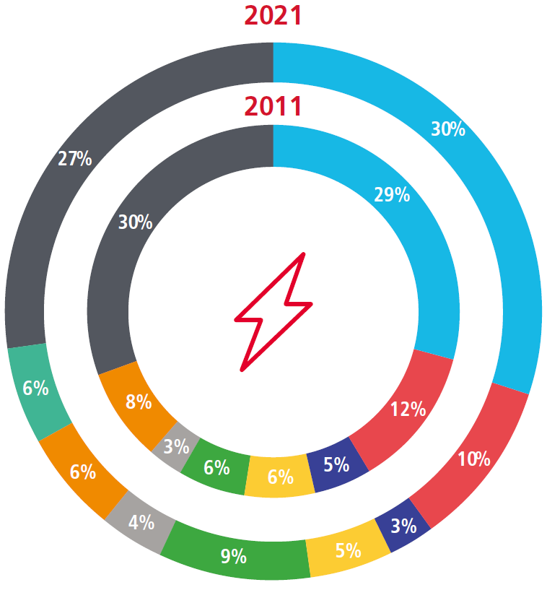
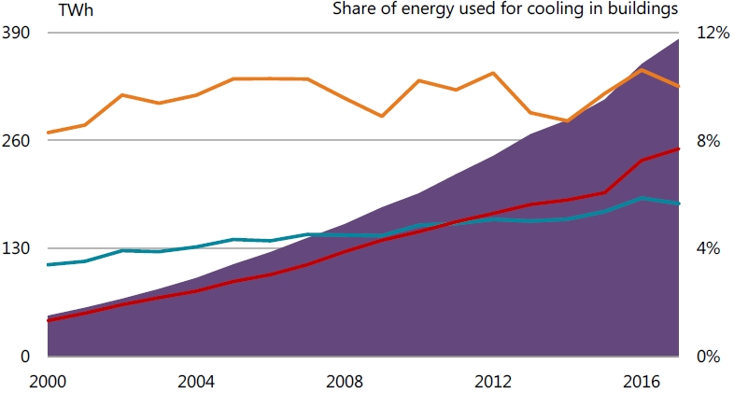
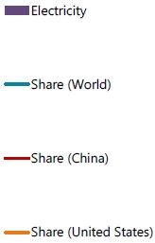
1. Research background and literature review
1.1 Cooling energy use in buildings
China: cooling energy use has been growing fast in past 10 years, accounting for 1/5 of global cooling energy use.
Hong Kong: the electricity end use for A/C increased by 29% in past 10 years and is about 30% of the total electricity use in building sector.
1.46GWh
US
World
1.30GWh
China
Electricity use for space cooling, 2000-2017
Electricity Consumption by End-use in HK, 2011-2021
Source: International Energy Agency (IEA). The Future of Cooling in China. 2019
Source: EMSD. Hong Kong Energy End-use Data. 2023
Seek for environmental friendly technology for cooling
中文要点｜建筑制冷能耗
中国制冷能耗约占全球的五分之一；香港过去十年空调用电增长 29%。发展高效、环保的制冷技术十分必要。

Slide 5
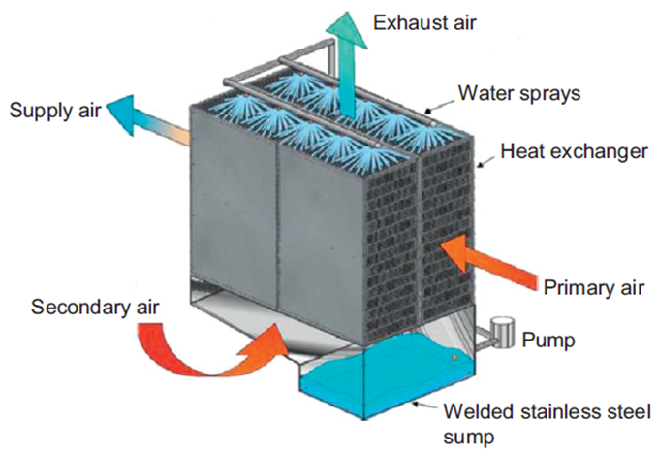
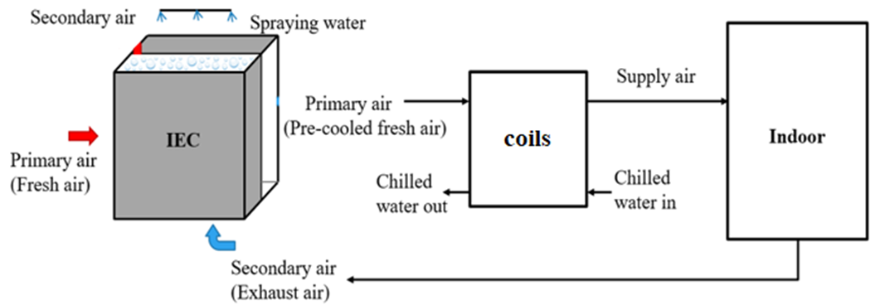
1. Research background and literature review
1.2 Development of indirect evaporative cooling (IEC)
The IEC technology is a green and energy-saving technology that uses water to evaporate and absorb heat for cooling.
Conventional IEC: for sensible cooling-dominant buildings under dry climates.
Updated IEC: for energy recovery in hot and humid regions.
Fig.1.2.1 Schematic diagram of a traditional IEC
Key point: the process of evaporation of water into air.
Enhanced!
Fig.1.2.2 System diagram of an IEC for energy recovery
Source: A statistical modeling approach on the performance prediction of indirect evaporative cooling energy recovery systems. 2019
中文要点｜间接蒸发冷却技术
IEC 利用水蒸发吸热实现降温；应用由干燥地区的显热冷却，拓展至湿热地区的能量回收。

Slide 6
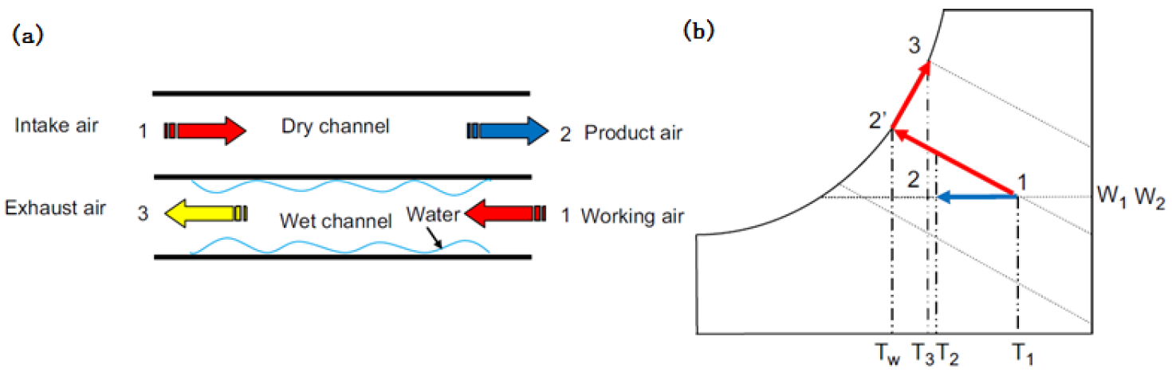
  Appendix
  Working principle
Fig. 8.1 (a) schematics and (b) psychrometric process of traditional IEC
When IEC is applied in hot and humid areas, the primary air humidity is high and the wet-bulb temperature of the secondary air (exhaust air) in the air-conditioned space is low, resulting in condensation where the temperature of the plate surface is lower than the dew-point temperature of the primary air.
中文要点｜工作原理
湿热地区的一次空气湿度较高。当板面温度低于其露点温度时，一次空气侧发生冷凝，可同时回收显热与潜热。
(c) Upper side configuration (d) Lower side configuration

Slide 7
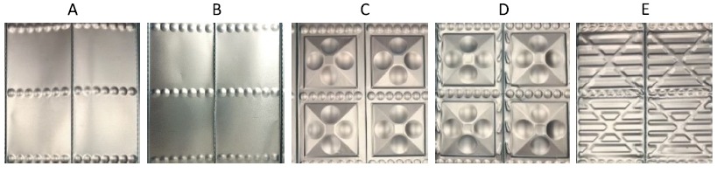
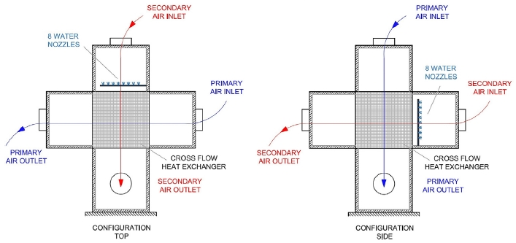
1. Research background and literature review
1.3 Research on wettability of secondary air channel
Water supply
Low water supply Low wettability and heat & mass transfer
High water supply Higher film thickness and thermal resistance
Plate structure
Air flow direction
Fig.1.3.1 Plate with different pitch or protrusion geometry
Fig.1.3.2 Scheme of Top and Side configuration
Source: Effect of plates coating on performance of an indirect evaporative cooling system. 2019;
Effect of heat exchanger plates geometry on performance of an indirect evaporative cooling system, 2020
中文要点｜湿通道润湿性
供水不足导致干区和传热传质性能下降；供水过多则使水膜增厚、热阻增大。应协同优化板面结构与供水方式。

Slide 8
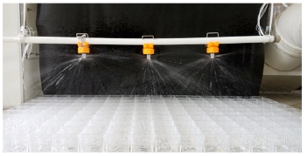
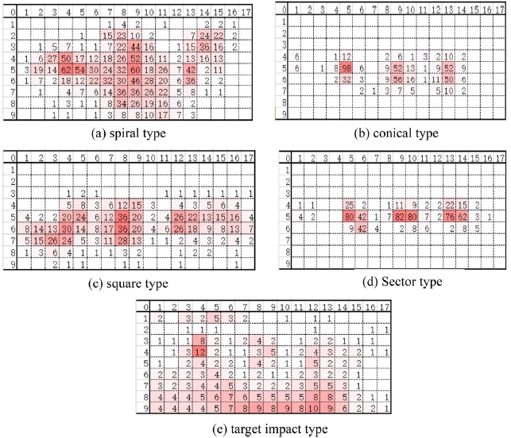
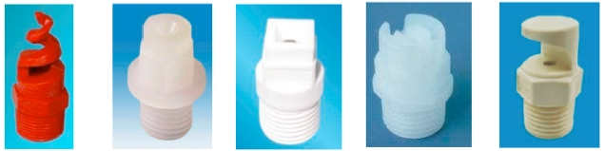
1. Research background and literature review
Water spray nozzle
Arrangement
Distributions
Fig.1.3.3 The photos of water distribution effect^{[1]}
Types
Fig.1.3.5 Water distribution volume of spraying nozzles(220 L/h) ^{[1]}
Fig.1.3.4 Five types of commonly used spray nozzle^{[1]}
[1] Sun T, Huang X, Chen Y, Zhang H. Experimental investigation of water spraying in an indirect evaporative cooler from nozzle type and spray strategy perspectives.
中文要点｜喷嘴与布水特性
喷嘴类型、布置方式及喷淋分布共同决定板面的布水效果，是改善润湿性的重要设计因素。

Slide 9
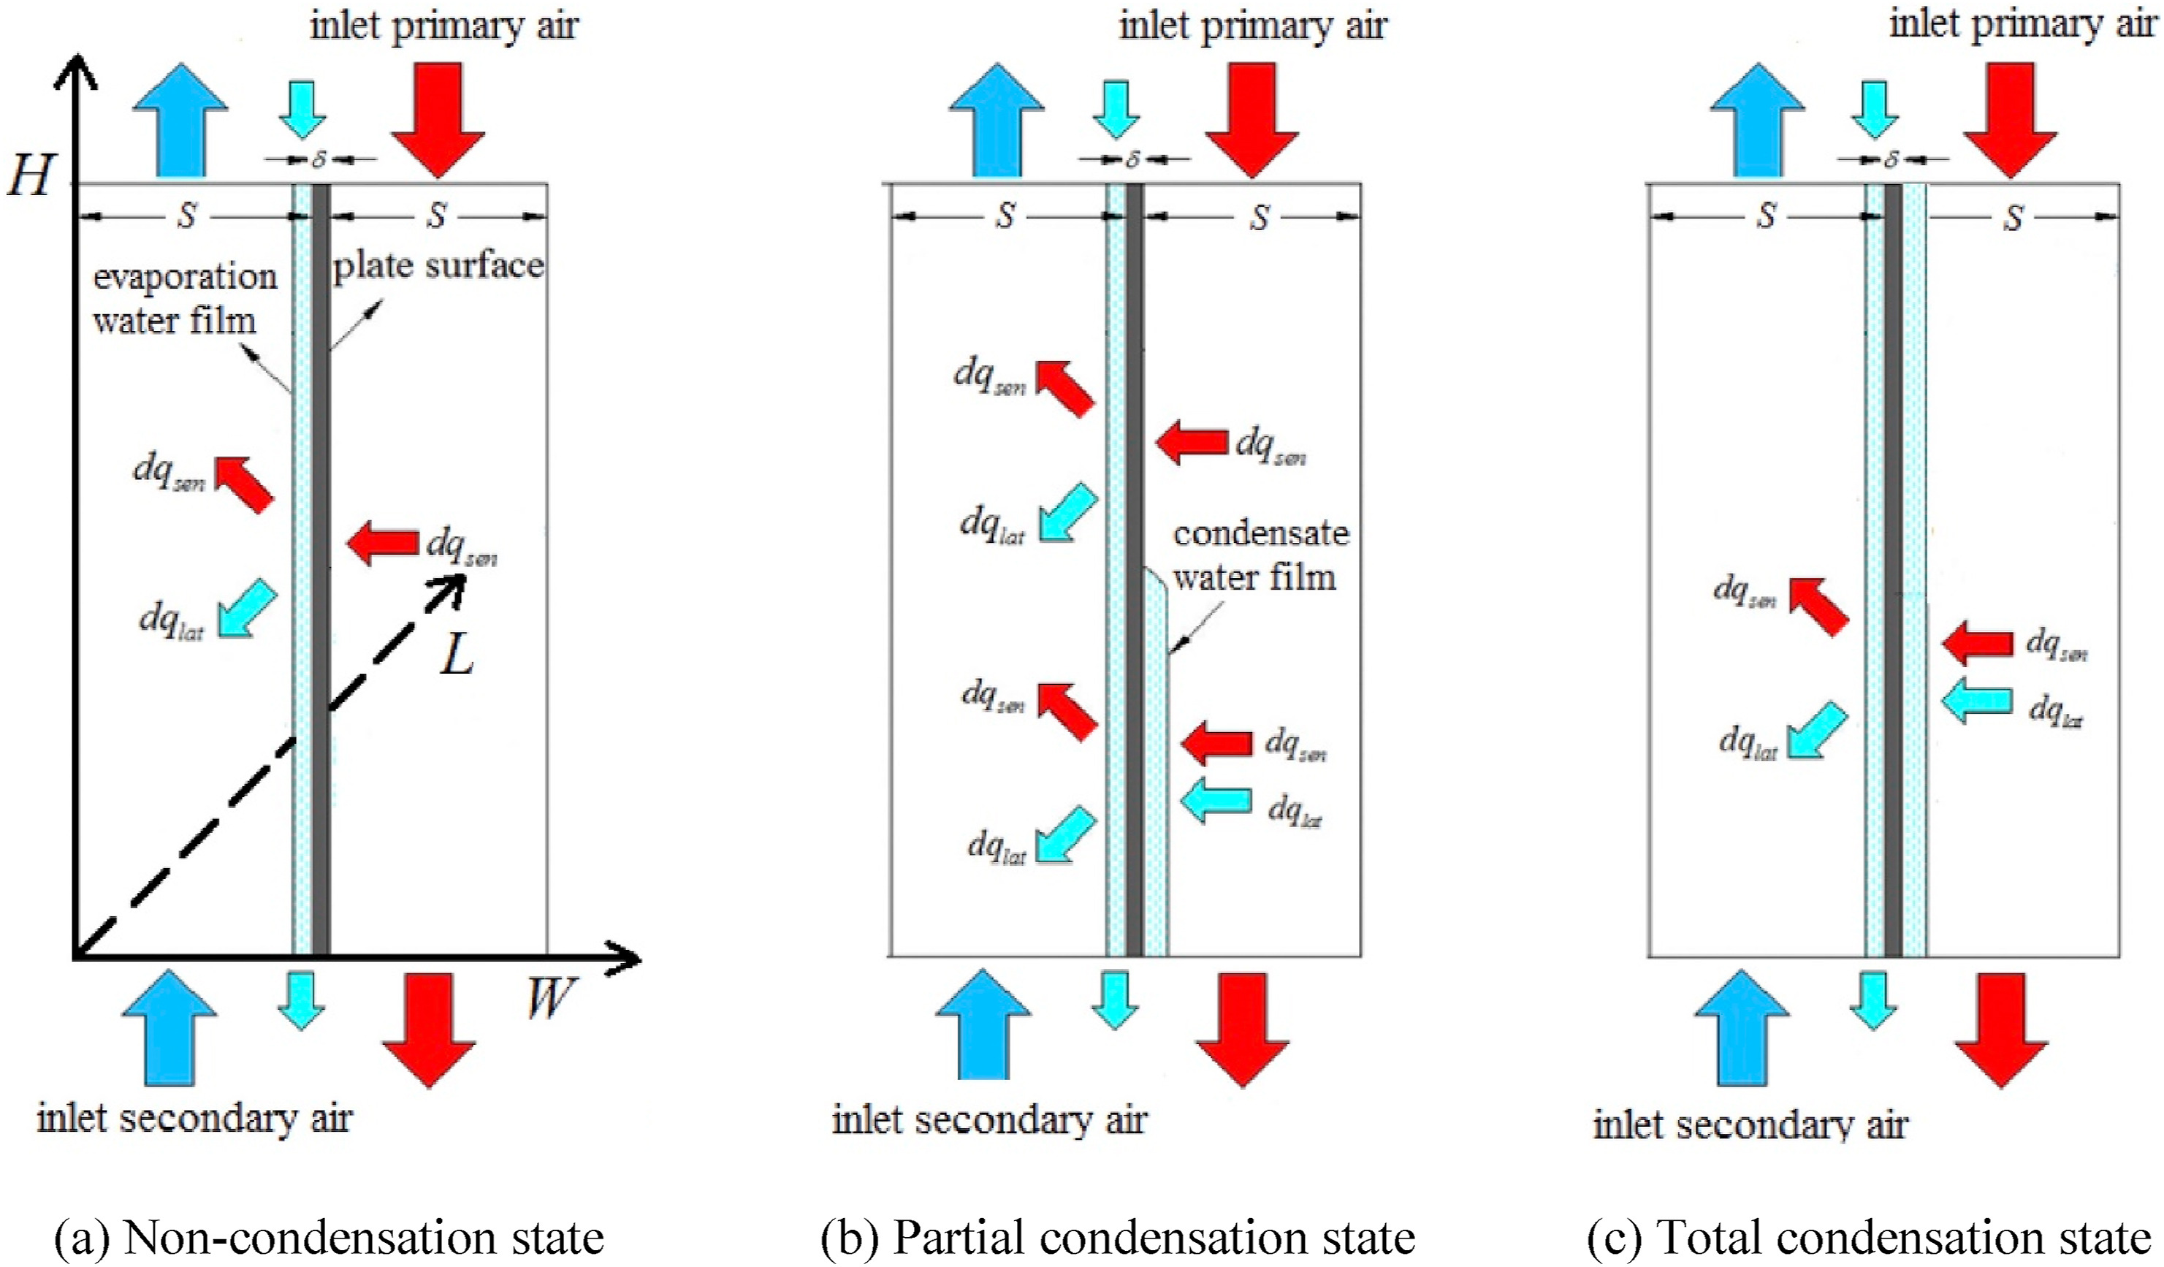
1. Research background and literature review
1.4 Research on previous model
Fig.1.3.5 Previous model of the IEC
Assumption: the thin water film entirely and evenly covered the surface of the wet channel.
Ideal!
中文要点｜现有模型的局限
“水膜完整且均匀覆盖湿通道”的理想假设与实际情况存在差异，需考虑不完全润湿与真实喷淋分布。

Slide 10
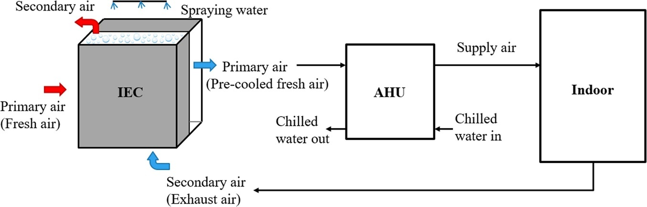
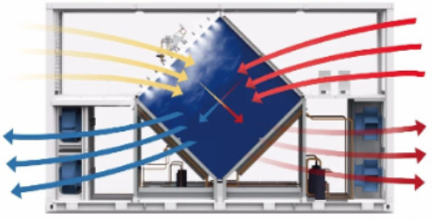
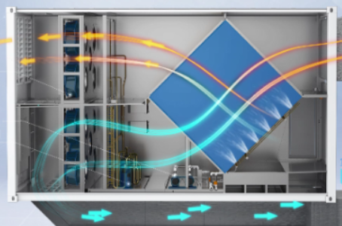
1. Research background and literature review
1.5 IEC as the recovery unit
Fig.1.5.1 Schematics diagram of IEC followed by AHU
Various nozzle settings for diamond-shaped IEC
A more standardized nozzle arrangement guideline has not yet emerged.
中文要点｜IEC 能量回收应用
IEC 可与空气处理机组（AHU）结合使用，但菱形 IEC 仍缺少标准化的喷嘴布置指导方法。

Slide 11
Outline
Research background and literature review
Research gaps and objectives
Development of FDM model for spray distribution optimization of IEC
Development of CFD model for IEC considering water film formation with spray parameter analysis
Performance assessment and optimization of water spray strategy for IEC based on ANN modeling and GA
Performance analysis and nozzle setting optimization of IEC for energy recovery in data centers
Conclusions and recommendations for future work
中文要点｜研究不足与目标
围绕实际水膜分布、喷淋参数耦合和工程优化需求，建立从机理模型到智能预测的研究体系。

Slide 12
2. Research gaps and objectives
  2.1 Research gaps
Most of the existing analysis about water spray of IEC are based on experimental data, and few mathematical models can quantitatively simulate the various parameters.
The existing heat and mass transfer model of IEC has not fully discussed on the wetting ratio, and the ideal assumption needs to be corrected.
The current 2D model is not enough to accurately simulate the state of the water film distribution, and to deal with more complex hydraulic and thermal properties.
The optimal nozzle arrangement and parameter setting to maintain the best wetted situation of the IEC wet channel have not been identified.
There is a need for straightforward method to predict the IEC performance for use in reality and optimize spray design parameters in large scale projects.
The diamond-shaped IEC used as heat recovery units combined with AHU in DCs require targeted water spray system settings.
中文要点｜六项研究不足
现有研究在定量喷淋建模、真实润湿率、三维水膜模拟、最优喷嘴设计、高效预测及数据中心适配方面仍有不足。

Slide 13
2. Research gaps and objectives
  2.2 Research objectives
To propose a FDM model for predicting the water spray distribution of the nozzles in IEC.
To establish a 3D CFD model to identify the formation and flow state of the water membrane covering the plate surface.
To set up the test bench with the complete IEC system that can investigate the practical wetted sections in single channel pair for model verification.
To conduct the parametric analysis and determine the optimal water spraying strategies for IEC system.
To develop high-efficiency prediction model based on ML to accurately predict the performance of IEC system combined with genetic algorithm for multi-objective optimization.
To establish and verified a CFD model based on the diamond-shaped IEC to explore the optimal nozzle configurations and performances, as well as the enhancement strategies for IEC in DCs
中文要点｜研究目标
建立并验证 FDM、三维 CFD 和 ANN 模型，结合实验与遗传算法，优化常规及菱形 IEC 的喷淋策略。
Notes:
PIEC model to do the parameter analysis as and determine the inter…
Compare

Slide 14
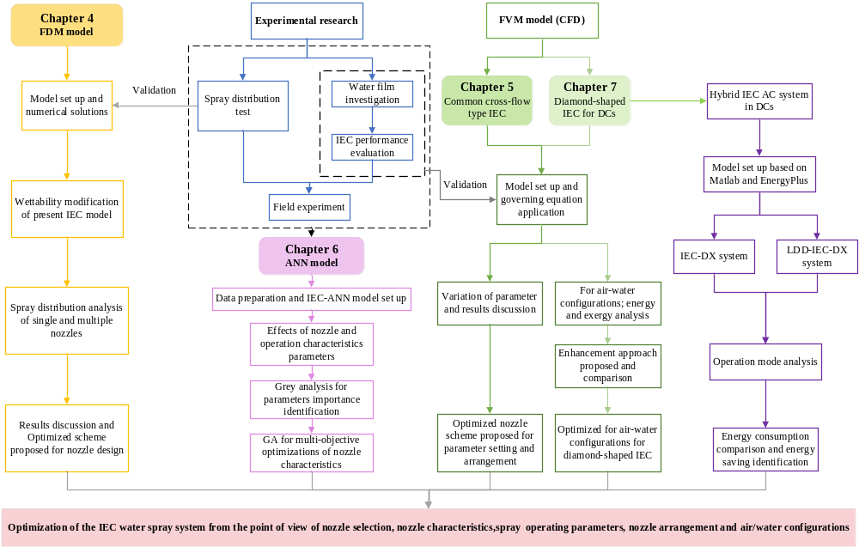
Section 3
FDM model
Section 4
Common cross-flow type IEC
Section 6
Diamond-shaped IEC
Section 5
ANN model
中文要点｜研究技术路线
以 FDM 研究喷淋分布，以 CFD 分析水膜形成，以 ANN 提高预测效率，并拓展至菱形 IEC 的应用优化。
Notes:
PIEC model to do the parameter analysis as and determine the inter…
Compare

Slide 15
Outline
Research background and literature review
Research gaps and objectives
Development of FDM model for spray distribution optimization of IEC
Development of CFD model for IEC considering water film formation with spray parameter analysis
Performance assessment and optimization of water spray strategy for IEC based on ANN modeling and GA
Performance analysis and nozzle setting optimization of IEC for energy recovery in data centers
Conclusions and recommendations for future work
中文要点｜第三部分：FDM 模型
建立喷淋分布模型，通过实验验证与多喷嘴方案对比，优化板面润湿性及 IEC 能量回收性能。

Slide 16
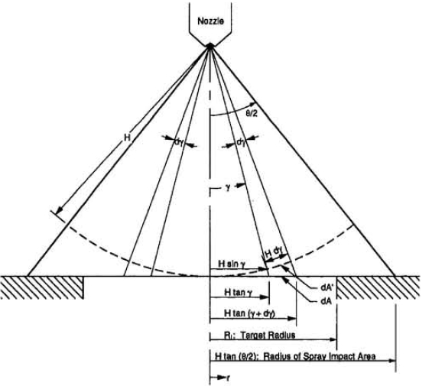
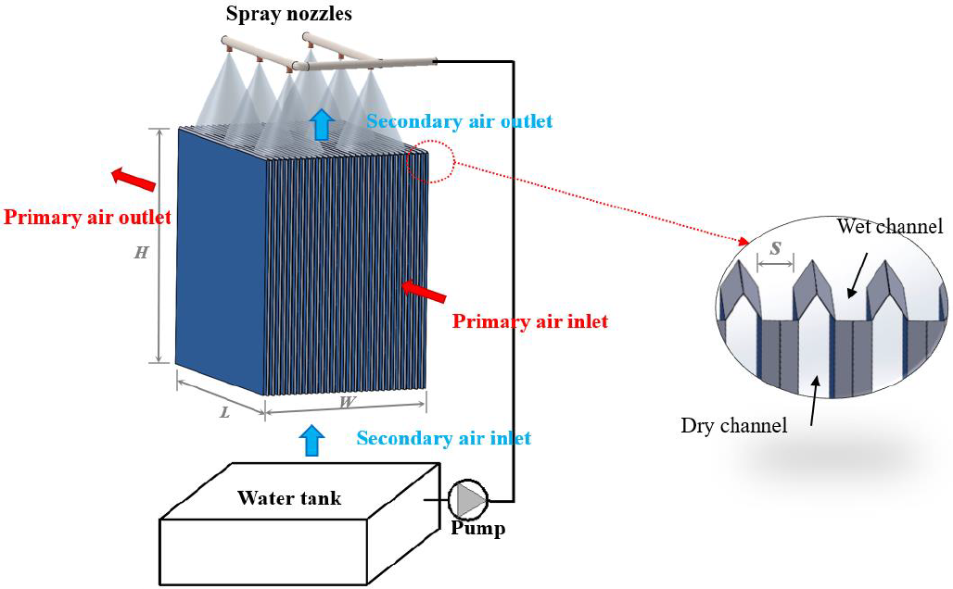
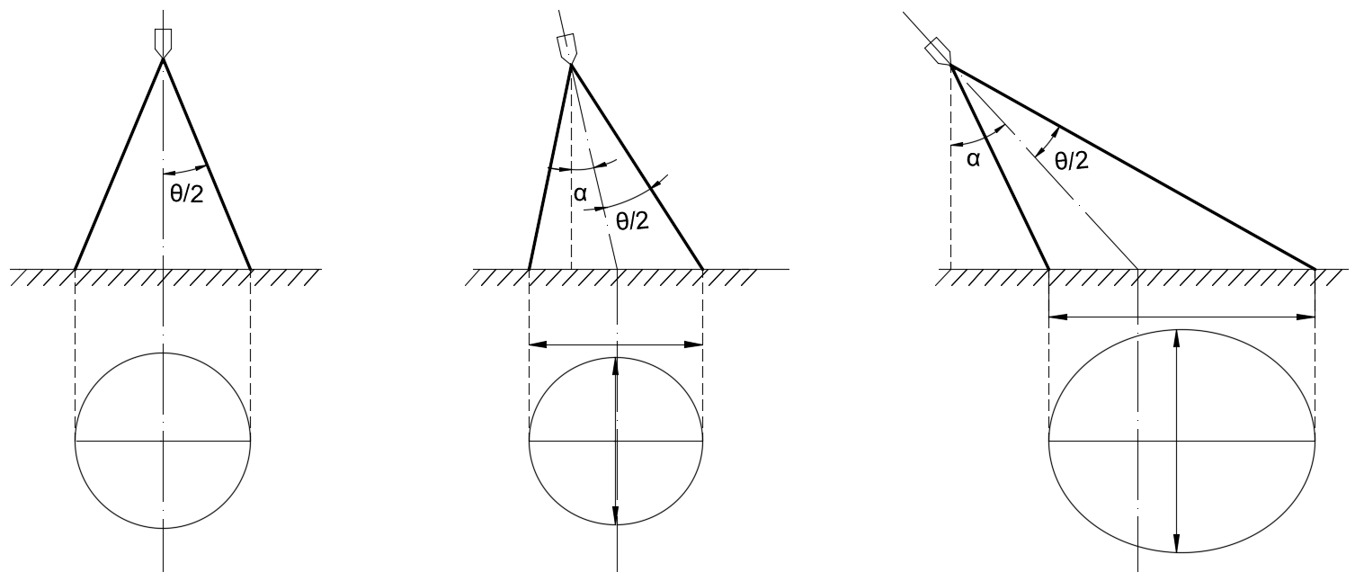
3. Development of FDM model for nozzle optimization of IEC
  3.1 Mathematical model
Fig. 3.1.2 Geometry used in volumetric flux distribution model ^{[1]}
Fig. 3.1.1 Configuration of an IEC system
Assumption：
The total spray flow rate, Q, is uniformly distributed over any spherical surface centered at the spray orifice.
Fig. 3.1.3 Three scenarios of spray impact area
[1] Mudawar I, Estes KA. Optimizing and predicting CHF in spray cooling of a square surface. J Heat Transfer 1996;118:672–9. https://doi.org/10.1115/1.2822685.
中文要点｜数学模型与假设
以喷口为球心，假设总喷淋流量 Q 在任一球面上均匀分布，据此计算不同区域的喷淋通量。

Slide 17
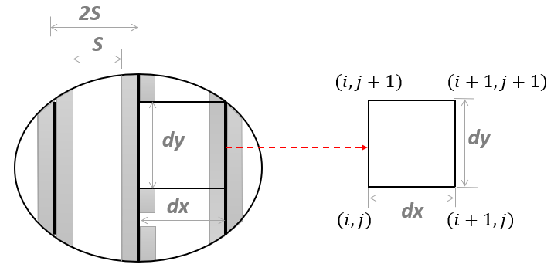
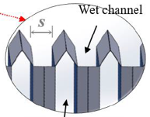
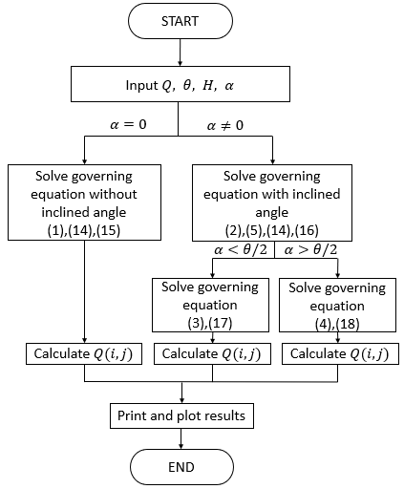
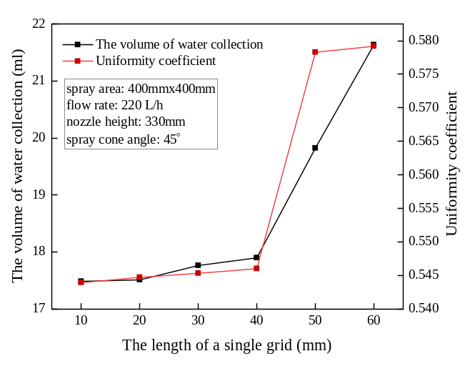
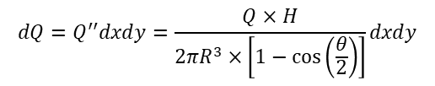

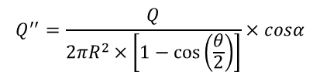
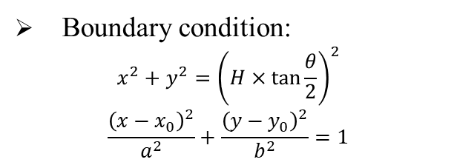


3. Development of numerical model for nozzle optimization of IEC
3.2 Model equations
Differential element division:
Simulation process (MATLAB)
Boundary condition:
$$\begin{aligned}x^{2}+y^{2}={\left(H×\tan{\frac{θ}{2}}\right)}^{2}\end{aligned}$$
$$\begin{aligned}\frac{{\left(x−x_{0}\right)}^{2}}{a^{2}}+\frac{{\left(y−y_{0}\right)}^{2}}{b^{2}}=1\end{aligned}$$
Imaginary spherical surface:
$$\begin{aligned}Q_{(i,j)}=\int_{x_{i}}^{x_{i+1}}{\int_{y_{i}}^{y_{i+1}}{\frac{Q×H}{{2π\left(\sqrt{x^{2}+y^{2}+H^{2}}\right)}^{3}×\left[1−\cos\left(\frac{θ}{2}\right)\right]}dxdy}}\#\end{aligned}$$
$$R=\sqrt{x^{2}+y^{2}+H^{2}}$$
Grid independence:
$$cosα=\frac{H}{R}$$
$$\begin{aligned}dA={2πR}^{2}×\frac{sinα}{cosα}dα\#\end{aligned}$$
$$\begin{aligned}A={2πR}^{2}×\frac{\left[1−\cos\left(\frac{θ}{2}\right)\right]}{cosα}\#\end{aligned}$$
Volume flux of spray surface area:
Fig. 3.2.2 Flow chart of simulation procedure
$$\begin{aligned}&Q^{′′}=\frac{Q}{{2πR}^{2}×\left[1−\cos\left(\frac{θ}{2}\right)\right]}×cosα\#\end{aligned}$$
Fig.3.2.1 Proof of grid independence
中文要点｜模型方程与求解
通过球面几何与微元划分计算局部体积通量，并在 MATLAB 中完成求解与网格无关性验证。
$$dQ=Q^{′′}dxdy=\frac{Q×H}{{2πR}^{3}×\left[1−\cos\left(\frac{θ}{2}\right)\right]}dxdy$$

Slide 18
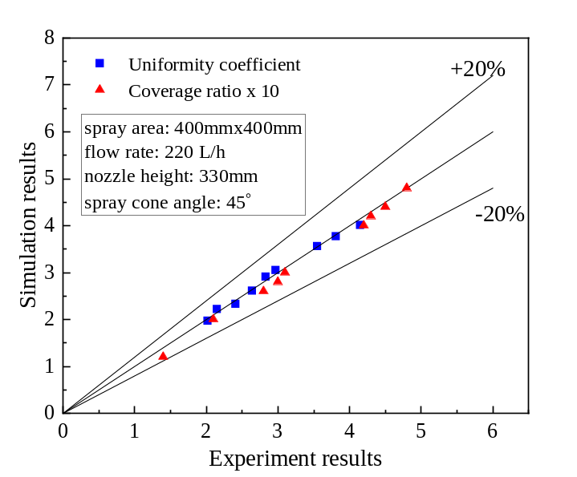
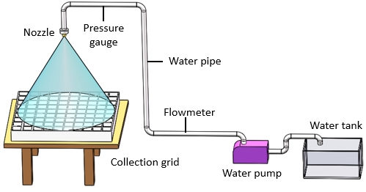
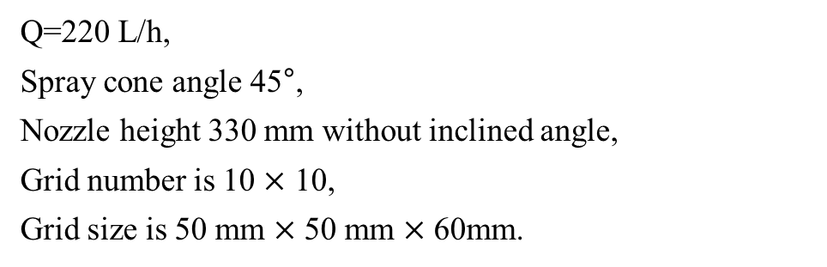
3. Development of numerical model for nozzle optimization of IEC with experimental validation
3.3 Experiment validation
Validation result:
Condition:
Q=220 L/h,
Spray cone angle 45°,
Nozzle height 330 mm without inclined angle,
Grid number is 10 $×$ 10,
Grid size is 50 mm $×$ 50 mm $×$ 60mm.
Fig. 3.3.2 Validation results
The maximum discrepancy is acceptable.
Fig. 3.3.1 Experiment bench
中文要点｜喷淋分布模型验证
搭建实验台，对比实验与模拟结果；模型最大偏差在可接受范围内，可用于后续喷嘴优化分析。

Slide 19
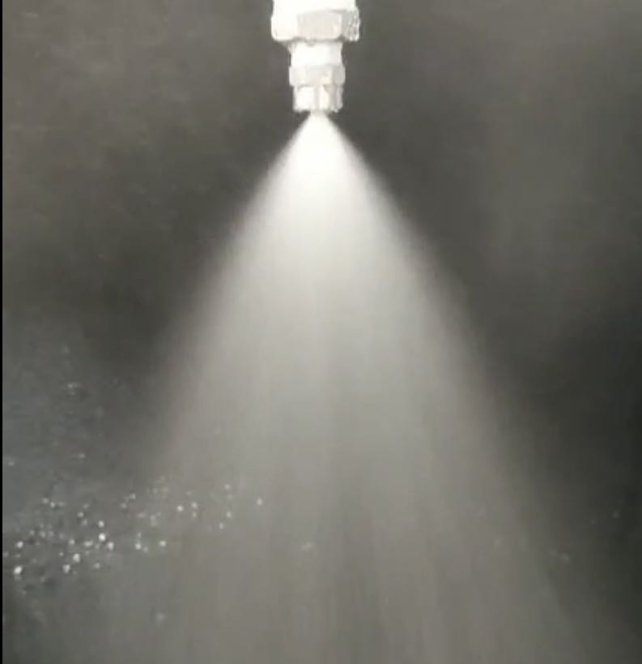
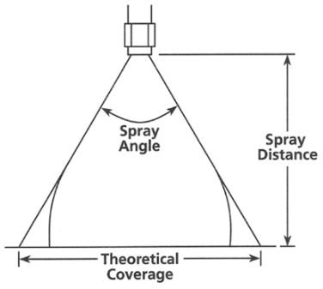
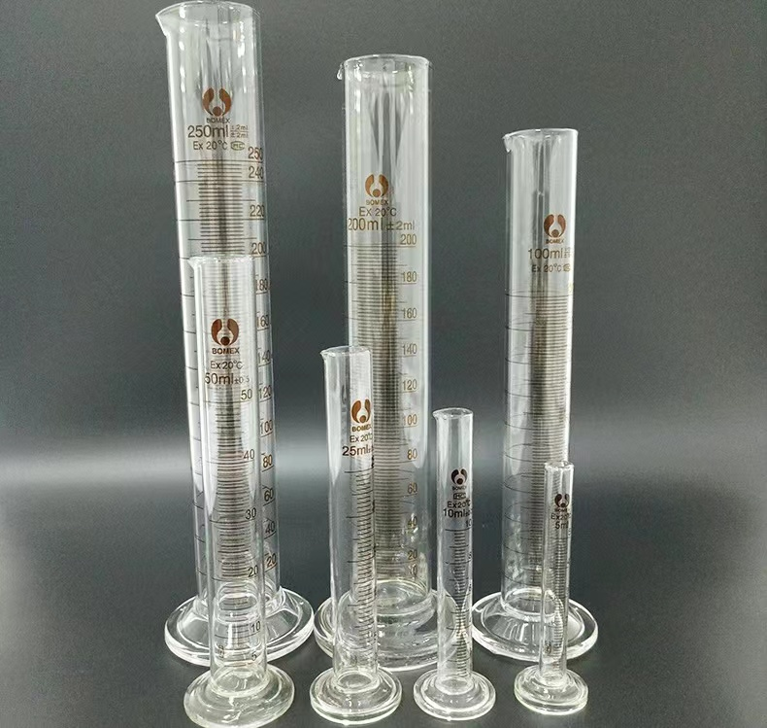
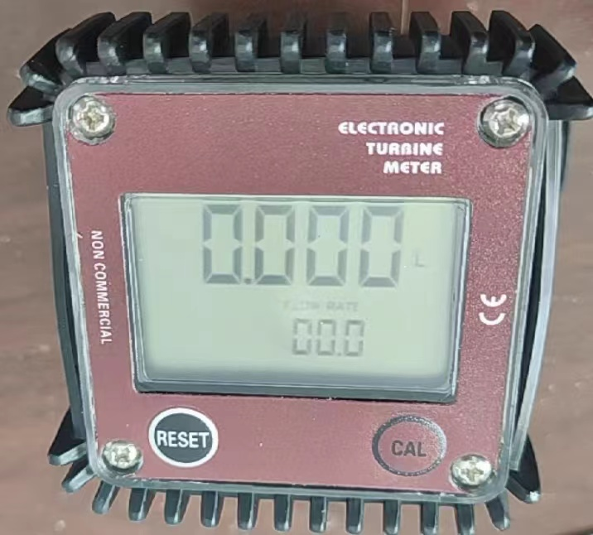
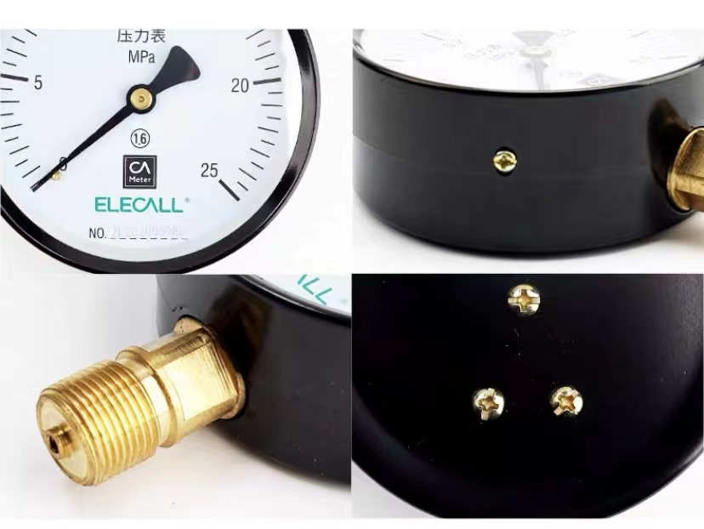
  Appendix
Instrument selection
Table 8.1 Solid nozzle selection
Nozzle | Orifice diameter (mm) | Volumetric flow rate | Pressure | Spray angle
1 | 2.4 | 1.9-8.4 | 0.4-10 | 45-50
2 | 3.0 | 2.9-13 | 0.4-10 | 60-70
3 | 3.2 | 6.7-16.2 | 0.4-10 | 70-75
Fig. 3.3.1 Photos of the nozzles
Table 8.2 Instrument parameters list
Instrument | Parameter | Range | Accuracy
Flowmeter | Water flow rate | 1.9-8.4 | 0.4-10
Pressure gage | Water pressure | 2.9-13 | 0.4-10
Measuring cylinder | Water volume | 6.7-16.2 | 0.4-10
Fig. 8.3 Photos of test instrument
中文要点｜实验仪器与喷嘴选型
根据孔径、流量、压力和喷雾锥角选择喷嘴，并通过流量计、压力表与量筒开展喷淋测量。

Slide 20

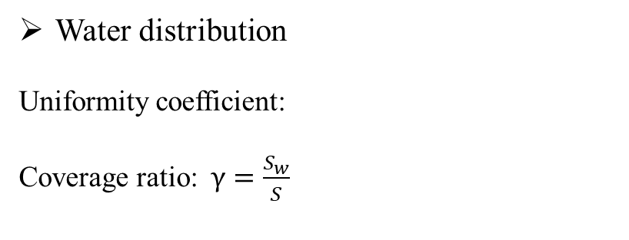
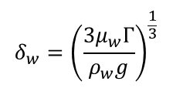

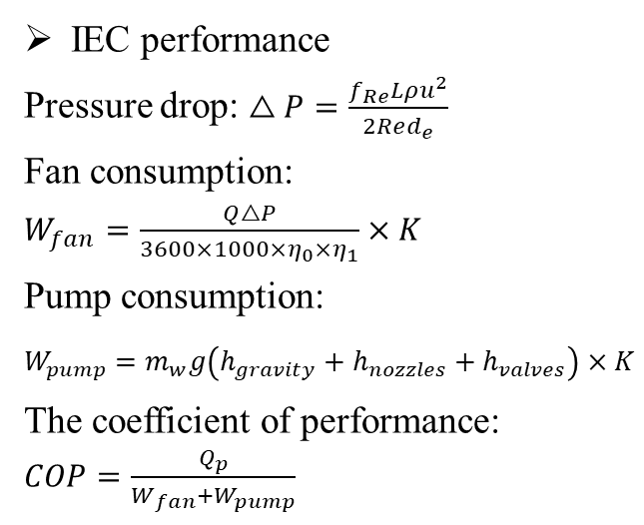
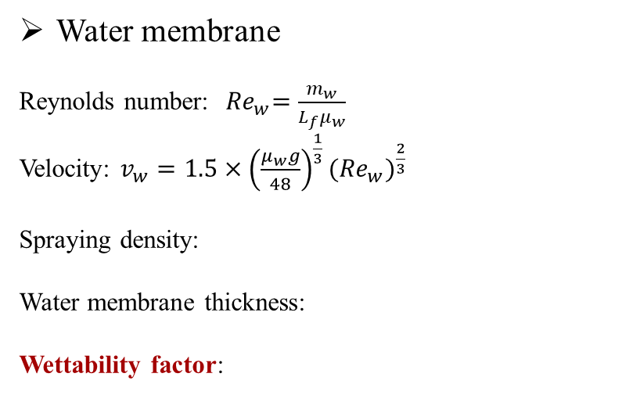

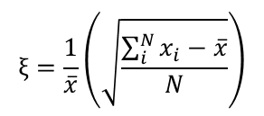

3. Development of numerical model for nozzle optimization of IEC with experimental validation
3.4 Performance indexes
Water distribution
Uniformity coefficient:
Coverage ratio: $γ=\frac{S_{w}}{S}$
IEC performance
Pressure drop: $\begin{aligned}△P=\frac{f_{Re}Lρu^{2}}{2Red_{e}}\end{aligned}$
Fan consumption: $\begin{aligned}W_{fan}=\frac{Q△P}{3600×1000×η_{0}{×η}_{1}}×K\end{aligned}$
Pump consumption: $\begin{aligned}W_{pump}=m_{w}g\left(h_{gravity}+h_{nozzles}+h_{valves}\right)×K\end{aligned}$
The coefficient of performance: $COP=\frac{Q_{p}}{W_{fan}+W_{pump}}$
$$ξ=\frac{1}{\overline{x}}\left(\sqrt{\frac{\sum_{i}^{N}{x_{i}−\overline{x}}}{N}}\right)$$
Water membrane
Reynolds number:${ Re}_{w}=\frac{m_{w}}{L_{f}μ_{w}}$
Velocity: $v_{w}=1.5×{\left(\frac{μ_{w}g}{48}\right)}^{\frac{1}{3}}{({Re}_{w})}^{\frac{2}{3}}$
Spraying density:
Water membrane thickness:
Wettability factor:
Wet-bulb efficiency:
Cooling capacity:
$$Γ=\frac{{\dot{m}}_{w}}{\left(n+1\right)L_{f}}$$
$$η_{wb}=\frac{t_{p,in}−t_{p,out}}{t_{p,in}−t_{wb,s,in}}$$
$$δ_{w}={\left(\frac{{3μ}_{w}Γ}{ρ_{w}g}\right)}^{\frac{1}{3}}$$
$$Q_{c}=m_{p}c_{pa}\left(t_{p,in}−t_{p,out}\right)$$
中文要点｜性能评价指标
采用湿球效率和制冷量等指标，评价喷淋优化对 IEC 热湿处理能力与运行性能的影响。
$$σ={\dot{m}}_{w}\frac{h}{2δ_{w}v_{w}ρ_{w}}$$

Slide 21
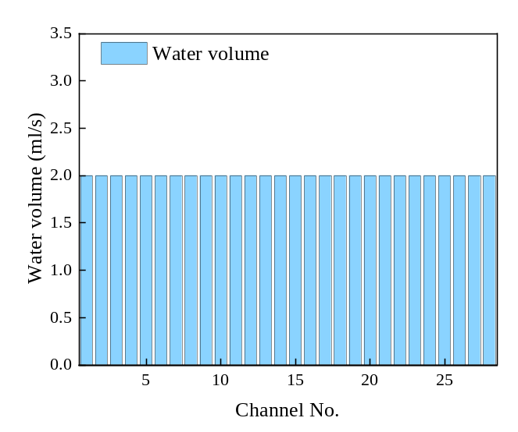
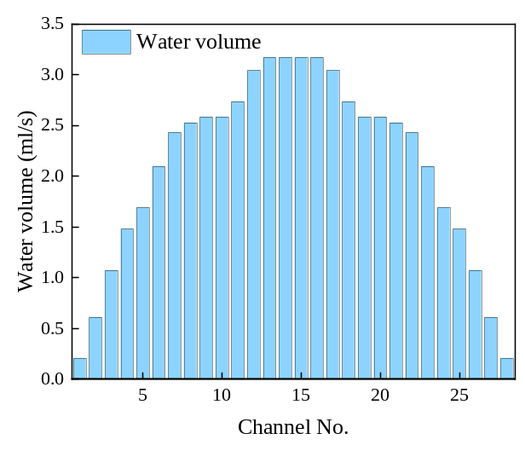
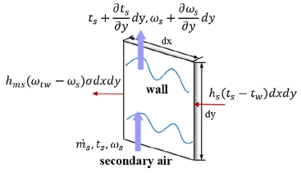

3. Development of numerical model for nozzle optimization of IEC with experimental validation
3.5 Results and discussions
3.5.1 The water density and wettability in channels
Water density modification
Original spraying density:
$$Γ=\frac{{\dot{m}}_{w}}{\left(n+1\right)L_{f}}$$
Fig. 3.5.1 Heat and mass transfer of the
secondary air flow channel
Ideal scenario
Reality scenario
中文要点｜喷淋密度与润湿修正
将真实喷淋密度和局部润湿状态纳入湿通道传热传质分析，修正理想完全润湿假设。

Slide 22
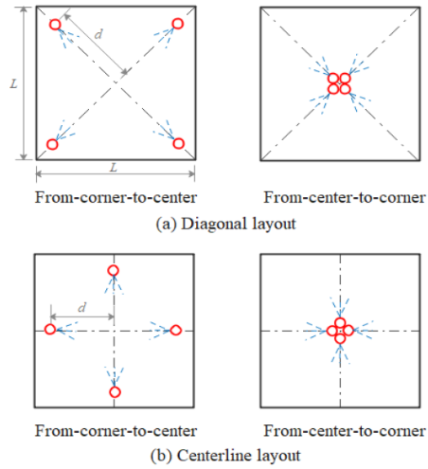
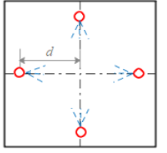
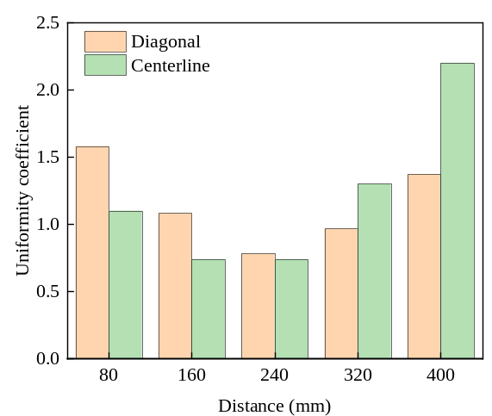
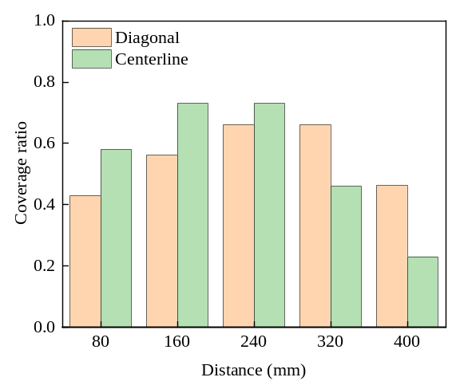
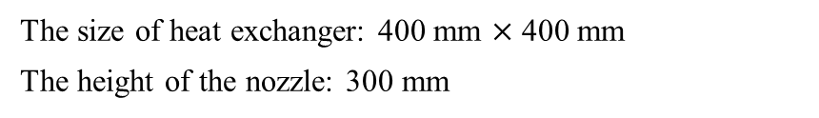
3. Development of numerical model for nozzle optimization of IEC with experimental validation
3.5 Results and discussions
3.5.2 Results of multiple nozzles
Arrangement schemes
The size of heat exchanger: 400 mm $×$ 400 mm
The height of the nozzle: 300 mm
(a) Diagonal (b) Centerline
Fig. 3.5.2 Nozzle arrangement schemes
The effect of the nozzle distance on the spray distribution
Uniformity coefficient
Coverage ratio
Spray optimal arrangement: Centerline with 160 mm distance.
Uniformity coefficient is 0.74 and coverage ratio is 0.72.
中文要点｜多喷嘴最优布置
本研究中，沿中心线布置、间距 160 mm 时效果最佳；均匀性系数为 0.74，覆盖率为 0.72。

Slide 23
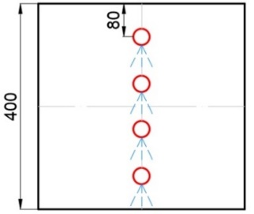
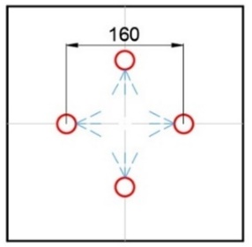
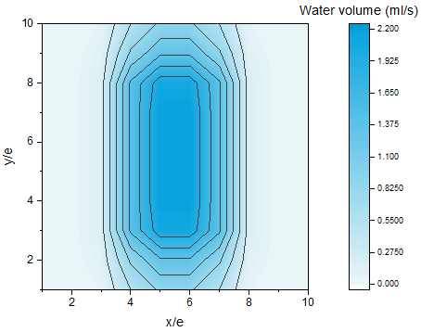

3. Development of numerical model for nozzle optimization of IEC with experimental validation
3.5 Results and discussions
3.5.3 Comparison between original and optimized schemes
Original arrangement scheme
Optimized arrangement scheme
Fig. 3.5.3 Original arrangement scheme
Fig. 3.5.4 Optimized arrangement scheme
Wettability value: 0.48
Wettability value: 0.89
46%
中文要点｜原始与优化方案对比
优化喷嘴布置后，润湿系数由 0.48 提高至 0.89，表明合理布水可显著改善板面润湿状态。

Slide 24



3. Development of numerical model for nozzle optimization of IEC with experimental validation
3.5 Results and discussions
3.5.4 Performance improvement with optimized nozzle arrangement
For dehumidification
For COP value
Fig. 15 Average value of COP
Fig. 3.5.5 Average value of the dehumidification rate
Fig. 3.5.6 Average value of the COP
The improvement of dehumidification rate is 5.85% .
The improvement of COP value is 16% .
中文要点｜系统性能提升
优化喷嘴布置后，除湿率提高 5.85%，性能系数（COP）提高 16%。

Slide 25
Outline
Research background and literature review
Research gaps and objectives
Development of FDM model for spray distribution optimization of IEC
Development of CFD model for IEC considering water film formation with spray parameter analysis
Performance assessment and optimization of water spray strategy for IEC based on ANN modeling and GA
Performance analysis and nozzle setting optimization of IEC for energy recovery in data centers
Conclusions and recommendations for future work
中文要点｜第四部分：CFD 水膜模型
建立考虑喷雾液滴与板面水膜的三维模型，分析喷淋参数、水膜覆盖及 IEC 性能之间的关系。

Slide 26




4. Development of CFD model for IEC considering water film formation with spray parameter analysis
4.1 Model description (ANSYS)
Flowchart
Model of single wet channel
Different heat transfer for different coverage area
Fig.4.1.3 Geometry used in volumetric flux distribution model
Fig.4.1.2 Configuration of an IEC system
Coverage factor:
$$φ=\frac{A_{w}}{A_{pl}}$$
中文要点｜CFD 模型构建
针对单个湿通道建模，区分润湿与未润湿区域的传热过程，并引入覆盖系数描述实际水膜状态。

Slide 27














4. Development of CFD model for IEC considering water film formation with spray parameter analysis
4.2 Model equations
(1) Conservation of mass
(5) Discrete phase model (DPM)
$$\frac{∂}{∂t}\left(ρ\right)+∇∙\left(ρu\right)=0$$
$$\frac{d\left(\vec{X_{g}}\right)}{dt}=\vec{V_{g}}$$
(2) Conservation of momentum
$$\frac{d\left(m_{d}\vec{F_{d}}\right)}{dt}=\vec{F_{D}}+\vec{F_{g}}$$
$$\frac{∂}{∂t}\left(ρE\right)+∇∙\left(ρu^{2}\right)=−∇P+∇∙\left(μ\left(∇u+∇u^{T}\right)\right)+ρg+F$$
$${\vec{F}}_{d}=−\frac{π}{8}C_{D}ρ_{a}D_{d}^{2}{\vec{V}}_{r}\left|{\vec{V}}_{r}\right|$$
(3) Mass transfer
(6) Turbulence model
$$h_{ms}\left(ω_{t_{w}}−ω_{s}\right)σ∙dxdy={\dot{m}}_{s}\frac{∂ω_{s}}{∂y}∙dy$$
$${Re}_{s}=4\overline{ω}δ/v$$
(7) Calculation method
(4) VOF multi-phase model
Applied $k−ε$ turbulence model
$$\frac{∂ω_{e}}{∂y}={\dot{m}}_{s}\frac{∂ω_{s}}{∂y}$$
EWF coupled DPM model
The SIMPLE and PRESTO! pressure
Fig.4.2.1 Sketch of meshing in the model
$$ρ=α_{1}ρ_{1}+α_{g}+ρ_{g}$$
$$μ=α_{1}μ_{1}+α_{g}+μ_{g}$$
中文要点｜控制方程与耦合求解
模型考虑质量、动量与传质过程，并采用欧拉壁膜（EWF）与离散相模型（DPM）耦合描述喷雾及水膜。
$$\frac{∂α_{1/g}}{∂t}+\vec{u}∙∇α_{1/g}=0$$

Slide 28




4. Development of CFD model for IEC considering water film formation with spray parameter analysis
4.3 Model validation
Illustration of the experimental and numerical results
Grid independence
(a) Experimental plate
(b) Numerical result
Fig.4.3.1 Coverage ratio at different numbers of grid
The grid number of 113200 could be decided as the simulation number for further research.
(c) Experimental result in ImageJ
The ICEM software in ANSYS was applied to the mesh computational model.
中文要点｜网格与水膜分布验证
采用 113,200 个网格开展后续研究，并将模拟水膜分布与实验及 ImageJ 图像处理结果对比。

Slide 29


4. Development of CFD model for IEC considering water film formation with spray parameter analysis
4.4 Environment validation
Conditions:
Validation result:
Q=0.01 kg/s;
Spray cone angle = 45°;
Nozzle height =150 mm
Requirements:
Outermost transparent casing;
Sliding nozzles mounted on top
Fig.4.4.2 Validation results
The maximum discrepancy is 7.1%, which was acceptable for the further analysis.
Fig.4.4.1 Experiment bench
中文要点｜水膜模型实验验证
在流量 0.01 kg/s、喷雾锥角 45°、喷嘴高度 150 mm 的验证工况下，最大偏差为 7.1%。

Slide 30


4. Development of CFD model for IEC considering water film formation with spray parameter analysis
4.4 Environment validation
Experiment bench
Validation result:
Fig.4.4.4 Validation results
Fig.4.4.3 Validation results
The maximum discrepancy is 8.2%, which was acceptable for the further analysis.
中文要点｜系统性能实验验证
实验与模拟结果的最大偏差为 8.2%，满足后续参数分析与系统性能研究的要求。

Slide 31





  Appendix
Spray characteristics
Theoretical mass flow rate is given by Lefebvre and McDonell
$${\dot{m}}_{th}=ρA_{O}{(\frac{2∆P}{ρ})}^{0.5}$$
The average droplet diameter is obtained from the following equation:
$$d=9.5d_{j}/(∆P_{1}sin(α/2))$$
The correlation for spray cone angle based on inviscid theory (Abramovich, 1944) overpredicts the spray cone angle by 25%.
Fig. 8.4 Nozzle spray characteristics
$$2α=334.32K^{−0.165}{(\frac{D_{S}}{D_{O}})}^{−0.484}W_{e}^{0.043}{Re}_{p}^{−0.065}$$
The parameters are interrelated and cannot be adjusted individually.
Maximise the film coverage and to balance the effects of each factor.
Ideal object: nozzle with a orifice diameter of 3.0 mm
Operating condition: at a pressure of 1.5 bar, the spray flow rate is 5.4 L/min, the spray cone angle is 68$°$.
中文要点｜喷雾参数的关联性
流量、液滴直径和喷雾锥角相互关联，不能独立调节；优化时应综合平衡各因素对水膜覆盖的影响。

Slide 32






4. Development of CFD model for IEC considering water film formation with spray parameter analysis
4.5 Results and discussions
4.5.1 Influence for single nozzle
Spray droplet diameter
0.05 mm
0.15 mm
0.25 mm
Fig. 4.5.2 Coverage ratio with different diameter
Droplet flow is counter-current to the airflow.
Too small, be blown away before contact with the plate surface.
Two large, slide out of the wet channel before making contact with the plate surface.
0.35 mm
0.45 mm
Fig. 4.5.1 Coverage area with different diameter
中文要点｜液滴直径的影响
液滴过小易被逆向气流吹离，过大则可能在接触板面前滑出通道；需选择适宜的液滴尺度。

Slide 33




4. Development of CFD model for IEC considering water film formation with spray parameter analysis
4.5.2 Influence for multiple nozzles
Spray distance
0 mm
20 mm
Fig. 4.5.4 Impact of nozzle gap on coverage factor
The best wetting situation of the plate surface occurs at a nozzle of 40 mm (1) and the gap was 80 mm (2).
The spray of nozzles are too far apart causing some droplets to escape from the boundary.
While being too close caused a large number of spray droplets to collide and splash against each other.
40 mm
60 mm
Fig. 4.5.3 Variation of the nozzle distance
中文要点｜喷嘴间距的影响
间距过大易使液滴逸出边界，过小则加剧碰撞飞溅；应通过布置优化提高板面覆盖率。

Slide 34







4. Development of CFD model for IEC considering water film formation with spray parameter analysis
4.5.3 Influence on IEC performance
Conventional scheme
Optimized scheme
Linear distribution
Triangular distribution
Fig. 4.5.5 Comparison between conventional and optimized schemes
The water film coverage ratio of conventional and optimized schemes are 0.72 and 0.91.
Most rapid temperature drop at the top of the heat exchanger plate, due to the widest area covered by the water film and the longest contact between airflow and water flow.
中文要点｜常规与优化方案对比
优化后水膜覆盖率由 0.72 提高至 0.91；板面顶部因水膜覆盖充分、气水接触时间长，降温更快。

Slide 35




4. Development of CFD model for IEC considering water film formation with spray parameter analysis
4.5.4 The effect of inlet parameter of primary air and secondary air
Inlet temperature of primary air
An inlet air temperature of 32°C, with increases of 15.1% and 17.6% for 𝜀𝑤 and COP.
Inlet velocity of secondary air
An inlet air velocity of 2 m/s, with increases of 10.4% and 14.9% for 𝜀_{𝑤} and COP.
中文要点｜入口空气参数的影响
在 32 ℃ 工况下，湿球效率与 COP 分别提高 15.1% 和 17.6%；2 m/s 工况下分别提高 10.4% 和 14.9%。

Slide 36
Outline
Research background and literature review
Research gaps and objectives
Development of FDM model for spray distribution optimization of IEC
Development of CFD model for IEC considering water film formation with spray parameter analysis
Performance assessment and optimization of water spray strategy for IEC based on ANN modeling and GA
Performance analysis and nozzle setting optimization of IEC for energy recovery in data centers
Conclusions and recommendations for future work
中文要点｜第五部分：ANN–GA 优化
基于实验数据建立人工神经网络（ANN），结合遗传算法（GA）开展喷淋策略的多目标优化。

Slide 37


5. Performance assessment and optimization of water spray strategy for IEC based on ANN modeling and GA
  5.1 Concept and model set up
Data preparation
Table 5.1.1 Solid nozzle selection
The six parameters of the spray system that affect the performance of IEC can be identified in the table.
Evaluation indexes: wet-bulb efficiency and pressure drop.
Collection of experimental data
(weight ratio)
Conducted on a laboratory-scale prototype of the IEC system
Components: cross-flow heat exchanger, nozzles and water pump.
Keep the other basic parameters of the IEC constant, change the six main parameters, and record the effects.
Fig.5.1.1 Schematic diagram of the IEC system
中文要点｜实验数据与评价指标
改变六项主要喷淋参数，采集实验数据；以湿球效率与压降作为模型预测和优化的评价指标。

Slide 38


5. Performance assessment and optimization of water spray strategy for IEC based on ANN modeling and GA
  5.2 Design of model setting
A 3-layer network with a hidden layer comprising 14 neurons, can effectively capture the relationship between the input and output variables.
The dataset could be divided into three sections: the training dataset, validation dataset, and testing dataset, with portions of 70%, 15%, and 15%, correspondingly
Equations describe the model
Input layer
$$X={\left(x_{1},x_{2},…,x_{i},x_{n}\right)}^{T}$$
Hidden layer
$$net_{j}=w_{1j}⋅x_{1}+…+w_{nj}⋅x_{n}$$
$$h_{j}=f\left(net_{j}−a_{j}\right)$$
$$H={\left(h_{1},h_{2},…,h_{j},…,h_{i}\right)}^{T}$$
Hidden layer
$$net_{k}=w_{1k}⋅h_{1}+…+w_{lk}⋅h_{l}$$
$$o_{k}=g\left(net_{k}−b_{k}\right)$$
$$O={\left(o_{1},o_{2},…o_{k},…o_{m}\right)}^{T}$$
$$Y={\left(y_{1},y_{2},…,y_{k},…,y_{m}\right)}^{T}$$
Fig.5.2.1 Structure of the IEC-ANN model
中文要点｜神经网络结构
采用三层网络，隐含层含 14 个神经元；训练集、验证集与测试集的比例分别为 70%、15% 和 15%。

Slide 39





5. Performance assessment and optimization of water spray strategy for IEC based on ANN modeling and GA
  5.3 Model validations
Evaluation metrics of neural network
Coefficient of determination (r²)
$$r^{2}=\frac{{\left[n\sum_{k=1}^{n}{Y_{P}\left(k\right)}Y_{T}\left(k\right)−\sum_{k=1}^{n}{Y_{P}\left(k\right)}\sum_{k=1}^{n}{Y_{T}\left(k\right)}\right]}^{2}}{[n{\sum_{k=1}^{n}{Y_{P}{\left(k\right)}^{2}\left[\sum_{k=1}^{n}{Y_{P}\left(k\right)}\right]}}^{2}]{\left[n\sum_{k=1}^{n}{Y_{P}{\left(k\right)}^{2}[}\sum_{k=1}^{n}{Y_{T}\left(k\right)}\right]}^{2}]}$$
Root mean square error (RMSE)
$$RMSE=\sqrt{\frac{\frac{n}{i=k}{\left(Y_{P}\left(k\right)−Y_{T}\left(k\right)\right)}^{2}}{n}}$$
Validation results
Validation results for $ε_{wb}$
Validation results for $∆P$
Fig.5.3.1 Validation results of the proposed IEC-ANN model
中文要点｜ANN 模型验证
通过神经网络评价指标及预测值与实验值的对比，检验所建立 IEC–ANN 模型的预测能力。

Slide 40





5. Performance assessment and optimization of water spray strategy for IEC based on ANN modeling and GA
  5.4 Results and discussions
5.4.1 Effect of variations in a single factor
Nozzle characteristics parameters
Effect of pressure on droplet diameter and coverage ratio
(a) Effect of pressure on cone angle
(b) Effect of pressure on flow rate
(a) The peak value of 67° is achieved at a pressure of 0.15 MPa.
(b) The increasing trend of spray flow rate with the rise in pressure.
(c) The trend of $ε_{wb}$ with pressure is consistent with spray angle.
(d) The maximum coverage ratio is achieved at a pressure of 0.15 MPa.
Fig.5.4.1 The effect of nozzle pressure variations
中文要点｜喷嘴压力的影响
压力改变会同时影响喷雾锥角、流量和液滴直径，进而影响水膜覆盖和系统性能。
(c) Effect of pressure on $ε_{wb}$

Slide 41


5. Performance assessment and optimization of water spray strategy for IEC based on ANN modeling and GA
  5.4 Results and discussions
5.4.1 Effect of variations in a single factor
Nozzle spacing
Nozzle aperture
Nozzle count
Fig.5.4.2 The effect of three other nozzle parameters variations
The peak value of wet-bulb efficiency is achieved at a spacing of 80 mm.
The $ε_{wb}$ initially increases with increasing nozzle aperture size and decreases with apertures larger than 6 mm.
The $ε_{wb}$demonstrates an initial increase as the number of nozzles increases, but it starts to decline when n≥10.
中文要点｜喷嘴几何参数的影响
喷嘴间距、孔径和数量共同影响喷淋分布，应结合润湿效果与运行阻力进行选择。

Slide 42





5. Performance assessment and optimization of water spray strategy for IEC based on ANN modeling and GA
  5.4 Results and discussions
5.4.1 Effect of variations in a single factor
Operation characteristics parameters
Ratio of air to water
Initial stage: improves the convective heat and mass transfer coefficient, thus optimising the $ε_{wb}$.
Later stage: disrupts the formation of a water film, increasing the pressure drop
Spray density
Lower stage: Uneven water film distribution, presence of dry areas
Higher stage: thicker water film lead to clogging of secondary air channel, increasing air resistance.
Fig.5.4.3 The effect of operation parameters on $ε_{wb}$
Fig.5.4.4 The effect of operation parameters on pressure drop
中文要点｜喷淋密度的影响
喷淋密度低时水膜不均、存在干区；过高时水膜增厚，可能堵塞二次空气通道并增大空气阻力。

Slide 43





5. Performance assessment and optimization of water spray strategy for IEC based on ANN modeling and GA
  5.4 Results and discussions
5.4.2 Combined effect of variations in two factors
The importance of different design parameters
Spacing and pressure
Aperture and pressure
Small spacing: increasing the pressure rapidly brings the IEC performance to its peak and then decreases.
Low pressure: aperture ${ ε}_{wb}$
High pressure: aperture ${ ε}_{wb}$
Ratio $<$Count $<$ Density $<$ Pressure $<$ Spacing $<$ Aperture
The smallest impact factor with a correlation coefficient of 0.5228, remains important.
中文要点｜双因素耦合与参数重要性
分析间距—压力、孔径—压力的耦合影响，并比较各设计参数对系统性能的重要性。

Slide 44


5. Performance assessment and optimization of water spray strategy for IEC based on ANN modeling and GA
  5.4 Results and discussions
5.4.3 Optimization of IEC-ANN model based on Genetic algorithm
Genetic algorithm
Four key aspects: determining the basic operating parameters, chromosome encoding and decoding, evaluating individual fitness, and implementing the three genetic operators.
Multi-objectives optimization
Optimization targets: wet-bulb efficiency and pressure drop Minimizing power consumption & Maximizing cooling performance.
The optimization function comprises of both a fitness as well as a constraint function.
$$J(P,s,d,n,Γ,v)=W_{1}\frac{ε_{wb}}{Rε_{wb}}+W_{2}\frac{ΔP}{RΔP}$$
Fig.5.4.3 The flow of GA-ANN optimization
中文要点｜遗传算法多目标优化
以提高湿球效率、降低压降为目标，通过适应度评价及遗传操作，平衡制冷性能与运行能耗。

Slide 45

5. Performance assessment and optimization of water spray strategy for IEC based on ANN modeling and GA
  5.4 Results and discussions
5.4.3 Optimization of IEC-ANN model based on Genetic algorithm
Results derived from GA
An equal-weight distribution yields the best conditions for optimization of IEC performance.
Under this condition, the optimal operating parameters are fixed, which is an increase of 23.2% in comparison with the base system.
中文要点｜ANN–GA 优化结果
等权重分配获得最佳综合优化效果；确定最优运行参数后，相比基准系统，性能提升 23.2%。

Slide 46
Outline
Research background and literature review
Research gaps and objectives
Development of FDM model for spray distribution optimization of IEC
Development of CFD model for IEC considering water film formation with spray parameter analysis
Performance assessment and optimization of water spray strategy for IEC based on ANN modeling and GA
Performance analysis and nozzle setting optimization of IEC for energy recovery in data centers
Conclusions and recommendations for future work
中文要点｜第六部分：数据中心应用
针对数据中心用菱形 IEC，研究喷嘴布置、板面强化措施及能量回收性能。

Slide 47


6. Performance analysis and nozzle setting optimization of IEC for energy recovery in data centers
  6.1 Model description
Internal circulation
Fresh air as the working air
Indoor return air as supply air
Separated channels avoid the cross-contamination.
Fig.6.1.1 A typical IEC air-conditioning system of DC
Diamond shaped IEC: compactness and flexible arrangement
Space claim in ANSYS work bench
Fig. 6.1.2 Two types of IEC models set up in work bench
中文要点｜菱形 IEC 与内循环模式
新风作为工作空气，室内回风作为送风；独立通道避免交叉污染，菱形结构兼具紧凑性与布置灵活性。

Slide 48




6. Performance analysis and nozzle setting optimization of IEC for energy recovery in data centers
  6.2 Model details
Boundary conditions
Grid independence
Model validation
450,000
10%
中文要点｜模型边界与验证
明确边界条件，并通过网格无关性和实验对比，检验菱形 IEC 模型的可靠性。
$$≤$$

Slide 49



6. Performance analysis and nozzle setting optimization of IEC for energy recovery in data centers
  6.3 Four schemes of nozzle configurations
Determination of the test water flow rate
The wet-bulb efficiency grows with the increase of water supply flow rate.
and stabilizes at a maximum value when the flow rate arrives 65 L/s.
(a) Top configuration (b) Bottom configuration
(c) Upper side configuration (d) Lower side configuration
Fig. 6.3.1 The determination of test spray flow rate
中文要点｜四种喷嘴布置方案
比较顶部、底部、上侧与下侧布置，并通过供水流量分析确定实验条件。流量数值及单位沿用原文。

Slide 50








6. Performance analysis and nozzle setting optimization of IEC for energy recovery in data centers
  6.3 Four schemes of nozzle configurations (aluminium)
Water film distribution
Temperature distribution
  TOP
  BOTTOM
  Upper side
  Lower side
中文要点｜水膜与温度分布对比
对比铝板 IEC 在四种喷嘴布置下的水膜及温度分布，分析布水位置对换热过程的影响。
(c) Upper side configuration (d) Lower side configuration

Slide 51






  Appendix
  Comparison of configurations of axial characteristics
Film formation
water vapor content distribution
Temperature distribution
(a) Upper side c (b) Lower side
(a) Upper side c (b) Lower side
(a) Upper side c (b) Lower side
More smooth and diffuse continuous water film.
Incomplete water film coverage due to aggregation from uneven gravity distribution.
The water vapor concentration significantly higher.
The water membrane transfers more mass to the airflow.
More temperature drop.
The temperature drop follows the same trend as the increase in water vapour concentration.
中文要点｜轴向分布特征
连续、均匀的水膜有利于传热传质；局部聚集与覆盖不足会限制水分向气流传递及降温效果。
(c) Upper side configuration (d) Lower side configuration

Slide 52

  Appendix
  Specific gaps in the four configurations
Fig. 8.5 The coverage ratio and outlet temperature of four configurations
The temperature drop follows the same trend as the water film coverage coefficient.
The best results are achieved in the upper side configuration, with a 59.2% and 27.4% improvement compared to the worst one.
中文要点｜四种布置的性能差异
上侧布置效果最佳；原文两项指标相对最差方案分别提升 59.2% 和 27.4%，温降与水膜覆盖呈同向变化。
(c) Upper side configuration (d) Lower side configuration

Slide 53







6. Performance analysis and nozzle setting optimization of IEC for energy recovery in data centers
  6.4 Approaches for cooling performance enhancement
Hydrophilic coating (Epoxy coating-Hydrophilic lacquer)
Fiber coating (70% rayon + 30% polyester textile)
Contact angle
Contact angle
0°
77.8°
$$≈$$
diffusion
57.8°
(a) Water film distribution (b) Temperature distribution
(a) Water film distribution (b) Temperature distribution
中文要点｜板面强化措施
比较亲水涂层与纤维涂层，通过降低接触角、促进水膜扩散，提高换热板的润湿性能。
(c) Upper side configuration (d) Lower side configuration

Slide 54


6. Performance analysis and nozzle setting optimization of IEC for energy recovery in data centers
  6.5 Assessment of the degree of enhancement
Effect on coverage ratio and contact angle
Comparison of the three performance indexes
Both the hydrophilic and fiber coating increase the wetting ratio by decreasing the contact angle
Besides, the fiber coating also increases the diffusion rate of the water film compared to the hydrophilic one, thus achieving a wetting ratio close to 1, which is regarded as complete wetting.
The wet-bulb efficiency of the IEC was optimized for both the increased hydrophilic and fiber coating on the plate surface, by 5.7% and 14.5% respectively.
The energy saving by pump resulting in a further increase for fiber coating in the COP value of 16.1%.
中文要点｜强化效果评价
亲水与纤维涂层分别使湿球效率提高 5.7% 和 14.5%；纤维涂层还可节省泵耗，使 COP 提高 16.1%。
(c) Upper side configuration (d) Lower side configuration
Fig. 11. The water film distribution of the four nozzle configurations
(a) Top configuration (b) Bottom configuration
(c) Upper side configuration (d) Lower side configuration

Slide 55
Outline
Research background and literature review
Research gaps and objectives
Development of FDM model for spray distribution optimization of IEC
Development of CFD model for IEC considering water film formation with spray parameter analysis
Performance assessment and optimization of water spray strategy for IEC based on ANN modeling and GA
Performance analysis and nozzle setting optimization of IEC for energy recovery in data centers
Conclusions and recommendations for future work
中文要点｜研究结论与未来展望
总结 FDM、CFD 与智能优化研究结果，并讨论模型适用性、运行控制及跨气候条件分析的拓展方向。

Slide 56
  7. Conclusions and recommendations for future work
7.1 Conclusions
1. We developed a FDM model to simulate the spray distribution above heat exchanger.
For the IEC with 400 mm length and width, the optimal nozzle arrangement scheme is the scheme with four nozzles separated by 160 mm along the centerline.
With the same water flow rate supplied (220 L/h), the optimized centerline scheme could increase the wettability factor of the IEC plate surface from 0.48 to 0.89, and the COP is increased up to 16%.
2. We proposed a novel 3D CFD model to investigate the water film inside wet channels, and the cooling performance of the whole IEC system.
Optimal nozzle parameters for maximum coverage were determined to be a droplet diameter of 0.25 mm, a pressure of 1.5 bar, a flow rate of 5.4 L/min, and a spray cone angle of 68°.
The refined IEC water distribution system employs a triangular nozzle arrangement based on distance analysis. This optimized configuration enhances water film coverage by 20.9% and significantly improves wet-bulb efficiency and COP by 15.1% and 17.6%, respectively.
中文要点｜主要研究结论
FDM 优化使润湿系数由 0.48 升至 0.89，COP 提高 16%；CFD 优化方案使湿球效率与 COP 提高 15.1% 和 17.6%。

Slide 57

  7. Conclusions and recommendations for future work
7.1 Conclusions
3. We trained a ML-based prediction model to estimate the performance of the IEC system, and GA was applied to optimize the IEC-ANN model.
The optimal parameters were found to be: nozzle pressure of 0.15 MPa, spacing of 85 mm, aperture of 6 mm, count of 11, spray density of 0.85 kg/(s$∙$m2), and air velocity of 2 m/s.
The wet-bulb efficiency is 0.85, the pressure drop is 210 Pa, and the COP is 12.4, which represents a 23.2% improvement over the baseline system.
4. We developed a CFD model based on the diamond-shaped IEC to explore the air-water flow, heat transfer, and mass transfer capabilities of the IEC as a heat recovery unit in data centers.
The nozzles are installed as upper side configuration when the water film distribution area in the wet channel is the largest and the temperature drop is the best, with 59.2% and 27.4% improvement over the worst case.
Benefit from the addition of hydrophilic coatings and fibre coatings, the water film coverage and COP are increased by 7.4% and 16.1%, respectively.
中文要点｜研究结论（续）
ANN–GA 优化方案的性能提升为 23.2%；菱形 IEC 中，纤维涂层可改善润湿性并使 COP 提高 16.1%。

Slide 58
  7. Conclusions and recommendations for future work
7.2 Future work
The primary focus of this study is on the common cross-flow plate-type IEC, which may not be applicable to other specialized types, such as tubular IEC. Therefore, it is necessary to conduct extensive simulations and experimental research on various types of IEC in the future to generalize the findings.
For the three operating modes of the IEC system in data centers, it is crucial to regulate the start and stop cycles of the water spray system to meet indoor requirements while minimizing the energy consumption. Therefore, it is necessary to further control the activation states of the three modes based on climatic conditions.
Future work will involve the development of ANN models for different spray parameters under various climatic conditions to achieve a more comprehensive analysis and optimization of the IEC system.
中文要点｜未来研究方向
拓展至不同结构的 IEC；根据气候条件优化数据中心运行模式与喷淋启停；建立跨气候条件的 ANN 预测模型。

Slide 59
  Academic contributions
Published papers:
[1] X. Ma, W. Shi, and H. Yang, “Study on water spraying distribution to improve the energy recovery performance of indirect evaporative coolers with nozzle arrangement optimization,” Applied Energy, vol. 318, 2022.
[2] X. Ma, W. Shi, and H. Yang, “Improving the performance of indirect evaporative cooler for energy recovery from the perspective of nozzle configuration: A CFD model analysis,” Journal of Building Engineering, vol. 76, p. 107195, 2023/10/01/ 2023.
[3] X. Ma, W. Shi, and H. Yang, “Spray parameter analysis and performance optimization of indirect evaporative cooler considering surface wettability,” Journal of Building Engineering, vol. 82, p. 108175, 2024/04/01/ 2024.
[4] X. Ma, W. Shi, Lin Lu and H. Yang, “Performance assessment and optimization of water spray strategy for indirect evaporative cooler based on artificial neural network modeling and genetic algorithm,” Applied Energy, vol. 318, 2024.
Conference papers:
[1] X. MA, W. Shi, and H. Yang. Study on water spraying distribution for improvement of indirect evaporative coolers with nozzle arrangement optimization. The 13th International Conference on Applied Energy (ICAE2021), virtual, 29 Nov - 2 Dec, 2021.
[2] X. MA, W. Shi, and H. Yang. Effect of spray nozzle parameters on surface wettability and performance improvement of indirect evaporative cooler. The 2022 MIT "A+B" Applied Energy Symposium (MITAB 2022), virtual, 5-8 July, 2022.
[3] X. MA, W. Shi, and H. Yang. Development of a wettability combined CFD model of indirect evaporative cooler with spray and water film optimization. The 14th International Conference on Applied Energy (ICAE2022), Bochum, Germany, 8-11 Aug, 2022.
中文要点｜学术成果
研究成果涵盖喷淋分布、喷嘴布置、水膜润湿性及 ANN–GA 优化，已形成期刊论文与会议论文。

Slide 60
Thank you!
中文要点｜致谢
感谢聆听，敬请批评指正！
60

Slide 61
  Appendix
  Working principle
Assumption：
The total spray flow rate, Q, is uniformly distributed over any spherical surface centered at the spray orifice.
Non-Uniform Edges: In reality, the edges of the spray area might not be perfectly straight or uniformly distributed.
Complex Geometries: The actual spray might have a more complex geometry, such as an elliptical or fan-shaped distribution, which is oversimplified by a cone.
Fig. 8.2 Geometry used in volumetric flux distribution model ^{[1]}
However, the results we obtain do not necessitate fine-grained precision at every line and point, but rather within individual small grids. The foundational model has already been validated, and the model we are using has also been successfully verified. To achieve more accurate analysis, we have employed the Discrete Phase Model (DPM) in subsequent models to simulate the dispersion of spray droplets.
中文要点｜模型假设与适用性
球面均匀喷淋假设用于网格平均分析；实际喷雾存在不规则边界，后续采用 DPM 更细致地描述液滴弥散。
(c) Upper side configuration (d) Lower side configuration

Slide 62
  Appendix
  Specific gaps in the four configurations
Fig. 8.5 The coverage ratio and outlet temperature of four configurations
The temperature drop follows the same trend as the water film coverage coefficient.
The best results are achieved in the upper side configuration, with a 59.2% and 27.4% improvement compared to the worst one.
中文要点｜四种布置的补充对比
上侧布置表现最佳；两项指标相对最差方案分别提升 59.2% 和 27.4%，体现布水方式对性能的重要影响。
(c) Upper side configuration (d) Lower side configuration

Slide 63
  Appendix
  IEC-ANN model
Accurate measurements: Use precise instruments to collect data. Regularly maintain equipment to ensure consistent accuracy.
Replication and Validation: Conduct multiple trials and replicate experiments to validate results.
Normalization and standardization: Normalize data to ensure that different features contribute equally to the model training process.
Cross-Validation: Use cross-validation techniques to assess the performance of the machine learning model. This helps in ensuring that the model generalizes well to unseen data.
Evaluation metrics: The reliability of the model was verified with the evaluation parameters
Fig.8.6 Structure of the IEC-ANN model
中文要点｜ANN 模型可靠性
通过精确测量、重复实验、归一化处理、交叉验证与评价指标检验，提高模型预测的可靠性和泛化能力。
(c) Upper side configuration (d) Lower side configuration

Slide 64




  Appendix
  Validation of the film thickness
Fig. 8.7 Valdation of film thickness between simulation results and Nusselt empirical formula
Uncertainty analysis:
Less than $±$2.5%
中文要点｜水膜厚度验证
将数值模拟的水膜厚度与 Nusselt 经验公式对比，并开展不确定性分析。
(c) Upper side configuration (d) Lower side configuration

