Slide 1
Robotic Navigation and Exploration
HW3: Deep Reinforcement Learning
Min-Chun Hu
CS, NTHU
anitahu@cs.nthu.edu.tw

Slide 2
HW3 Overview
HW3-1: Deep Reinforcement Learning on Path Tracking (40%)
Observation/action/reward fixed → complete PPO/agent implementation
HW3-2: Deep Reinforcement Learning on Proly (50%)
Algorithm/Observation/Action fixed → complete reward design
Report (10%)
Write two reports for HW3-1 and HW3-2, 5% each
Briefly explain your implementation, writing a lot won’t get you more points!

Slide 3
HW3-1: Path Tracking

Slide 4
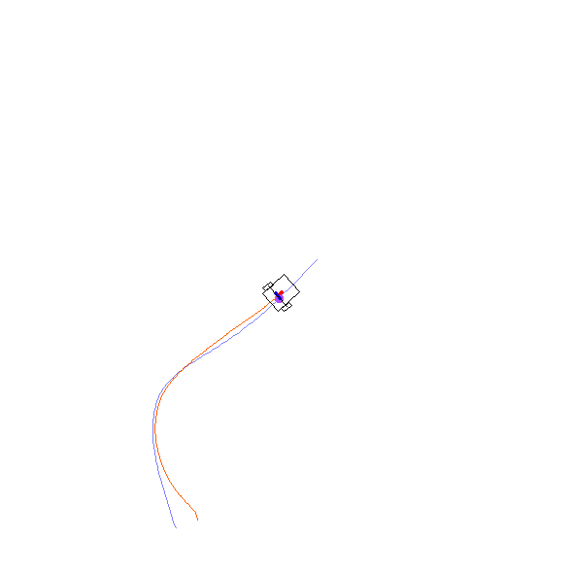
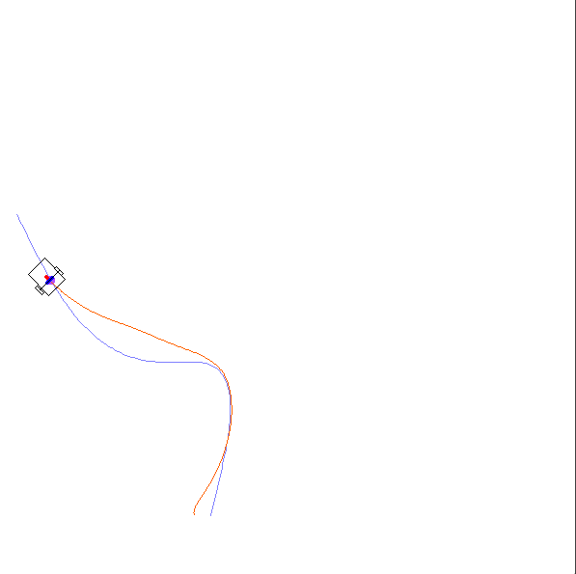
PathTracking Environment
Controls the car to follow the given path

Slide 5
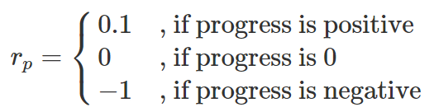

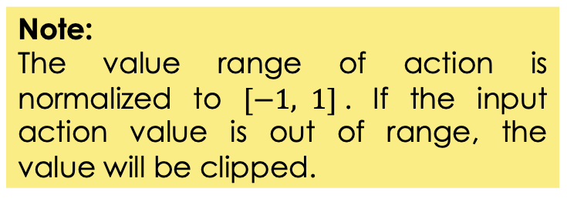
PathTracking Environment
Observation Space: $o∈ℝ^{14}$
Elements 0-2: Car pose from 2 timestep ago (x, y, yaw)
Elements 3-5: Car pose from 1 timestep ago (x, y, yaw)
Elements 6-7: Coordinate of the nearest point on path (x, y)
Elements 8-13: Coordinates of the next 3 waypoint on path (x,y)
where $x,y ∈[0, 1]$ and $\text{yaw}∈\left[0,2π\right]$
Action Space: Angular velocity $a∈\left[−1,1\right]$
Reward: $r=0.8 r_{d}+0.2{ r}_{y}+r_{p}$
$r_{d}=\exp\left(−0.1|p−p^{′}|^{2}\right)$: Distance reward
$r_{y}=\exp\left(−0.1|θ−θ^{′}|^{2}\right)$: Yaw reward
Termination: 100% progress or reach 400 timesteps
Note:
The value range of action is normalized to $[−1, 1]$. If the input action value is out of range, the value will be clipped.

Slide 6
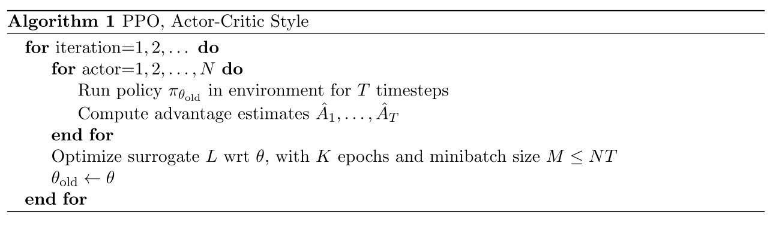
PPO Algorithm
Run an episode to collect data
Train the model using the collected data
Reference: John Schulman, et al. “Proximal Policy Optimization Algorithms." , CoRR abs/1707.06347.arXiv:1707.06347

Slide 7
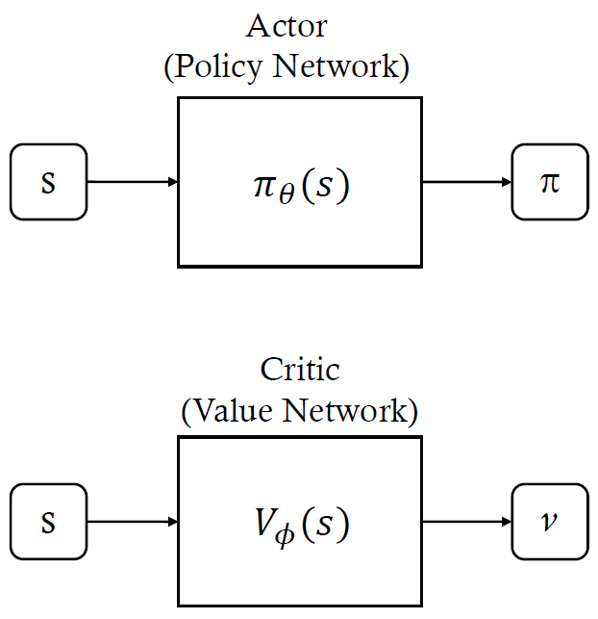


PPO Algorithm
Actor Network:
Critic Network:

Slide 8

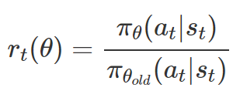
PPO Algorithm
Value Loss:
Policy Gradient Loss: (Surrogate):

Slide 9
Repo Structure
HW3-1/
PathTracking/ # PathTracking Utilities
Simulation/ # Simulation framework
model.py
Define policy & value network architecture (TODO 1 & 2)
env_runner.py
Run simulation environment to collect batched data (TODO 3)
agent.py
PPO algorithm implementation (TODO 4)
train.py # Training script (TODO 5)
play.py # Inference script
eval.py # Evaluation script
plot.py # Training curve visualization
# Environment & other utilities
cublic_spline.py & multi_env.py & wrapper.py

Slide 10
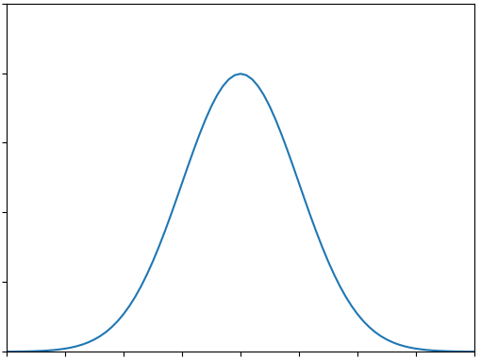
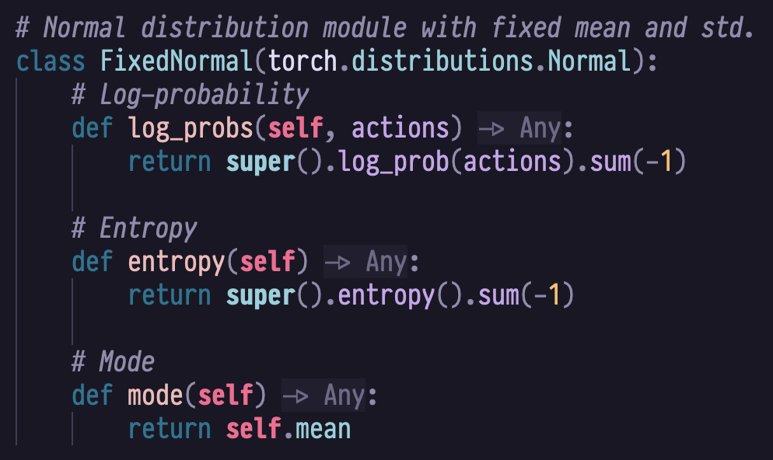





(model.py) Diagonal Gaussian Distribution
FixedNormal
$$x$$
$$μ$$
$$p(x|μ,σ)$$
$$σ$$

Slide 11
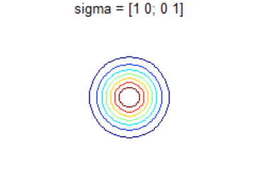
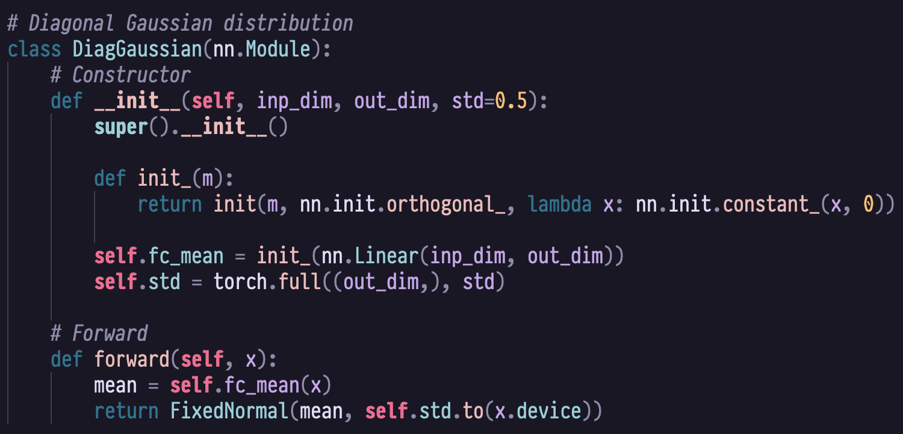
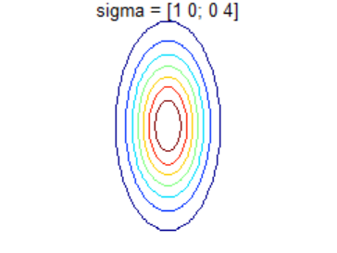
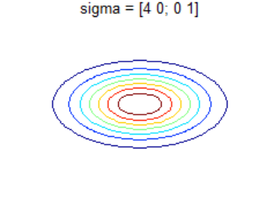
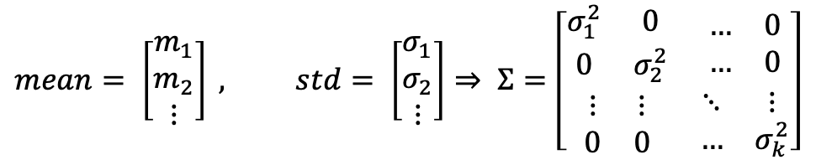
(model.py) Diagonal Gaussian Distribution
DiagGaussian
$$mean= \left[\begin{matrix}m_{1} \\ m_{2} \\ ⋮\end{matrix}\right] , std= \left[\begin{matrix}σ_{1} \\ σ_{2} \\ ⋮\end{matrix}\right]⇒ Σ=\left[\begin{matrix}\begin{matrix}σ_{1}^{2} & 0 \\ 0 & σ_{2}^{2}\end{matrix} & \begin{matrix}… & 0 \\ … & 0\end{matrix} \\ \begin{matrix}⋮ & ⋮ \\ 0 & 0\end{matrix} & \begin{matrix}⋱ & ⋮ \\ … & σ_{k}^{2}\end{matrix}\end{matrix}\right]$$

Slide 12
(model.py) Policy Network
PolicyNet class contains the following methods:
__init__(self, s_dim, a_dim, std)
(TODO) Initializes the policy network with state/action dimensions and configures network layers.
forward(self, state, deterministic)
Computes action and log-probability from state, sampling stochastically or deterministically based on input flag.
action_step(self, state, deterministic)
Outputs a single action from state, with optional deterministic mode for evaluation.
evaluate(self, state, action)
Computes log-probabilities and entropy for given state-action pairs, used for policy gradient calculations.

Slide 13
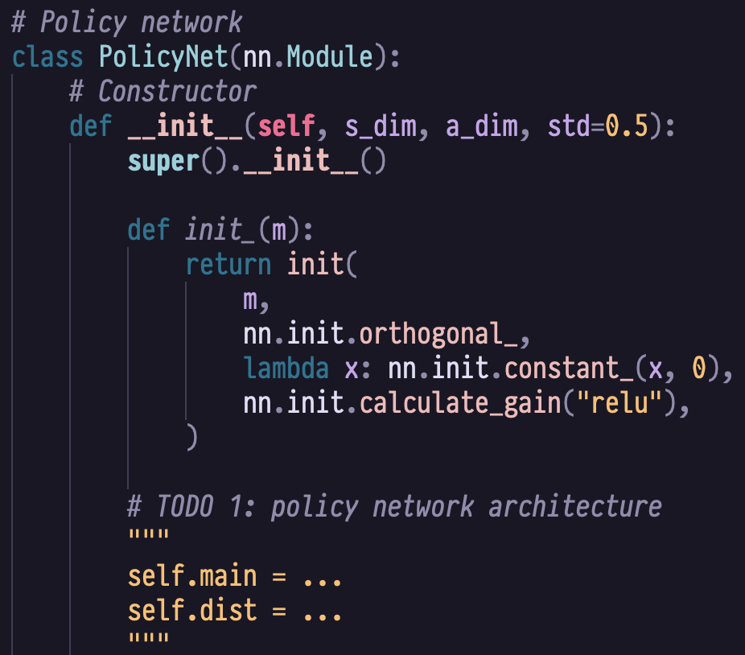
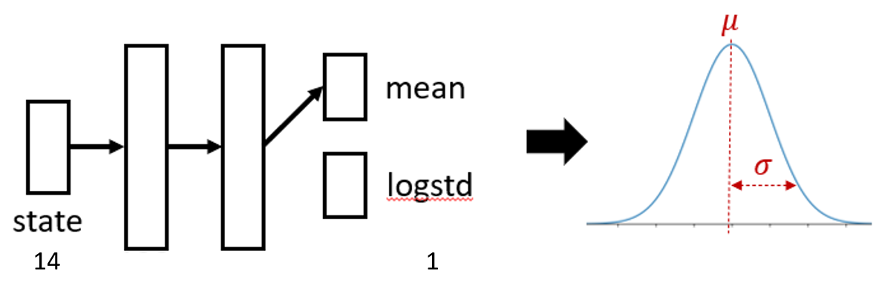
TODO 1 (model.py)
Implement the policy network architecture
(Hint: use nn.Sequential & DiagGaussian)

Slide 14
(model.py) Value Network
ValueNet class contains the following methods:
__init__(self, s_dim)
(TODO) Initializes the value network with state dimension and configures network layers.
forward(self, state)
Computes the state value estimate by passing state through the network and extracting the scalar output.

Slide 15
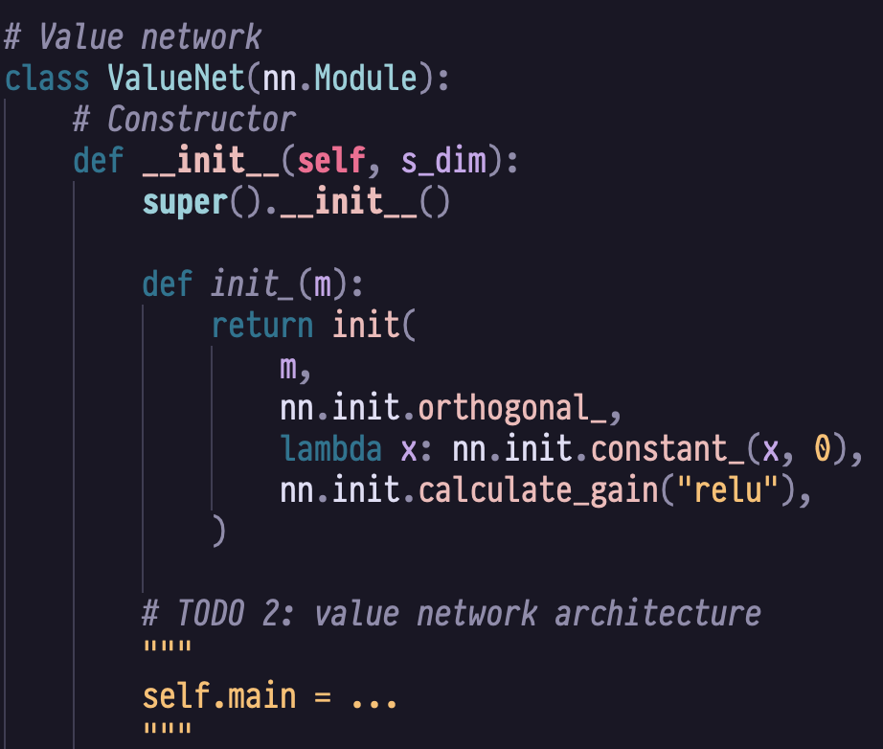
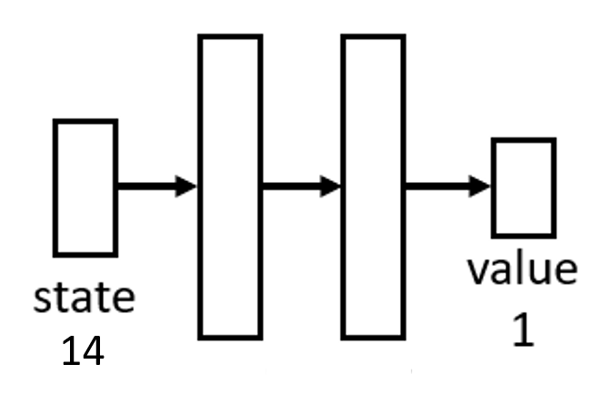
TODO 2 (model.py)
Implement the value network architecture
(Hint: use nn.Sequential)

Slide 16
(env_runner.py) EnvRunner
EnvRunner class contains the following methods:
__init__(self, env, s_dim, a_dim, n_step, gamma, lamb, device)
Initializes the environment runner with environment, network dimensions, and pre-allocates storage buffers for trajectory data collection.
run(self, policy_net, value_net)
(TODO) Collects n-step trajectories from parallel environments and returns batches of states, actions, log-probabilities, values, and GAE returns for training.
record(self)
Tracks cumulative rewards and episode lengths, storing completed episode metrics in buffers for performance monitoring.
get_performance(self)
Computes and returns mean/std of episode returns and mean episode length from the recorded episode history.

Slide 17
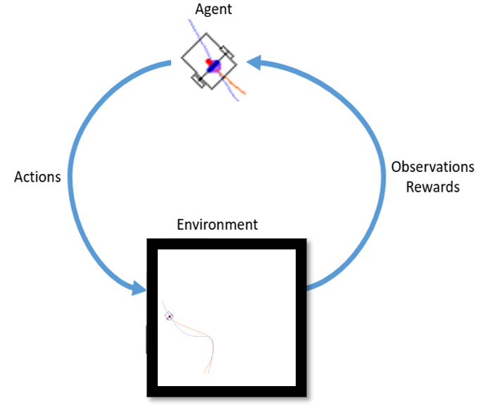
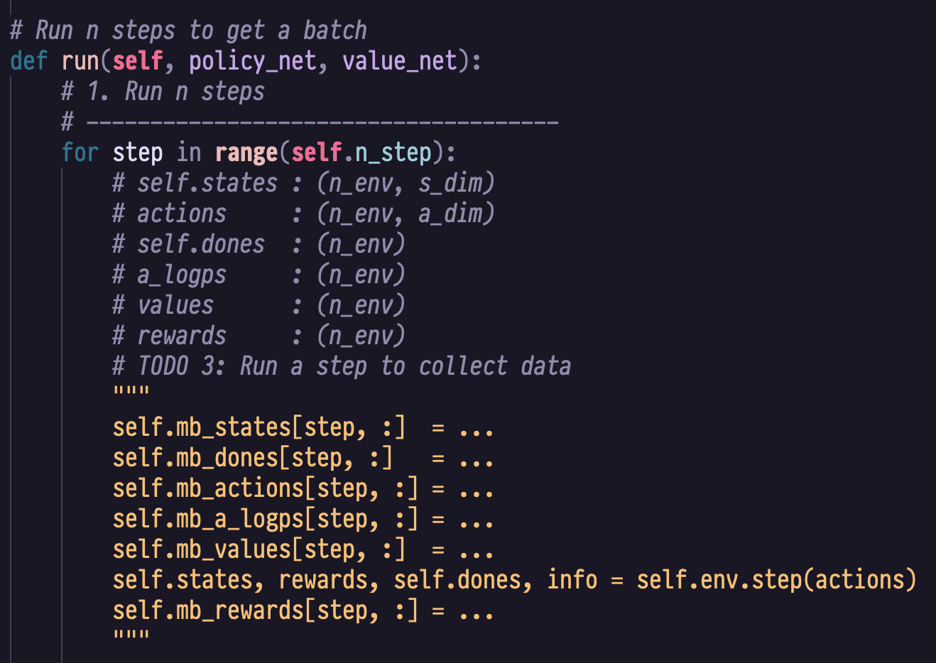
TODO 3 (env_runner.py)
Complete the run method
(Hint: use value_net & policy_net)
mb_states: (n_step, n_env, s_dim)
mb_actions: (n_step, n_env, a_dim)
mb_dones: (n_step, n_env)
mb_a_logps: (n_step, n_env)
mb_values: (n_step, n_env)
mb_rewards: (n_step, n_env)

Slide 18
(agent.py) PPO
PPO class contains the following methods:
__init__(self, policy_net, value_net, lr, max_grad_norm, clip_val, sample_n_epoch, sample_mb_size, mb_size, device)
Initializes the PPO agent with policy/value networks, optimizers, and hyperparameters for clipping, learning rate, and batch sampling.
train(self, mb_states, mb_actions, mb_old_values, mb_advs, mb_returns, mb_old_a_logps)
(TODO) Performs PPO training over multiple epochs by sampling mini-batches, computing clipped policy and value losses, and updating both networks with gradient clipping.
lr_decay(self, it, n_it)
Applies linear learning rate decay to both actor and critic optimizers.

Slide 19
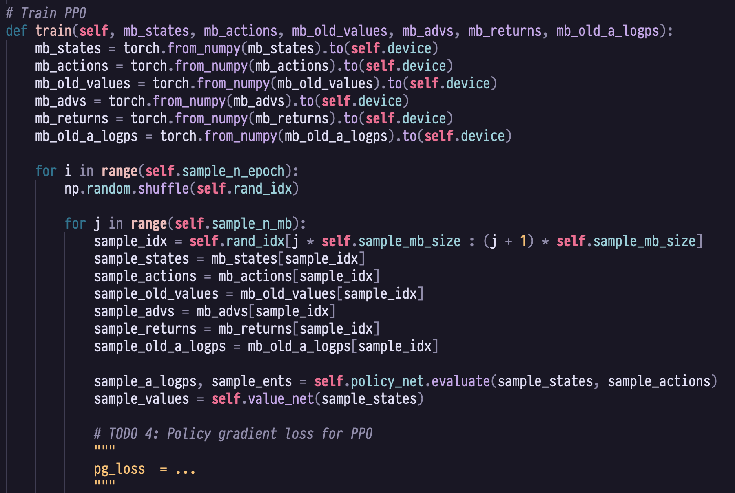
TODO 4 (agent.py)
Implement the policy gradient loss
(Hint: Use sample_a_logps & sample_old_a_logps to compute the probability ratio)

Slide 20
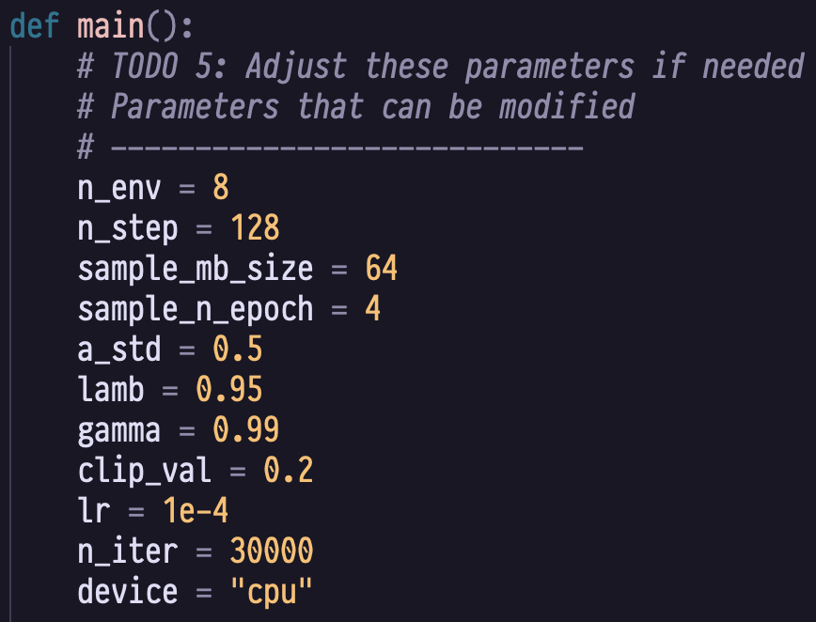
TODO 5 (train.py)
n_env: number of environments (actors)
n_step: number of step for runner
sample_mb_size: sample mini-batch size
sample_n_epoch: number of epoch in PPO
a_std: std. dev. of action distribution
lamb: gae factor 𝜆
gamma: discount factor 𝛾
clip_val: clip value 𝜖
lr: learning rate
n_iter: number of iteration
Note:
Too many environments may cause "OSError: The paging file is too small for this operation to complete". If so, please set a smaller n_env.

Slide 21
Shell Commands
Training: python train.py
Inferencing: python play.py
Evaluation: python eval.py
Training Visualization: python plot.py

Slide 22
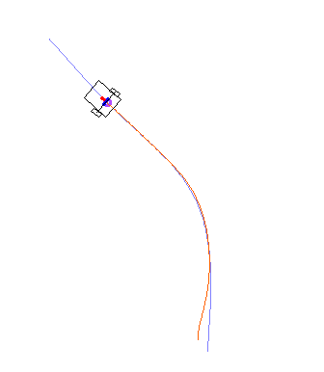
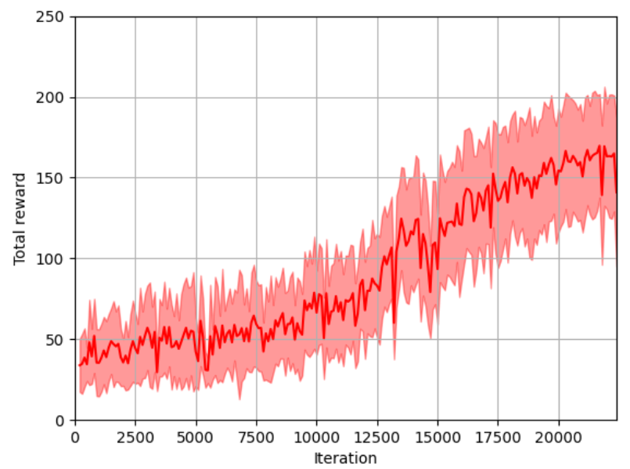
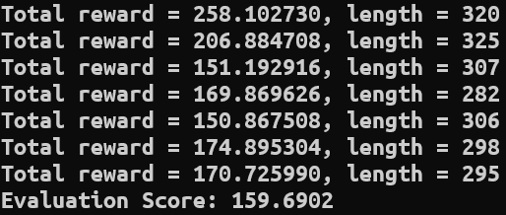
Experimental Results
play.py
plot.py
eval.py

Slide 23
Setup Requirements
Python version: 3.6+
Install the following python packages with your package manager of choice
numpy>=1.20,<2.0
matplotlib
opencv-python
torch
cloudpickle

Slide 24
HW3-2: Proly

Slide 25
Proly
Flag capturing 2.5D game

Slide 26
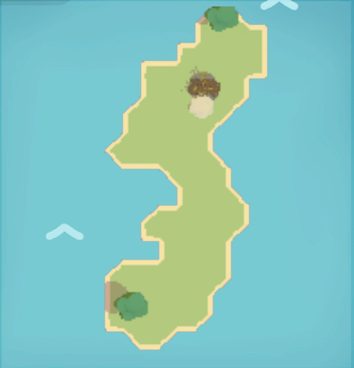
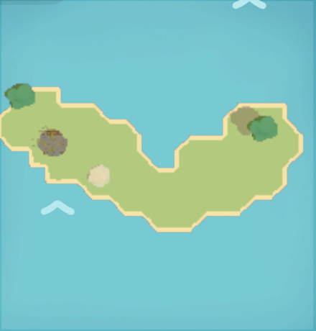
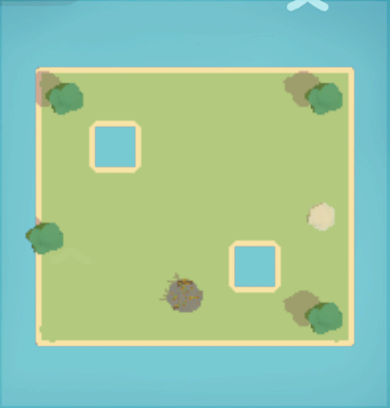
Task
Design reward function to train an RL agent to play Proly
We provide 3 public map and 2 private map for grading, 10% each
map 1
map 2
map 3

Slide 27
Repo Structure
HW3-2/
models/*/*.zip
Model checkpoints
model.zip
Latest model checkpoint
rl_play.py(TODO)
Contains MLPlay class to train model with PPO
model_play.py
Contains MLPlay class to play Proly with trained model stored at model.zip
kb_play.py
Contains MLPlay class to play Proly with keyboard, useful for debugging
dummy_env.py
A dummy class used to initialize StableBaselines’ PPO policy (DO NOT MODIFY)
Proly.app/.exe/.x86_06 (depends on OS)
Submit model.zip, rl_play.py and model_play.py

Slide 28
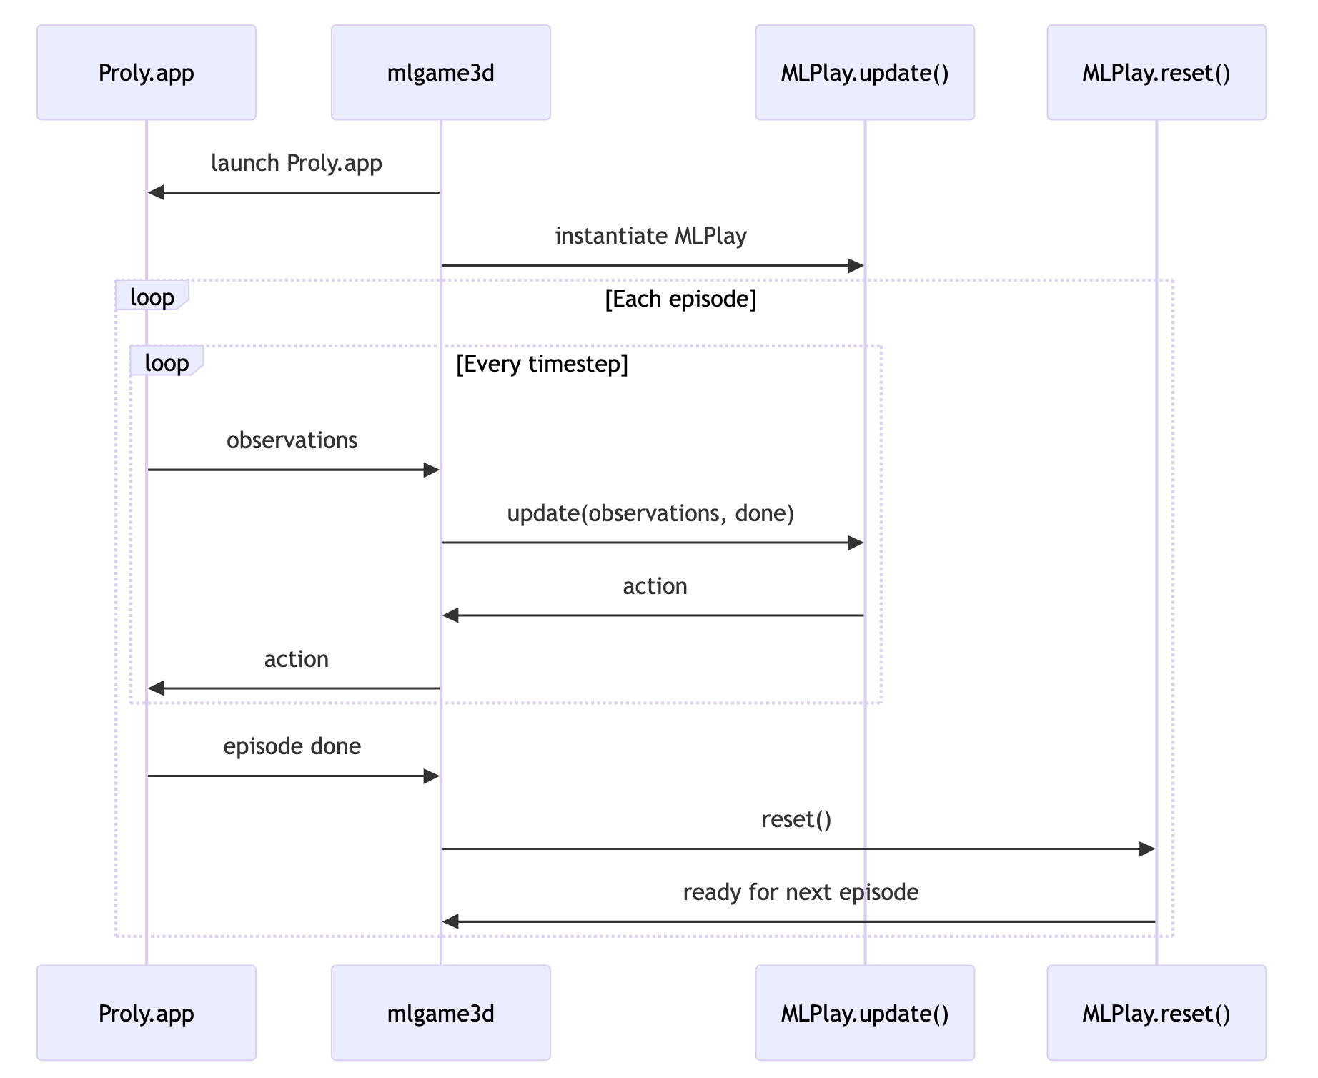
MLGame3D
A bridge between the Unity game and RL algorithm

Slide 29
(rl_play.py) Walkthrough
MLPlay
__init__(self, observation_structure, action_space_info, …)
Initialize hyperparameters in self.config
Initialize PPO policy model via self._initialize_model
update(self, observation, done, …) -> action
Called at each timestep, receives observation & predicts action with policy via self._predict_action
Add (observation, action, reward, etc.) to rollout buffer via self._add_to_rollout_buffer
reset(self)
Update policy with rollout datas via self._update_policy
Clear rollout buffer
_initialize_model(self)
Load model if model.zip exists, initialize otherwise
_save_model(self)
Save current model checkpoint to self.model_save_dir and self.model_path
_predict_action(self, obs)
_add_to_rollout_buffer(self, obs, action, reward, done, value, log_prob)
_update_policy(self)

Slide 30
TODO 6 (rl_play.py)
RewardManager
update(self, observation)
Update reward manager with current observation & cache previous observation in self.prev_observation. Called by MLPlay.update
reset(self)
Clean cached observations. Called by MLPlay.reset
calculate_reward(self) -> float # required
Calculates the total reward signal at each timestep. Called by MLplay.update after RewardManager.update
calculate_flag_capture_reward(self) -> float # optional
Hint: When a new flag is captured, give a large reward to encourage the agent to move along the correct path.
calculate_distance_reward(self) -> float # optional
Hint: Guide the agent to constantly move closer to the target point.
calculate_survival_reward(self) -> float # optional
Hint: Teach the agent the importance of survival - avoid jumping off the cliff
Implement

Slide 31
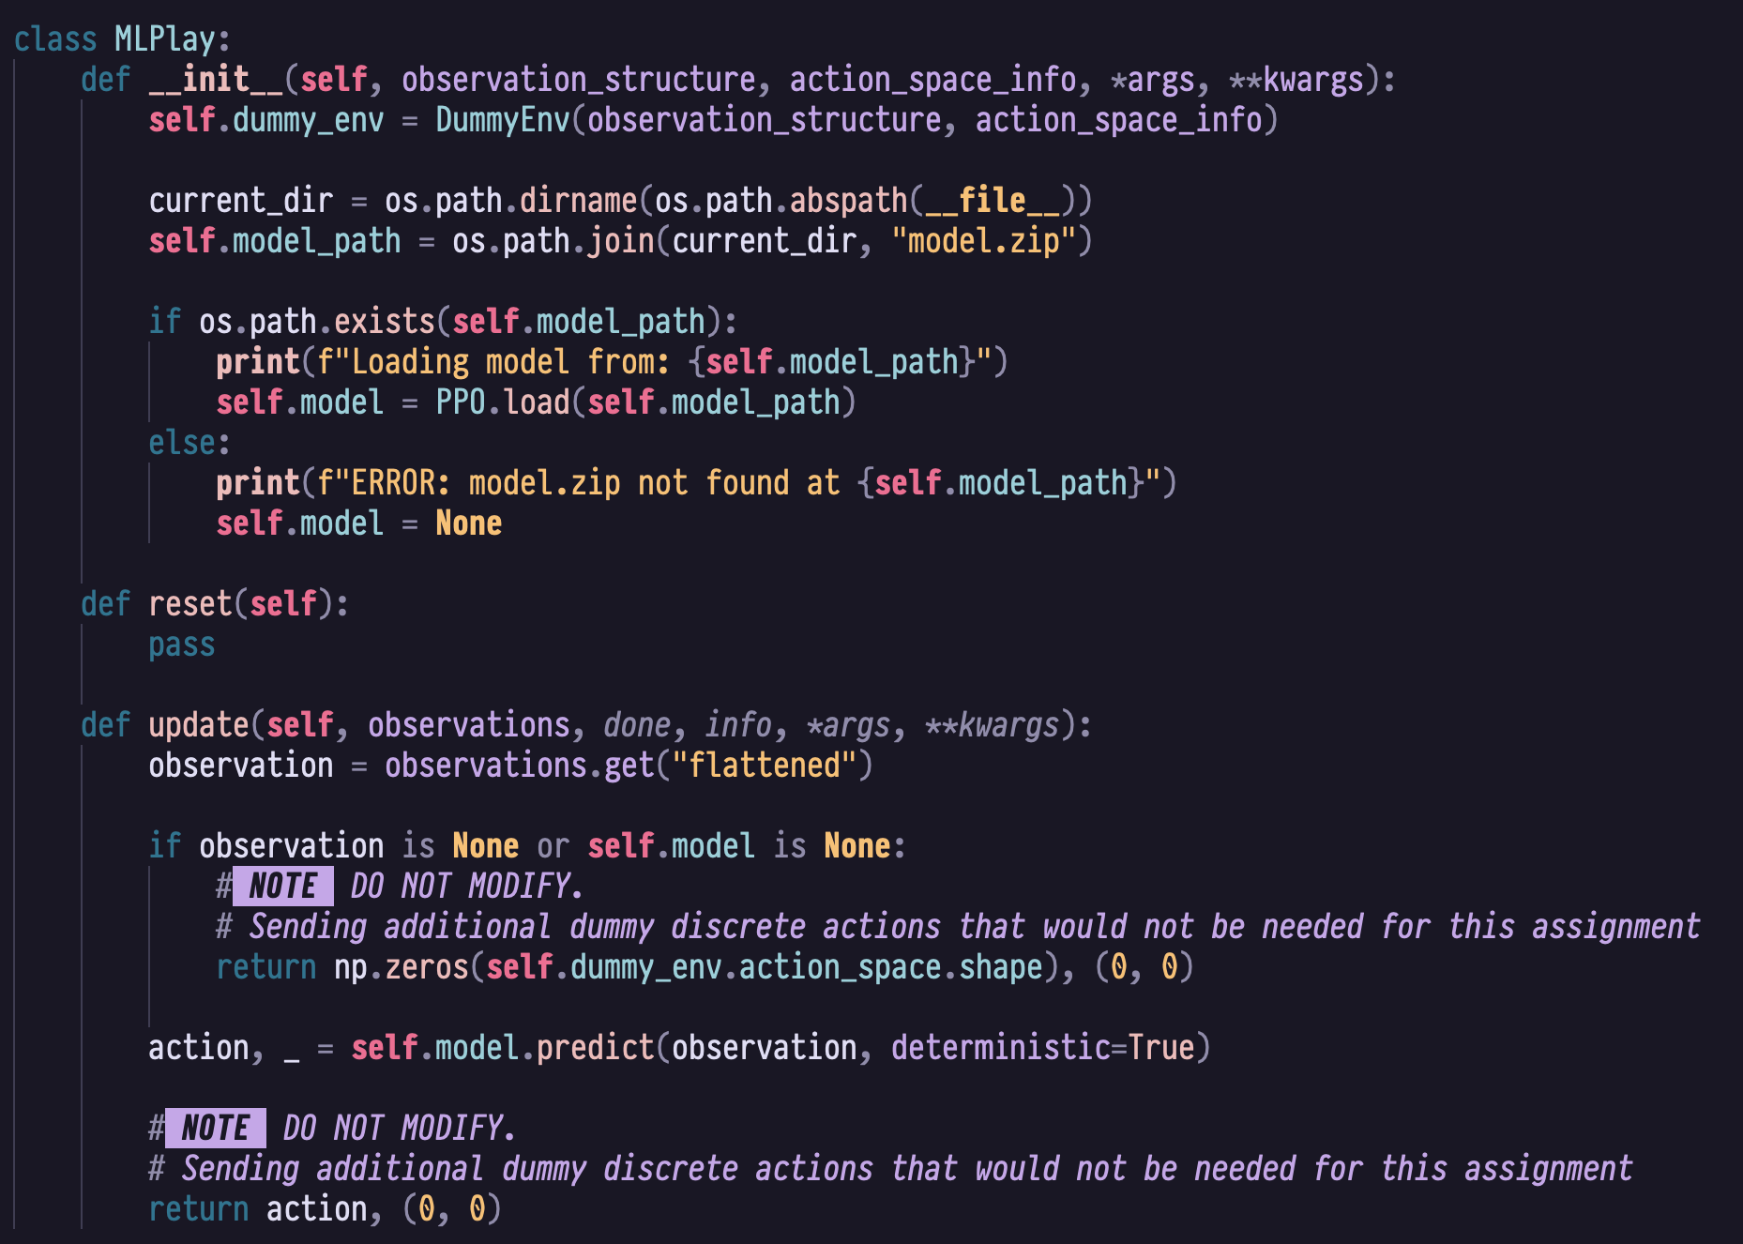
(model_play.py) Walkthrough
Load pre-trained weights
Model inference

Slide 32
Observation Space
target_position: Relative position to the next checkpoint
agent_health: Current health of the agent
last_checkpoint_index: Index of the last checkpoint passed
terrain_grid: 5x5 grid of terrain features around the agent
Detailed specs: https://github.com/PAIA-Playful-AI-Arena/Proly/#observation-space

Slide 33
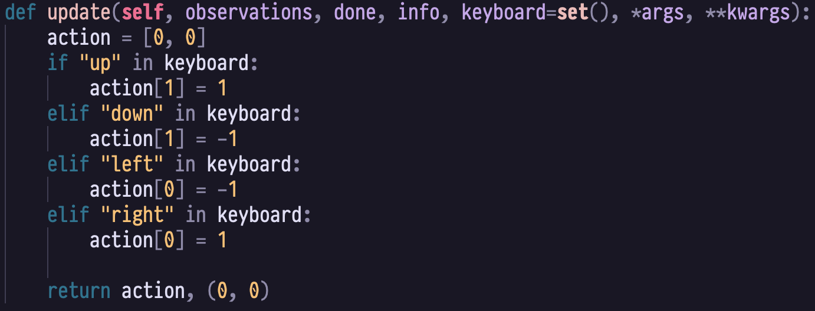
Action Space
Continuous actions: Acceleration (A_x, A_y)
Values range from -1.0 to 1.0 for each axis
Represents normalized movement direction
Controls acceleration rather than direct velocity
e.g.
(0, 1) moves up
(-1, 0) moves left
y
x

Slide 34
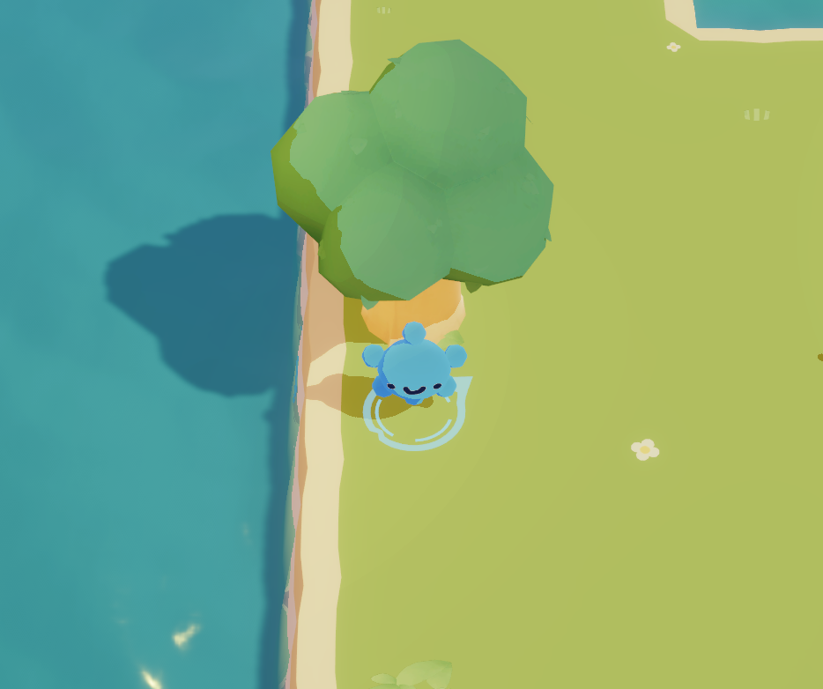
terrain_grid
5x5 grid of terrain features around the agent
self.observation["terrain_grid"][i][j]:
relative_position:
Grid center's relative position to the player
terrain_type:
0 : normal
-1 : water
1 : obstacle
y
x
j=4
self.observation["terrain_grid"][0][4] = {
"relative_position": (-2, 2),
"terrain_type": -1
}
j=0
self.observation["terrain_grid"][2][3] = {
"relative_position": (0, 1),
"terrain_type": 1
}
i=0
i=4

Slide 35
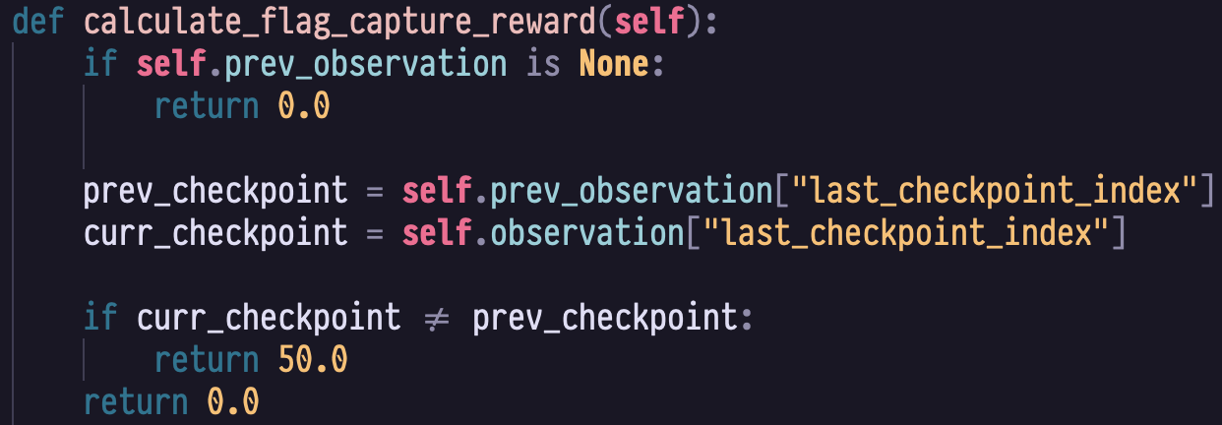
Reward Example
Check if the "last_checkpoint_index" changed between last and current timestep
yes: captured a flag → give reward
no → do nothing

Slide 36
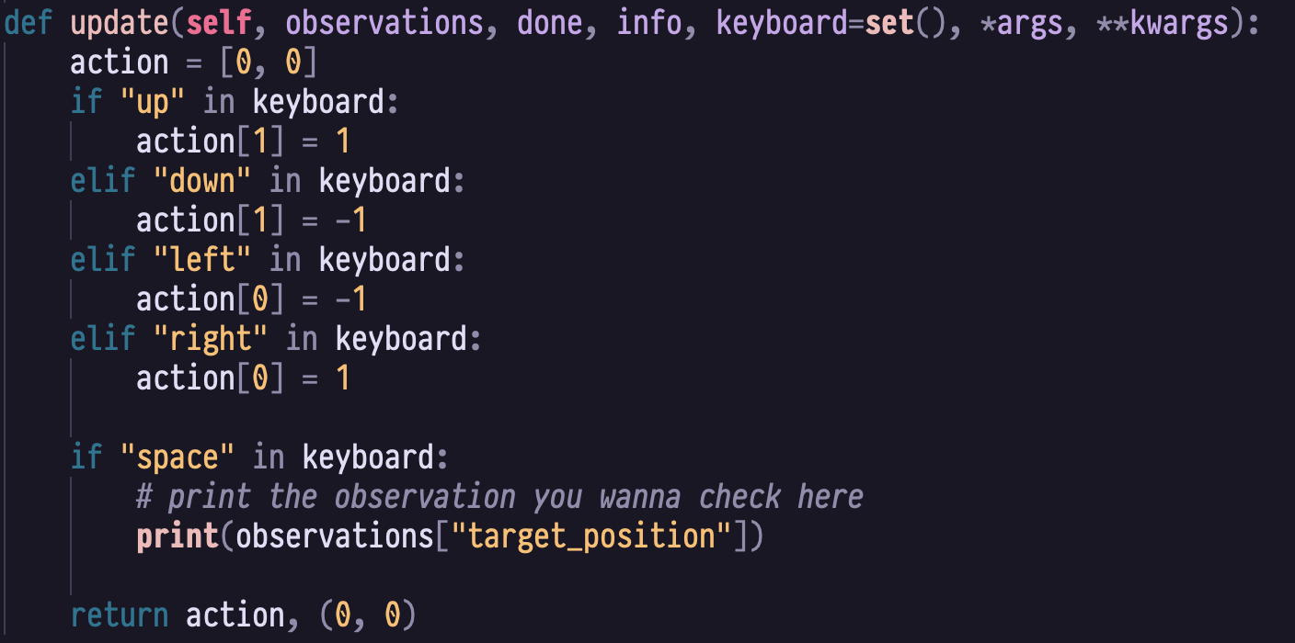
(kb_play.py) Walkthrough
Use arrow key to control the character
Press space to print observation infos for debugging

Slide 37
Setup Requirements
Python version: 3.12
Install the following python packages with your package manager of choice
gymnasium==1.2.3
numpy<2.0.0
mlgame3d==0.8.0
stable-baselines3==2.7.1
tensorboard==2.20.0
setuptools<81.0 # important for running tensorboard
torch==2.10.0

Slide 38
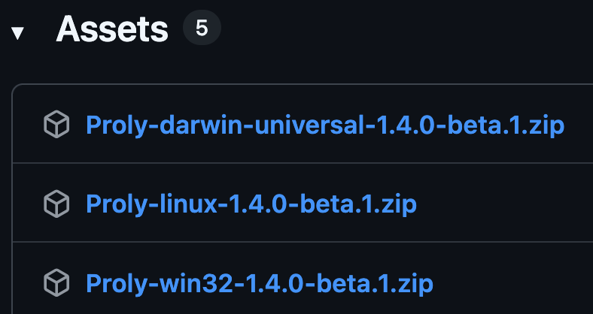
Install Proly
Download page: https://github.com/PAIA-Playful-AI-Arena/Proly/releases/tag/1.4.0-beta.1
Unzip & put under HW3-2/ directory root
Windows : Proly.exe
macOS : Proly.app
Linux : Proly.x86_64
To test if the game is working, run:
python –m mlgame3d <Proly executable path>
macOS
Linux
Windows

Slide 39
Training Command
Game executable path,
make sure to change the extension
# of episodes to run
Hide other player, as it is not needed for this assignment (DON'T MODIFY)
Disable items(DONT MODIFY) & audio
Map to load, can be 1, 2 or 3
# of checkpoints
Other useful arguments:
-ng: Disable game rendering
-f <int>: Frame per second
-ts <int>: Time scale factor
--seed <int>: Random seed
Time limit for each episode in secs

Slide 40
Inferencing Command
Play with trained model from model.zip, we will be grading your model with this same arguments, except for map # and random seed

Slide 41
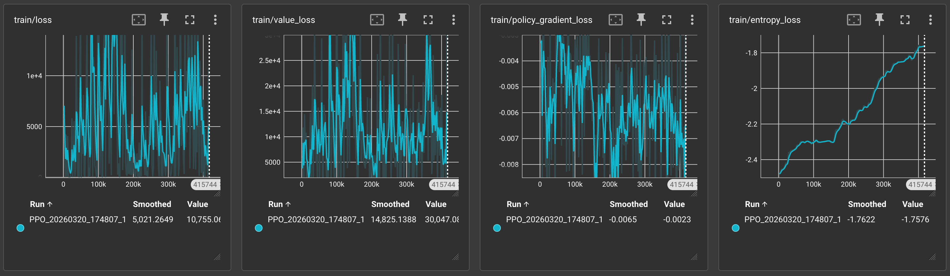
Visualizing Training Metrics
Run the following command to launch TensorBoard:
Then visit http://localhost:6006/ to see various metrics logged during training
tensorboard --logdir tensorboard/

Slide 42
Submission

Slide 43
Implementation Rules
You should only modify the following files
HW3-1/
model.py
env_runner.py
agent.py
train.py
HW3-2/
rl_play.py
model_play.py
For HW3-2, do not implement hard coded gameplay rule in MLPlay.update()
Use of additional .py scripts & packages are prohibited
Violating rules above will result in a score of zero

Slide 44
HW3-1: Score & Requirement
plot.py(10%)
Graded based on the plotted graph drawn from save/return.txt
Make sure the overall reward goes up
Do not copy other's return.txt, violation will result in a score of zero for HW3
eval.py(30%)
Graded based on the evaluation score
30 * ES / 120, where ES is your evaluation score (you will get all 30% if ES > 120)
Report(5%)
Briefly explain your implementation
Note:
Do not submit plot.py and eval.py, we'll evaluate based on the original script, so make sure to not touch those during you're own testing.

Slide 45
HW3-2: Score & Requirement
Agent evaluation(50%)
You're agent will be evaluated on 5 different maps(map 1/2/3 and two private maps), each with 10 flags, 1% per flag captured. Thus a total of 50%
We'll run each map three times with different random seeds
Your score for each map will be the highest score across those 3 runs
Report(5%)
Briefly explain your implementation

Slide 46
Submission Rules
Submission to NTU COOL should be a zipped file with following structure:
HW3_<your_student_id>.zip
├── HW3-1/
│ ├── save/
│ │ ├── model.pt
│ │ └── return.txt
│ ├── agent.py
│ ├── env_runner.py
│ ├── model.py
│ ├── train.py
│ └── report_<your_student_id>.pdf
└── HW3-2/
├── model.zip
├── model_play.py
├── rl_play.py
└── report_<your_student_id>.pdf
DO NOT include any other folder/files
Any violation on the rules will result in a deduction of (5 points)/(each violation)

Slide 47
Deadline
Same as announcement on NTU COOL (2026/4/12 23:59)
Hard deadline, no late submission allowed

Slide 48
Question

