Slide 1
Encryption
CS 465
January 9, 2006
Tim van der Horst

Slide 2
What is Encryption?
Transform information such that its true meaning is hidden
  Requires “special knowledge” to retrieve the information
Examples
  AES, 3DES, RC4, ROT-13, …
Notes:
Steganography, One-Time pad

Slide 3
Types of Encryption Schemes
Ciphers
Classical
Modern
Rotor Machines
Substitution
Transposition
Public Key
Secret Key
Steganography
Stream
Block

Slide 4




Symmetric Encryption Terms
Key
Key
Alice
Bob
Plaintext
Ciphertext
Plaintext
Encryption
Algorithm
Decryption
Algorithm
Notes:
Animated figure of terms
Plaintext, ciphertext, encrypt, decrypt, key, algorithm

Slide 5
What can go wrong?
Algorithm
  Rely on the secrecy of the algorithm
    Examples: Substitution ciphers
  Algorithm is used incorrectly
    Example: WEP used RC4 incorrectly
Key
  Too small
  Too big
Notes:
Mention brute forcing the key

Slide 6
Big numbers
Uses really big numbers
  1 in 2⁶¹ odds of winning the lotto and being hit by lightning on the same day
  2⁹² atoms in the average human body
  2¹²⁸ possible keys in a 128-bit key
  2¹⁷⁰ atoms in the planet
  2¹⁹⁰ atoms in the sun
  2²³³ atoms in the galaxy
  2²⁵⁶ possible keys in a 256-bit key

Slide 7
Thermodynamic Limitations*
Physics: To set or clear a bit requires no less than kT
    k is the Boltzman constant (1.38*10⁻¹⁶ erg/ºK)
    T is the absolute temperature of the system
Assuming T = 3.2ºK (ambient temperature of universe)
    kT = 4.4*10⁻¹⁶ ergs
Annual energy output of the sun 1.21*10⁴¹ ergs
  Enough to cycle through a 187-bit counter
Build a Dyson sphere around the sun and collect all energy for 32 year, we could
  Enough to cycle through a 192-bit counter.
Supernova produces in the neighborhood of 10⁵¹ ergs
  Enough to cycle through a 219-bit counter
*From Applied Cryptography

Slide 8
Perfect Encryption Scheme?
One-Time Pad (XOR message with key)
Example*:
  Message: ONETIMEPAD
  Key: TBFRGFARFM
  Ciphertext: IPKLPSFHGQ
  The key TBFRGFARFM decrypts the message to ONETIMEPAD
  The key POYYAEAAZX decrypts the message to SALMONEGGS
  The key BXFGBMTMXM decrypts the message to GREENFLUID
*From Applied Cryptography

Slide 9
Advanced Encryption Standard
Not “American” Encryption Standard
a.k.a
Lab #1

Slide 10
How was AES created?
AES competition
  Started in January 1997 by NIST
  4-year cooperation between
    U.S. Government
    Private Industry
    Academia
Why?
  Replace 3DES
  Provide an unclassified, publicly disclosed encryption algorithm, available royalty-free, worldwide

Slide 11
The Finalists
MARS
  IBM
RC6
  RSA Laboratories
Rijndael
  Joan Daemen (Proton World International) and
  Vincent Rijmen (Katholieke Universiteit Leuven)
Serpent
  Ross Anderson (University of Cambridge),
  Eli Biham (Technion), and
  Lars Knudsen (University of California San Diego)
Twofish
  Bruce Schneier, John Kelsey, and Niels Ferguson (Counterpane, Inc.),
  Doug Whiting (Hi/fn, Inc.),
  David Wagner (University of California Berkeley), and
  Chris Hall (Princeton University)
Wrote the book on crypto

Slide 12
Evaluation Criteria (in order of importance)
Security
    Resistance to cryptanalysis, soundness of math, randomness of output, etc.
Cost
    Computational efficiency (speed)
    Memory requirements
Algorithm / Implementation Characteristics
    Flexibility, hardware and software suitability, algorithm simplicity

Slide 13
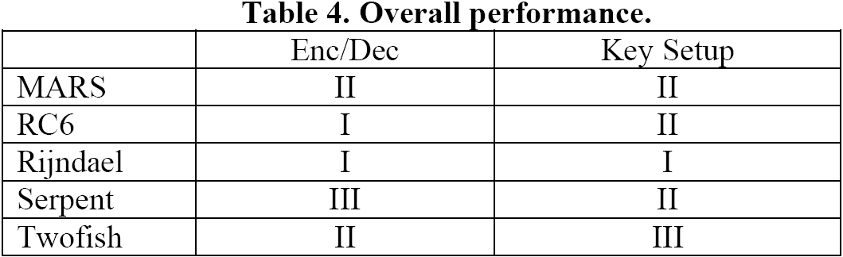
Results

Slide 14
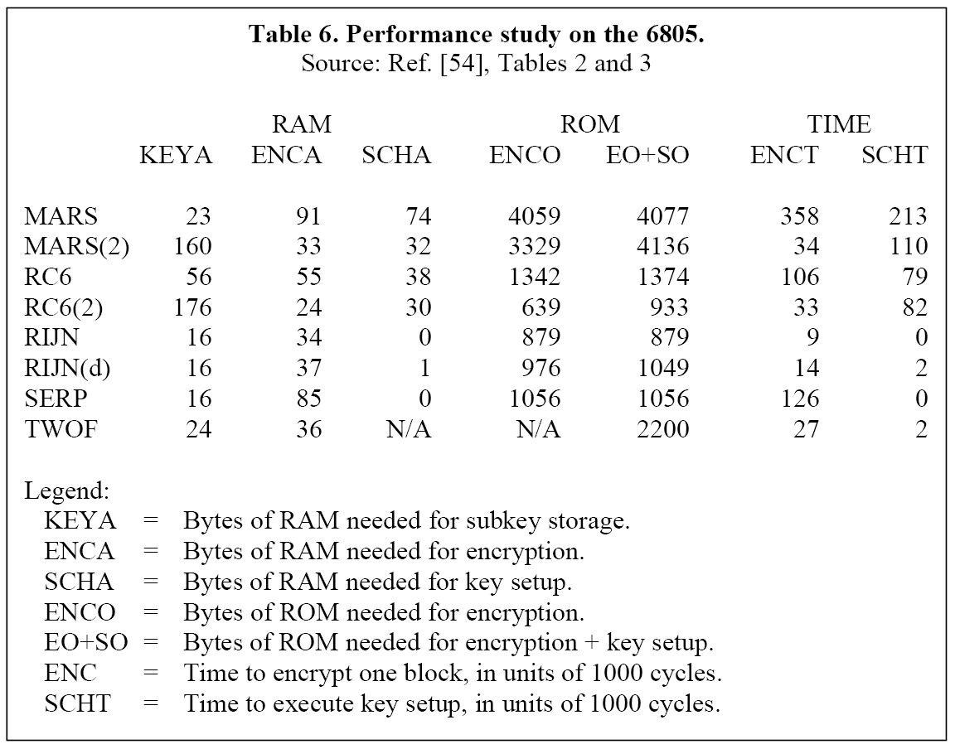
Results

Slide 15
The winner: Rijndael
AES adopted a subset of Rijndael
  Rijndael supports more block and key sizes

Slide 16
Lab #1
Implement AES
  Use FIPS 197 as guide
    Everything in this tutorial but in more detail
    Pseudocode
    20 pages of complete, step by step debugging information

Slide 17
Finite Fields
AES uses the finite field GF(2⁸)
  b₇x⁷ + b₆x⁶ + b₅x⁵ + b₄x⁴ + b₃x³ + b₂x² + b₁x + b₀
    {b₇, b₆, b₅, b₄, b₃, b₂, b₁, b₀}
Byte notation for the element: x⁶ + x⁵ + x + 1
  {01100011} – binary
  {63} – hex
Has its own arithmetic operations
  Addition
  Multiplication

Slide 18
Finite Field Arithmetic
Addition (XOR)
    (x⁶ + x⁴ + x² + x + 1) + (x⁷ + x + 1) = x⁷ + x⁶ + x⁴ + x²
    {01010111} ⊕ {10000011} = {11010100}
    {57} ⊕ {83} = {d4}
Multiplication is tricky

Slide 19
Finite Field Multiplication (•)
(x⁶ + x⁴ + x² + x +1) (x⁷ + x +1) =
x¹³ + x¹¹ + x⁹ + x⁸ + x⁷ + x⁷ + x⁵ + x³ + x² + x + x⁶ + x⁴ + x² + x +1
= x¹³ + x¹¹ + x⁹ + x⁸ + x⁶ + x⁵ + x⁴ + x³ +1
and
x¹³ + x¹¹ + x⁹ + x⁸ + x⁶ + x⁵ + x⁴ + x³ +1 modulo ( x⁸ + x⁴ + x³ + x +1)
= x⁷ + x⁶ +1.
These cancel
Irreducible Polynomial

Slide 20
Efficient Finite field Multiply
There’s a better way
  xtime() – very efficiently multiplies its input by {02}
Multiplication by higher powers can be accomplished through repeat application of xtime()

Slide 21
Efficient Finite field Multiply
Example: {57} • {13}
  {57} • {02} = xtime({57}) = {ae}
  {57} • {04} = xtime({ae}) = {47}
  {57} • {08} = xtime({47}) = {8e}
  {57} • {10} = xtime({8e}) = {07}
{57} • {13} = {57} • ({01} ⊕ {02} ⊕ {10})
= ({57} • {01}) ⊕ ({57} • {02}) ⊕ ({57} • {10})
= {57} ⊕ {ae} ⊕ {07}
= {fe}

Slide 22
AES parameters
Nb – Number of columns in the State
  For AES, Nb = 4
Nk – Number of 32-bit words in the Key
  For AES, Nk = 4, 6, or 8
Nr – Number of rounds (function of Nb and Nk)
  For AES, Nr = 10, 12, or 14
Notes:
Also known as block size

Slide 23
AES methods
Convert to state array
Transformations (and their inverses)
    AddRoundKey
    SubBytes
    ShiftRows
    MixColumns
Key Expansion

Slide 24
Convert to State Array
Input block:
0 | 4 | 8 | 12
1 | 5 | 9 | 13
2 | 6 | 10 | 14
3 | 7 | 11 | 15
=
S_{0,0} | S_{0,1} | S_{0,2} | S_{0,3}
S_{1,0} | S_{1,1} | S_{1,2} | S_{1,3}
S_{2,0} | S_{2,1} | S_{2,2} | S_{2,3}
S_{3,0} | S_{3,1} | S_{3,2} | S_{3,3}
0
1
2
3
4
5
6
7
8
9
10
11
12
13
14
15

Slide 25
AddRoundKey
XOR each byte of the round key with its corresponding byte in the state array
XOR
S_{0,1}
S_{0,0} | S_{0,1} | S_{0,2} | S_{0,3}
S_{1,0} | S_{1,1} | S_{1,2} | S_{1,3}
S_{2,0} | S_{2,1} | S_{2,2} | S_{2,3}
S_{3,0} | S_{3,1} | S_{3,2} | S_{3,3}
S_{1,1}
S’_{0,1}
R_{0,1}
S_{2,1}
S’_{0,0} | S’_{0,1} | S’_{0,2} | S’_{0,3}
S’_{1,0} | S’_{1,1} | S’_{1,2} | S’_{1,3}
S’_{2,0} | S’_{2,1} | S’_{2,2} | S’_{2,3}
S’_{3,0} | S’_{3,1} | S’_{3,2} | S’_{3,3}
R_{0,0} | R_{0,1} | R_{0,2} | R_{0,3}
R_{1,0} | R_{1,1} | R_{1,2} | R_{1,3}
R_{2,0} | R_{2,1} | R_{2,2} | R_{2,3}
R_{3,0} | R_{3,1} | R_{3,2} | R_{3,3}
S’_{1,1}
R_{1,1}
S_{3,1}
S’_{2,1}
R_{2,1}
S’_{3,1}
R_{3,1}

Slide 26
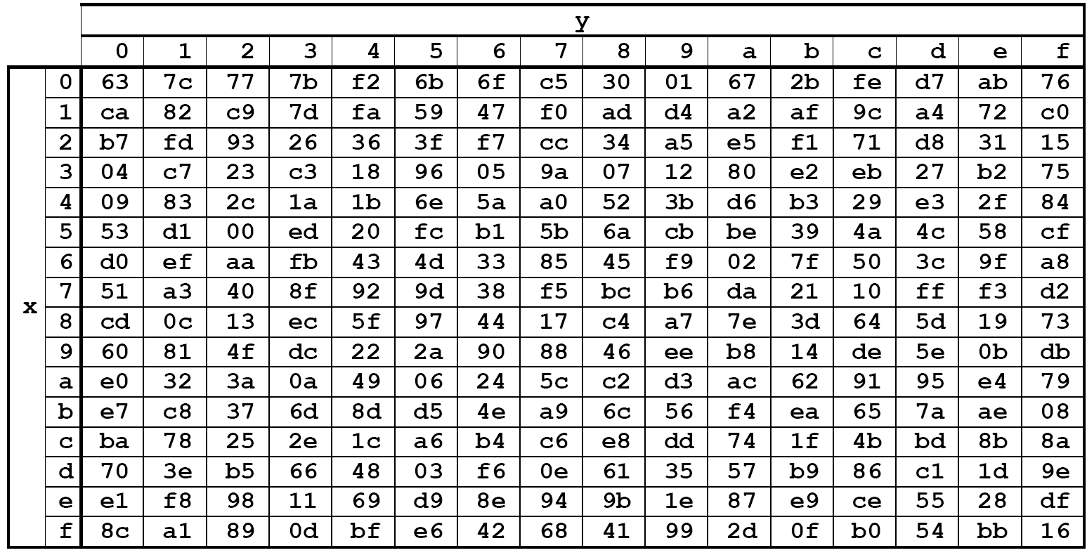
SubBytes
Replace each byte in the state array with its corresponding value from the S-Box
00 | 44 | 88 | CC
11 | 55 | 99 | DD
22 | 66 | AA | EE
33 | 77 | BB | FF
55

Slide 27
ShiftRows
Last three rows are cyclically shifted
S_{0,0}
S_{0,1}
S_{0,2}
S_{0,3}
S_{1,0}
S_{1,0}
S_{1,1}
S_{1,2}
S_{1,3}
S_{2,0}
S_{2,1}
S_{2,0}
S_{2,1}
S_{2,2}
S_{2,3}
S_{3,0}
S_{3,1}
S_{3,2}
S_{3,0}
S_{3,1}
S_{3,2}
S_{3,3}

Slide 28
MixColumns
Apply MixColumn transformation to each column
S’_{0,c} = ({02} • S_{0,c}) ⊕ ({03} • S_{1,c}) ⊕ S_{2,c} ⊕ S_{3,c}
S’_{1,c} = S_{0,c} ⊕ ({02} • S_{1,c}) ⊕ ({03} • S_{2,c}) ⊕ S_{3,c}
S’_{2,c} = S_{0,c} ⊕ S_{1,c} ⊕ ({02} • S_{2,c} ) ⊕ ({03} • S_{3,c})
S’_{3,c} = ({03} • S_{0,c}) ⊕ S_{1,c} ⊕ S_{2,c} ⊕ ({02} • S_{3,c}
MixColumns()
S_{0,1}
S’_{0,1}
S_{0,0} | S_{0,1} | S_{0,2} | S_{0,3}
S_{1,0} | S_{1,1} | S_{1,2} | S_{1,3}
S_{2,0} | S_{2,1} | S_{2,2} | S_{2,3}
S_{3,0} | S_{3,1} | S_{3,2} | S_{3,3}
S’_{0,0} | S’_{0,1} | S’_{0,2} | S’_{0,3}
S’_{1,0} | S’_{1,1} | S’_{1,2} | S’_{1,3}
S’_{2,0} | S’_{2,1} | S’_{2,2} | S’_{2,3}
S’_{3,0} | S’_{3,1} | S’_{3,2} | S’_{3,3}
S_{1,1}
S’_{1,1}
S_{2,1}
S’_{2,1}
S_{3,1}
S’_{3,1}

Slide 29
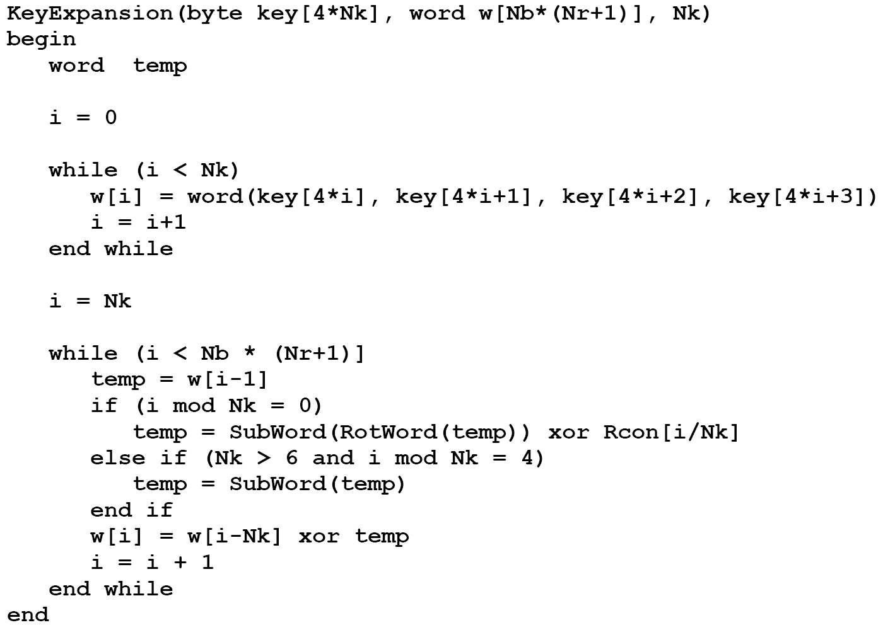
Key Expansion
Expands the key material so that each round uses a unique round key
  Generates Nb(Nr+1) words
Filled with just the key
Filled with a combination of the previous work and the one Nk positions earlier

Slide 30
Encryption
byte state[4,Nb]
state = in
AddRoundKey(state, keySchedule[0, Nb-1])
for round = 1 step 1 to Nr–1 {
SubBytes(state)
ShiftRows(state)
MixColumns(state)
AddRoundKey(state, keySchedule[round*Nb, (round+1)*Nb-1])
}
SubBytes(state)
ShiftRows(state)
AddRoundKey(state, keySchedule[Nr*Nb, (Nr+1)*Nb-1])
out = state
Prevents an attacker from even beginning to encrypt or decrypt without the key
First and last operations involve the key

Slide 31
Decryption
byte state[4,Nb]
state = in
AddRoundKey(state, keySchedule[Nr*Nb, (Nr+1)*Nb-1])
for round = Nr-1 step -1 downto 1 {
InvShiftRows(state)
InvSubBytes(state)
AddRoundKey(state, keySchedule[round*Nb, (round+1)*Nb-1])
InvMixColumns(state)
}
InvShiftRows(state)
InvSubBytes(state)
AddRoundKey(state, keySchedule[0, Nb-1])
out = state

Slide 32
Encrypt and Decrypt
Encryption AddRoundKey SubBytes ShiftRows MixColumns AddRoundKey SubBytes ShiftRows AddRoundKey | Decryption AddRoundKey InvShiftRows InvSubBytes AddRoundKey InvMixColumns InvShiftRows InvSubBytes AddRoundKey

