Slide 1
Side channel attack: Power Analysis

Slide 2
Light bulb riddle
Setting: There are three light bulbs in a room, and three light switches outside the room. You are outside and cannot see the bulbs.
Goal: Determine which switch controls which light bulb
Constraints: You can only travel into the room once, and cannot come back in again. You can do anything before you enter the room.
Notes:
2

Slide 3
Conventional Cryptanalysis
Conventional cryptanalysis considers crypto systems as mathematical objects
Assumptions:
Knows the details of the cryptographic algorithm
Tries to find out secret keys from the inputs and outputs
Does not consider the weakness in hardware implementations
Implementation of a strong algorithm is not necessarily secure
Notes:
Traditional researchers consider cryptosystems as mathematics objects. They assume the algorithm itself is a black box. They calculate the input and outputs and try to design or prove the security.
However, nowadays the detail of the algorithm are public knowledge, so to break the algorithm, you can find the secret key if you know the input or output of the algorithm. While security on cryptography focuses on improving security of the algorithm, the implementation of the algorithm may be at risk.

Slide 4
Implementation of crypto algorithms
Implementation of a strong algorithm is not necessarily secure
Defective computation
Information leak
Timing
Power
Electromagnetic
Notes:
Cryptographic designs have traditionally assumed that secrets are manipulated in environments that expose no information beyond the specified inputs and outputs. Many techniques have been designed for testing cryptographic algorithms in isolation, but the actual implementation may still be insecure. Because attacks that involve multiple layers of a system are difficult to predict and model, security vulnerabilities often result from unanticipated interactions between components and layers. For example, failures can be caused by defective computation, information leaked during secret key operations, attacks on the hardware such as the timing, power leakage or electromagnetic emanations.

Slide 5
Attacking the implementation
All models are wrong, but some are useful. – G. E.P. Box
Conventional cryptanalysis
Crypto Systems
Plaintext
Ciphertext
Secret Key
Side Channel Attack
Side-channel information

Slide 6
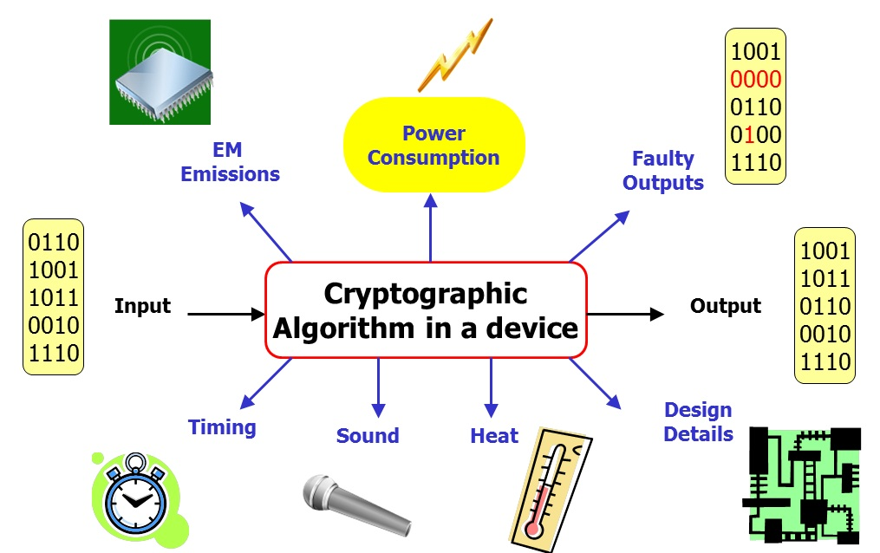
Side Channel Attacks
Side channel attacks exploit information from hardware
Is easy to carry out
Does not require expensive equipment
Notes:
The attacks we are focusing on is called side channel attack. Side channel attack does not actively try to change anything or take information, but it catches information leaked by the system, such as EM emission, sound, heat, power consumption etc. Thus, it is very difficult to detect and non-intrusive. Most of these attacks are also easy to carry out and does not require expensive equipment

Slide 7
Side channel attacks
Key
Plaintext
Side Channel Attack
Cipher
Ciphertext
Notes:
When a message is encrypted, the message or user input is combined with a secret key, then put through the cipher. A common cipher or encryption algorithm used is AES. As the algorithm calculate the cipher text,

Slide 8
Power analysis
Non-invasively extract information from the power consumption of a cryptographic hardware device.
Common power analysis attacks
SPA: Simple Power Analysis
Different operations consume different power
Effective if operations are dependent on key bits
DPA: Differential Power Analysis
Different data consume different power even if the operations are the same
CPA: Correlation Power Analysis
More advanced than DPA
Notes:
Power Analysis exploits power dissipation in cryptographic operations. Power analysis attacks combine elements of algorithmic cryptanalysis and implementation security. There are three types of power analysis. SPA, DPA and CPA. SPA and DPA were introduced in the open cryptology community in 1998 by Cryptography Research’s Paul Kocher, Joshua Jaffe and Benjamin Jun.

Slide 9
Example: DES Power Trace
Kocher et al. 1999

Slide 10
DPA
Exploits the correlation between power consumption and the operations or data using advanced statistical methods
Goal
Secret keys used by cryptographic device
AES as target
Widely used cipher
Applicable to other systems
Notes:
Differential power analysis (DPA) is a more advanced form of power analysis than SPA. DPA attacks use statistical techniques to extract information from multiple power consumption measurements. They are highly effective at extracting secrets even when the information available within any individual measurement contain too much noise to be analyzed using simple power analysis. The attack is based on the fact that power consumption of microprocessors and hardware are different when performing different operations using secret key. Instead of visually examine the graph, DPA statistically analyses the power consumption measurements from the system. Based on the power data from multiple cryptographic operations, the attacker can compute the intermediate values within cryptographic computations.
Cryptographic algorithms are normally designed to be secure against attackers who can access the inputs and/or the outputs of the algorithm, but not the secret keys or information about computational intermediates. SPA and DPA work by measuring the power consumption of a device, which provides measurements correlated to computational intermediates, thus violating the assumptions behind the security guarantees provided by the algorithm.
Attackers who successfully attack a cryptographic device using SPA or DPA typically extract the secret keys used by the device. With this information the attacker gets access to all the system secrets and capabilities that were available to the device. For example, these keys can enable adversaries to decrypt or forge messages, issue rogue certificates, create unauthorized digital signatures, impersonate/clone a device, or perform other malicious activities. DPA has also been used to reverse engineer implementations of proprietary cryptosystems. As a result, power analysis countermeasures are required for tamper resistant products.

Slide 11
Example of DPA on 1-bit operations
M ⊕ K = Y
Assumption:
M can be controlled by the attacker
K is unknown
Generating 0 and 1 consumes different amount of energy
Attack:
Set M = 0, do the operation and measure the power (P0)
Set M = 1, do the operation and measure the power (P1)
Guess a value of K, and check it with power traces
If K = 0, then Y is 0 in P0 and 1 in P1.
If K = 1, then Y is 1 in P0 and 0 in P1.

Slide 12
Attacking table lookups (1)
Mem[M ⊕ K] = Y
Similar assumptions
M and K have multiple bits
M can be controlled by the attacker
K is unknown
Y is the table lookup results (value loaded from the memory)
Select one bit in Yt

Slide 13
Attacking table lookups (2)
Generate a set of input so the table lookups are uniformly distributed over all entries
M0, …, Mn
Feed the input to the device and measure the power consumption
P0, …, Pn
For each possible value of K
Place the power traces into two sets, according to Yt
S0: if Yt = 0 and S1: if Yt = 1
Compute the average of power traces in each set
Compute the differences of the averages
Find the largest differences

Slide 14
Selection Function
Determines how to put power traces into subsets
Dependent on power models, and can be complicated
0-1 vs. 1-0 transition
Hamming weight/distance model
Word-oriented leaks
FPGA writing byte differences
Notes:
If the final DPA trace shows significant spikes, the function output is correlated to a value computed by the target device. If no correlation is observed, then output was not correlated (or the correlation was too small to observe). Selection functions may be the predicted value of a single bit, such as an output bit from an S-box or multiplier, or functions of multiple bits, such as output 1 if a multi-bit intermediate is predicted to equal a constant (or a different intermediate) and otherwise output 0. Selection functions used in DPA are typically binary valued functions.
Previously we gave an example of an attack targeting an intermediate bit in the first round of an AES encryption. Many aspects of the device state may leak. In some devices, transitions from 0 to 1 leak differently than transitions from 1 to 0. Hamming weight and Hamming distance models treat bits independently, but in real devices, the amplitude of leaks varies significantly for different bits, and may be further modulated by multi-bit effects. Some devices have word-oriented leaks which may be correlated to flag bits such as sign, zero, overflow, or carry. On the SASEBO-GII AES implementation, the FPGA uses significantly less power than average when a byte being written into the round register has the value 0. It uses even less power when a byte written into the round register is the same value as the overwritten byte. Knowledge of these effects, often discovered through trial-and-error, is helpful in formulating selection functions.

Slide 15
DPA Process
Identify the target operation
Select power model, target, selection function, a set of inputs
Measurement/Data collection
Setup for instrumentation
Feed the selected inputs to the device
Data analysis
Signal processing
For each value of the key related to the targeted state
Generate the value of the targeted state from the guess
Place power traces into subsets according to the selection function
Compare the differences between averaged power traces from subsets
Evaluation
Notes:
Leaks exploited by DPA can be much smaller than the level of noise in a set of traces, but better signal-to-noise ratios
require fewer traces. Time is often of the essence in an evaluation lab or adversarial setting, and improvements in the
initial data collection can reduce the time to recover keys by improving signal quality.
The basic method involves partitioning a set of traces into subsets, then computing the difference of the averages of these subsets. If the choice of which trace is assigned to each subset is uncorrelated to the measurements contained in the traces, the difference in the subsets’ averages will approach zero as the number of traces increases. Otherwise, if the partitioning into subsets is correlated to the trace measurements, the averages will approach a nonzero
value. Given enough traces, extremely tiny correlations can be isolated—no matter how much noise is present in the
measurements.

Slide 16
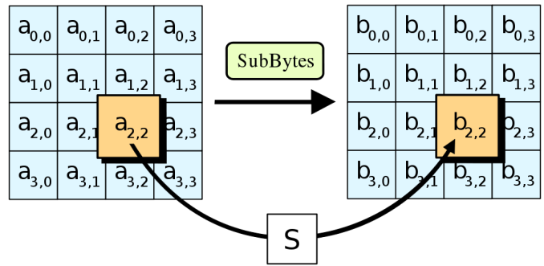
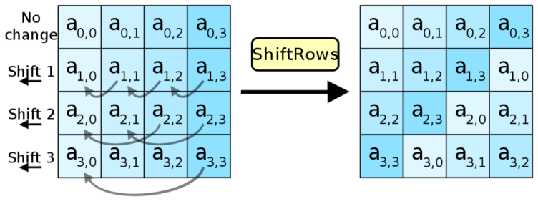
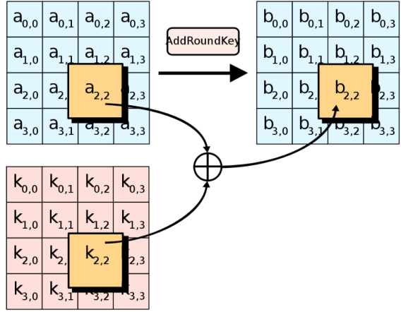
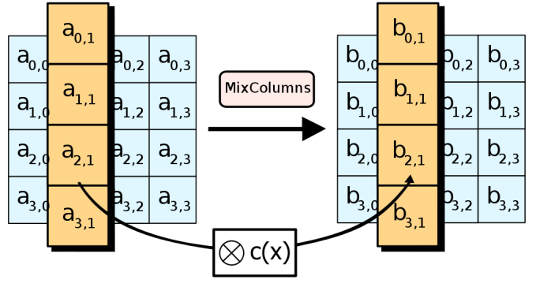
Summary of AES Operations
Round operations:
Substitute bytes
Shift rows
Mix columns
Add round key

Slide 17
Attacking the S-Box (or Table Lookup)
Plaintext
If a plaintext byte is known, as well as a first-round table lookup, a key byte is learned
Key xor
Table
Key xor
Table
…
Table
The same is true for cipher text bytes and final round table lookups
Key xor
Ciphertext

Slide 18
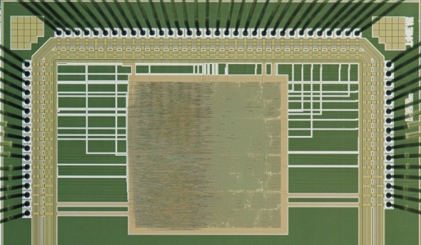
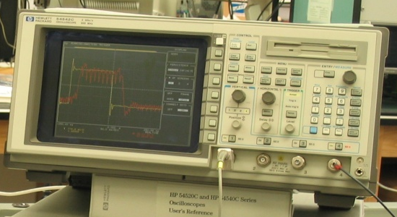

Setup
Unknown secret key
device
measurement
analysis
Input
A Selection Function for an intermediate value
D = SBOX (K_{g}⊕m)
subkey guess
Notes:
You need to communicate with the device to invoke cryptographic operations and to record its responses. The measurement apparatus, such as digital oscilloscope driven by a PC, is connected to the target device. Depending on the device and the access available, a resistor or a current probe in series with the device’s power or ground lines can be used. Measurements taken closer to the cryptographic component will generally be of better quality, although a larger number of lower-quality traces can also be used. A resistor in series with a power or ground line is the simplest way to obtain power traces. If a resistor cannot be inserted (e.g., if a device uses an internal battery), the device’s internal resistance is often sufficient. For triggering, the measurement system is typically connected to the device’s I/O lines.
Many factors influence the signal quality of power measurements. On large ASICs/ SoCs with multiple power and ground connections, inputs that power the circuitry that performs the cryptographic computations are likely to provide better data. Similarly, at the board level, removal of decoupling capacitors or use of an external bench-grade power supply can reduce noise. In some cases, signal quality is affected by a device’s operating parameters, such as voltage, temperature, and clock rate/waveform. Stressing a device by running it near the edge of its operational envelope may enhance the leak being targeted or reduce the effectiveness of certain countermeasures. For example, lowering the input voltage may stress voltage regulators and increase leakage. A bench-grade clock can reduce timing jitter, especially when synchronized to the sampling clock of the measurement apparatus. Using a sine-wave clock may reduce high-frequency noise in measurements. For some devices, it is possible to control the number of cryptographic operations performed in a given command, e.g., by selecting the input message length. Commands that perform more cryptographic operations are often preferred, since increasing the number of cryptographic operations per trace usually speeds up the data collection stage. While many DPA attacks work with random or arbitrary input messages (such as typical ciphertext), chosen input messages can sometimes reveal additional leakage or simplify the analysis. For example, holding part of the input constant can enable a practical attack or decrease the complexity of subsequent steps on the analysis. Holding part of the input constant can also amplify leakage by increasing the number of intermediate bits that are correlated to the value being predicted. Depending on the algorithm being analyzed and the attack strategy, it may be most efficient to use a sequence of adaptively-chosen input sets, where each set of inputs depend on the results of a DPA analysis done on the prior set. In other cases, such as with the “doubling attack”, a chosen message strategy can help circumvent poorly-designed DPA countermeasures. In some instances, when inputs are not fully controllable by an attacker, fault or glitching attacks may be used to influence the cryptographic operations being performed.

Slide 19
Instrumentation
High-speed analog to digital conversion system
Accurate enough to detect small fluctuations
Important factor in selecting a scope:
Deep memory
Trigger flexibility
Signal to noise ration
Rapid trigger re-arming time and fast transfer rate
Notes:
Digital storage oscilloscopes are well-suited to this task. In selecting a scope, most important factors are:
reasonably deep memory (for capturing longer traces)
trigger flexibility (to help start trace capturing at the appropriate time) are helpful.
rapid trigger re-arming time and fast transfer rates can help speed up the data collection phase. (Data collection is often the most time-consuming step of DPA.)
the signal-to-noise ratio
In our experience, signal fidelity and calibration are less important, since the types of distortions introduced by cheaper lab equipment generally do not interfere with the leakage signals exploited by DPA. While it might appear that sampling resolution would matter significantly when dealing with very small correlations, the primary concern for DPA is the signal-to-noise ratio, and sampling errors are usually significantly smaller than other noise sources. Analog pre-processing of the raw signal prior to A/D conversion is helpful in some situations. Similarly, simple bandwidth limiting (a feature in many oscilloscopes) can help remove unwanted high-frequency artifacts. In other cases, a preliminary DPA test using the known input and output bits as selection functions can highlight the precise location where the cryptographic operation is performed.

Slide 20
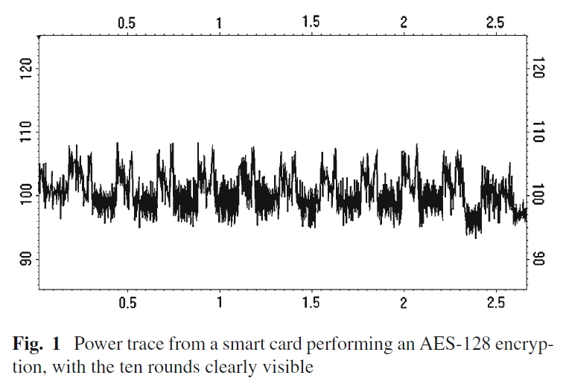
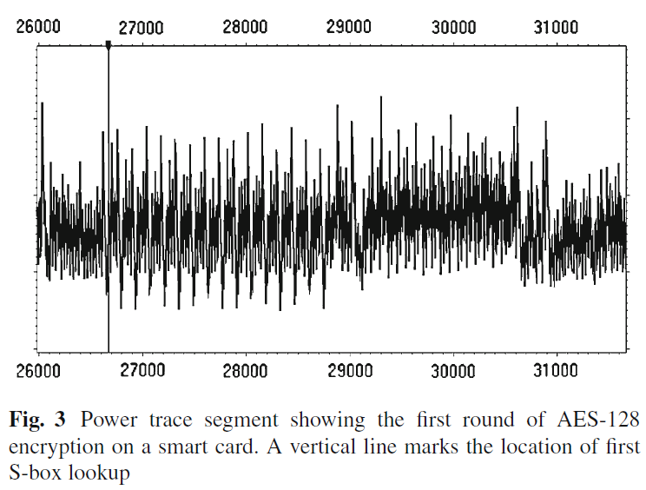
Data Collection
Capture traces from target device
Clean measurements are not required for DPA attacks
4000 traces from a smart card while performing AES-128
Different plaintext, same key
8-bit A/D converter
Notes:
Data collection stage:
The first step in the power analysis process is to collect one or more traces from the target device. Power traces are recorded while the target device performs cryptographic operations. Each captured trace is stored on a PC with the associated cryptographic data (e.g., the plaintext or ciphertext). As needed, trace quality and capture efficiency may be improved by adding analog filters, adjusting bandwidth or sampling rates to remove irrelevant regions.
Figure 1 shows ~3 ms of a power trace from a smart card performing an AES-128 encryption operation. The power consumption was sampled at 100 MHz, and each point in the trace is the average of multiple samples. The trace data were captured by placing a resistor in series with the device’s ground line, then using an oscilloscope to measure the voltage at the ground input. X&Y are time & power consumption.
The following experiment, conducted using a set of traces collected from the smart card, illustrates how power consumption can be dependent on sensitive data. Figure 3 shows the region of the power trace during the first round of the AES-128 operation. (more detail than Fig. 1 because fewer points are averaged together to produce each point in the plot.) The moment in time when the card computes the output of the first S-box is marked by a vertical line. Each trace observes the encryption of a different, randomly chosen, plaintext. The same random known key was used each time.
Figure 2 shows a 5 microsecond segment of a power trace recorded from an FPGA encrypting 1MB of data using AES-
128 in CBC mode. Four individual AES-128 encryptions are visible in the figure. The full trace recorded nearly 40 million
measurements at 500 MHz, spanning the 216 AES operations in the complete CBC encryption. This trace was captured by
placing a resistor in series with the power (Vcc) input and measuring the voltage at the device, so higher power consumption appears as a lower value in the figure. Although the AES rounds are clearly identifiable in both Figs. 1 and 2, clean measurements such as these are not required for DPA attacks.

Slide 21
Signal Processing
Improves efficiency of the DPA process and outcome (Optional)
Remove alignment errors
Isolate features
Highlight signals
Reduce noise
Notes:
Signal processing This optional stage involves processing traces in software to remove alignment errors, isolate features of interest, highlight signals, and reduce noise. In many cases, only simple temporal alignment will be necessary,
or this step can be omitted entirely.
Trace alignment (identifying a reference time location in each trace) is typically performed and is the simplest signal processing technique. To align a trace Ti against a reference trace T0, a simple correlation test is employed to find the time shift d that minimizes the differences (or the square of the differences) between T0[ j ] and Ti [ j + d]. Occasionally, more complex alignment methods are needed. For example, clock drifts across traces can be a source of misalignment, and several countermeasures have been designed to create misalignments. (These include shuffling the order of operations, insertion of random no-ops or clock skips, and use of desynchronized clocks.) Often, careful alignment or signal resynchronization can reduce or eliminate these effects. Although correct alignment is not necessary for DPA to succeed, good alignment does reduce the number of traces required to extract a key. An alternative to performing alignment is to perform DPA in the frequency domain. To do this, the signal processing phase involves performing Fourier analysis on the relevant regions of each trace. Other digital filtering of signals at this stage can also help reduce noise and to focus on the parts of the spectrum where the leakage signal is present. For example, trace “compression” can be performed by adding together successive measurements, and can help reduce high-frequency noise and amplify signal resolution while reducing the amount of data that requires processing in subsequent steps. If unwanted repetitive effects are present, these can be detected and subtracted from the traces. Another simple strategy to reduce extraneous and measurement noise from traces is to collect multiple traces while an identical operation is repeated, then average these together. DPA testing can be a highly data intensive task, especially when performed with a very large number of traces each containing a large number of measurement points. Much of the information present within the traces is not useful in the DPA test; only a few trace offsets typically show DPA signals. Once a particular device has been characterized, traces can be greatly compressed by discarding all points except the few that matter. In the simplest case, certain traces may be discarded (filtered out) based on the value of some portion of the signal. For example, if all traces with below-average measurements at a first location are discarded, high-order effects involving this location and any other location will appear.

Slide 22
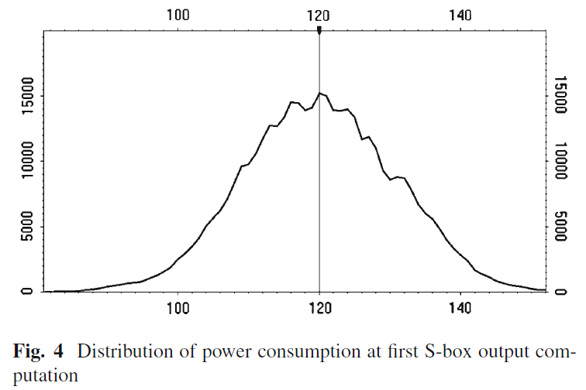
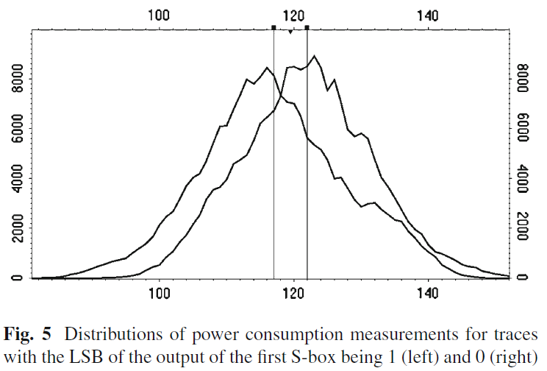
Distribution of power consumption
Gaussian Distribution
Mix everything together
Mean – 120 unit
Standard deviation – 10.66
Least significant bit is 1:
M = 116.9
Sd = 10.7
Least significant bit is 0:
M = 121.9
Sd = 9.7
Notes:
Figure 4 shows the probability distribution of power measurements, at the time marked in Fig. 3. An 8-bit A/D converter was used, so the possible range of points is from 0 to 255. Figure 4 shows that there is significant variation in the power consumption measurements among the traces at this point during the computation. Such variations combine a range of effects, including data-dependent variations, other activity in a device, measurement inaccuracies, interference, environmental factors, and so forth.

Slide 23
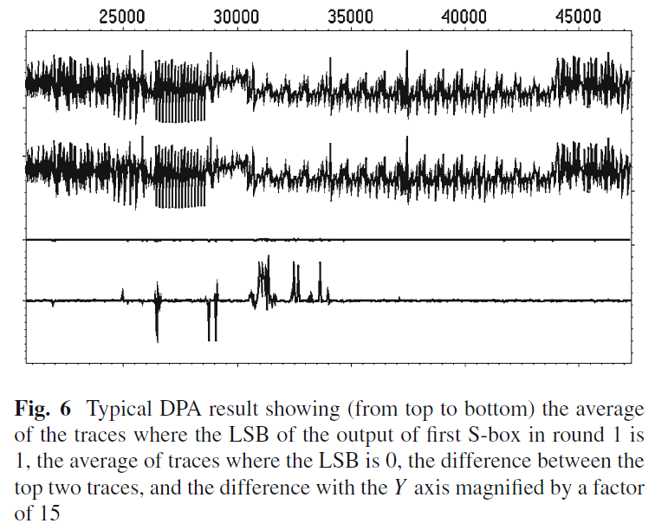
Correct guess
If the guessed key-related value is correct, power traces are placed in subsets correctly according to selection function and spike occurs
Notes:
The DPA result can be graphed where the X axis is the trace offset (time) and the Y axis shows the difference in the averages of the two distributions at that point. At offsets where the power consumption is correlated to the selection function output (e.g., because the device is manipulating this value internally), the distributions at that offset will differ, resulting in a nonzero value (e.g., a spike) in the graph. In regions of the graph where the power consumption is unrelated to the selection function output, the distributions will not have statistically significant differences. The points in the graph will converge to 0 as the number of traces increases, making these regions appear flat.
A general technique for characterizing the leakage from a device is to perform DPA tests using selection functions based on the expected intermediate values within the cryptographic operation. This “known-key” analysis is only possible if the attacker can obtain a device with a known key. Tests using these intermediates help identify what information is leaking from the implementation. For example, Fig. 6 used known key analysis to illustrate how the least significant bit of the first S-box lookup leaked from an AES implementation.
Figure 6 shows the components of a typical successful DPA result. In this case, the target device is the same smart
card performing AES, and the subsets are based on the actual values of the LSB of the first S-box output in the first round. Four traces are shown in the figure. The uppermost trace is the average of the traces for which the LSB was 1 over the time interval covering the first two rounds of the AES encryption. The second trace is the average of the traces for which the LSB was 0. The top two traces appear to be the same, since the difference between the averages is much smaller than overall power consumption variations. The third trace shows the difference of the top two traces, and appearsmostly flat— again, because the differences are small. The fourth (lowest) trace shows the difference of the averages with the Y axis scaling increased by a factor of 15, and the DPA results are clearly visible. Areas of leakage are visible as spikes in the lowest trace. The first spike occurs when the S-box output bit is first computed by the target device. Further spikes appear when this bit is further processed in the rest of the first round. By the end of the first round, the AES intermediates are no longer correlated to the LSB of the S-box output due to mixing with other bits and the cipher’s avalanche. As a result, no spikes are seen in the difference trace in the second round or beyond. Figure 6 shows relatively little noise between the spikes, since the number of traces used (4,000) is high relative to the noise within individual traces. While more traces yield cleaner results, there is normally no reason to use more data than is necessary to distinguish the desired signals.

Slide 24

Classification with selection function and average
T – set of traces
T_{i}[j] – sample at j^{th} time offset within trace T_{i}
C – set of known input/output
D(C_{i} K_{n}) – binary valued from the selection function
Notes:
A DPA test can be summarized as follows: Let T denote the set of traces that are collected and let Ti denote the ith
trace. Let Ti [ j ] denote power measurement or sample at the j th time offset within the trace Ti. Let C denote the set of
known inputs or outputs for the traces with Ci corresponding to the ith trace. Let D(Ci , Kn) denote a binary valued selection function with input Ci and the guess Kn of a part of a key. Each point j in the differential trace D for the guess
Kn is computed as follows:
For a typical DPA analysis, the guess for Kn that produces the largest spikes in the differential trace D is considered
to be the most likely candidate for the correct value. The attack can be adjusted easily for other cipher modes
and target devices. For example, Fig. 9 shows a DPA result from the FPGA implementation of AES-CBC shown in
Fig. 2. For convenience, a single oscilloscope capture was used to capture all AES operations needed for the attack,
then the capture file was divided into 65,536 separate AES operations for analysis. Also, because the ciphertext (instead
of plaintext) was available, the DPA process was used to find bytes of the last round key.6 The top trace in Fig. 9 is
the average power trace for an AES operation. The middle trace is a differential trace for a DPA test carried out with an
incorrect guess for the first byte of the last round key and the bottom trace shows the corresponding differential trace for
the correct key byte guess.

Slide 25
Evaluation
Analyze test results to determine most likely candidate key guesses
Large peaks for correct key guess
If needed, repeat analysis for more key bits
Improving the attack
Multiple bits
CPA
Notes:
This process can be done visually or using automated tools. The correct key guess results in large peaks in the differential trace, while much smaller peaks are visible for incorrect key guesses. It is also easy to develop automated tools to measure peaks and list or plot their amplitudes, or even suggest the most likely key guesses.
Regions with unusually high noise can show spurious spikes in a differential trace. To correct for these effects, and to help assess the statistical significance of the results, each point in the differential trace can be divided by the standard deviation of all traces at that point. The result is a normalized trace giving the polarity and significance of the difference (measured in standard deviations) at each point in time. The “difference of averages” is just one way that two distributions of measurements can differ.
A more general statistical test can compare at the distribution of measurements at each point in the subsets of traces, and calculates the significance of differences observed between them. For such analysis, the “averaging” stage actually computes the distributions of measurements rather than compressing the distributions down into their averages.
For some algorithms, and for certain types of DPA attacks, the evaluation process is more complex, since there are be multiple other guesses besides the correct key which have significant correlation to the target leak and thus may show spikes in the differential trace. These guesses are termed as “harmonics” of the correct key.
For some algorithms the attack is applied iteratively, as new information about the key enables the generation of new selection functions. In these cases, the DPA evaluation stage is not the final stage of an attack. The iteration process usually restarts back at the selection function generation stage, but for adaptive chosen message attacks, the evaluation result guides the next sets of inputs for the data collection stage. Iteration is also required for algorithms such as AES-256 and triple DES where multiple round subkeys or multiple encryption keys must be found.
The final three steps (prediction, averaging, and evaluation) are often iterated. For example, with AES-256, the first
round key is typically found before the attack can begin on the second round key. In other cases, additional steps may also be repeated, e.g., if adaptively chosen input messages are being used.

Slide 26
DPA Prevention
Methods:
Reduce signal size (Cost and size increase)
Leakage reduction
Noise introduction
Obfuscation
Incorporating randomness
Protocol level countermeasures
Balancing
Blinding and masking
Risk reduced but not eliminated.
Notes:
Reduce signal size by using constant execution path code, choosing operations that leak less information in their power consumption, physically shielding the device etc. Makes attacks infeasible but adds significantly to a device’s cost and size.
Noise, errors from mismatch of clocks, incorrect temporal misalignment of traces, randomize execution timing/order. But then we can fine tune the measurement and use more sophisticated selection functions to calculate bits.
Differential power analysis is difficult to prevent, since even small biases in the power consumption can lead to exploitable weaknesses. Some countermeasure strategies involve algorithmic modifications such that the cryptographic operations occur on data that is related to the actual value by some mathematical relationship that survives the cryptographic operation. One approach involves blinding parameters to randomize their value. Other countermeasure strategies to reduce the effectiveness of DPA attacks involve hardware modifications: varying the chip internal clock frequency has been considered to desynchronize electric signals, which lead in return to algorithmic enhancements of traditional DPA.
Leakage reduction: techniques to make the set or sequence of operations independent of the key as well as hardware and software balancing techniques to reduce variation in the power consumption for different data.
Noise introduction: techniques for adding different types of noise into the power consumption measurements available to the attacker.
Obfuscation: by keeping algorithms secret, the attacker is forced to perform reverse engineering along with power analysis. While we do not recommend this countermeasure, it is better than having no countermeasure at all.
Incorporating randomness: includes techniques for randomizing the data manipulated by the device in a way that still produces the correct result and encompasses techniques such as the masking or blinding of data and keys.
Protocol level countermeasures: applicable when there is flexibility to modify cryptographic protocols used by the device. Protocols are modified so that secrets can be continually refreshed and updated during the lifetime of the device, protecting them from leak exposure.
Balancing: Leakage may be reduced by structuring cryptographic circuits to use a more balanced amount of power. Balancing aims to reduce signal by making the amount of power used less dependent on data values and/or operation type
Blinding and masking: Countermeasures based on masking or blinding resist DPA by randomly changing the representation of secret parameters.

Slide 27


Summary
Algorithms that are mathematically strong may be vulnerable to power analysis attacks
Potential victims:
RFID, smartcard
FPGA, SoCs ASIC
HSM, mobile phone
Product have DPA countermeasure implemented if it have the DPA security logo:
Notes:
Implementations of algorithms such as AES and DES that are believed to be mathematically strong may be breakable using power analysis attacks. Implementations of all cryptographic algorithms, both symmetric and asymmetric, are susceptible to SPA and DPA attacks. Power analysis attacks have been implemented against products using DES, AES, MISTY, SHA, Diffie-Hellman, RSA, Elliptic Curves, as well as proprietary algorithms.
For applications where devices may fall into the physical possession of an adversary, protection against power analysis is generally a major design requirement. SPA and DPA are effective against: simple ICs such as RFID devices and smart cards to large chips such as field programmable gate arrays (FPGAs), system on chips (SoCs) and ASICs. The attacks also work against multi-chip systems, such as hardware security modules (HSMs) and mobile telephones.
Countermeasures to power analysis attacks are required for security in any product which needs to protect cryptographic keys from external tampering. Relevant applications and industries include secure access and ID cards, SIM cards, payment devices, storage products (such as secure USB flash devices), pay television set-top boxes, optical disc players, audiovisual decoders, mobile phones, FPGAs, VPN appliances, secure radios, satellites, and government/military products.

Slide 28
References
P. Kocher, J. Jaffe, and B. Jun, “Differential power analysis,” Proceedings of CRYPTO'99, vol. 1666, pp. 388-397, August 1999.
Kong, J.; Aciicmez, O.; Seifert, J.-P.; Huiyang Zhou; , "Hardware-software integrated approaches to defend against software cache-based side channel attacks," High Performance Computer Architecture, 2009. HPCA 2009. IEEE 15th International Symposium on , vol., no., pp.393-404, 14-18 Feb. 2009 URL: http://ieeexplore.ieee.org/stamp/stamp.jsp?tp=&arnumber=4798277&isnumber=4798227
Kocher, Jaffe, Jun. Introduction to Differential Power Analysis and Related Attacks. http://www.cryptography.com/public/pdf/DPATechInfo.pdf
Power Analysis. Wikipedia. http://en.wikipedia.org/wiki/Power_analysis

