Slide 1



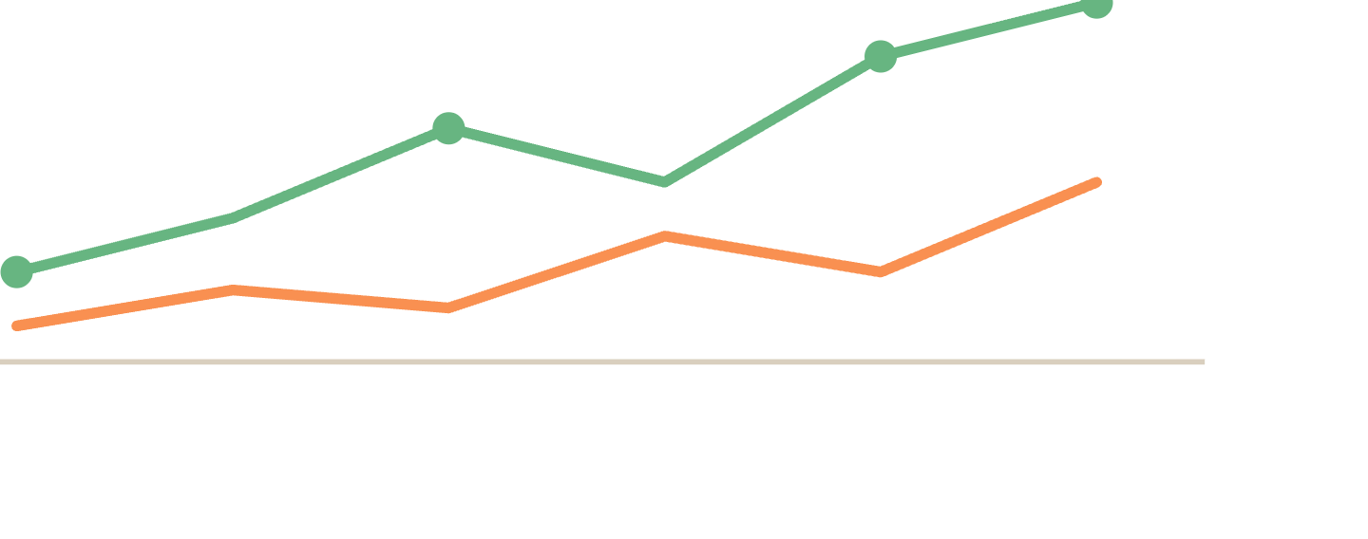
Lesson 3 · Writing
Grammar for
data description
.
The tenses, comparatives, and linking words that make your sentences accurate.
Notes:
Welcome to Lesson 3. Grammatical Range and Accuracy is one of the four Task 1 marking criteria. This lesson covers the tenses, comparatives, prepositions and linking words that keep your descriptions accurate.

Slide 2
WHY THIS MATTERS
Grammar is its own band score, and an easy one to win.
Task 1 is marked on four criteria, and Grammatical Range & Accuracy is one of them. You can have great vocabulary and still lose marks if your tenses don't match the data, or your comparatives don't agree.
in this lesson →
01
Past simple for data
02
Comparatives & superlatives
03
Prepositions for amounts
04
Linking contrasting trends
Lesson 3 of 6 · IELTS Writing Task 1 · orangeenglish.nl
2
Notes:
Grammatical Range and Accuracy is a full quarter of the Task 1 score, and it is one of the easiest to control. Strong vocabulary won't save a sentence with a tense error. Preview the four parts.

Slide 3
PART 1 · VERB TENSES
Most Task 1 data needs the
past simple
.
If the graph shows data recorded up to a fixed point, even last year, describe it in the past simple. Only switch tense if the graph shows a future projection ("is expected to rise").
COMMON IRREGULAR VERBS
rise
→
rose
Internet usage rose steadily between 2010 and 2020.
fall
→
fell
not "rises", the data is already recorded
grow
→
grew
become
→
became
Lesson 3 of 6 · IELTS Writing Task 1 · orangeenglish.nl
3
Notes:
Part 1. Most Task 1 data was recorded up to a fixed point, so the default is past simple. Only switch to a future form when the graph shows a projection. Drill the four common irregular verbs.

Slide 4

PART 2 · COMPARING DATA
Comparatives & superlatives.
Comparative
Superlative
comparing two things
comparing the whole set
higher than · lower than · more than · fewer than · twice as many as
the highest · the lowest · the largest · the smallest
"Spending on housing was higher than spending on food in every year shown."
"2020 saw the highest number of visitors."
Lesson 3 of 6 · IELTS Writing Task 1 · orangeenglish.nl
4
Notes:
Part 2. Comparatives compare two things within the data; superlatives single out one across the whole set. Note the agreement: 'higher than', 'the highest'.

Slide 5

PART 3 · PREPOSITIONS
Showing exactly how much something changed.
by
Sales increased by 15% between 2015 and 2018.
the size of the change
to
Unemployment fell to 4% by the end of the period.
the end point
from … to
The figure rose from 20% to 60%.
the start and end point
Lesson 3 of 6 · IELTS Writing Task 1 · orangeenglish.nl
5
Notes:
Part 3. Three prepositions do the heavy lifting: 'by' for the size of the change, 'to' for the end point, 'from … to' for both ends. Match each to its example.

Slide 6
PART 4 · LINKING IDEAS
Connecting two trends in one sentence.
Mid-sentence
New sentence
Showing a shift
while · whereas
in contrast · by contrast
however
"While sales of product A increased, sales of product B declined."
"In contrast , expenditure on transport fell."
"However , the trend reversed after 2015."
Lesson 3 of 6 · IELTS Writing Task 1 · orangeenglish.nl
6
Notes:
Part 4. Three ways to connect two trends: mid-sentence with while/whereas, a new sentence with in contrast, and however to signal a shift. Note the punctuation each one needs.

Slide 7
examiner mode
One mixed tense can undo a good sentence.
✗
WEAK
"The price of oil rise sharply in 2008 and now it is falling."
tense mix, stay in the past throughout
✓
STRONGER
"The price of oil
rose sharply
in 2008
before falling
steadily thereafter."
'before' links two past actions smoothly
Lesson 3 of 6 · IELTS Writing Task 1 · orangeenglish.nl
7
Notes:
Examiner Mode. A single tense slip undoes an otherwise good sentence. Stay in the past throughout, and use 'before' to link two past actions smoothly.

Slide 8
ACTIVITY
your turn!
Fix the grammar.
Each sentence below has one grammar mistake. Rewrite it correctly on the line beneath.
1
In 2010, the number of users were higher than in 2005.
2
The figure for coal rise to 40% in 2012.
3
China has the highest population than India.
4
Profits increased of 20% between 2010 and 2015.
Lesson 3 of 6 · IELTS Writing Task 1 · orangeenglish.nl
8
Notes:
Activity. Each sentence has one grammar mistake, a tense error, a wrong verb form, a comparative-superlative mix, or a wrong preposition. Students rewrite each correctly on the line beneath.

Slide 9
KEY TAKEAWAYS
What to carry into your writing.
Default to the past simple for completed, historical data, switch tense only for projections.
Use comparatives within a graph, superlatives across the whole data set.
'By' shows the amount of change, 'to' shows the end point, 'from … to' shows both.
Link contrasting trends with while / whereas / in contrast, not just "and".
next up →
Structuring the Response
Lesson 3 of 6 · IELTS Writing Task 1 · orangeenglish.nl
9
Notes:
Recap the four takeaways. Default to past simple, comparatives within / superlatives across, the three prepositions, and proper linking words. Preview Lesson 4: Structuring the Response.

