Slide 1



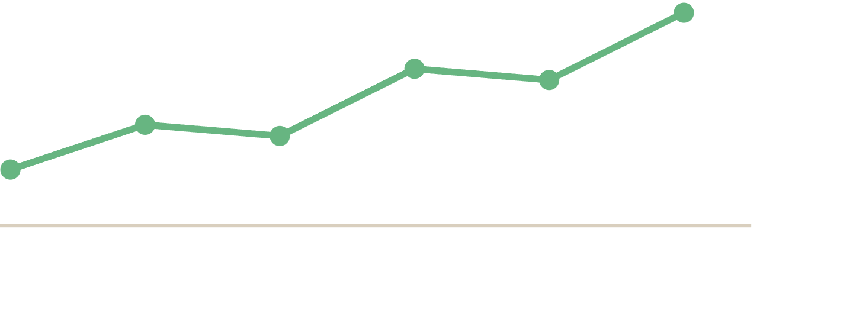
Lesson 5 · Writing
Writing
practice
.
Put vocabulary, grammar, and structure together in one full, untimed response.
Notes:
Welcome to Lesson 5. This is full practice without a timer, the chance to produce a complete, accurate response while the good habits are still settling in. Lesson 6 will add the clock.

Slide 2
WHY THIS MATTERS
Build the habit before the clock starts.
Lesson 6 adds time pressure. Before that, you need to prove you can produce a full, accurate response when you're not rushed, so the good habits are automatic, not something you're thinking about for the first time under a timer.
in this lesson →
01
Reading the question
02
Planning before writing
03
A model answer, annotated
04
Self-editing checklist
Lesson 5 of 6 · IELTS Writing Task 1 · orangeenglish.nl
2
Notes:
The point of untimed practice is to make the good habits automatic before the timer is added in Lesson 6. Prove you can produce a full, accurate response when you're not rushed. Preview the four parts.

Slide 3


PART 1 · BEFORE YOU WRITE
Read the question like an examiner will read your answer.
Before writing a word, identify the graph type, the time period, the units, and every category shown. Missing a category in your answer is one of the fastest ways to lose Task Achievement marks.
✓
✓
✓
✓
Graph type
Time period
Units
All categories
%, millions, °C…
Lesson 5 of 6 · IELTS Writing Task 1 · orangeenglish.nl
3
Notes:
Part 1. Before writing a word, identify the graph type, the time period, the units, and every category shown. Missing a category is one of the fastest ways to lose Task Achievement marks.

Slide 4
PART 2 · PLANNING
Two minutes of planning saves ten minutes of rewriting.
01
Note the
overview pattern
(1–2 big trends) before you write a single sentence.
02
Decide your
paragraph grouping
, by category, by time period, or by trend (Lesson 4).
03
Jot 3–4 key figures per body paragraph so you're not hunting for numbers mid-sentence.
Lesson 5 of 6 · IELTS Writing Task 1 · orangeenglish.nl
4
Notes:
Part 2. Two minutes of planning saves ten minutes of rewriting. Note the overview pattern, decide the paragraph grouping, and jot a few key figures per body paragraph before writing.

Slide 5
PART 3 · A FULL EXAMPLE
One graph, one complete response.
Introduction
"The line graph illustrates how many people visited three London museums over the 30-year period from 1990 to 2020."
Overview
"Overall, one museum consistently attracted far more visitors than the other two, while numbers at all three venues rose considerably."
paraphrased prompt
two trends, no figures
Body 1
"The British Museum began at around 2 million in 1990 and climbed steadily to roughly 6 million by 2020, remaining the most popular throughout."
Body 2
"In contrast, the other two began under 1 million. While the Tate grew gradually to 3 million, the Science Museum fluctuated before reaching 2.5 million."
first group, with figures
second group, with figures
note
Each paragraph uses the vocabulary and grammar choices from Lessons 2–3, varied verbs, past simple, comparatives, linking words.
Lesson 5 of 6 · IELTS Writing Task 1 · orangeenglish.nl
5
Notes:
Part 3. A complete response, paragraph by paragraph. Each one is labelled and annotated with the vocabulary and grammar choices from Lessons 2 and 3. This is the museum visitors graph from Lesson 4.

Slide 6
PART 4 · BEFORE YOU FINISH
Run this checklist every time.
✓
Is the tense consistent, past simple throughout?
✓
Is the overview free of numbers?
✓
Are body paragraphs grouped logically?
✓
Is vocabulary varied, no repeated verbs?
✓
Are at least two linking words used (while, in contrast, however)?
Lesson 5 of 6 · IELTS Writing Task 1 · orangeenglish.nl
6
Notes:
Part 4. Run this five-point checklist every time before you finish: tense consistency, a number-free overview, logical grouping, varied vocabulary, and at least two linking words.

Slide 7
examiner mode
Same data, two outcomes.
✗
WEAK
"Visitors increased to 6 million. It increased to 3 million. It increased to 2.5 million."
listed numbers, repeated "increased," no comparison or linking
✓
STRONGER
"The British Museum
the Science Museum only reached 2.5 million."
climbed to 6 million
, far higher than the Tate,
while
varied verb + comparative + linking word + clear comparison
Lesson 5 of 6 · IELTS Writing Task 1 · orangeenglish.nl
7
Notes:
Examiner Mode. The same body data, two outcomes. A weak version lists numbers with no comparison and repeats 'increased'. A strong version uses varied verbs, a comparative, a linking word, and a clear point of comparison.

Slide 8
ACTIVITY
your turn!
Write a full response.
Using the checklist from this lesson, write a complete answer to the practice graph provided in your workbook. No timer yet, focus on accuracy, not speed.
write here →
Lesson 5 of 6 · IELTS Writing Task 1 · orangeenglish.nl
8
Notes:
Activity. Using this lesson's checklist, students write a complete answer to the practice graph in their workbook. No timer yet, the focus is accuracy, not speed.

Slide 9
KEY TAKEAWAYS
What to carry into your writing.
Read the question fully before writing, graph type, time period, units, categories.
Spend two minutes planning your overview and paragraph grouping.
Use the self-editing checklist every time you finish a draft.
Accuracy first, speed next, that's what Lesson 6 adds.
next up →
Timed Task
Lesson 5 of 6 · IELTS Writing Task 1 · orangeenglish.nl
9
Notes:
Recap the four takeaways: read the question fully, plan for two minutes, run the self-editing checklist, and prioritise accuracy now, speed comes in Lesson 6. Preview Lesson 6: Timed Task.

