Slide 1



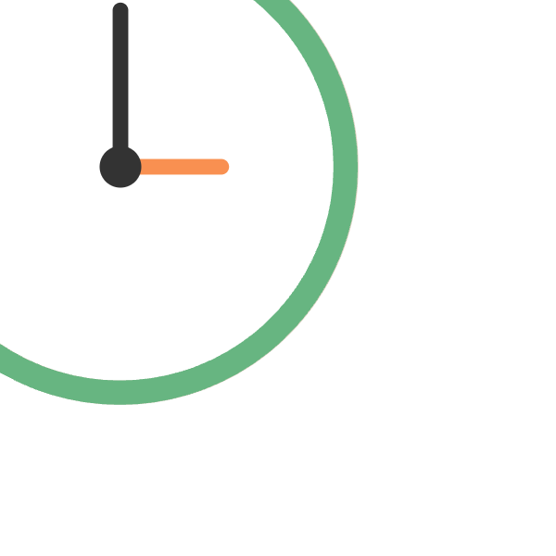
Lesson 6 · Writing
Timed
task
.
Bring it all together under real exam conditions: 20 minutes, one graph, one response.
Notes:
The final lesson. Everything comes together under real exam conditions: 20 minutes, one graph, one complete response.

Slide 2
WHY THIS MATTERS
Time pressure is where good habits get abandoned.
Under a clock, students drop the structure, repeat simple verbs, and skip the overview. This lesson is about protecting everything you've already learned when the pressure is on.
in this lesson →
01
Time budgeting
02
Word count target
03
Pacing under pressure
04
Self-assessment
Lesson 6 of 6 · IELTS Writing Task 1 · orangeenglish.nl
2
Notes:
Under a clock, students drop the structure, repeat simple verbs, and skip the overview. This lesson is about protecting the habits already learned when the pressure is on. Preview the four parts.

Slide 3
PART 1 · THE 20 MINUTES
A simple time budget.
2min
15min
3min
Read the question, plan the overview and paragraph grouping.
Write the full response, introduction, overview, two body paragraphs.
Check tense, overview, and word count.
plan
write
check
Lesson 6 of 6 · IELTS Writing Task 1 · orangeenglish.nl
3
Notes:
Part 1. A simple budget for the 20 minutes: two to plan, fifteen to write, three to check. The timeline shows the proportions.

Slide 4
PART 2 · LENGTH
Aim for
150+ words
, not a word less.
Underlength answers are penalised regardless of quality. Rough paragraph guide:
Introduction
25–30 words
Overview
30–40 words
Body paragraph 1
40–50 words
Body paragraph 2
40–50 words
Lesson 6 of 6 · IELTS Writing Task 1 · orangeenglish.nl
4
Notes:
Part 2. Aim for 150+ words, underlength answers are penalised regardless of quality. Use the rough per-paragraph guide so the total lands safely over the minimum.

Slide 5

PART 3 · STAYING ON TRACK
Don't redraft mid-sentence.
01
Keep planning notes to
single words or numbers
, not full sentences.
02
Write forward
, fix small errors at the end, not while you're mid-paragraph.
03
Protect the last 2–3 minutes for checking, even if it means cutting a sentence short.
Lesson 6 of 6 · IELTS Writing Task 1 · orangeenglish.nl
5
Notes:
Part 3. Don't redraft mid-sentence. Keep planning notes to single words, write forward and fix at the end, and protect the last two to three minutes for checking.

Slide 6
PART 4 · AFTER YOU FINISH
Score yourself against all four criteria.
Task Achievement
Coherence & Cohesion
Every category covered, overview included, 150+ words.
Clear four-part structure, linking words used.
Lexical Resource
Grammatical Range & Accuracy
Varied verbs and adverbs, no repetition.
Consistent tense, correct comparatives.
Lesson 6 of 6 · IELTS Writing Task 1 · orangeenglish.nl
6
Notes:
Part 4. After finishing, score yourself against all four marking criteria. This mirrors exactly how the examiner reads your answer.

Slide 7
examiner mode
20 minutes, well spent vs. poorly spent.
✗
WEAK
Answer stops mid-body paragraph, no overview, under 120 words.
ran out of time, no plan, no check
✓
STRONGER
Complete four-paragraph response
, overview included, 165 words, finished with time to spare.
planned, paced, and checked
Lesson 6 of 6 · IELTS Writing Task 1 · orangeenglish.nl
7
Notes:
Examiner Mode. Twenty minutes well spent versus poorly spent. A weak answer stops mid-paragraph, skips the overview, and falls under 120 words. A strong one is complete, includes the overview, and finishes with time to spare.

Slide 8

ACTIVITY
your turn!
Set a timer for 20 minutes.
Using the graph prompt in your workbook, complete a full Task 1 response under real timed conditions. Apply everything from Lessons 1–5, vocabulary, grammar, structure, and your self-editing checklist.
2 plan · 15 write · 3 check
this is the real thing, good luck!
Lesson 6 of 6 · IELTS Writing Task 1 · orangeenglish.nl
8
Notes:
Activity. Set a 20-minute timer and complete a full Task 1 response to the workbook prompt under real exam conditions, applying everything from Lessons 1 to 5.

Slide 9
course complete!
You can now do all of this.
✓
Read, describe, and structure a Task 1 line graph response accurately.
✓
Apply a repeatable four-paragraph shape to any graph.
✓
Use a vocabulary and grammar toolkit for describing change precisely.
✓
Write a complete, accurate response inside the 20-minute limit.
Lesson 6 of 6 · Orange English, Line Graph Success, complete.
9
Notes:
The course is complete. Students can now read, describe, and structure a Task 1 line graph response accurately, with a repeatable shape, a vocabulary and grammar toolkit, and the ability to finish inside 20 minutes. Congratulate them.

