Slide 1
PLAYWRIGHT ENTERPRISE E2E TEST FRAMEWORK
Architecture & CI/CD Overview
Page Object Model · Data-Driven · Multi-Auth API · Rich Reporting · GitHub Actions CI/CD
Prepared for: Technical Architecture Review
Presenter: Gukan · QA Engineering
Notes:
One-line intro: this is our in-house Playwright + TypeScript E2E framework. Goal of this review: make the case for the framework vs. a bare test set, walk the architecture and the reporting/CI-CD pipeline, and show how we fold the existing web-pet-golang Playwright e2e specs in without duplicating infrastructure.

Slide 2
THE CASE
Migration Plan — Why This Framework
The web-pet e2e suite is a set of tests — not a framework. This project is the platform those tests should run on.
Scope: this targets the Playwright e2e layer only — 56 specs. The web-pet Go API (451) and Vitest (230) test layers are separate and unaffected.
Capability | web-pet e2e (tests only) | This framework
Reusable POM / components | No page-object layer | BasePage + Nav / Modal / Form
External test data | By-name id lookups in specs | JSON / CSV data-driven layer
API authentication | Session login (storageState) | OAuth2 / Basic / API-Key + retry
Reporting | Playwright HTML only | HTML · Allure · Email · Slack · ELK*
CI/CD & notifications | Manual run; no notify pipeline | Push / cron / dispatch + Email / Slack
web-pet's strengths — storageState auth, resolve-ids-by-name, and the equiv/ legacy-parity suite — are preserved as framework conventions. * ELK in progress.
MIGRATION PLAN
1 Adopt the harness
Point specs at framework fixtures, config & auth; retire parallel glue.
2 Refactor to POM
Pickers → components; shared helpers; drop ad-hoc selectors.
3 Wire reporting & CI
Route through Allure / Email / Slack; run under CI triggers.
4 Preserve parity
Keep equiv/ + by-name ids; then broaden coverage.
Playwright Enterprise E2E Test Framework
2
Notes:
Open with the core argument: the web-pet Playwright layer is 56 spec files plus minimal glue — no reusable engineering layer (no POM base, no external data layer, no multi-auth API, no rich reporting, no CI notification pipeline). Our project IS that layer. The move is not 'rebuild tests' — it's migrate the existing specs onto this platform and delete the duplicate glue. Scope only the e2e layer; the Go (451) and Vitest (230) layers stay put. Four phases; and be fair — web-pet's storageState auth and equiv/ parity are good, we keep them.

Slide 3
Agenda
• Migration plan & why this framework — tests vs. platform
• Framework at a glance — purpose, stack, design principles
• Architecture — the layered design
• Project structure — how the code is organised
• Core capabilities — POM, data-driven, fixtures, API auth, observability
• AI-augmented authoring — Claude skills & Playwright agents
• Reporting — Allure size-fix, rich Email & Slack, ELK (in progress)
• CI/CD — triggers (dev push, cron, manual), pipeline, notifications, environments
• Consolidating the web-pet-golang e2e suite — one harness, no duplication
• Roadmap & status
Playwright Enterprise E2E Test Framework
3
Notes:
Keep this quick — it's a signpost. Emphasise two things the architect cares about most: the CI/CD trigger model and the no-duplication consolidation of the existing 56 web-pet specs.

Slide 4
At a Glance
What it is
Enterprise Playwright + TypeScript E2E framework for the PET Tiger app.
Page Object Model + component architecture.
Scales with coverage — no upfront over-engineering.
Tech stack
Playwright Test 1.58 · TypeScript 5
Allure reporting + trend history
GitHub Actions CI · Node 22 / Java 21
Nodemailer (email) · Slack webhook
Consolidation scope
web-pet-golang has 3 test layers: Go API (451), Vitest (230), Playwright e2e (56).
This platform consolidates the Playwright e2e layer only.
Go & Vitest layers are unaffected.
One harness: authored tests + data + auth + reporting + CI, in a single maintained codebase.
Design principle
Thin base classes over native Playwright APIs — no redundant wrappers; folders earn their place by real usage. Recent cleanup removed ~40 unused wrapper methods and pruned unused type surface to keep the framework lean and navigable.
Playwright Enterprise E2E Test Framework
4
Notes:
Frame it as intentional and disciplined: we deliberately keep base classes thin (call Playwright's Locator/expect directly) and only add structure when a real second consumer appears. That keeps onboarding fast.

Slide 5
LAYERED DESIGN
Architecture
L1
CI / CD & Triggers
GitHub Actions — push, cron, manual, external dispatch
L2
Configuration
playwright.config.ts · envLoader · env.local / dev / qa
L3
Global Lifecycle
global-setup (auth dir, results) · global-teardown
L4
Fixtures & Hooks
base.fixture / api.fixture · beforeEach / afterEach · lifecycle manager
L5
Page Objects & Components
BasePage · BaseComponent · Navigation / Modal / Form
L6
Data Layer
DataProvider · JSON / CSV readers (read directly, no conversion)
L7
Authentication & API
AuthorizationManager · RequestBuilder · AuthContextFactory
L8
Reporting & Utilities
HTML · Allure · Email · Slack · ELK · Logger · network helpers
Playwright Enterprise E2E Test Framework
5
Notes:
Walk top to bottom: a run is triggered (L1), config resolves the environment (L2), global setup logs in once and saves storage state (L3), fixtures inject page objects and run lifecycle hooks (L4), tests drive pages/components (L5) with data from JSON/CSV (L6), API calls go through the auth layer (L7), and everything fans out to reporting (L8).

Slide 6
src/
Project Structure
core/ Framework primitives — constants, exceptions, @HandleError decorator
config/ Env loading, environment definitions, data-source resolution
auth/ OAuth2 / Basic / API-Key request auth + 401/403 retry
components/ BaseComponent + Navigation / Modal / Form (root-scoped)
context/ executionContext (runId/branch/commit) · testMetrics · testRunContext
data/ runnerManager.json / .csv · module data · optional runnerList filter
fixtures/ base.fixture (UI) · api.fixture · global setup / teardown
pages/ BasePage + LoginPage / LeftNavigationPage
reporting/ email · slack · dashboard (ELK) · shared runSummary
utils/ DataProvider · logger · allureHelper · network · assertions · dataReaders/
tests/ — auth.setup.ts (storageState login) · login/ · spec files (**/*.spec.ts)
Playwright Enterprise E2E Test Framework
6
Notes:
Point out the recent tidy-up: single-file concerns collapsed into core/, and the structure is flat where it should be. Each folder maps to a capability we'll cover next.

Slide 7
THE FRAMEWORK
Core Capabilities (1 / 2)
Page Object Model & Components
BasePage — thin: navigate(), waitForCondition(), screenshot convention.
Actions/assertions use native Locator + expect() directly (no wrappers).
BaseComponent — root-scoped locator finders; Navigation / Modal / Form.
Prevents selector collisions; pages stay small and readable.
Data-Driven Testing
Reads JSON or CSV directly — no conversion / preprocessing step.
DataProvider singleton + JSON/CSV readers behind one interface.
testCaseId / testCaseName fixtures auto-load & validate a row.
Disabled rows (enabled:false) auto-skip.
Why it matters
New pages plug into a proven base; new scenarios are added as data rows, not new code. This is how the suite scales without the page layer ballooning.
Playwright Enterprise E2E Test Framework
7
Notes:
POM keeps locators in one place per page; components keep reusable widgets DRY. Data-driven means QA can add cases by editing a JSON/CSV row — no TS changes — which is the key to scaling coverage.

Slide 8
THE FRAMEWORK
Core Capabilities (2 / 2)
Fixtures & Lifecycle
base.fixture (UI) & api.fixture (API-only).
beforeEach/afterEach → lifecycle manager.
TestMetrics per test (status, duration, retry).
ExecutionContext: runId, branch, commit, trigger.
API Testing & Auth
Strategies: OAuth2, Basic, API-Key, none.
OAuth2 token cache + auto-refresh.
executeWithAuthRetry — retry once on 401/403.
authContextFactory builds the request context.
Logging & Observability
Structured Logger — console + daily file.
Per-test metrics + run-level context.
Screenshot / video / trace on failure.
Feeds the reporting layer.
Browser auth = saved storageState
A one-time auth-setup project logs in and persists the session to .auth/user.json; every browser test starts authenticated. API auth is separate and configurable per environment.
Playwright Enterprise E2E Test Framework
8
Notes:
Two independent auth paths: (1) browser login once via storageState for UI tests, (2) API request auth (OAuth2/Basic/API-Key) for direct API calls and validation. ExecutionContext gives every report the run's branch/commit/trigger.

Slide 9
CLAUDE CODE
AI-Augmented Test Engineering
Tests are authored, planned and repaired with Claude Code. Skills encode THIS framework's conventions; agents drive a real browser via MCP — so output follows the POM, fixtures and data-driven layer and runs without rework.
Claude Skills (repo-scoped)
ui-script-generator — generate/update a UI spec from a chat scenario; encodes POM, fixtures, data-driven & locator rules.
data-driven-testing — runnerManager rows + testCaseId / testCaseName fixtures; JSON ↔ CSV, no conversion.
tdd — red → green: write the failing spec from acceptance criteria first, then build page objects.
jira-to-script — Jira ticket → plan → generate → run → heal (via Jira MCP + the agents).
Playwright Agents (subagents)
planner — explores the live app in a real browser and saves a comprehensive test plan.
generator — executes each planned step live, then writes the Playwright spec.
healer — runs failing tests; debugs via snapshot / console / network; fixes selectors & timing.
Each runs as an isolated subagent with only its Playwright MCP tools — planner & generator author, healer repairs.
Powered by MCP (.mcp.json)
playwright-test server → real-browser tools (snapshot, click, generate-locator, run/debug) · jira server → pulls stories. The skills carry the repo's conventions, so generated specs use the POM / fixtures / data-driven layer and pass without manual correction.
Playwright Enterprise E2E Test Framework
9
Notes:
This is the differentiator: authoring isn't manual. Four repo-scoped Claude skills encode our conventions — ui-script-generator (scenario in chat → spec), data-driven-testing (runnerManager rows + fixtures), tdd (red/green), and jira-to-script (ticket → passing spec). Three Playwright subagents do the browser work via the playwright-test MCP server: the planner explores the live app and writes a plan, the generator executes each step live then emits the spec, and the healer runs failures and repairs selectors/timing. The key point: because the skills embed the framework's POM/fixtures/data-driven rules, the AI output drops straight into the suite and runs — it doesn't fight our conventions.

Slide 10
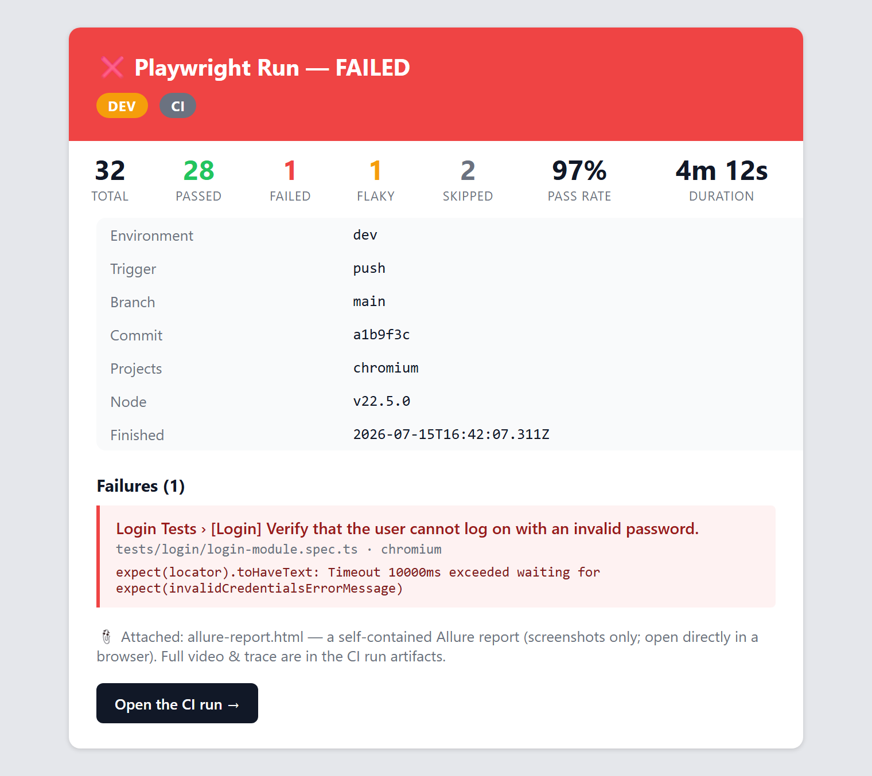
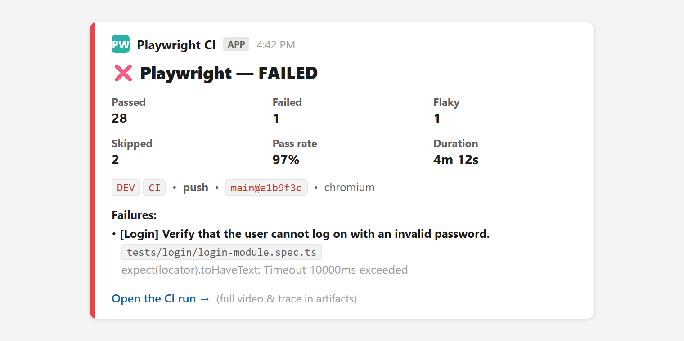
OUTPUTS
Reporting
Environment-tagged, rich notifications — real Email & Slack output shown below.
EMAIL NOTIFICATION
SLACK NOTIFICATION
Highlights
• Allure embeds screenshots only → the size failure is gone (~3 MB vs 5.8 MB); video & trace stay in the Playwright HTML report + artifacts.
• Env badges: LOCAL / DEV / QA + CI · pass rate · failures with spec & error · run link.
• Channels: List · HTML · JSON · Allure · Email · Slack · ELK (in progress). Email/Slack/ELK share one runSummary and are self-gating (opt-in).
ELK: WIP
Playwright Enterprise E2E Test Framework
10
Notes:
Show, don't tell: these are our actual rich Email and Slack notifications, environment-tagged (DEV + CI badges), with pass rate, counts, duration, metadata, and failures showing the spec file + error line. The key reliability win is the Allure size-fix — screenshots only, so the single-file report no longer blows the size limit; video and full trace remain in the Playwright HTML report and CI artifacts. Email, Slack and ELK share one runSummary module; all are opt-in. ELK is scaffolded, not yet wired live.

Slide 11
GITHUB ACTIONS
CI/CD Pipeline & Triggers
End-to-end: a developer commit flows all the way to Developer & QA reviewing the results.
Developer Commit
Dev Repository
GitHub Actions
Build
Deploy to DEV
Developer & QA Review Results
Return PASS / FAIL
Generate Report & Artifacts
Run Playwright Tests
Trigger Playwright Automation
Cron 4:00 PM IST
+ manual dispatch
Two entry points into the automation: (1) dev push → Build → Deploy to DEV auto-triggers it; (2) Cron 4:00 PM IST daily / manual dispatch.
Results — PASS / FAIL plus Allure, Email & Slack — flow back to Developer & QA.
CI policy: workers=1 (shared storageState) · retries=2 · test.only blocked · concurrency-cancel per ref.
Playwright Enterprise E2E Test Framework
11
Notes:
Walk the flow: a developer commit lands in the dev repo, GitHub Actions builds and deploys to DEV, and the DEV deploy automatically triggers the Playwright automation — it runs the tests, generates the report & artifacts, returns a PASS/FAIL status, and developer & QA review the results. The amber path shows the second entry point: a 4:00 PM IST cron (and manual dispatch) that triggers the automation directly, independent of a deploy. Results go back via Allure, Email and Slack.

Slide 12
INFRASTRUCTURE
CI/CD Features, Notifications & Environments
Artifacts & History
Playwright HTML report (with traces).
Allure report — screenshots only.
Trend history cached across runs.
Retained as CI artifacts per run.
Notifications
Email — rich HTML + lean Allure attach.
Slack — Block Kit summary + color bar.
ELK push — in progress.
All self-gating (SEND_* env flags).
Environments & Secrets
env.local / env.dev / env.qa · TEST_ENV.
CI secrets take precedence over files.
Env badges surface where a run executed.
SMTP / Slack / creds via CI secrets only.
Secrets never live in the repo
Committed env files hold only non-secret defaults; real credentials (app login, SMTP, Slack webhook) come from CI secret stores or the local shell, with OS/CI values always winning.
Playwright Enterprise E2E Test Framework
12
Notes:
Reassure on security: no secrets in git; CI secrets override committed defaults. Notifications are opt-in per channel via SEND_EMAIL / SEND_SLACK / SEND_RESULT_ELK, so local runs stay silent unless you ask.

Slide 13
ONE HARNESS · NO DUPLICATION
Consolidating the web-pet e2e Suite
web-pet e2e today (56 specs)
Chromium-only; import { test } from ./fixtures (storageState auth).
global-setup logs in once; restricted-user gating for scope tests.
parent-picker-helpers.ts for non-native pickers; resolve ids by name.
equiv/ — 7 parity specs (scenario.yaml, RUN_TOKEN, env-gated).
No page-object layer; kebab-case + JSDoc headers; onBlur gotchas.
Duplication risk
Two parallel fixture layers.
Two storageState auth setups.
Two Playwright configs & reporting paths.
Divergent conventions over time.
Consolidation strategy — specs move into the framework, reuse one harness
• Framework base.fixture becomes the single storageState auth source — retire web-pet's fixtures.ts / global-setup.
• parent-picker-helpers → reusable Modal / Form / custom-picker components.
• Route every spec through one reporting pipeline (Allure / Email / Slack) under CI triggers.
• Keep the good patterns as conventions: resolve-ids-by-name + equiv/ parity + JSDoc headers.
Playwright Enterprise E2E Test Framework
13
Notes:
This is the slide the architect will probe. Message: we do NOT keep two harnesses. The 56 web-pet specs migrate into the framework and reuse its auth, config, and reporting. employee.spec.ts (their documented reference, 14/14) is a natural first spec to port. We preserve what's valuable — resolve-ids-by-name, the equiv/ parity suite, and the JSDoc header convention. Net result: one config, one auth, one reporting pipeline.

Slide 14
Status & Next Steps
Framework & Reporting
✓ POM & reusable component architecture
✓ Data-driven testing (JSON / CSV direct)
✓ Fixtures & lifecycle + metrics tracking
✓ API testing with multi-auth strategies
✓ Structured logging & observability
✓ Rich Email & Slack + Allure size-fix
◷ Broaden spec coverage beyond login
CI/CD & Migration
✓ Pipeline (install, browsers, test run)
✓ Triggers: push, cron, manual, dispatch
✓ Reporting & artifacts + Allure trend
✓ Environment config & secrets
◷ ELK dashboard — connect live endpoint
◷ Migrate web-pet e2e (56 specs) onto platform
◷ Preserve equiv/ parity + port picker helpers
✓ Done ◷ In progress / next
Playwright Enterprise E2E Test Framework
14
Notes:
Close with an honest status: the framework capabilities, reporting, and the CI/CD pipeline are in place; the open items are (1) wiring ELK to a live endpoint, (2) migrating the 56 web-pet e2e specs onto the platform while preserving the equiv/ parity suite and porting the picker helpers to components, and (3) broadening coverage beyond the login module.

