Slide 1
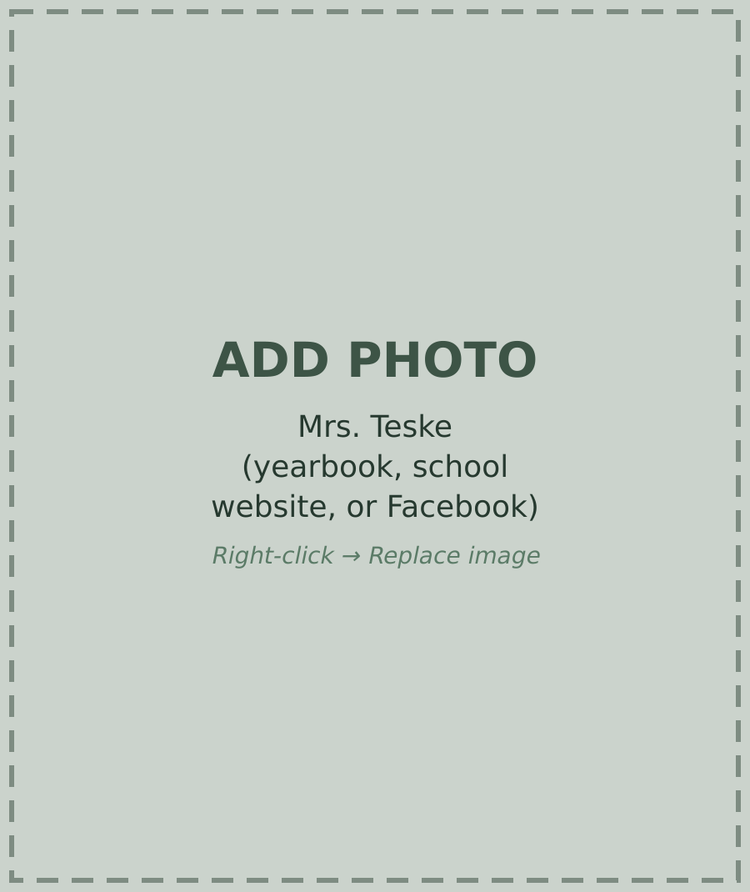
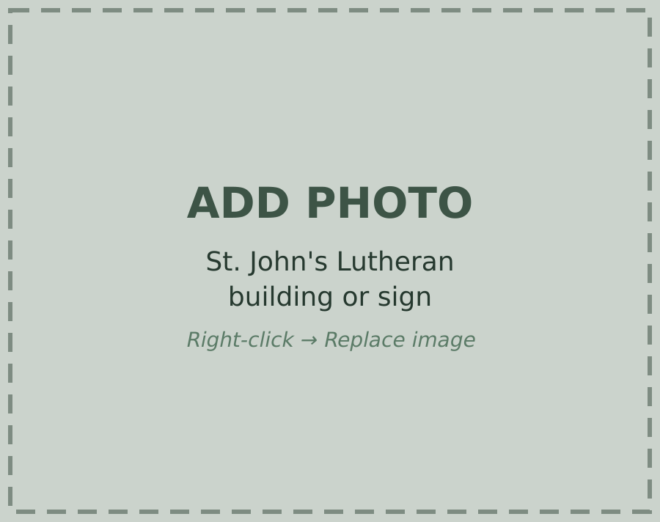
Mrs. Teske
A TRIBUTE TO
7th & 8th Grade Teacher
Mrs. Teske
St. John's Lutheran
Notes:
INTRO
Imagine you are stuck on a homework problem. You walk up to the teacher's desk to ask for help. But the second you get there, you figure it out on your own. In Mrs. Teske's class, that happened all the time.
Mrs. Teske was my 7th and 8th grade teacher at St. John's Lutheran School in Buckley. My class only had about ten students, and she taught us almost every subject for two years. My sister had her as a teacher, too, and my brother still goes there.
My 7th and 8th grade teacher, Mrs. Kata Teske, is one of the main reasons I was ready for high school.
She was caring, she was dedicated to getting us ready, and both traits had a big impact on the student I am today.

Slide 2
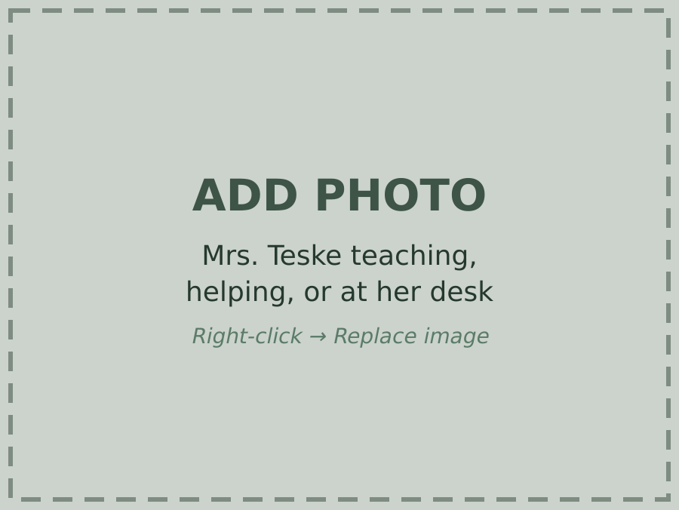
Caring
Always There to Help
Mrs. Teske Teaching
Notes:
MAIN POINT 1: CARING (part 1)
First, Mrs. Teske was caring. In 7th grade, I was the only boy in my class, but she treated me the same as everyone else, so it never felt weird. She could tell when our whole class was struggling, and she would slow down and explain it in a way that made sense. You could walk up to her desk at any time, and she would explain it until you got it.
[CLICK → SLIDE 3]

Slide 3
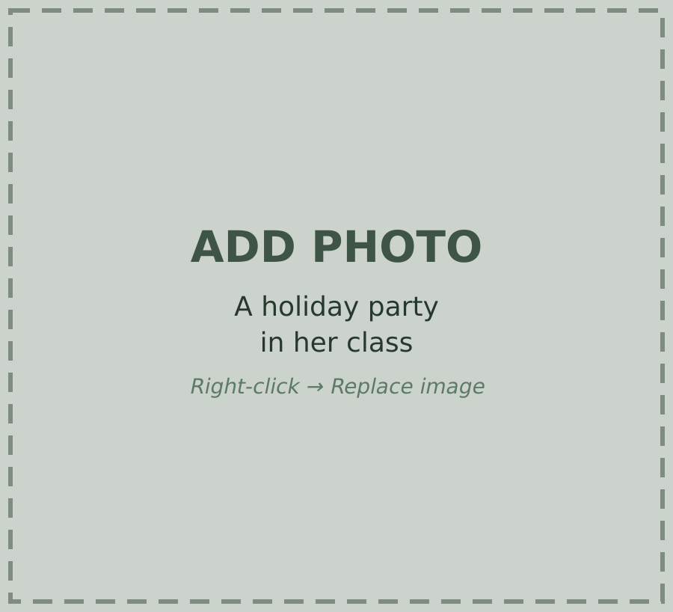
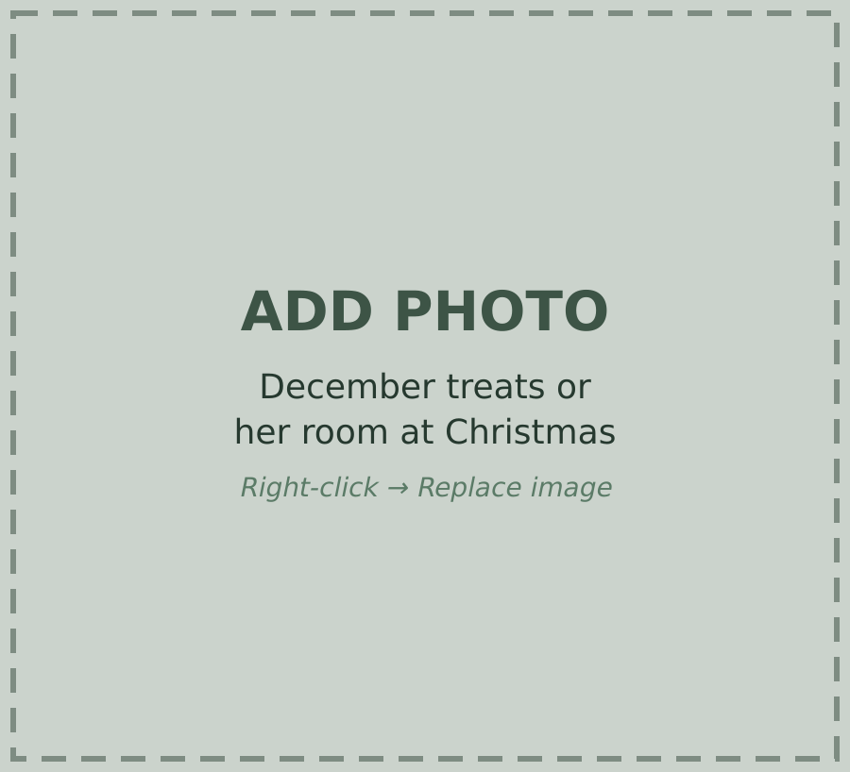
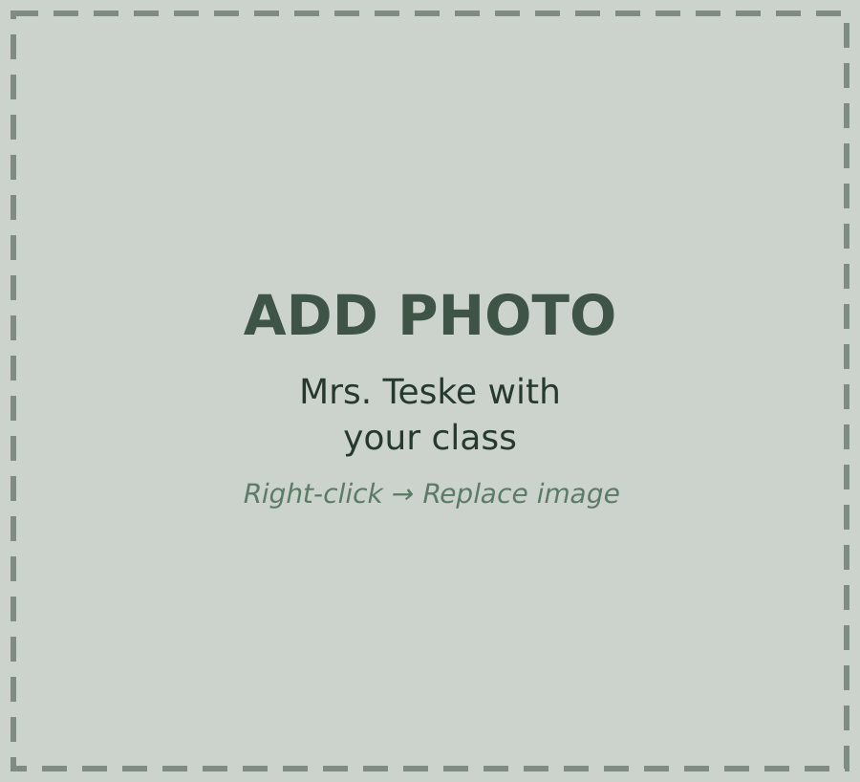
Caring
MADE CLASS FUN
Holiday Parties
December Treats
Our Class
Notes:
MAIN POINT 1: CARING (part 2)
She also made class fun. Every day in December, she gave us a treat, and we had a party for every holiday. She told us stories about her family and her past students, and sometimes spelling tests turned into story time.
TRANSITION: Mrs. Teske cared about us, but she also expected a lot from us.

Slide 4
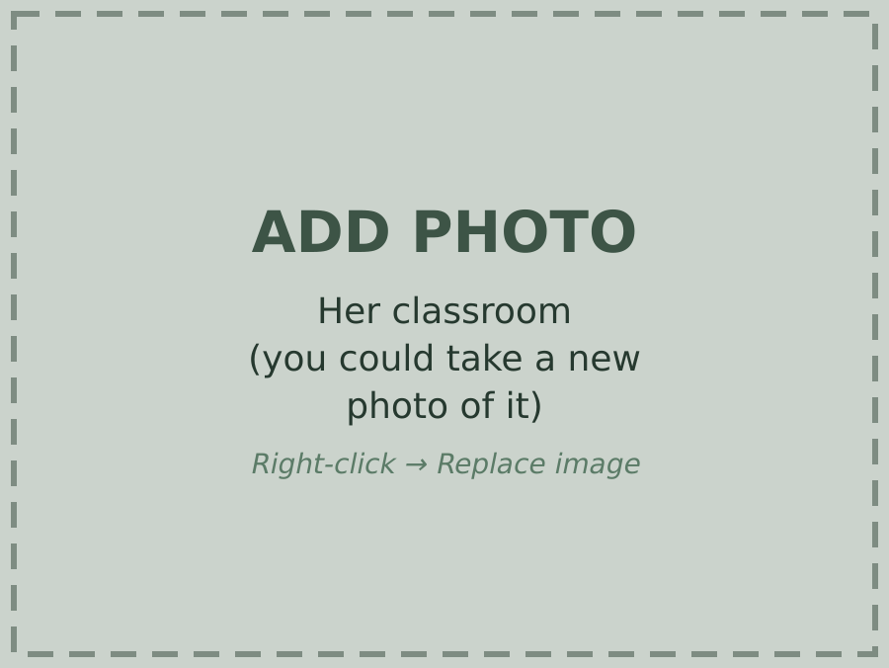
Dedicated
High Expectations
Mrs. Teske's Classroom
Notes:
MAIN POINT 2: DEDICATED
Second, Mrs. Teske was dedicated to getting us ready for high school. She gave us quite a bit of homework, and there were no excuses for late work. Her tests were hard, but she offered extra credit because she wanted us to do well. She just wanted us to earn it. In her class, nobody really thought about slacking off. Working hard was just normal.
TRANSITION: Her caring and her dedication still help me today.

Slide 5
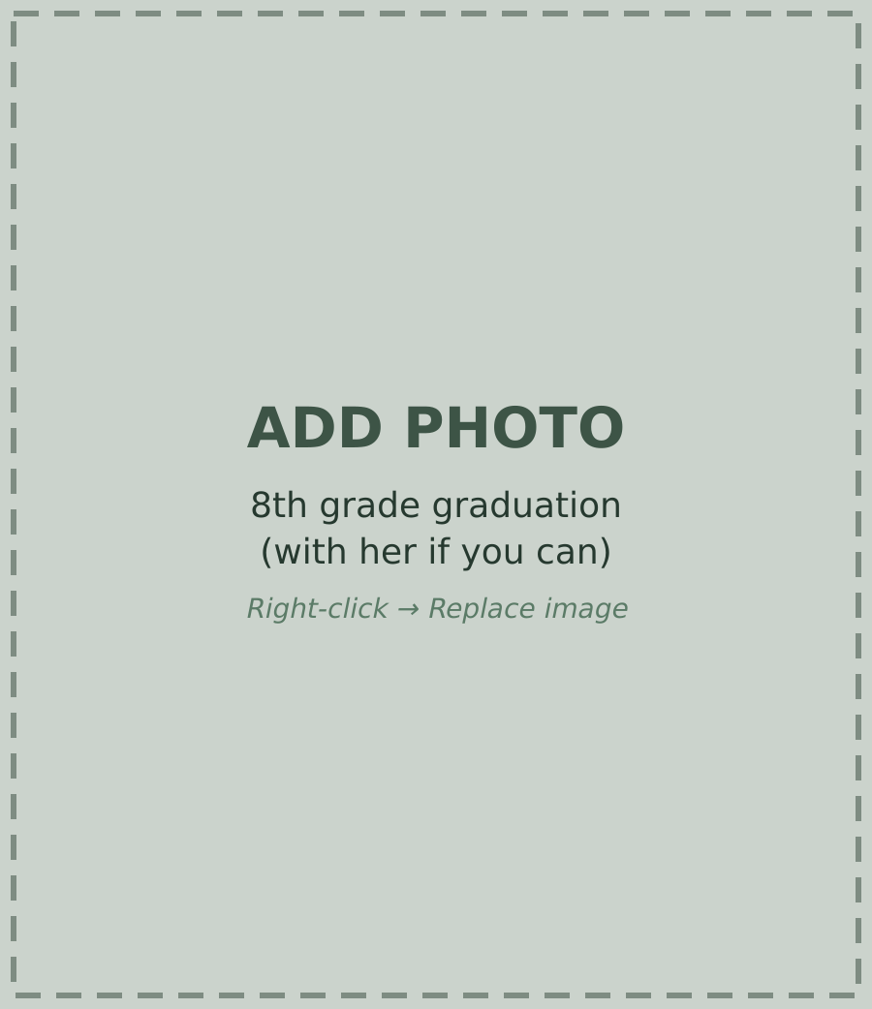
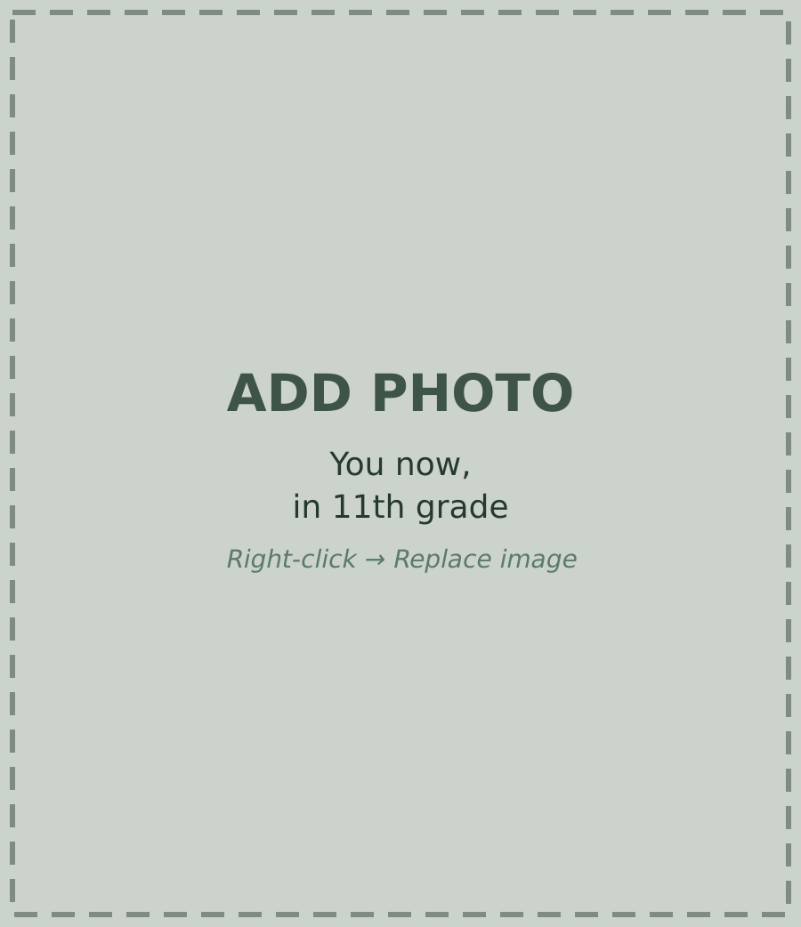
Ready for High School
Made Me the Student I Am
8th Grade Graduation
11th Grade
Notes:
MAIN POINT 3: IMPACT ON ME
Mrs. Teske helped make me the student I am today. It was not only her, but she was a big part of it. Because she was caring, I am more confident when something is hard. She always took the time to explain things, so I learned I could figure it out if I kept working. Because she was dedicated, I was ready for high school. I was more prepared than a lot of other students, and now I am in advanced classes and in the top ten of my class. Her caring made me feel like I could do it, and her dedication made sure I actually did.

Slide 6
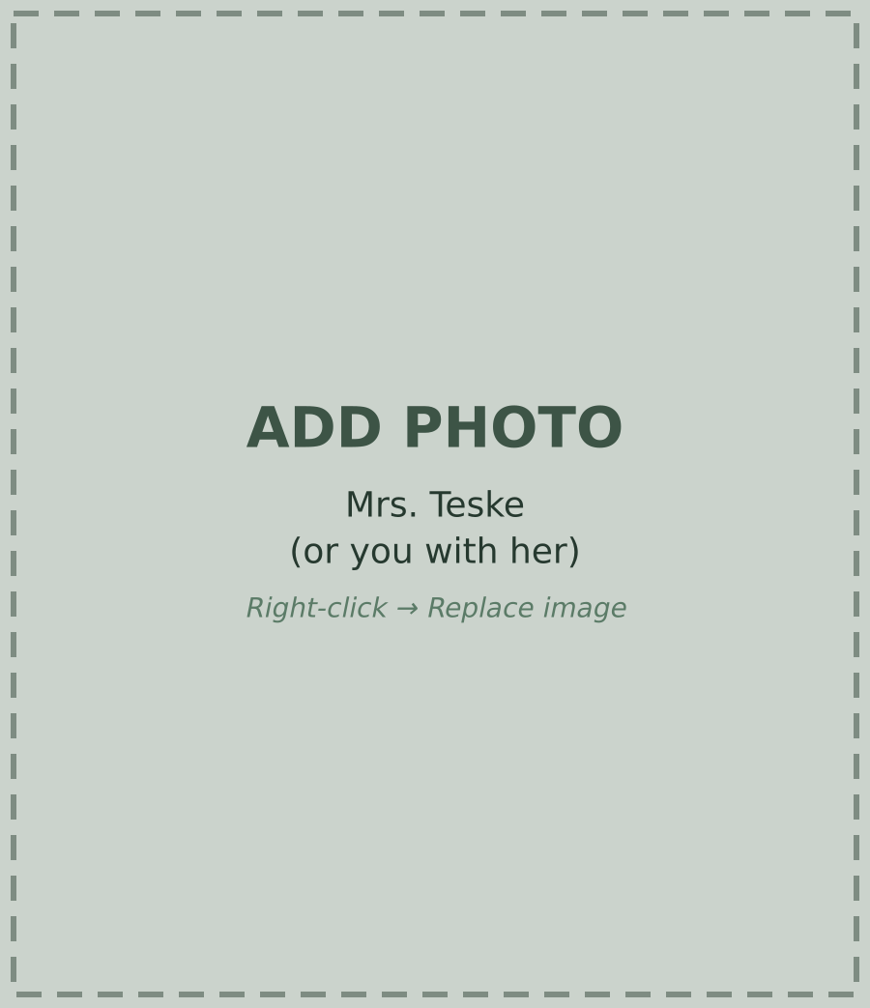
Thank You, Mrs. Teske
CARING · DEDICATED
Mrs. Teske
Notes:
CONCLUSION
Mrs. Teske's caring, her dedication, and her impact on me make her one of the most important teachers I have ever had.
Think back to that walk up to her desk. I used to think it was funny that we figured it out as soon as we got there. Now I think she had already taught us how to work through it. We just needed to know she was there.
She showed me that the teachers who expect the most from you are usually the ones who care the most. If you have a teacher like that, do not wait to take it seriously. And if you get the chance, thank them. Mine was Mrs. Teske.

