Slide 1




Credit Card Fraud Detection
TEAM V
Aveline Mariya Shaji, Kyuri Kim, Satya Bharath Reddy Duvvi

Slide 2
INTRODUCTION

Slide 3
Purpose
To use different methods to handle “Unbalanced Data”.
Implement different ML Algorithms and identify the best model for predicting Credit Card Fraud Detection.

Slide 4
SMART Questions
Which ML model performs best in predictive analysis on credit card transaction dataset and detect the fraudulent transactions from the given dataset !?

Slide 5
Data
September 2013 data by European cardholders
Unbalanced Data: 492 frauds out of 284,807 transactions (0.172%)
Contains only numerical input variables which are the result of a PCA transformation
Data Source: https://www.kaggle.com/mlg-ulb/creditcardfraud

Slide 6
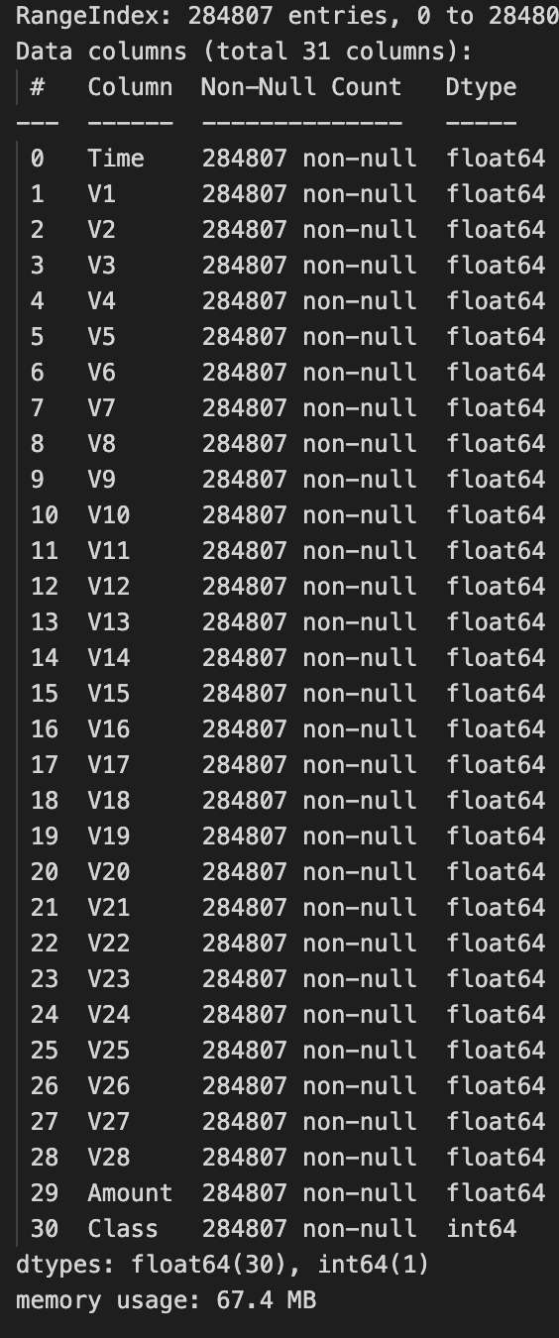
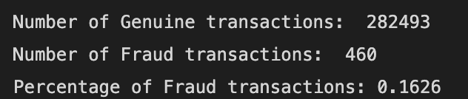
Understanding DATA
Import Data set
Removed missing Values
Checked and deleted Duplicates
Basic EDA
Implemented Balancing Techniques
Used ML Algorithms on final data

Slide 7
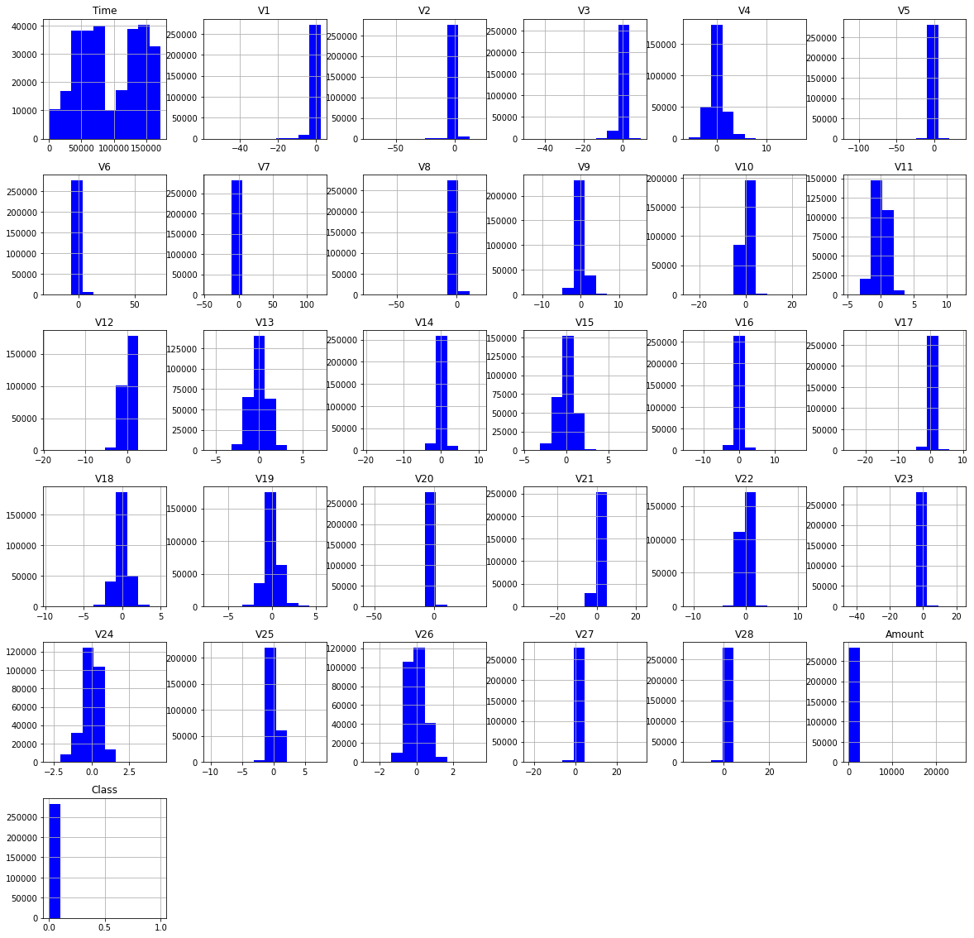
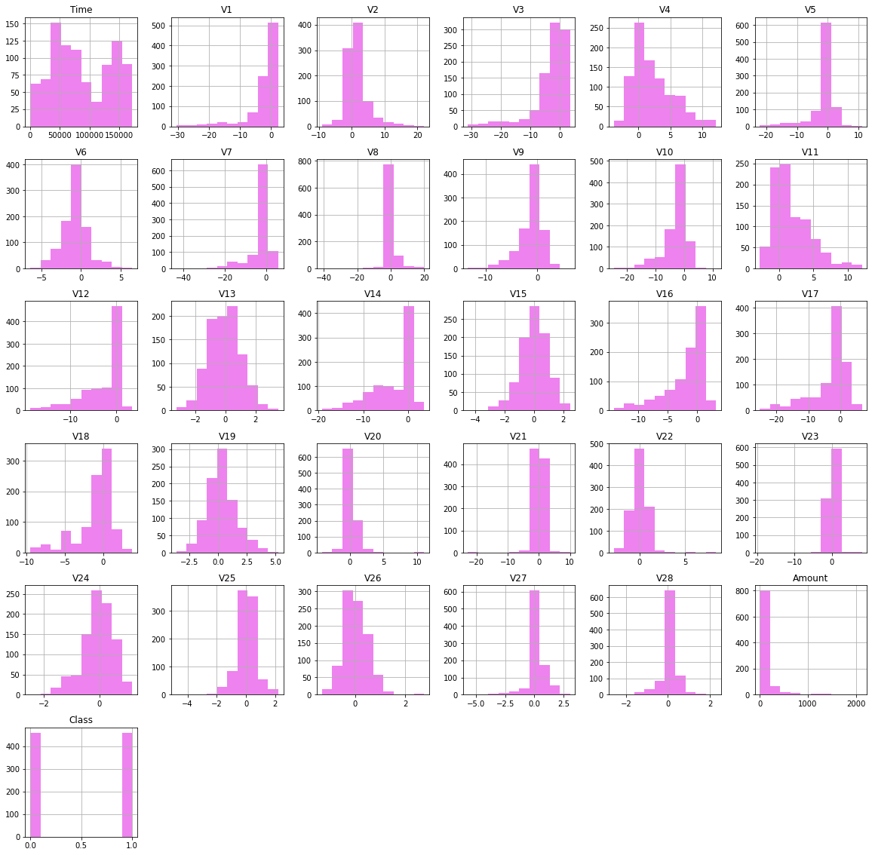
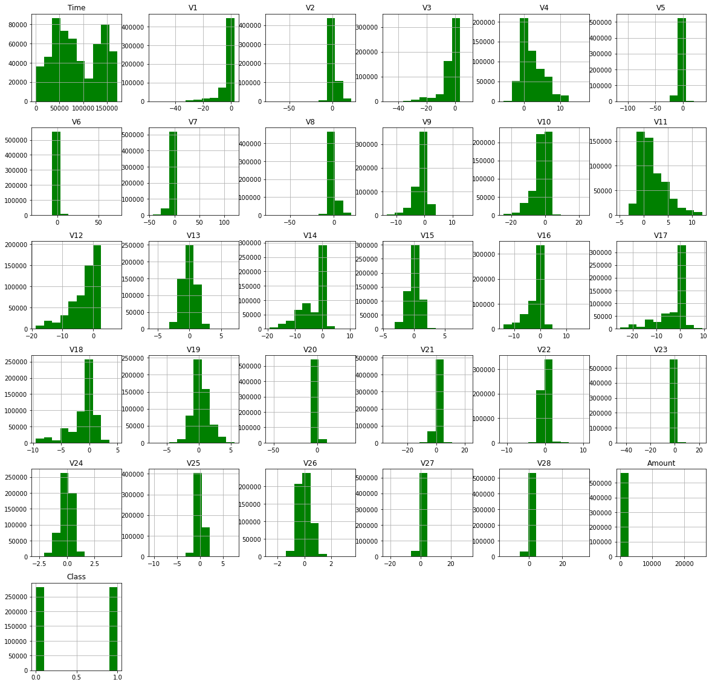
Data Visualization
Unbalanced Data
Under Sampling
Over Sampling

Slide 8
ML Models in Under-Sampling

Slide 9
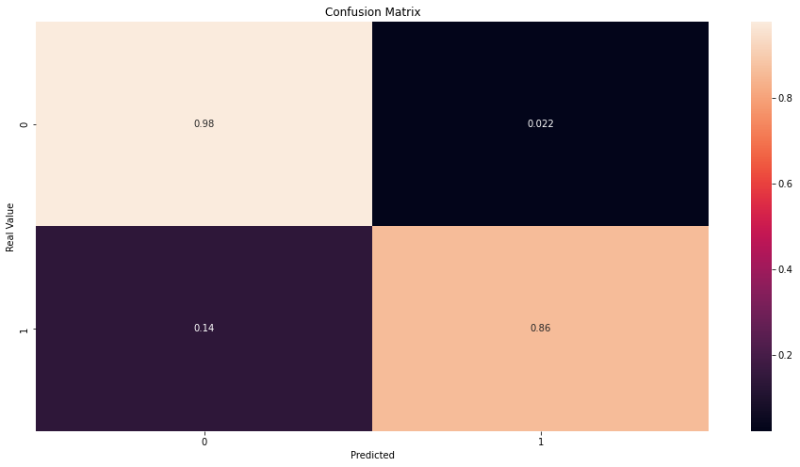
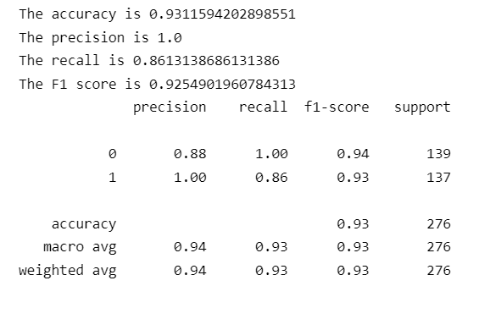
Random Forest Classifier

Slide 10
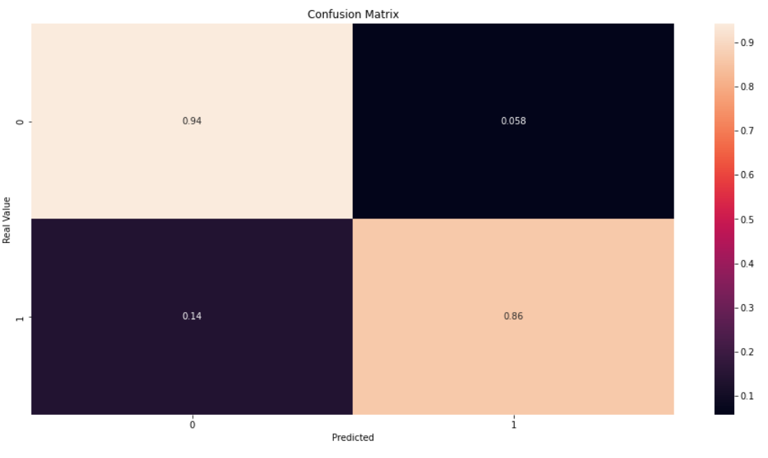
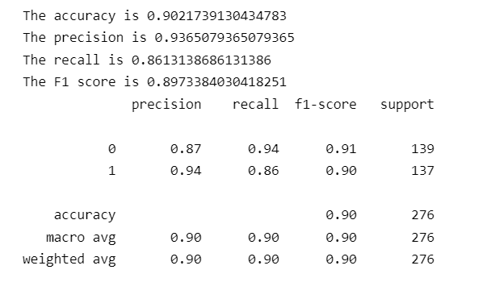
Logistic Regression

Slide 11
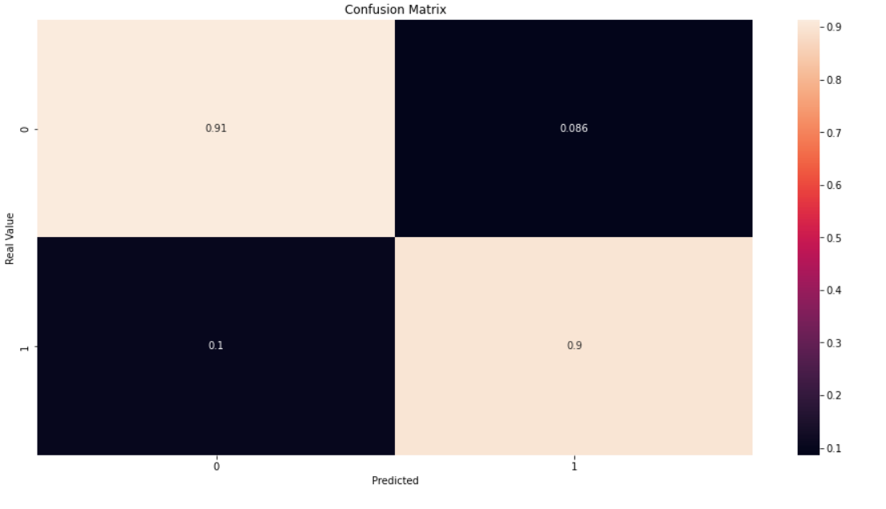
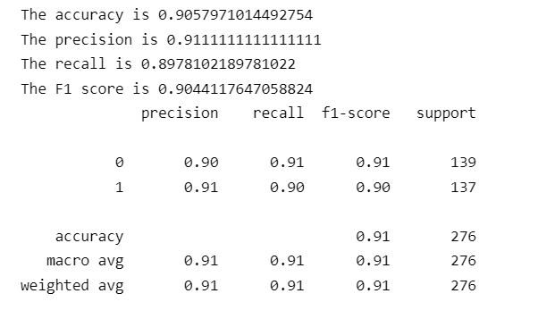
Decision Tree

Slide 12
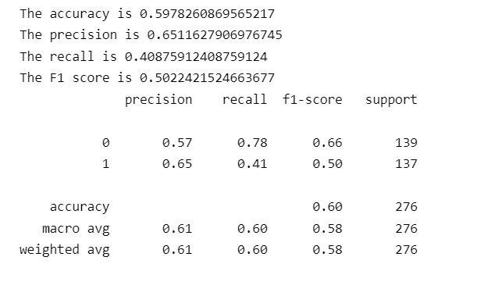
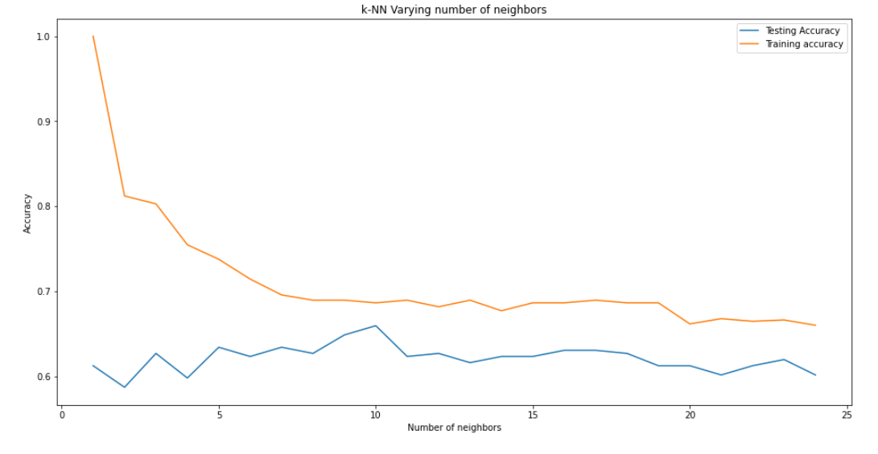
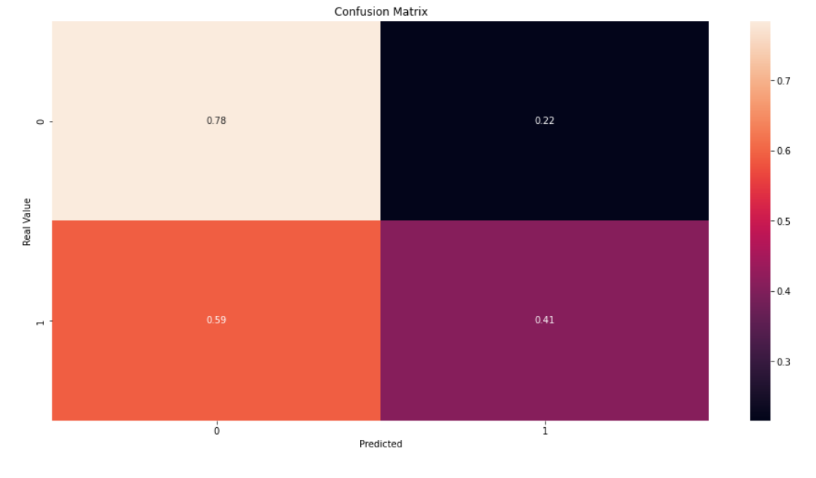
KNN Model

Slide 13
ML Models in Over-Sampling

Slide 14
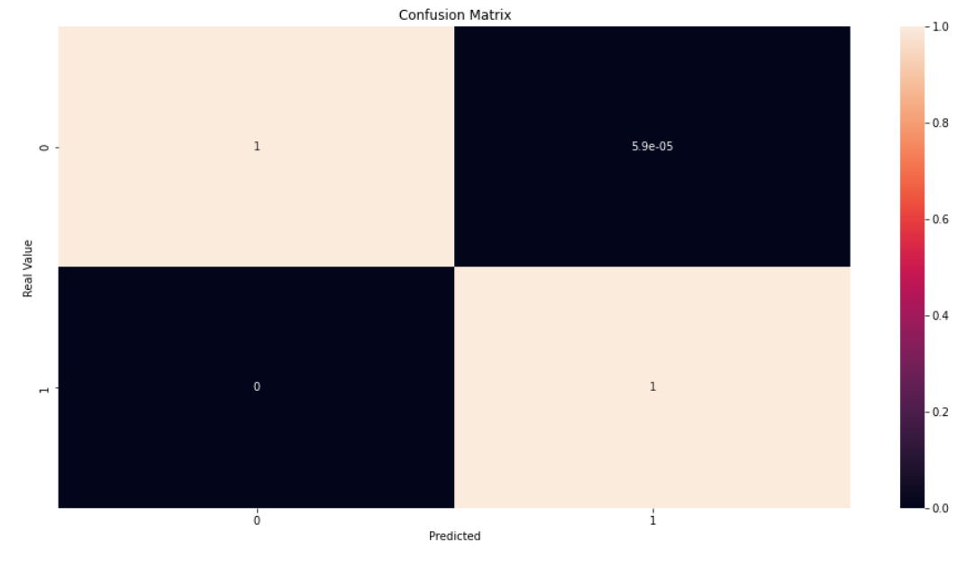
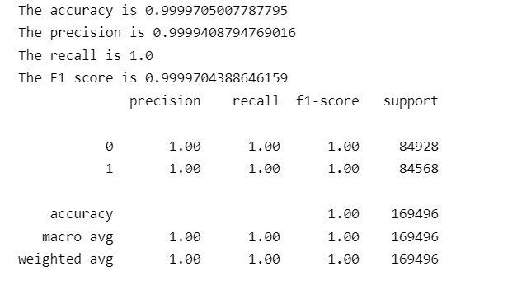
Random Forest Classifier

Slide 15
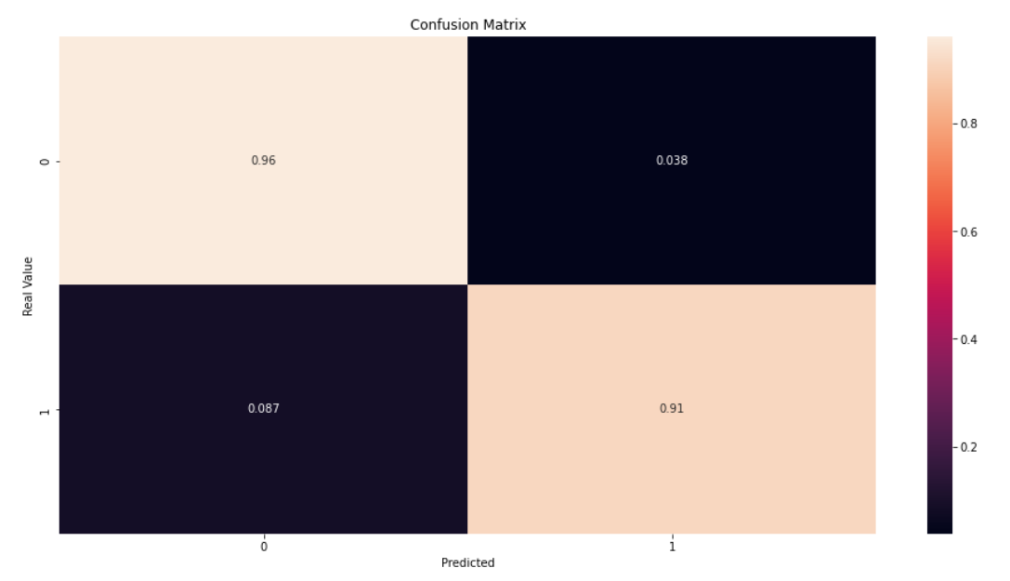
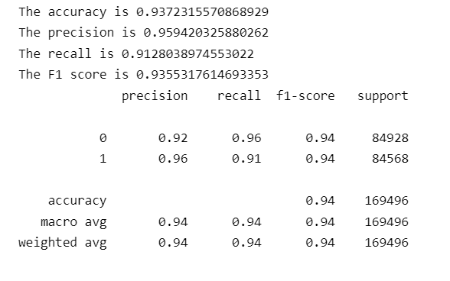
Logistic Regression

Slide 16
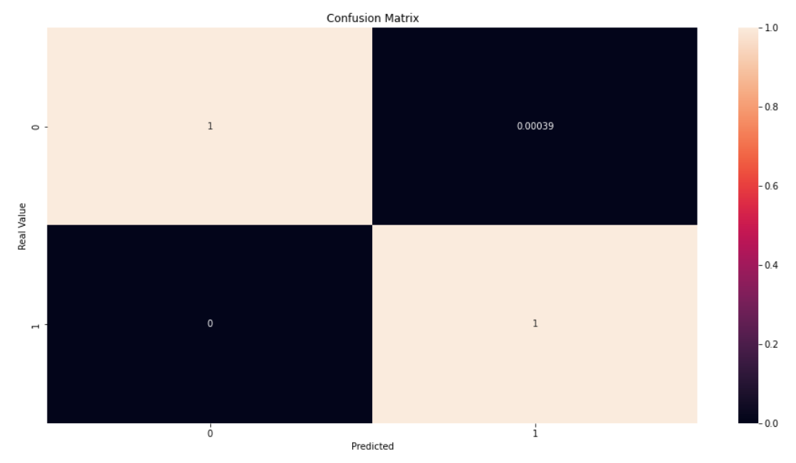
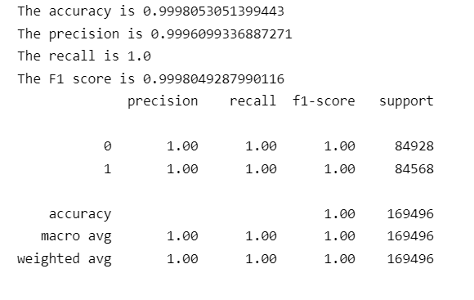
Decision Tree

Slide 17
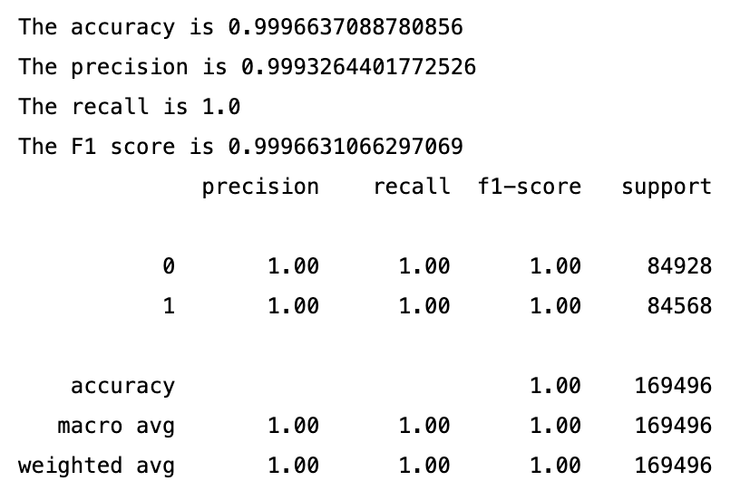
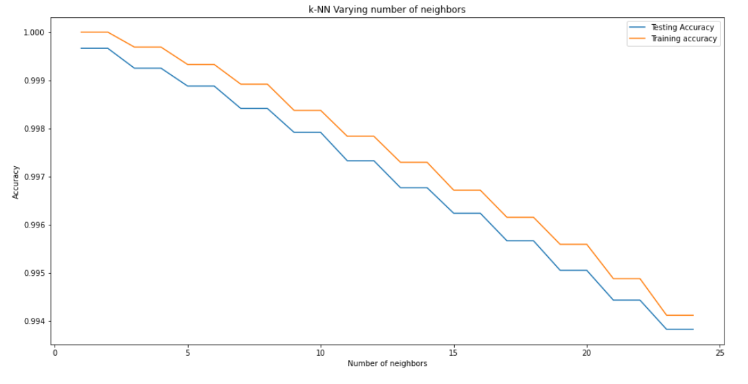
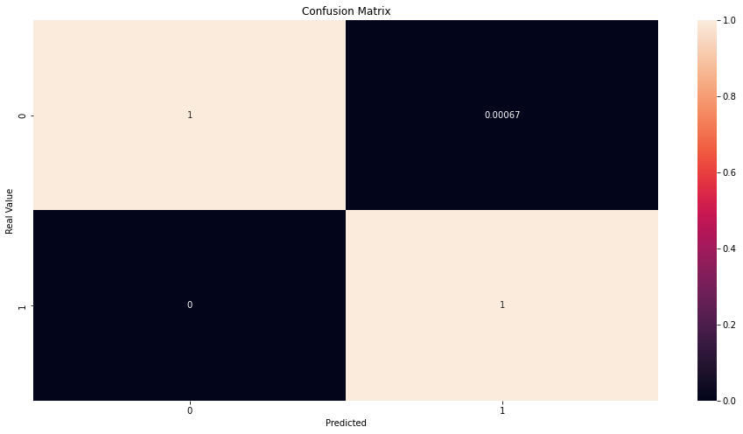
KNN Model

Slide 18
CONCLUSION

Slide 19
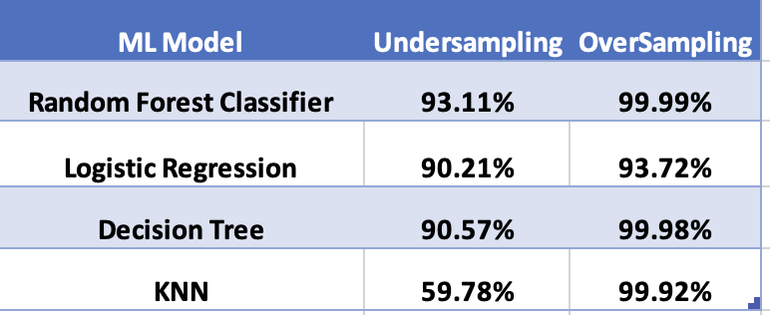
Oversampling gives better accuracy models
RFC is the best model

