Slide 1
Credit Card Fraud Detection
TEAM V
Aveline Mariya Shaji, Kyuri Kim, Satya Bharath Reddy Duvvi

Slide 2
Purpose
To use different methods to handle “Unbalanced Data”.
Implement different ML Algorithms and identify the best model for predicting Credit Card Fraud Detection.

Slide 3
SMART Questions
Which ML model performs best in predictive analysis on credit card transaction dataset and detect the fraudulent transactions from the given dataset !?

Slide 4
Data
September 2013 data by European cardholders
Unbalanced Data: 492 frauds out of 284,807 transactions (0.172%)
Contains only numerical input variables which are the result of a PCA transformation
Data Source: https://www.kaggle.com/mlg-ulb/creditcardfraud

Slide 5
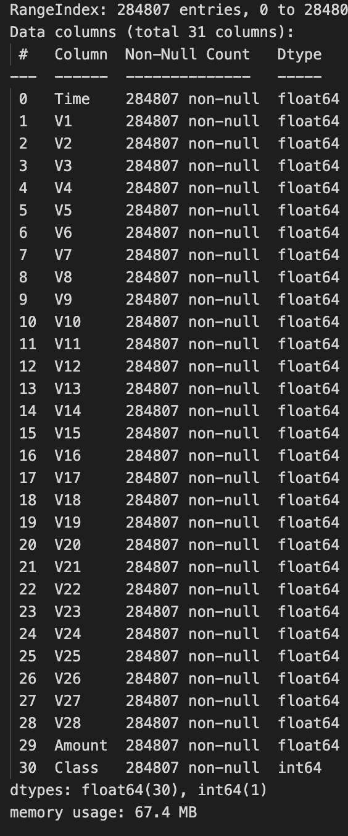
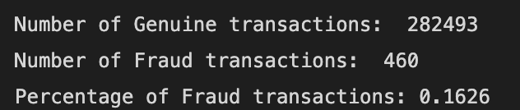
Understanding DATA
Import Data set
Removed missing Values
Checked and deleted Duplicates
Basic EDA
Implemented Balancing Techniques
Used ML Algorithms on final data

Slide 6
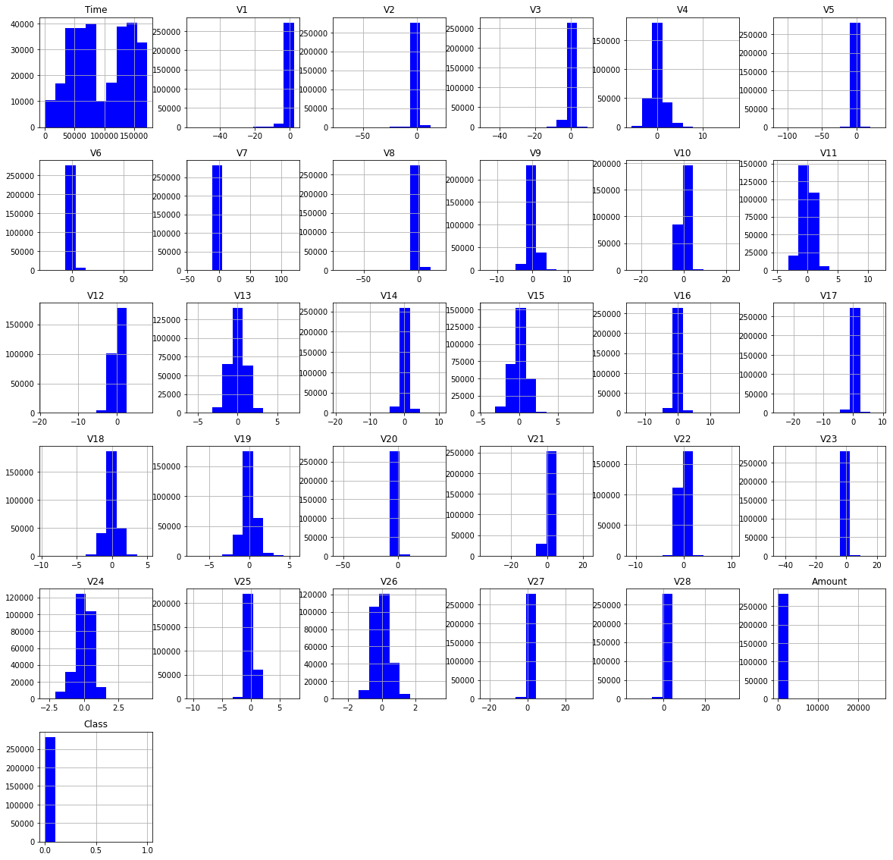
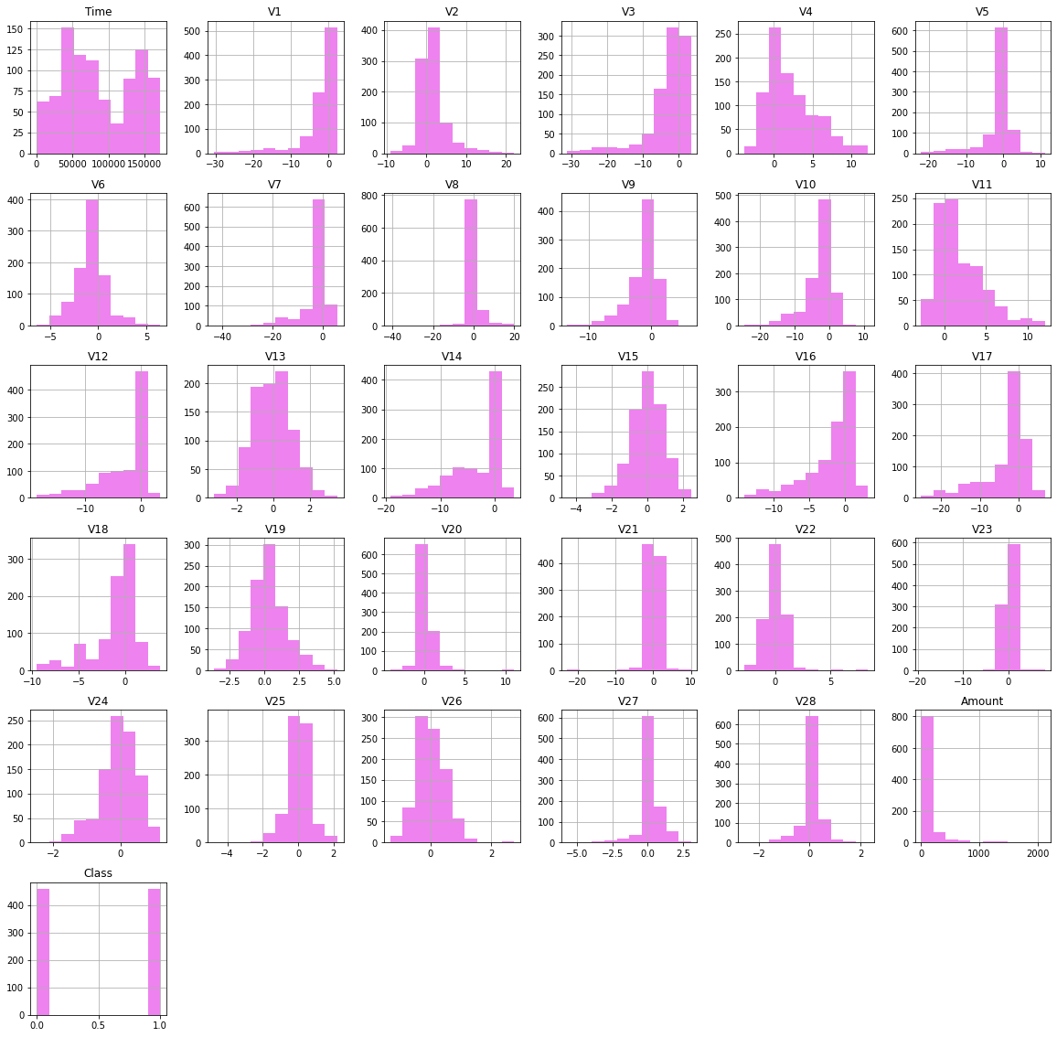
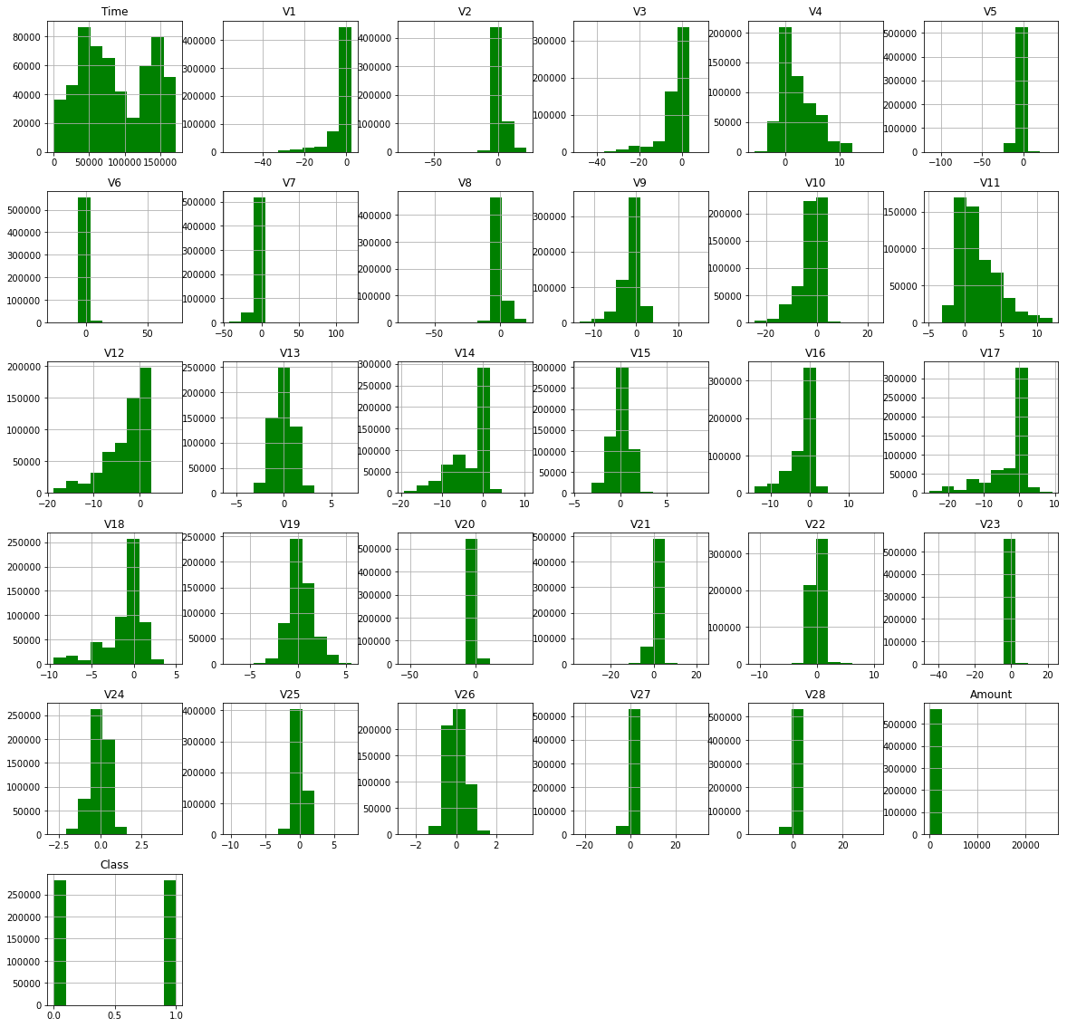
Data Visualization
Unbalanced Data
Under Sampling
Over Sampling

Slide 7
ML Models in Under-Sampling

Slide 8
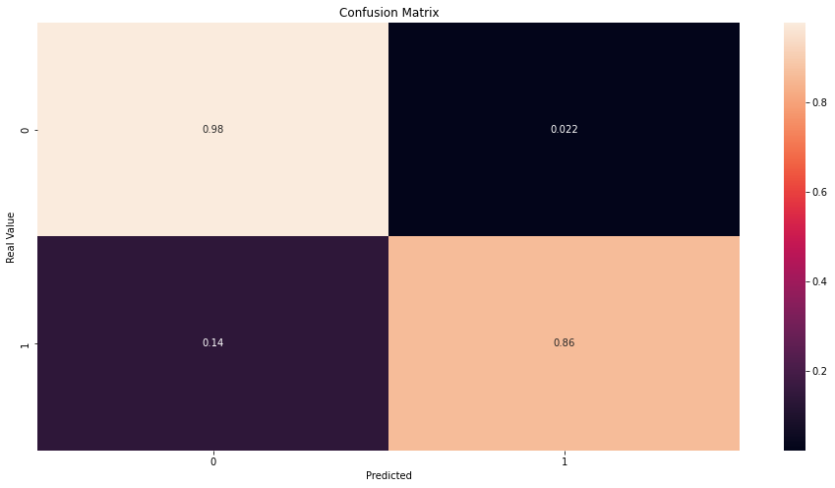
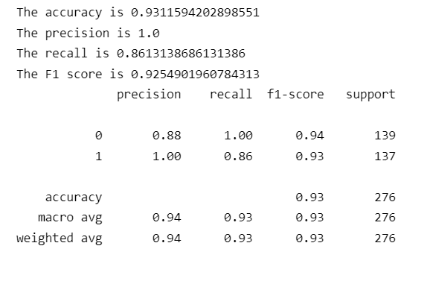
Random Forest Classifier

Slide 9
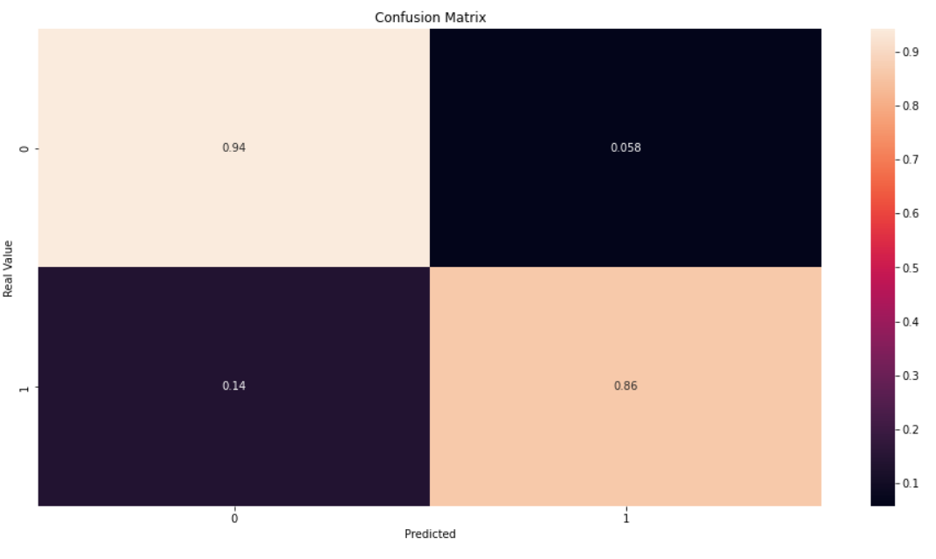
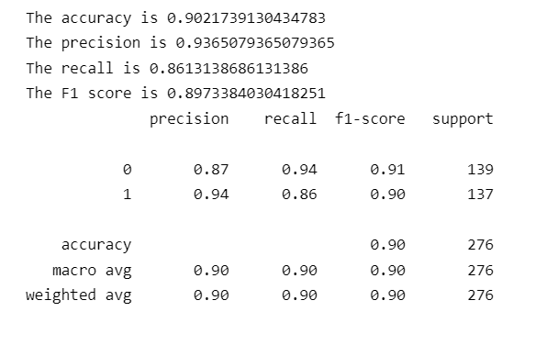
Logistic Regression

Slide 10
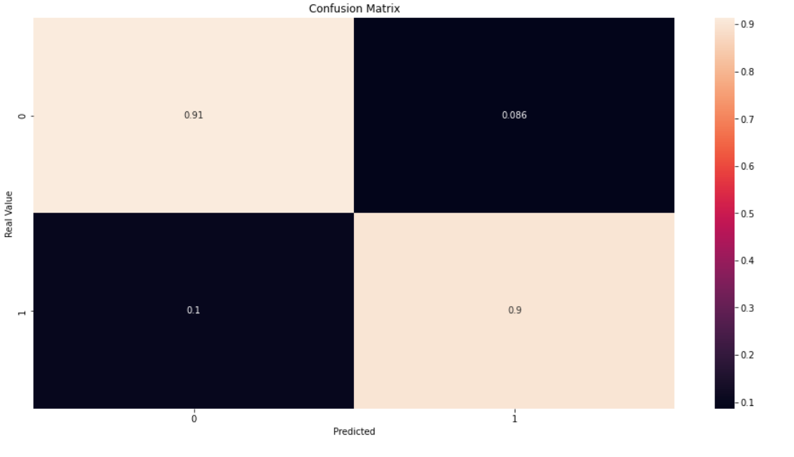
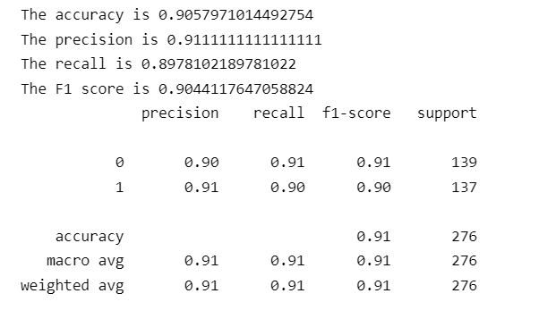
Decision Tree

Slide 11
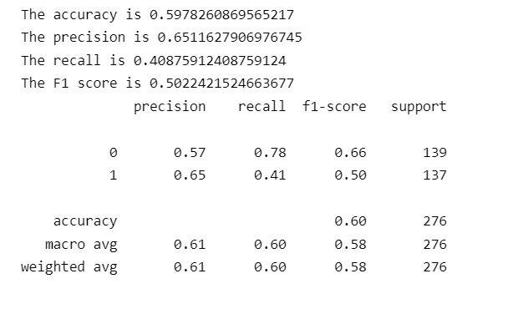
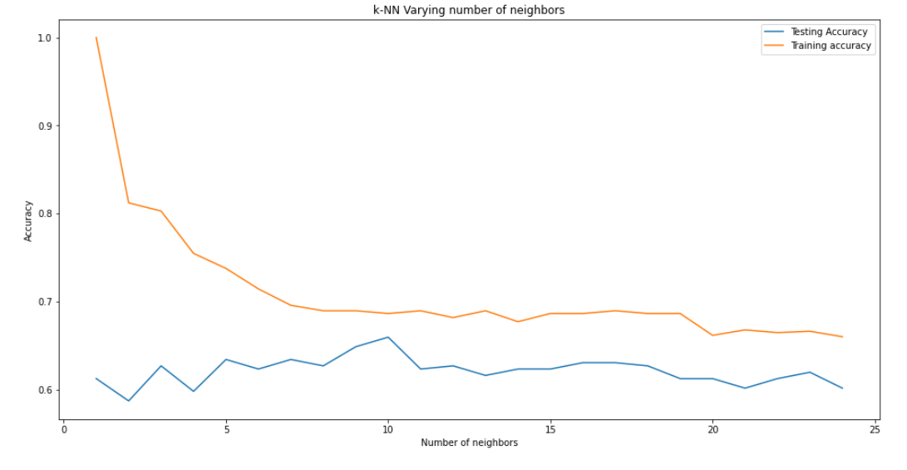
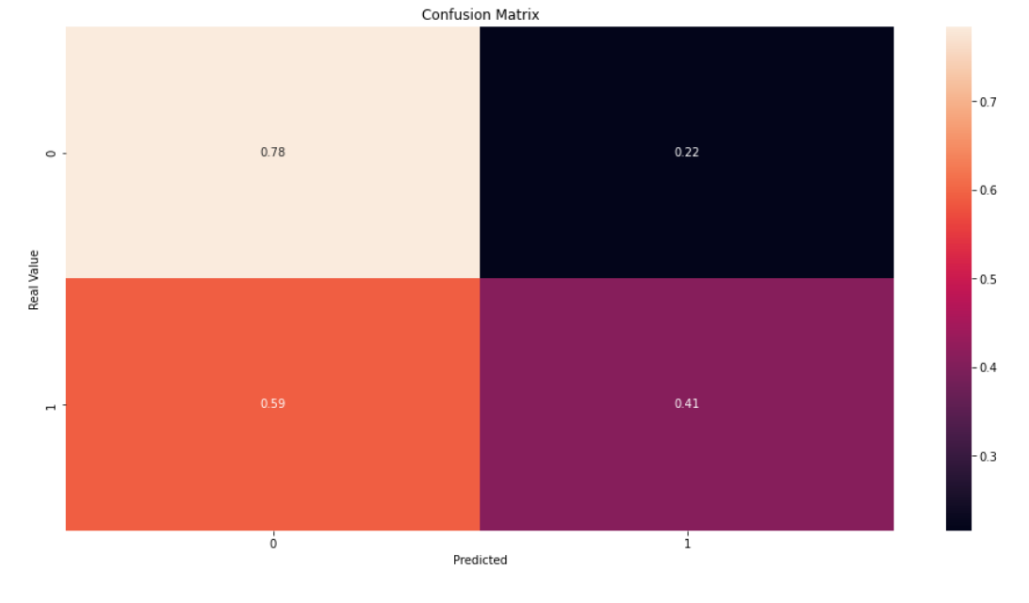
KNN Model

Slide 12
ML Models in Over-Sampling

Slide 13
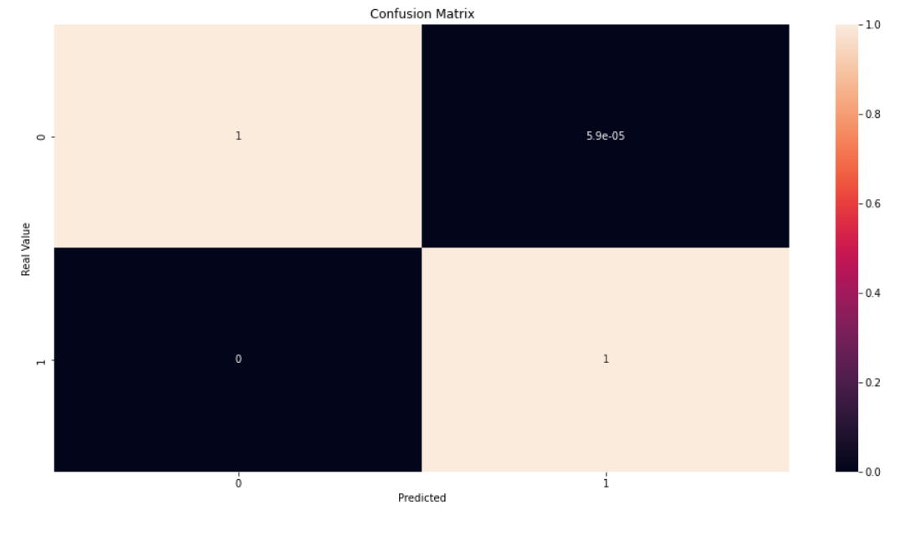
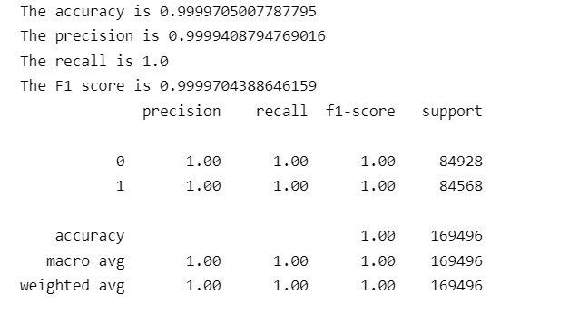
Random Forest Classifier

Slide 14
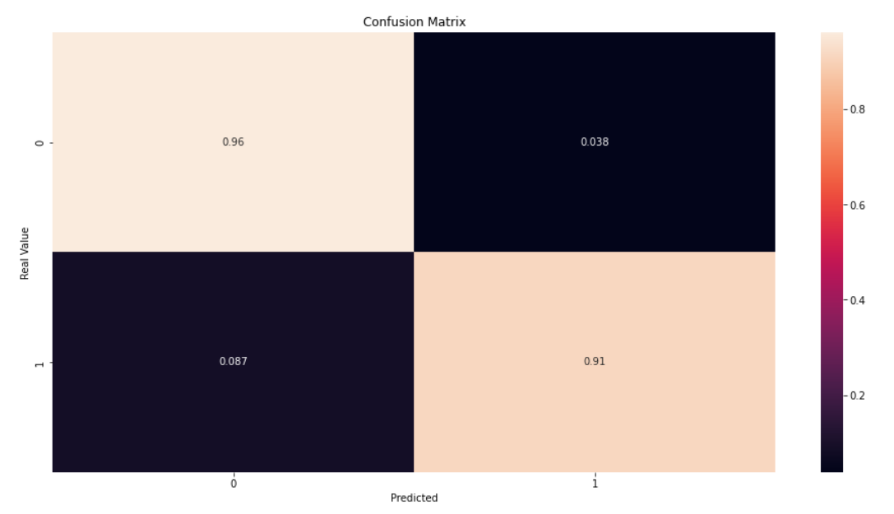
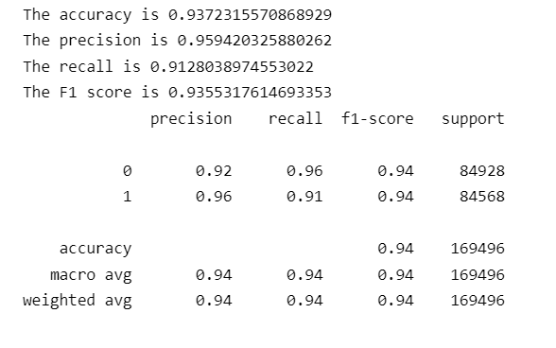
Logistic Regression

Slide 15
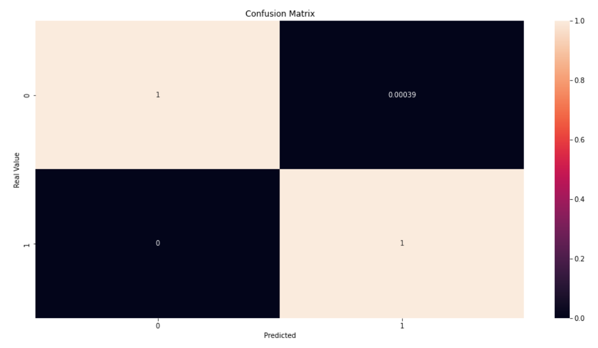
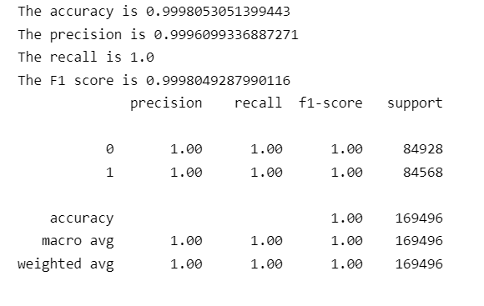
Decision Tree

Slide 16
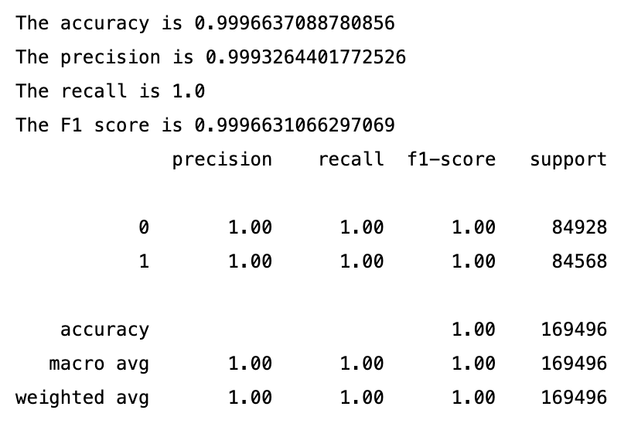
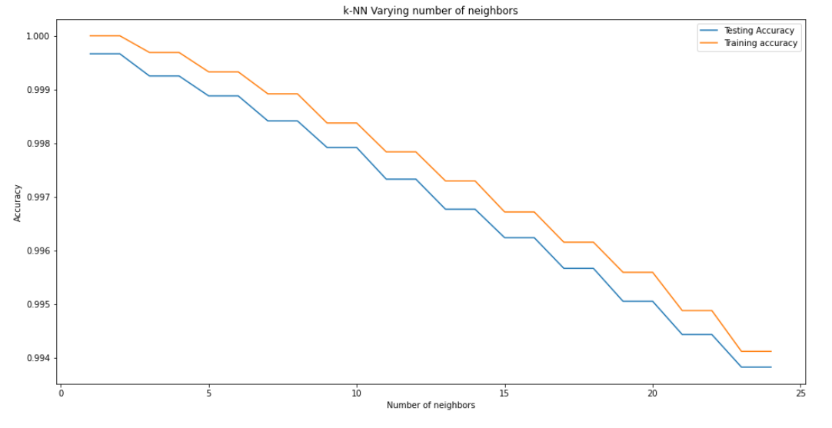
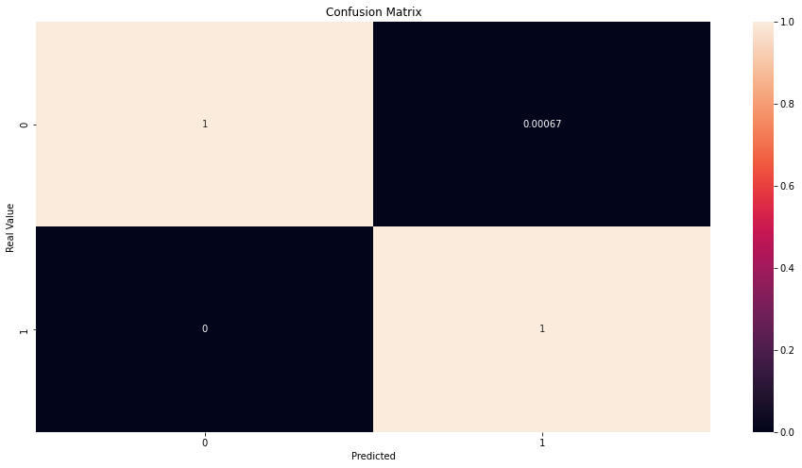
KNN Model

