Slide 1

Advanced Databases Distributed Concurrency Control and Distributed Deadlock Schemes
Dr. George Mertzios Michaelmas Term
george.mertzios@durham.ac.uk
Room 2066, MCS Building
Tel: 42 429

Slide 2
Distributed Deadlocks
We have seen various distributed locking protocols
to ensure serializability
Distributed 2PL concurrency control protocols
Centralized 2PL
Primary Copy 2PL
Distributed 2PL
Majority 2PL
Deadlocks:
two (or more) transactions wait for each other
a basic problem of all locking methods: also with 2PL

Slide 3
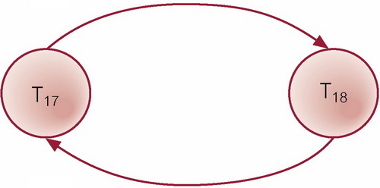
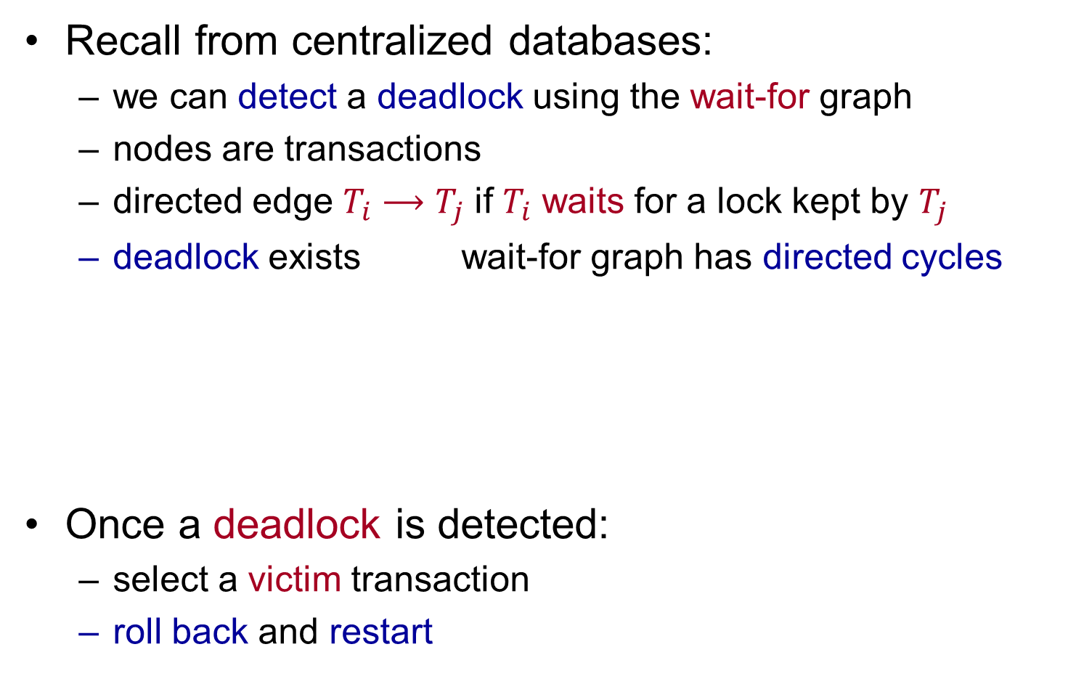
Distributed Deadlocks
Recall from centralized databases:
we can detect a deadlock using the wait-for graph
nodes are transactions
directed edge $T_{i}⟶$ $T_{j}$ if $T_{i}$ waits for a lock kept by $T_{j}$
deadlock exists wait-for graph has directed cycles
Once a deadlock is detected:
select a victim transaction
roll back and restart
deadlock:

Slide 4
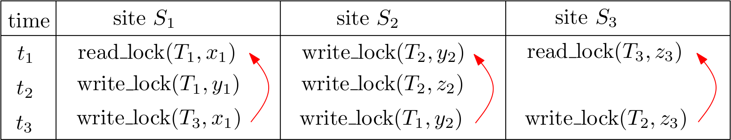
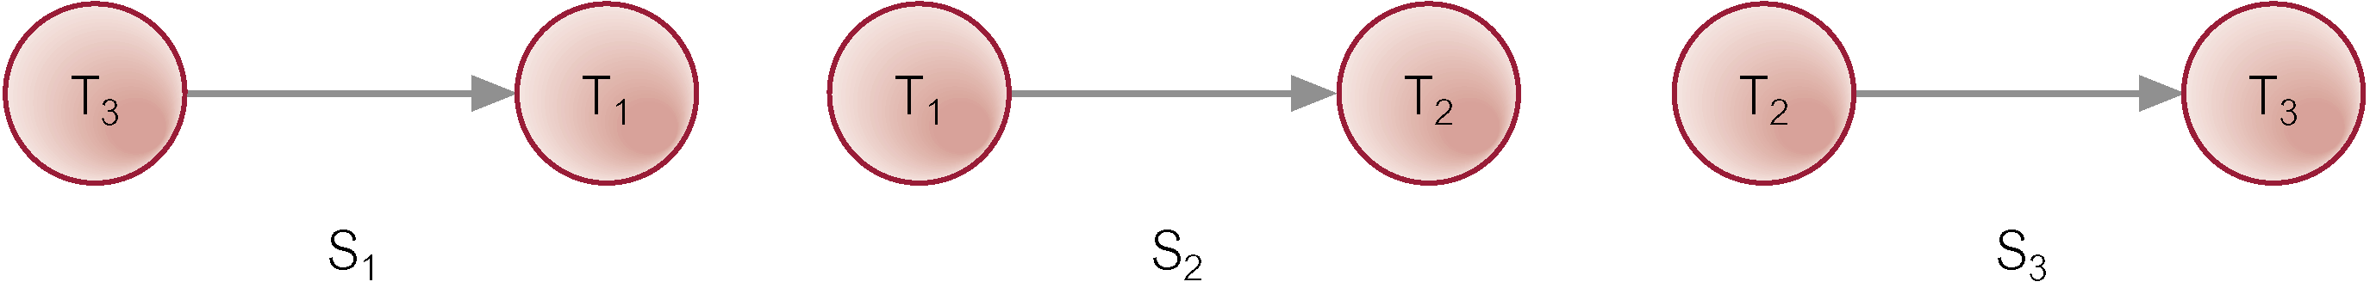

Distributed Deadlocks
Transaction $T_{1}$: initiated at site $S_{1}$, also used at $S_{2}$
Transaction $T_{2}$: initiated at site $S_{2}$, also used at $S_{3}$
Transaction $T_{3}$: initiated at site $S_{3}$, also used at $S_{1}$
local Wait-For Graphs:
no local deadlocks !

Slide 5
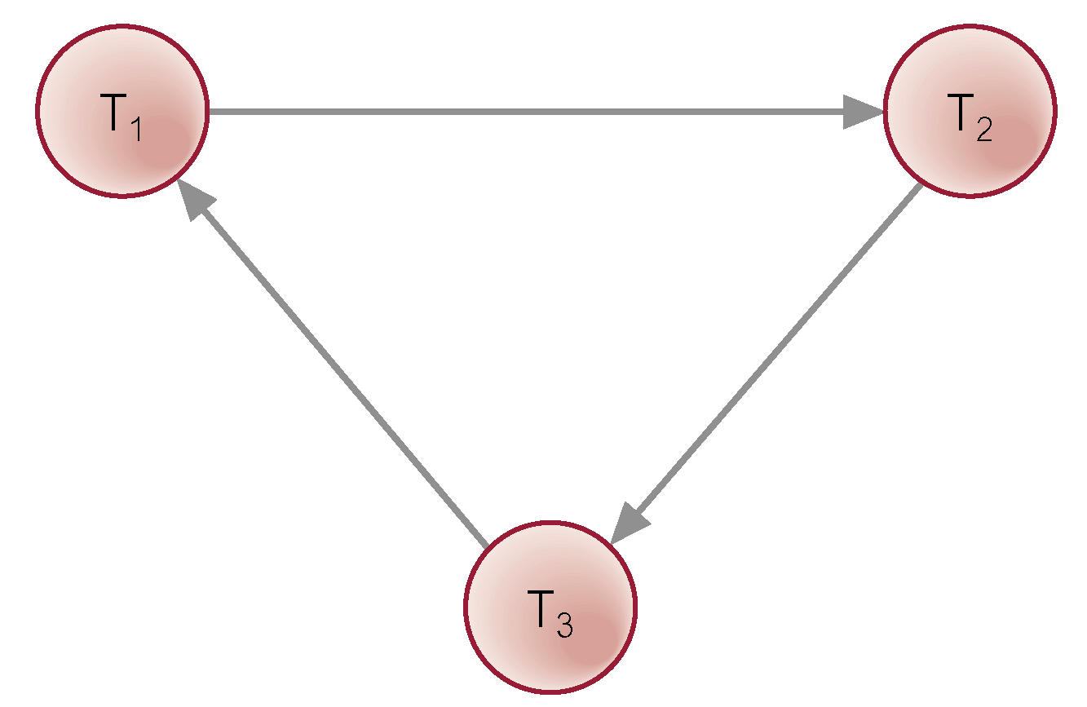

Distributed Deadlocks
global Wait-For Graph:
$⟹$ global deadlock !
local Wait-For Graphs:
no local deadlocks !

Slide 6
Distributed Deadlock Schemes
Centralized Deadlock Detection
Hierarchical Deadlock Detection
Distributed Deadlock Detection

Slide 7
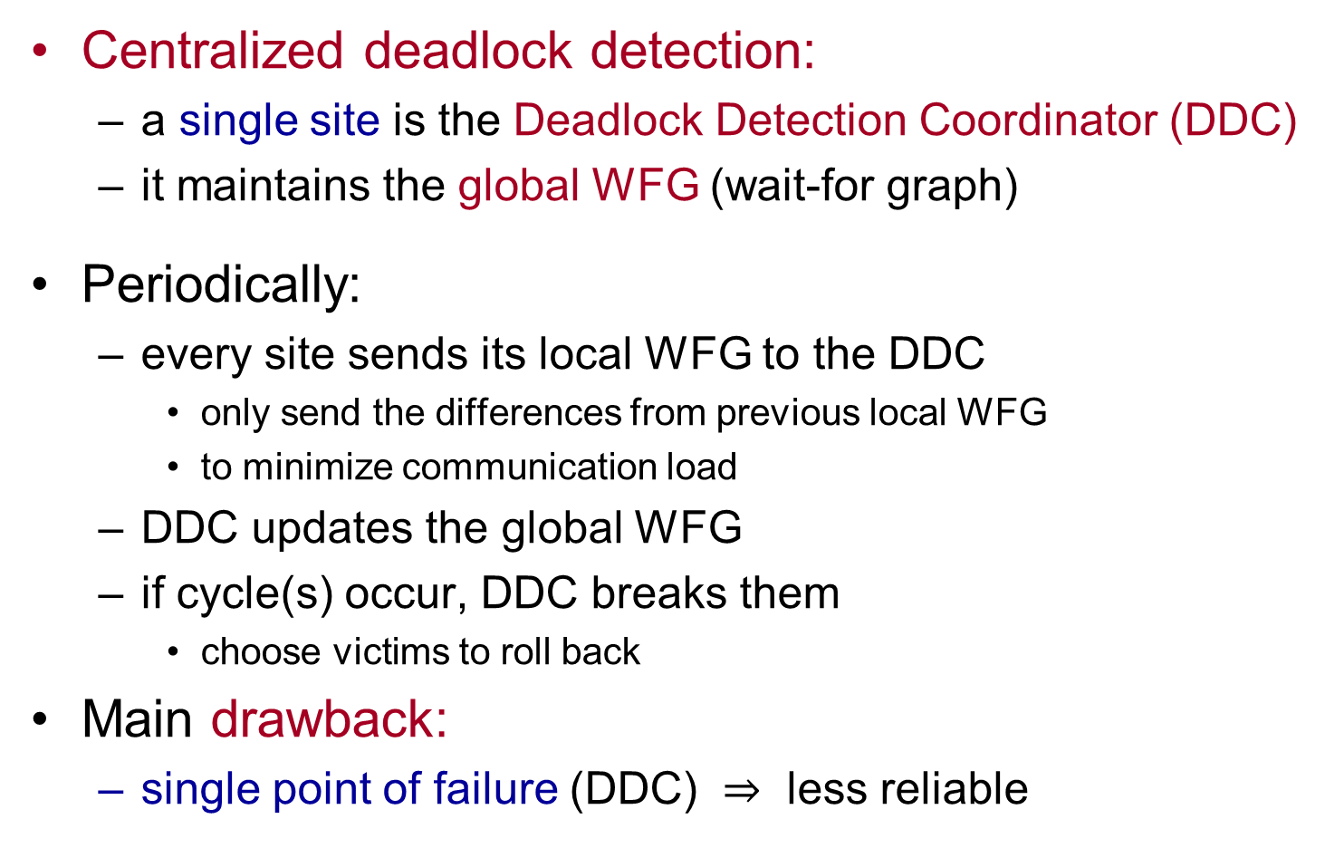
Centralized Deadlock Detection
Centralized deadlock detection:
a single site is the Deadlock Detection Coordinator (DDC)
it maintains the global WFG (wait-for graph)
Periodically:
every site sends its local WFG to the DDC
only send the differences from previous local WFG
to minimize communication load
DDC updates the global WFG
if cycle(s) occur, DDC breaks them
choose victims to roll back
Main drawback:
single point of failure (DDC) $⇒$ less reliable
Notes:
GWFG = global wait for graph
Single site appointed deadlock detection coordinator (DDC).
DDC has responsibility for constructing and maintaining GWFG.
If one or more cycles exist, DDC must break each cycle by selecting transactions to be rolled back and restarted.

Slide 8
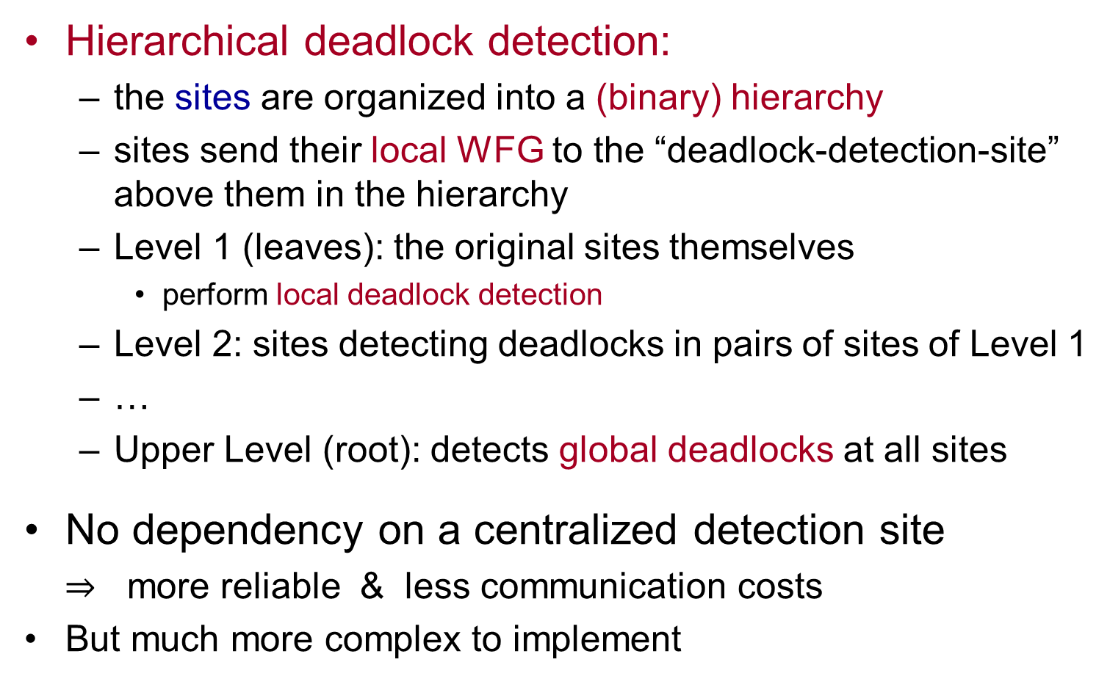
Hierarchical Deadlock Detection
Hierarchical deadlock detection:
the sites are organized into a (binary) hierarchy
sites send their local WFG to the “deadlock-detection-site” above them in the hierarchy
Level 1 (leaves): the original sites themselves
perform local deadlock detection
Level 2: sites detecting deadlocks in pairs of sites of Level 1
…
Upper Level (root): detects global deadlocks at all sites
No dependency on a centralized detection site
$⇒$ more reliable & less communication costs
But much more complex to implement
Notes:
More complex to implement: in particular in the presence of site and communication failures, which we also need to take into account.

Slide 9
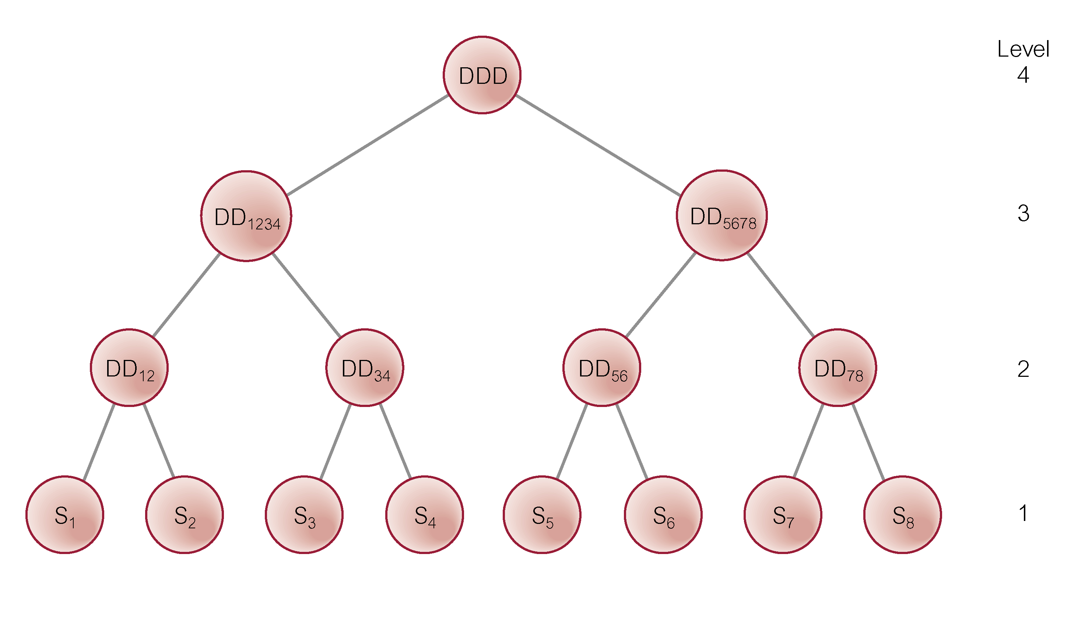
Hierarchical Deadlock Detection
Notes:
More complex to implement: in particular in the presence of site and communication failures, which we also need to take into account.

Slide 10
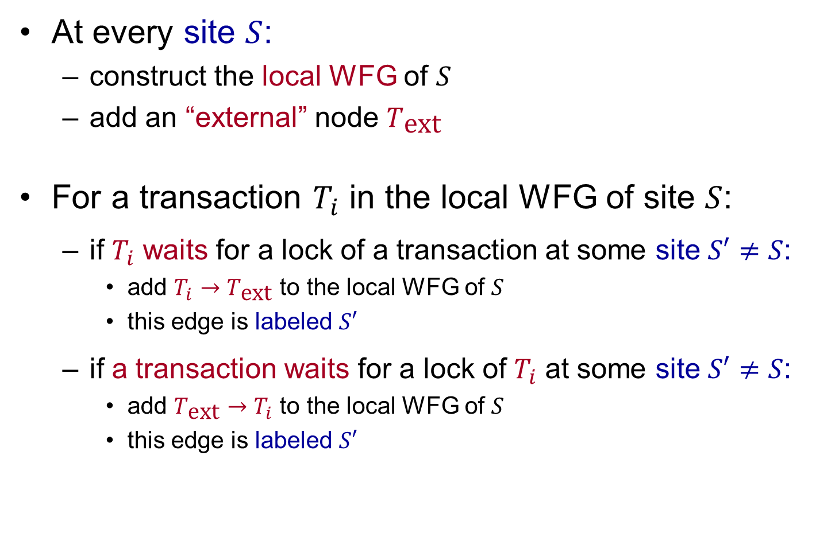
Distributed Deadlock Detection
At every site $S$:
construct the local WFG of $S$
add an “external” node $T_{\text{ext}}$
For a transaction $T_{i}$ in the local WFG of site $S$:
if $T_{i}$ waits for a lock of a transaction at some site $S′≠S$:
add $T_{i}→T_{\text{ext}}$ to the local WFG of $S$
this edge is labeled $S′$
if a transaction waits for a lock of $T_{i}$ at some site $S′≠S$:
add $T_{\text{ext}}→T_{i}$ to the local WFG of $S$
this edge is labeled $S′$
Notes:
Most well-known method (Obermarck, 1982). Potentially more robust than other methods.
external node, T_{ext}, added to LWFG as remote agent.
If a LWFG contains a cycle without T_{ext}, then site and DDBMS are in deadlock.
Global deadlock may (still) exist if LWFG contains a cycle involving T_{ext}. To check, graphs are merged.

Slide 11
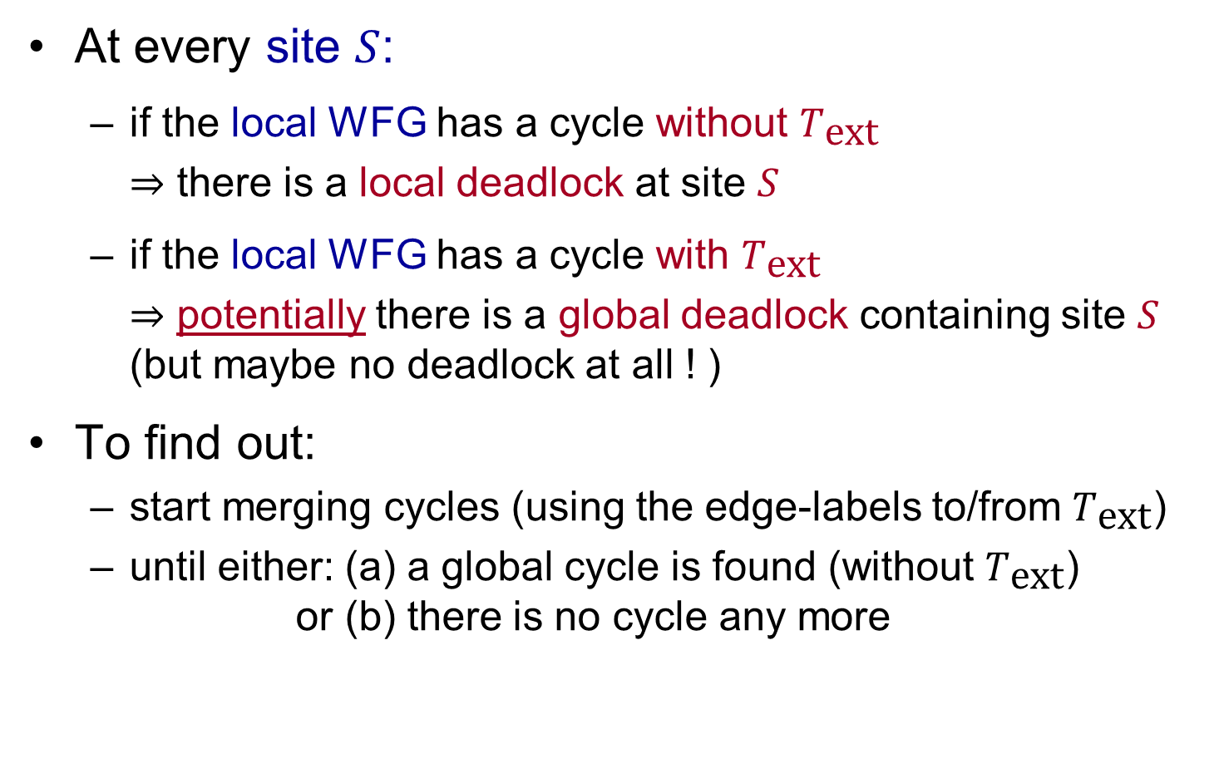
Distributed Deadlock Detection
At every site $S$:
if the local WFG has a cycle without $T_{\text{ext}}$
$⇒$ there is a local deadlock at site $S$
if the local WFG has a cycle with $T_{\text{ext}}$
$⇒$ potentially there is a global deadlock containing site $S$ (but maybe no deadlock at all ! )
To find out:
start merging cycles (using the edge-labels to/from $T_{\text{ext}}$)
until either: (a) a global cycle is found (without $T_{\text{ext}}$) or (b) there is no cycle any more
Notes:
Most well-known method (Obermarck, 1982). Potentially more robust than other methods.
external node, T_{ext}, added to LWFG as remote agent.
If a LWFG contains a cycle without T_{ext}, then site and DDBMS are in deadlock.
Global deadlock may (still) exist if LWFG contains a cycle involving T_{ext}. To check, graphs are merged.

Slide 12
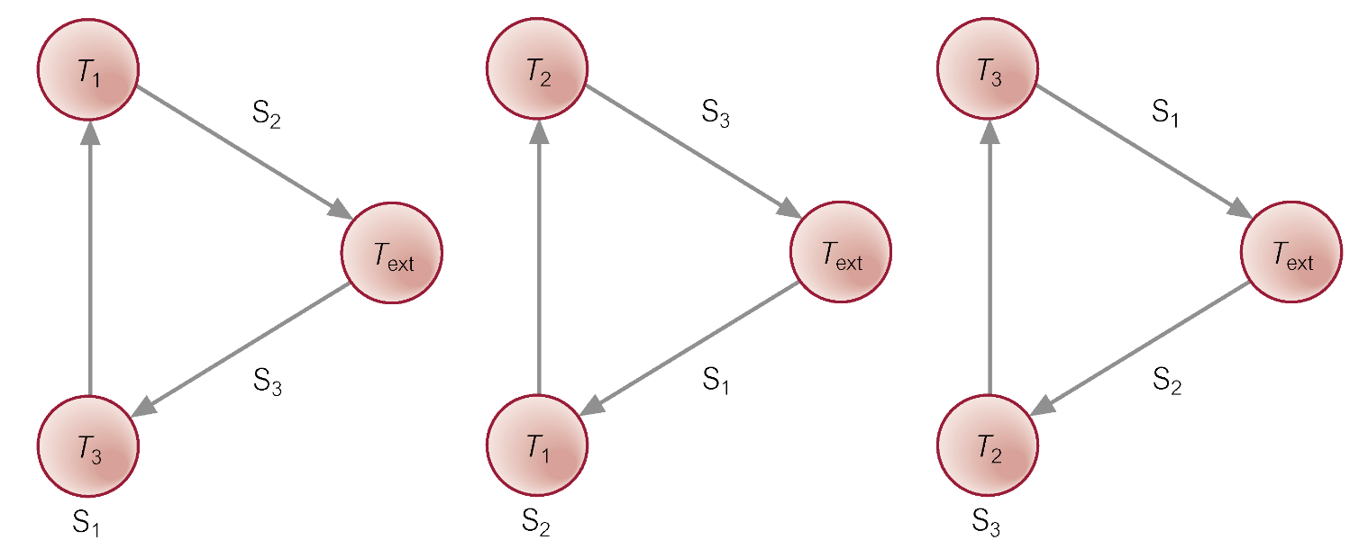
Distributed Deadlock Detection
In the previous example:
Notes:
Most well-known method (Obermarck, 1982). Potentially more robust than other methods.
external node, T_{ext}, added to LWFG as remote agent.
If a LWFG contains a cycle without T_{ext}, then site and DDBMS are in deadlock.
Global deadlock may (still) exist if LWFG contains a cycle involving T_{ext}. To check, graphs are merged.

Slide 13
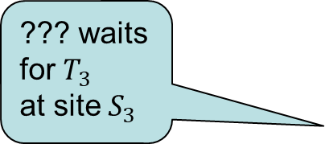
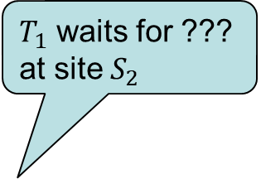
Distributed Deadlock Detection
In the previous example:
$T_{1}$ waits for ??? at site $S_{2}$
??? waits for $T_{3}$ at site $S_{3}$
Notes:
Most well-known method (Obermarck, 1982). Potentially more robust than other methods.
external node, T_{ext}, added to LWFG as remote agent.
If a LWFG contains a cycle without T_{ext}, then site and DDBMS are in deadlock.
Global deadlock may (still) exist if LWFG contains a cycle involving T_{ext}. To check, graphs are merged.

Slide 14


Distributed Deadlock Detection
no local cycle without $T_{\text{ext}}$ $⇒$ no local deadlock
cycle $T_{\text{ext}}→T_{3}→T_{1}→T_{\text{ext}}$ at site $S_{1}$
transmit the local WFG of $S_{1}$
Thus: $T_{\text{ext}}→T_{3}→T_{1}→T_{2}→T_{\text{ext}}$ at site $S_{2}$
to the site for which transaction $T_{1}$ is waiting, i.e. to site $S_{2}$
Notes:
Most well-known method (Obermarck, 1982). Potentially more robust than other methods.
external node, T_{ext}, added to LWFG as remote agent.
If a LWFG contains a cycle without T_{ext}, then site and DDBMS are in deadlock.
Global deadlock may (still) exist if LWFG contains a cycle involving T_{ext}. To check, graphs are merged.

Slide 15
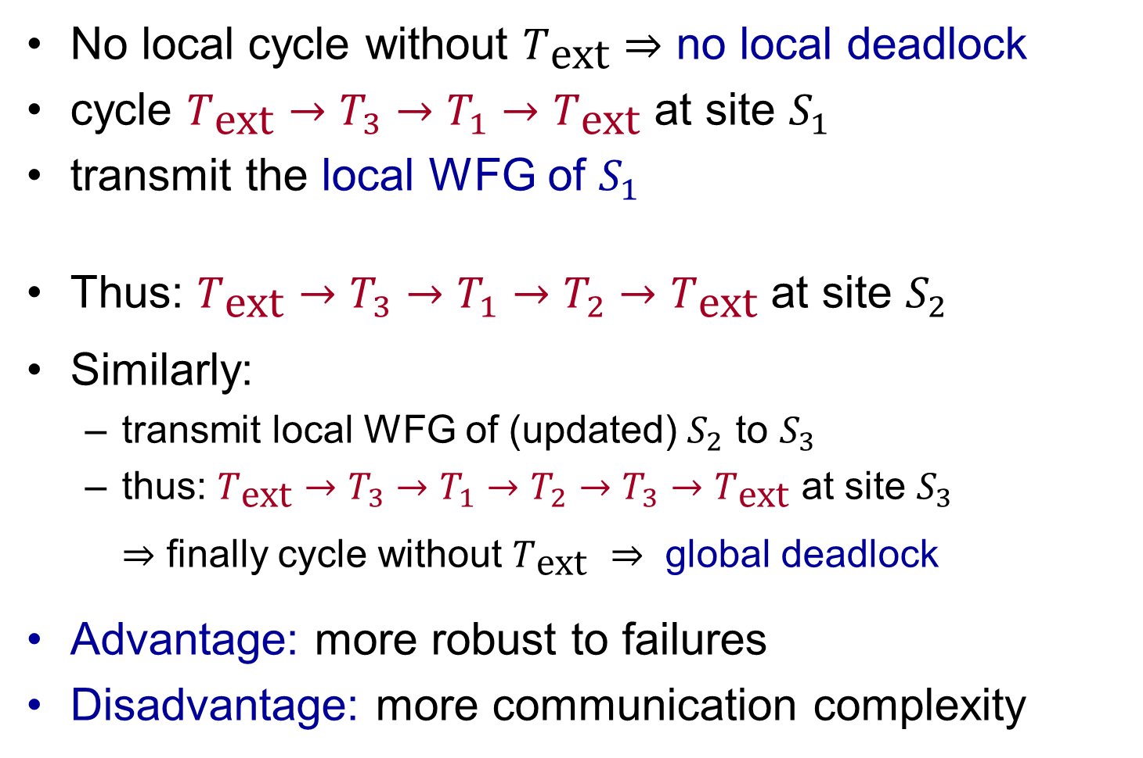

Distributed Deadlock Detection
No local cycle without $T_{\text{ext}}$ $⇒$ no local deadlock
cycle $T_{\text{ext}}→T_{3}→T_{1}→T_{\text{ext}}$ at site $S_{1}$
transmit the local WFG of $S_{1}$
Thus: $T_{\text{ext}}→T_{3}→T_{1}→T_{2}→T_{\text{ext}}$ at site $S_{2}$
Similarly:
transmit local WFG of (updated) $S_{2}$ to $S_{3}$
thus: $T_{\text{ext}}→T_{3}→T_{1}→T_{2}→T_{3}→T_{\text{ext}}$ at site $S_{3}$
$⇒$ finally cycle without $T_{\text{ext}}$ $⇒$ global deadlock
Advantage: more robust to failures
Disadvantage: more communication complexity
to the site for which transaction $T_{1}$ is waiting, i.e. to site $S_{2}$
Notes:
Most well-known method (Obermarck, 1982). Potentially more robust than other methods.
external node, T_{ext}, added to LWFG as remote agent.
If a LWFG contains a cycle without T_{ext}, then site and DDBMS are in deadlock.
Global deadlock may (still) exist if LWFG contains a cycle involving T_{ext}. To check, graphs are merged.

Slide 16
Failures in Distributed Systems
Typical types of failure in distributed systems:
Loss of a message
Failure of a communication link
Failure of a site
Even more critical failure: Network partitioning
communication failures can result in network becoming split into two or more partitions
difficult to distinguish whether communication link or site has failed
Notes:
DC = data communication component of the database management system (DDBMS)

Slide 17
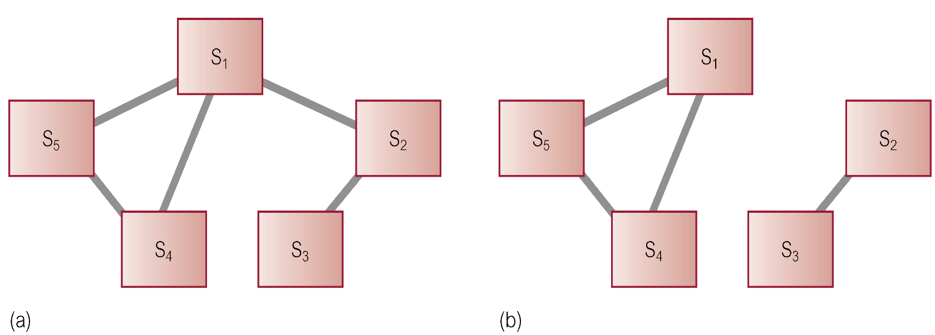

Network Partitioning
Site $S_{1}$ cannot reach $S_{2}$ within a fixed (timeout) period:
difficult to distinguish whether communication link or site has failed
Could be:
$S_{2}$ crashed or network is down
communication link $S_{1}−S_{2}$ failed
network is partitioned
$S_{2}$ is very busy and delays to respond
Notes:
DC = data communication component of the database management system (DDBMS)

Slide 18
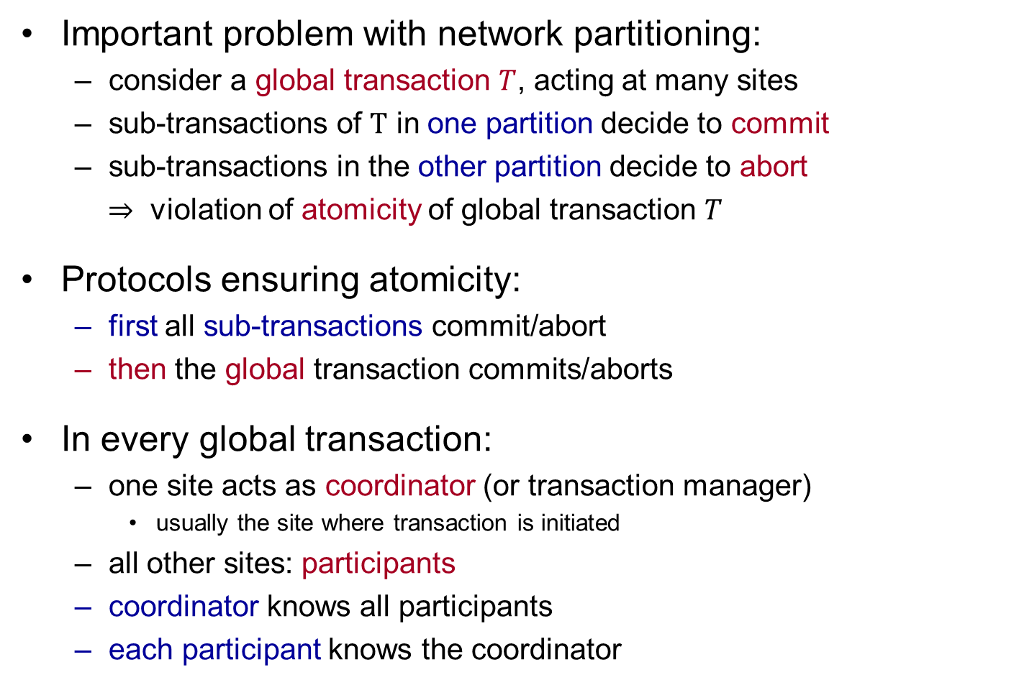
Network Partitioning
Important problem with network partitioning:
consider a global transaction $T$, acting at many sites
sub-transactions of $T$ in one partition decide to commit
sub-transactions in the other partition decide to abort
$⇒$ violation of atomicity of global transaction $T$
Protocols ensuring atomicity:
first all sub-transactions commit/abort
then the global transaction commits/aborts
In every global transaction:
one site acts as coordinator (or transaction manager)
usually the site where transaction is initiated
all other sites: participants
coordinator knows all participants
each participant knows the coordinator
Notes:
The coordinator knows the identity of all participants
Each participant knows the identity of the coordinator (not necessarily the identity of all other participants)
DC = data communication component of the database management system (DDBMS)

Slide 19
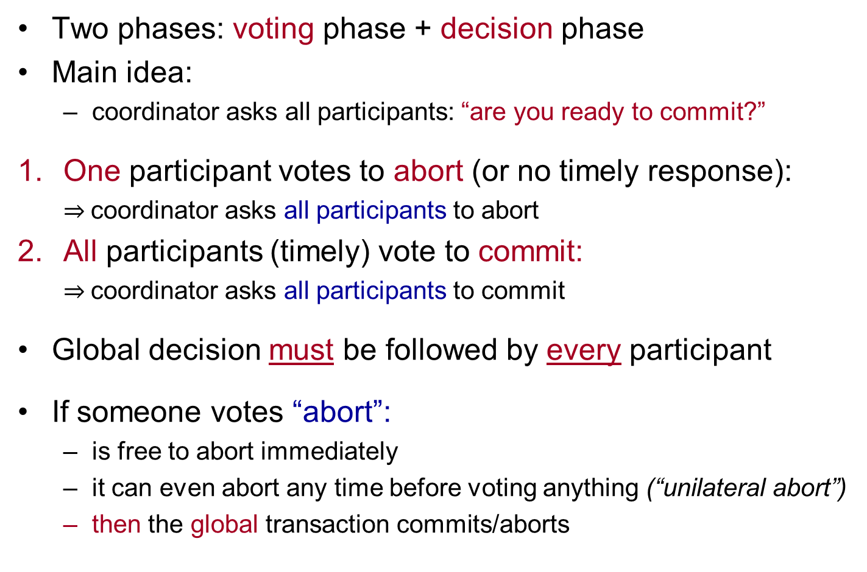
Two-Phase Commit (2PC)
Two phases: voting phase + decision phase
Main idea:
coordinator asks all participants: “are you ready to commit?”
One participant votes to abort (or no timely response):
$⇒$coordinator asks all participants to abort
All participants (timely) vote to commit:
$⇒$coordinator asks all participants to commit
Global decision must be followed by every participant
If someone votes “abort”:
is free to abort immediately
it can even abort any time before voting anything (“unilateral abort”)
then the global transaction commits/aborts
Notes:
Two phases: a voting phase and a decision phase.
Coordinator asks participants to commit transaction
If all vote commit, coordinator instructs all participants to commit.
If one participant votes abort (or times out) coordinator instructs all participants to abort transaction.
All participants must adopt global decision.
Participant:
If votes abort, free to abort transaction immediately
If votes commit, wait for coordinator global-commit or global-abort message.
If no instruction from coordinator, can abort.
Protocol assumes each site has own local log and can rollback or commit transaction reliably.

Slide 20
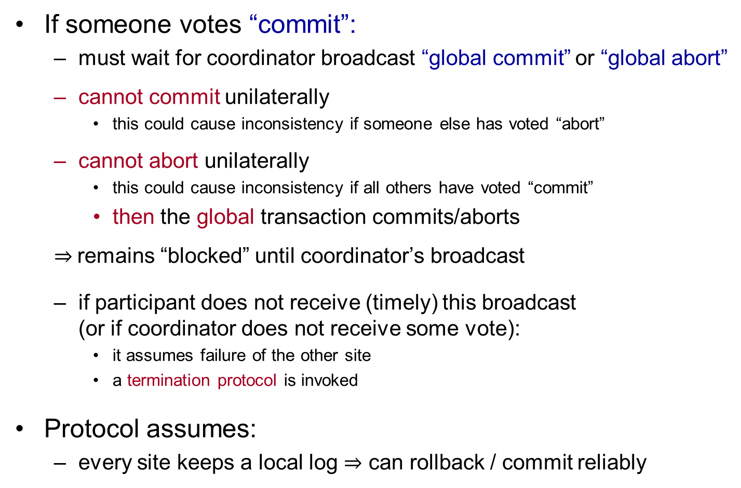
Two-Phase Commit (2PC)
If someone votes “commit”:
must wait for coordinator broadcast “global commit” or “global abort”
cannot commit unilaterally
this could cause inconsistency if someone else has voted “abort”
cannot abort unilaterally
this could cause inconsistency if all others have voted “commit”
then the global transaction commits/aborts
$⇒$remains “blocked” until coordinator’s broadcast
if participant does not receive (timely) this broadcast (or if coordinator does not receive some vote):
it assumes failure of the other site
a termination protocol is invoked
Protocol assumes:
every site keeps a local log $⇒$ can rollback / commit reliably
Notes:
Two phases: a voting phase and a decision phase.
Coordinator asks participants to commit transaction
If all vote commit, coordinator instructs all participants to commit.
If one participant votes abort (or times out) coordinator instructs all participants to abort transaction.
All participants must adopt global decision.
Participant:
If votes abort, free to abort transaction immediately
If votes commit, wait for coordinator global-commit or global-abort message.
If no instruction from coordinator, can abort.
Protocol assumes each site has own local log and can rollback or commit transaction reliably.

Slide 21
Two-Phase Commit (2PC)
Procedure for the coordinator:
Phase 1 (voting):
write begin_commit record to its log file
send PREPARE message to all participants
wait for them to respond within a timeout period
Notes:
Two phases: a voting phase and a decision phase.
Coordinator asks participants to commit transaction
If all vote commit, coordinator instructs all participants to commit.
If one participant votes abort (or times out) coordinator instructs all participants to abort transaction.
All participants must adopt global decision.
Participant:
If votes abort, free to abort transaction immediately
If votes commit, wait for coordinator global-commit or global-abort message.
If no instruction from coordinator, can abort.
Protocol assumes each site has own local log and can rollback or commit transaction reliably.

Slide 22
Two-Phase Commit (2PC)
Procedure for the coordinator:
Phase 2 (decision):
if a participant returns ABORT:
write abort record to its log file
send GLOBAL_ABORT to all participants & wait for acks*
if a participant returns READY_COMMIT:
if all participants already voted to commit:
write commit to its log file
send GLOBAL_COMMIT to all participants & wait for acks*
once all acks have been received:
write end_transaction to its log file
if a site does not acknowledge:
resend the global decision until an ack is received
* acks = acknowledgments
Notes:
Two phases: a voting phase and a decision phase.
Coordinator asks participants to commit transaction
If all vote commit, coordinator instructs all participants to commit.
If one participant votes abort (or times out) coordinator instructs all participants to abort transaction.
All participants must adopt global decision.
Participant:
If votes abort, free to abort transaction immediately
If votes commit, wait for coordinator global-commit or global-abort message.
If no instruction from coordinator, can abort.
Protocol assumes each site has own local log and can rollback or commit transaction reliably.

Slide 23
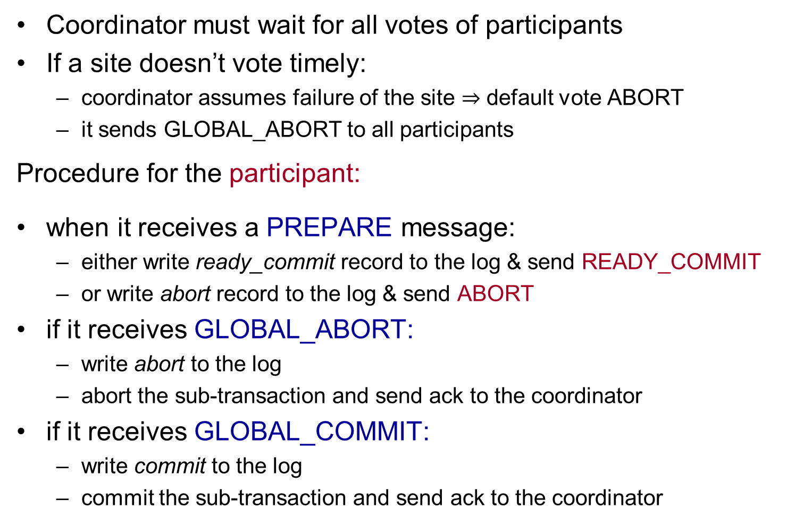
Two-Phase Commit (2PC)
Coordinator must wait for all votes of participants
If a site doesn’t vote timely:
coordinator assumes failure of the site $⇒$ default vote ABORT
it sends GLOBAL_ABORT to all participants
Procedure for the participant:
when it receives a PREPARE message:
either write ready_commit record to the log & send READY_COMMIT
or write abort record to the log & send ABORT
if it receives GLOBAL_ABORT:
write abort to the log
abort the sub-transaction and send ack to the coordinator
if it receives GLOBAL_COMMIT:
write commit to the log
commit the sub-transaction and send ack to the coordinator
Notes:
Two phases: a voting phase and a decision phase.
Coordinator asks participants to commit transaction
If all vote commit, coordinator instructs all participants to commit.
If one participant votes abort (or times out) coordinator instructs all participants to abort transaction.
All participants must adopt global decision.
Participant:
If votes abort, free to abort transaction immediately
If votes commit, wait for coordinator global-commit or global-abort message.
If no instruction from coordinator, can abort.
Protocol assumes each site has own local log and can rollback or commit transaction reliably.

Slide 24
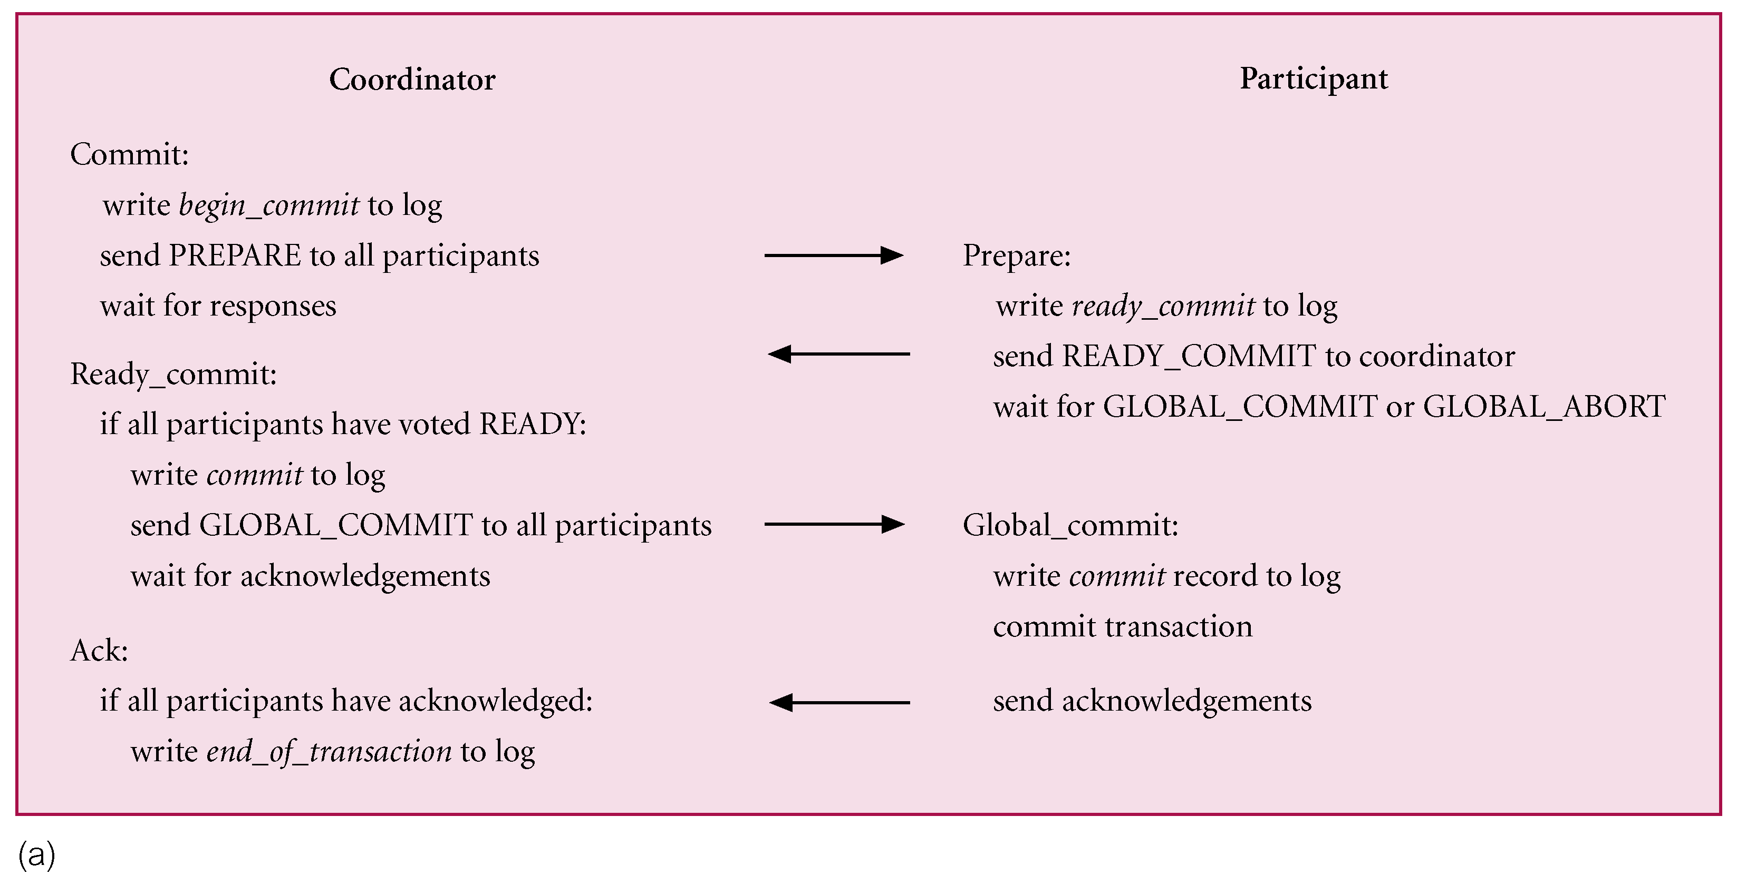
2PC: Participant voting commit

Slide 25
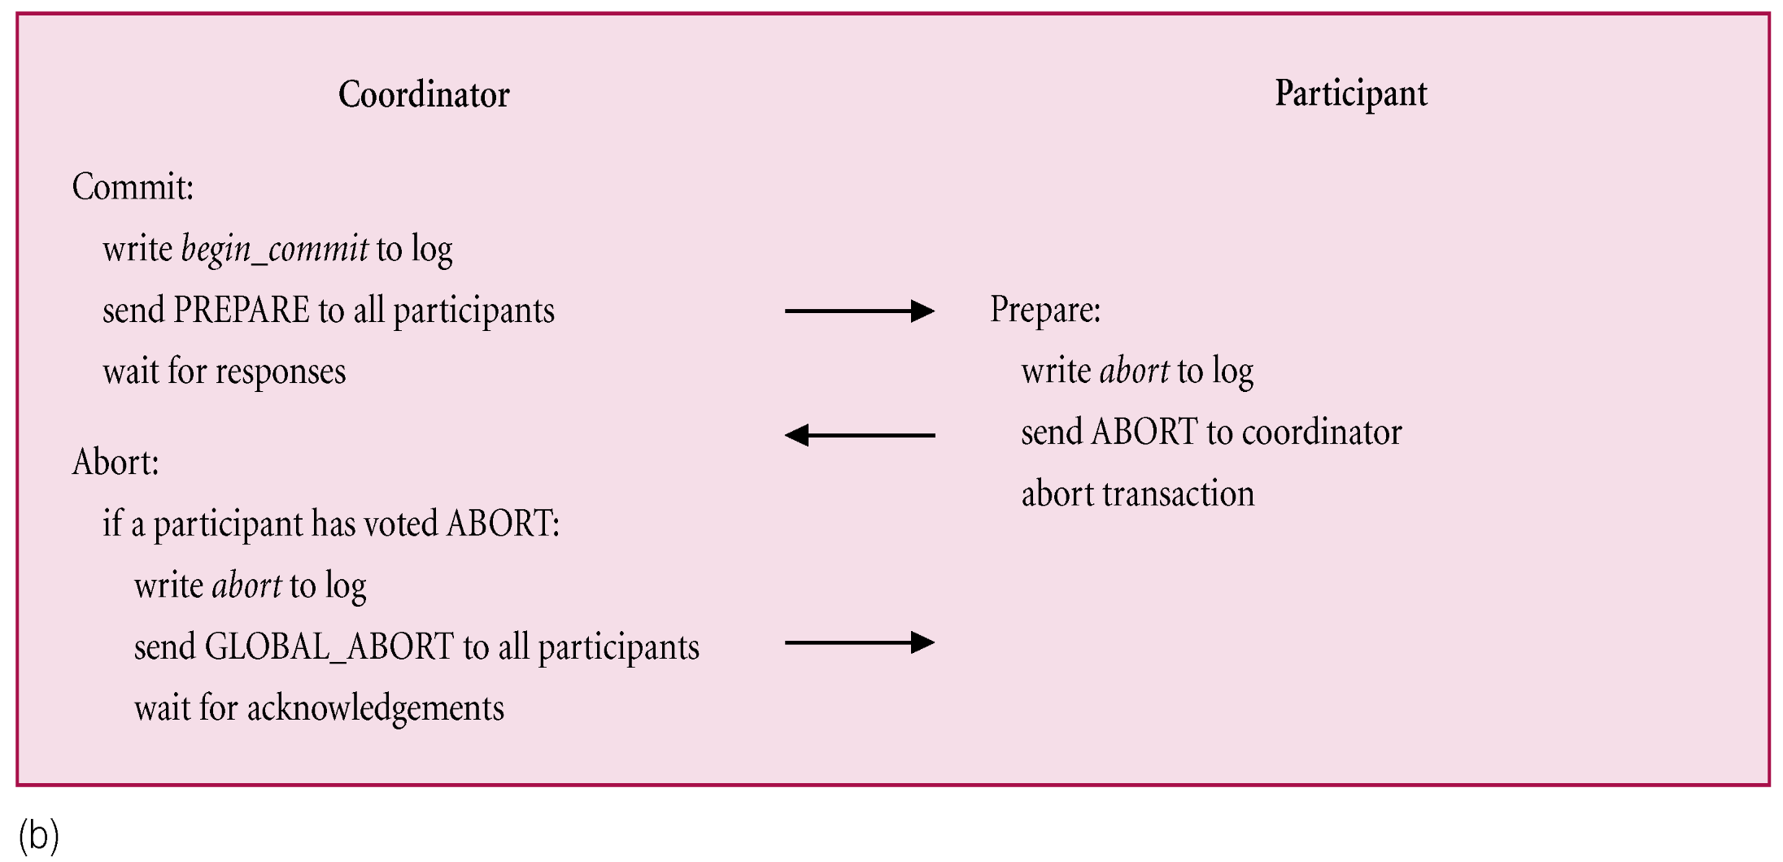
2PC: Participant voting abort

Slide 26
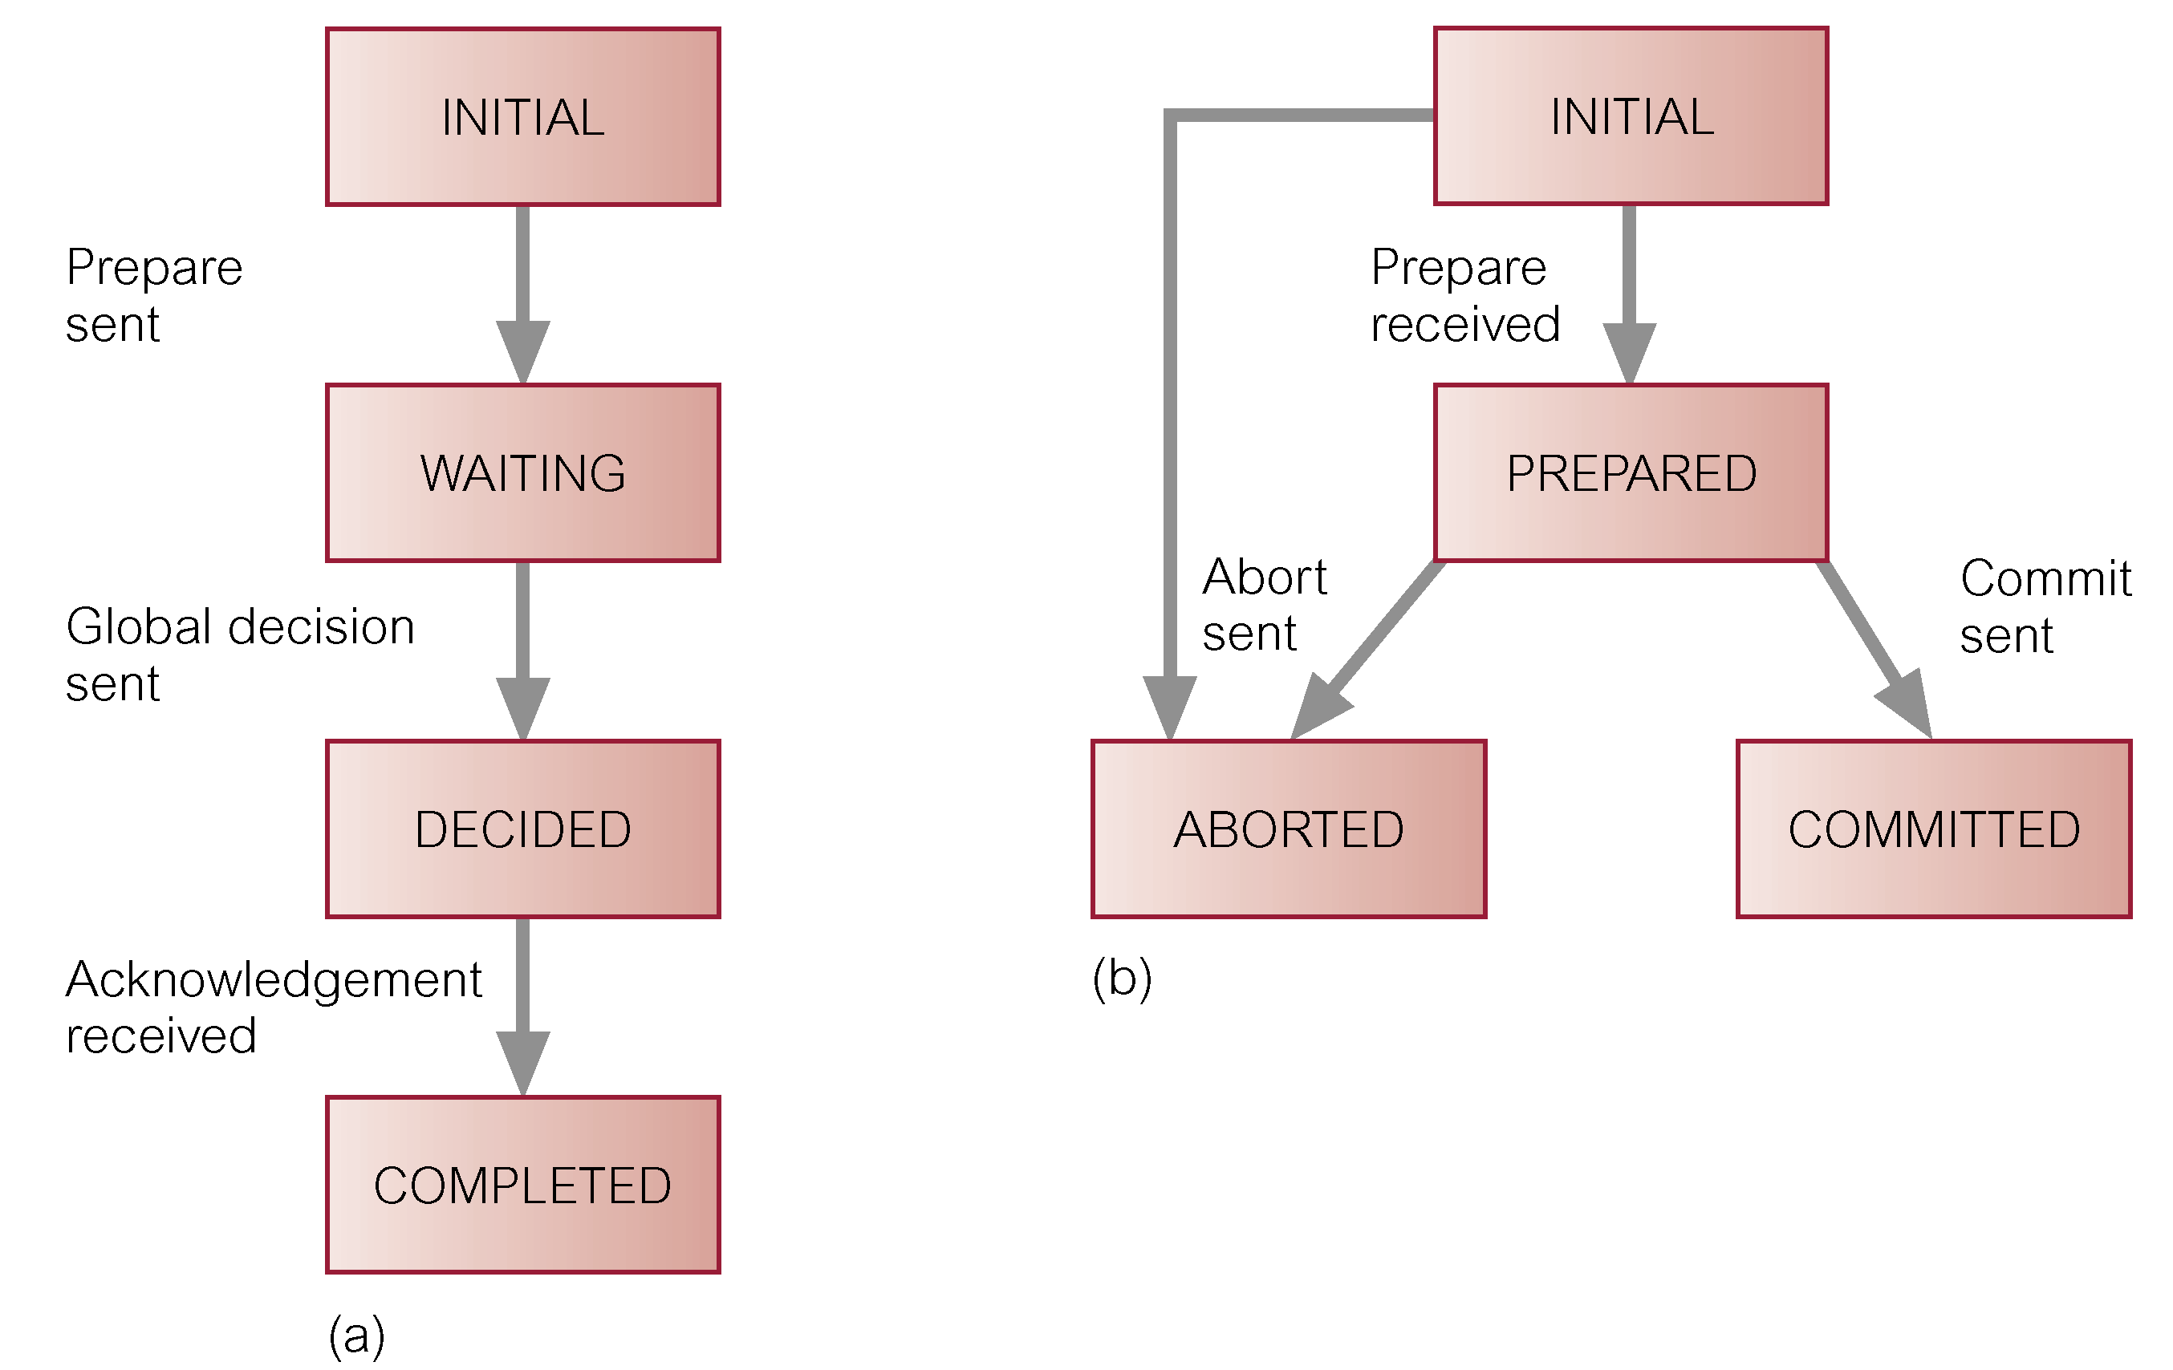
State transition diagram of 2PC
coordinator participant

Slide 27
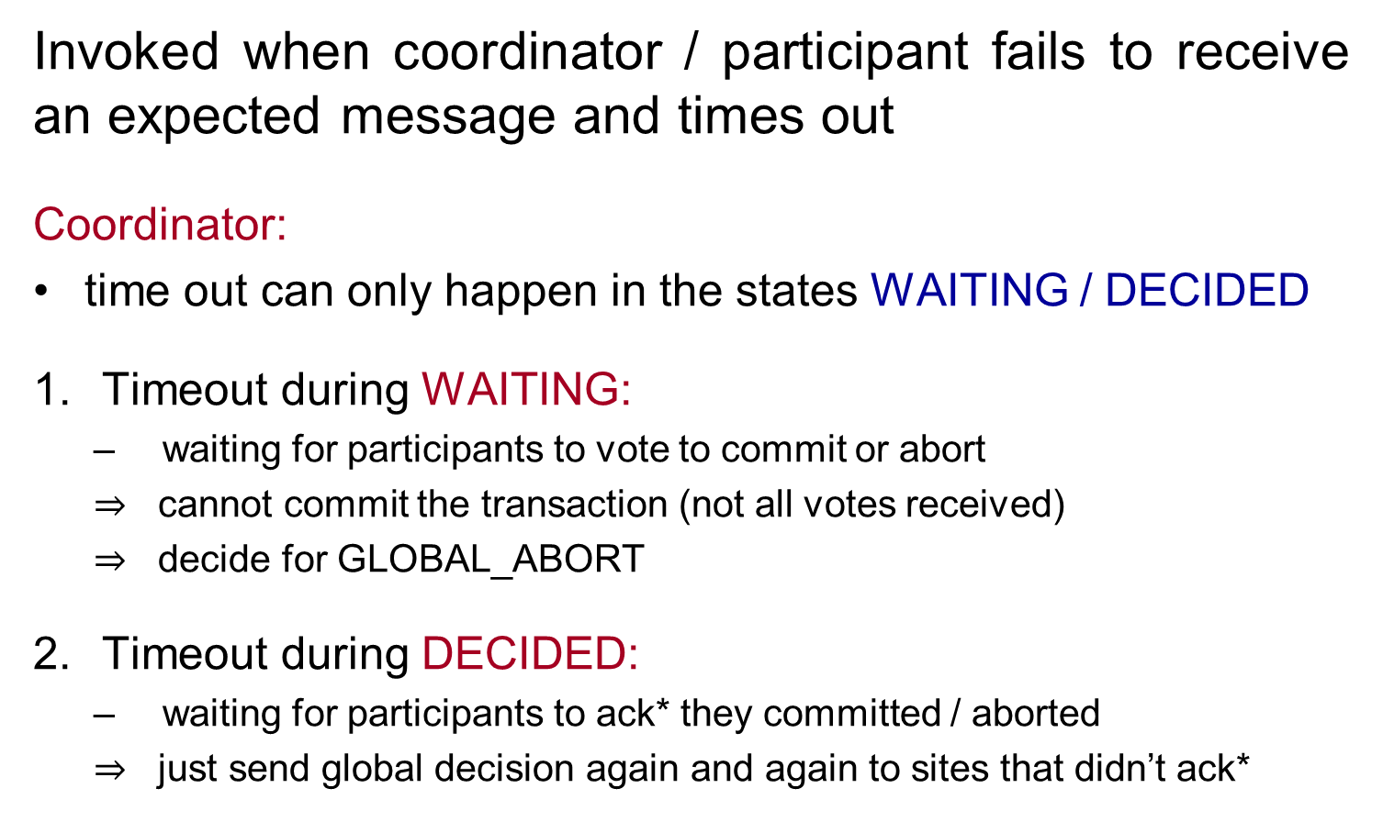
2PC termination protocols
Invoked when coordinator / participant fails to receive an expected message and times out
Coordinator:
time out can only happen in the states WAITING / DECIDED
Timeout during WAITING:
waiting for participants to vote to commit or abort
$⇒$ cannot commit the transaction (not all votes received)
$⇒$ decide for GLOBAL_ABORT
Timeout during DECIDED:
waiting for participants to ack* they committed / aborted
$⇒$ just send global decision again and again to sites that didn’t ack*
* acks = acknowledgments
Notes:
The action to be taken depends on who timed our (coordinator or participant) and on when the timeout occurred.
Invoked whenever a coordinator or participant fails to receive an expected message and times out.
Coordinator
Timeout in WAITING state
Globally abort transaction.
Timeout in DECIDED state
Send global decision again to sites that have not acknowledged.

Slide 28
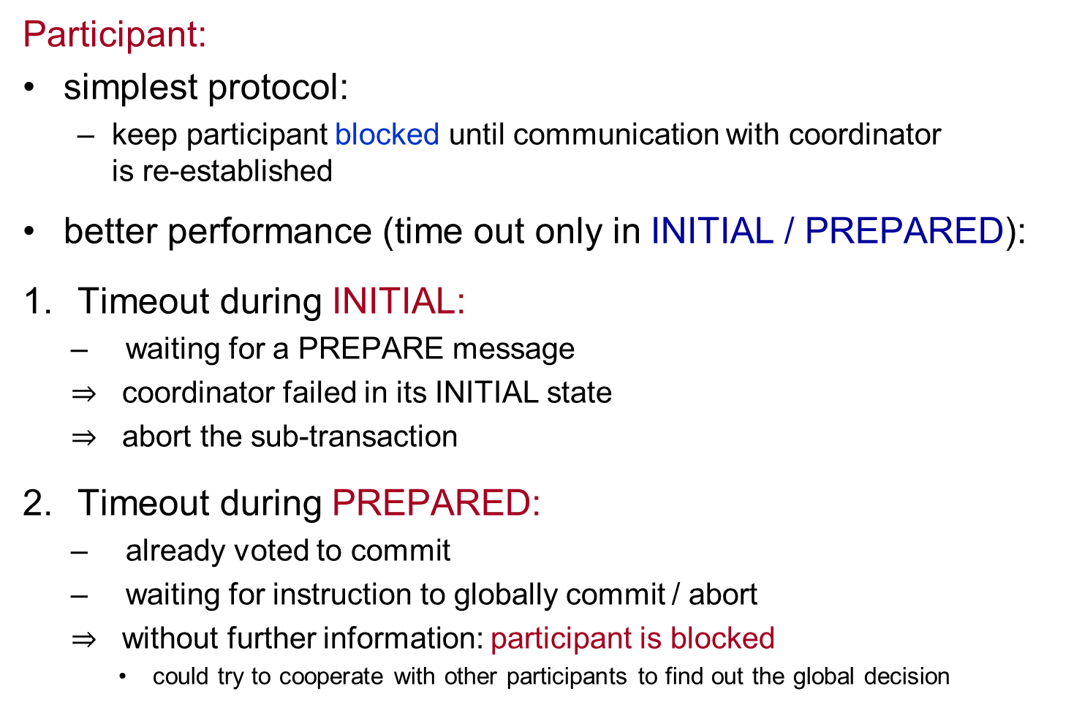
2PC termination protocols
Participant:
simplest protocol:
keep participant blocked until communication with coordinator is re-established
better performance (time out only in INITIAL / PREPARED):
Timeout during INITIAL:
waiting for a PREPARE message
$⇒$ coordinator failed in its INITIAL state
$⇒$ abort the sub-transaction
Timeout during PREPARED:
already voted to commit
waiting for instruction to globally commit / abort
$⇒$ without further information: participant is blocked
could try to cooperate with other participants to find out the global decision
Notes:
If a participant is blocked, it could contact other participants to try to find one that knows the decision of the coordinator.
This is known as cooperative termination protocol.
A straightforward way to tell the participants who the other participants are is for the coordinator to append a list of participants to the vote instruction.
Although the cooperative termination protocol reduces the likelihood of blocking, blocking is still possible => blocked processes just have to keep on trying to unblock as failures are repeated
If only the coordinator failed (and no other participant) and all participants detect this, they can elect a new coordinator and resolve the block in this way.

Slide 29
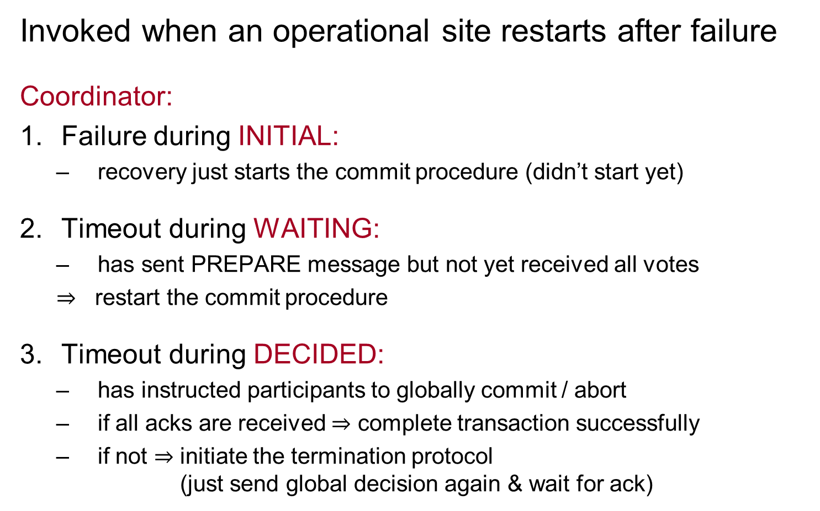
2PC recovery protocols
Invoked when an operational site restarts after failure
Coordinator:
Failure during INITIAL:
recovery just starts the commit procedure (didn’t start yet)
Timeout during WAITING:
has sent PREPARE message but not yet received all votes
$⇒$ restart the commit procedure
Timeout during DECIDED:
has instructed participants to globally commit / abort
if all acks are received $⇒$ complete transaction successfully
if not $⇒$ initiate the termination protocol (just send global decision again & wait for ack)

Slide 30
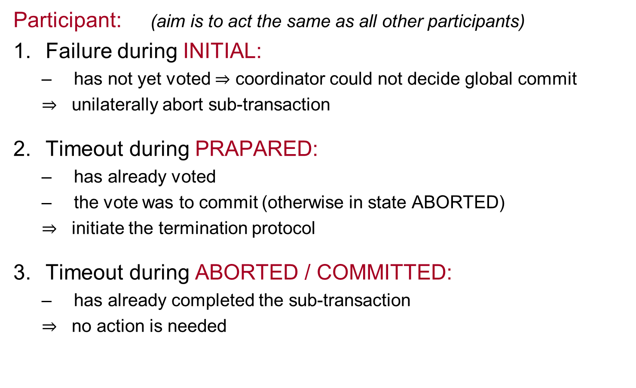
2PC recovery protocols
Participant: (aim is to act the same as all other participants)
Failure during INITIAL:
has not yet voted $⇒$ coordinator could not decide global commit
$⇒$ unilaterally abort sub-transaction
Timeout during PRAPARED:
has already voted
the vote was to commit (otherwise in state ABORTED)
$⇒$ initiate the termination protocol
Timeout during ABORTED / COMMITTED:
has already completed the sub-transaction
$⇒$ no action is needed

Slide 31
Additional Slides

Slide 32
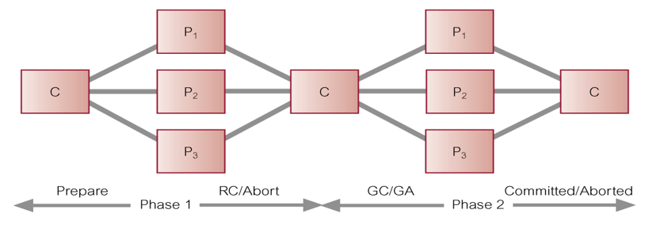
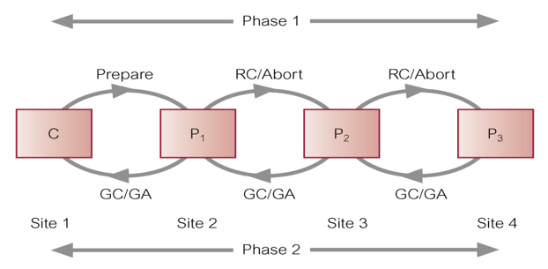
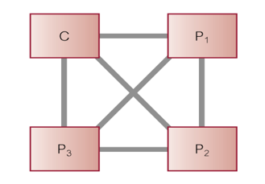
Other 2PC topologies
Centralized 2PC:
already discussed
Linear 2PC:
forward/backward chains for phases 1 / 2
fewer messages in total
easier blocked
Distributed 2PC:
all communicate to all
no need for the phase 2 (decision phase)

Slide 33
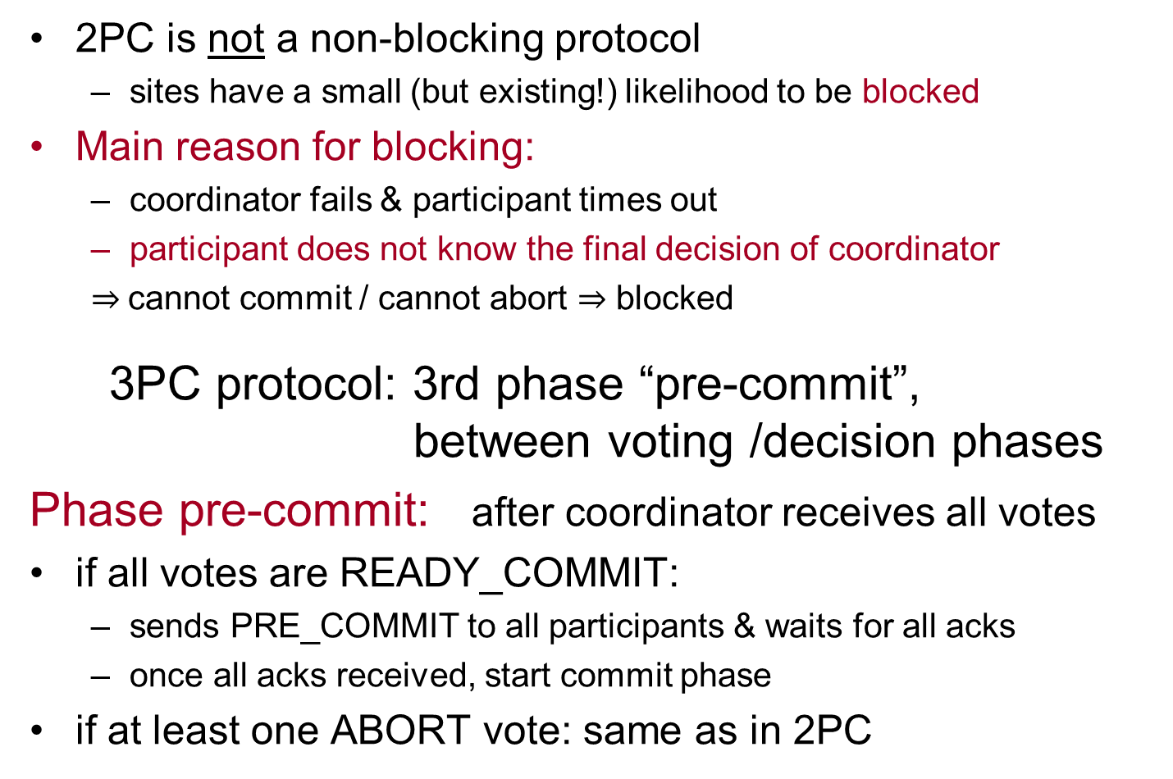
Three-Phase Commit (3PC)
2PC is not a non-blocking protocol
sites have a small (but existing!) likelihood to be blocked
Main reason for blocking:
coordinator fails & participant times out
participant does not know the final decision of coordinator
$⇒$cannot commit / cannot abort $⇒$ blocked
3PC protocol: 3rd phase “pre-commit”, between voting /decision phases
Phase pre-commit: after coordinator receives all votes
if all votes are READY_COMMIT:
sends PRE_COMMIT to all participants & waits for all acks
once all acks received, start commit phase
if at least one ABORT vote: same as in 2PC
Notes:
2PC has low probability to block, but is not non-blocking.
E.g., a process that times out after voting commit, but before global instruction, is blocked if it cannot communicate with sites that know global decision.
Communication failures can result in different sites reaching different decisions, thereby violating atomicity of global transactions.
3PC: Non-blocking for site failures (except if all sites fail).
3PC removes uncertainty period for participants who have voted commit and await global decision.
Introduces third phase, called pre-commit, between voting and global decision.
On receiving all votes from participants, coordinator sends global pre-commit message.
Participant with global pre-commit, knows all other participants have voted commit and that, in time, participant itself will definitely commit.

Slide 34
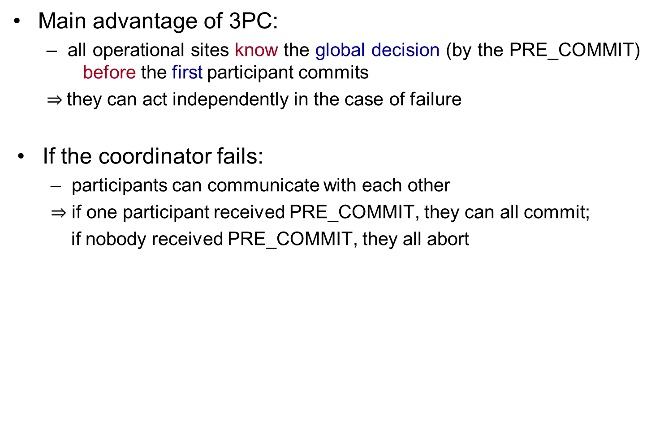
Three-Phase Commit (3PC)
Main advantage of 3PC:
all operational sites know the global decision (by the PRE_COMMIT) before the first participant commits
$⇒$they can act independently in the case of failure
If the coordinator fails:
participants can communicate with each other
$⇒$ if one participant received PRE_COMMIT, they can all commit;
if nobody received PRE_COMMIT, they all abort

Slide 35
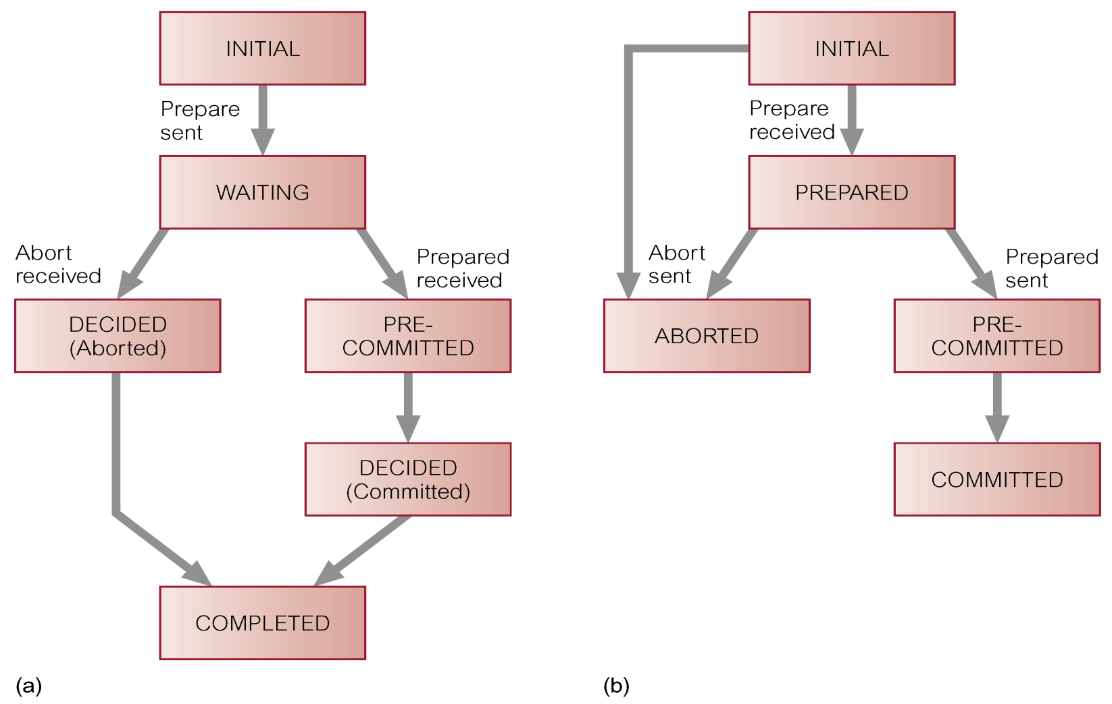
State transition diagram of 3PC
coordinator participant

Slide 36
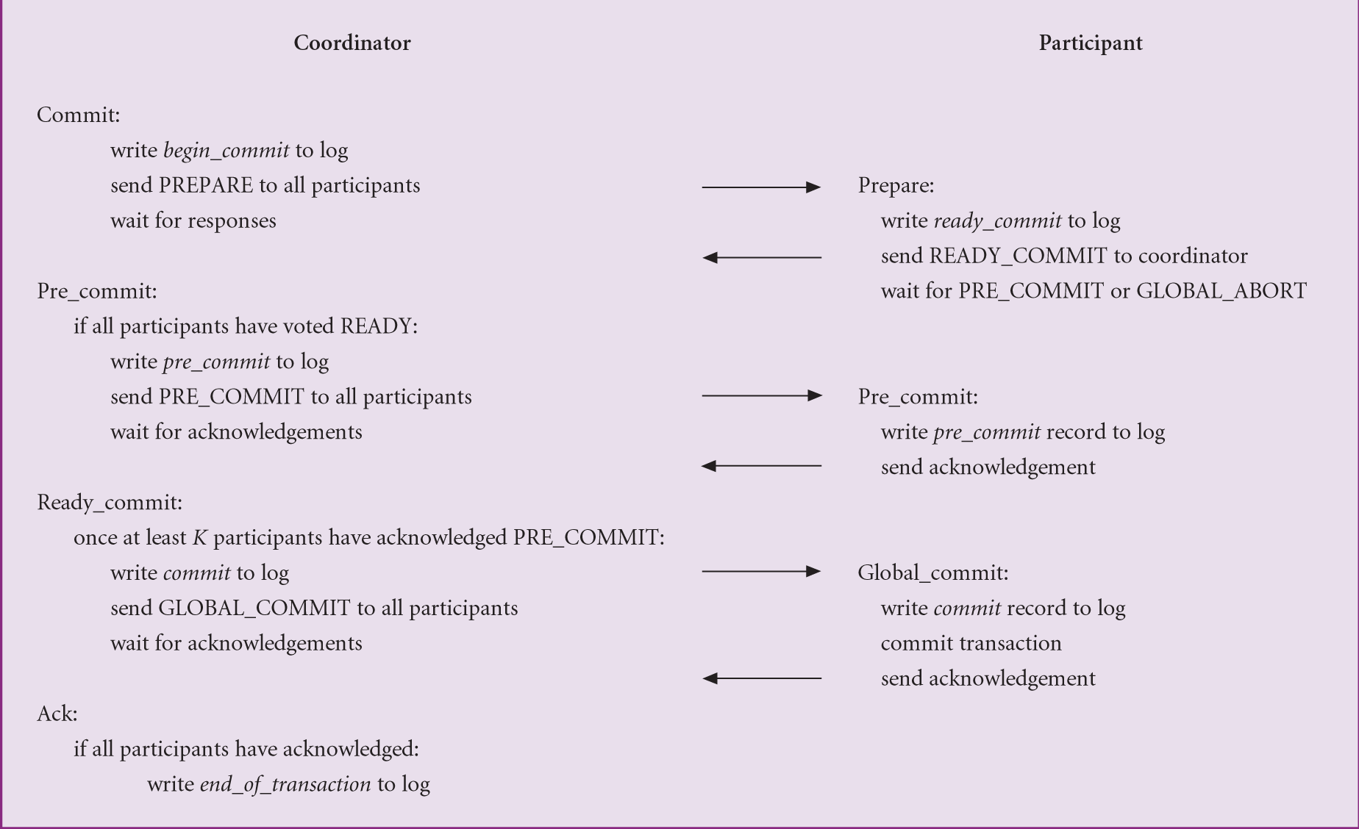
3PC: Participant voting commit
Notes:
K is a parameter, the larger the K the smaller probability of blocking

Slide 37
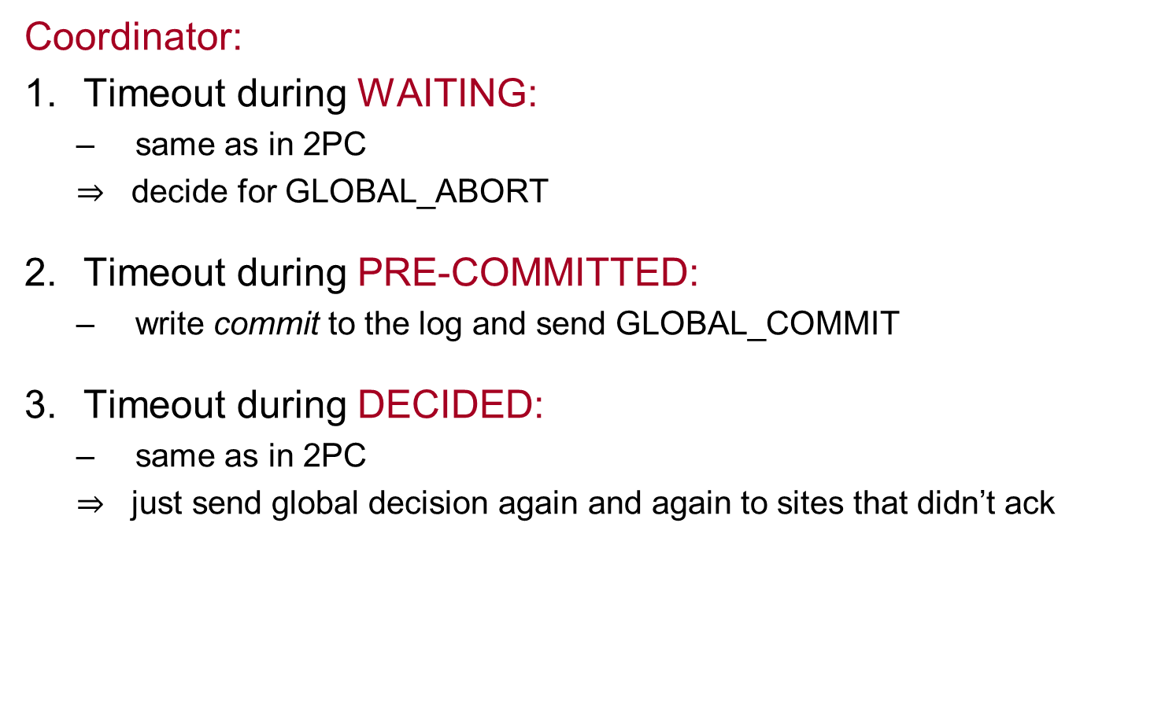
3PC termination protocols
Coordinator:
Timeout during WAITING:
same as in 2PC
$⇒$ decide for GLOBAL_ABORT
Timeout during PRE-COMMITTED:
write commit to the log and send GLOBAL_COMMIT
Timeout during DECIDED:
same as in 2PC
$⇒$ just send global decision again and again to sites that didn’t ack

Slide 38
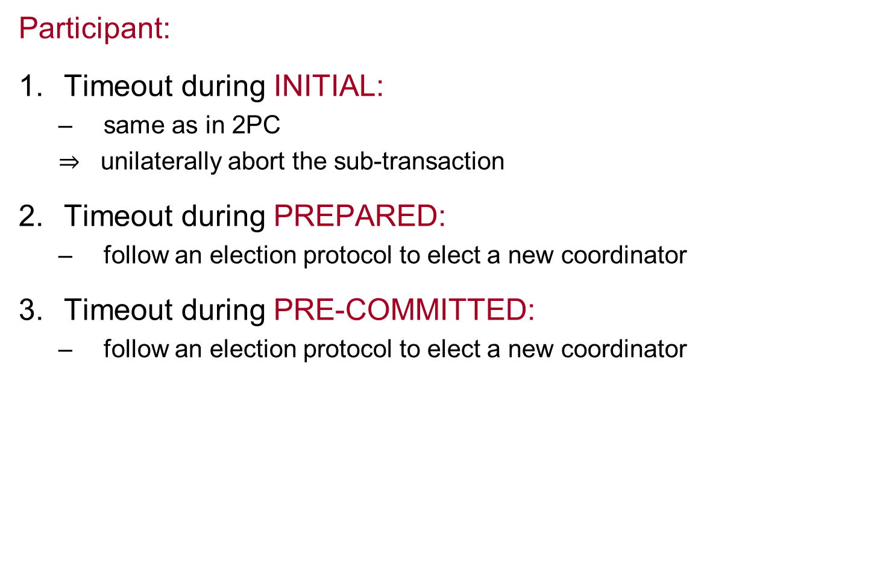
3PC termination protocols
Participant:
Timeout during INITIAL:
same as in 2PC
$⇒$ unilaterally abort the sub-transaction
Timeout during PREPARED:
follow an election protocol to elect a new coordinator
Timeout during PRE-COMMITTED:
follow an election protocol to elect a new coordinator

Slide 39
3PC termination protocol after electing new coordinator
Newly elected coordinator:
sends STATE-REQ to all participants (to find out their state)
if some participant aborted ⇒ globally abort
if some participant committed ⇒ globally commit
if all participants reply they are uncertain ⇒ global abort
if some participant in PRE-COMMIT ⇒ global commit (first send PRE-COMMIT, next GLOBAL-COMMIT).

Slide 40
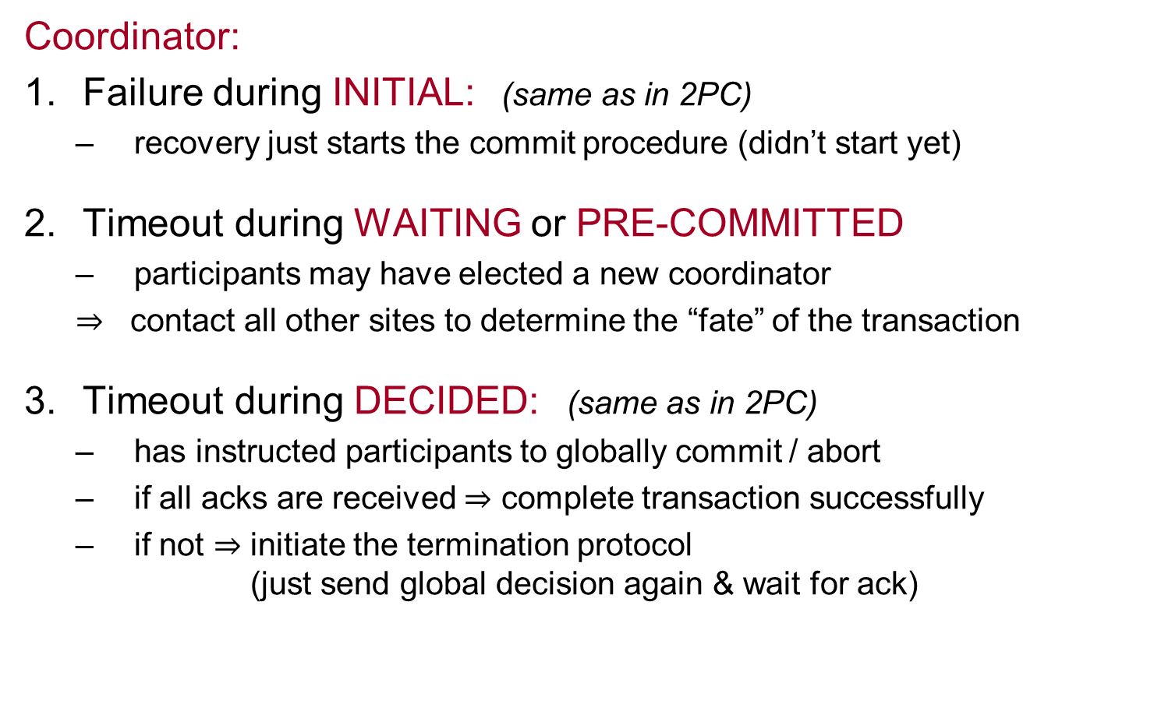
3PC recovery protocols
Coordinator:
Failure during INITIAL: (same as in 2PC)
recovery just starts the commit procedure (didn’t start yet)
Timeout during WAITING or PRE-COMMITTED
participants may have elected a new coordinator
$⇒$ contact all other sites to determine the “fate” of the transaction
Timeout during DECIDED: (same as in 2PC)
has instructed participants to globally commit / abort
if all acks are received $⇒$ complete transaction successfully
if not $⇒$ initiate the termination protocol (just send global decision again & wait for ack)

Slide 41
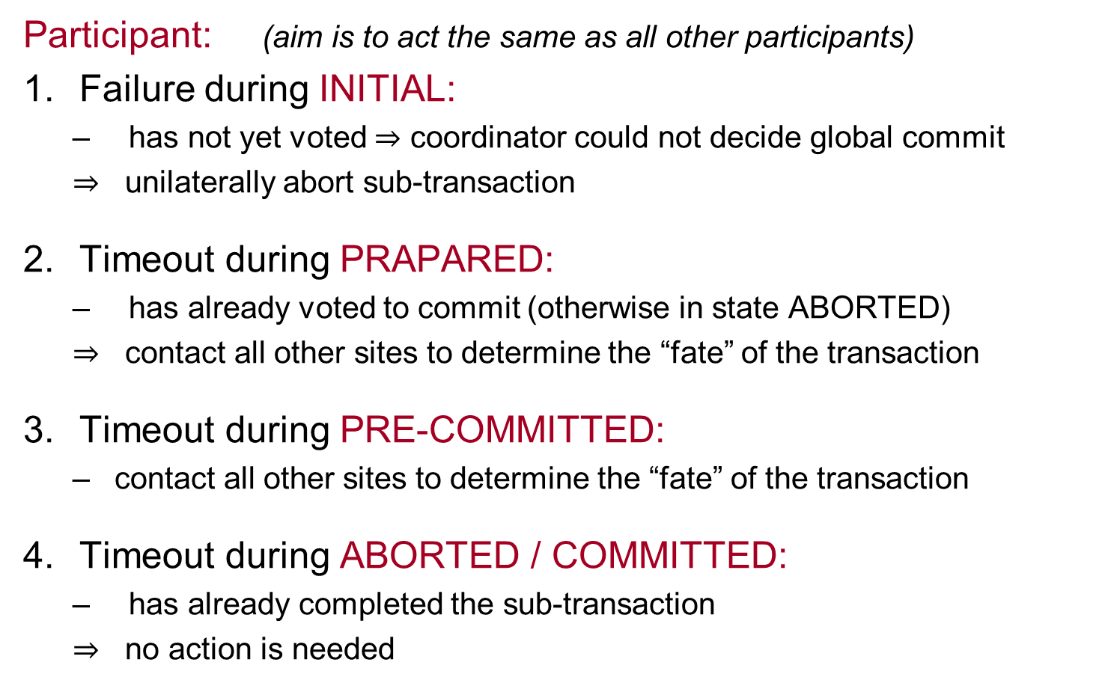
2PC recovery protocols
Participant: (aim is to act the same as all other participants)
Failure during INITIAL:
has not yet voted $⇒$ coordinator could not decide global commit
$⇒$ unilaterally abort sub-transaction
Timeout during PRAPARED:
has already voted to commit (otherwise in state ABORTED)
$⇒$ contact all other sites to determine the “fate” of the transaction
Timeout during PRE-COMMITTED:
contact all other sites to determine the “fate” of the transaction
Timeout during ABORTED / COMMITTED:
has already completed the sub-transaction
$⇒$ no action is needed

