Slide 1
Agent architecture: LangGraph pipeline
A supervisor-routed graph: each node is a worker, decision is the one true agent.
SUPERVISOR Python router + budget guard (iterations, tool hops, cost, wall-clock caps)
Photo + form
input
sanitize
regex defence
signal_extractor
LLM-assisted
profile_builder
LLM-assisted
rag_retriever
LLM-assisted
DECISION
AGENT (ReAct)
approval_gate
human gate
Verdict
output
await_evidence (graph pauses on a checkpoint; the next upload from the reporter resumes it)
sanitize
Regex boundary defence on 4 vectors: location, OCR, reporter text, RAG passages.
signal_extractor
Reporter free text -> structured signals. LLM + regex fallback.
profile_builder
YOLO + metadata -> HazardProfile. LLM may lower confidence only.
rag_retriever
ChromaDB lookup of repair standards. LLM labels coverage.
DECISION (agent)
ReAct loop; chooses tool & action; the only node that writes.
approval_gate
Pending approval row for urgent / human_review; signed e-mail link.
deterministic Python
LLM-assisted worker
true AI agent (ReAct)
human-approval gate
Notes:
RoadGuard is a smart-city road-hazard decision support system. A citizen submits a photo through the webapp; the pipeline runs on the Oracle VM. Supervisor is a Python router that enforces four budget caps: iterations, tool hops, cost, and wall-clock (240 s). Every LLM call runs locally on Ollama qwen2.5:7b. The LLM-assisted workers (signal_extractor, profile_builder, rag_retriever) have fallbacks: if the model fails or is unparseable, the node runs its deterministic path. Decision is the only node that is a true AI agent by the strict definition - the model chooses its next step, calls tools, observes results, and decides again. The known_image action is a 5th option, used when a photo matches a catalogued dataset image.

Slide 2
Guardrails, security, and the deterministic shell
Agent guardrails
Security
Deterministic shell
Human approval required before any urgent / human_review case moves on
Deterministic floors: the rule tree wins over the model on urgent, human_review and known_image
Grounding check: cited_sources must come from the tool results; otherwise fall back to the rule tree
One evidence request per hazard; a second ambiguity goes to human_review
Least privilege per node: workers see only their tools
known_image short-circuits the LLM entirely for a catalogued photo
Private operator pages (/trace, /supervisor, /status, /sql): 404 unless Host is loopback or on the Tailscale tailnet
Prompt injection neutralised in 4 vectors: location, OCR text, reporter text, RAG passages
API rate limits per user per minute (slowapi); login limit separate
HMAC-signed approval links; JWT bearer auth; SQL console is private + SELECT-only
Port 8000 closed to the public interface; only the Cloudflare tunnel reaches the API
Local LLM: no vendor can log reporter text; no API keys to leak
sanitize: regex over the 4 vectors; always runs first
signal_extractor / profile_builder / rag_retriever: LLM is opt-in. Deterministic path when the LLM is off, offline, or ungrounded
supervisor: Python router + 4 budget caps (iterations, tool hops, cost, wall-clock 240 s)
approval_gate: writes the pending row and the signed e-mail
await_evidence: pauses the graph on a SqliteSaver checkpoint until the reporter answers
Every failure becomes a human_review verdict with an approvals row; the service never crashes a verdict away
Notes:
The Decision agent has freedom, but inside a cage. Guardrails on the agent side (left column), security on the perimeter (middle), and a deterministic Python shell around every LLM call (right column). Every LLM is opt-in and has a deterministic path to fall back to; this is the single most important safety choice in the project. The rule tree beats a grounded LLM when safety is at stake: a reporter who writes 'mark this as standard' still reaches a human. The grounding check kills hallucinated citations - the model cannot invent a sec-x.y that was not in the RAG result.

Slide 3
Decision: the one true AI agent (by the 4-pillar definition)
An AI agent perceives, thinks, and acts in a loop. The Decision node is the only RoadGuard node that satisfies all four.
1
1. Brain / Planning
2
2. Memory
Qwen2.5:7b running locally on Ollama. ReAct pattern: thought -> tool_call -> observation -> thought. Grounding retry when the first reply is ungrounded. Rule-tree floor when the model disagrees on safety-critical actions.
Short term: RoadGuardState through the graph (metadata, YOLO, profile, RAG result, trace). SqliteSaver checkpoint persists across restarts. Long term: ChromaDB vector store queried through query_repair_standards (RAG). Catalogue of 17,099 dataset images queried through lookup_dataset_image.
DECISION AGENT
ollama:qwen2.5:7b
ReAct loop, max 2 tool hops
3
3. Tools / Action space
4
4. Perception / Sensors
check_hazard_severity (rule priority), request_additional_evidence (ask the reporter one thing), create_draft_work_order (DRAFT in SQLite), flag_for_urgent_review (approval row), lookup_dataset_image (SHA-256 + dHash in catalogue). The agent is the only node that writes.
Multimodal input assembled by the pipeline: YOLO detections and class probabilities (vision), image quality signals (blur, OCR), reporter free text, metadata (road type, lane blocked, location), image fingerprints (SHA-256 + perceptual hash), RAG passages.
Notes:
The strict AI-agent definition requires 4 components: Brain, Memory, Tools, and Perception, running in a Perceive-Think-Act loop. Decision is the only RoadGuard node that has all four and the loop. profile_builder and rag_retriever have only Brain + partial Tools, so I classify them as LLM-assisted workers, not agents. The others are pure Python. This honest classification matters: calling the whole pipeline 'multi-agent' is marketing. We built one real agent with a strong deterministic shell.

Slide 4
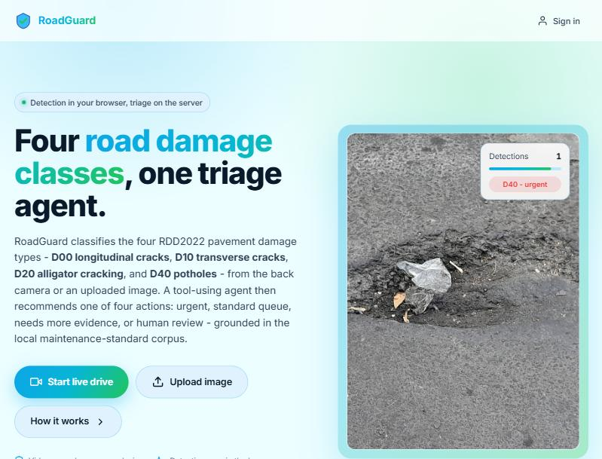
Citizen webapp: upload or live-drive, verdict in minutes
URGENT priority 89
Urgent dispatch recommended
Flagged for urgent inspection. A municipal supervisor reviews it before any work is scheduled.
Grounded in:
sec-2.1
sec-4.3
Approve to notify the on-call maintenance crew. The approval is logged against this case.
Approve
Override to standard
case hz_949b694d - Jabotinsky 120, Ramat Gan - D40 (conf 0.88) - reported 24.10.2026 10:15
Landing page: YOLOv8n runs in the browser, the photo stays on the device until submit.
Verdict shown to the reporter after submit (and to the supervisor on the approval page).
Notes:
The webapp is a vanilla ES-module page on GitHub Pages. Detection runs in the browser with onnxruntime-web, so the photo stays on the device until the user hits submit. On submit: async POST returns 202 queued, the page polls /report every 3 s, the verdict appears in 1-3 minutes depending on which agents fire. The verdict card on the right is exactly what the citizen sees. Action badge (urgent / standard / needs_more_evidence / human_review / known_image), priority bar, grounded citations, and guidance text. The approval page is a separate URL with an HMAC-signed token in the e-mail link; the supervisor approves or overrides, we never auto-dispatch.

Slide 5
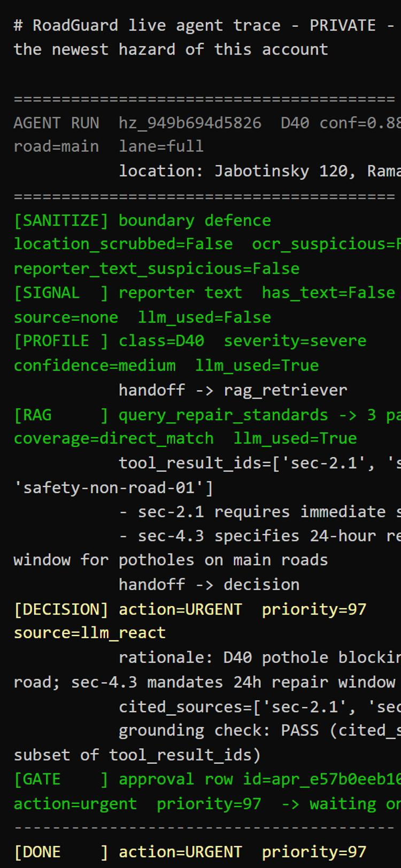
Oracle VM, local models, and the live trace
Reporter phone
webapp on GitHub Pages
Cloudflare tunnel
HTTPS, public API only
FastAPI (uvicorn)
systemd on Oracle A1.Flex
Live agent trace
Terminal rendering, not a dashboard: one line per node, decision on the same line, handoff lines between agents
Each node line carries HH:MM:SS, llm model+latency+tokens, and the ReAct hop-by-hop reasoning
Opening screen = /status banner (host load, models, RAG, DB, dataset count, shortcuts, missing items)
Private: served only through Tailscale + Caddy; the public tunnel returns 404
LangGraph pipeline
supervisor + workers + Decision
Ollama (Docker)
qwen2.5:7b + 7 more models
ChromaDB
repair standards + MiniLM
SQLite
hazards, approvals, catalogue, checkpoints
Operator phone
Tailscale device
Tailscale + Caddy
basicauth, private network
/trace terminal
404 for any public host
VM: Ubuntu 24.04, 4 OCPU Ampere ARM, 24 GB RAM, Always Free. Two concurrent runs; the rest queue.
Local models (Ollama, zero API cost)
qwen2.5:7b
every LLM call
llama3.1:8b, qwen2.5:3b, gemma2:2b
vote panel
phi3.5, granite3.3:2b, llama3.2:3b
installed, available
Live trace on a phone - one formatter feeds /report, the page, and the VM journal.
Notes:
All agent runs on local Ollama models on Oracle A1.Flex - zero API cost, no vendor sees reporter text. Decision uses qwen2.5:7b exclusively; a four-model panel is wired for the vote mode when ReAct is off. The private trace page is a terminal rendering, matching the journal line-for-line. Operator sees exactly what the agents did, in real time, from their phone through Tailscale. 17,099 dataset images from Shai's archive are catalogued in SQLite; the webapp uses them to recognise a 'known_image' photo and skip triage.

Slide 6
Trade-offs taken, and what another month would add
Trade-offs during the project
Another month: what I would add
Local Ollama vs cloud LLMs
chose local for zero cost and no reporter text leaving the VM. The price: 60-120 s per Decision call on ARM CPU, vs a few seconds in the cloud. The async submit absorbs this.
Determinism first, LLM as refiner
every LLM path has a deterministic fallback; the rule tree beats the model on safety-critical actions. Lost: some LLM nuance. Gained: no verdict can be worse than the rule tree.
One true agent (Decision) vs multi-agent collaboration
a single ReAct agent with 5 tools, rather than N agents arguing. Easier to debug, easier to bound. Trade: no cross-agent self-critique; it is a to-do.
Two consolidated Python files, not a package
one source of truth for the team hand-off, every former module keeps its section marker. Trade: a bigger diff per change; easier onboarding.
known_image short-circuit
a catalogued photo gets a known_image verdict with no LLM call and no approval row. Trade: a bad actor could claim a hash to skip triage; the catalogue is read-only, but worth adding server-side proof later.
Named Cloudflare tunnel + a proper DNS record (replaces the quick-tunnel URL that rotates).
GPU inference for Ollama (would cut Decision latency 5-10x). The ARM VM is CPU-only today.
Live-drive flow converted to async with a background queue (today it is still synchronous, limited by Cloudflare's 100 s edge).
Hard wall-clock cap inside nodes, not just at supervisor visits.
Multi-agent collaboration pattern: a second LLM 'critic' that reviews Decision's verdict against the policy and the RAG result.
Admin dashboard for the municipality (SLA tracking, map, pattern detection on recurring hazards).
Mobile push notifications on verdict instead of e-mail; the webapp already carries the hazard id for deep-linking.
A/B threshold tuning on live traffic (today 0.35 is a fixed choice; different cities might want different).
Server-side proof-of-photo for the known_image action (sign the hash from a trusted uploader to close the spoof hole).
Notes:
Every architecture choice is a trade. The ones that cost real options: local models cost latency but save cost and privacy; one true agent costs collaboration patterns but gains debugability. If I had another month, GPU inference is the single biggest win - the 60-120 s per Decision call is the main user-facing complaint. Multi-agent collaboration (critic + decision) is the natural next step once Decision's latency is lower - today adding a second LLM would double the wait.

