Slide 1
Stone Flakes: Analysis of Prehistoric tool use
Sean Asaro
21 APRIL 2016

Slide 2
Introduction
STONEFLAKES DATA SET RETREIVED FROM MACHINE LEARNING REPOSITORY AT UCI
MEASURING AVERAGE OF STONE RESIDUE FROM A VARIETY OF SITES AROUND GERMANY AND CENTRAL EUROPE

Slide 3
INTRODUCTION
FLAKES CREATED AS BYPRODUCTS OF STONE TOOL CREATION AND USE
ARCHEOLOGISTS MEASURE VARIABLES ON THESE FLAKES SUCH AS:
LENGTH
WIDTH
STRIKING ANGLE
FREQUENCY OF FACETS

Slide 4
INTRODUCTION
ALONG WITH THESE FLAKE MESUREMENTS IS A SERIES OF GEOGRAPHICAL AND DATING DATA
SITE NUMBERS AND AGE OF STONE BASED ON DATING
DATES RANGE FROM 40 -400 THOUSAND YEARS
LATE LOWER PALEOLITHIC TO EARLY UPPER

Slide 5
Data
Each point is labeled by the site ID from the data set
each is assigned a grouping based on factors such as age and hominid type by the archeologists
Model consists of mostly age as a response to 8 variables from archeologists measurements
Using complete cases and model clarification

Slide 6
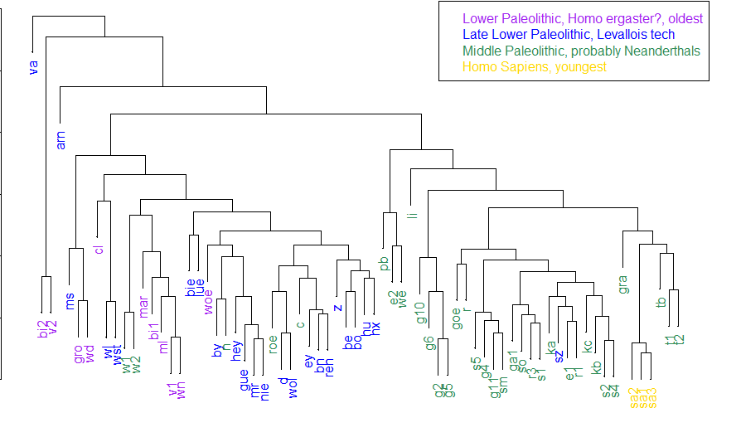
Clustering

Slide 7
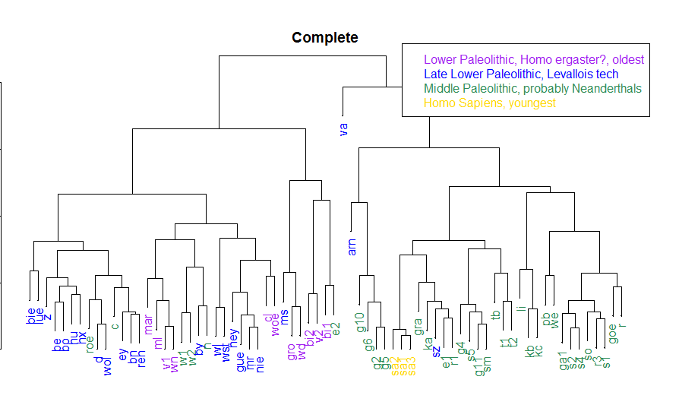
CLustering

Slide 8
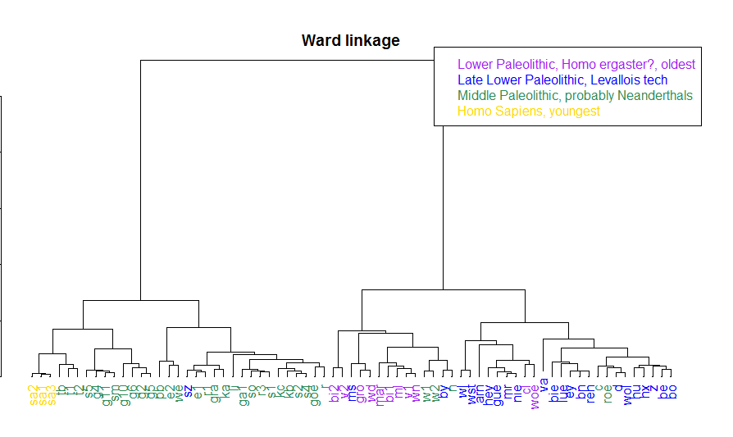
CLustering

Slide 9
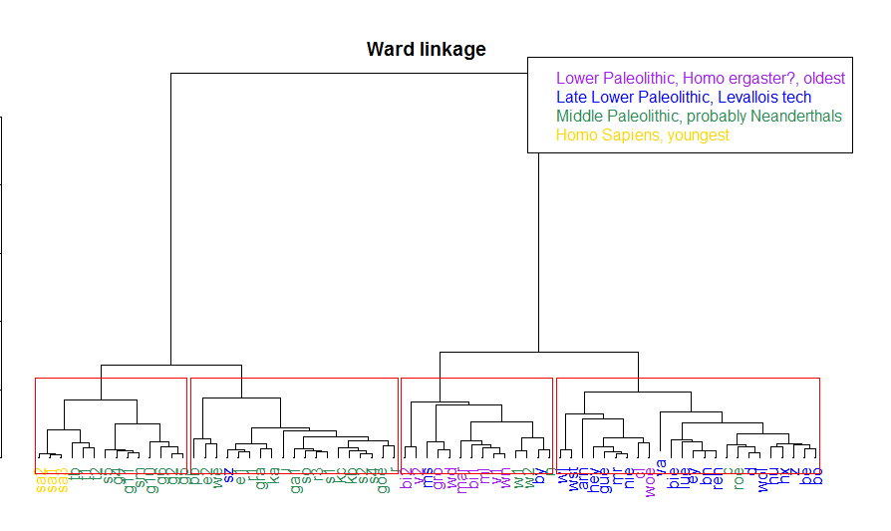
CLustering

Slide 10
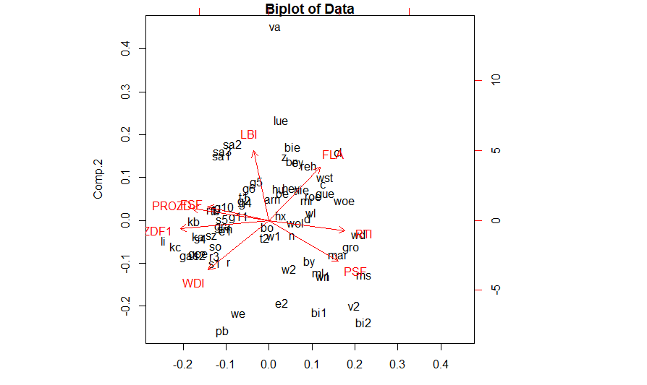
PCA
PC1 PC2
LBI 0.08353495 0.62934222
RTI 0.40814766 0.09025955
WDI 0.32520276 0.44596791
FLA 0.27519939 0.48080250
PSF 0.37225126 0.36452757
FSF 0.33009028 0.12286919
ZDF1 0.47592915 0.07252034
PROZD 0.41340865 0.11174422

Slide 11
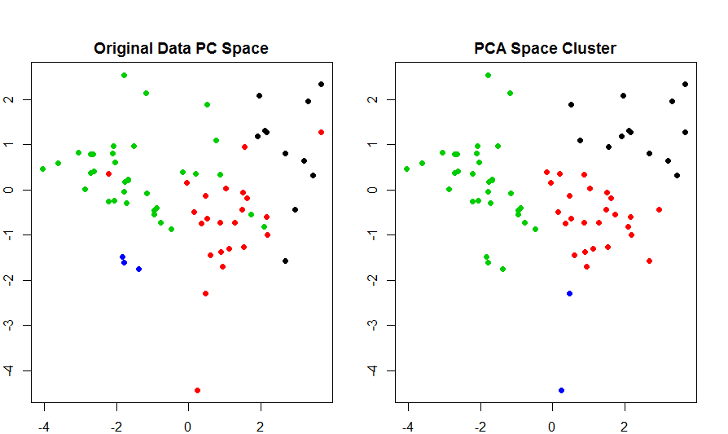
PCA

Slide 12
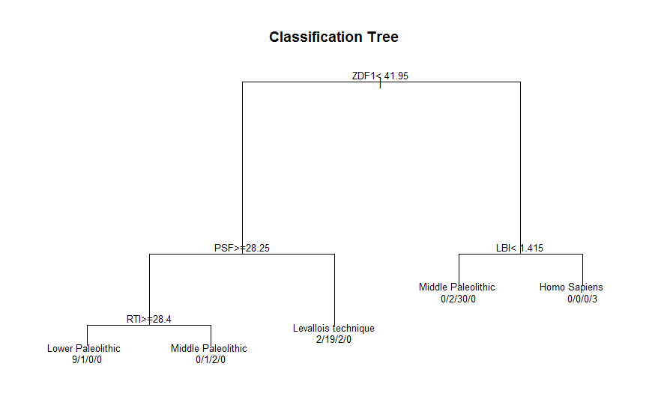
Classification

Slide 13
Classification
By using the Group variable as a classifier made predictions with 8 original variables (not age)
11.3% resubstitution and Leave one out CV error rates
Also use Bagging and RandomForest

Slide 14
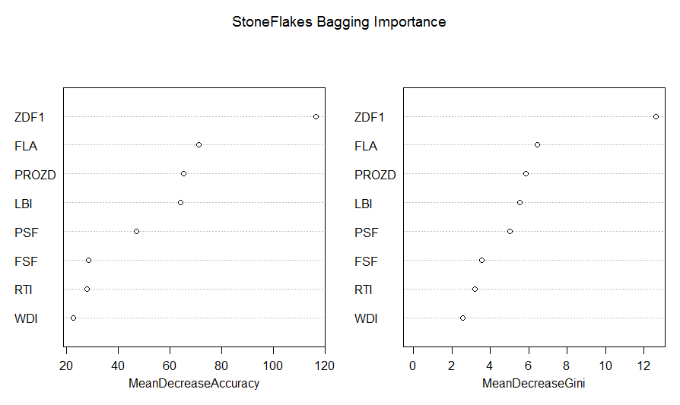
Classification

Slide 15
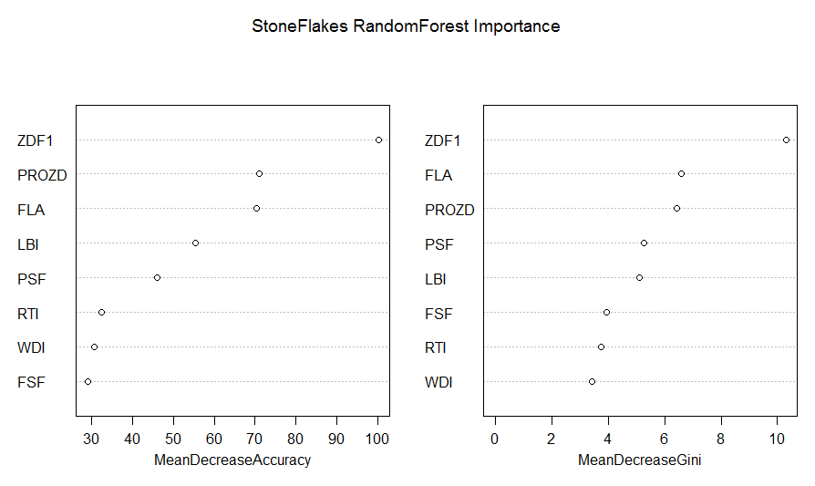
Classification

Slide 16
Classification
Both models show similar importance in ZDF1, FLA, and PROZD variables
Error Rates
16.9% Bagging
19.7% RF

Slide 17
conclusion
Clustering shows good amount of variation between groups
Classifier is fairly accurate

