Slide 1
Chapter 2: Everything Becomes Programmable
Vịnh Nguyễn
Introduction to the Internet of Things v2.0
Notes:
Cisco Networking Academy Program
Introduction to the Internet of Things v2.0
Chapter 2: Everything Becomes Programmable

Slide 2
Instructor Materials – Chapter 2 Planning Guide
This PowerPoint deck is divided in two parts:
Instructor Planning Guide
Information to help you become familiar with the chapter
Teaching aids
Instructor Class Presentation
Optional slides that you can use in the classroom
Begins on slide # 10
Note: Remove the Planning Guide from this presentation before sharing with anyone.
Notes:
2

Slide 3
Chapter 2: Everything Becomes Programmable
Introduction to the Internet of Things v2.0 Planning Guide
Notes:
Cisco Networking Academy Program
Introduction to the Internet of Things
Chapter 2: Everything Becomes Programmable

Slide 4
Chapter 2: Activities
What activities are associated with this chapter?
Page # | Activity Type | Activity Name
2.1.1.1 | Activity | Follow the Flowchart
2.1.1.6 | Activity | Programming Language Concepts
2.1.1.7 | Activity | Identify Programming Terms
2.1.1.8 | Lab | Create a Process Flowchart
2.1.1.9 | Topic Assessment | Match the Flowchart Symbol to the Task
2.1.2.3 | Lab | Blinking an LED Using Blockly
2.1.3.6 | Lab | Setting Up a Virtualized Server Environment
2.1.3.7 | Lab | Basic Python Programming
2.1.3.8 | Lab | Create a Simple Game with Python
2.2.2.5 | Optional Lab | Setting up PL-App with the Raspberry Pi
Notes:
4

Slide 5
Chapter 2: Activities (Cont.)
What activities are associated with this chapter?
Page # | Activity Type | Activity Name
2.2.2.6 | Optional Lab | Using a PL-App Notebook
2.2.2.7 | Optional Lab | Blinking an LED using Raspberry Pi and PL-App
2.2.2.8 | Optional Lab | Introduction to Arduino
Notes:
5

Slide 6
Chapter 2: Assessment
Students should complete Chapter 2, “Assessment” after completing Chapter 2.
Quizzes, labs, topic assessments and other activities can be used to informally assess student progress.
Notes:
6

Slide 7
Chapter 2: Best Practices
Prior to teaching Chapter 2, the instructor should:
Complete Chapter 2, Quiz
Preview the labs, videos and activities.
Investigate Google’s Blockly Games - https://blockly-games.appspot.com/
As you are teaching this chapter, you will need samples of Blockly and Python code that works.
Spend some time investigating the URLs in this chapter.
Notes:
7

Slide 8
Chapter 2: Additional Help
For additional help with teaching strategies, including lesson plans, analogies for difficult concepts, and discussion topics, visit the Community Forums .
If you have lesson plans or resources that you would like to share, upload them to the Community Forums in order to help other instructors.
Students can enroll in Introduction to Packet Tracer (self-paced)
Notes:
8

Slide 10
Chapter 2: Everything Becomes Programmable
Introduction to the Internet of Things v2.0
Notes:
Cisco Networking Academy Program
Introduction to the Internet of Things
Chapter 2: Everything Becomes Programmable

Slide 11
Chapter 2 - Sections & Objectives
2.1 Apply Basic Programming to Support IoT Devices
Use Python to create programs that accept user input and read and write to external files.
Describe basic programming variables and fundamentals.
Apply basic programming variables and fundamentals in Blockly.
Apply basic programming variables and fundamentals using Python
2.2 Prototyping Your Idea
Explain prototyping and its purpose
Describe Prototyping.
Describe the various tools and materials to use to prototype.
Notes:
11
Cisco Networking Academy Program
Introduction to the Internet of Things
Chapter 2: Everything Becomes Programmable

Slide 12
2.1 Apply Basic Programming to Support IoT Devices
Notes:
2 – Everything Becomes Programmable
2.1 – Apply Basic Programming to Support IoT Devices

Slide 13
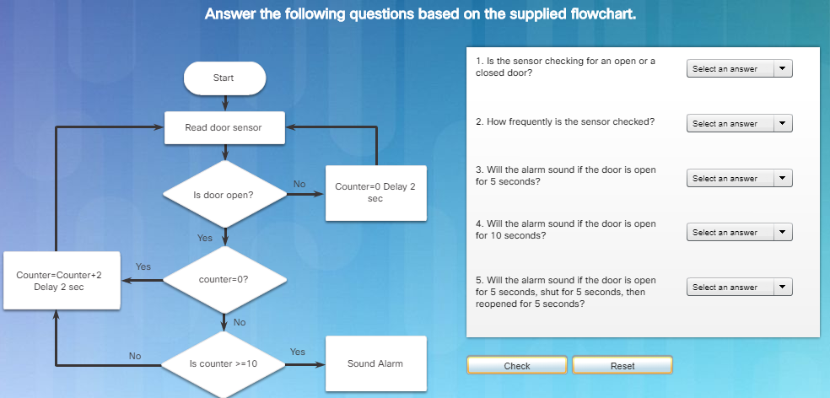
Basic Programming Concepts Follow the Flowchart
Notes:
2.1 – Apply Basic Programming to Support IoT Devices
2.1.1 – Basic Programming Concepts
2.1.1.1 – Follow the Flowchart

Slide 14
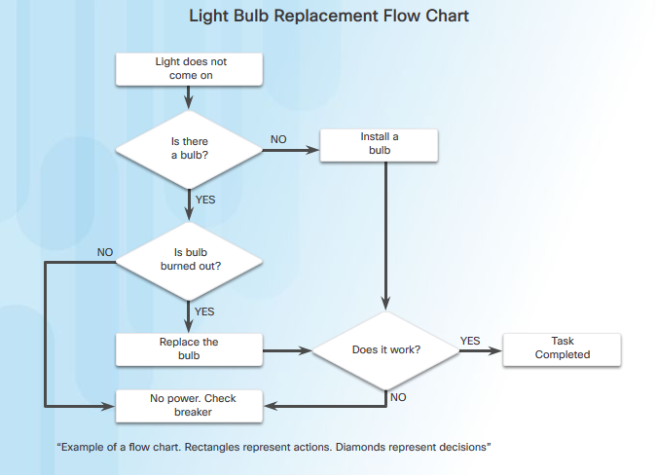
Basic Programming Concepts Flowcharts
Flowcharts:
Diagrams that are used to represent processes or workflows.
Illustrate how a process should work.
Show input states, any decisions made, and the results of those decisions.
Notes:
2.1 – Apply Basic Programming to Support IoT Devices
2.1.1 – Basic Programming Concepts
2.1.1.2 – Flowcharts

Slide 15
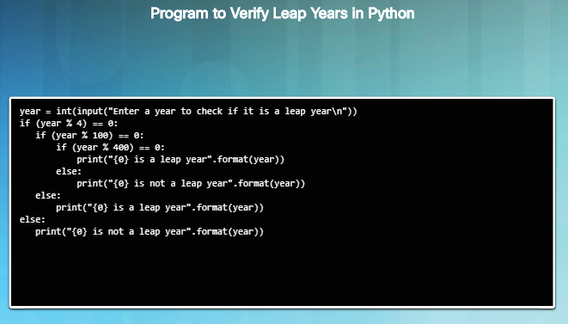
Basic Programming Concepts System Software, Application Software, and Computer Languages
Two common types of computer software: system software and application software.
Application software programs are created to accomplish a certain task or collection of tasks.
System software works between the computer hardware and the application program.
Both system software and application software are created using a programming language.
Python is an example of an interpreted programming language.
Notes:
2.1 – Apply Basic Programming to Support IoT Devices
2.1.1 – Basic Programming Concepts
2.1.1.3 – System Software, Application Software, and Computer Languages

Slide 16

Basic Programming Concepts Programming Variables
Programming languages use variables to hold phrases, numbers, or other important information that can be used in coding.
Variables can hold the result of a calculation, the result of a database query, or some other value.
x + y = z
“x, y and z” are variables which can represent characters, character strings, numeric values or memory addresses
a = 10
associates the value 10 to variable “a”
Variables allow programmers to quickly create a wide range of simple or complex programs which tell the computer to behave in a pre-defined fashion.
Notes:
2.1 – Apply Basic Programming to Support IoT Devices
2.1.1 – Basic Programming Concepts
2.1.1.4 – Programming Variables

Slide 17
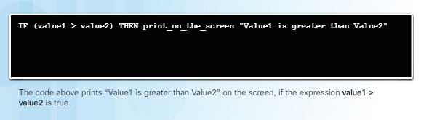
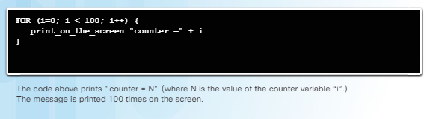
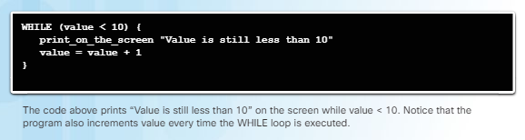
Basic Programming Concepts Basic Program Structures
Most common logic structures are:
IF – THEN allows the computer to make a decision based on the result of an expression.
myVar > 0
True if the value stored in the myVar variable is greater than zero.
If false, the computer moves on to the next structure,
If true, the computer executes the associated action before moving on to the next instruction in the program.
FOR Loops execute a specific set of instructions a specific number of times, based on an expression.
A variable acts as a counter inside a range of values identified by a minimum and a maximum. Every time the loop is executed, the counter variable is incremented. When the counter is equal to the defined maximum value, the loop is abandoned and the execution moves on to the next instruction.
WHILE Loops execute a specific set of instructions while an expression is true.
Notes:
2.1 – Apply Basic Programming to Support IoT Devices
2.1.1 – Basic Programming Concepts
2.1.1.5 – Basic Program Structures
2.1.1.6 – Activity – Programming Language Concepts
2.1.1.7 – Activity – Identify Programming Terms

Slide 18
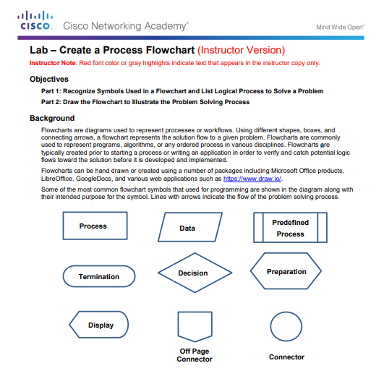
Basic Programming Concepts Lab – Create a Process Flowchart
Notes:
2.1 – Apply Basic Programming to Support IoT Devices
2.1.1 – Basic Programming Concepts
2.1.1.8 – Lab – Create a Process Flowchart
2.1.1.9 – Topic Assessment: Match the Flowchart Symbol to the Task

Slide 19
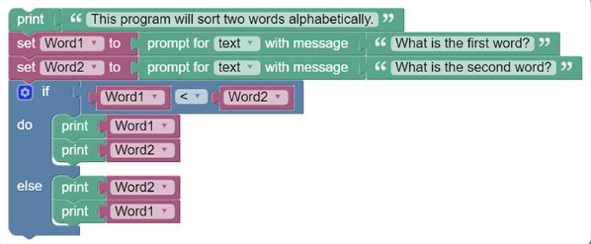
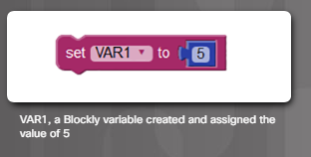
Basic Programming Using Blockly What is Blockly
Setting Up a Variable
Work Space
Visual programming tool created to help beginners understand the concepts of programming. Allows a user to create a program without entering any lines of code.
Assigns different programming structures to colored blocks which contain slots and spaces to allow programmers to enter values. Programmers can connect structures together by dragging and attaching the appropriate blocks.
Specific blocks represent functions. Select and drag function blocks to the work space and fill in the required slots.
Notes:
2.1 – Apply Basic Programming to Support IoT Devices
2.1.2 – Basic Programming Using Blockly
2.1.2.1 – What is Blockly?

Slide 20
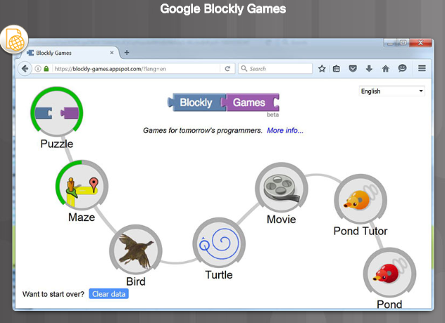
Basic Programming Using Blockly Blockly Games
https://blockly-games.appspot.com/
Notes:
2.1 – Apply Basic Programming to Support IoT Devices
2.1.2 – Basic Programming Using Blockly
2.1.2.2 – Blockly Games

Slide 21
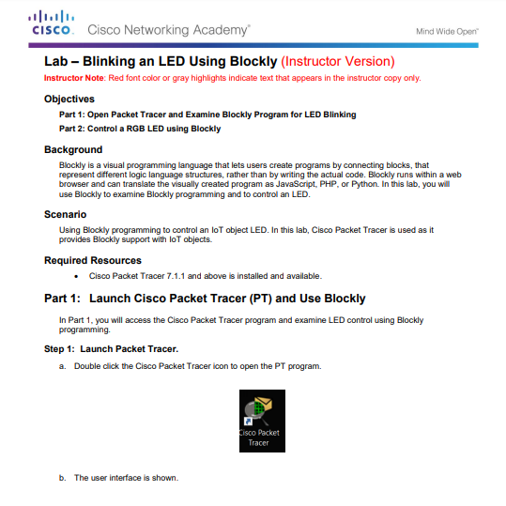
Basic Programming Using Blockly Lab – Blinking an LED Using Blockly
Notes:
2.1 – Apply Basic Programming to Support IoT Devices
2.1.2 – Basic Programming Using Blockly
2.1.2.3 – Lab – Blinking an LED Using Blockly

Slide 22
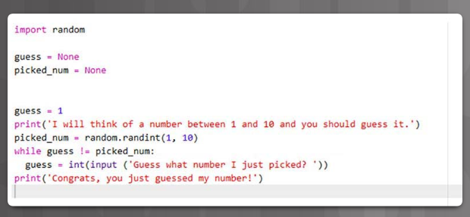
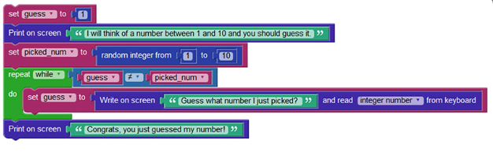
Programming with Python What is Python?
Guessing Game with Blockly
Guessing Game with Python
Python is a very popular language that is designed to be easy to read and write.
Philosophy of the language:
Beautiful is better than ugly
Explicit is better than implicit
Simple is better than complex
Complex is better than complicated
Readability counts
Notes:
2.1 – Apply Basic Programming to Support IoT Devices
2.1.3 – Programming with Python
2.1.3.1 – What is Python?

Slide 23
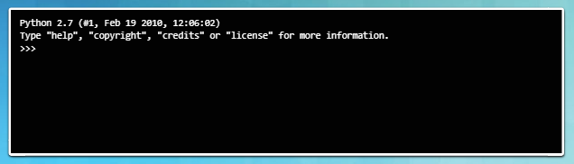
Programming with Python The Python Interpreter
Interpreter Welcome Message
The Python interpreter understands and executes Python code. Python code can be created in any text editor and Python interpreters are available for many operating systems.
In Linux machines, the Python interpreter is usually installed in /usr/bin/python or /usr/bin/python3.
With the new Windows Python installer, Python is installed by default into the user’s home directory. After the Python interpreter has been installed, it operates somewhat like the Linux shell. This means that when called with no arguments, it reads and executes commands interactively. When called with a file name argument or with a file as standard input, it reads and executes a script from that file.
Notes:
2.1 – Apply Basic Programming to Support IoT Devices
2.1.3 – Programming with Python
2.1.3.2 – The Python Interpreter

Slide 24
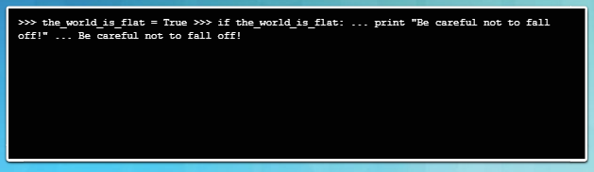
Programming with Python The Python Interpreter (Cont.)
IF-THEN Block
To start the interpreter, simply type python or python3 at the shell prompt.
In interactive mode, the interpreter waits for commands. The primary prompt is represented by three greater-than signs (>>>). Continuation lines are represented by three dots (...).
The >>> prompt indicates the interpreter is ready and waiting commands.
Notes:
2.1 – Apply Basic Programming to Support IoT Devices
2.1.3 – Programming with Python
2.1.3.2 – The Python Interpreter (Cont.)

Slide 25
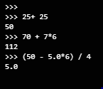
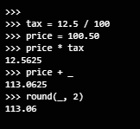
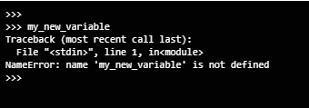

Programming with Python Variables and Basic Statements in Python
The interpreter receives and executes statements interactively.
Special variable “_” holds the result of the last expression issued.
Acts as a simple calculator.
Attempts to use a not defined variable will result in an error.
To assign values to variables, use the = sign.
Notes:
2.1 – Apply Basic Programming to Support IoT Devices
2.1.3 – Programming with Python
2.1.3.3 – Variables and Basic Statements in Python

Slide 26
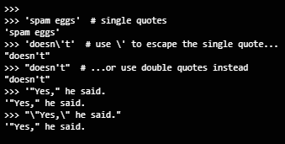
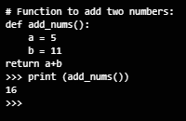

Programming with Python Variables and Basic Statements in Python (Cont.)
The interpreter receives and executes statements interactively.
Print statement prints the result of the expression it was given.
Functions allow for a block of code to be given a name and re-used as needed.
Use the backslash character (\) to escape characters. As an example, a string uses double quotes but also needs to use a double quote within the string.
Single quotes or double quotes can be used to wrap strings.
Notes:
2.1 – Apply Basic Programming to Support IoT Devices
2.1.3 – Programming with Python
2.1.3.3 – Variables and Basic Statements in Python

Slide 27
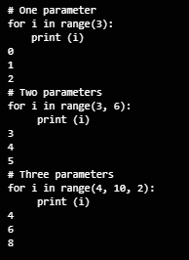
Programming with Python Useful Functions and Data Types in Python
Python supports many useful functions and datatypes. Some of the more important ones are as follows:
Range() - Generates a list of numbers usually used to iterate with FOR loops.
range(stop) - number of integers (whole numbers) to generate, starting from zero
range([start], stop[, step] – Starting number of the sequence, the ending number in the sequence, and the difference between each number in the sequence.
Notes:
2.1 – Apply Basic Programming to Support IoT Devices
2.1.3 – Programming with Python
2.1.3.4 – Useful Functions and Data Types in Python

Slide 28
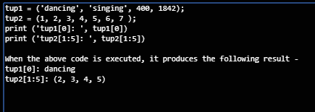
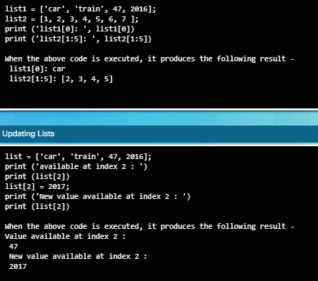
Programming with Python Useful Functions and Data Types in Python (Cont.)
Tuples - sequences, separated by parentheses.
Lists - sequence of changeable Python objects, created by putting different comma-separated values between square brackets.
Notes:
2.1 – Apply Basic Programming to Support IoT Devices
2.1.3 – Programming with Python
2.1.3.4 – Useful Functions and Data Types in Python

Slide 29
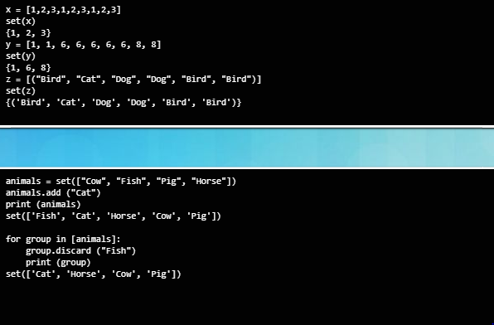
Programming with Python Useful Functions and Data Types in Python (Cont.)
Sets are unordered collections of unique elements. Common uses include membership testing, removing duplicates from a sequence, and computing standard math operations on sets such as intersection, union, difference, and symmetric difference.
Notes:
2.1 – Apply Basic Programming to Support IoT Devices
2.1.3 – Programming with Python
2.1.3.4 – Useful Functions and Data Types in Python

Slide 30
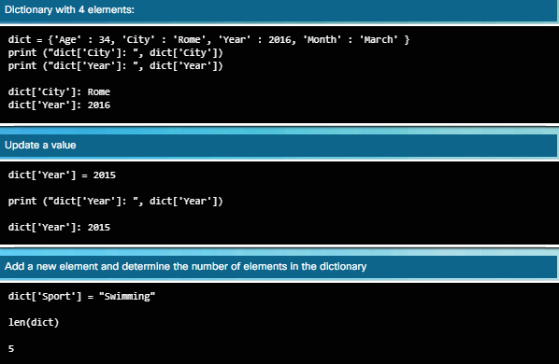
Programming with Python Useful Functions and Data Types in Python (Cont.)
A dictionary is a list of elements that are separated by commas.
Each element is a combination of a value and a unique key.
Each key is separated from its value by a colon.
Dictionary elements can be accessed, updated, and deleted.
Notes:
2.1 – Apply Basic Programming to Support IoT Devices
2.1.3 – Programming with Python
2.1.3.4 – Useful Functions and Data Types in Python

Slide 31
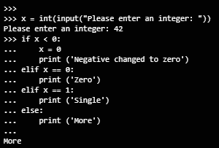
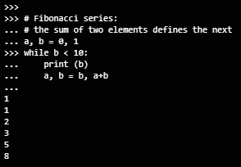
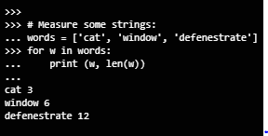
Programming with Python Programming Structures in Python
FOR Loop
Iterates the items of any sequence (a list or a string), in the order that they appear in the sequence
IF-THEN, ELSE, ELIF
Make decisions based upon the result of an expression
ELSE specify instructions to be executed if the expression is false.
ELIF is used to perform a second test.
WHILE Loop
Executes a block of code if the expression is true
Notes:
2.1 – Apply Basic Programming to Support IoT Devices
2.1.3 – Programming with Python
2.1.3.5 – Programming Structures in Python

Slide 32
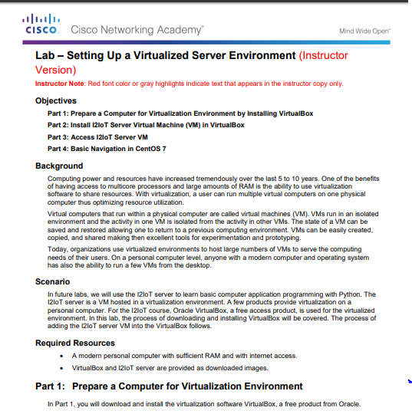
Programming with Python Lab – Setting Up a Virtualized Server Environment
Notes:
2.1 – Apply Basic Programming to Support IoT Devices
2.1.3 – Programming with Python
2.1.3.6 – Lab – Setting Up a Virtualized Server Environment

Slide 33
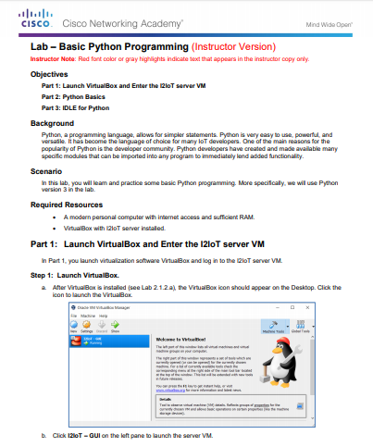
Programming with Python Lab – Basic Python Programming
Notes:
2.1 – Apply Basic Programming to Support IoT Devices
2.1.3 – Programming with Python
2.1.3.7 – Lab – Basic Python Programming

Slide 34
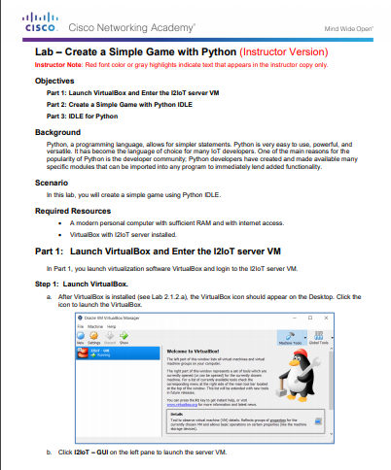
Programming with Python Lab – Create a Simple Game with Python
Notes:
2.1 – Apply Basic Programming to Support IoT Devices
2.1.3 – Programming with Python
2.1.3.8 – Lab – Create a Sample Game with Python

Slide 35
2.2 Prototyping Your Idea
Notes:
2 – Everything Becomes Programmable
2.2 – Prototyping Your Idea

Slide 36
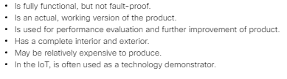
What is Prototyping? Defining Prototyping
Prototyping is the process of creating a working model of a product or system.
In IoT, it helps to have design skills, electrical skills, physical/mechanical skills, programming skills, and to understand how TCP/IP works.
Because the IoT is still developing, there are still unknown tasks to discover.
This is a great time to invent something that is part of the IoT.
Notes:
2.2 – Prototyping Your Idea
2.2.1 – What is Prototyping?
2.2.1.1 – Defining Prototyping

Slide 37
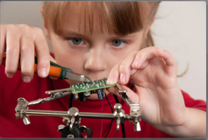
What is Prototyping? How to Prototype
How do you prototype? A team at Google used the “Rapid Prototyping Method” to create the Google Glass.
Kickstarter, Indiegogo, and Crowdfunder are just three of the many online crowd funding programs.
What IoT invention will you create?
Notes:
2.2 – Prototyping Your Idea
2.2.1 – What is Prototyping?
2.2.1.2 – How to Prototype

Slide 38
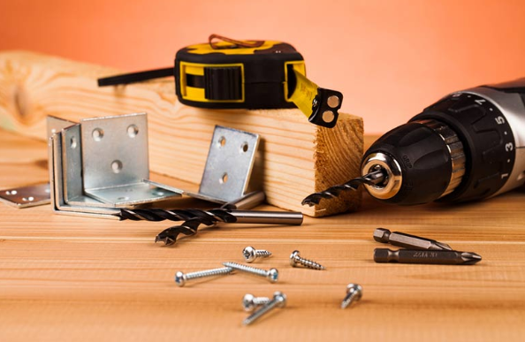
Prototyping Resources Physical Materials
A good place to start is, of course, the Internet. People who have never physically met can now collaborate and work together.
Maker Media is a global platform for connecting makers with each other to exchange projects and ideas.
Making Society has a good section on modeling plastic and clay.
LEGO Mindstorms has a large community of contributors and fans.
Meccano, or Erector Set, is a model construction system that consists of reusable metal strips, plates, angle girders, wheels, axles, and gears, with nuts and bolts to connect the pieces. It lets you build working prototypes and mechanical devices.
3D printing is the process of making a solid object based on a 3D model computer file.
Notes:
2.2 – Prototyping Your Idea
2.2.2 – Prototyping Resources
2.2.2.1 – Physical Materials

Slide 39

Prototyping Resources Electronic Toolkits
While you can create programs for almost any computer, some platforms are designed for the beginner. Below you will find some of the most popular platforms:
Arduino is an open-source physical computing platform based on a simple microcontroller board, and a development environment for writing software for the board. You can develop interactive objects that take input from a variety of switches or sensors to control lights, motors, and other physical objects.
Raspberry Pi is a low cost, credit-card-sized computer that plugs into a computer monitor or TV. You operate it using a standard keyboard and mouse. It is capable of doing everything a computer can do, from browsing the Internet and playing high-definition video, to making spreadsheets, word-processing, and playing games.
The Beaglebone is very similar to the Raspberry Pi in size, power requirements, and application. The Beaglebone has more processing power than the Raspberry Pi; therefore, it is a better choice for applications with higher processing requirements.
Notes:
2.2 – Prototyping Your Idea
2.2.2 – Prototyping Resources
2.2.2.2 – Electronic Toolkits

Slide 40
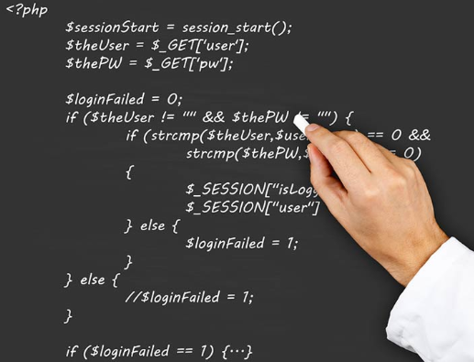
Prototyping Resources Programming Resources
Programming is critical to the IoT. Creating custom code is very useful when developing an IoT solution. There are many other free resources that can help you get started with programming:
The MIT OpenCourseWare (OCW) is a web-based publication of almost all MIT course content. Open and available to the world, OCW is a great place to get familiar with computer programming for free. OCW programming related courses can be found at http://ocw.mit.edu/courses/intro-programming.
Khan Academy is a non-profit educational website created in 2006 to provide “a free, world-class education for anyone, anywhere”. The lectures related to computer programming can be found at https://www.khanacademy.org/computing/cs.
Code Academy is another excellent resource. It relies on interactivity to help people learn how to write computer programs. You can find them at http://www.codeacademy.com.
Notes:
2.2 – Prototyping Your Idea
2.2.2 – Prototyping Resources
2.2.2.3 – Programming Resources

Slide 41
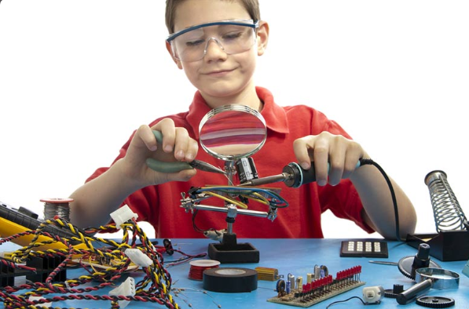
Prototyping Resources Community Inventor and Entrepreneurship Workshops
So, perhaps you have just created something really great. What now? There are a number of places where you can get help exposing your idea or prototype to others.
Investigate what is available in your community.
The Internet has many resources to help your idea get exposure. A good example is Quirky. Quirky allows users to share their ideas. When an idea is submitted, other Quirky users can vote and choose whether or not they want to support your idea. If an idea is good, it may become a real product. You can learn more about Quirky at https://www.quirky.com/how-it-works.
Notes:
2.2 – Prototyping Your Idea
2.2.2 – Prototyping Resources
2.2.2.4 – Community Inventor and Entrepreneurship Workshops

Slide 42
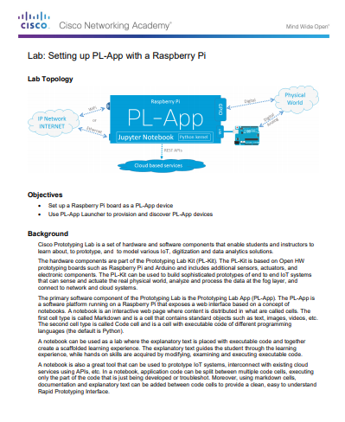
Prototyping Resources Optional Lab – Setting up PL-App with the Raspberry Pi
Notes:
2.2 – Prototyping Your Idea
2.2.2 – Prototyping Resources
2.2.2.5 – Optional Lab – Setting up PL-App with the Raspberry Pi

Slide 43
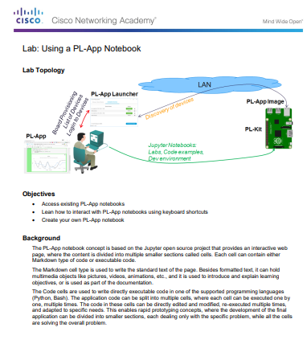
Prototyping Resources Optional Lab – Using a PL-App Notebook
Notes:
2.2 – Prototyping Your Idea
2.2.2 – Prototyping Resources
2.2.2.6 – Optional Lab – Using a PL-App Notebook

Slide 44
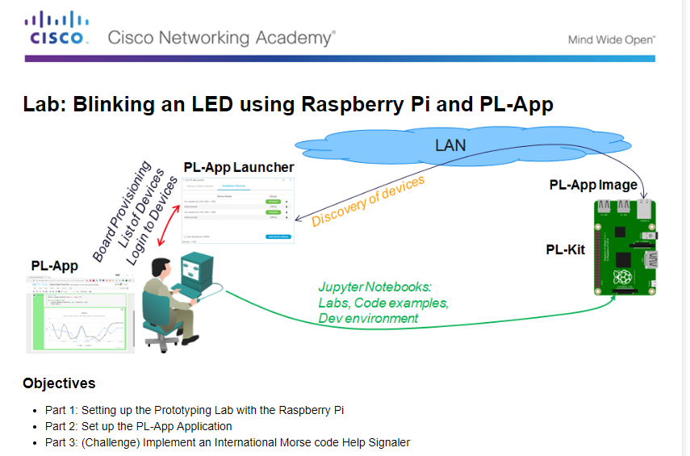
Prototyping Resources Optional Lab – Blinking an LED using Raspberry Pi and PL-App
Notes:
2.2 – Prototyping Your Idea
2.2.2 – Prototyping Resources
2.2.2.7 – Optional Lab – Blinking an LED using Raspberry Pi and PL-App

Slide 45
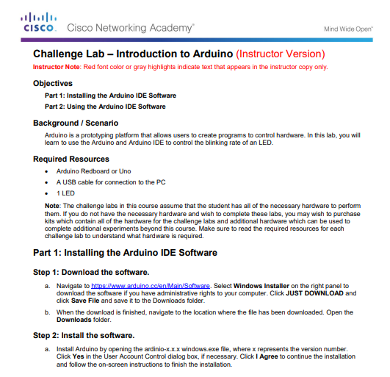
Prototyping Resources Optional Lab – Introduction to Arduino
Notes:
2.2 – Prototyping Your Idea
2.2.2 – Prototyping Resources
2.2.2.8 – Optional Lab – Introduction to Arduino

Slide 46
2.3 Chapter Summary
Notes:
2 – Everything Becomes Programmable
2.3 - Summary

Slide 47
Chapter Summary Summary
Flowcharts are diagrams that are used to represent processes.
There are two common types of computer software: system software and application software. Application software programs are created to accomplish a certain task. System software works between the computer hardware and the application program.
The most common logic structures are IF – THEN, FOR Loops, and WHILE Loops.
Blockly is a visual programming tool created to help beginners understand the concepts of programming. Blockly implements visual programming by assigning different programming structures to colored blocks.
Python is a very popular language that is designed to be easy to read and write. Python is an interpreted language; therefore, an interpreter is required to parse and execute Python code.
Python supports many useful functions and datatypes including Range(), Tuples, Lists, Sets, Dictionary. Python also implements two sub-structures named ELSE and ELIF.
Notes:
2 – Everything Becomes Programmable
2.3 – Summary

