Slide 1
Chapter 6: Educational and Business Opportunities
Vịnh Nguyễn
Introduction to the Internet of Things v2.0
Notes:
Cisco Networking Academy Program
Introduction to the Internet of Things v2.0
Chapter 6: Educational and Business Opportunities

Slide 2
Instructor Materials – Chapter 6 Planning Guide
This PowerPoint deck is divided in two parts:
Instructor Planning Guide
Information to help you become familiar with the chapter
Teaching aids
Instructor Class Presentation
Optional slides that you can use in the classroom
Begins on slide # 9
Note: Remove the Planning Guide from this presentation before sharing with anyone.
Notes:
2

Slide 3
Chapter 6: Educational and Business Opportunities
Introduction to the Internet of Things v2.0 Planning Guide
Notes:
Cisco Networking Academy Program
Introduction to the Internet of Things
Chapter 6: Educational and Business Opportunities

Slide 4
Chapter 6: Activities
What activities are associated with this chapter?
Page # | Activity Type | Activity Name
6.1.2.6 | Lab | IoT Related Job and Learning Opportunities
Notes:
4

Slide 5
Chapter 6: Assessment
Students should complete Chapter 6, “Assessment” after completing Chapter 6.
Quizzes, labs, topic assessments and other activities can be used to informally assess student progress.
Notes:
5

Slide 6
Chapter 6: Best Practices
Prior to teaching Chapter 6, the instructor should:
Complete Chapter 6, Quiz
Preview the labs, videos and activities.
Notes:
6

Slide 7
Chapter 6: Additional Help
For additional help with teaching strategies, including lesson plans, analogies for difficult concepts, and discussion topics, visit the Community Forums .
If you have lesson plans or resources that you would like to share, upload them to the Community Forums in order to help other instructors.
Students can enroll in Introduction to Packet Tracer (self-paced)
Notes:
7

Slide 9
Chapter 6: Educational and Business Opportunities
Introduction to the Internet of Things v2.0
Notes:
Cisco Networking Academy Program
Introduction to the Internet of Things
Chapter 6: Educational and Business Opportunities

Slide 10
Chapter 6 - Sections & Objectives
6.1 Explain the challenges and opportunities that exist in the digitized world.
Explain the challenges and opportunities that exist in the digitized world.
Describe the educational opportunities and communities of interest related to IoT.
Notes:
10
Cisco Networking Academy Program
Introduction to the Internet of Things
Chapter 6: Educational and Business Opportunities

Slide 11
6.1 Where Can I Go from Here?
Notes:
6 – Educational and Business Opportunities
6.1 – Where Can I Go from Here?

Slide 12

Challenges and Opportunities in the Digital World Become an Informed Consumer
Technical gains, together with recent developments in automation and artificial intelligence, have created a highly digitized world.
Digitization currently impacts every aspect of our daily lives and continues to provide new opportunities for professionals.
The IoT provides an immeasurable amount of information that is readily available for consumption.
Think about what else has changed in your life because of the IoT.
The IoT is also freeing humans from the drudgery of routine and repetitive tasks such as restocking shelves and order fulfillment.
How will you use the IoT to help improve the future?
Notes:
6.1 – Where Can I Go from Here?
6.1.1 – Challenges and Opportunities in the Digital World
6.1.1.1 – Become an Informed Consumer

Slide 13

Challenges and Opportunities in the Digital World Challenges in the Digitized World
We are now faced with an ever expanding collection of new technology that we must master.
Transformational technologies that we have experienced in recent history.
The development of the automobile allowed for greater mobility of the workforce and increased recreational activities.
The personal computer allowed the automation of many routine tasks and improved their accuracy and efficiency.
The Internet started to break down geographic barriers and improve equality between people on a global scale.
Each perceived challenge opens up many new opportunities.
Can you imagine how your life would be without a car, personal computer, or access to the Internet?
Notes:
6.1 – Where Can I Go from Here?
6.1.1 – Challenges and Opportunities in the Digital World
6.1.1.2 – Challenges in the Digitized World

Slide 14

Challenges and Opportunities in the Digital World The Evolving Job Market
Traditional jobs are being replaced with jobs that are designed to embrace this new world and all it offers.
These jobs reflect skills spanning multiple disciplines that include computer science, computer engineering, and software engineering in the following areas:
Artificial Intelligence
Application Development
IoT Program Developer
IoT Security Specialist
Collaboration
Enterprise Networks
Data Center and Virtualization
Notes:
6.1 – Where Can I Go from Here?
6.1.1 – Challenges and Opportunities in the Digital World
6.1.1.3 – The Evolving Job Market

Slide 15
Challenges and Opportunities in the Digital World The Evolving Job Market (Cont.)
There are broad categories that summarize the job opportunities that exist in the evolving digitized world:
Enablers – These jobs develop and implement the underlying technology.
Engagers –These jobs design, create, integrate, and deliver IoT services to customers.
Enhancers – These jobs devise their own value-added services, on top of the services provided by Engagers, which are unique to the Internet of Things.
Notes:
6.1 – Where Can I Go from Here?
6.1.1 – Challenges and Opportunities in the Digital World
6.1.1.3 – The Evolving Job Market

Slide 16
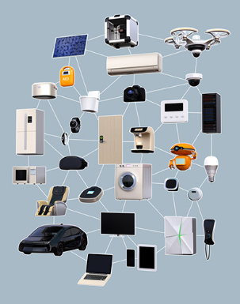
Challenges and Opportunities in the Digital World Entrepreneurs needed!
New kind of IT specialist needed! Individuals with the knowledge and skillsets to develop new IoT-enabled products and process the data they collect.
An entrepreneurial workforce is needed that specializes in both information science and software or computer engineering.
People must collaborate and learn from each other to understand the things, the networks, and methodologies that harness the limitless potential of the IoT.
Notes:
6.1 – Where Can I Go from Here?
6.1.1 – Challenges and Opportunities in the Digital World
6.1.1.4 – Entrepreneurs needed!

Slide 17

Challenges and Opportunities in the Digital World Lifelong Learning
With the ever changing landscape of the digitized world, we must stay current in order to realize the full potential of what the IoT has to offer.
The job market will continue to offer more opportunities as new technologies evolve.
The skill sets required for these jobs will evolve at the same time, thus creating the need for lifelong learning.
Notes:
6.1 – Where Can I Go from Here?
6.1.1 – Challenges and Opportunities in the Digital World
6.1.1.5 – Lifelong Learning

Slide 18
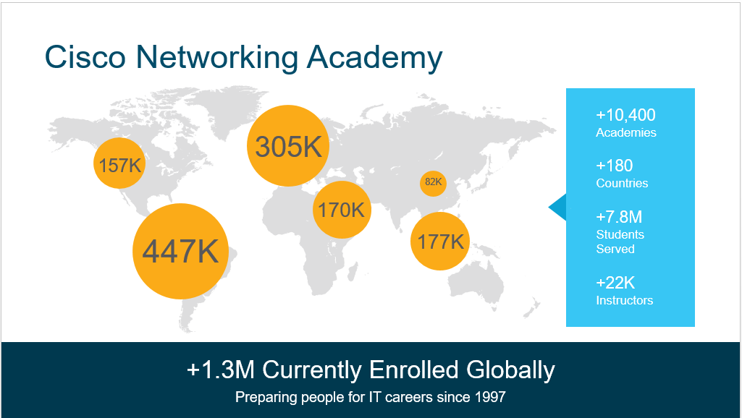
Educational and Professional Opportunities Cisco Networking Academy
There is a global shortage of people who are qualified to implement and maintain networking solutions.
Cisco Networking Academy:
Helps individuals prepare for industry-recognized certifications and entry-level information and communication technology (ICT) careers in virtually every type of industry.
Trained more than five million students to date.
Many graduates have gone on to successful IT careers in a variety of industries, while others have started their own businesses.
Notes:
6.1 – Where Can I Go from Here?
6.1.2 – Educational and Professional Opportunities
6.1.2.1 – Cisco Networking Academy

Slide 19
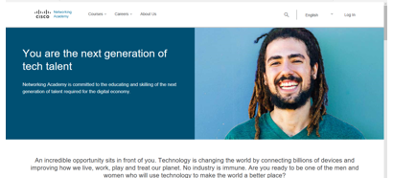
Educational and Professional Opportunities Networking Academy Curriculum
Students complete hands-on learning activities and network simulations to develop practical skills that will help them find jobs in IT.
These are some of the offerings of the Networking Academy:
IoT Fundamentals
IT Essentials
Entrepreneurship
Introduction to Cybersecurity
CCNA Routing and Switching
CCNA Security
CCNP
For more information on our latest offerings, go to the Networking Academy website at www.netacad.com.
Notes:
6.1 – Where Can I Go from Here?
6.1.2 – Educational and Professional Opportunities
6.1.2.2 – Networking Academy Curriculum

Slide 20

Educational and Professional Opportunities Communities of Interest
A community of interest is a group of people who share a common interest or passion about a specific topic.
IEEE and LinkedIn have an IoT community.
Some communities are supported by industry and provide a place to help development of their products and technology, as well as those of their business partners. Two such communities provided by Cisco are the Cisco Learning Network and Cisco DevNet.
Cisco Learning Network is designed for people who wish to develop their skills in various Cisco technologies and pursue Cisco certification. learningnetwork.cisco.com
DevNet is a Developer Program from Cisco that consists of a website, an interactive developer community, coordinated developer tools, integrated discussion forums, and sandboxes. developer.cisco.com
Notes:
6.1 – Where Can I Go from Here?
6.1.2 – Educational and Professional Opportunities
6.1.2.3 – Communities of Interest

Slide 21
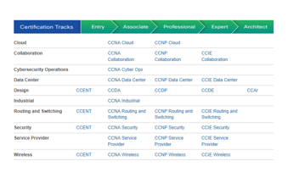
Educational and Professional Opportunities Industry Certifications
Industry certifications are highly respected by employers around the world and help validate the skills needed to launch successful careers in networking and IT.
Certifications are achieved by passing an exam proctored by a certifying authority.
There are two basic types of certification available: vendor-specific and vendor-neutral.
Most often, certifications must be renewed over time.
To explore all of the different Cisco career certifications, visit the following website: https://learningnetwork.cisco.com.
Notes:
6.1 – Where Can I Go from Here?
6.1.2 – Educational and Professional Opportunities
6.1.2.4 – Industry Certifications

Slide 22

Educational and Professional Opportunities Additional Learning Resources
Community college or university degrees can show that a person has gained a broad understanding in a field of study.
A combination of industry certifications and university degrees provides a student with the best background, experience, and education to pursue a career with greater opportunities and higher salary.
Look for a degree to pursue at a community college or university that will pertain to the skillsets needed for a career in IoT, watch for some of the following degrees:
Business Intelligence
Computer Information Systems
Computer Programming
Computer Science
Database Administration
Electromechanical Automation
Electronics Engineering
Linux Networking
Machining
Network Administration
System Analysis
Web Server Administrator
Notes:
6.1 – Where Can I Go from Here?
6.1.2 – Educational and Professional Opportunities
6.1.2.5 – Additional Learning Resources

Slide 23
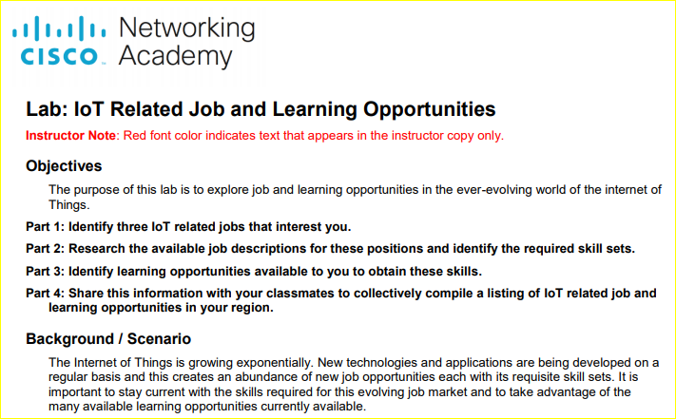
Educational and Professional Opportunities Lab – IoT Related Job and Learning Opportunities
Notes:
6.1 – Where Can I Go from Here?
6.1.2 – Educational and Professional Opportunities
6.1.2.6 – Lab – IoT Related Job and Learning Opportunities

Slide 24
6.2 Chapter Summary
Notes:
6 – Educational and Business Opportunities
6.2 - Summary

Slide 25
Chapter Summary Summary
Technical gains, together with recent developments in automation and artificial intelligence, have created a highly digitized world.
Digitization currently impacts every aspect of our daily lives and continues to provide new opportunities for professionals.
We are now faced with an ever expanding collection of new technology that we must master.
Traditional jobs are being replaced with jobs that are designed to embrace this new world and all it offers.
There are broad categories that summarize the job opportunities that exist in the evolving digitized world:
Enablers – These jobs develop and implement the underlying technology.
Engagers –These jobs design, create, integrate, and deliver IoT services to customers.
Enhancers – These jobs devise their own value-added services, on top of the services provided by Engagers, which are unique to the Internet of Things.
Notes:
6 – Educational and Business Opportunities
6.2 – Summary

Slide 26
Chapter Summary Summary (Cont.)
An entrepreneurial workforce is needed that specializes in both information science and software or computer engineering.
People must collaborate and learn from each other to understand the things, the networks, and methodologies that harness the limitless potential of the IoT.
The job market will continue to offer more opportunities as new technologies evolve.
The skill sets required for these jobs will evolve at the same time, thus creating the need for lifelong learning.
Cisco Networking Academy:
Helps individuals prepare for industry-recognized certifications and entry-level information and communication technology (ICT) careers in virtually every type of industry.
Trained more than five million students to date.
For more information on our latest offerings, go to the Networking Academy website at www.netacad.com.
Notes:
6 – Educational and Business Opportunities
6.2 – Summary

Slide 27
Chapter Summary Summary (Cont.)
A community of interest is a group of people who share a common interest or passion about a specific topic.
Cisco Learning Network is designed for people who wish to develop their skills in various Cisco technologies and pursue Cisco certification. learningnetwork.cisco.com
DevNet is a Developer Program from Cisco that consists of a website, an interactive developer community, coordinated developer tools, integrated discussion forums, and sandboxes. developer.cisco.com
Certifications are achieved by passing an exam proctored by a certifying authority.
There are two basic types of certification available: vendor-specific and vendor-neutral.
To explore all of the different Cisco career certifications, visit the following website: https://learningnetwork.cisco.com.
Community college or university degrees can show that a person has gained a broad understanding in a field of study.
Notes:
6 – Educational and Business Opportunities
6.2 – Summary

