Slide 1

Smart team
Michaela Belušková
Bibiana Dobrová
Diana Hasinová
Patrik Neštrák
Glib Zakharov

Slide 2

Timeline
Week 1-4
Choose relevant data, store and manage collections of data
Design the structure of the real-time data collection
Code the system for obtained data

Slide 3






Slide 4
Timeline
Week 5
Find relevant relations between the system outputs and inputs
Measure the step responses of different variables
Evaluate system models represented as transfer functions

Slide 5
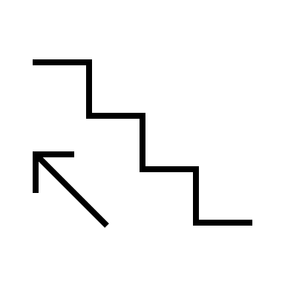
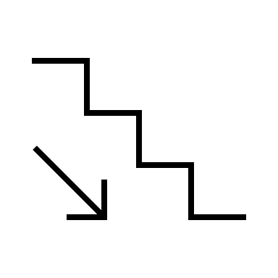
STEP CHANGES:
0 → 25 → 50 → 75 → 100
0 → 33 → 66 → 100
0 → 50 → 100
0 → 100
100 → 75 → 50 → 25 → 0
100 → 66 → 33 → 0
100 → 50 → 0
100 → 0

Slide 6
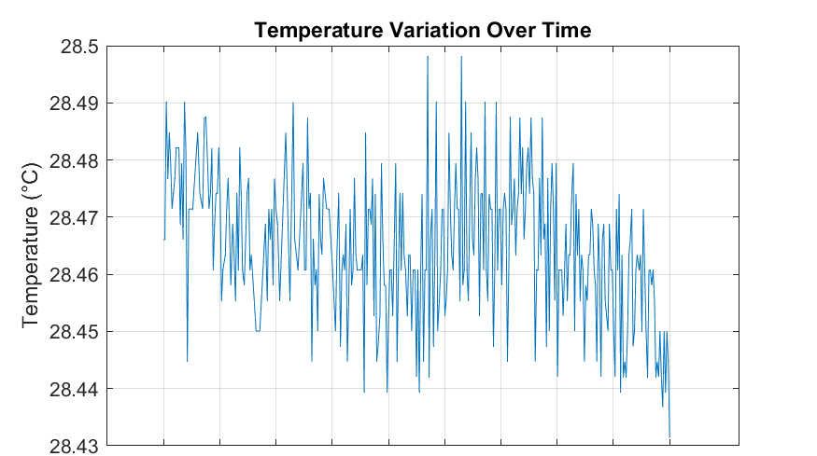
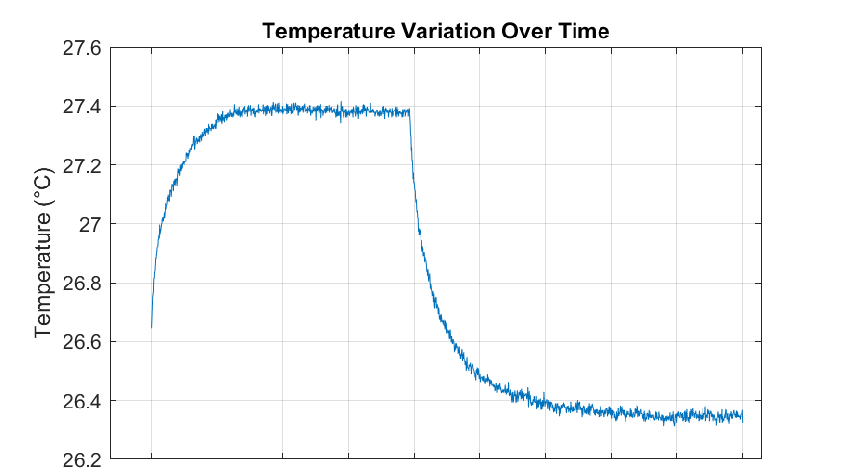
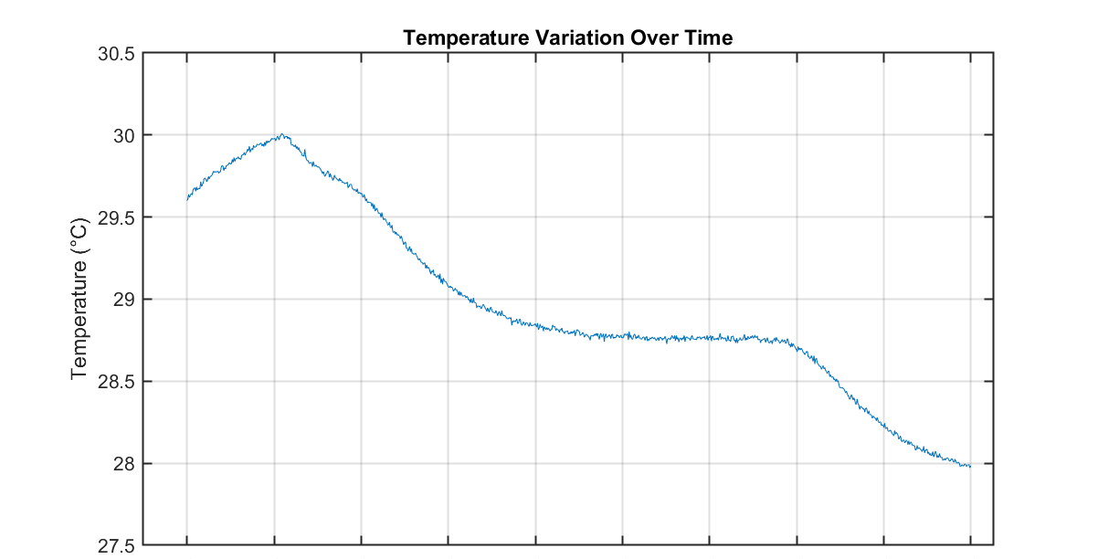
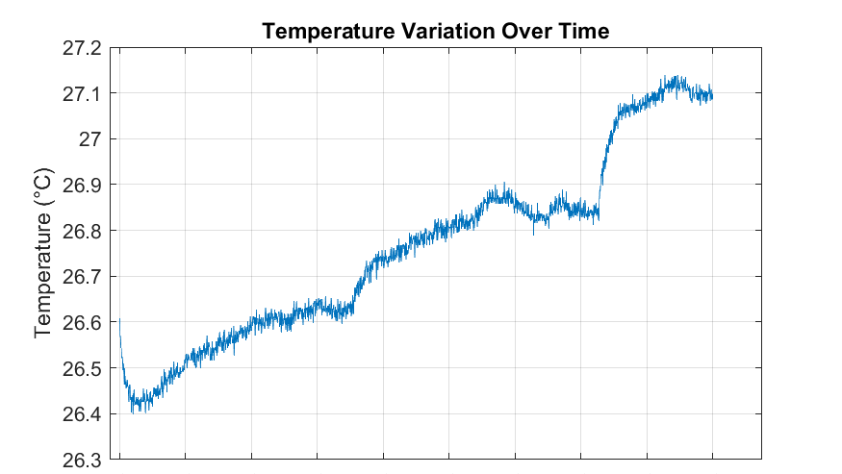

Slide 7
Timeline
Week 6-10
Mid-term presentation
Choose the right controller and select variables
Code feedback control for selected variables
Adjust the PID controllers in Matlab

Slide 8
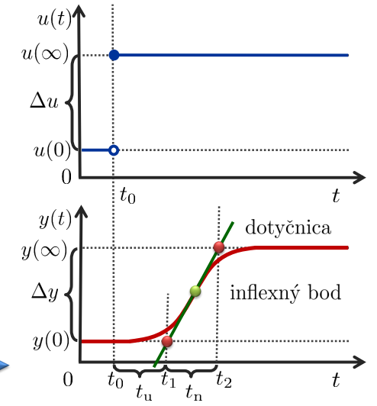
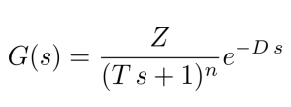
Identification of the system by the Strejc method

Slide 9
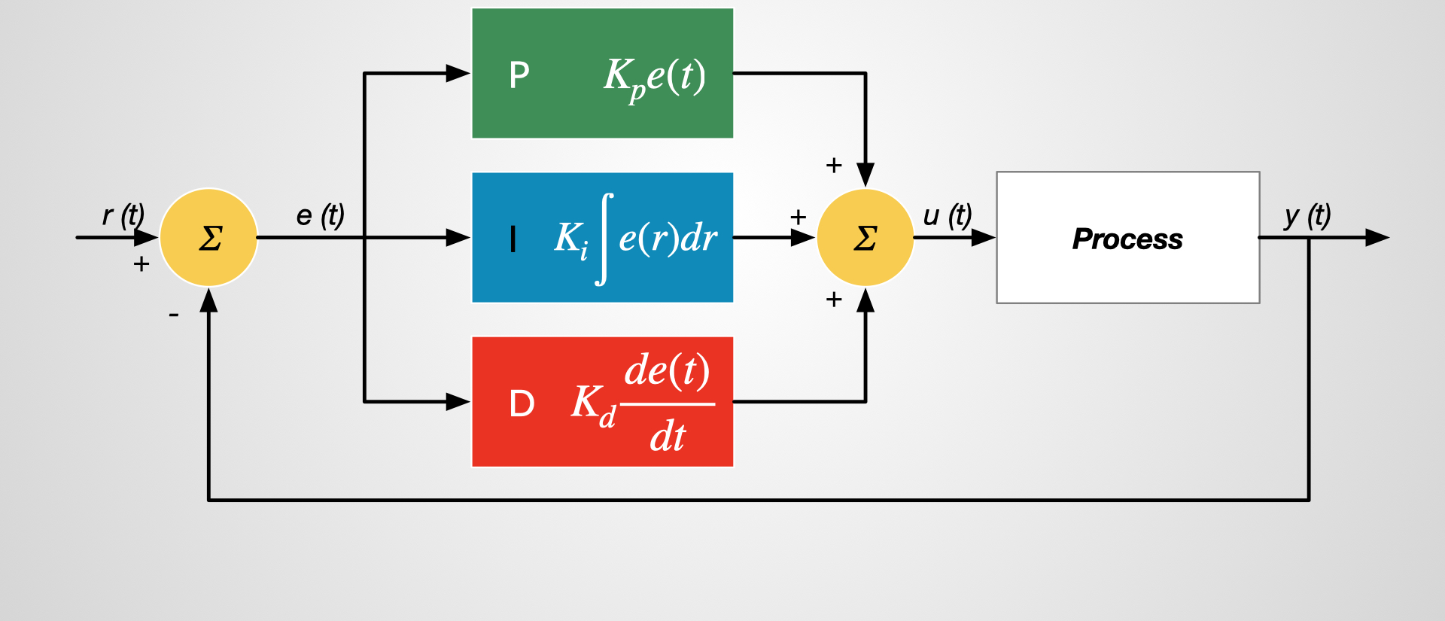
PI
PID

Slide 10
Timeline
Week 11-12
Eleminate mistakes
Optimizing
Ensure everything works

Slide 11
Timeline
Week 13
Complete documentation
Final presentation

Slide 12
Responsibilities:
Collecting data
Managing data
Helping with managing data and programming
Designing PID controller
Collecting data
Communication and cooperation
291
391
all

