Slide 1
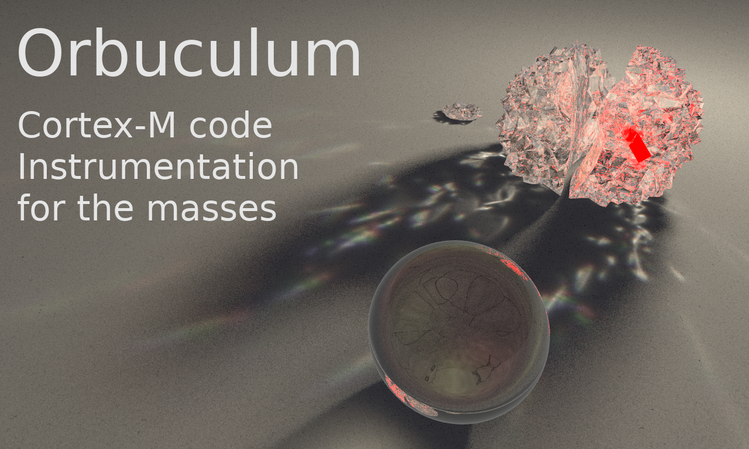
ORBTrace CMSIS-DAP Performance
(unoptimised)
26 May 2021
STM32F427VI Linux pyOCD Linux OpenOCD | 50MHz Connection First Run Other Runs |  | 25MHz Connection First Run Other Runs
Flash 512K (all 1’s) (No caching) | 5.336 Sec 4.579 Sec 89 KB/Sec 113 KB/Sec | 0.939 Sec 9.654 Sec 545 KB/Sec 53 KB/Sec | 5.748 Sec 4.625 Sec 90 KB/Sec 112 KB/Sec | 1.175 Sec 9.615 Sec 436 KB/Sec 53 KB/Sec
Flash 512K (all 0’s) (No caching) | 12.379 Sec 12.457 Sec 41 KB/Sec 41 KB/Sec | 0.940 Sec 7.466 Sec 545 KB/Sec 69 KB/Sec | 12.511 Sec 12.449 Sec 41 KB/Sec 41KB/Sec | 1.180 Sec 7.435 Sec 434 KB/Sec 69 KB/Sec
Dump 2MB to file | 4.382 Sec 1.35 Sec 479 KB/Sec 1.48 MB/Sec | 2.223 Sec* 1.35 Sec 944 KB/Sec 1.48 MB/Sec | 5.865 Sec 1.87 Sec 358 KB/Sec 1.07 MB/Sec | 2.222 Sec* 1.87 Sec 944 KB/Sec 1.07 MB/Sec

