Slide 1
Advanced Tables
Microsoft Access 2013
Lesson 9

Slide 2
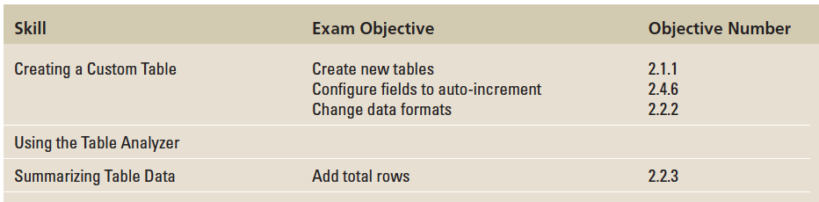
Objectives

Slide 3
Step by Step: Create a Custom Table in Design View
GET READY. Before you begin these steps, be sure to turn on and/or log on to your computer and LAUNCH Access.
OPEN Lucerne Publishing from the data files for this lesson.
SAVE the database as Lucerne PublishingXXX (where XXX is your initials).

Slide 4
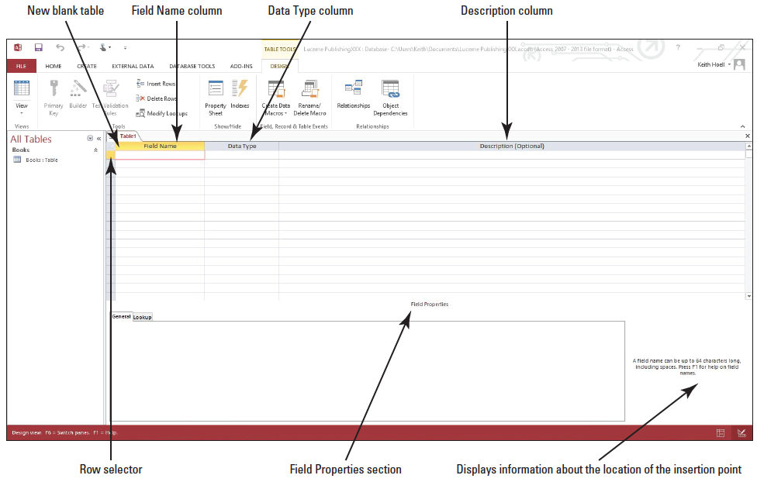
Step by Step: Create a Custom Table in Design View
On the CREATE tab, in the Tables group, click the Table Design button. A new blank table is created in Design view, as shown below.

Slide 5
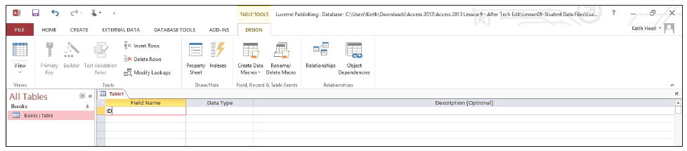
Step by Step: Create a Custom Table in Design View
Key ID in the Field Name column, as shown below.
[Press the Tab key] to move to the Data Type column.
Notes:
Take Note: Throughout this lesson you will see information that appears in black text within brackets, such as [Press Enter], or [your e-mail address]. The information contained in the brackets is intended to be directions for you rather than something you actually type word-for-word. It will instruct you to perform an action or substitute text. Do not type the actual text that appears within brackets.

Slide 6
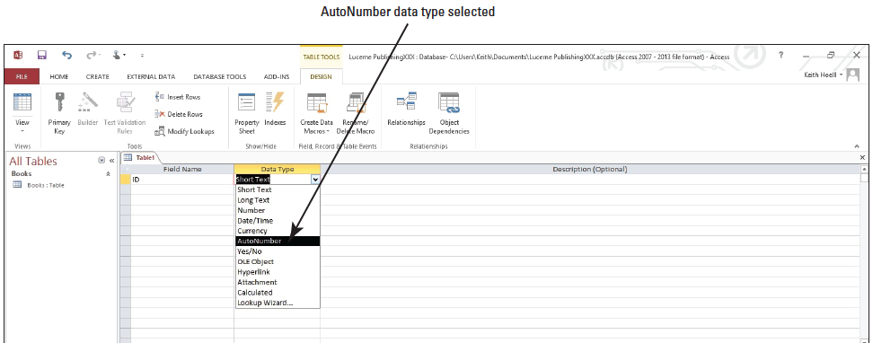
Step by Step: Create a Custom Table in Design View
Click the down arrow in the Data Type column and select AutoNumber from the menu, as shown below. The AutoNumber data type will automatically number your records starting at 1.
[Press the Tab key] to move to the Description field.

Slide 7
Step by Step: Create a Custom Table in Design View
Key Record Number and [press Tab] again to move to the next blank field row.
Key Gross Sales and [press the Tab key].
Click the down arrow on the Data Type column and select Currency from the menu.

Slide 8
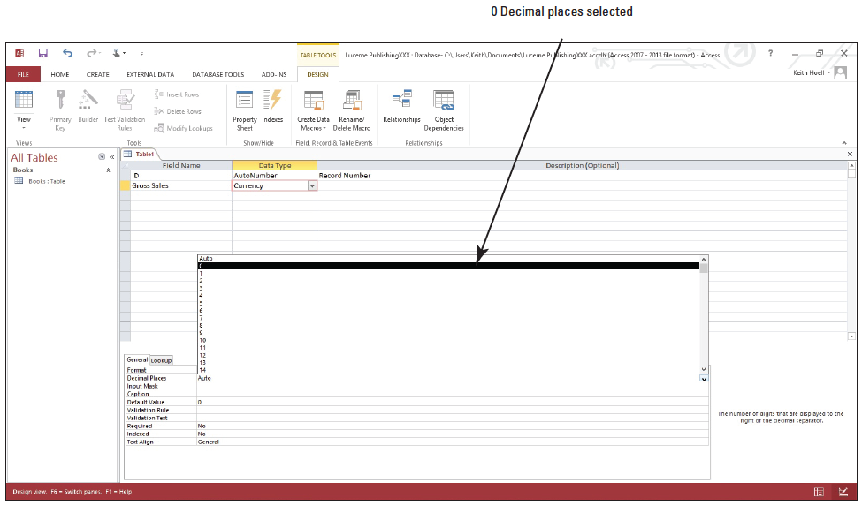
Step by Step: Create a Custom Table in Design View
Click in the Decimal Places row in the Field Properties section. Click the down arrow and select 0 from the menu, as shown below.

Slide 9
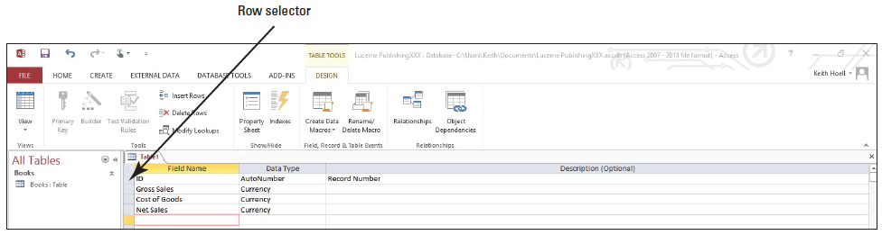
Step by Step: Create a Custom Table in Design View
Enter the remaining fields, as shown below, formatting each with the Currency data type and 0 decimal places.

Slide 10
Step by Step: Create a Custom Table in Design View
Click the row selector to the left of the ID field to select the row.
On the DESIGN tab, in the Tools group, click the Primary Key button.
Click the Save button on the Quick Access Toolbar. The Save As dialog box appears.
Key Sales and click OK.
PAUSE. LEAVE the database open to use in the next exercise.

Slide 11
Step by Step: Insert and Delete Rows in Design View
USE the database that is open from the previous exercise.
Click the row selector to the left of the Gross Sales field to select the entire row.
In the Tools group on the TABLE TOOLS DESIGN contextual tab, click the Delete Rows button. The field row is deleted from the table.
Click the Undo button on the Quick Access Toolbar. The field row reappears.

Slide 12
Step by Step: Insert and Delete Rows in Design View
In the Tools group on the TABLE TOOLS DESIGN contextual tab, click the Insert Rows button. A blank row is inserted above the Gross Sales field.
In the Field Name column, key Area and [press the Tab key].
[Press the Tab key] again to accept the Short Text data type.
Leave the Description field blank and [press Tab] again to move to the next field.
Click the Save button on the Quick Access Toolbar.

Slide 13
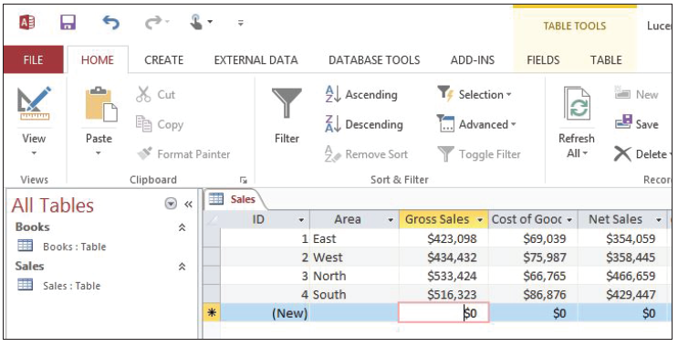
Step by Step: Insert and Delete Rows in Design View
Switch to Datasheet view and enter the records in the table as shown below. The ID field will be automatically generated, so just [press Tab] to get past it.
SAVE and CLOSE the table.
PAUSE. LEAVE the database open to use in the next exercise.

Slide 14
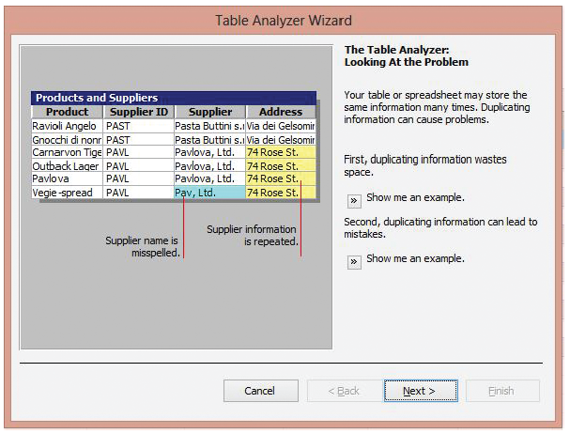
Step by Step: Use the Table Analyzer
USE the database that is open from the previous exercise.
Open the Books table.
Scroll through the table to become familiar with the fields in the table.
On the DATABASE TOOLS tab, in the Analyze group, click the Analyze Table button. The Table Analyzer Wizard dialog box, screen 1, appears, as shown above. This first dialog box provides more information about the types of problems the wizard will find. Click the two Show me an example buttons to read more about how duplicating information can lead to problems.

Slide 15
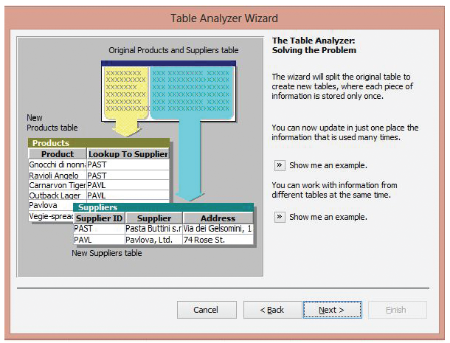
Step by Step: Use the Table Analyzer
Click the Next > button. The Table Analyzer Wizard dialog box, screen 2, appears, as shown at right. This dialog box provides more information about what the wizard will do. Click the two Show me an example buttons to read more about how splitting the table is helpful.

Slide 16
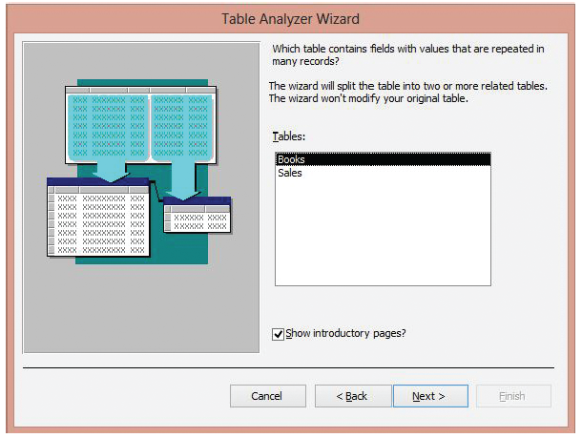
Step by Step: Use the Table Analyzer
Click the Next > button. The Table Analyzer Wizard dialog box, screen 3, appears, as shown at right.

Slide 17
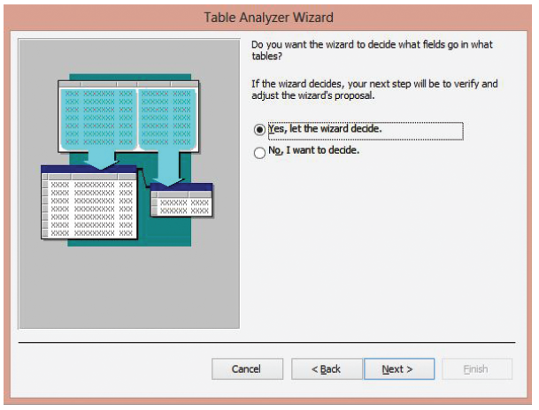
Step by Step: Use the Table Analyzer
The Books table should be selected in the list; if it is not, select it. Click the Next > button. The Table Analyzer Wizard dialog box, screen 4, appears, as shown at right.

Slide 18
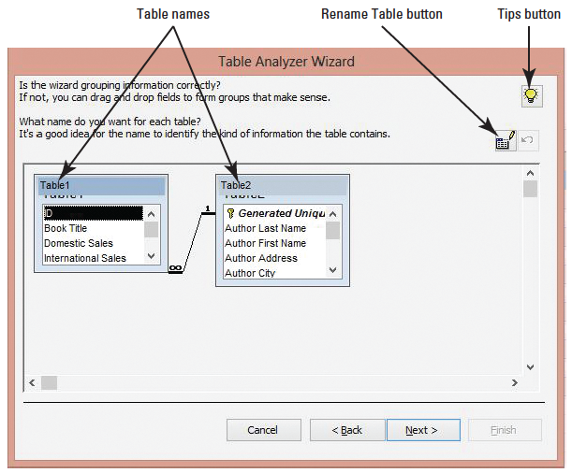
Step by Step: Use the Table Analyzer
The Yes, let the wizard decide button should be selected; if it is not, select it. Click the Next > button. The Table Analyzer Wizard dialog box, screen 5, appears, as shown at right.

Slide 19
Step by Step: Use the Table Analyzer
Scroll to the bottom of the Table2 box and click the Year field to select it. Notice that the wizard has placed it in the wrong table.
Drag the selected field to the Table1 box, positioning the horizontal black line below the Book Title field and releasing the mouse button to place the Year field in its new location.

Slide 20
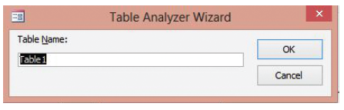
Step by Step: Use the Table Analyzer
Click the Table1 name to select it. Click the Rename Table button. The Table Analyzer Wizard dialog box appears, as shown below.
Notes:
Another Way: You can also double-click a table name to launch the Table Analyzer Wizard dialog box.

Slide 21
Step by Step: Use the Table Analyzer
Key Book Sales and click OK.
Click the Table2 name and click the Rename Table button. The Table Analyzer Wizard dialog box appears.
Key Author Contact Information and click OK.
Scroll down to the bottom of the Book Sales table. Notice that the Lookup to Author Contact Information field was added.

Slide 22
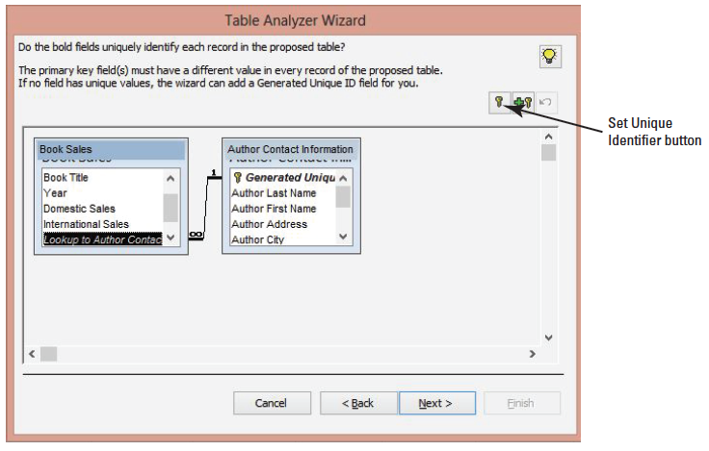
Step by Step: Use the Table Analyzer
Scroll through the Author Contact Information table. Notice that the Generated Unique ID field was added as a primary key. Click the Next > button. The Table Analyzer Wizard dialog box, screen 6, appears, as shown above.
Click the ID field in the Book Sales table to select it. Click the Set Unique Identifier button. A primary key is inserted.

Slide 23
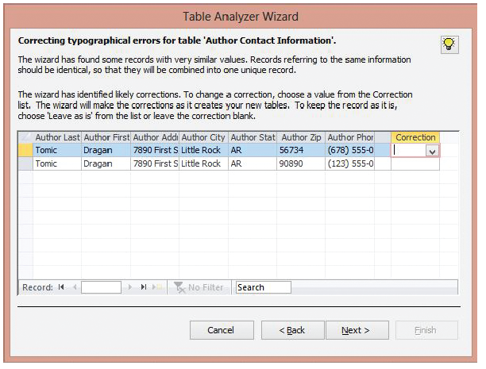
Step by Step: Use the Table Analyzer
Click Next >. The Table Analyzer Wizard dialog box, screen 7, appears, as shown at right.
Notice that the Table Analyzer Wizard has detected two similar records, one with an incorrect zip code and phone number. Click the down arrow in the first row of the Correction field and select Leave as is. This is the correct record.

Slide 24
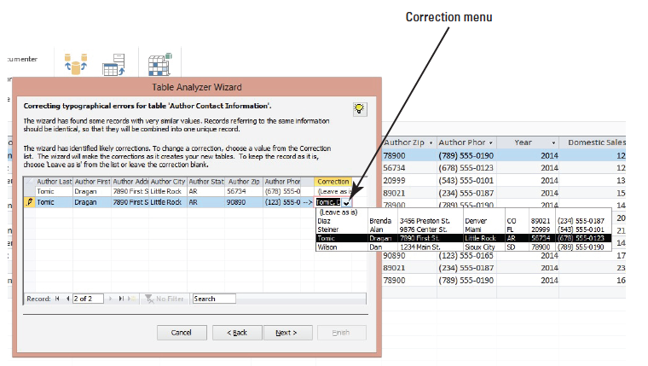
Step by Step: Use the Table Analyzer
Click the down arrow on the second row of the Correction field and select the Tomic correction from the menu, as shown below, to replace the incorrect record.

Slide 25
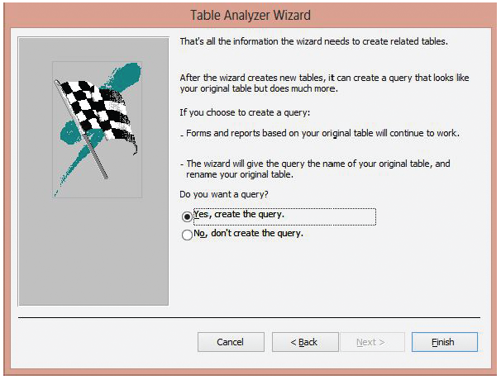
Step by Step: Use the Table Analyzer
Click Next >. The final Table Analyzer Wizard dialog box appears, as shown at right.
The Yes, create the query option button should be selected. Click the Finish button.
A message saying that the new query will be saved as Books_NEW appears. Click OK.

Slide 26
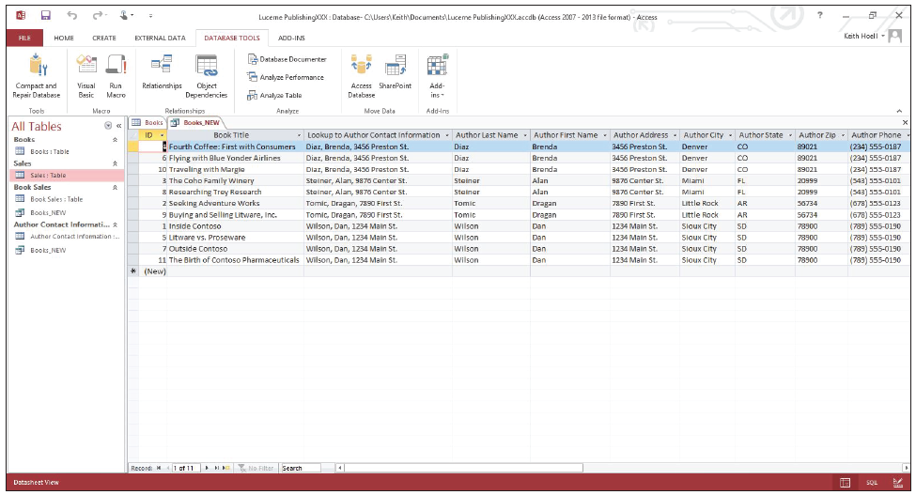
Step by Step: Use the Table Analyzer
If Access Help appears on your screen, close it. Your screen should look similar to the figure below.
SAVE and CLOSE all tables and queries.
PAUSE. LEAVE the database open to use in the next exercise.

Slide 27
Step by Step: Insert a Total Row
USE the database open from the previous exercise.
Open the Book Sales table.
On the HOME tab, in the Records group, click the Totals button. The Total row appears below the row with the asterisk (*) in the record selector box.

Slide 28
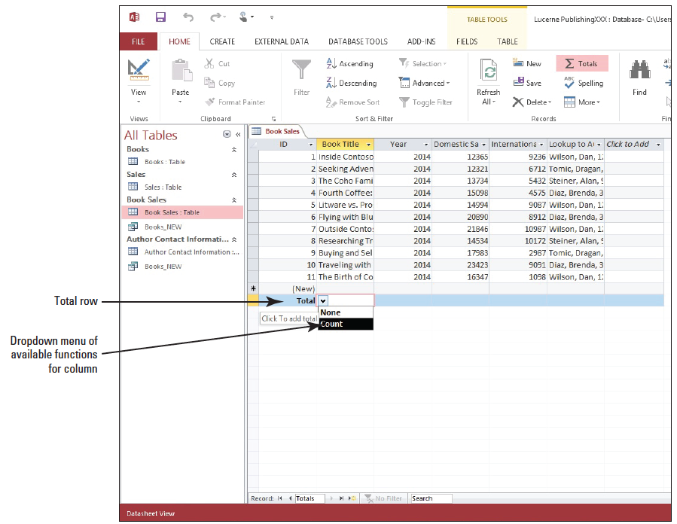
Step by Step: Insert a Total Row
Click the down arrow in the Book Title column of the Total row. Select Count from the menu, as shown at right. The number of records in the column is counted, and the number 11 is displayed.
Click the down arrow in the Domestic Sales column of the Total row and select Sum from the menu.

Slide 29
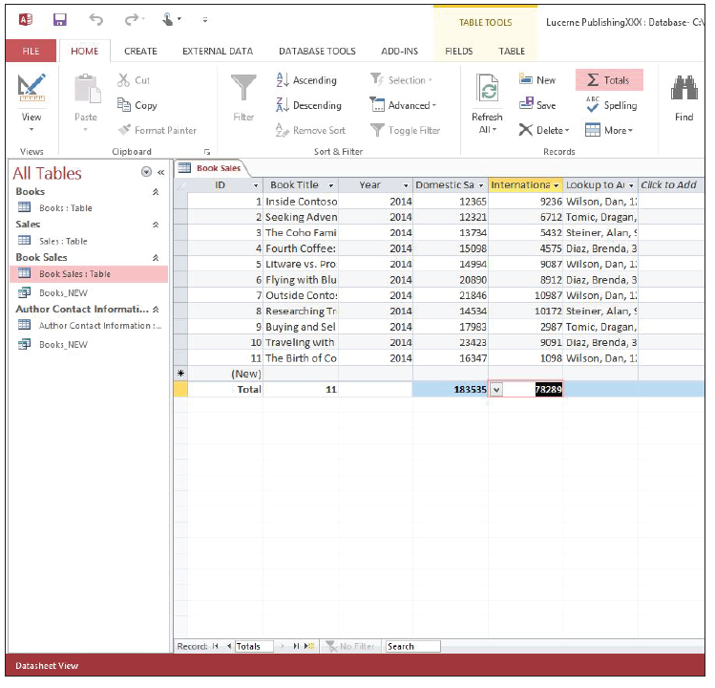
Step by Step: Insert a Total Row
Click the down arrow in the International Sales column of the Total row and select Sum from the menu. Your screen should look similar to the figure at right.

Slide 30
Step by Step: Insert a Total Row
Save the table.
On the HOME tab, in the Records group, click the Totals button. The Total row is hidden.
On the HOME tab, in the Records group, click the Totals button again. The Total row reappears.
Save and close the table.
CLOSE Access.

Slide 31
Skill Summary

