Slide 1
Advanced Forms
Microsoft Access 2013
Lesson 10

Slide 2
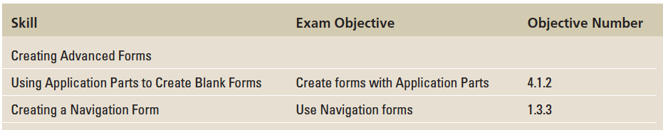
Objectives

Slide 3
Step by Step: Create a Multi-Item Form
GET READY. Before you begin these steps, be sure to LAUNCH Microsoft Access.
OPEN the Contoso database from the data files for this lesson.
SAVE the database as ContosoXXX (where XXX is your initials).
In the Navigation Pane, double-click the Doctors table to open it.

Slide 4
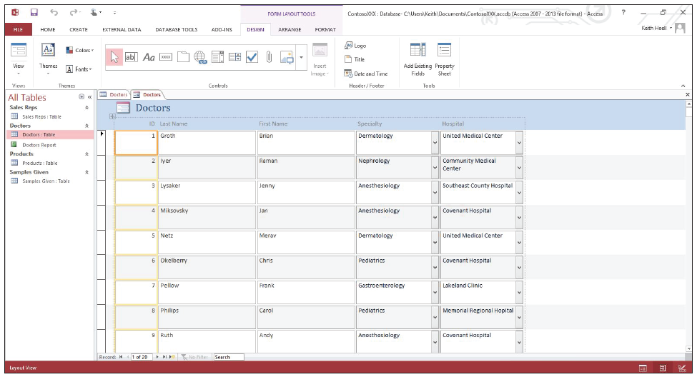
Step by Step: Create a Multi-Item Form
On the CREATE tab, in the Forms group, click the More Forms button. On the menu that appears, click the Multiple Items button. Access creates the form and displays it in Layout view, as shown below.

Slide 5
Step by Step: Create a Multi-Item Form
Scroll down to view the multiple records on the form.
Click the FILE tab and click Save.
In the Save As dialog box, key Doctors Multiple and click OK.
Click the Close button on Doctors Multiple to close the form.
Click the Close button on Doctors to close the table.
LEAVE the database open.
PAUSE. LEAVE Access open to use in the next exercise.
Notes:
Cross Ref: You learned about using controls to format your forms in Lesson 8.

Slide 6
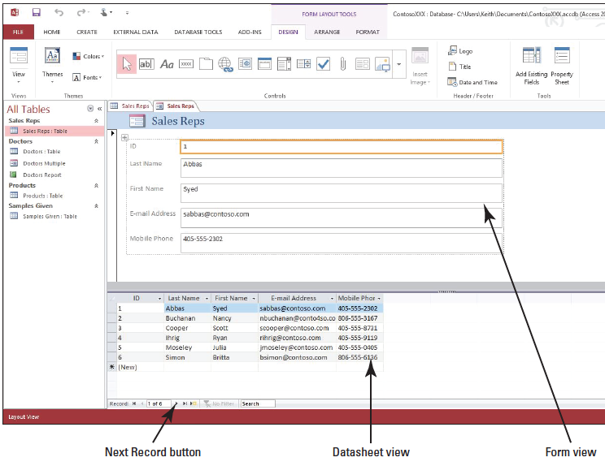
Step by Step: Create a Split Form
USE the database that is open from the previous exercise.
In the Navigation Pane, double-click the Sales Reps table to open it.
On the CREATE tab, in the Forms group, click the More Forms button. On the menu that appears, click the Split Form button. Access creates the form and displays it in Form view and Datasheet view at the same time, as shown above.

Slide 7
Step by Step: Create a Split Form
Click the Next Record navigation button to display the next record in Form view.
In the Datasheet view on the bottom, place the insertion point in the Mobile Phone field for Nancy Buchanan. Notice that the same field is selected in the Form view at the top.
Change the number for Nancy Buchanan in the Mobile Phone field to 806-555-4489.

Slide 8
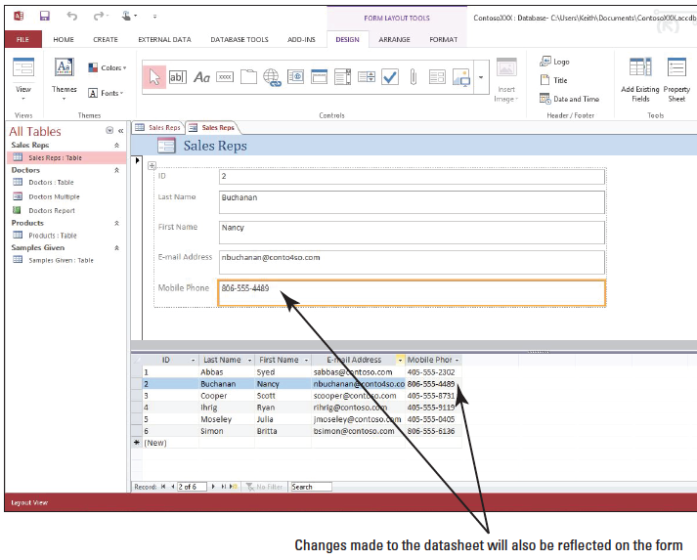
Step by Step: Create a Split Form
Click anywhere on the Form view above the datasheet and notice that the mobile phone number has been changed there as well, as shown at right.
On the HOME tab, in the Views group, click the lower half of the View button and click Design View.
8 [Press F4] to display the Property Sheet.
Notes:
Another Way: You can also click the Property Sheet button on the Ribbon to display the Property Sheet.
Take Note: Throughout this lesson you will see information that appears in black text within brackets, such as [Press Enter], or [your e-mail address]. The information contained in the brackets is intended to be directions for you rather than something you actually type word-for-word. It will instruct you to perform an action or substitute text. Do not type the actual text that appears within brackets.

Slide 9
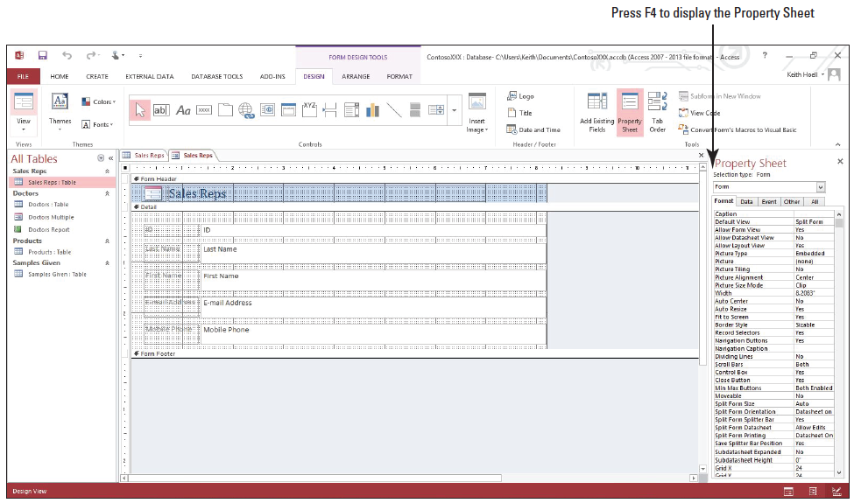
Step by Step: Create a Split Form
Click Form in the drop-down list at the top of the Property Sheet, if necessary, and click the FORMAT tab, if necessary, as shown below.

Slide 10
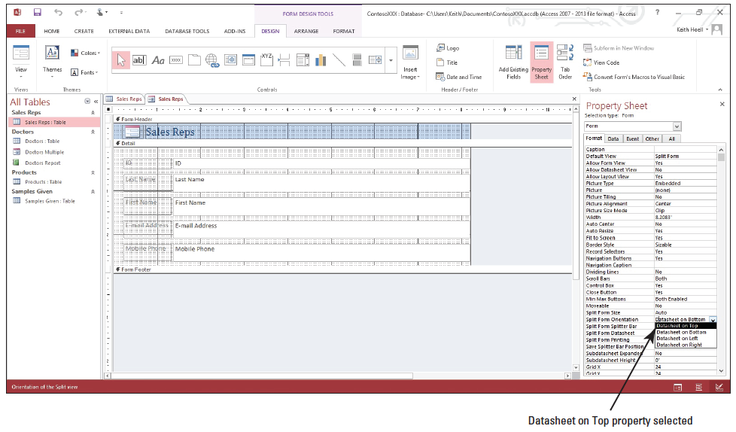
Step by Step: Create a Split Form
Scroll down to the Split Form Orientation property, click the down arrow, and click Datasheet on Top, as shown below.
Click the Close button to close the Property Sheet.
Notes:
Take Note: If all text for the properties is not visible, click the left border of the Property Sheet and drag to widen it.

Slide 11
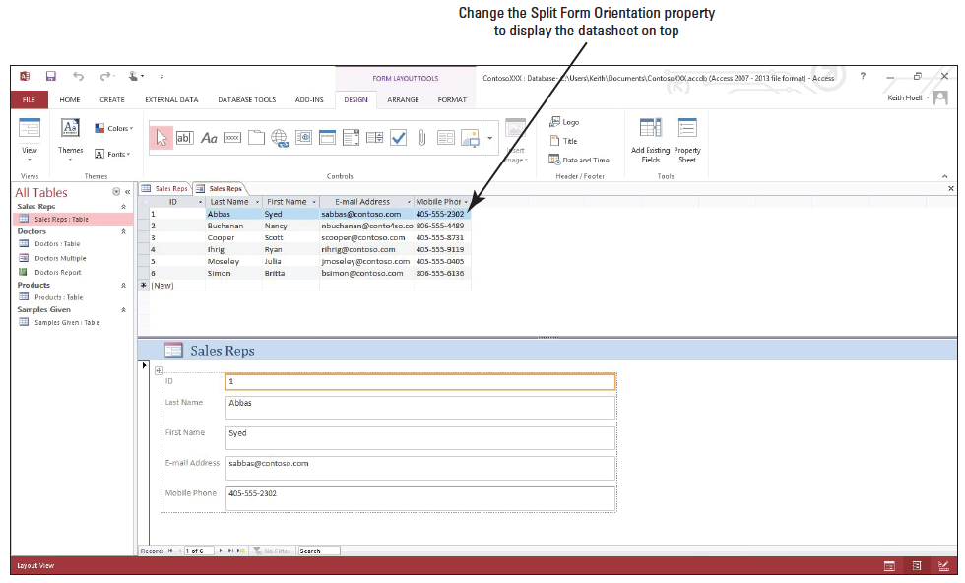
Step by Step: Create a Split Form
On the HOME tab, in the Views group, click the lower half of the View button and click Layout View. The split form is displayed with the datasheet on top, as shown below.

Slide 12
Step by Step: Create a Split Form
Click the FILE tab and click Save.
In the Save As dialog box, key Sales Reps Split and click OK.
Click the Close button on Sales Reps Split to close the form.
Click the Close button on Sales Reps to close the table.
LEAVE the database open.
PAUSE. LEAVE the database open to use in the next exercise.

Slide 13
Step by Step: Create a Subform
USE the database that is open from the previous exercise.
On the CREATE tab, in the Forms group, click Form Wizard.
In the first screen on the Form Wizard, click the down arrow in the Tables/Queries box and click Table: Samples Given.
In the Available Fields box, double-click the Week Name, Sales Rep, Product, and Quantity fields to move them to the Selected Fields box.
Click the down arrow in the Tables/Queries box and click Table: Doctors.

Slide 14
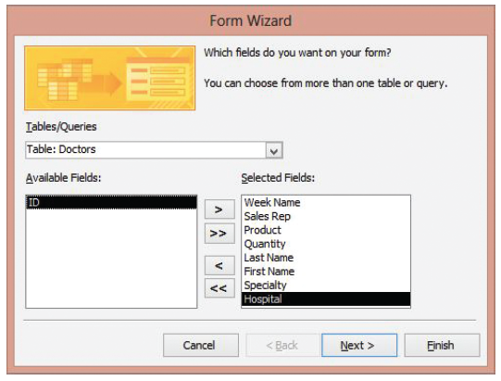
Step by Step: Create a Subform
In the Available Fields box, double-click the Last Name, First Name, Specialty, and Hospital fields to move them to the Selected Fields box. The screen should look like the figure at right.
Click the Next > button.

Slide 15
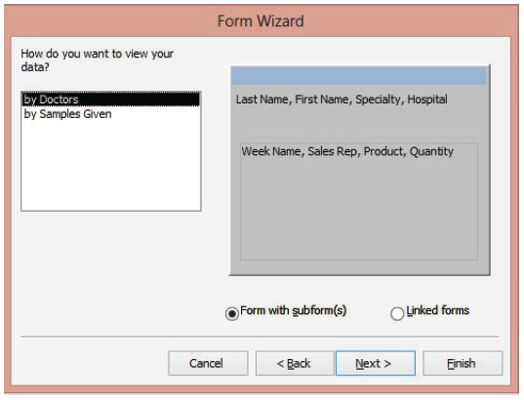
Step by Step: Create a Subform
In the How do you want to view your data? box, click by Doctors. The Form with subform(s) option button should be selected, and the Form Wizard should look like the figure at right.
Click the Next > button.

Slide 16
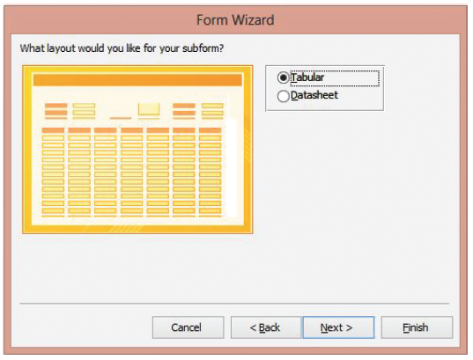
Step by Step: Create a Subform
Click the Tabular option button to select that as the layout for your subform, as shown at right.

Slide 17
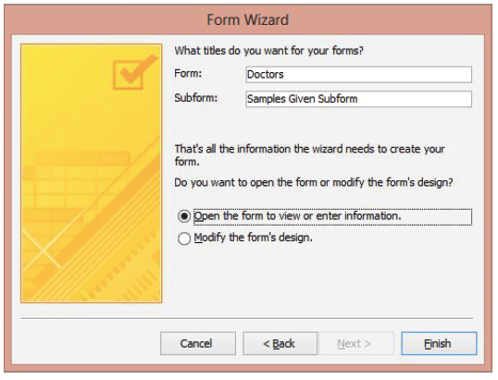
Step by Step: Create a Subform
Click the Next > button. Access has suggested titles for the forms, as shown at right. Keep the default selection to open the form.

Slide 18
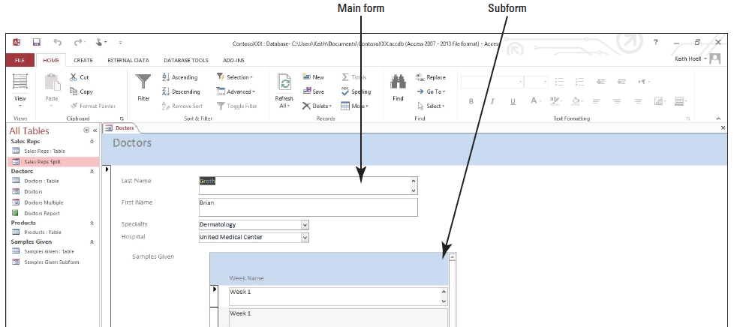
Step by Step: Create a Subform
Click the Finish button to create the forms. The Doctors form appears with the Samples Given subform, as shown below.

Slide 19
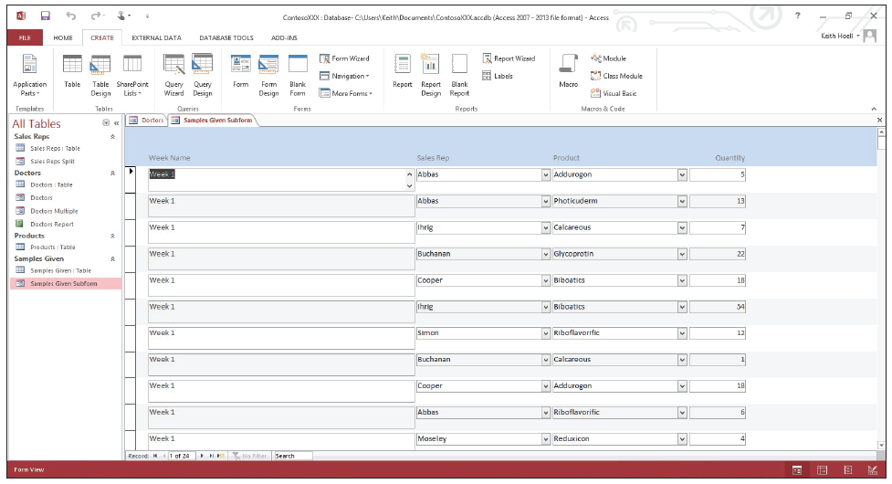
Step by Step: Create a Subform
In the Navigation Pane, double-click the Samples Given Subform to open it, as shown below.

Slide 20
Step by Step: Create a Subform
Scroll down and to the right, if necessary, to see the data contained in the records and then click the Close button on the Samples Given Subform to close the subform.
Click the Close button on the Doctors form to close the form.
LEAVE the database open.
PAUSE. LEAVE the database open to use in the next exercise.

Slide 21
Step by Step: Use Application Parts to Create Blank Forms
USE the database that is open from the previous exercise.
On the CREATE tab, in the Templates group, click the Application Parts button. In the Blank Forms category, hover your mouse over the 1 Right button. A ScreenTip appears informing you of the form’s layout.

Slide 22
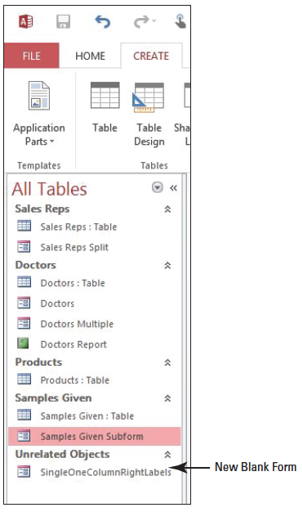
Step by Step: Use Application Parts to Create Blank Forms
Click the 1 Right button and a new form object named SingleOneColumnRightLabels appears in the Navigation Pane in the Unrelated Objects category, as shown at right.

Slide 23
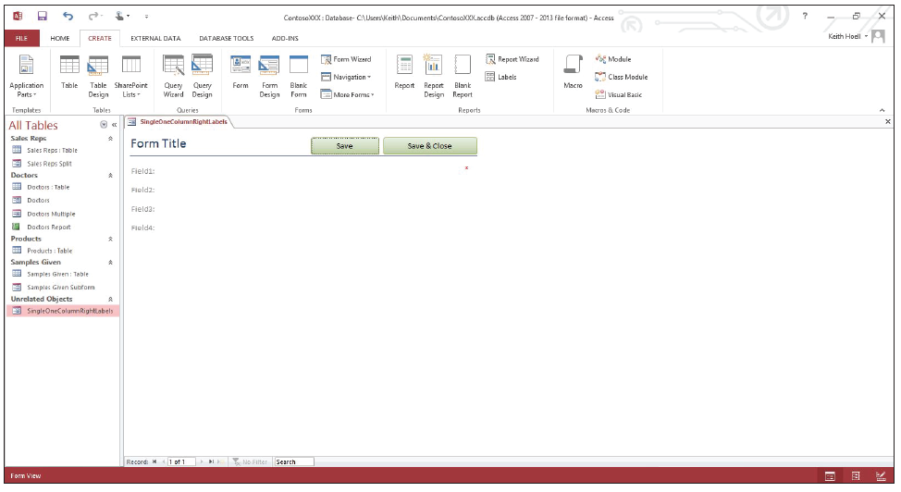
Step by Step: Use Application Parts to Create Blank Forms
Open the SingleOneColumnRightLabels form. The form displays in Form view, as shown below.

Slide 24
Step by Step: Use Application Parts to Create Blank Forms
Switch to Layout view and [press Shift] while clicking on the label control placeholders titled Field1, Field2, Field3, and Field4 to select them all. [Press the Delete key] on the keyboard to delete the label controls. Also delete the label control placeholder that contains the red asterisk, which could be used to denote an important field, like a key field.

Slide 25
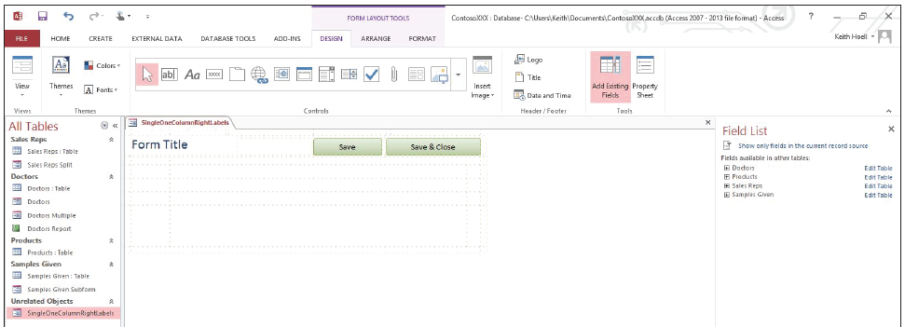
Step by Step: Use Application Parts to Create Blank Forms
Click the Add Existing Fields button in the Tools group. The Field List pane appears. If necessary, click the Show all tables link. Your screen should resemble the figure below.
In the Field List pane, expand the Doctors table.

Slide 26
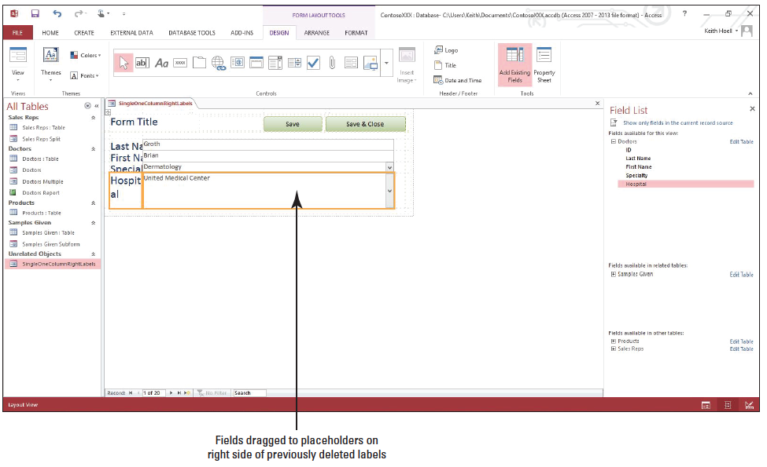
Step by Step: Use Application Parts to Create Blank Forms
In the Field List pane, click and drag each Last Name, First Name, Specialty, and Hospital field to the form and to the right placeholder of the original locations of the Field1, Field2, Field3, and Field4 label controls that you just deleted. You screen should resemble the figure below.

Slide 27
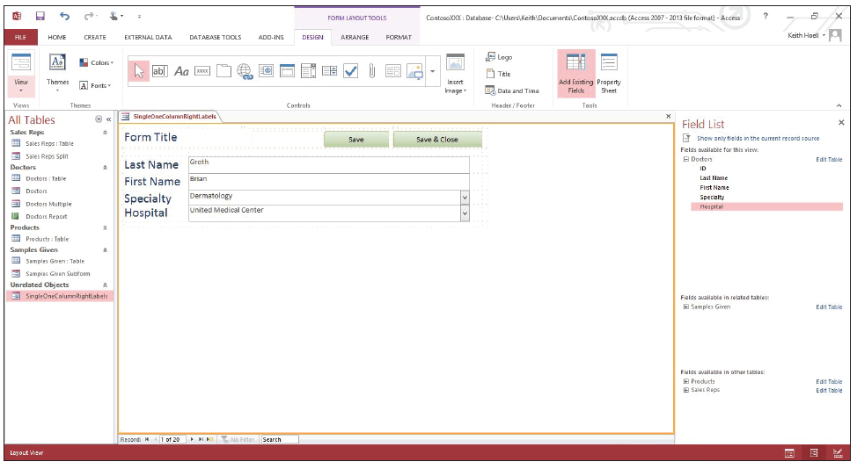
Step by Step: Use Application Parts to Create Blank Forms
Resize the label and field controls that you just added until your screen resembles the figure below.
Click the Form Title label and delete Form Title. Key Doctors.

Slide 28
Step by Step: Use Application Parts to Create Blank Forms
Switch to Form view and cycle through the records. Click the Save & Close button on the form to close the form. Click Yes in the dialog box prompting you to save design changes to the form.
Rename the SingleOneColumnRightLabels form as Doctors Blank Form.
PAUSE. LEAVE the database open to use in the next exercise.

Slide 29
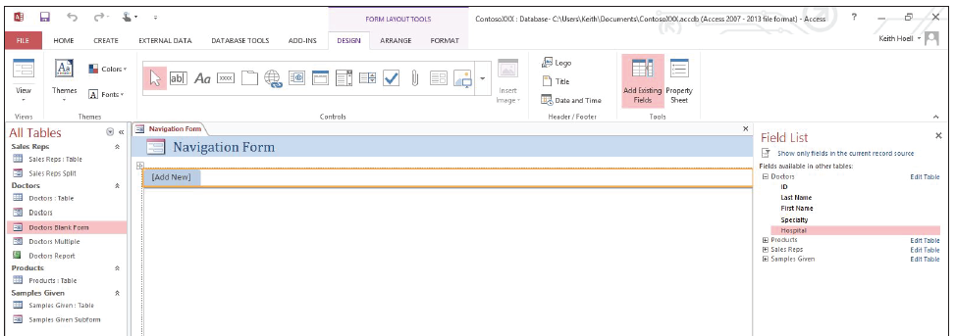
Step by Step: Create a Navigation Form
USE the database that is open from the previous exercise.
On the CREATE tab, in the Forms group, click the Navigation button to display a menu that contains six form layouts.
Click the Horizontal Tabs button and a new Navigation form appears in Layout view, as shown below.

Slide 30
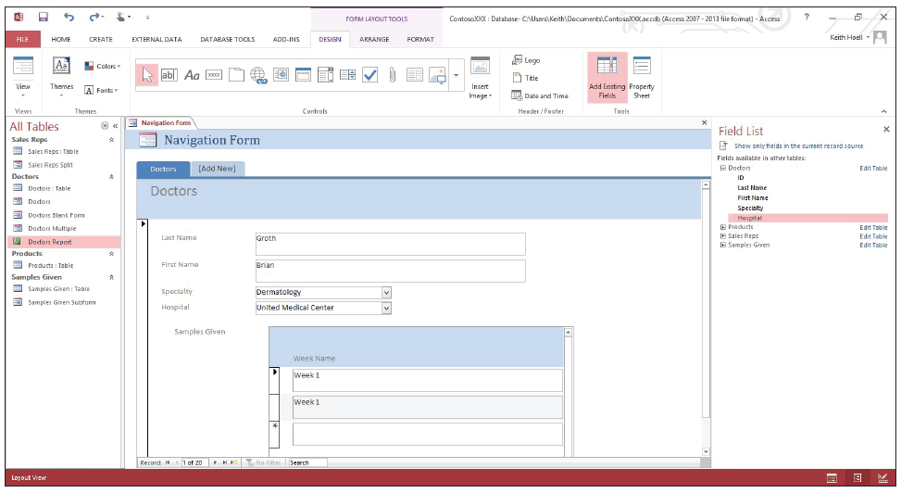
Step by Step: Create a Navigation Form
Click and drag the Doctors form object from the Navigation Pane to the [Add New] tab near the top of the form. The form tab has been renamed Doctors and all the Doctors form’s controls appear. A new [Add New] tab appears next to the Doctors tab. Your screen should resemble the figure below.
Notes:
Take Note: You cannot drag table objects from the Navigation Pane to the [Add New] tab.

Slide 31
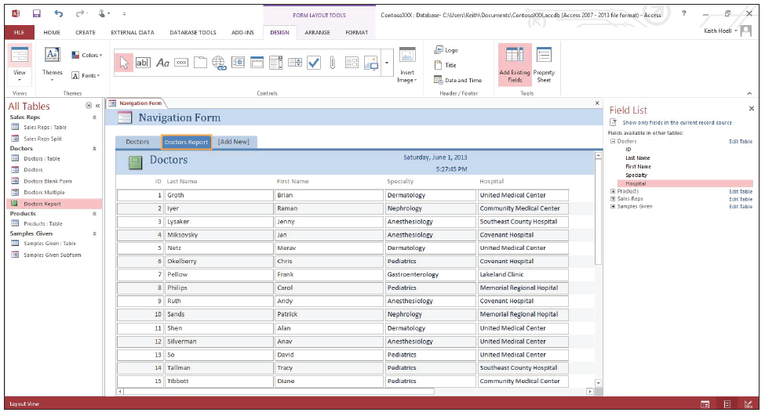
Step by Step: Create a Navigation Form
Click and drag the Doctors Report object from the Navigation Pane to the [Add New] tab near the top of the form. The form tab has been renamed Doctors Report and all the Doctors report controls appear. A new [Add New] tab appears next to the Doctors Report tab. Your screen should resemble the figure.

Slide 32
Step by Step: Create a Navigation Form
Double-click the Doctors tab and key Doctors Form to rename the tab.
Switch to Form view and use the form’s tabs to switch between the form and report.
Click the FILE tab and click Save.
In the Save As dialog box, key Doctors Navigation Form and click OK.
Click the Close button to close the Doctors Navigation Form.
STOP. CLOSE the database.

Slide 33
Skill Summary

