Slide 1
Create Database Tables
Microsoft Access 2013
Lesson 2

Slide 2
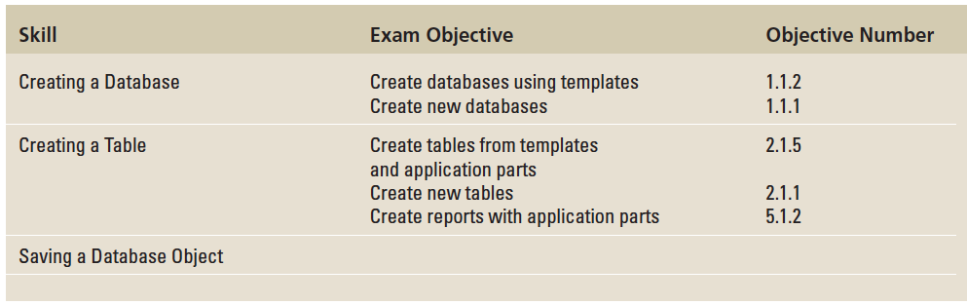
Objectives

Slide 3
Step by Step: Use a Template to Create a Database
GET READY. Before you begin these steps, be sure that you are logged on to the Internet. LAUNCH Microsoft Access to display the startup screen.
On the top center of the startup screen window, in the Search for online templates search box, key Personal and then press Enter.

Slide 4
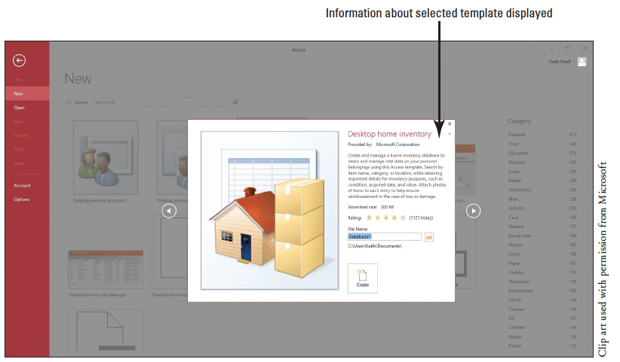
Step by Step: Use a Template to Create a Database
In the list of Personal templates that appears in the middle of the startup screen results pane, click Desktop home inventory. A preview screen of the selected template appears in the center of the startup screen, as shown below. Close the Desktop home inventory template preview screen.

Slide 5
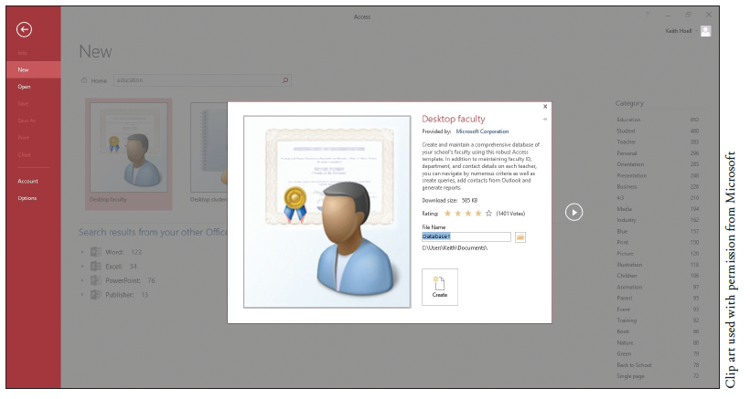
Step by Step: Use a Template to Create a Database
In the Search for online templates search box, key Education and then press Enter.
In the list of Education templates that appears, click Desktop faculty. Your screen should look similar to Figure 2-3. Close the Desktop faculty template preview screen.

Slide 6
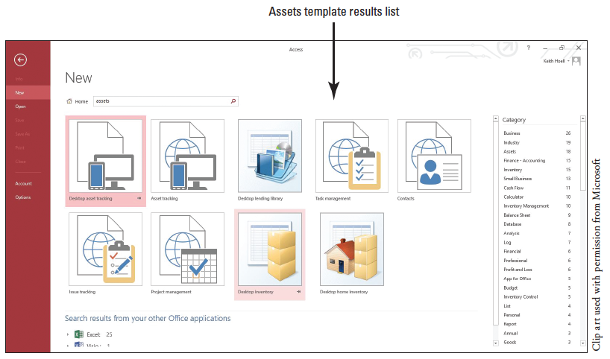
Step by Step: Use a Template to Create a Database
In the Search for online templates search box, key in assets and then press Enter.
In the Assets template results list, click the Desktop asset tracking database. The Desktop asset tracking template preview screen appears. Your screen should look similar to the figure above.
Notes:
Take Note: Throughout this lesson you will see information that appears in black text within brackets, such as [Press Enter], or [your email address]. The information contained in the brackets is intended to be directions for you rather than something you actually type word-for-word. It will instruct you to perform an action or substitute text. Do not type the actual text that appears within brackets.

Slide 7
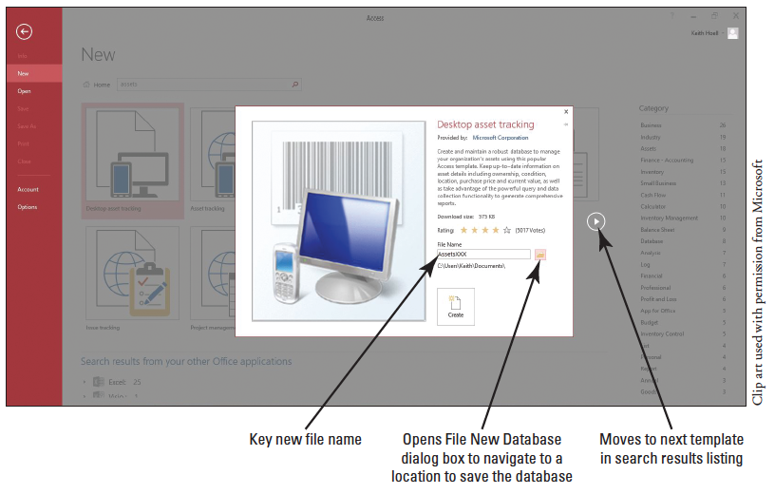
Step by Step: Use a Template to Create a Database
In the Desktop asset tracking template preview screen, click in the File Name box and replace the default file by keying AssetsXXX (where XXX is your initials), as shown below.
Notes:
Take Note: If you do not add an extension to your database file name, Access does it for you—for example, AccessXXX.accdb.

Slide 8
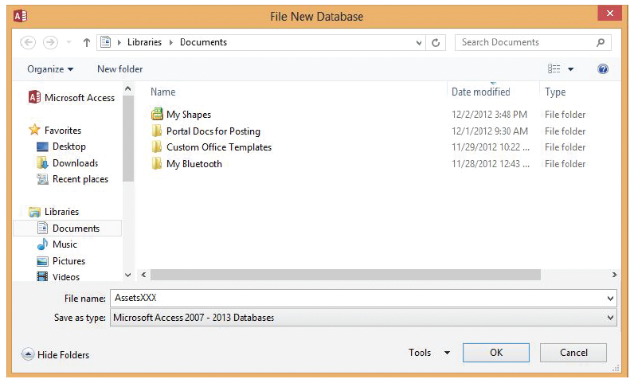
Step by Step: Use a Template to Create a Database
Click the folder icon to the right of the File Name box. The File New Database dialog box appears, as shown below.
Navigate to the location where you want to save the file and then click OK.
Notes:
Take Note: You should save your files in a separate directory from where your data files are stored. This will ensure that you don’t overwrite the original data files with your updated files. Check with your instructor to see if she wants you to save your work on a flash drive or in a particular network directory.
Take Note: Unless you choose a different folder, Access uses the following default location in Windows Server 2008/2012, Windows 7, and Windows 8 to store your databases:

Slide 9
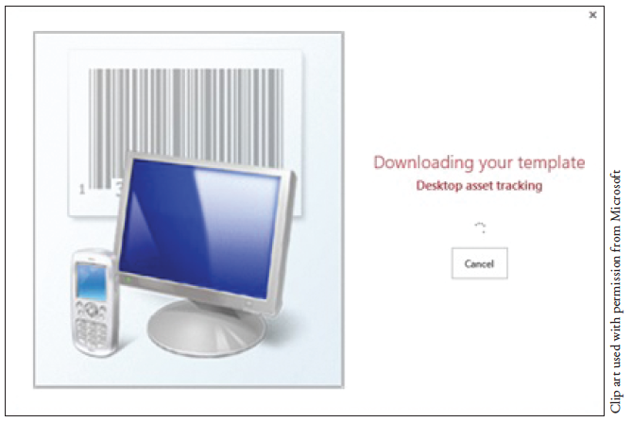
Step by Step: Use a Template to Create a Database
Click the Create button at the bottom of the preview pane. The preview pane indicates that the template is being downloaded, as shown below. When the download is complete, the preview pane closes.

Slide 10
Step by Step: Use a Template to Create a Database
Access creates and then opens the AccessXXX database, as shown on the next slide. Because this database was downloaded from Office.com (a trusted source), click Enable Content on the Message Bar. Getting Started, and Access Help windows may appear, which contain helpful videos and links about using the Asset tracking database. Close these windows, if necessary, to return to the AccessXXX database with the Asset List form active. Click to place the insertion point in the first cell of the Item field and then key Canon EOS Rebel T3i.
Notes:
Troubleshooting: Sometimes you may be asked if you want to enable content by clicking the Enable Content button on the Security Warning Message Bar. By default, Access blocks potentially harmful content that might contain viruses or present other security issues. This content should be enabled only if the database is downloaded from a trustworthy site, like Office.com.

Slide 11
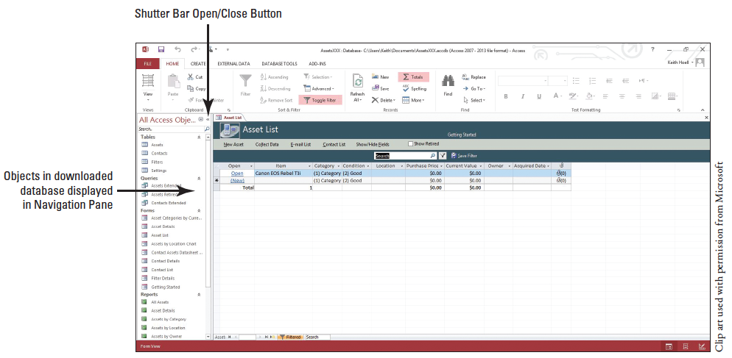
Step by Step: Use a Template to Create a Database
Click the Shutter Bar Open/Close Button, if necessary, to display the Navigation Pane, as shown below, to see all the objects in the database.
CLOSE the database.
PAUSE. LEAVE Access open to use in the next exercise.

Slide 12
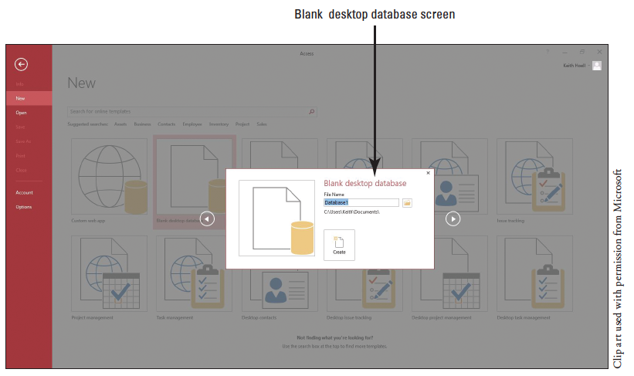
Step by Step: Create a Blank Database
GET READY. The Access work area window should be on the screen from the previous exercise.
Click the FILE tab to open the New screen in Backstage view.
In the temp- lates section of the New screen, click the Blank desktop data- base icon. A Blank desktop database screen appears in the center of the screen, as shown above.

Slide 13
Step by Step: Create a Blank Database
In the File Name box, key BlankDatabaseXXX (where XXX is your initials).
If you want to save the file in a location other than the one shown beneath the File Name box, click the folder icon to the right of the File Name box and browse to a different location.

Slide 14
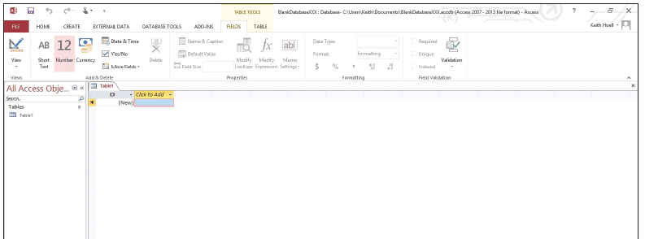
Step by Step: Create a Blank Database
Click the Create button to create the blank database in your chosen location. Access creates the database and then opens an empty table named Table1 in datasheet view, as shown below.
PAUSE. LEAVE the database open to use in the next exercise.
Notes:
Cross Reference: You learn more about defining and modifying a primary key in Lesson 3.

Slide 15
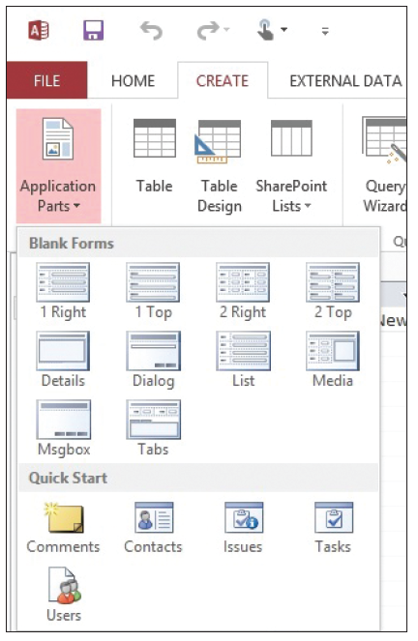
Step by Step: Create a Table Using the Application Parts Gallery and Quick Start
USE the database that is open from the previous exercise.
On the CREATE tab, in the Templates group, click the Application Parts button to display the gallery shown at right.
In the Quick Start section of the gallery, click Comments. When prompted to close all open objects before instantiating this application part, click Yes on the Microsoft Access dialog box that appears. Notice the Comments table appears as a new object in the Navigation pane.

Slide 16
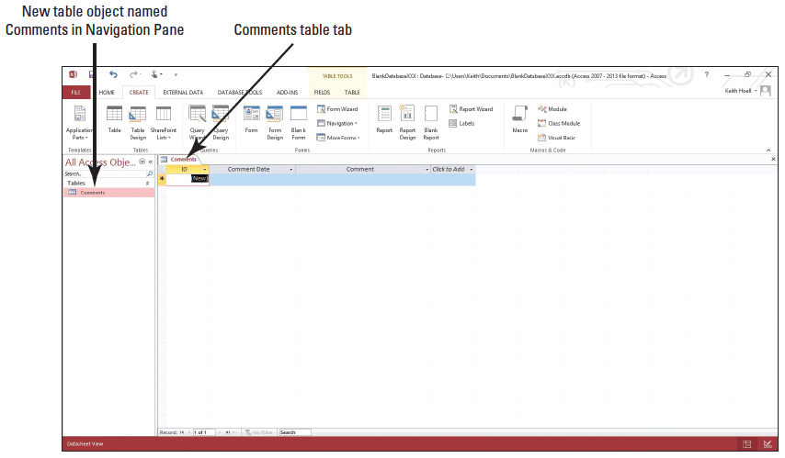
Step by Step: Create a Table Using the Application Parts Gallery and Quick Start
Click the Enable Content button on the Message Bar to trust the database.
In the Navigation Pane, double-click Comments to display the newly created table with fields for comments, as shown below. Close the Comments table by clicking the Comments table close button.

Slide 17
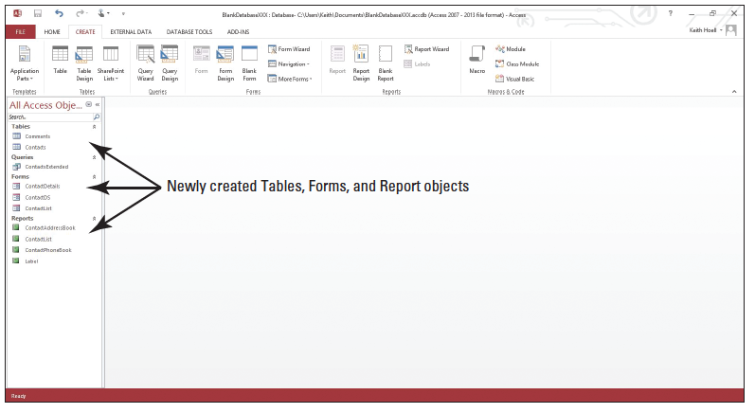
Step by Step: Create a Table Using the Application Parts Gallery and Quick Start
On the Application Parts menu, click Contacts. In the Create Relationship dialog box that appears, select the There is no relationship radio button then click Create. A new table is created along with supporting forms and report objects, as shown below.
PAUSE. LEAVE the database open to use in the next exercise.
Notes:
Cross Reference: You learn how to create a custom table in Lesson 9.

Slide 18
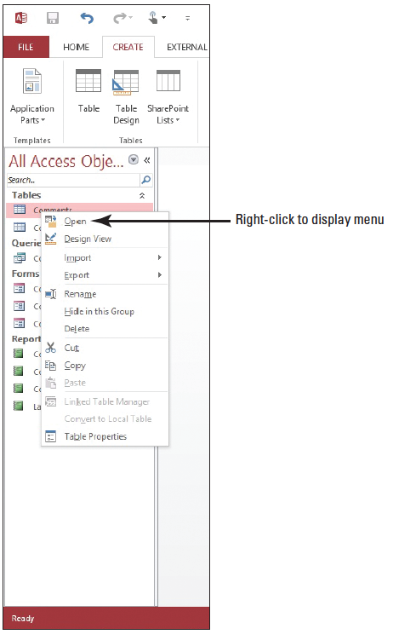
Step by Step: Create a Table from Another Table
USE the database that is open from the previous exercise.
On the Navigation Pane, right- click the Comments table database object to display the menu shown at right.
Click Copy.

Slide 19
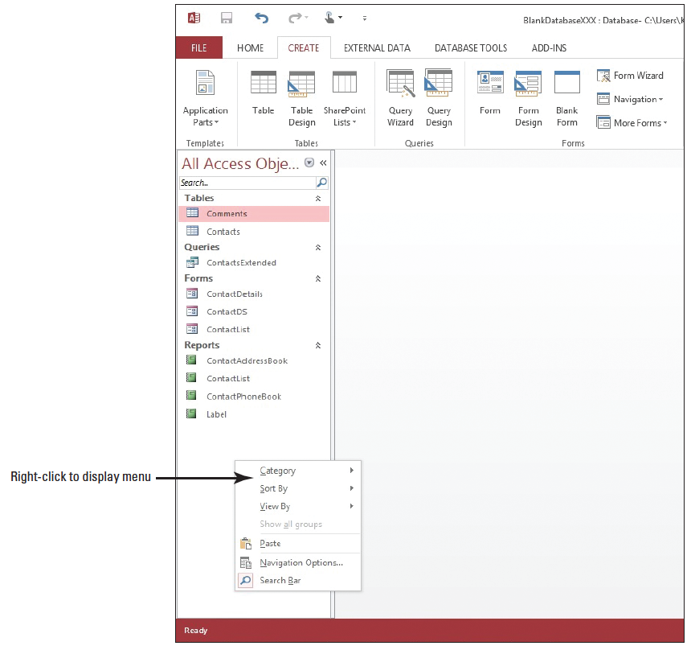
Step by Step: Create a Table from Another Table
Right-click in a blank area of the Navigation Pane and, in the short- cut menu that appears, click Paste (right).

Slide 20
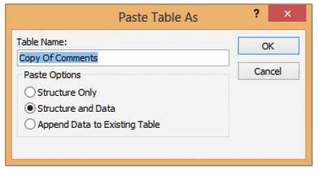
Step by Step: Create a Table from Another Table
The Paste Table As dialog box appears, as shown below. Notice the default name, Copy Of Comments, in the Table Name box.
In the Paste Options section, select the Structure Only radio button, to paste only the table’s structure, rather than pasting a copy of the table’s data along with its structure (in this case, the Comments table doesn’t contain any record data).

Slide 21
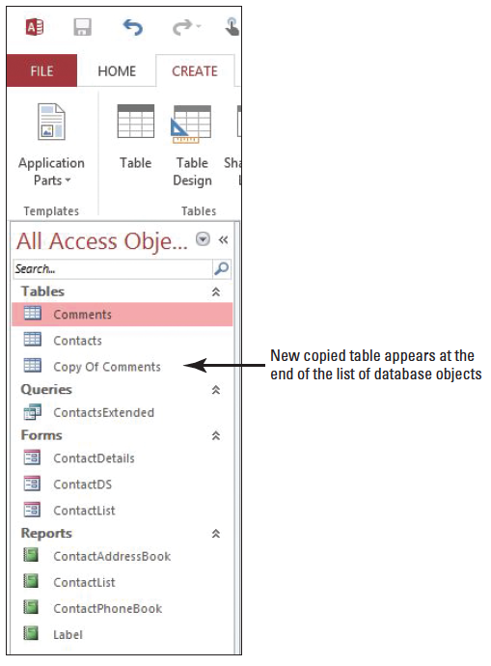
Step by Step: Create a Table from Another Table
Click OK.
The new table appears at the end of the list of data-base table objects in the Navigation Pane, as shown at right.
Double-click Copy Of Comments to open the new table. Notice that the structure of the new table is the same as the table from which it was copied.
PAUSE. CLOSE the database.
LEAVE Access open for the next project.

Slide 22
Step by Step: Save a Table
GET READY. The Backstage view should be on the screen from the previous exercise.
If necessary, click the New command, then click the Blank desktop database icon; a Blank desktop database screen appears in the center of the screen.
In the Blank desktop database screen’s File Name box, the default name should be Database1. If not, replace the default name by keying Database1.

Slide 23
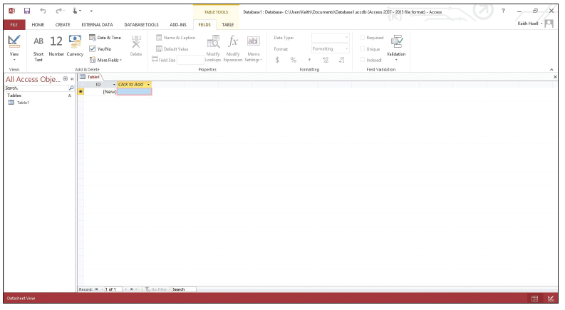
Step by Step: Save a Table
If you want to save the file in a location other than the one shown beneath the File Name box, click the folder icon and browse to a different location.
Click the Create button. A new blank database appears with the default table labeled Table1 displayed, as shown below.

Slide 24
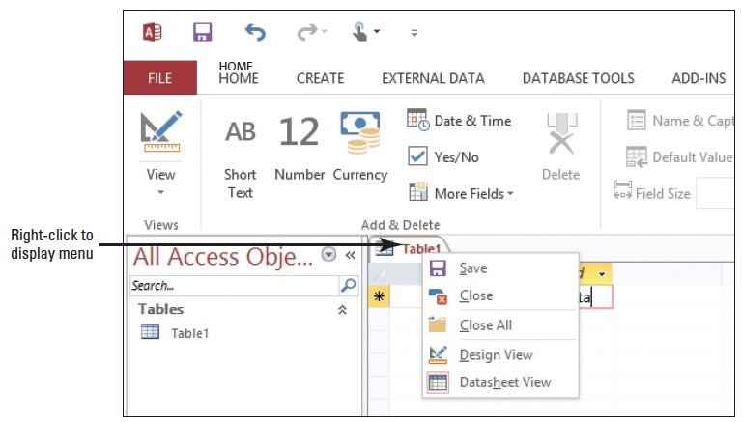
Step by Step: Save a Table
Click to place the insertion point in the cell under the Click to Add field and key Sample Data.
Right-click on the Table1 tab to display the shortcut menu, as shown below.

Slide 25
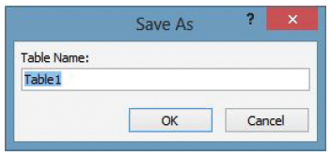
Step by Step: Save a Table
Click Save. The Save As dialog box appears, as shown below.
In the Table Name box, key Sample Table.
Click OK to close the dialog box and return to the table, which now is labeled Sample Table.

Slide 26
Step by Step: Save a Table
Click the File tab to display the Backstage view.
Click Save As to display the Save As screen.
Under the File Types heading, click the Save Object As command.
Click the Save As button

Slide 27
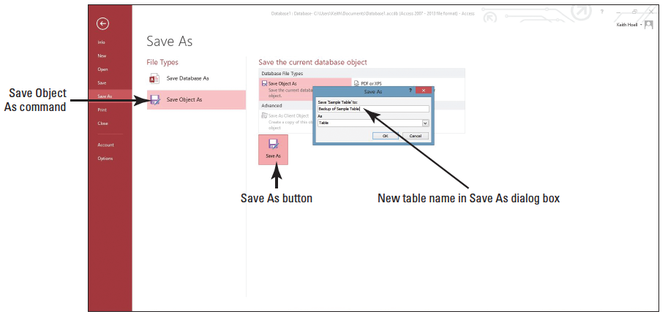
Step by Step: Save a Table
In the Save As dialog box, key Backup of Sample Table in the area under “Save ‘Sample Table’ to:” as shown below.
Click OK.
Notice the new table object named Backup of Sample Table in the Navigation Pane.

Slide 28
Step by Step: Save a Table
Double-click the Backup of Sample Table in the Navigation Pane to open it. Notice the table contains the same row you created in the Sample Table table.
Close the Backup of Sample Table.
CLOSE the database.
CLOSE Access.

Slide 29
Skill Summary

