Slide 1
Create Forms
Microsoft Access 2013
Lesson 5

Slide 2
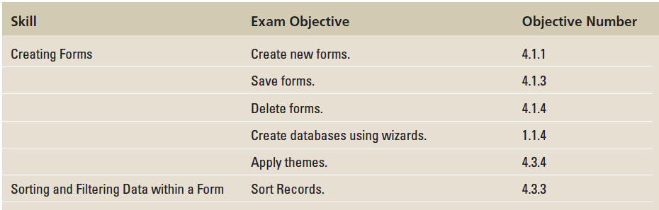
Objectives

Slide 3
Step by Step: Create a Simple Form and Delete a Form
GET READY. Before you begin these steps, be sure to LAUNCH Microsoft Access.
OPEN the Graphic Art database from the data files for this lesson.
SAVE the database as Graphic ArtXXX (where XXX is your initials).
In the Navigation Pane, click the Photo Exhibit table. This is the table for which you will create a form.

Slide 4
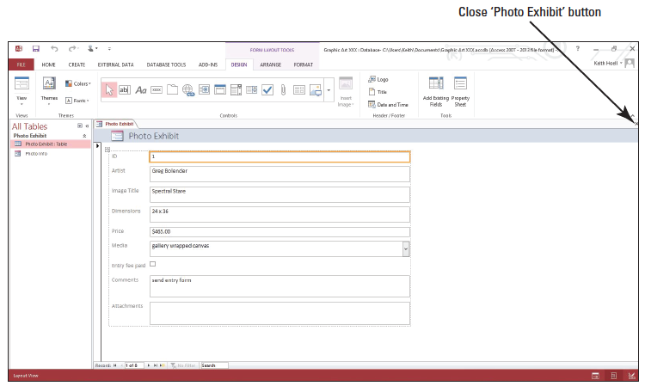
Step by Step: Create a Simple Form and Delete a Form
On the Create tab, in the Forms group, click the Form button. Access creates the form and displays it in Layout view (shown below). Your form may be slightly different.

Slide 5
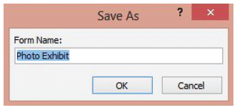
Step by Step: Create a Simple Form and Delete a Form
Click the File tab and click Save. The Save As dialog box appears (shown below).
Click OK to accept the Photo Exhibit form name suggested by Access. The form name appears in the Navigation Pane.
Notes:
Take Note: You can use the record navigation buttons at the bottom of a form to navigate among the form’s records, just as you used them to navigate among records in a table in Lesson 3.

Slide 6
Step by Step: Create a Simple Form and Delete a Form
Click the Close button on Photo Exhibit to close the form.
In the Navigation Pane, click the Photo Info form. This is a form that you no longer need.
In the Records group, click the Delete button and then click the Delete command on the menu that appears.
Click Yes on the dialog box asking you if you want to permanently delete the Photo Info form. The form is now permanently deleted from the database.
LEAVE the database open.
PAUSE. LEAVE Access open to use in the next exercise.

Slide 7
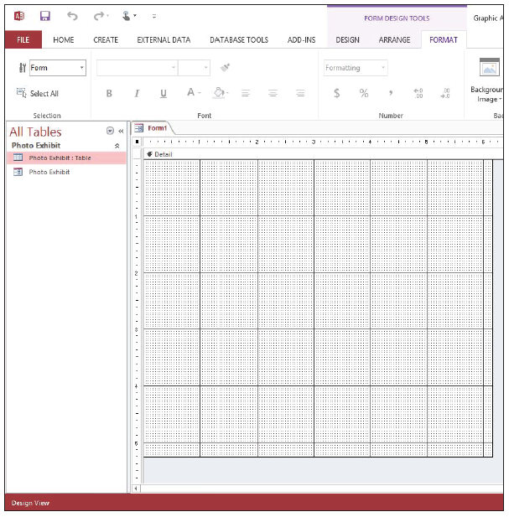
Step by Step: Create a Form in Design View
USE the database that is open from the previous exercise.
On the Create tab, in the Forms group, click the Form Design button. A new blank form is created in Design view (at right).

Slide 8
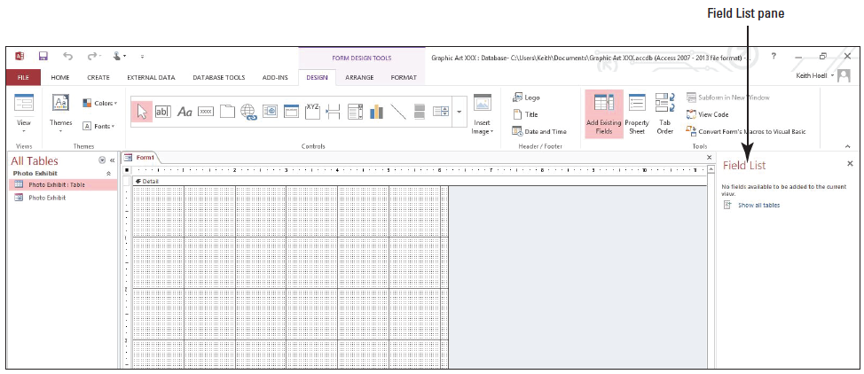
Step by Step: Create a Form in Design View
On the Form Design Tools Design contextual tab, in the Tools group, click the Add Existing Fields button. The Field List pane appears (shown below).

Slide 9
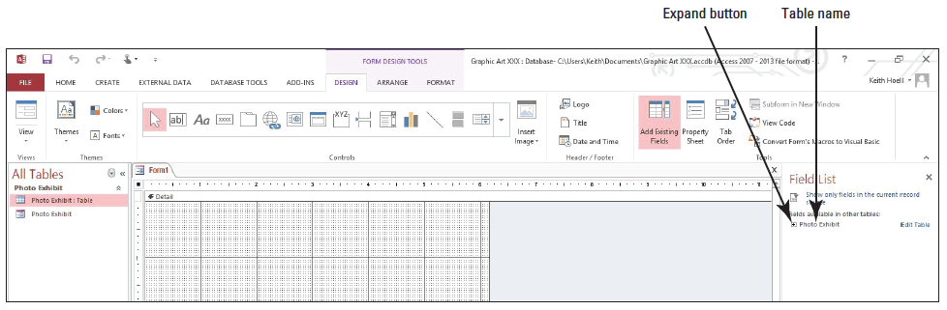
Step by Step: Create a Form in Design View
Click the Show all tables link, then the expand button to the left of the table name (shown below).

Slide 10
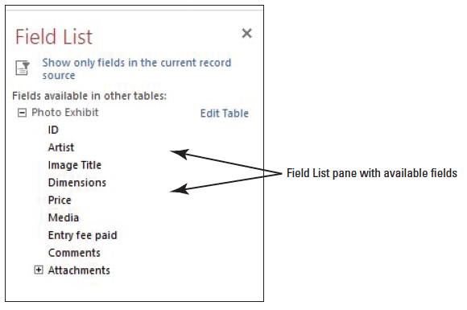
Step by Step: Create a Form in Design View
The available fields display from the Photo Exhibit table (shown below). In the list of fields, double-click Artist to add it to the form.
Double-click Image Title to add it to the form.

Slide 11
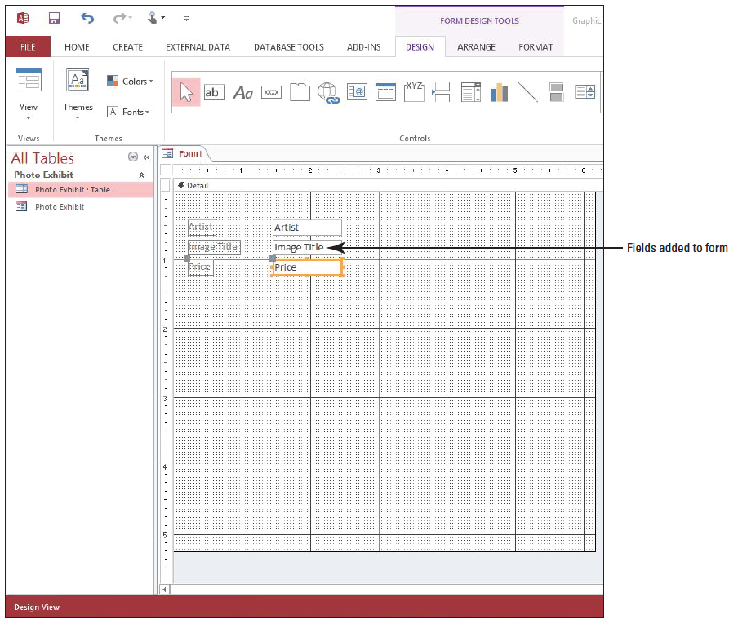
Step by Step: Create a Form in Design View
Double-click Price to add it to the form. Your form should look similar to the figure at right.
Click the File tab and click Save.

Slide 12
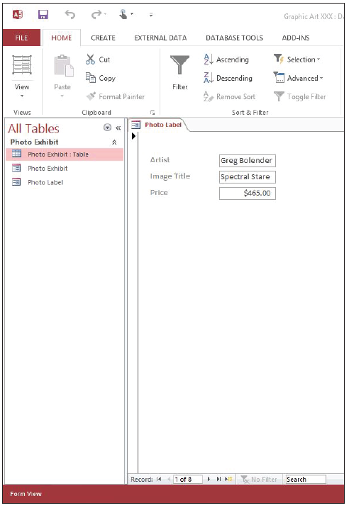
Step by Step: Create a Form in Design View
In the Save As dialog box, key Photo Label, and click OK.
On the Design menu, in the Views group, click the lower half of the View button and click Form View to display the form in Form view (see the figure at right).
Click the Close button on Photo Label to close the form.
LEAVE the database open.
PAUSE. LEAVE the database open to use in the next exercise.

Slide 13
Step by Step: Create a Form in Layout View
USE the database that is open from the previous exercise.
On the Create tab, in the Forms group, click the Blank Form button. A new blank form is created in Layout view.
Click the Show all tables link in the Field List pane to show the Photo Exhibit table name, if necessary.

Slide 14

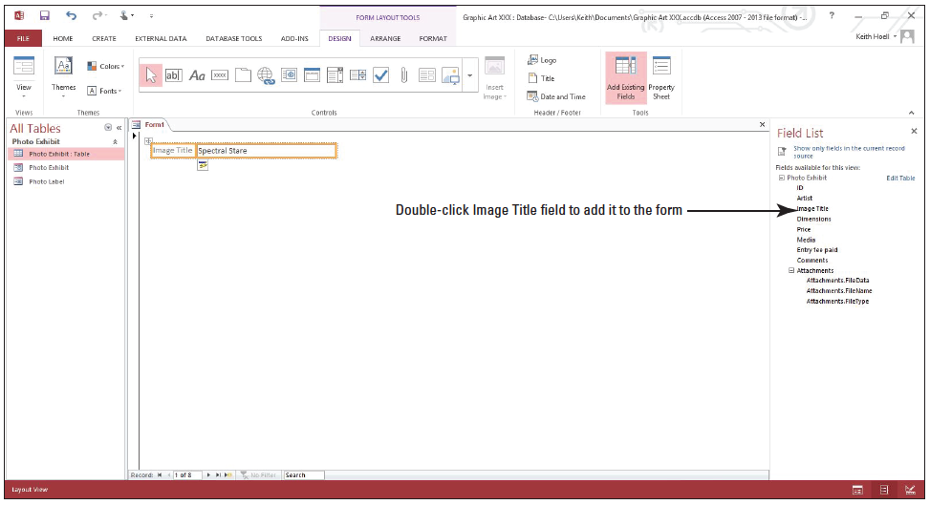
Step by Step: Create a Form in Layout View
Click the expand button next to the Photo Exhibit table name to show a list of fields related to the table and double-click Image Title to add it to the form. Your screen should look like the figure below.

Slide 15
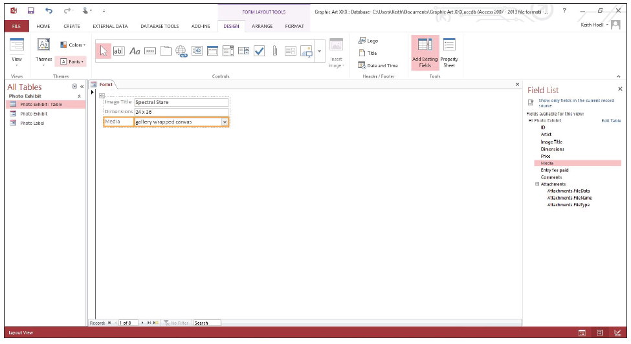
Step by Step: Create a Form in Layout View
Double-click Dimensions to add it to the form.
Double-click Media to add it to the form. Your form should look similar to the figure below.
Click the File tab and click Save.

Slide 16
Step by Step: Create a Form in Layout View
In the Save As dialog box, key Image Info, and click OK.
Click the Close button to close the Field List.
Click the Close button on Image Info to close the form.
LEAVE the database open.
PAUSE. LEAVE the database open to use in the next exercise.
Notes:
Take Note: To add more than one field at a time, press Ctrl and click several fields; then, drag them all onto the form at once.

Slide 17
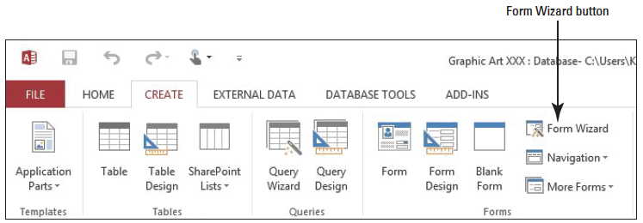
Step by Step: Use the Form Wizard
USE the database that is open from the previous exercise.
On the Create tab, in the Forms group, click the Form Wizard button (shown below).

Slide 18
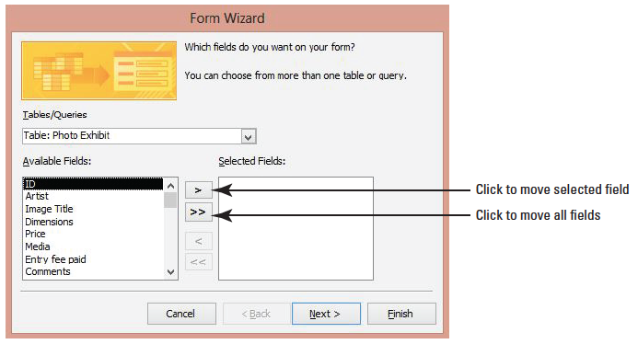
Step by Step: Use the Form Wizard
The Form Wizard displays (shown below).
Click the >> button to move all the fields from the Available Fields box to the Selected Fields box.

Slide 19
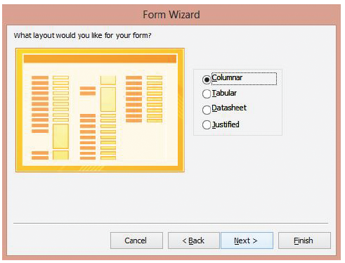
Step by Step: Use the Form Wizard
Click the Next > button to move to the next page in the Form Wizard (see right).
Click Datasheet as the layout for the form. Form layouts help determine the positioning of controls, objects, and data on a form.

Slide 20
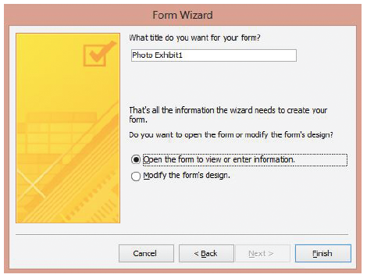
Step by Step: Use the Form Wizard
Click the Next > button to move to the final page in the Form Wizard (see right).
Key Photo Details as the title of the form.

Slide 21
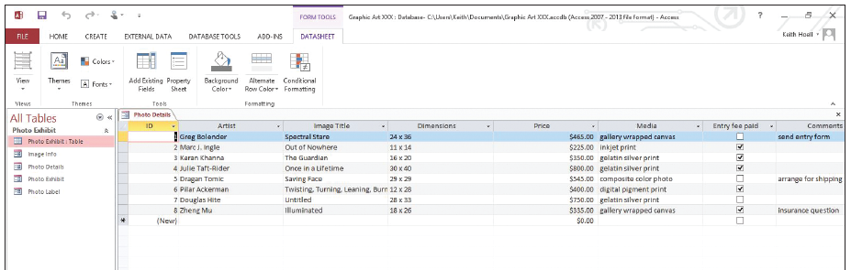
Step by Step: Use the Form Wizard
Click the Finish button. A datasheet form appears (shown (shown below).
Click the Close button on Photo Details to close the form.
PAUSE. LEAVE the database open for the next exercise.
Notes:
Take Note: To include fields from more than one table on your form, do not click Next or Finish after you select the fields from the first table on the first page of the Form Wizard. Instead, repeat the steps to select another table, and click any additional fields that you want to include on the form before continuing.

Slide 22
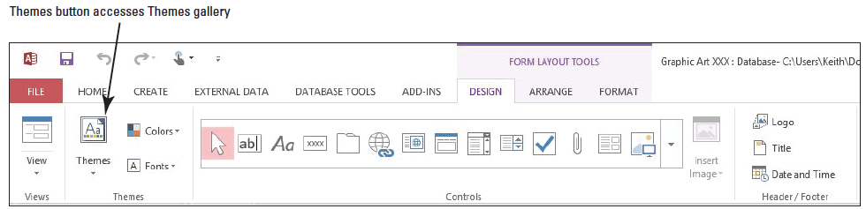
Step by Step: Apply a Theme
USE the database that is open from the previous exercise.
Double-click the Image Info form in the Navigation Pane to open it.
On the Home tab, in the Views group, click the lower half of the View button, and click Layout View on the View menu.
On the Form Layout Tools Design contextual tab, in the Themes group, click the Themes button (shown below).

Slide 23
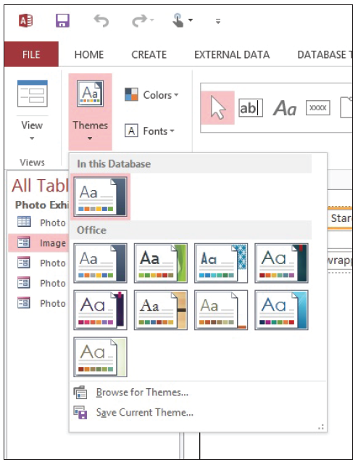
Step by Step: Apply a Theme
A gallery of themes appears (see right).

Slide 24
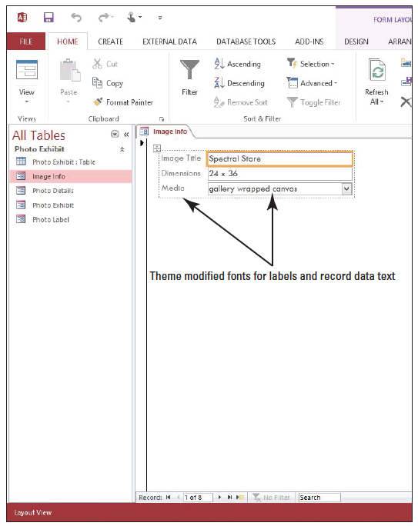
Step by Step: Apply a Theme
Click the Integral theme (first row, third column) to apply it to the form. Notice how the form’s text has changed (see right).
Click the Close button on Image Info to close the form.
PAUSE. LEAVE the database open to use in the next exercise.

Slide 25
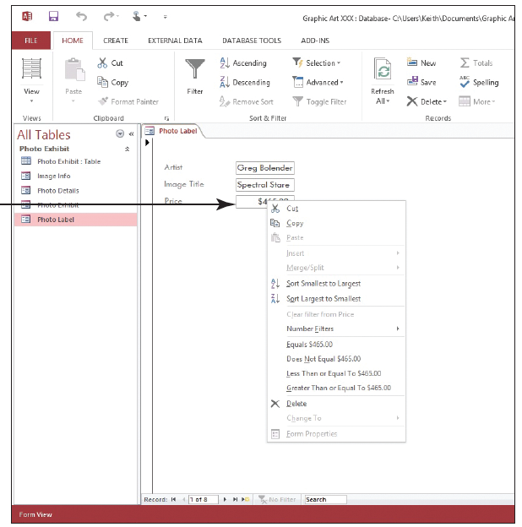
Step by Step: Sort Data within a Form
USE the database that is open from the previous exercise.
Double-click the Photo Label form in the Navigation Pane to open it in Form view.
Right-click the Price field to display the shortcut menu (see right).

Slide 26
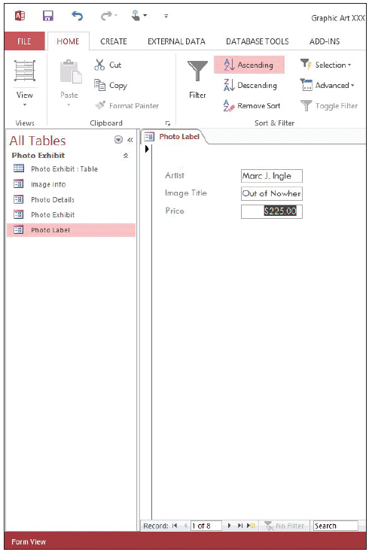
Step by Step: Sort Data within a Form
Click Sort Smallest to Largest. The form is sorted by price from smallest to largest. The record with the smallest price is displayed first (see right).

Slide 27
Step by Step: Sort Data within a Form
Click the Next record button on the record navigator at the bottom of the form. Continue clicking through all the records to see the records in order according to price.
On the Home tab, in the Sort & Filter group, click the Remove Sort button. The records have resorted back to their original order.
Click the Close button on Photo Label to close the form.
PAUSE. LEAVE the database open to use in the next exercise.
Notes:
Take Note: You cannot sort on a field that contains attachments. When sorting on a field with the Yes/No data type, a value of “Yes,” “True,” or “On” is considered “Selected,” and when sorted in ascending order will appear at the top of the list; a value of “No,” “False,” or “Off” is considered “Cleared,” and when sorted in ascending order will appear at the bottom of the list.

Slide 28
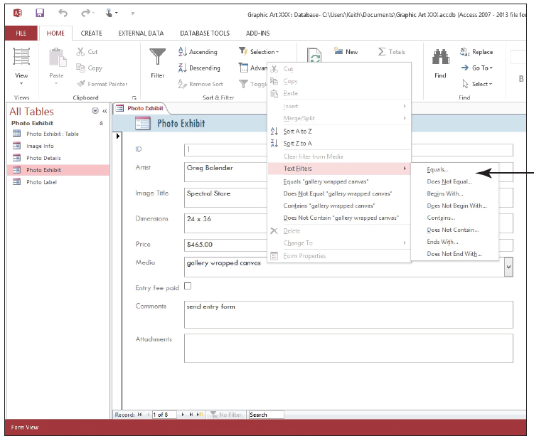
Step by Step: Filter Data with Common Filters
USE the database that is open from the previous exercise.
Double-click the Photo Exhibit form in the Navigation Pane to open it in Form view.
Right-click the Media field to display the shortcut menu and click Text Filters (see right).

Slide 29
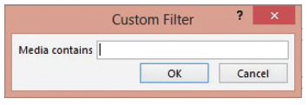
Step by Step: Filter Data with Common Filters
Click Contains... to display the Custom Filter dialog box (hown below).
In the Media contains box, key print, and click OK.
Click the Next record button on the record navigator at the bottom of the form. Continue clicking to see the five records that contain the word “print” in the Media field.

Slide 30
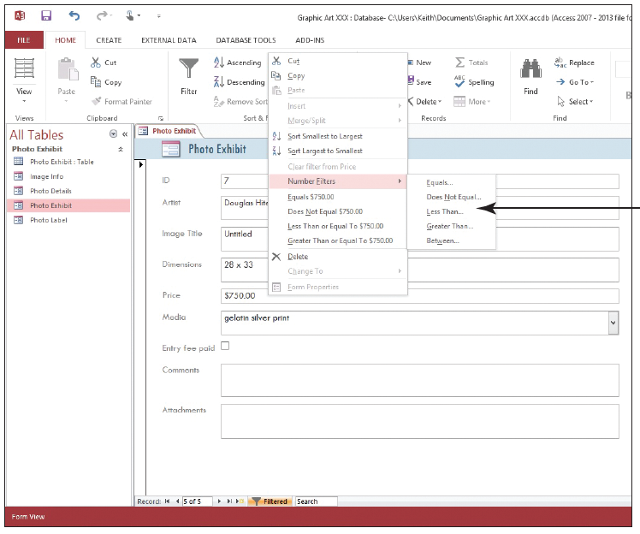
Step by Step: Filter Data with Common Filters
Right-click the Price field to display the shortcut menu and click Number Filters (see right).

Slide 31
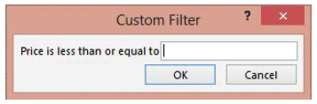
Step by Step: Filter Data with Common Filters
Click Less Than... to display the Custom Filter dialog box shown below.
In the Price is less than or equal to box, key 500, and click OK.
Click the Next record button on the record navigator at the bottom of the form. Continue clicking to see the three photos that use print media and are less than $500.

Slide 32
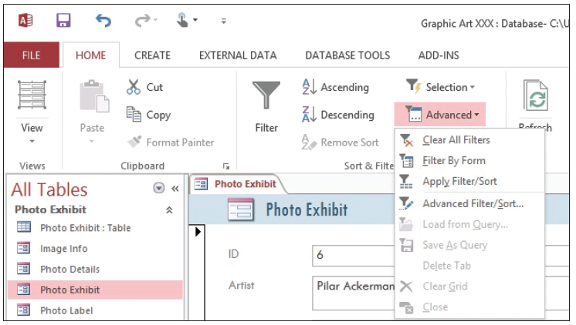
Step by Step: Filter Data with Common Filters
On the Home tab, in the Sort & Filter group, click the Advanced Filter Options button to display the menu shown below.
Click Clear All Filters.
PAUSE. LEAVE the database open to use in the next exercise.
Notes:
Cross-Reference: You already learned how to filter data within a table in Lesson 3. Filtering in a form using common filters is very similar.

Slide 33
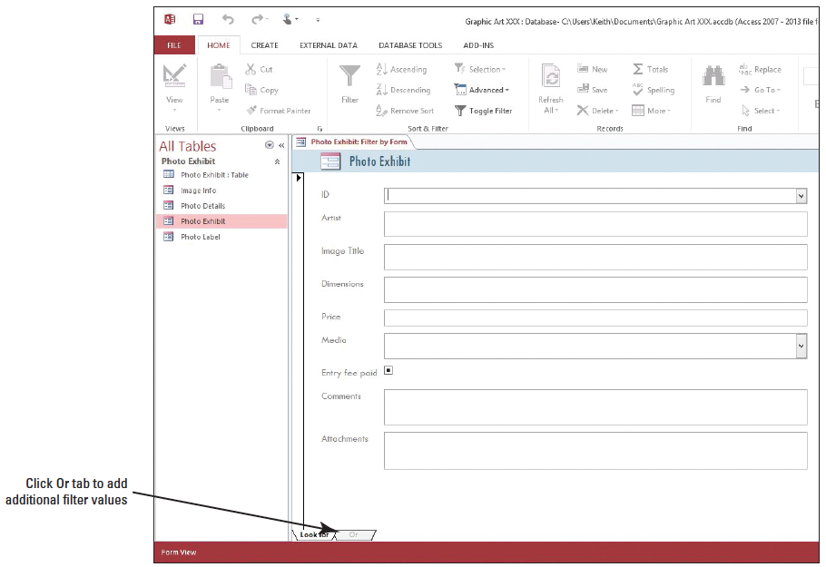
Step by Step: Use Filter by Form
USE the database that is open from the previous exercise.
On the Home tab, in the Sort & Filter group, click the Advanced Filter Options button and click Filter by Form. A form filter appears (see right).

Slide 34
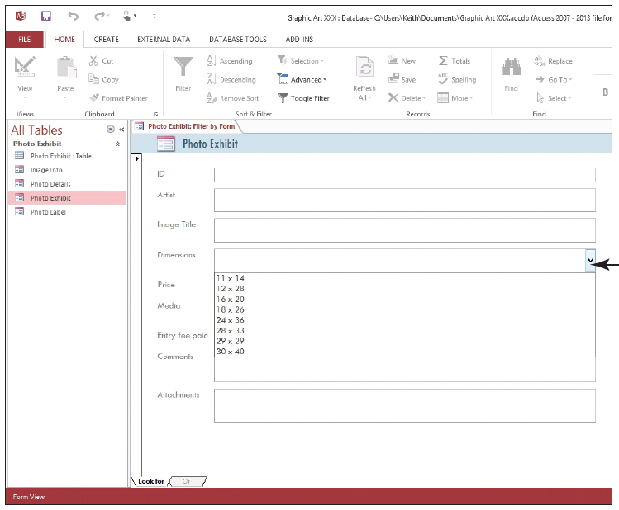
Step by Step: Use Filter by Form
Place the insertion point in the Dimensions box, and click the down arrow on the right to display the list of options shown at right.
Click 30 X 40.
Click the Or tab at the bottom of the form.
Place the insertion point in the Dimensions box, click the down arrow, and then click 12 X 28.

Slide 35
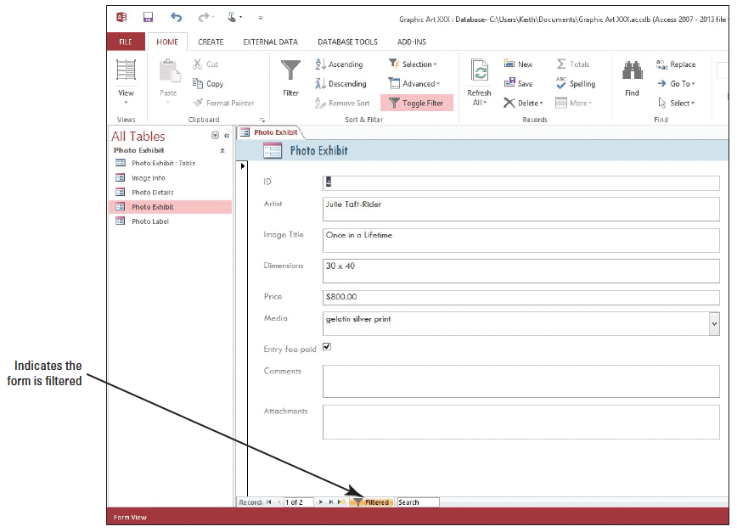
Step by Step: Use Filter by Form
On the Home tab, in the Sort & Filter group, click the Toggle Filter button to apply the filter. The records containing either the dimensions 30 X 40 or 12 X 28 are displayed (right).

Slide 36
Step by Step: Use Filter by Form
Click the Next record button on the record navigator at the bottom of the form to see the second record in the form filter results.
On the Home tab, in the Sort & Filter group, click the Toggle Filter button again to remove the filter.
On the Home tab, in the Sort & Filter group, click the Advanced button and click Clear All Filters.
Click the File tab and click Close.
STOP. LEAVE Access open for use in the projects.
Notes:
Take Note: If you want a field value to operate as a filter that is independent of other field values, you must enter that value on the Look for tab and each Or tab. In other words, the Look for tab and each Or tab represents an alternate set of filter values.

Slide 37
Skill Summary

