Slide 1
Create Reports
Microsoft Access 2013
Lesson 6

Slide 2
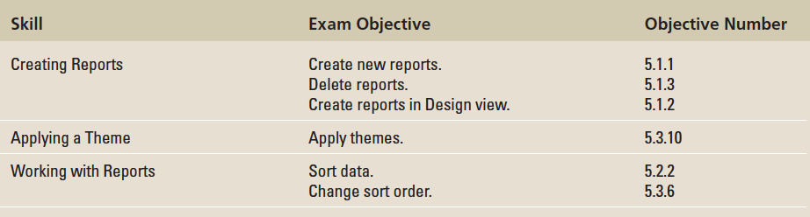
Objectives

Slide 3
Step by Step: Create and Delete a Report
GET READY. Before you begin these steps, be sure to turn on and/or log on to your computer and start Access.
OPEN AlpineSkiHo use from the data files for this lesson.
SAVE the database as AlpineSkiHo useXXX (where XXX is your initials).
In the Navigation Pane, click the Rooms table to select it. This is your record source.

Slide 4
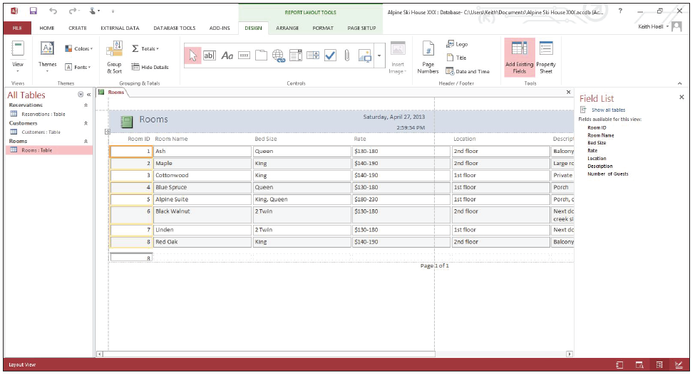
Step by Step: Create and Delete a Report
On the Create tab, in the Reports group, click the Report button. The report appears in Layout view (shown below). Notice the Report Layout tools that appear in the Ribbon.

Slide 5
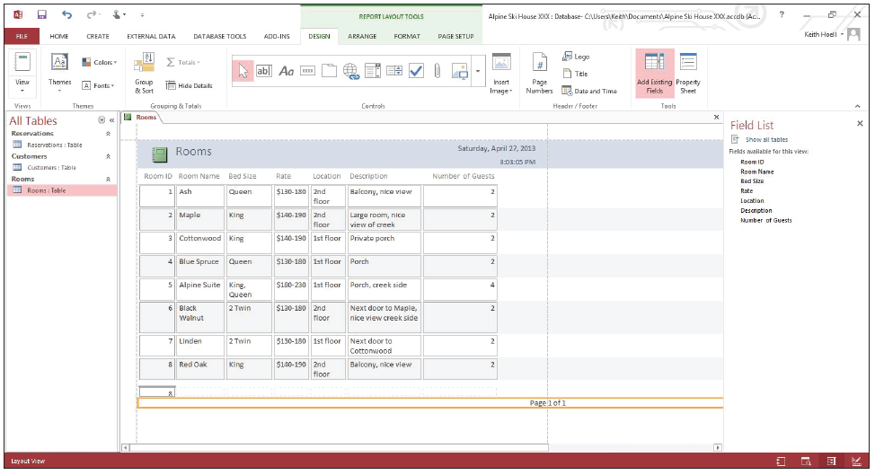
Step by Step: Create and Delete a Report
Click the Room ID header to select it. Position the pointer over the right border until you see a double-sided arrow. Click and drag to the left, resizing the column to remove white space.
Resize the other columns until your screen looks similar to the figure below.

Slide 6
Step by Step: Create and Delete a Report
Click the Save button on the Quick Access Toolbar. The Save As dialog box appears with Rooms in the Report Name box. Click OK. Notice that the Rooms report is listed in the Navigation Pane.
Click the Close button to close the Rooms report.
In the Navigation Pane, click the Reservations report to select it.
On the Home tab, in the Records group, click the Delete button and then click the Delete command on the menu that appears.
Click Yes on the dialog box asking you if you want to permanently delete the Reservations report. The report is now permanently deleted from the database.
PAUSE. LEAVE the database open to use in the next exercise.

Slide 7
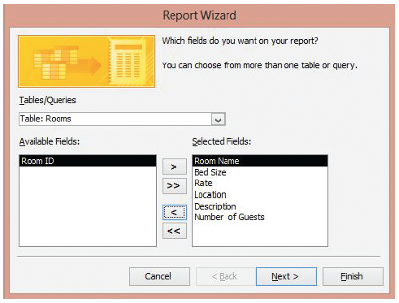
Step by Step: Use the Report Wizard
On the Create tab, in the Reports group, click the Report Wizard button. The first screen of the Report Wizard appears.
Make sure the Rooms table is selected in the Tables/Queries menu.
Click the >> button to move all the fields into the Selected Fields list.
Click the Room ID field to select it and click the < button to move it back to the Available Fields list (see right). Click the Next > button.

Slide 8
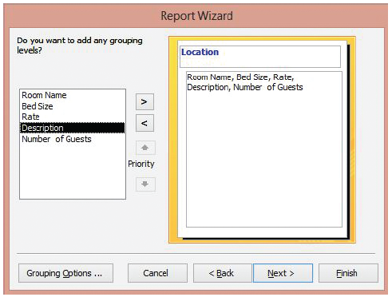
Step by Step: Use the Report Wizard
Click the Location field to select it and click the > button to add it as a grouping level (see right).
Click the Next > button.

Slide 9
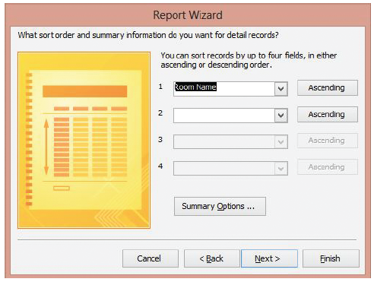
Step by Step: Use the Report Wizard
Select Room Name from the fields menu to sort in ascending order (see right), and click the Next > button.

Slide 10
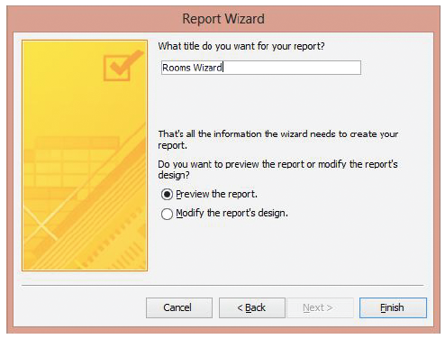
Step by Step: Use the Report Wizard
In the Layout section, click the Outline button. In the Orientation section, click the Landscape button (see right). Click Next >.

Slide 11
Step by Step: Use the Report Wizard
Key Rooms Wizard as the title of the report (see right).

Slide 12
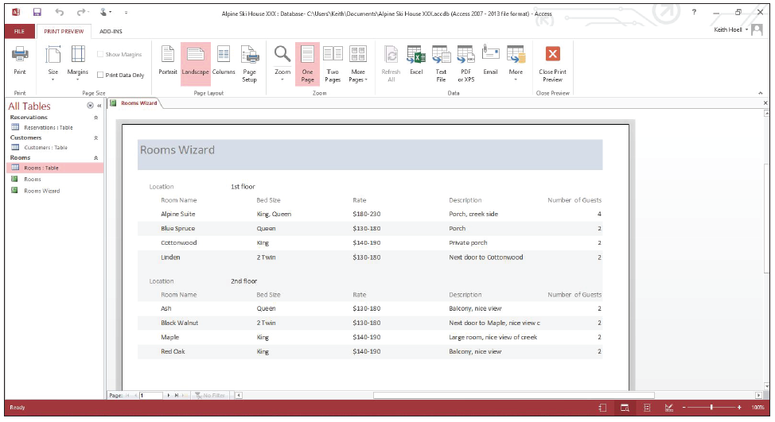
Step by Step: Use the Report Wizard
Click Finish. The Rooms Wizard report appears on the screen (see below).
CLOSE the report. Notice that the new report is listed in the Navigation Pane.
PAUSE. LEAVE the database open to use in the next exercise.

Slide 13
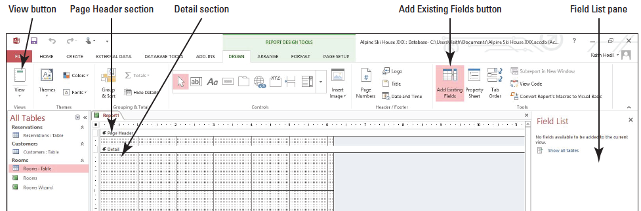
Step by Step: Create a Report in Design View
USE the database you used in the previous exercise.
If necessary, click the Rooms table in the Navigation Pane to select it.
On the Create tab, in the Reports group, click the Report Design button. A new blank report is displayed in Design view (shown below).

Slide 14
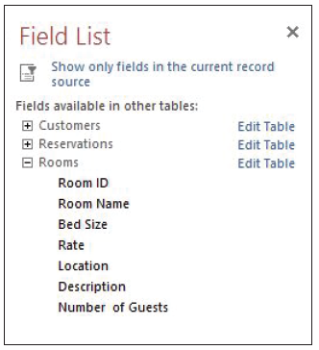
Step by Step: Create a Report in Design View
If the Fields List is not already displayed, on the Design tab, in the Tools group, click the Add Existing Fields button. The Show All Tables link appears.
Click the Show all tables link then the plus (+) box beside Rooms to display the fields in the table (see right).
Double-click Room ID. The field is inserted onto the design grid.

Slide 15
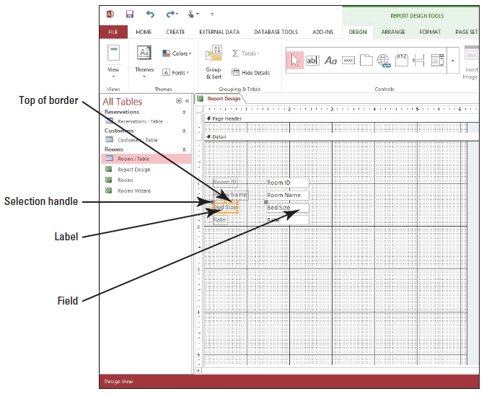
Step by Step: Create a Report in Design View
Double-click Room Name, Bed Size, and Rate.
Click the Close button on the Field List pane.
Click the Bed Size label. The border around the label changes to orange, indicating that it is selected. Position the insertion point over the top of the border (see right) until the pointer changes to a four-sided arrow.

Slide 16
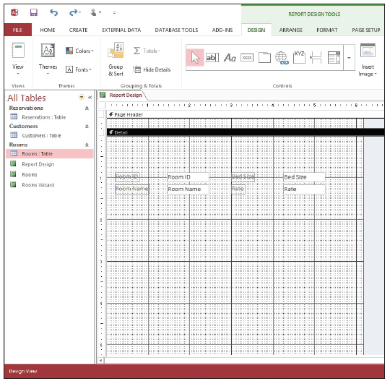
Step by Step: Create a Report in Design View
Click and drag the label to position it about one-half inch to the right of the Room ID field and release the mo use button. The field is moved along with the label.
In the same manner, move the Rate label and field to position it below the Bed Size field (see right).

Slide 17
Step by Step: Create a Report in Design View
Click the Room ID field to select it. Position the mo use pointer on the square handle in the middle of the right-side border. Click and drag the field to the left to decrease the size by about one-quarter inch.
On the Ribbon, in the Views group, click the bottom half of the View button and select Report View from the menu. The report is shown in Report view. Scroll down to see all the records.
Click the Save button on the Quick Access Toolbar.
Key Report Design in the Report Name box, and click OK.
CLOSE the report.
PAUSE. LEAVE the table open to use in the next exercise.
Notes:
Take Note: You can add more than one field to a report design at once. Hold down the Ctrl key and click the fields you want, and then drag the selected fields onto the report.
Cross Reference: In Lesson 8, you learn how to add more functionality to a report by adding controls in Design view.

Slide 18
Step by Step: Apply a Theme
USE the database open from the previous exercise.
OPEN the Rooms report.
On the Ribbon, in the Views group, click the bottom half of the View button. Select Layout view from the menu.
On the Report Layout Tools Design contextual tab, in the Themes group, click the Themes button. The Themes gallery of predefined report themes appears.

Slide 19
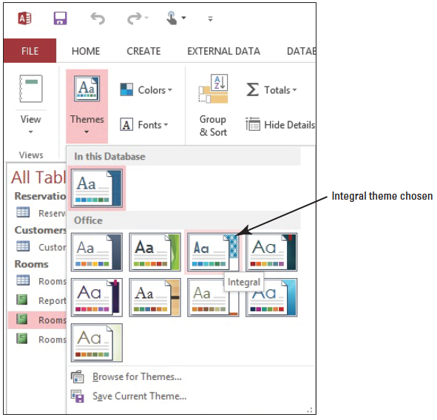
Step by Step: Apply a Theme
In the Office section and the first row, third column, click the Integral design (see right). The format is applied to the report.

Slide 20
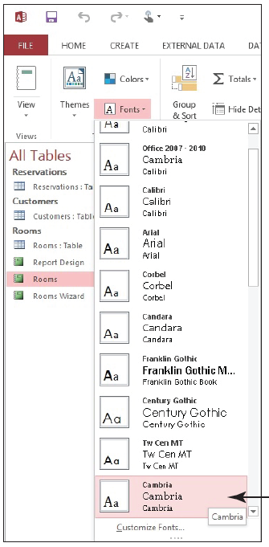
Step by Step: Apply a Theme
In the Themes group, click the Fonts button. Select Cambria from the menu (see right). The new Font theme is applied.
SAVE the report.
PAUSE. LEAVE the report open to use in the next exercise.

Slide 21
Step by Step: Sort Data within a Report
USE the report open from the previous exercise.
On the Home tab in the Views group, click the bottom half of the View button. Select Layout view from the menu.
Click the Room Name header.
On the Home tab, in the Sort & Filter group, click the Ascending button. The column is sorted in ascending alphabetic order.
On the Home tab, in the Sort & Filter group, click the Remove Sort button. The Sort is removed.

Slide 22
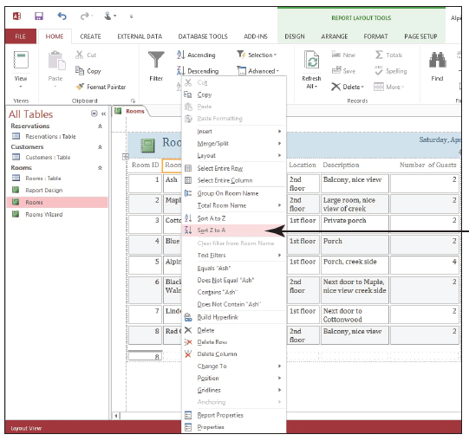
Step by Step: Sort Data within a Report
Right-click the Room Name header. The shortcut menu appears.
Select Sort Z to A (see right). The column is sorted.

Slide 23
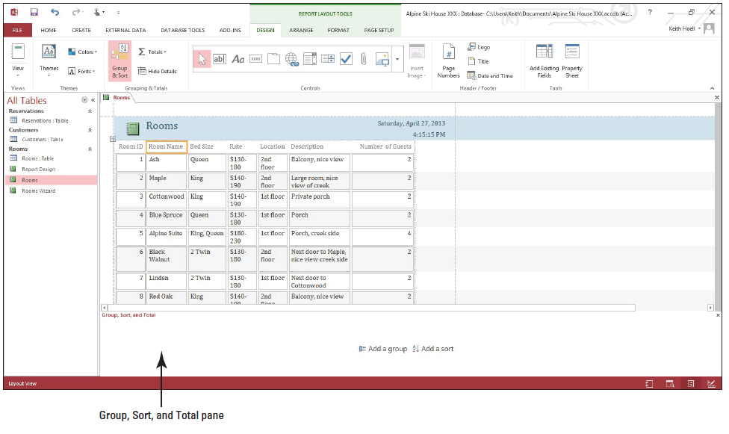
Step by Step: Sort Data within a Report
On the Home tab, in the Sort & Filter group, click the Remove Sort button. The Sort is cleared.
On the Report Layout Tools Design contextual tab, in the Grouping & Totals group, click the Group & Sort button. The Group, Sort, and Total pane appears at the bottom of the screen (shown below).

Slide 24
Step by Step: Sort Data within a Report
Click the Add a Sort button in the Group, Sort, and Total pane.
Click the Room Name field in the fields list. Notice that the field was sorted in ascending order by default and a line was added describing the sort.

Slide 25
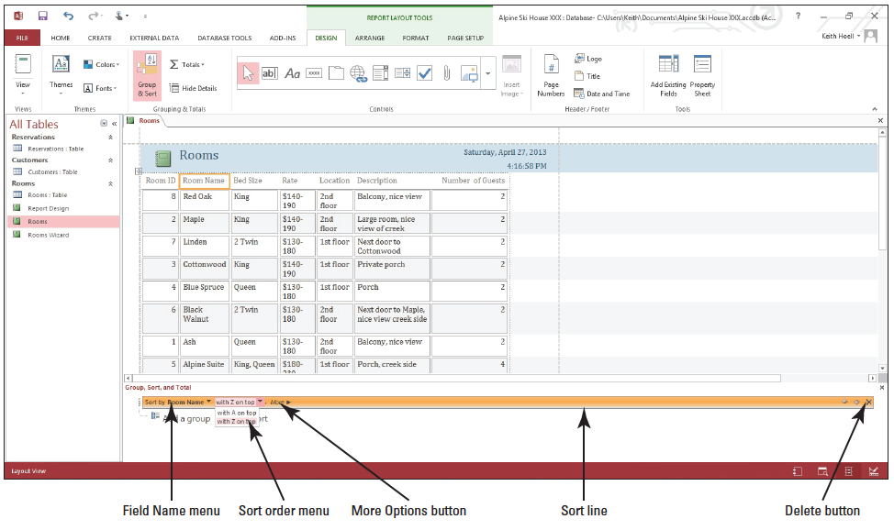
Step by Step: Sort Data within a Report
Click the down arrow beside with A on top and select with Z on top from the menu (shown below). The field is sorted in descending order.

Slide 26
Step by Step: Sort Data within a Report
Click the More Options button in the Sort line. Notice the options available for customizing a sort.
Click the Delete button. The sort is cleared.
In the Grouping & Totals group on the Ribbon, click the Group & Sort button. The Group, Total, and Sort pane is removed.
SAVE the report.
PAUSE. LEAVE the database open to use in the next exercise.

Slide 27
Step by Step: Filter Data within a Report
USE the database you used in the previous exercise.
Click the Location header to select it.
On the Home tab, in the Sort & Filter group, click the Filter button. A menu appears.

Slide 28
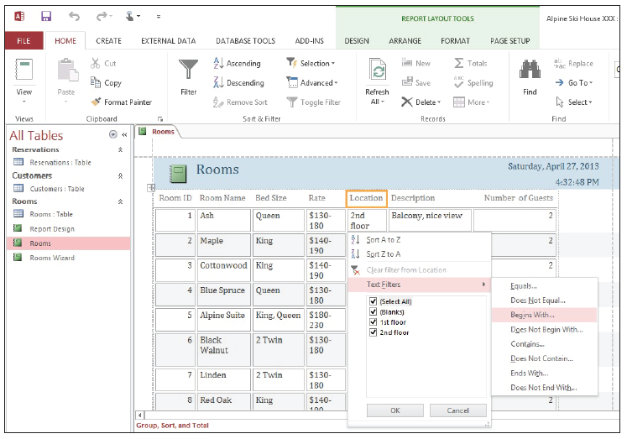
Step by Step: Filter Data within a Report
Point to Text Filters. A second menu appears. Select Begins with... (seeright). The Custom Filter box appears.

Slide 29
Step by Step: Filter Data within a Report
Key 1 into the Custom Filter box and click OK. The data is filtered to show only the rooms on the first floor.
Click the Toggle Filter button on the Ribbon. The report returns to its unfiltered state.
In the Bed Size field, click King in the second row.
On the Home tab, in the Sort & Filter group, click the Selection button. Select Equals “King” from the menu. The data is filtered to show only the rooms with King-sized beds.

Slide 30
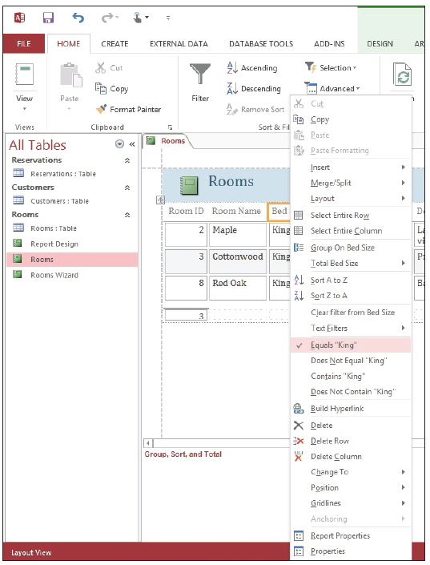
Step by Step: Filter Data within a Report
Right-click the Bed Size header. A shortcut menu appears. Notice that the Equals “King” filter and the other filters from the Selection menu are also available in the shortcut menu (see right).
Select Clear filter from Bed Size from the menu. The filter is cleared.
CLOSE the report.
PAUSE. LEAVE the database open to use in the next exercise.

Slide 31
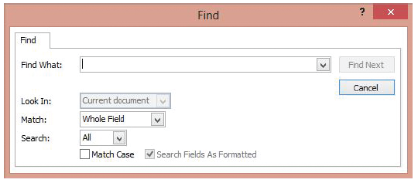
Step by Step: Find Data within a Report
USE the database open from the previous exercise.
OPEN the Rooms report.
On the Home tab, in the Find group, click the Find button. The Find dialog box appears (shown below).

Slide 32
Step by Step: Find Data within a Report
Key King in the Find What drop-down box and select Current document in the Look In drop-down box.
Click the Find Next button. Access highlights the first occurrence of ‘King’ in the report. Continue clicking the Find Next button until Access reports that it has finished searching the records.
CLOSE the report. CLOSE the database.
STOP. CLOSE Access.

Slide 33
Skill Summary

