Slide 1
Working with Excel
Microsoft Excel 2013
Lesson 2

Slide 2
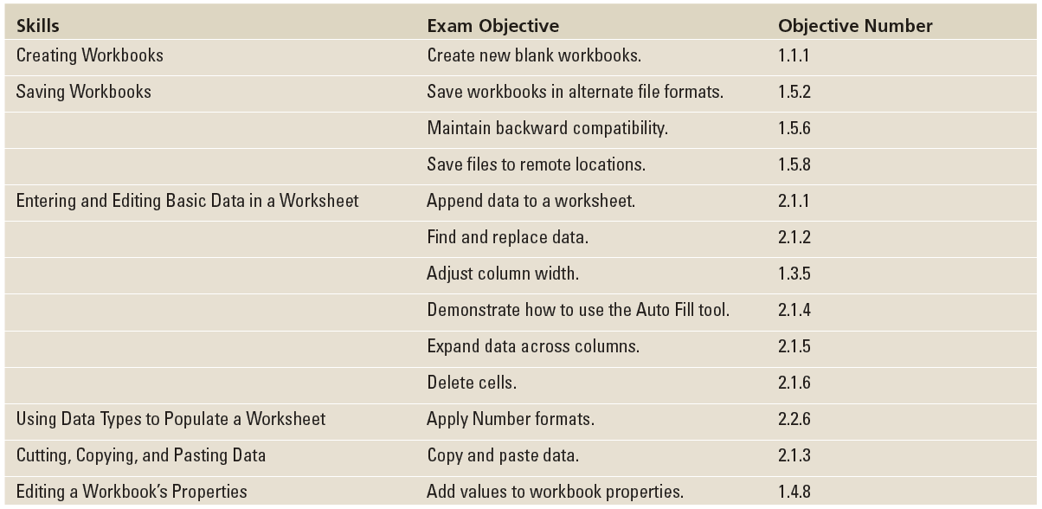
Objectives

Slide 3
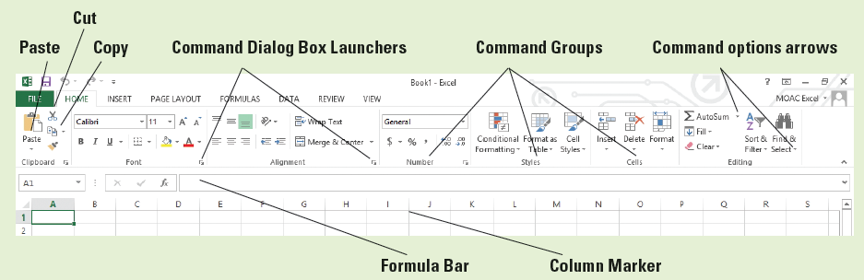
Software Orientation
The ribbon in Microsoft Office Excel 2013 is made up of a series of tabs, each related to specific kinds of tasks.
The HOME tab, shown below, contains the commands people use the most when creating Excel documents.
Having commands visible on the work surface lets you see at a glance most tasks you want to perform. Each tab contains groups of commands related to specific tasks or functions.

Slide 4
Software Orientation
Some commands have an arrow associated with them. In the figure on the previous slide, you see the option arrows associated with AutoSum and Find & Select. This indicates that in addition to the default task, other options are associated with the task.
Similarly, some of the groups have Dialog Box Launchers associated with them. Clicking these displays additional commands not shown on the ribbon.
In the figure on the previous slide, the Clipboard, Font, Alignment, and Number groups have associated dialog boxes, whereas Styles, Cells, and Editing do not.

Slide 5
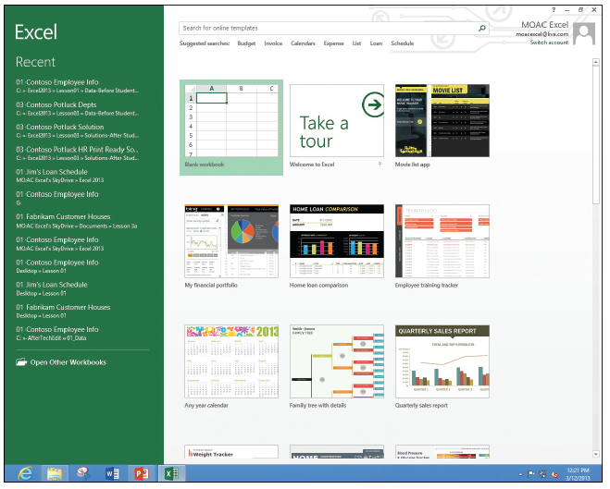
Step by Step: Create a Workbook from Scratch
GET READY. LAUNCH Excel. Excel gives you options for starting a blank workbook, taking a tour, or using templates (right).

Slide 6
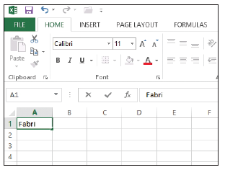
Step by Step: Create a Workbook from Scratch
Click Blank workbook. If you have just launched Excel, Book1 – Excel appears in the title bar at the top of the window. A blank workbook opens with A1 as the active cell.
In cell A1, type Fabrikam Inc. This cell is the primary title for the worksheet. Note that as you type, the text appears in the cell and in the formula bar (see figure).

Slide 7
Step by Step: Create a Workbook from Scratch
Press Enter. The text is entered into cell A1, but appears as if it flows into cell B1.
In cell A2, type 123 Fourth Street and press Enter.
In cell A3, type Columbus, OH 43204 and press Enter.
Sometimes you need a quick work area to complete another task while you are in the middle of a workbook. You can open another workbook as a scratch area. Click the FILE tab, and in the left pane, click New. The templates available appear.
In the Backstage area, click Blank Workbook. A second Excel workbook opens and Book2 appears in the title bar.
In cell A1, type Phone Calls and press Enter.
In cell A2, type David Ortiz UA flight 525 arriving 4:30 pm and press Enter.
PAUSE. LEAVE both Excel workbooks open for the next exercise.
Notes:
Another Way: When you work in Excel, you can open a blank workbook with the shortcut combination Ctrl + N.

Slide 8
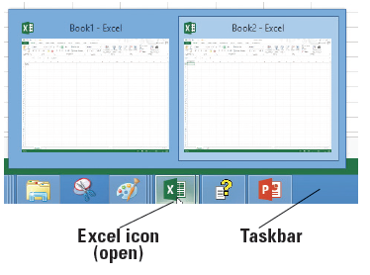
Step by Step: Switch Between Open Workbooks
GET READY. Both temporary workbooks with the address and phone message should be open. The Phone Call workbook is the current workbook in this case.
To return to the company address, click the Excel icon on the taskbar (see figure). Each of the open workbooks appears in a preview window. When you move the mouse pointer over each workbook, it previews on the screen.
Click Book1 - Excel. The unsaved company address becomes the active workbook.
Notes:
Another Way: You can also switch between two recent active workbooks with Ctrl + Tab.
Take Note: Unlike previous versions, Excel now displays each workbook in a separate window.

Slide 9
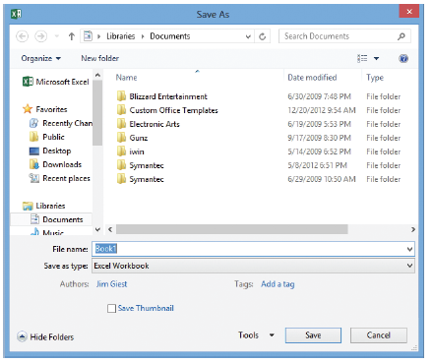
Step by Step: Name and Save a Workbook
GET READY. USE the workbook from the previous exercise or type your name and address in a new workbook.
Click the FILE tab to open Backstage view. In the left pane, click Save As to display the save options.
Double-click Computer to open the Save As dialog box (see figure).
Notes:
Another Way: You can also save the workbook with Ctrl + S.

Slide 10
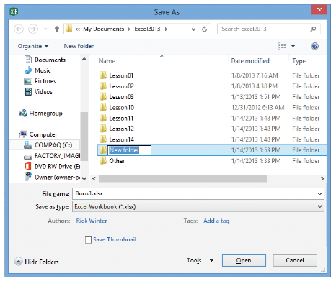
Step by Step: Name and Save a Workbook
From the left-hand navigation pane, in the Save As dialog box, click Desktop. The Desktop becomes the new destination of your saved file.
In the Save As dialog box, click New folder. A folder icon appears with the words “New folder” selected (see figure).
Type Excel Lesson 2 and press Enter.
Click the Open button.

Slide 11
Step by Step: Name and Save a Workbook
In the File Name box, type 02 Fabrikam Address Solution.
Click the Save button.
PAUSE. LEAVE the workbook open to use in the next exercise.
Notes:
Take Note: Save your workbook often and especially before opening another workbook, printing, or after you enter information.

Slide 12
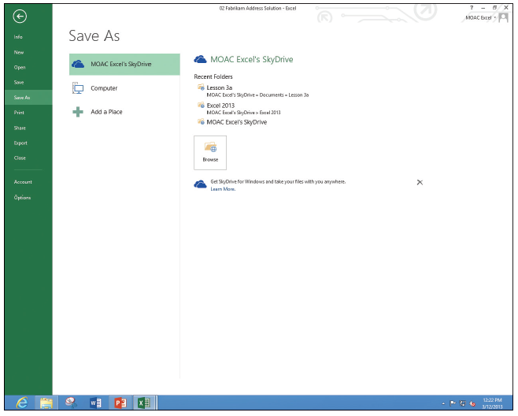
Step by Step: Save to Your SkyDrive
GET READY. USE the workbook from the previous exercise or type your name and address in a new workbook.
Click the FILE tab and then click Save As.
In the Backstage area, under Save As, click [Your name] SkyDrive (see figure). You may need to sign in to SkyDrive if you haven't already.
Click the Browse button.
Click the New folder button.

Slide 13
Step by Step: Save to Your SkyDrive
In the New folder text box, type Excel Lesson 2 to also have a folder for this lesson on your SkyDrive and press Enter.
Double-click the Excel Lesson 2 icon to move to that folder.
Keep the file with the same name (or type 02 Fabrikam Address Solution in the File name box), and then click the Save button.
PAUSE. LEAVE the workbook open to use in the next exercise.

Slide 14

Step by Step: Save a Workbook Under a Different Name
GET READY. USE the workbook from the previous exercise or type Fabrikam Inc. in cell A1.
In cell A2, type 87 East Broad Street.
In cell A3, type Columbus, OH 43215.
Click the FILE tab, and in the left pane, click Save As. The Backstage view shows that the Current Folder (see figure 2-8) is Excel Lesson 2 on your SkyDrive, because it was the folder that was last used to save a workbook.

Slide 15
Step by Step: Save a Workbook Under a Different Name
Click on Computer to return to the drive you used before.
In the right pane, double-click Excel Lesson 2.
Click in the File name box, click after Fabrikam, and type Broad so the name reads 02 Fabrikam Broad Address Solution.
Click Save. You created a new workbook by saving an existing workbook with a new name.

Slide 16
Step by Step: Save a Workbook Under a Different Name
Click the FILE tab, click Save As in the left pane, and click Browse.
In the File Name box, type 02 Fabrikam Address Template Solution.
In the Save As Type box, click the drop-down arrow and choose Excel Template. Click the Save button.
PAUSE. EXIT Excel. Do not save the phone message workbook.
Notes:
Take Note: Templates are automatically saved in another location so they can be opened with the FILE, New option.

Slide 17
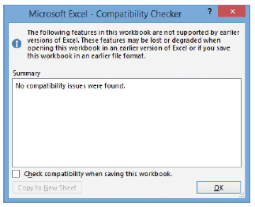
Step by Step: Save a Workbook in a Previous Excel Format
GET READY. LAUNCH Excel.
Click the FILE tab, and then click Open.
In the Backstage Recent Workbooks pane, click 02 Fabrikam Broad Address Solution.
First check for compatibility issues. Click the FILE tab, click Info, click Check for Issues, and then click Check Compatibility. The Microsoft Excel – Compatibility Checker dialog box at right opens.

Slide 18
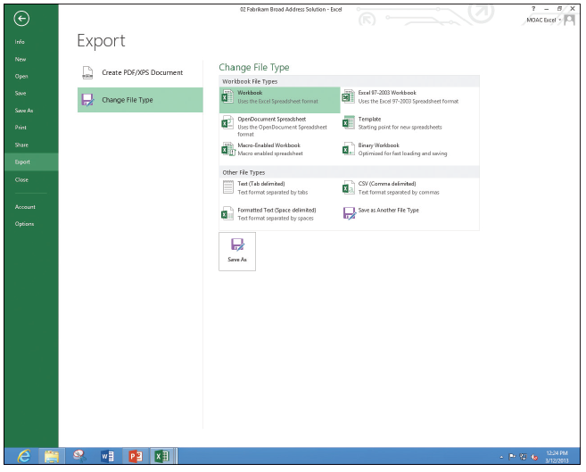
Step by Step: Save a Workbook in a Previous Excel Format
Read the information in the Compatibility Checker dialog box and click OK.
Click the FILE tab, click Export, and then click Change File Type. The Backstage window shows the different file types (right).
Click Excel 97-2003 Workbook (*.xls) and click Save As.

Slide 19
Step by Step: Save a Workbook in a Previous Excel Format
In the File name box, click before Solution and type 97-03, and then click Save.
Click the FILE tab, and then click Open. The Recent Workbooks pane in Backstage shows the last set of documents that have been saved.
Click 02 Fabrikam Broad Address Solution.
PAUSE. LEAVE the workbook open to use in the next exercise.

Slide 20
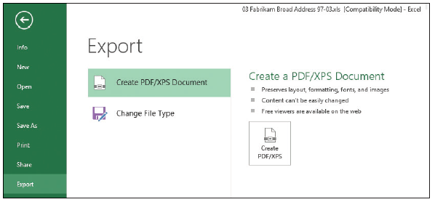
Step by Step: Save in Different File Formats
GET READY. USE the workbook from the previous exercise or type your name and address in a new workbook.
Display Backstage view, click the FILE tab, and then click the Export button.
Click the Change File Type button. Excel explains the different file types.
Click the Create PDF/XPS Document option (right).
Click the Create PDF/XPS button in the right pane.

Slide 21

Step by Step: Save in Different File Formats
In the left navigation pane, click Desktop.
Double-click Excel Lesson 2 to move to that folder.
The file name gives the last name with a PDF extension.
Click Publish.
The Reader application opens with the PDF file displayed (right).

Slide 22
Step by Step: Save in Different File Formats
Close the Reader. Right-click in a blank area, and then click More, Close file.
If necessary, press Alt+Tab to return to the Excel file.
PAUSE. CLOSE all open workbooks and LEAVE Excel open to use in the next exercise.
Notes:
Take Note: Adobe PDF (Portable Documents Format) ensures that your printed or viewed file retains the formatting that you intended, but the file cannot be easily changed. You can also save your workbooks in a Web page format for use on websites with Single File Web Page or Web Page options. To import data into another format and the other program does not accept Excel worksheets, you can also try Text (Tab delimited) or CSV (Comma delimited) formats. All of these options are available from the Save As type drop-down menu on the FILE tab.

Slide 23
Step by Step: Enter Basic Data in a Worksheet
GET READY. If necessary LAUNCH Excel and OPEN a new workbook.
Click cell A1, type Fabrikam Inc., and press Enter. Notice that the active cell moves to the next row, to cell A2.
In cell A2, type Employee List and press Enter.
Click cell A4, type Name, and press Tab. Notice that the active cell moves to the next column, to cell B4.
Type Extension and press Enter. Notice that the active cell moves to the first cell in the next row.
Type Richard Carey and press Tab.
Type 101 and press Enter. Richard Carey looks cut off.
Notes:
Troubleshooting: If you type the wrong data, you can click the cell and retype the entry. In the following sections, you see how to edit text.

Slide 24
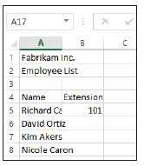
Step by Step: Enter Basic Data in a Worksheet
Click cell A5 and notice that the complete entry for Richard Carey appears in the formula bar.
Click cell A6, type David Ortiz, and press Enter.
Type Kim Akers and press Enter.
Type Nicole Caron and press Enter.
SAVE the workbook in the Computer’s Excel Lesson 2 folder as 02 Fabrikam Employees Solution. Your file should look like the figure at r ight.
PAUSE. LEAVE the workbook open for the next lesson.
Notes:
Take Note: Text is stored in only one cell, even when it appears to extend into adjacent cells. If an entry is longer than the cell width and the next cell contains data, the entry appears in truncated form. To edit the data, you need to go to the cell where the text starts and not in the adjacent cells.

Slide 25
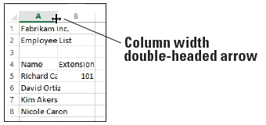
Step by Step: Change the Column Width
GET READY. Use the 02 Fabrikam Employees Solution file from the previous exercise.
Move the mouse pointer between columns A and B, to the column markers at the top of the worksheet (below). The mouse pointer changes to a double-headed arrow.
Double-click the column marker between A and B. The width of the column changes to the widest entry in column A. In this case, it is Employee list and Richard Carey's name.
Notes:
Take Note: To change the column width manually, point to the column marker between columns A and B and drag the pointer left or right instead of double-clicking.

Slide 26
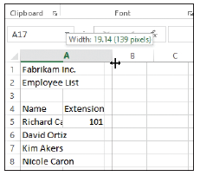
Step by Step: Change the Column Width
Drag the double-headed arrow mouse pointer between columns B and C until the ScreenTip shows Width: 12.00 (89 pixels) or something close to this amount (below).
SAVE the 02 Fabrikam Employees Solution file. This overwrites your previous version without the column width change.
PAUSE. CLOSE the workbook and LEAVE Excel open for the next exercise.
Notes:
Take Note: When you type text that is longer than the cell’s width, the text appears as if it extends into the next cell. However, when you type in the next cell, the overflow text does not display. The text is still there. It is often easier to proof your work if you have the column widths match the longest text. You can double-click on the column markers to automatically adjust to the widest entry or drag the column marker to adjust the column width to your desired width.

Slide 27
Step by Step: Edit a Cell’s Contents
GET READY. OPEN a blank workbook.
Click cell A1, type Fabrikam, and press Enter. The insertion point moves to cell A2 and nothing appears in the formula bar.
Click cell A1. Notice that the formula bar displays "Fabrikam."

Slide 28
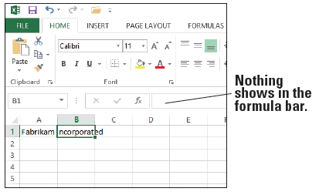
Step by Step: Edit a Cell’s Contents
Click after Fabrikam in the formula bar, type a space, type Incorporated, and press Tab. The insertion point moves to cell B1 and nothing appears in the formula bar (right).
Click cell A1 and double-click on Incorporated in the formula bar to select it. Type Inc. and press Enter.
Type Sales and press Enter.

Slide 29
Step by Step: Edit a Cell’s Contents
Click cell A2 and click after Sales. The insertion point moves to the formula bar.
Press Home. The insertion point moves to the beginning of the formula bar.
Type Monthly and then press the spacebar. Press Enter.
In cell A3, type January and press Enter.
Notes:
Take Note: While you are editing in the formula bar, you can press Home to move to the beginning, End to move to the end, or the left or right arrow keys to move one character at a time. Press Delete to delete characters after the insertion point. Press Backspace to delete characters before the insertion point.

Slide 30
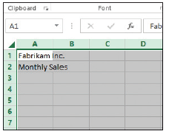
Step by Step: Edit a Cell’s Contents
Click cell A3, type February, and press Enter. Cell A3's original text is gone and February replaces January.
Click cell A3 and press Enter. The entry in A3 is removed.
Above row 1 and to the left of column A, click the Select All button (below). All cells on the worksheet are selected.

Slide 31
Step by Step: Edit a Cell’s Contents
Press Enter. All entries are removed.
PAUSE. CLOSE the workbook without saving and LEAVE Excel open for the next exercise.
Notes:
Another Way: You can right-click a cell or a selected range of cells and choose Delete from the shortcut menu that appears.
Take Note: If you edit a cell's contents and change your mind before you press Enter, press Esc and the original text will be restored. If you change the content of a cell and then do not want the change, click the Undo button on the Quick Access Toolbar or press Ctrl + Z. The deleted text will be restored.

Slide 32
Step by Step: Delete and Clear a Cell’s Contents
GET READY. OPEN a blank workbook.
In cell A1, type 1 and press Enter.
Type 2 and press Enter.
Type 3 and press Enter.
Type 4 and press Enter.
Highlight cells A1 through A4 (containing the numbers 1 through 4).
Press Delete. All the cells are erased.
On the Quick Access Toolbar, click the Undo button to return the cell entries.
Notes:
Another Way: You can right-click a cell or a selected range of cells and choose Delete from the menu that appears.

Slide 33
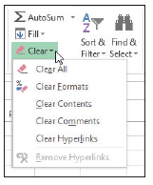
Step by Step: Delete and Clear a Cell’s Contents
Click cell B5, type $275,000, and press Enter. The value and format are placed into the cell.
Click cell B5 and press Enter.
Type 225000 without the dollar sign and comma and press Enter. Notice that $225,000 is formatted. Although the text is gone, the cell retains the revious format when you press Delete.
Click cell B5 and on the HOME tab, in the Editing group, click Clear (right).
Click Clear Formats. 225000 displays without the dollar sign and comma.
PAUSE. CLOSE the workbook without saving and LEAVE Excel open for the next exercise.
Notes:
Take Note: Clear displays a number of options. To remove both the entry and the format, choose Clear All.

Slide 34
Step by Step: Enter Labels and Use AutoComplete
GET READY. OPEN a blank workbook.
In cell A1, type Fabrikam Inc. and press Enter.
Type Monthly Sales.
Click cell A4 and type Agent and press Tab.
In cell B4, type Last Closing Date and press Tab.
In cell C4, type January and press Enter.
Click cell A5, type Richard Carey, and press Enter.
In cell A6, type David Ortiz and press Enter.
In cell A7, type Kim Akers and press Enter.
Type Nicole Caron and press Enter.
Notes:
Troubleshooting: To verify that AutoComplete is enabled, click the FILE tab accessing Backstage, click Options, and then click Advanced in the navigation pane. In the Editing options section, click the Enable AutoComplete for cell values check box if it is not already checked. Click OK.

Slide 35
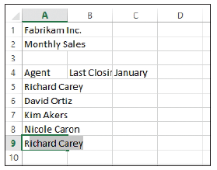
Step by Step: Enter Labels and Use AutoComplete
Click cell A9 and type R. As shown below, AutoComplete is activated when you type the R because it matches the beginning of a previous entry in this column. AutoComplete displays the entry for Richard Carey.

Slide 36
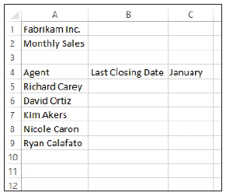
Step by Step: Enter Labels and Use AutoComplete
Type y. The AutoComplete entry disappears. Finish typing the entry for Ryan Calafato and press Enter.
Type R. Notice that no AutoComplete entry appears this time. Type i and notice that the AutoComplete entry shows Richard Carey.
Press Esc to undo the entry.
Increase the column widths for columns A and B so you can see the entries in row 4 and below (right).
PAUSE. LEAVE the workbook open to use in the next exercise.
Notes:
Take Note: Excel bases the list of potential AutoComplete entries on the text in the rows above the current row. If different rows start with the same character, you might have to type more than one character for the AutoComplete entry to display.

Slide 37
Step by Step: Enter Numeric Values
GET READY. USE the workbook from the previous exercise.
Click cell C5, type $275,000, and press Enter.
Click cell C5 and notice that 275000 appears in the formula bar and the formatted value appears in the cell.
Click cell C6, type 125,000, and press Enter. Be sure to include the comma in your entry. The number is entered in C6 and C7 becomes the active cell. The number appears in the cell with the comma and no dollar sign (unlike the entry in C5); however, the formula bar displays the true value and disregards the special characters.

Slide 38
Step by Step: Enter Numeric Values
Type 209000 and press Enter. The number is entered with no dollar sign and no comma.
Type 258,000 and press Enter.
Type 145700 and then click cell C5. Figure 2-22 illustrates how your spreadsheet should look with the values you just typed.
PAUSE. LEAVE the workbook open to use in the next exercise.

Slide 39
Step by Step: Enter Dates
GET READY. Use the workbook from the previous exercise.
Click cell B5, type 1/4/2014, and press Enter.
Click cell B6, type 1/25/14, and press Enter. The date is entered in C6 as 1/25/2014 and B7 becomes the active cell.
Type 1/17 and Press Enter. 17-Jan is entered in the cell. Click cell B7, and notice that 1/17/20XX (with XX representing the current year) appears in the formula bar.
If the year is not 2014, click cell B7 and press F2. Change the year to 2014 and press Enter.
In cell B8, type 1/28/14 and press Enter.

Slide 40
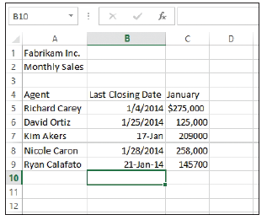
Step by Step: Enter Dates
Type January 21, 2014 and press Enter. 21-Jan-14 appears in the cell. If you enter a date in a different format than specified or had already entered something in the cell and deleted it, your worksheet might not reflect the results described. The date formats in column B is not consistent (right). You apply a consistent date format in the next section.

Slide 41
Step by Step: Enter Dates
In cell B9, type 1/1/10 and press Enter. Notice that the value changes but the formatting remains the same.
Click the Undo button to return to the workbook shown at right.
PAUSE. LEAVE the workbook open to use in the next exercise.
Notes:
Another Way: Ctrl + ; (semicolon) enters the current date into a worksheet cell; Ctrl + : (colon) enters the current time.

Slide 42
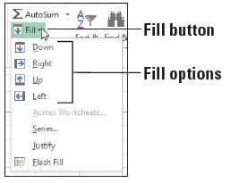
Step by Step: Fill a Series with Auto Fill
GET READY. USE the workbook from the previous exercise or type the text in Figure 2-23.
Select the range C4:H4. January is in the first cell.
On the HOME tab, in the Editing group, click the Fill button. The Fill menu appears (right).
From the menu, click Right. The contents of C4 (January) are filled into all the cells.
Click the Undo button.

Slide 43
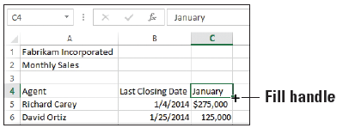
Step by Step: Fill a Series with Auto Fill
Select the range C9:C13 and click the Fill button. Choose Down. The content of C9 is copied into the four additional cells.
Click the Undo button.
Click cell C4, point to the fill handle in the lower-right corner of the cell (below), and drag it to E4 and release. The Auto Fill Options button appears, and January through March are displayed.
Notes:
Another Way: To quickly fill a range of cells with the contents of the first cell, select the range, and then press Ctrl + D (cells below) or Ctrl + R (cells to the right).

Slide 44
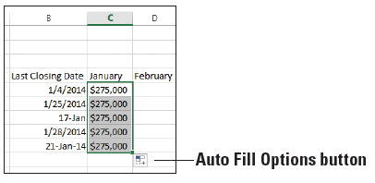
Step by Step: Fill a Series with Auto Fill
Click cell C5, point to the fill handle, and drag it to C9 and release. All the numbers turn to $275,000 in column C. The Auto Fill Options button appears in D10 (right).
Click the Auto Fill Options button, and choose Fill Formatting Only from the list that appears. All the numbers return to their values and are formatted with dollar signs and commas.
Repeat Step 9 for the range B5:B9.
Click cell A9, and then drag the fill handle down to A15. Ryan Calafato's name is repeated.

Slide 45
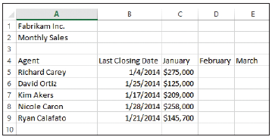
Step by Step: Fill a Series with Auto Fill
Click the Undo button to return the spreadsheet to what is shownbelow.
SAVE the workbook as 02 Fabrikam Sales Solution.
PAUSE. EXIT Excel.
Notes:
Take Note: When Excel recognizes a series, the default fill option is to complete the series. When you use the fill handle and a series is not present, the default is to copy the cell contents. The Fill Options button also allows you to fill formatting only or to fill without formatting.

Slide 46
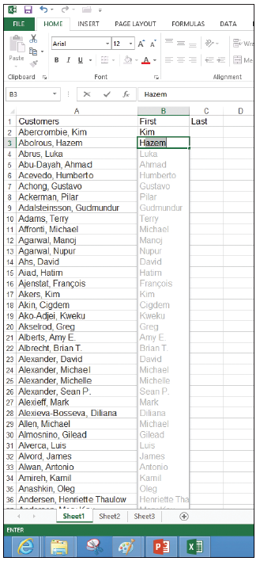
Step by Step: Fill Cells with Flash Fill
GET READY. Before you begin these steps, LAUNCH Microsoft Excel.
Open the 02 Customers file.
Click cell B1, type First, and press Tab.
Click cell C1, type Last, and press Enter.
Click cell B2, type Kim, and press Enter.
In cell B3, type H. Notice that Hazem shows in the rest of the cell and the other first names of the customers appear (right).
Press Enter.

Slide 47
Step by Step: Fill Cells with Flash Fill
Click cell C2, type Abercrombie, and press Enter.
In cell C3, type A and notice that Abercrombie is repeated with AutoComplete. Continue typing bol and notice that the last names all appear. Press Enter.
Double-click the right border of columns B and C to set the column width.
Scroll down and notice that the entire worksheet is filled in.
SAVE the file as 02 Customers Solution.
PAUSE. EXIT Excel.

Slide 48
Step by Step: Copy a Data Series with the Mouse
GET READY. Before you begin these steps, LAUNCH Microsoft Excel.
Open the 02 Customer Houses file.
Select the range A12:A22.
Press Ctrl and hold the mouse button down as you point to the right border of the selected range. The copy pointer is displayed.
With the copy pointer displayed, hold down the left mouse button and drag the selection to the right, until H12:H22 appears in the scrolling ScreenTip next to the selection.
Release the mouse button and then release Ctrl. The data in A12:A22 also appears in H12:H22.
PAUSE. LEAVE the workbook open to use in the next exercise.
Notes:
Troubleshooting: Be sure to hold down the Ctrl key the entire time you are dragging a data series for copying with the mouse, or you will move the series instead of copying it.

Slide 49
Step by Step: Move a Data Series with the Mouse
GET READY. USE the 02 Customer Houses workbook from the previous exercise.
Select E12:E22.
Point to the right border of the selected range. The move pointer is displayed.
With the move pointer displayed, hold down the left mouse button and drag the selection to the right, until I12:I22 appears in the scrolling ScreenTip beside the selected range.
Release the mouse button. In your worksheet, the destination cells are empty; therefore, you are not concerned with replacing existing data. The data previously in E12:E22 is now in I12:I22.

Slide 50
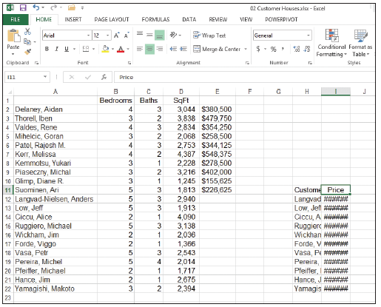
Step by Step: Move a Data Series with the Mouse
Drag A1 to H12. Note that a dialog box warns you about replacing the contents of the destination cells.
Click Cancel.
Drag A1 to H11.
Drag E1 to I11. Your worksheet should look like the one shown at right.
PAUSE. LEAVE the workbook open to use in the next exercise.
Notes:
Take Note: When you attempt to move a selection to a location that contains data, a caution dialog box opens. “There’s already data here. Do you want to replace it?” is a reminder that moving data to a new location replaces the existing data. You can click OK or cancel the operation.

Slide 51
Step by Step: Copy and Paste Data
GET READY. USE the 02 Customer Houses workbook from the previous exercise.
On the HOME tab of the ribbon, click the Clipboard Dialog Box Launcher. The Clipboard pane opens on the left side of the worksheet. The most recently copied item is always added at the top of the list in this pane, and it is the item that will be copied when you click Paste or a shortcut command.
Select A1:E22 and press Delete.
Select H11:I22 and in the Clipboard group, click the Copy button. The border around the selected range becomes a moving border.
Notes:
Another Way: To copy, you can use Ctrl + C or right-click and chose Copy. To paste, you can use Ctrl + V or right-click and choose Paste.

Slide 52
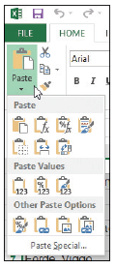
Step by Step: Copy and Paste Data
Select A1 and click the Paste button. The moving border remains active around H11 through I22. A copied range does not deactivate until you type new text, issue another command, or double-click on another cell or you can press Esc.
Select A20 and click the down arrow on the Paste button. The Paste options menu appears (right).

Slide 53
Step by Step: Copy and Paste Data
Select the first option under Paste Values. Notice that the values in column B are no longer formatted.
Click the Undo button.
Select H11:I22 and press Delete.
Press Ctrl + Home to return to the top of the workbook.
SAVE the workbook as 02 Customer Houses Solution.
PAUSE. LEAVE the workbook open to use in the next exercise.
Notes:
Take Note: Paste with Live Preview was new as of Office 2010. If you point to the Paste options in either the shortcut menu, or the Paste command options in the Clipboard group, you will be able to view your changes before actually implementing them.

Slide 54
Step by Step: Cut and Paste Data
GET READY. USE the 02 Customer Houses Solution workbook from the previous exercise.
Select A1:B12 to highlight the Customer House Prices table.
In the Clipboard group, click the Cut button. The contents of A1:B12 are displayed in the Clipboard pane.
Click the + New sheet button on the bottom of the worksheet.
You create Sheet2 and cell A1 is active.
Click Paste to move the former contents of Sheet1 to cell A1 into Sheet2.
PAUSE. EXIT Excel and do not save the workbooks if requested.
Notes:
Another Way: To cut, you can use Ctrl + X or right-click and choose Cut.
Take Note: When you delete text, it is not stored on the Clipboard. To remove data and use the text later, use Cut rather than Delete. By using the Cut feature, you are able to access the data or information from the Clipboard if needed. Deleted text can be restored only with Undo.

Slide 55
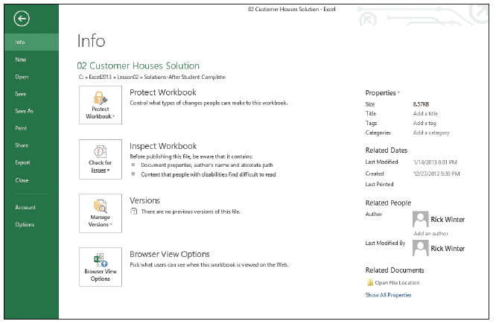
Step by Step: Assign Keywords
GET READY. Before you begin these steps, LAUNCH Microsoft Excel.
OPEN the 02 Customer Houses Solution file you worked with in the previous exercises.
Click FILE. The Backstage window displays current properties on the right side of the window (below).

Slide 56
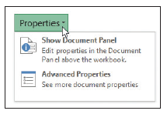
Step by Step: Assign Keywords
Click the Properties button at the top of the right pane. The Properties drop-down menu shows two options (right). Click Show Document Panel.
Click the Keywords field and type Customer, Sq Ft, Price.
Click the Category field and type Revenue.
Click the Author field and type your name.
Above the Author field, click the Document Properties drop-down arrow, and then click Advanced Properties. The Properties dialog box opens.
Click the Summary tab in the dialog box to see the properties you entered.

Slide 57
Step by Step: Assign Keywords
Click the Statistics tab to see the date you modified the file.
Click OK to close the Properties dialog box.
At the top right corner of the Document Information panel, click the Close button.
SAVE the workbook as 02 Customer Houses Prop Solution.
PAUSE. EXIT Excel.

Slide 58
Skills Summary

